Slide 1
Cross Language perception of Coda by Min speakers
Presenter: Chris & Tzu-Hsuan
2019/01/09

Slide 2
Purpose
Final stop sound in Min was dropped, affected by Mandarin
e.g. 新 竹 “tik”

Slide 3
Research question
Do Min speakers have the ability to discriminate the final stop sound?

Slide 4
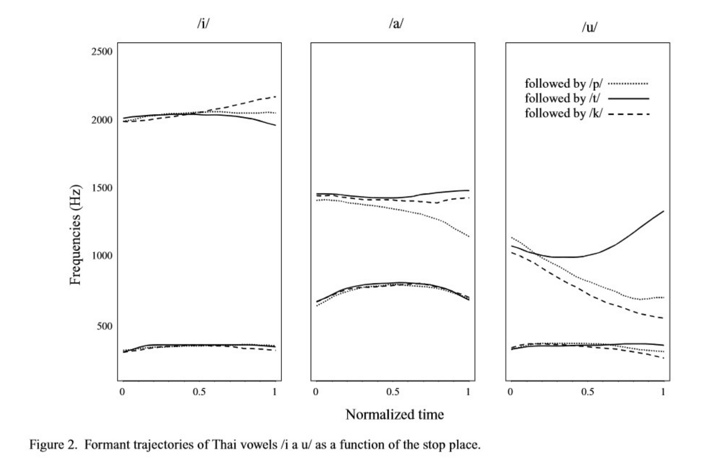
Prediction
We can predict the final stop sound by comparing the transition size of f2

Slide 5
Participant
Speaker_1 : male speaker
Speaker_2: female speaker

Slide 6
Stimuli
/a/ with /p/ ending - 6 words
/a/ with /t/ ending - 6 words
/a/ with /k/ ending - 6 words
/i/ with /p/ ending - 6 words
/i/ with /t/ ending - 6 words
/i/ with /k/ ending - 6 words
total: 36 words

Slide 7
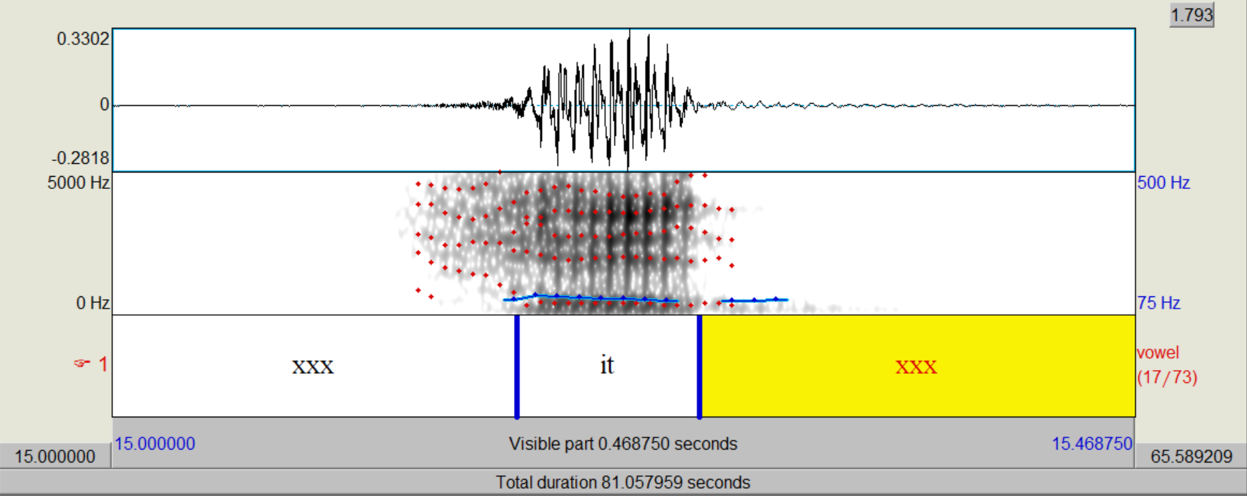
Sound processing
Praat

Slide 8
Sound processing
Praat script
cut each lable into ten intervals

Slide 9
Data processing
Run R

Slide 10
Data visualization – plotting

Slide 11
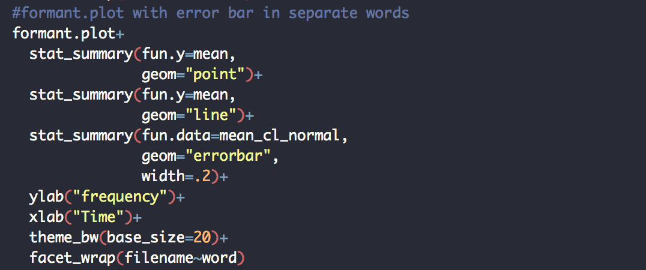

Slide 12
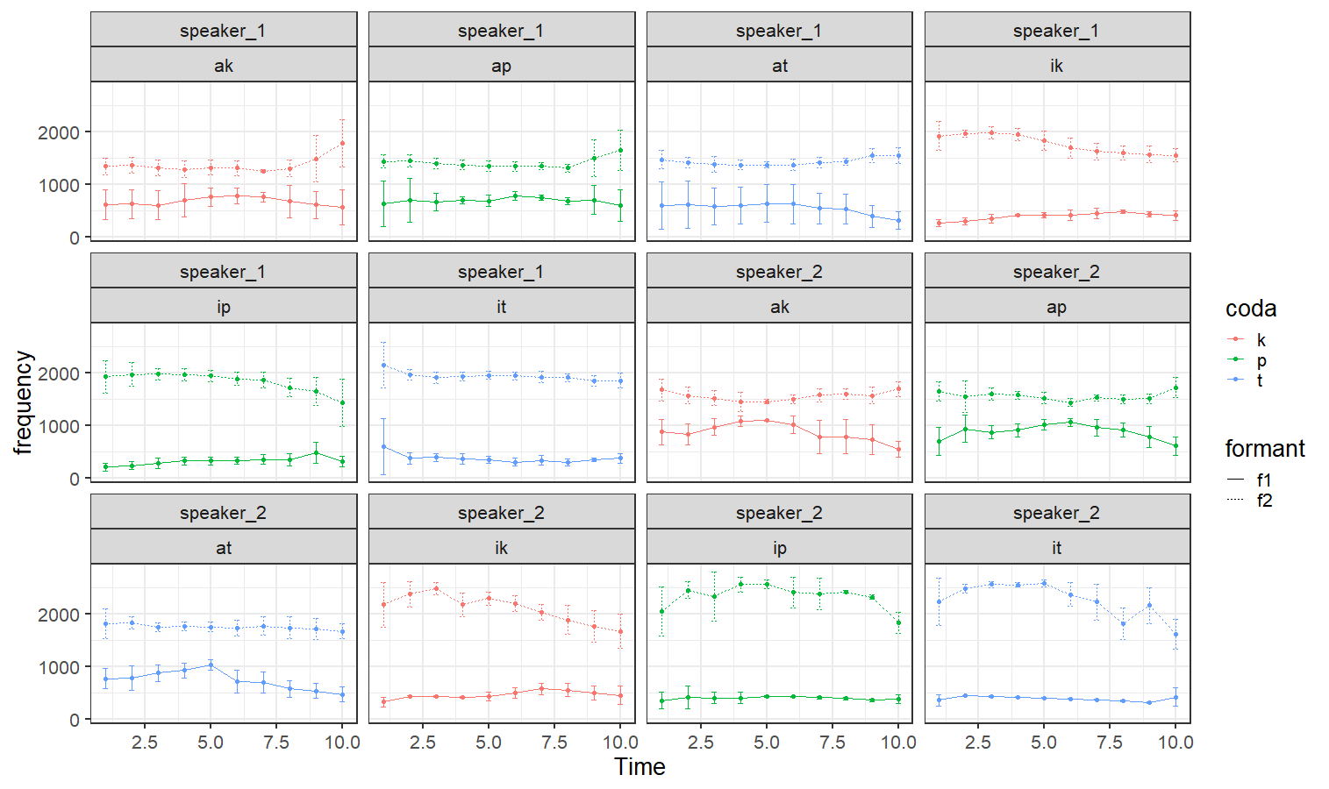

Slide 13
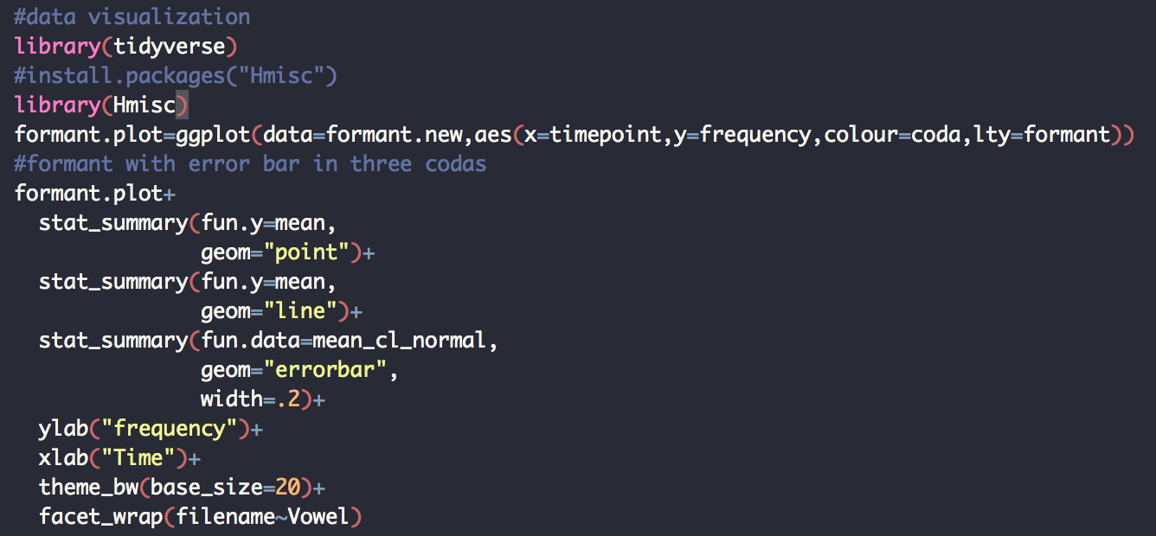

Slide 14
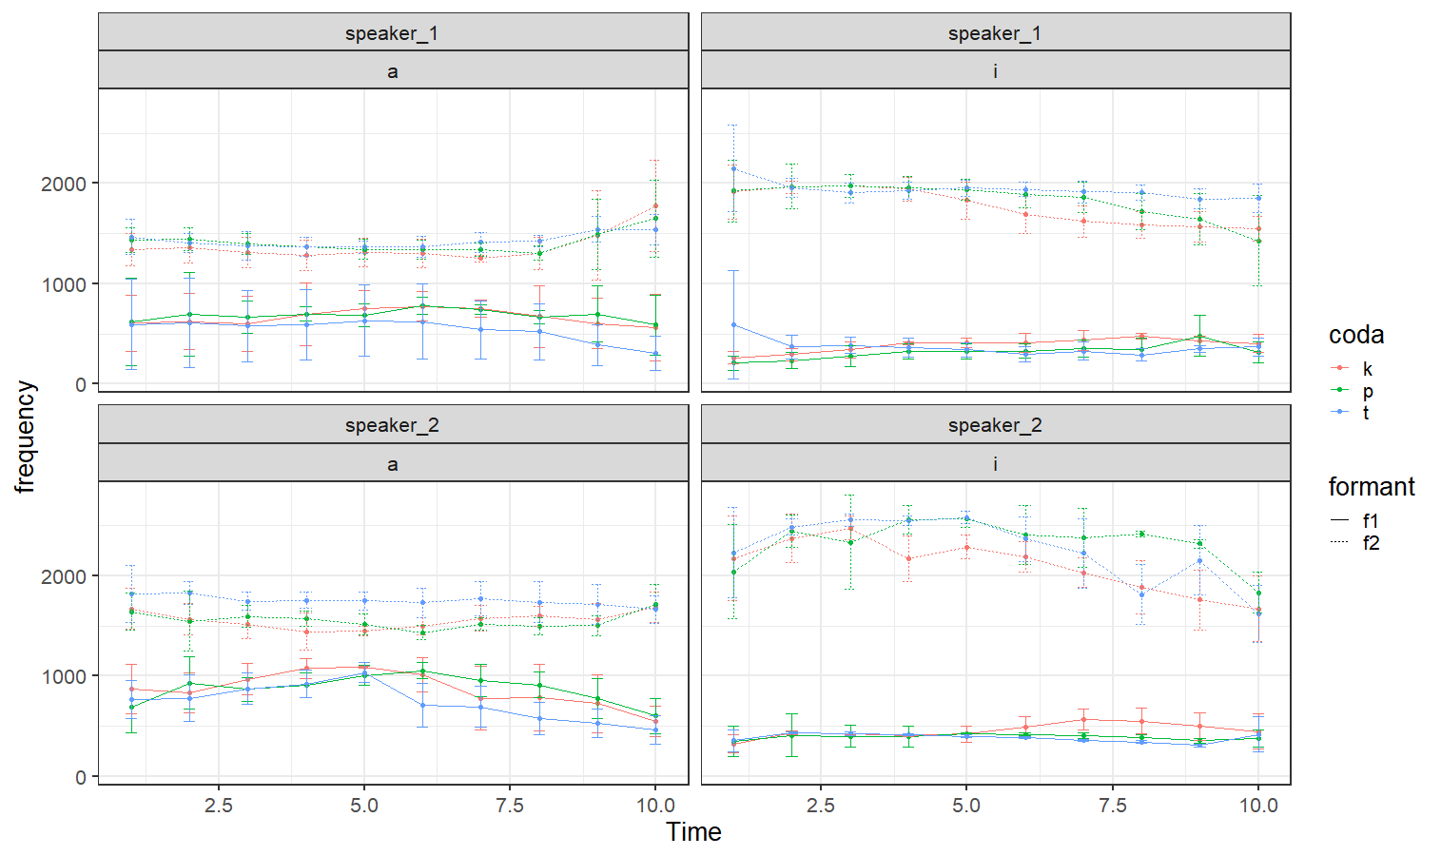

Slide 15
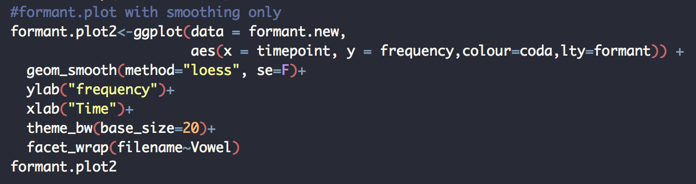

Slide 16
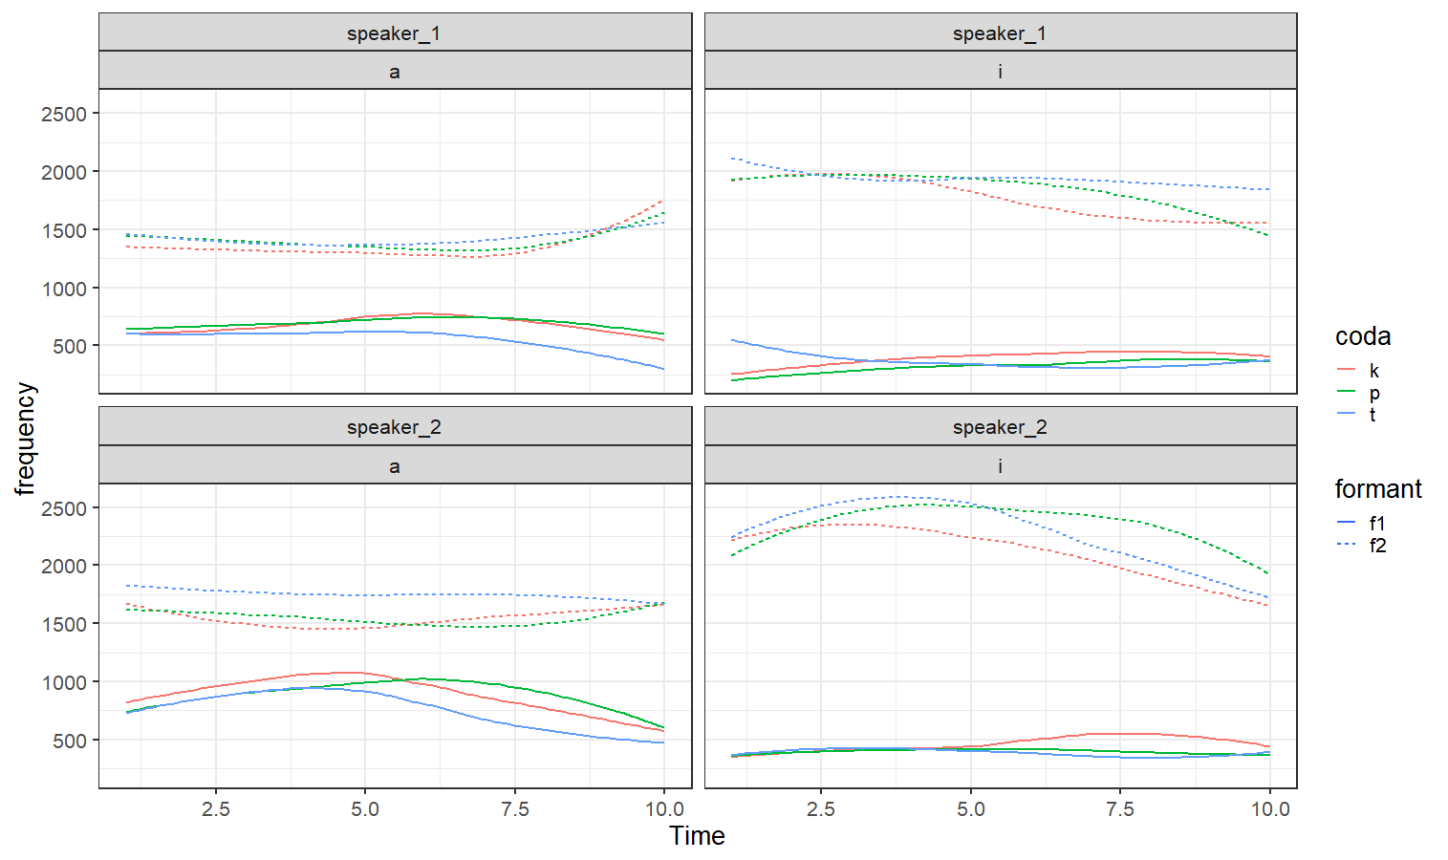

Slide 17
Link to Github repo
https://github.com/chrisweng12/NCTU-R-Programming-2018.git

Slide 18
Work distribution
Data processing: Chris
Data visualization: Tzu-hsuan

Slide 19
Thank you!

