Slide 1
Python - Pygame
108/06/14

Slide 2
Motivation

Slide 3
Fun!!

Slide 4
Module

Slide 5
Module involved
1
Pygame
2
Random
3
Time

Slide 6
Pygame
What can pygame do?
Graphics and animation
Sounds
Control

Slide 7
Pygame
How to start the pygame?
import pygame
pygame.init() → initializing the game
// do something here
pygame.quit() → quitting the game

Slide 8
Pygame
Set up the display
pygame.display.set_mode((width,height))
(0,0)
(50,0)
(0,50)

Slide 9
Game loop
What happens in every game
Process input
Updating
Time
Render
Events
Changing
Draw
Frame per second
Mouse click or Keyboard
From the input
Draw everything on the screen
How fast you repeat the game loop

Slide 10
Space shooting

Slide 11



Three objects
Function needed - pygame.sprite.Sprite
1. Draw a rectangle around the image
2. Get the (x,y) of each pixel
- Get the length of the top, left, right, bottom of rectangle
Alien
Space ship
Bullet

Slide 12
Alien Object
Starting position
(1) y-axis: above the screen
(2) x-axis: randomly inside the display
(deduct the width of alien)
2. Speed
(1) Set the speed to move in every update
3. Challenging
(1) If Alien move under the bottom of display,
speed up!

Slide 13
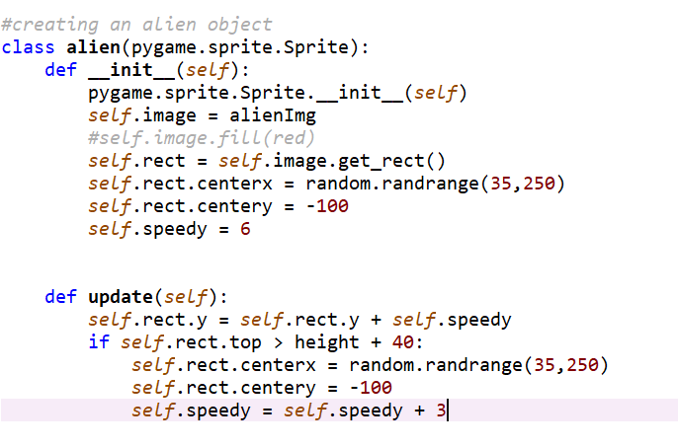
Alien Object

Slide 14
Bullet Object
Starting position
(1) y-axis: at the top of space ship
(2) x-axis: center of the spaceship
2. Speed
(1) Set the speed to move in every update
3. Kill
(1) When the bottom of bullet if over the screen

Slide 15
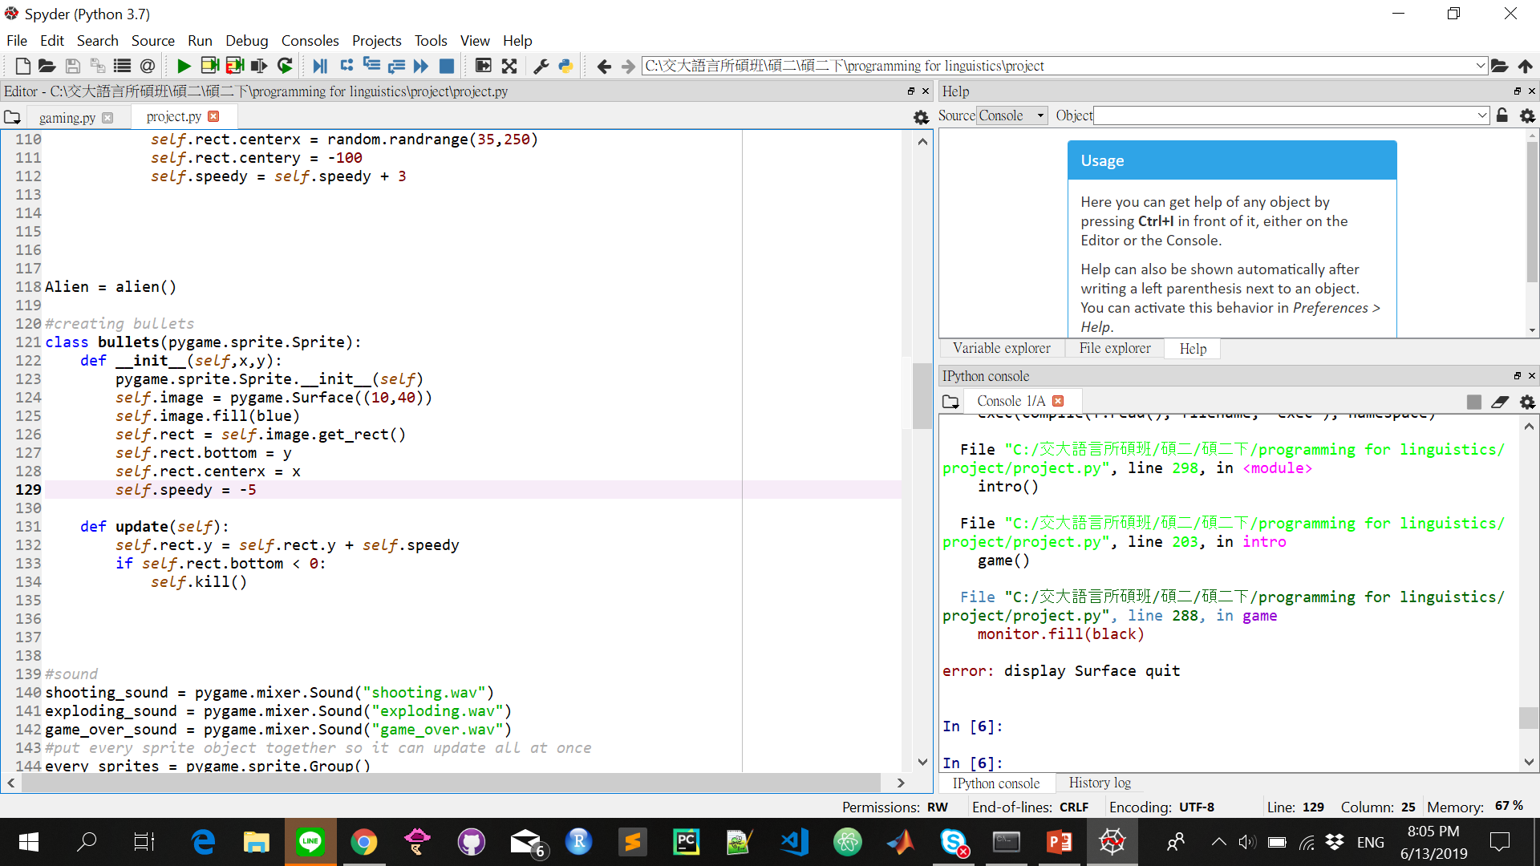
Bullet Object

Slide 16
Spaceship Object
Starting position
(1) y-axis: bottom of the display
(2) x-axis: center of the display
2. Movement
(1) Being able to move up, down, left, right
3. Shoot
(1) Being able to shoot the bullet

Slide 17
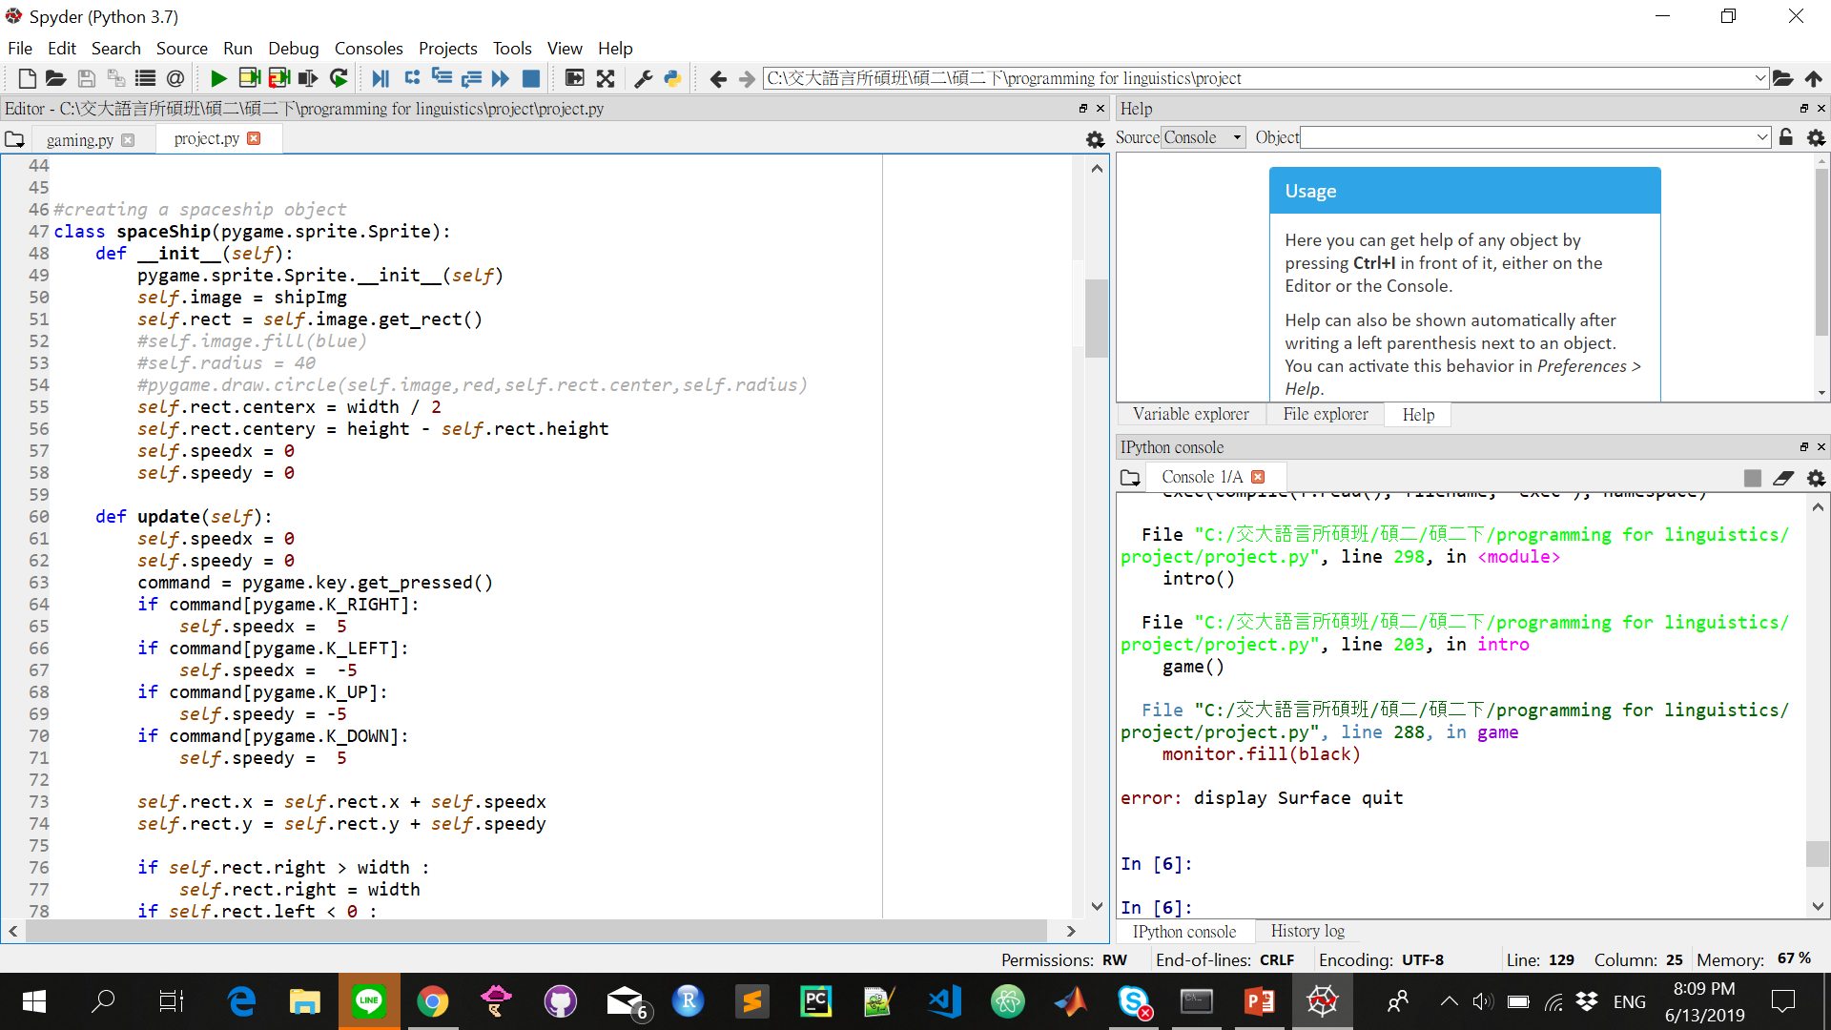
Spaceship Object

Slide 18
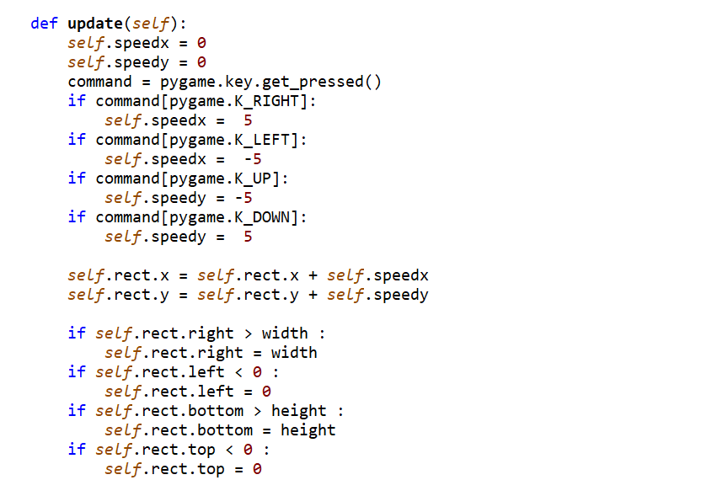
Spaceship Object

Slide 19
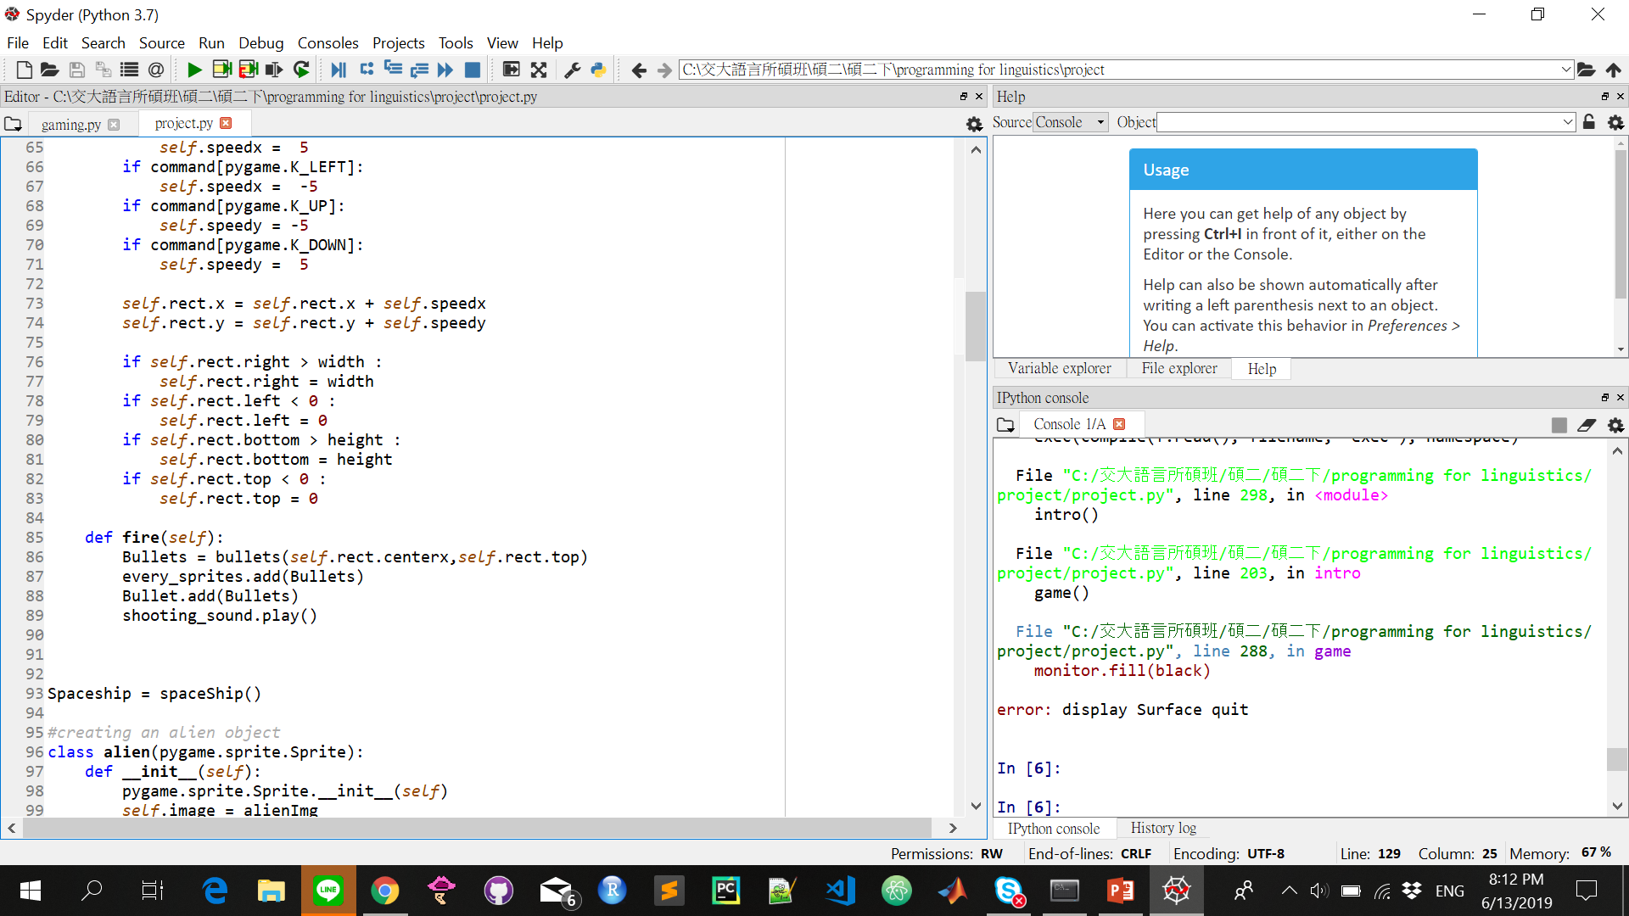
Spaceship Object

Slide 20
Creating sprite group
Pygame.sprite.Group()
→ Makes everything easier!!

Slide 21
Death condition
save
save
save
save
save
save
save

Slide 22

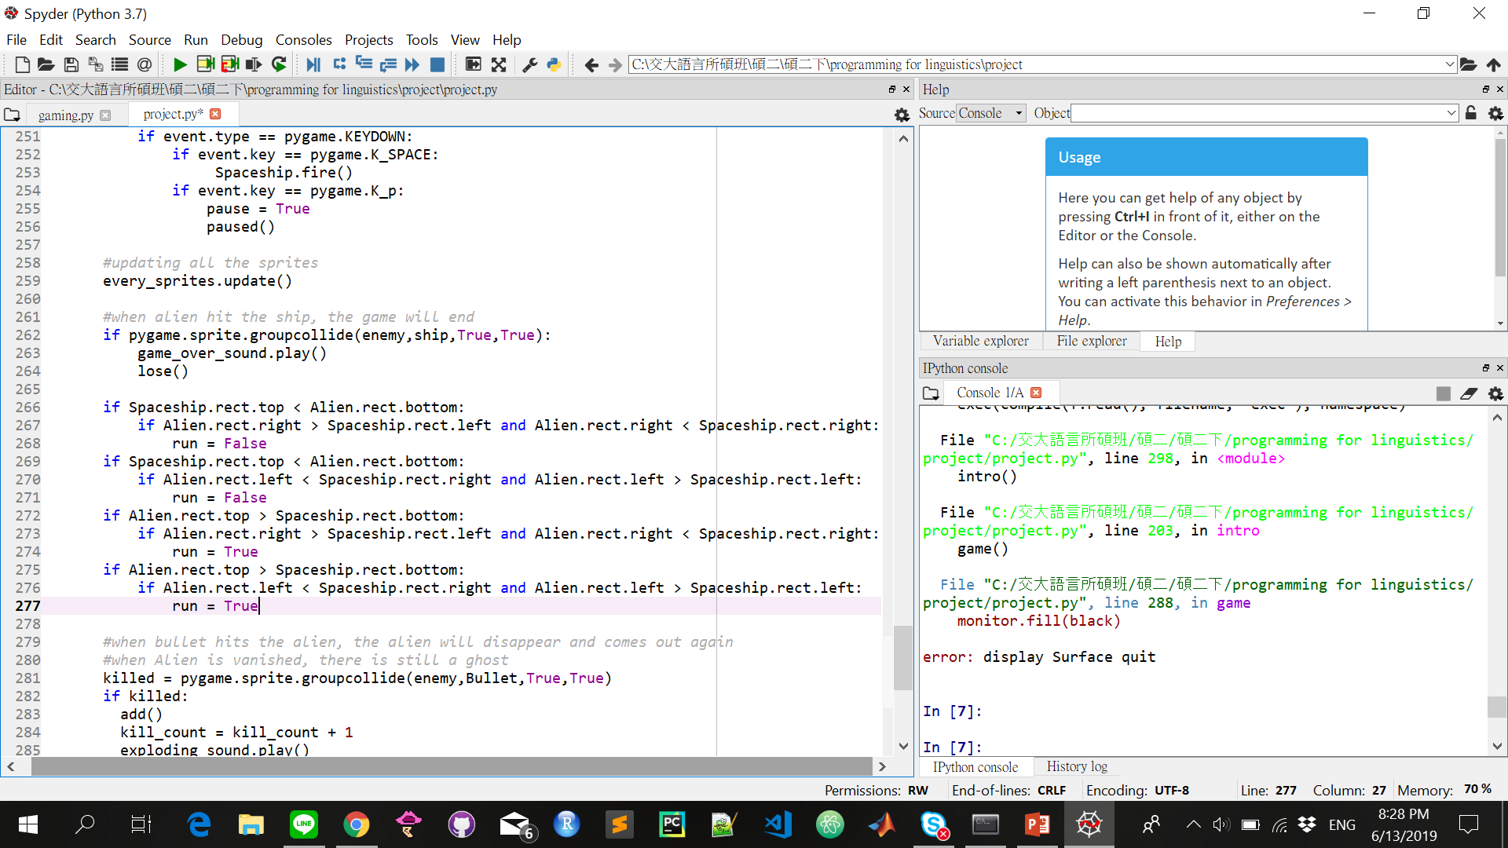
save
save
save
save
save
save
save

Slide 23
Creating sprite group
Pygame.sprite.Group()
→ pygame.sprite.groupcollide (ship,enemy,True,True)
Argument 1 kill?
Argument 2 kill?

Slide 24
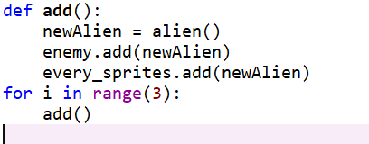
Creating infinite enemies
No enemy after bullets and enemy collide
→ Add a new variable to the sprite Group by using enemy variable

Slide 25
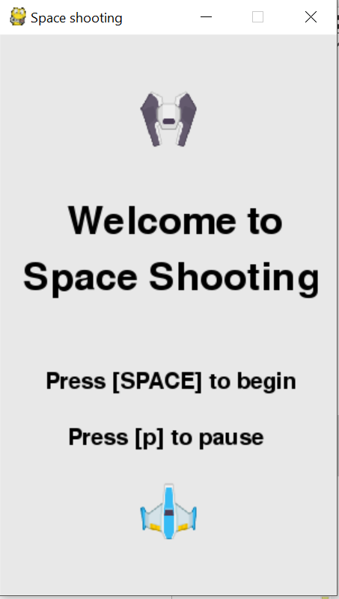
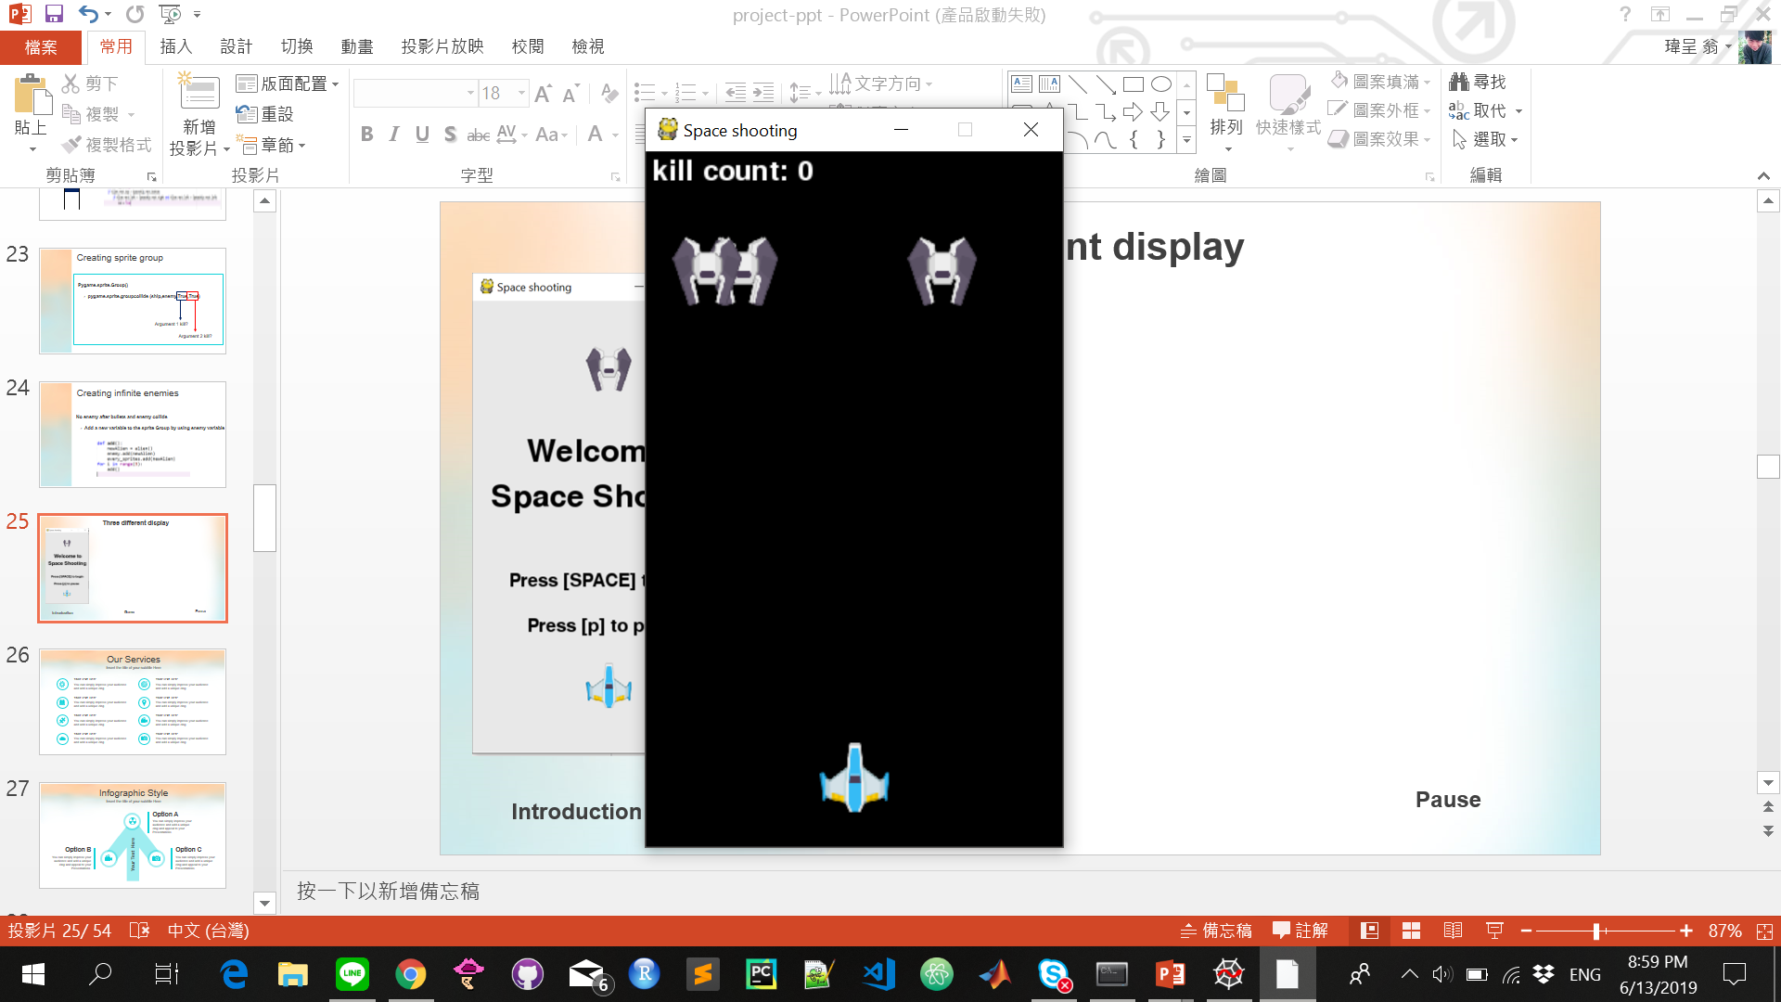
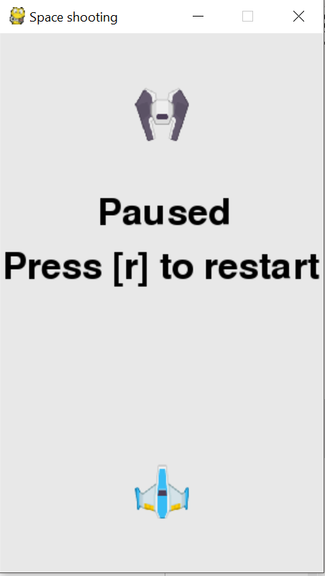
Three different display
Introduction
Game
Pause

Slide 26
How to draw on the display
1. Background-color: fill (color)
→ rgb (red,green,blue)
2. Font: pygame.font.init() initializing the font
→ pygame.font.SysFont(“font-style”, “font-size”)
3. Type: rend(“[Type here]”, “Boolean(smooth font?)”,font-color)
4. Draw: display.blit(Type,(x,y))
5. pygame.display.flip()

Slide 27
How to process input
pygame.event.get ( ) → get the events from the game
(1) Mouse Click: event.type == pygame.QUIT (quit the game)
(2) KeyBoard: event.type == pygame.KEYDOWN:
event.key == pygame.K_SPACE

Slide 28
Improvements

Slide 29
More works
More challenging
More challenging
Different levels
Different enemies
Upgrading
Upgrading
Different types of bullets
More lives

Slide 30
Demo

