Slide 1

AI-Powered Personal Study Assistant
Source: ChatGPT
Your Intelligent Companion for Mastering Complex Materials

Slide 2
Learning from complex materials is overwhelming
📚 Students and researchers manage documents across multiple courses/projects
⏰ Traditional study methods are time-consuming and inefficient
🧠 Passive reading doesn't lead to deep understanding or retention
🔀 Current tools are fragmented - need multiple apps for different tasks
📄 Research papers are especially difficult to break down and internalize
73% of students report feeling overwhelmed by study material volume

Slide 3
A unified AI platform that transforms passive materials into active learning
Upload documents (PDFs, PowerPoints, Word docs, research papers)
AI generates flashcards, quizzes, and study guides automatically
Chat with AI about your specific materials
Spaced repetition system for long-term retention
Track progress and master concepts over time
We bridge the gap between understanding content and truly mastering it

Slide 4
Target Users
👩‍🎓 College & University Students
Managing multiple courses, need efficient study methods
👨‍🔬 Graduate Students & Researchers
Learning new domains, breaking down complex papers
👩‍💼 Professionals
Continuous learning and skill development
🎯 Common traits: Tech-comfortable, time-constrained, seeking deep understanding

Slide 5
Intelligent Document Processing
📄 Multi-format support: PDF, DOCX, PPTX, images (OCR)
🏷️ Automatic categorization by course/subject
🔍 Full-text search across all materials
📁 Cloud storage with version history
📑 Document preview and annotation

Slide 6

Active Learning
Spaced Repetition & Progress Tracking
🗓️ Smart Scheduling
Review at optimal intervals based on performance (Hard/Medium/Easy)
📊 Progress Analytics
Study time by course
Quiz performance trends
Topic mastery levels
Study streaks
Evidence-based approach improves retention by 50-100%

Slide 7
Design Process
Figma for UI/UX design for low-fidelity wireframes
User Research
User personas to target potential users
User journeys to detail app navigation options
Information Architecture
Higher-fidelity prototypes
Accessibility Implementation (WCAG Compliance)
User Testing & Iteration
site structure
data storage alternatives

Slide 8
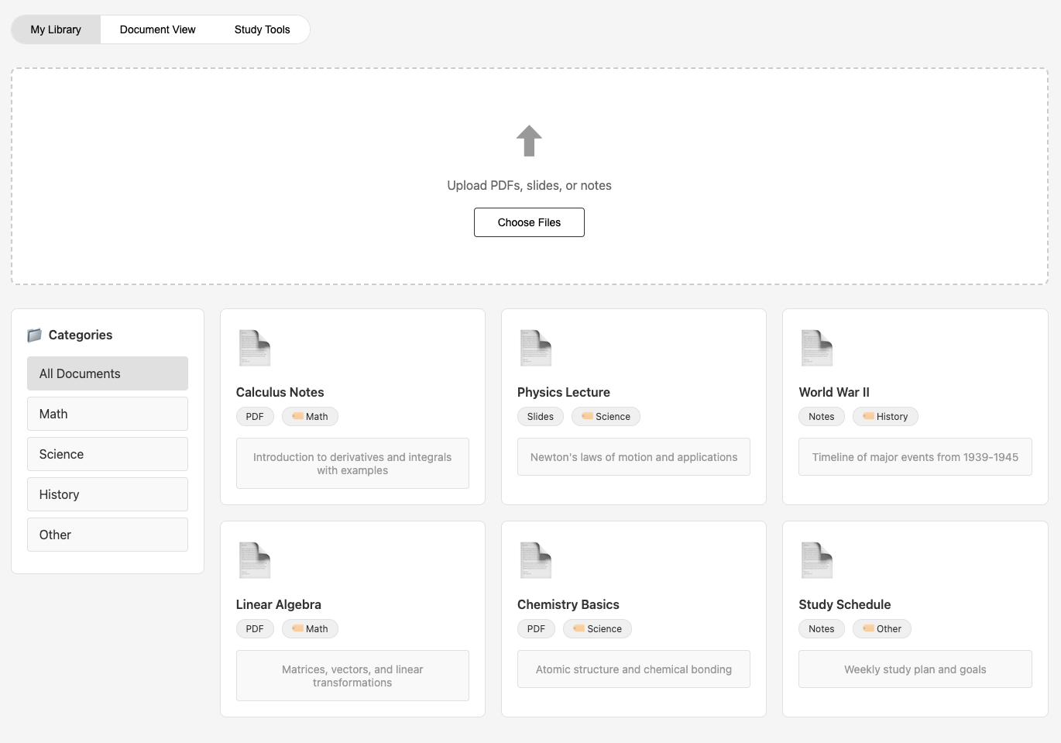
Clean. Fast. Focused.
Every pixel serves a purpose.
Every feature earns its place.
We've stripped away everything that doesn't move you forward, leaving only what matters: your work and the tools to do it brilliantly.

