Slide 1
The Red Matrix
A Decentralised Identity Platform

Slide 2
What is an identity platform?
It’s a collection of linked websites
Each website knows who is looking at any given content
The website can alter the content depending on who is looking at it.
…Even if the viewer doesn’t have an account on this website

Slide 3
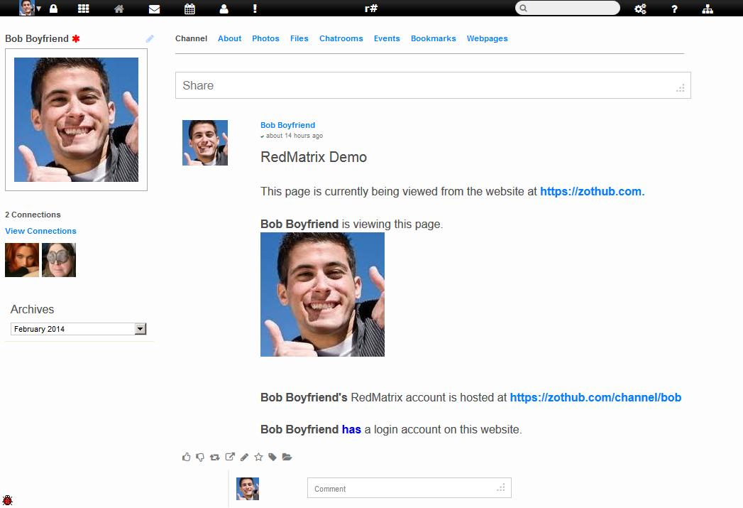
Example: Here’s Bob

Slide 4
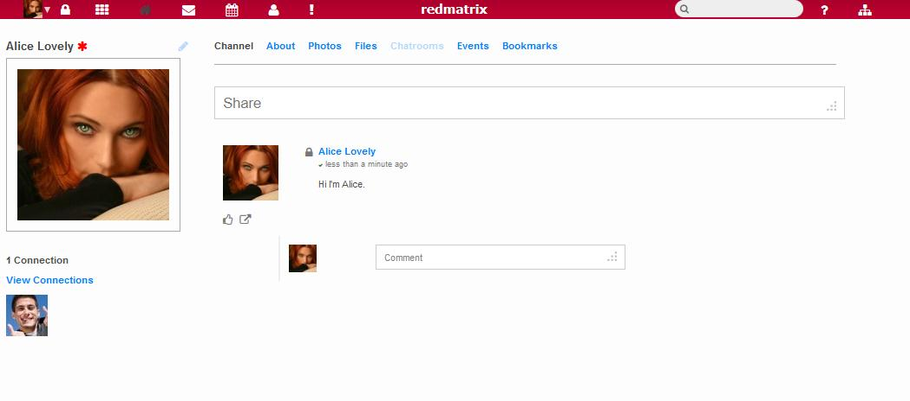
Here’s Alice

Slide 5
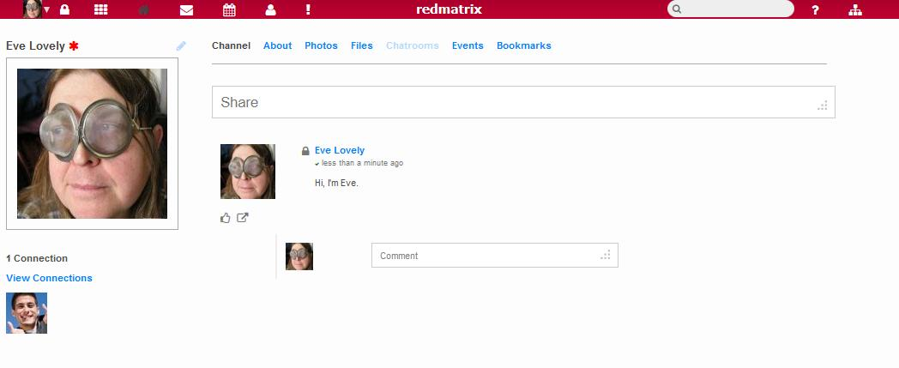
And Alice’s sister - Eve

Slide 6
Bob is “friends” with Alice and Eve
Bob likes Alice
He doesn’t care for Eve
Bob’s profile is on website ‘A’ (zothub.com)
Alice and Eve both have accounts on website ‘B’ (redmatrix.me)
Both website ‘A’ and website ‘B’ are connected to the matrix
Alice and Eve DO NOT have a password to login to website ‘A’ (zothub.com)

Slide 7
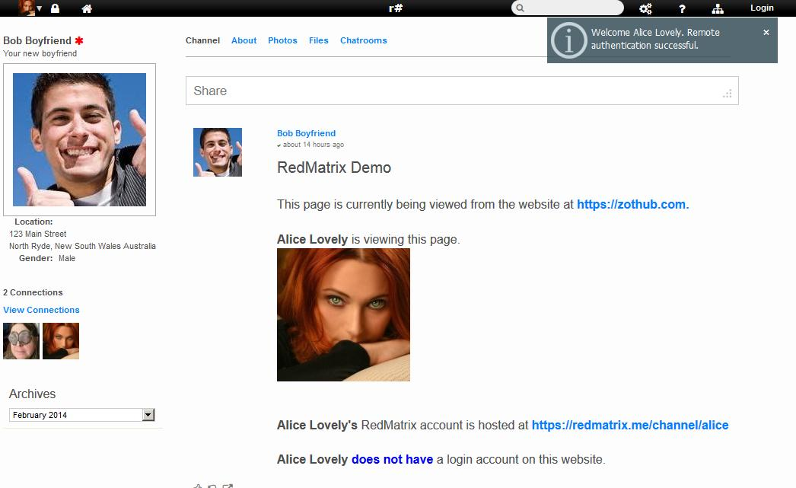
Alice views Bob’s homepage
Notice that Bob’s website knows who she is

Slide 8
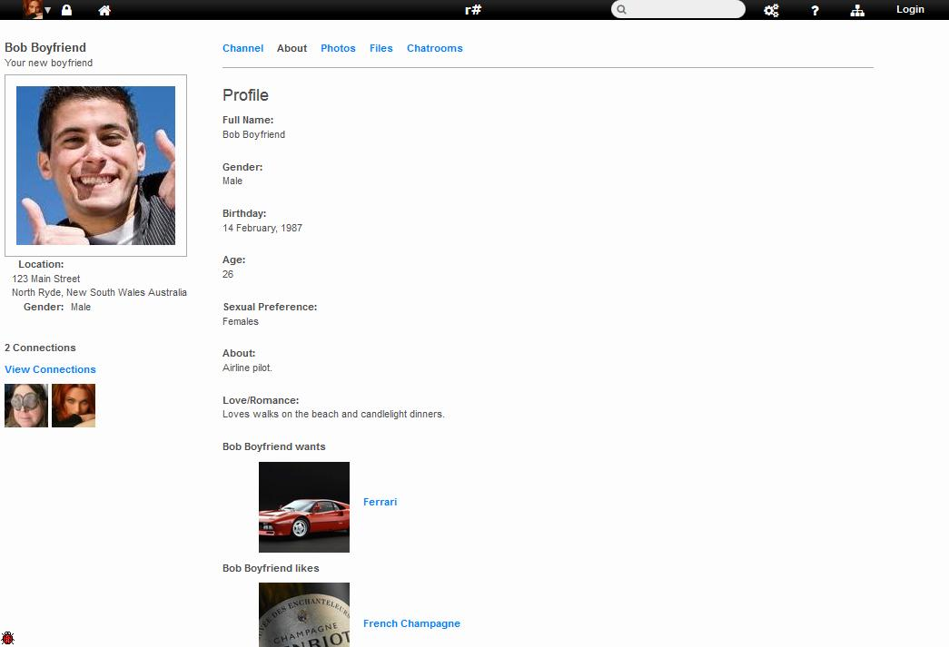
Alice views Bob’s profile

Slide 9
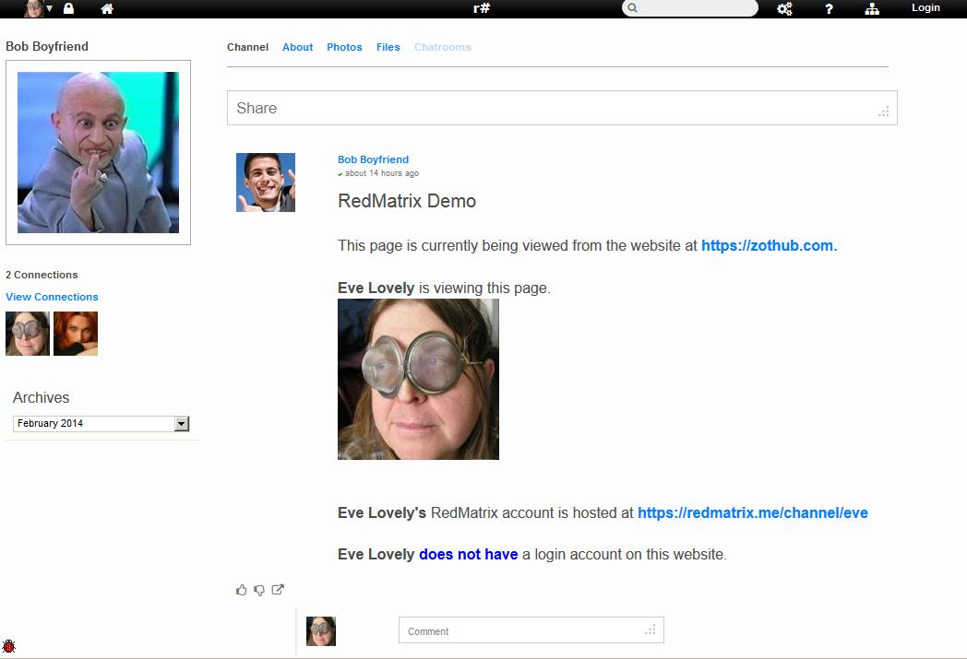
Eve views Bob’s homepage
Hmmm, this looks “different”

Slide 10
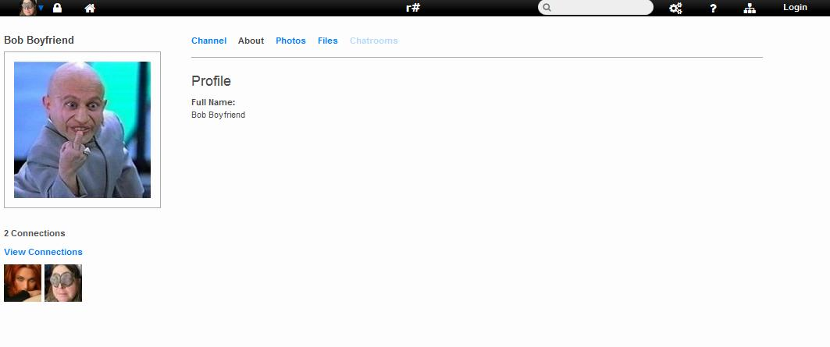
Eve views Bob’s profile
WTF?

Slide 11
Content that knows who you are
Social Communications
Profiles
Photos
File Sharing
Events
Chatrooms
…and more

Slide 12
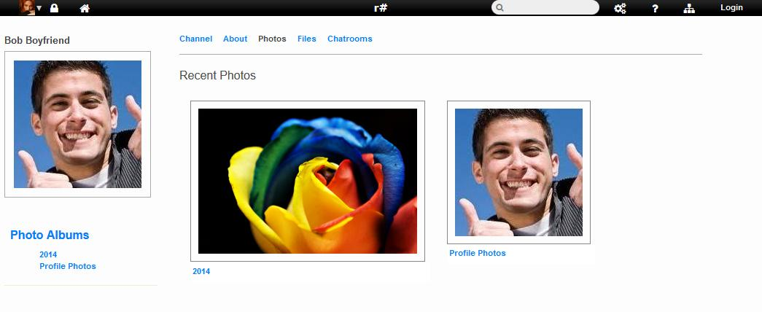
Cannot be “fusked”

Slide 13
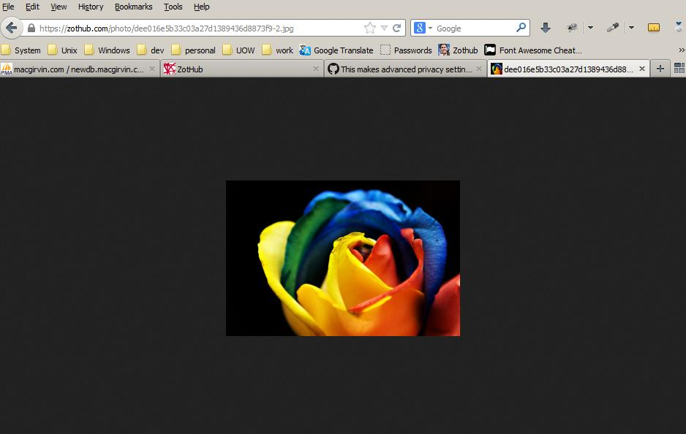
Alice views Bob’s photo by URL

Slide 14
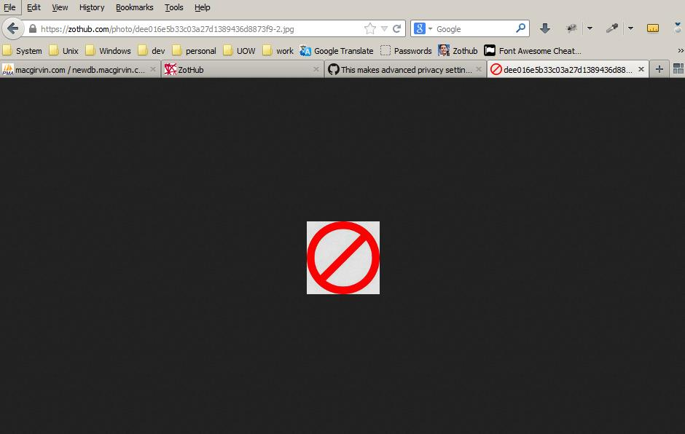
Eve “fusks” the URL

Slide 15
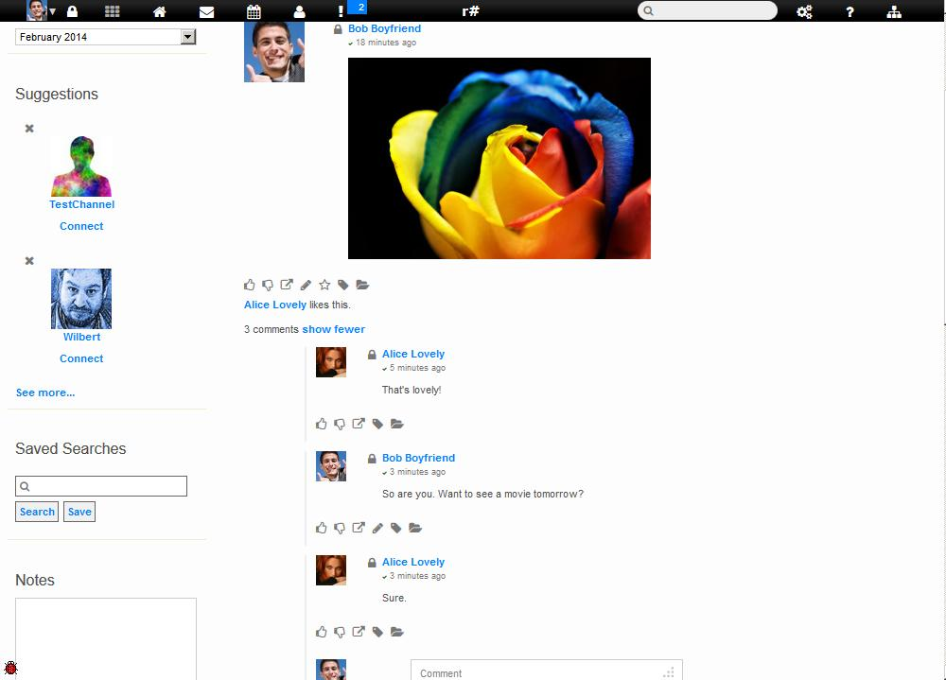
Want privacy? What Bob sees.

Slide 16
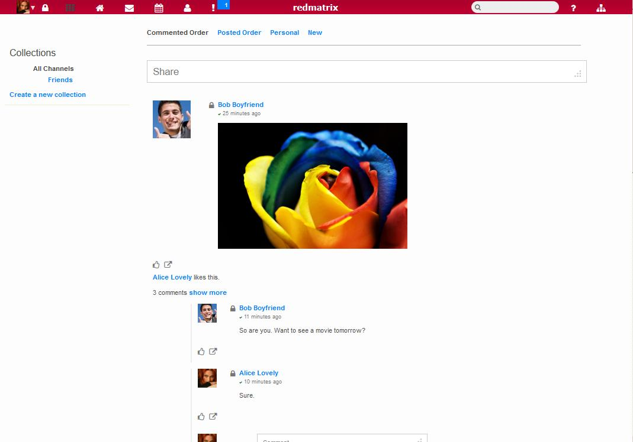
What Alice sees

Slide 17
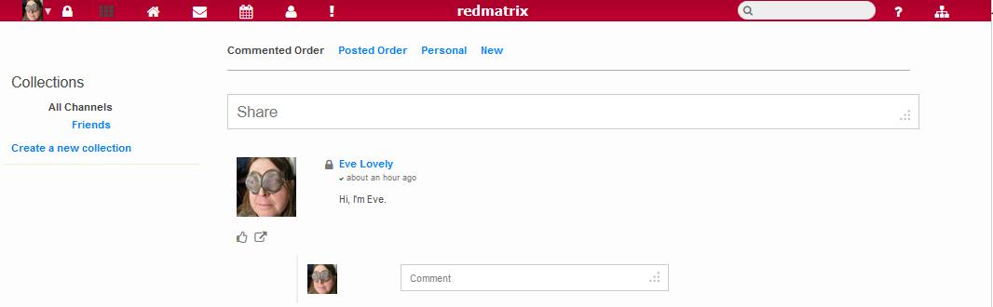
What Eve sees

Slide 18
To summarise
Identity aware content
Network wide single sign-on
Privacy
But wait, there’s more…

Slide 19
We’ve only scratched the surface
Optional End-to-end encryption that will seriously piss off the NSA
Nomadic Identity – Alice can clone her account on multiple websites and see the same content on or from all of them. So can Eve (see the same content ).
WebDAV allows you to copy files to your website as if it were a thumbdrive.
Message Expiration

Slide 20
But wait, there’s more…
Unsend private mail (if you catch it before they read it).
Bookmarking
Expire messages at some future time
Open Source project with all the goodies built-in (theme selection, addons/plugins)
Uses Twitter API and works off the shelf with many third party clients and mobile devices

Slide 21
And even more…
Webpage and website building tools
Community forums
Privacy groups/collections
Decentralised (with all the advantages thereof, including resistance to censorship, ownership of your own content, freedom from mass spying, etc.)

Slide 22
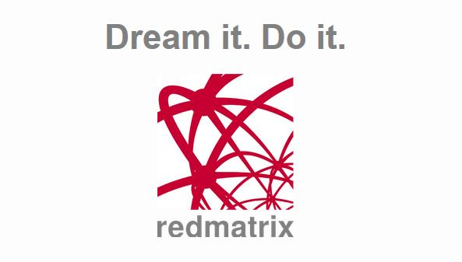
https://redmatrix.me

