Slide 1
HTML5
by Christian Dangl & Philipp Wolber

Slide 2
Basic Exercises
Headers
Paragraphs
Text formatting (bold, italic, …)
Block and Inline Elements (div, span)

Slide 3
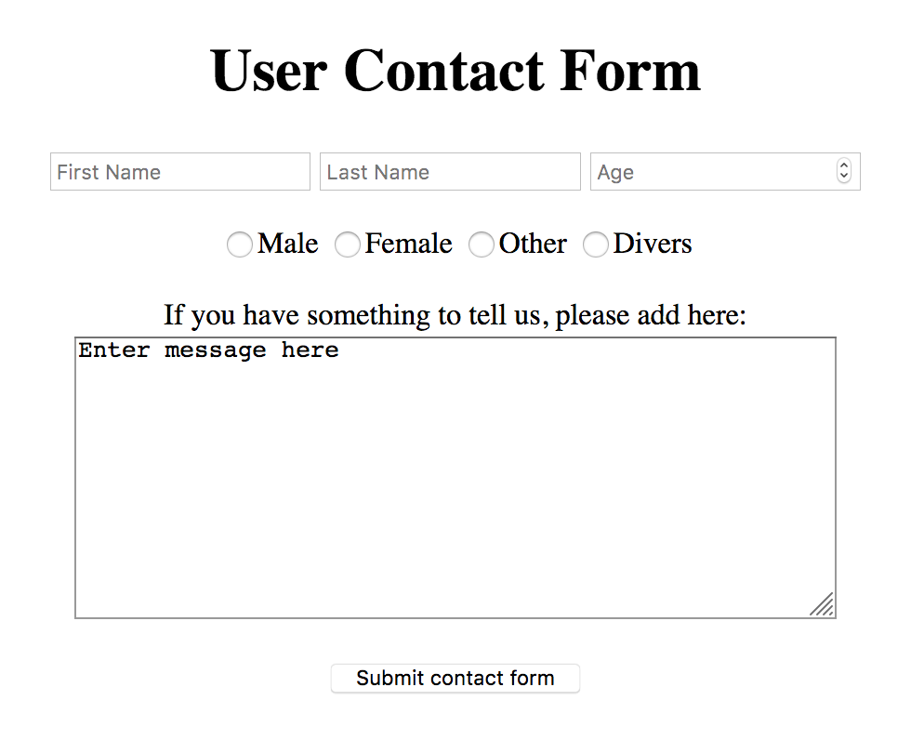
Intermediate Exercises
Input types (text, radio, submit)

Slide 4
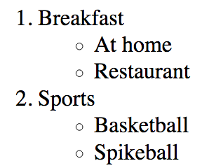
Advanced Exercises
Links between pages
<a href=“linkURL” title=“description”>linkTitle</a>
Tables and Lists
Ordered lists
Unorderd lists
Nested lists

Slide 5
GitHub
Distribute files with git to share with your partner
Tipps:
Inform your partner when you push or pull
Add useful commits
Don’t mess it up ☺

