Slide 1
Probabilistic Information Retrieval
Christopher Manning and Pandu Nayak

Slide 2
From Boolean to Ranked Retrieval
Ch. 6
Why ranked retrieval?
Introduction to the classical probabilistic retrieval model and the probability ranking principle
The Binary Independence Model: BIM
Relevance feedback, briefly
The vector space model (VSM) (quick cameo)
BM25 model
Ranking with features: BM25F (if time allows …)

Slide 3
1. Ranked retrieval
Ch. 6
Thus far, our queries have all been Boolean
  Documents either match or don’t
Can be good for expert users with precise understanding of their needs and the collection
  Can also be good for applications: Applications can easily consume 1000s of results
Not good for the majority of users
  Most users incapable of writing Boolean queries
    Or they are, but they think it’s too much work
  Most users don’t want to wade through 1000s of results
    This is particularly true of web search

Slide 4
Problem with Boolean search: feast or famine
Ch. 6
Boolean queries often result in either too few (=0) or too many (1000s) results
Query 1: “standard user dlink 650” → 200,000 hits
Query 2: “standard user dlink 650 no card found”: 0 hits
It takes a lot of skill to come up with a query that produces a manageable number of hits
  AND gives too few; OR gives too many
Suggested solution:
  Rank documents by goodness – a sort of clever “soft AND”
Notes:
Cf. our discussion of how Westlaw Boolean queries didn’t actually outperform free text querying
First step is just soft matching whether words are contained in documents or not.
Second step is putting in more accurate term weights using term frequency

Slide 5
2. Why probabilities in IR?
User
Information Need
Query
Representation
Understanding
of user need is
uncertain
How to match?
Document
Representation
Uncertain guess of
whether document has relevant content
Documents
In traditional IR systems, matching between each document and
query is attempted in a semantically imprecise space of index terms
Probabilities provide a principled foundation for uncertain reasoning
Can we use probabilities to quantify our search uncertainties?

Slide 6
Probabilistic IR topics
Classical probabilistic retrieval model
  Probability ranking principle, etc.
  Binary independence model (≈ Naïve Bayes text cat)
  (Okapi) BM25
Bayesian networks for text retrieval
Language model approach to IR (IIR Ch. 12)
  An important development in 2000s IR
Probabilistic methods are one of the oldest, but also one of the currently hot topics in IR
  Traditionally: neat ideas, but didn’t win on performance
  It seems to be different now

Slide 7



Who are these people?
Karen Spärck Jones
Stephen Robertson
Keith van Rijsbergen

Slide 8
The document ranking problem
We have a collection of documents
User issues a query
A list of documents needs to be returned
Ranking method is the core of modern IR systems:
  In what order do we present documents to the user?
  We want the “best” document to be first, second best second, etc.
Idea: Rank by probability of relevance of the document w.r.t. information need
  P(R=1|document_{i}, query)

Slide 9
The Probability Ranking Principle (PRP)
“If a reference retrieval system’s response to each request is a ranking of the documents in the collection in order of decreasing probability of relevance to the user who submitted the request, where the probabilities are estimated as accurately as possible on the basis of whatever data have been made available to the system for this purpose, the overall effectiveness of the system to its user will be the best that is obtainable on the basis of those data.”
    [1960s/1970s] S. Robertson, W.S. Cooper, M.E. Maron; van Rijsbergen (1979:113); Manning & Schütze (1999:538)

Slide 10
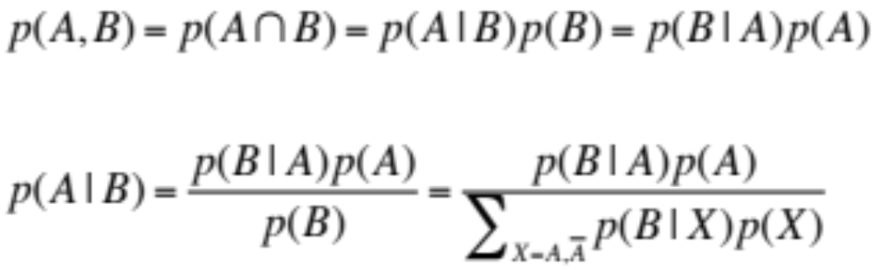
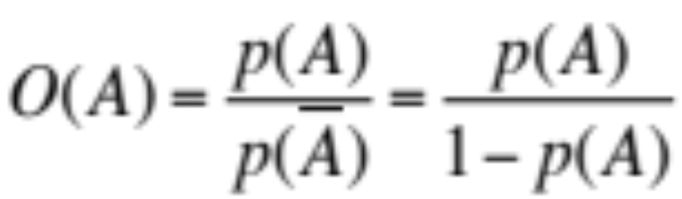
Recall a few probability basics
For events A and B:
Bayes’ Theorem
Odds:
Prior
Posterior

Slide 11
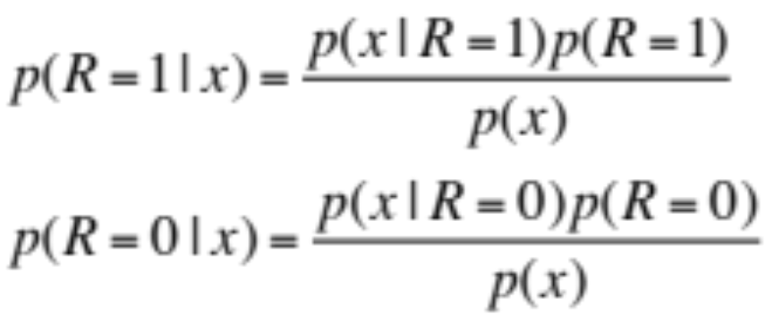

The Probability Ranking Principle (PRP)
Let x represent a document in the collection
Let R represent relevance of a document w.r.t. given (fixed) query and let R=1 represent relevant and R=0 not relevant
Need to find p(R=1|x) – probability that a document x is relevant
p(R=1),p(R=0) - prior probability
of retrieving a relevant or non-relevant
document at random
p(x|R=1), p(x|R=0) - probability that if a relevant (not relevant) document is retrieved, it is x.

Slide 12
Probabilistic Retrieval Strategy
First, estimate how each term contributes to relevance
  How do other things like term frequency and document length influence your judgments about document relevance?
    Not at all in BIM
    A more nuanced answer is given by BM25
Combine to find document relevance probability
Order documents by decreasing probability
Theorem: Using the PRP is optimal, in that it minimizes the loss (Bayes risk) under 1/0 loss
  Provable if all probabilities correct, etc. [e.g., Ripley 1996]
Notes:
In addition to the “document independence assumption” on previous slide, we have a “term independence assumption”: terms’ contributions to relevance are treated as independent events.
Okapi is one particular way of estimating probability given tf, df, and length.

Slide 13
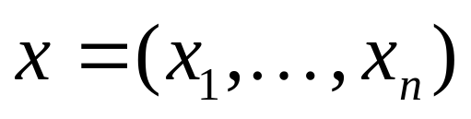
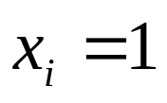
3. Binary Independence Model
Traditionally used in conjunction with PRP
“Binary” = Boolean: documents are represented as binary incidence vectors of terms (cf. IIR Chapter 1):
  iff term i is present in document x
“Independence”: terms occur in documents independently
Different documents can be modeled as the same vector

Slide 14
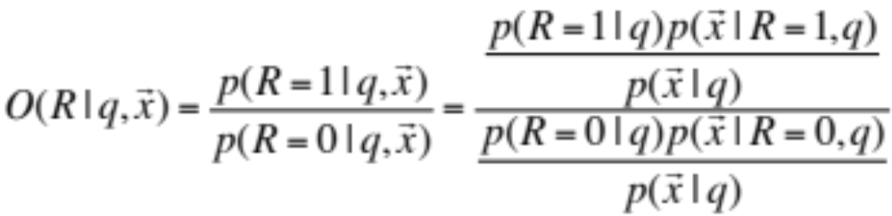
Binary Independence Model
Queries: binary term incidence vectors
Given query q,
  for each document d need to compute p(R|q,d)
  replace with computing p(R|q,x) where x is binary term incidence vector representing d
  Interested only in ranking
Will use odds and Bayes’ Rule:

Slide 15
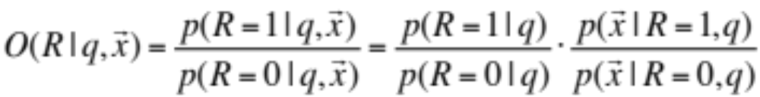
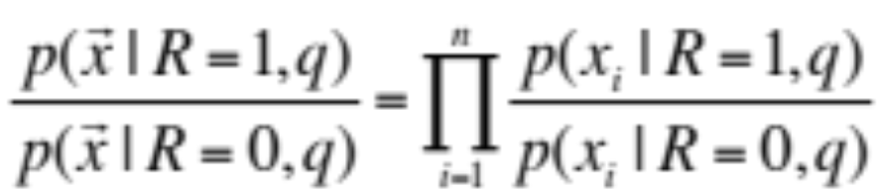
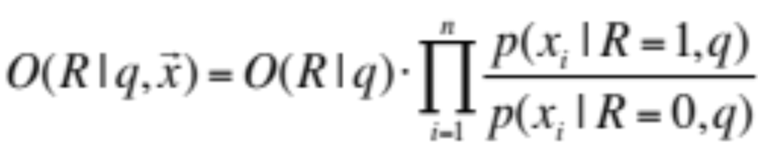
Binary Independence Model
Constant for a given query
Needs estimation
Using Independence Assumption:

Slide 16
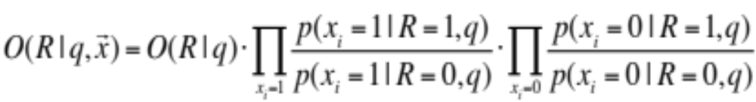



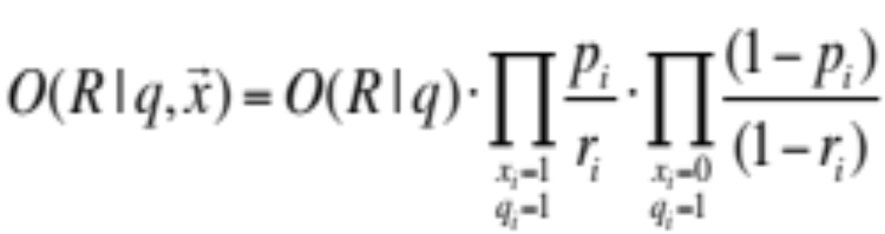
Binary Independence Model
Since x_{i} is either 0 or 1:
Let
Assume, for all terms not occurring in the query (q_{i}=0)

Slide 17
 | document | relevant (R=1) | not relevant (R=0)
term present | x_{i} = 1 | p_{i} | r_{i}
term absent | x_{i} = 0 | (1 – p_{i}) | (1 – r_{i})

Slide 18
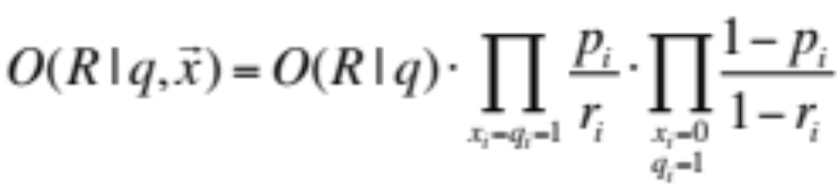
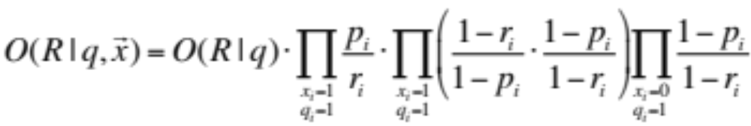
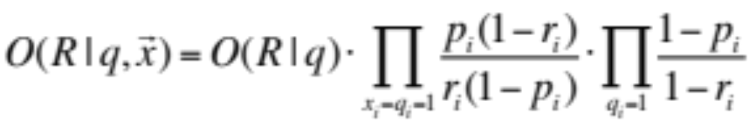
Binary Independence Model
All matching terms
Non-matching query terms
All matching terms
All query terms
Notes:
Put all terms in query into right product and then divide through by them in left product.
Just go straight from the top to the bottom line with a multiply and a divide.

Slide 19
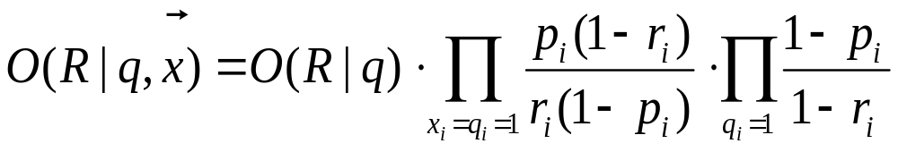
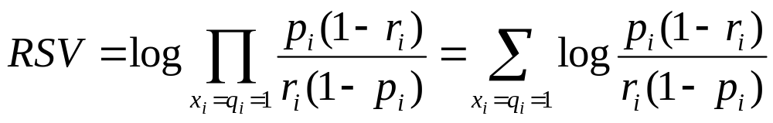
Binary Independence Model
Constant for
each query
Only quantity to be estimated
for rankings
Retrieval Status Value:

Slide 20
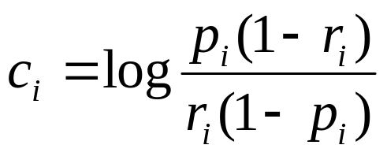
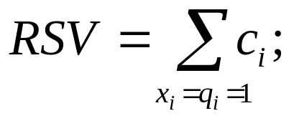
Binary Independence Model
[Robertson & Spärck-Jones 1976]
All boils down to computing RSV
The c_{i} are log odds ratios (of contingency table a few slides back)
They function as the term weights in this model
So, how do we compute c_{i}’s from our data?
Notes:
Used to say: Linear Discriminant Function, because it is a linear function in terms of log probabilities, but maybe that’s too far afield for here, and is better discussed later

Slide 21
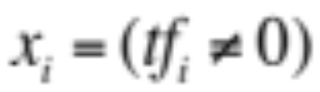

Graphical model for BIM – Bernoulli NB
R
x_{i}
Binary
variables

Slide 22
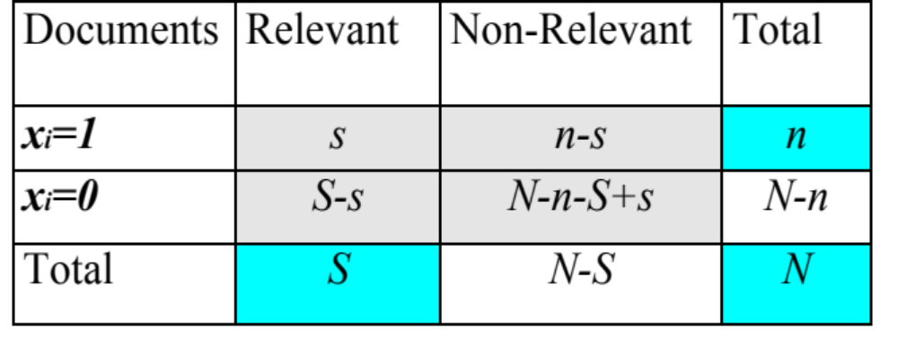
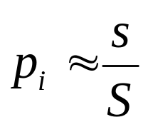
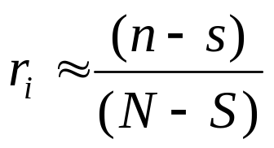
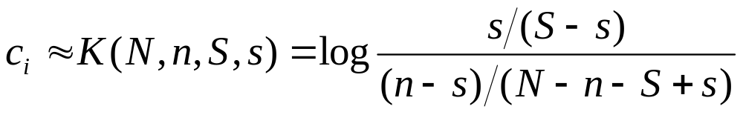
Binary Independence Model
Estimating RSV coefficients in theory
For each term i look at this table of document counts:
Estimates:
For now,
assume no
zero terms.
Remember
smoothing.
Notes:
p_i(1 – r_i) / r_i(1 - p_i) = denominators cancel out.
Log expression has numerators of p / (1 – p ) and denominators r / (1 – r).
Prabhakar wanted the add 0.5 explained. Here or elsewhere?
Log odds ratio. Add 0.5 to every expression

Slide 23
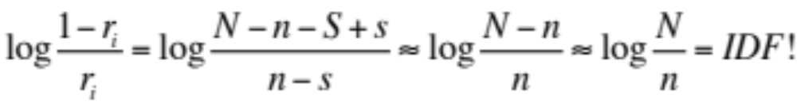
Estimation – key challenge
If non-relevant documents are approximated by the whole collection, then r_{i} (prob. of occurrence in non-relevant documents for query) is n/N and
Inverse Document Frequency (IDF)
  Spärck-Jones (1972)
  A key, still-important term weighting concept

Slide 24
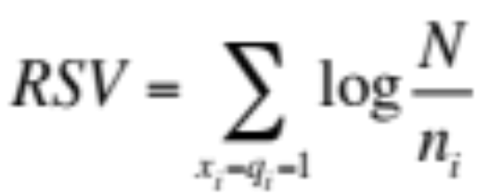
Estimation – key challenge
p_{i} (probability of occurrence in relevant documents) cannot be approximated as easily
p_{i} can be estimated in various ways:
  from relevant documents if you know some
    Relevance weighting can be used in a feedback loop
  constant (Croft and Harper combination match) – then just get idf weighting of terms (with p_{i}=0.5)
  proportional to prob. of occurrence in collection
    Greiff (SIGIR 1998) argues for 1/3 + 2/3 df_{i}/N

Slide 25
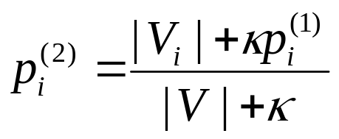
4. Probabilistic Relevance Feedback
Guess a preliminary probabilistic description of R=1 documents; use it to retrieve a set of documents
Interact with the user to refine the description: learn some definite members with R = 1 and R = 0
Re-estimate p_{i} and r_{i} on the basis of these
  If i appears in V_{i} within set of documents V: p_{i} = |V_{i}|/|V|
  Or can combine new information with original guess (use Bayesian prior):
Repeat, thus generating a succession of approximations to relevant documents
κ is
prior
weight
Notes:
explicit Bayesian smoothing with a prior

Slide 26
Pseudo-relevance feedback
(iteratively auto-estimate p_{i} and r_{i})
Assume that p_{i} is constant over all x_{i} in query and r_{i} as before
  p_{i} = 0.5 (even odds) for any given doc
Determine guess of relevant document set:
  V is fixed size set of highest ranked documents on this model
We need to improve our guesses for p_{i} and r_{i}, so
  Use distribution of x_{i} in docs in V. Let V_{i} be set of documents containing x_{i}
    p_{i} = |V_{i}| / |V|
  Assume if not retrieved then not relevant
    r_{i} = (n_{i} – |V_{i}|) / (N – |V|)
Go to 2. until converges then return ranking

Slide 27
PRP and BIM
It is possible to reasonably approximate probabilities
  But either require partial relevance information or need to make do with somewhat inferior term weights
Requires restrictive assumptions:
  “Relevance” of each document is independent of others
    Really, it’s bad to keep on returning duplicates
  Term independence
  Terms not in query don’t affect the outcome
  Boolean representation of documents/queries
  Boolean notion of relevance
Some of these assumptions can be removed

Slide 28
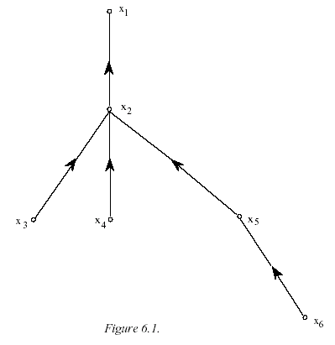
Removing term independence
In general, index terms aren’t independent
  “Hong Kong”
Dependencies can be complex
van Rijsbergen (1979) proposed simple model of dependencies as a tree
Each term dependent on one other
  Exactly Friedman and Goldszmidt’s Tree Augmented Naive Bayes (AAAI 13, 1996)
In 1970s, estimation problems held back success of this model

Slide 29
5. Term frequency and the VSM
Right in the first lecture, we said that a page should rank higher if it mentions a word more
  Perhaps modulated by things like page length
Why not in BIM? Much of early IR was designed for titles or abstracts, and not for modern full text search
We now want a model with term frequency in it
We’ll mainly look at a probabilistic model (BM25)
First, a quick summary of vector space model

Slide 30
Summary – vector space ranking (Ch. 6)
Represent the query as a weighted tf-idf vector
  (0, 0, 0, 0, 2.3, 0, 0, 0, 1.78, 0, 0, 0, …, 0, 8.17, 0, 0)
Represent each document as a weighted tf-idf vector
  (1.2, 0, 3.7, 1.5, 2.0, 0, 1.3, 0, 3.7, 1.4, 0, 0, …, 3.5, 5.1, 0, 0)
Compute the cosine similarity score for the query vector and each document vector
Rank documents with respect to the query by score
Return the top K (e.g., K = 10) to the user

Slide 31
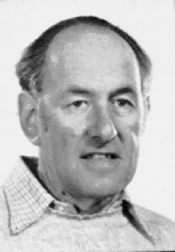
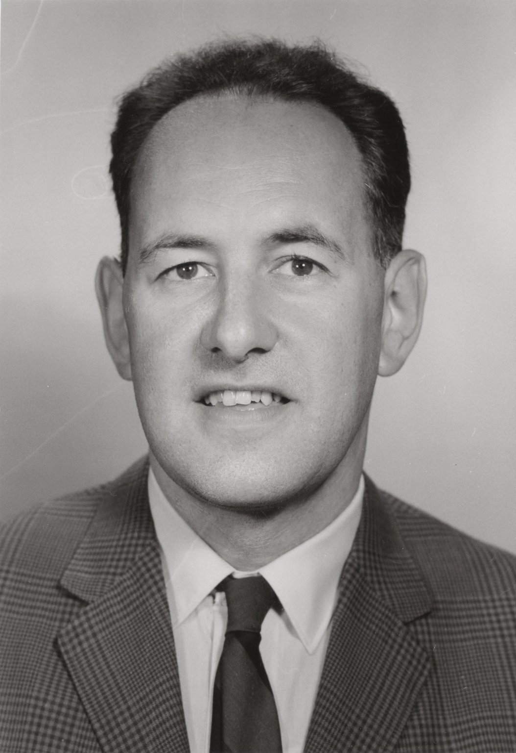
Notes:
Amit Singhal last of Gerard Salton students

Slide 32
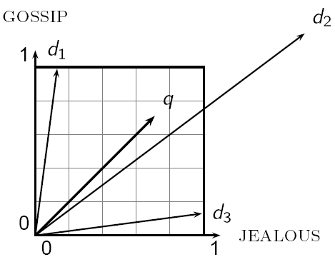
Cosine similarity
Sec. 6.3

Slide 33
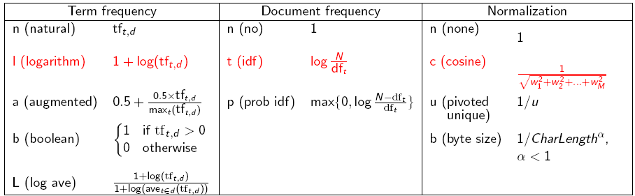
tf-idf weighting has many variants
Sec. 6.4
Notes:
n default is just term frequency
ltc is best known form of weighting

Slide 34
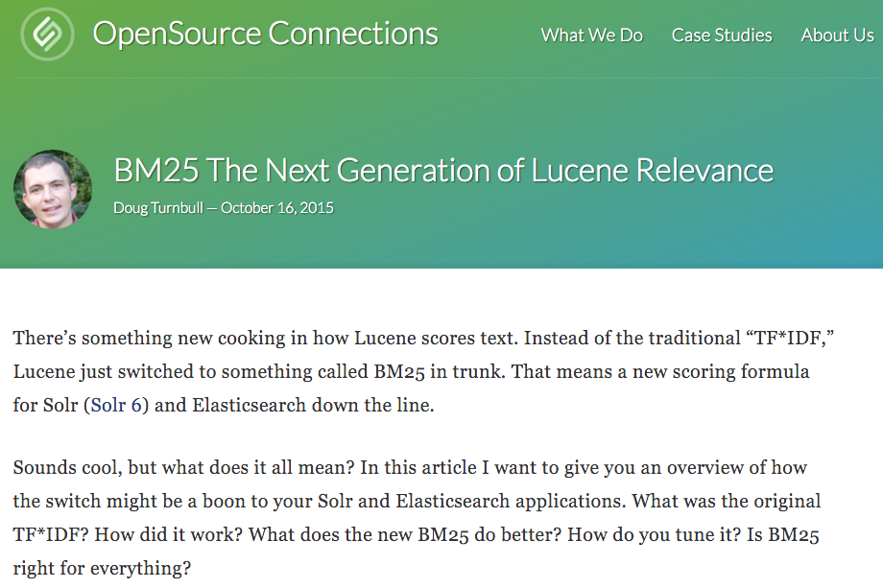
6. BM25
Notes:
Lucene 6.0 released 8 April 2016 has this!

Slide 35
Okapi BM25 [Robertson et al. 1994, TREC City U.]
BM25 “Best Match 25” (they had a bunch of tries!)
  Developed in the context of the Okapi system
  Started to be increasingly adopted by other teams during the TREC competitions
  It works well
Goal: be sensitive to term frequency and document length while not adding too many parameters
  (Robertson and Zaragoza 2009; Spärck Jones et al. 2000)

Slide 36
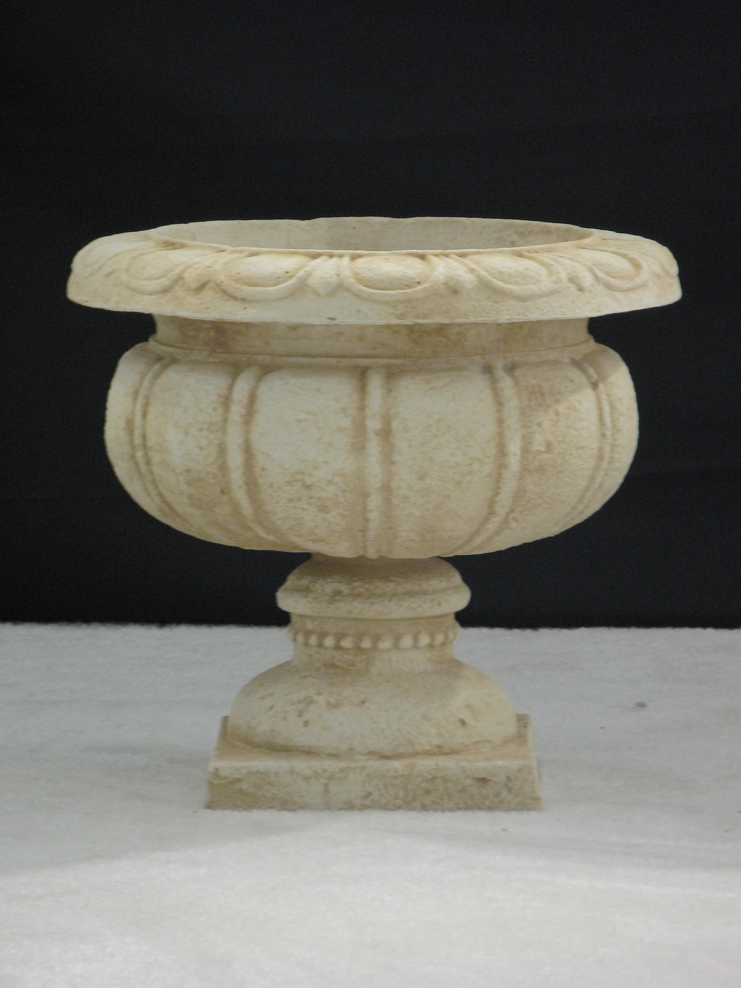
Generative model for documents
Words are drawn independently from the vocabulary using a multinomial distribution
... the draft is that each team is given a position in the draft …
basic
team
the
given
draft
each
nfl
annual
team
of
draft
nfl
football
design
is
that
football
…

Slide 37

Generative model for documents
Distribution of term frequencies (tf) follows a binomial distribution – approximated by a Poisson
... the draft is that each team is given a position in the draft …
draft
…
…

Slide 38
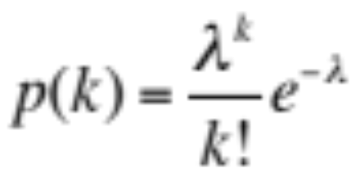
Poisson distribution
  The Poisson distribution models the probability of k, the number of events occurring in a fixed interval of time/space, with known average rate λ ( = cf/T), independent of the last event
Examples
  Number of cars arriving at a toll booth per minute
  Number of typos on a page

Slide 39
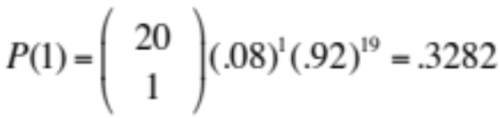
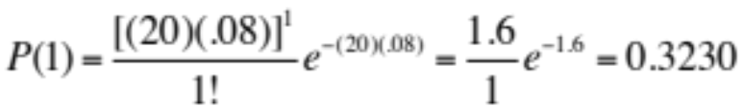
Poisson distribution
  If T is large and p is small, we can approximate a binomial distribution with a Poisson where λ = Tp
  Mean = Variance = λ = Tp
  Example p = 0.08, T = 20. Chance of 1 occurrence is:
    Binomial
    Poisson … already close

Slide 40
Poisson model
Assume that term frequencies in a document (tf_{i}) follow a Poisson distribution
  “Fixed interval” implies fixed document length … think roughly constant-sized document abstracts
    … will fix later

Slide 41
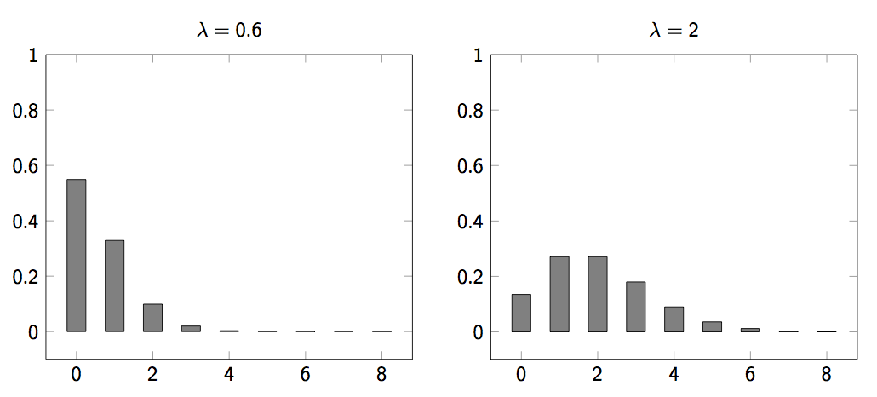
Poisson distributions

Slide 42
(One) Poisson Model flaw
Is a reasonable fit for “general” words
Is a poor fit for topic-specific words
  get higher p(k) than predicted too often
 |  | Documents containing k occurrences of word (λ = 53/650)
Freq | Word | 0 | 1 | 2 | 3 | 4 | 5 | 6 | 7 | 8 | 9 | 10 | 11 | 12
53 | expected | 599 | 49 | 2
52 | based | 600 | 48 | 2
53 | conditions | 604 | 39 | 7
55 | cathexis | 619 | 22 | 3 | 2 | 1 | 2 | 0 | 1
51 | comic | 642 | 3 | 0 | 1 | 0 | 0 | 0 | 0 | 0 | 0 | 1 | 1 | 2
Harter, “A Probabilistic Approach to Automatic Keyword Indexing”, JASIST, 1975
Notes:
Cathexis = the concentration of mental energy on one particular person, idea, or object (especially to an unhealthy degree).

Slide 43
Eliteness (“aboutness”)
Model term frequencies using eliteness
What is eliteness?
  Hidden variable for each document-term pair, denoted as E_{i} for term i
  Represents aboutness: a term is elite in a document if, in some sense, the document is about the concept denoted by the term
  Eliteness is binary
  Term occurrences depend only on eliteness…
  … but eliteness depends on relevance

Slide 44
Elite terms
Text from the Wikipedia page on the NFL draft showing elite terms
The National Football League Draft is an annual event in which the National Football League (NFL) teams select eligible college football players. It serves as the league’s most common source of player recruitment. The basic design of the draft is that each team is given a position in the draft order in reverse order relative to its record …

Slide 45
Graphical model with eliteness
R
E_{i}
Binary
variables
tf_{i}
Frequencies
(not binary)
Notes:
Simple topic model … if you know other topic models like LDA, you might think of other ways of doing this. Here, the model directly boosts the term frequency of a bunch of words. Generative language model.

Slide 46
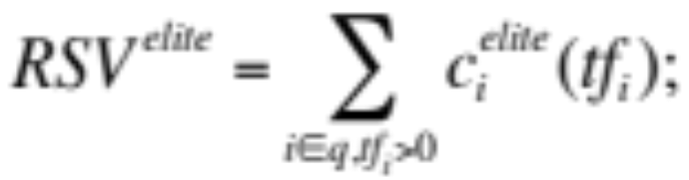
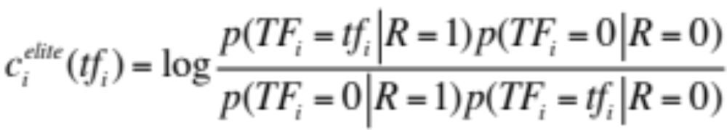
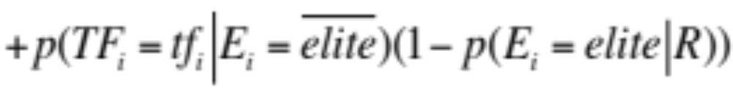
Retrieval Status Value
Similar to the BIM derivation, we have
where
and using eliteness, we have:

Slide 47
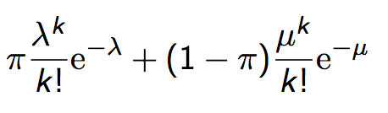
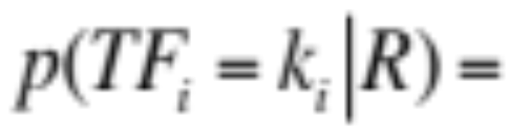
2-Poisson model
The problems with the 1-Poisson model suggests fitting two Poisson distributions
In the “2-Poisson model”, the distribution is different depending on whether the term is elite or not
where π is probability that document is elite for term
but, unfortunately, we don’t know π, λ, μ

Slide 48
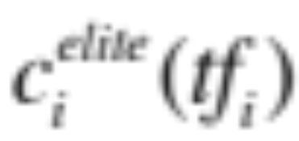
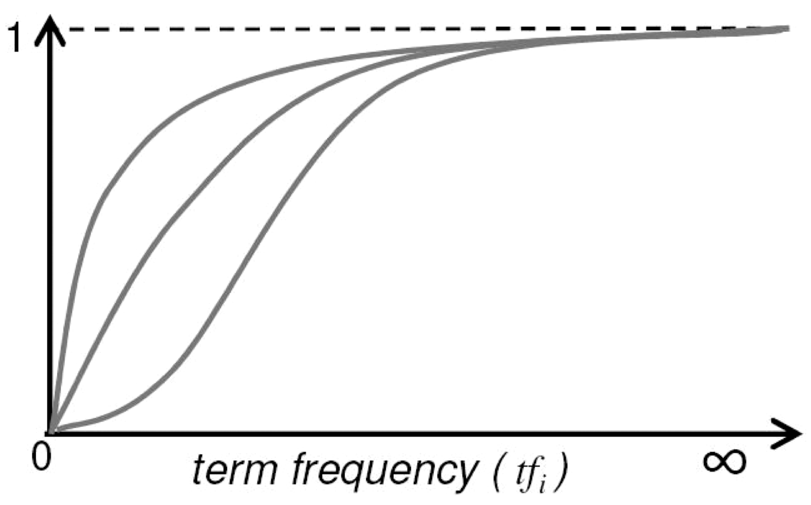
Let’s get an idea: Graphing for different parameter values of the 2-Poisson
Notes:
Concave upper two curves are for more “realistic” parameter values, so we want to approximate those ones not bottom ones.

Slide 49
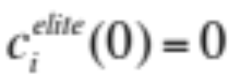


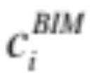
Qualitative properties
increases monotonically with tf_{i}
… but asymptotically approaches a maximum value as [not true for simple scaling of tf]
… with the asymptotic limit being
Weight of
eliteness
feature

Slide 50
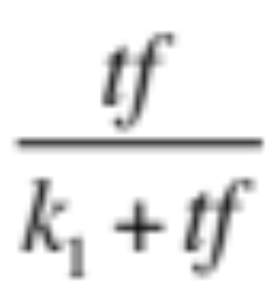
Approximating the saturation function
Estimating parameters for the 2-Poisson model is not easy
… So approximate it with a simple parametric curve that has the same qualitative properties

Slide 51
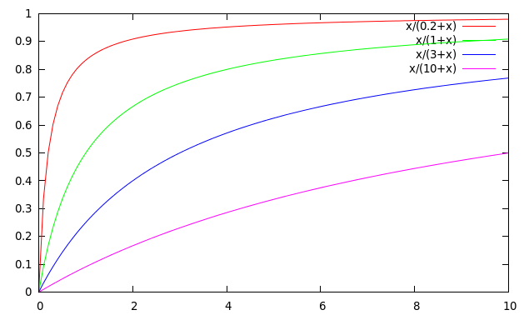
Saturation function
For high values of k₁, increments in tf_{i} continue to contribute significantly to the score
Contributions tail off quickly for low values of k₁

Slide 52
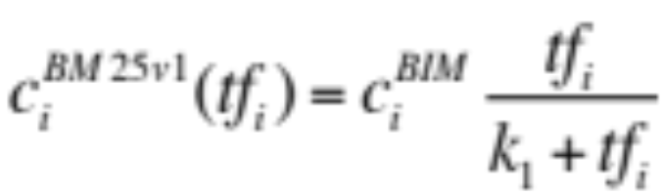
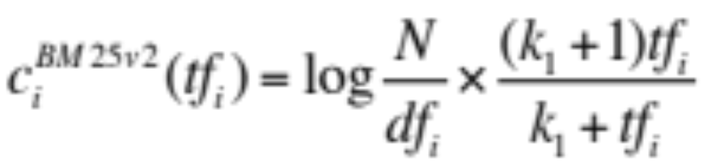
“Early” versions of BM25
Version 1: using the saturation function
Version 2: BIM simplification to IDF
  (k₁+1) factor doesn’t change ranking, but makes
  term score 1 when tf_{i} = 1
  Similar to tf-idf, but term scores are bounded
Notes:
But still don’t model document length

Slide 53
Document length normalization
Longer documents are likely to have larger tf_{i} values
Why might documents be longer?
  Verbosity: suggests observed tf_{i} too high
  Larger scope: suggests observed tf_{i} may be right
A real document collection probably has both effects
… so should apply some kind of partial normalization

Slide 54



Document length normalization
Document length:
avdl: Average document length over collection
Length normalization component
  b = 1 full document length normalization
  b = 0 no document length normalization
Notes:
Starts second half!

Slide 55

Document length normalization

Slide 56




Okapi BM25
Normalize tf using document length
BM25 ranking function

Slide 57

Okapi BM25
k₁ controls term frequency scaling
  k₁ = 0 is binary model; k₁ large is raw term frequency
b controls document length normalization
  b = 0 is no length normalization; b = 1 is relative frequency (fully scale by document length)
Typically, k₁ is set around 1.2–2 and b around 0.75
IIR sec. 11.4.3 discusses incorporating query term weighting and (pseudo) relevance feedback

Slide 58
Why is BM25 better than VSM tf-idf?
Suppose your query is [machine learning]
Suppose you have 2 documents with term counts:
  doc1: learning 1024; machine 1
  doc2: learning 16; machine 8
tf-idf: log₂ tf * log₂ (N/df)
  doc1: 11 * 7 + 1 * 10 = 87
  doc2: 5 * 7 + 4 * 10 = 75
BM25: k₁ = 2
  doc1: 7 * 3 + 10 * 1 = 31
  doc2: 7 * 2.67 + 10 * 2.4 = 42.7

Slide 59
7. Ranking with features
Textual features
  Zones: Title, author, abstract, body, anchors, …
  Proximity
  …
Non-textual features
  File type
  File age
  Page rank
  …
Notes:
Lucene calls zones “fields”

Slide 60
Ranking with zones
Straightforward idea:
  Apply your favorite ranking function (BM25) to each zone separately
  Combine zone scores using a weighted linear combination
But that seems to imply that the eliteness properties of different zones are different and independent of each other
  …which seems unreasonable

Slide 61
Ranking with zones
Alternate idea
  Assume eliteness is a term/document property shared across zones
  … but the relationship between eliteness and term frequencies are zone-dependent
    e.g., denser use of elite topic words in title
Consequence
  First combine evidence across zones for each term
  Then combine evidence across terms
Notes:
First is evidence for eliteness. Calculate saturation here.
Second is final document score

Slide 62




BM25F with zones
Calculate a weighted variant of total term frequency
… and a weighted variant of document length
where
    v_{z} is zone weight
    tf_{zi} is term frequency in zone z
    len_{z} is length of zone z
    Z is the number of zones
Average
across all
documents

Slide 63

Simple BM25F with zones
Simple interpretation: zone z is “replicated” v_{z} times
But we may want zone-specific parameters (k₁, b, IDF)
Notes:
If poisson parameters are different for different zones, should vary BM25F parameters.

Slide 64




BM25F
Empirically, zone-specific length normalization (i.e., zone-specific b) has been found to be useful
See Robertson and Zaragoza (2009: 364)

Slide 65

Ranking with non-textual features
Assumptions
  Usual independence assumption
    Independent of each other and of the textual features
    Allows us to factor out in BIM-style derivation
  Relevance information is query independent
    Usually true for features like page rank, age, type, …
    Allows us to keep all non-textual features in the BIM-style derivation where we drop non-query terms

Slide 66







Ranking with non-textual features
where
and is an artificially added free parameter to account for rescalings in the approximations
Care must be taken in selecting V_{j} depending on F_{j}. E.g.
Explains why works well

Slide 67
Resources
S. E. Robertson and K. Spärck Jones. 1976. Relevance Weighting of Search Terms. Journal of the American Society for Information Sciences 27(3): 129–146.
C. J. van Rijsbergen. 1979. Information Retrieval. 2nd ed. London: Butterworths, chapter 6. http://www.dcs.gla.ac.uk/Keith/Preface.html
K. Spärck Jones, S. Walker, and S. E. Robertson. 2000. A probabilistic model of information retrieval: Development and comparative experiments. Part 1. Information Processing and Management 779–808.
S. E. Robertson and H. Zaragoza. 2009. The Probabilistic Relevance Framework: BM25 and Beyond. Foundations and Trends in Information Retrieval 3(4): 333-389.

