Slide 1
Educational Data Mining and Applications: HW#1
By J. H. Wang
Sep. 30, 2025

Slide 2
Homework #1
Chap.2:
2.3
2.7(a)
2.11(a)(b)
2.14(a)(b)
2.18(a)(b)
2.19(b)
2.22(a)
Due: 2 weeks (Oct. 14, 2025)

Slide 3
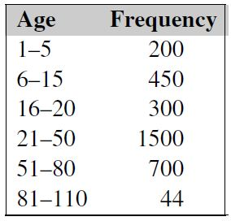
Exercises for Chap.2
2.3: Suppose that the values for a given set of data are grouped into intervals. The intervals and corresponding frequencies are as follows:
Compute an approximate median value for the data.

Slide 4
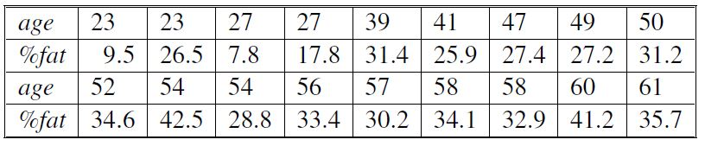
2.7: Suppose that a hospital tested the age and body fat data for 18 randomly selected adults with the following results:
(a) Calculate the mean, median, and standard deviation of age and %fat.

Slide 5
2.11: It is important to define or select similarity measures in data analysis. However, there is no commonly accepted subjective similarity measure. Results can vary depending on the similarity measures used. Nonetheless, seemingly different similarity measures may be equivalent after some transformation. (to be continued…)

Slide 6
(… continued from the previous slide) Suppose we have the following 2-D data set:
(a) Consider the data as 2-D data points. Given a new data point, x=(1.4,1.6) as a query, rank the database points based on similarity with the query using Euclidean distance, Manhattan distance, supremum distance, and cosine similarity.
(to be continued…)
 | A1 | A2
x1 | 1.5 | 1.7
x2 | 2 | 1.9
x3 | 1.6 | 1.8
x4 | 1.2 | 1.5
x5 | 1.5 | 1.0

Slide 7
(… continued from the previous slide)
(b) Normalize the data set to make the (Euclidean) norm of each data point equal to 1. Use Euclidean distance on the transformed data to rank the data points.

Slide 8
2.14: Given the following data (in increasing order) for the attribute age: 13, 15, 16, 16, 19, 20, 20, 21, 22, 22, 25, 25, 25, 25, 30, 33, 33, 35, 35, 35, 35, 36, 40, 45, 46, 52, 70.
(a) Use smoothing by bin means to smooth these data, using equal-frequency bins of size 3. Illustrate your steps. Comment on the effect of this technique for the given data.
(b) How might you determine outliers in the data?

Slide 9
2.18: Using the data for age given in Exercise 2.14, answer the following:
(a) Use min-max normalization to transform the value 35 for age onto the range [0.0, 1.0].
(b) Use z-score normalization to transform the value 35 for age, where the standard deviation of age is 12.70 years.

Slide 10
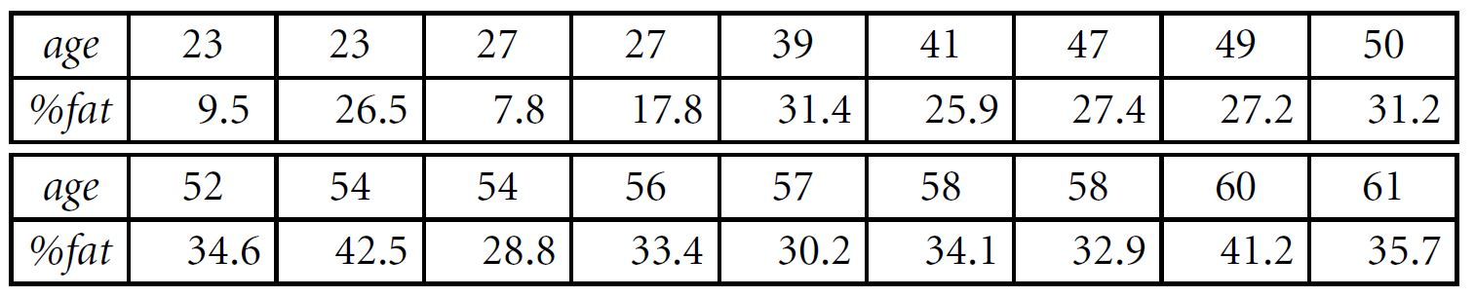
2.19: Using the data for age and body fat given in Exercise 2.7, answer the following:
(b) Calculate the correlation coefficient (Pearson’s product moment coefficient). Are these two attributes positively or negatively correlated? Compute their covariance.

Slide 11
2.22: Using the data for age given in Exercise 2.14,
(a) Plot an equal-width histogram of width 10.

Slide 12
Homework Submission
For hand-written exercises, please write your answers of the homework
You can hand in your homework in class (paper version),
Or submit the electronic file online to iSchool+ under the item [Assignments]\[HW#1]
The steps of answering each question has to be included
Please remember to write your name and student ID
Either typing or photos or scanning of your hand writing for the steps

Slide 13
Thanks for Your Attention!

