Slide 1
Exercise #1: Exploring Open-Source Operating Systems with Virtual Machines
J. H. Wang
Mar. 13, 2026

Slide 2
Objectives
To get you familiar with some open-source operating systems like Linux
To use virtualization tools such as VirtualBox, Qemu, or VMware Player
To explore the source code of Linux kernel

Slide 3
Exploring Linux Operating Systems
The traditional (and more difficult) way
  Download one of the Linux distributions as CDs or DVDs
    E.g. Ubuntu, Redhat, Debain, …
  Partition your hard disk and start installing the Linux distribution
  Configure your system parameters such as network, display, I/O devices, …
  Download the latest Linux kernel, compile it and replace the original kernel
Since we will not focus on directly installing Linux from scratch, this is not what we will do…

Slide 4
The easier way (that will not depend on hard disk partitions and your OS platform)
  Download the virtual machine manager
    VirtualBox, Qemu, or VMware Player
  Download a virtual machine image pre-installed with OS and applications
  Boot the virtual machine image
  Download the latest Linux kernel, compile it and replace the original kernel

Slide 5
Other (indirect) ways
  Connecting to remote Linux hosts or workstations
    using telnet, ssh
  Installing UNIX-like environment such as cygwin
    http://www.cygwin.com/
  For Win10 or Win11, install WSL2 (Windows Subsystems for Linux)
    wsl --install

Slide 6
Oracle VirtualBox
VirtualBox homepage:
  https://www.virtualbox.org/
  Latest version: 7.2.6
You can also download the VirtualBox appliances or virtual machine images from the textbook author’s website:
  http://people.westminstercollege.edu/faculty/ggagne/osc10e/vm/index.html
  Ubuntu 16.04.3 distribution, running kernel 4.4

Slide 7
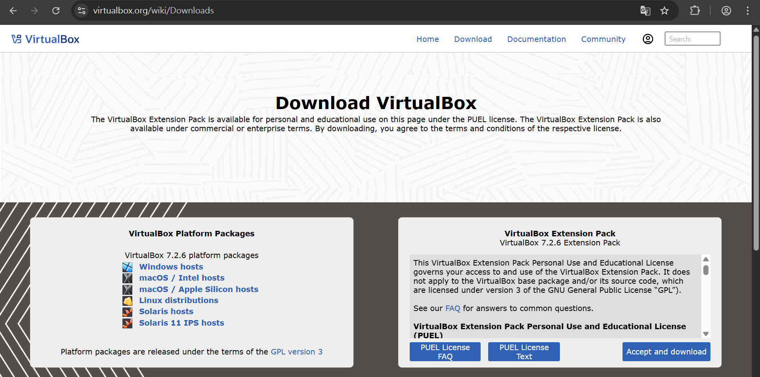

Slide 8
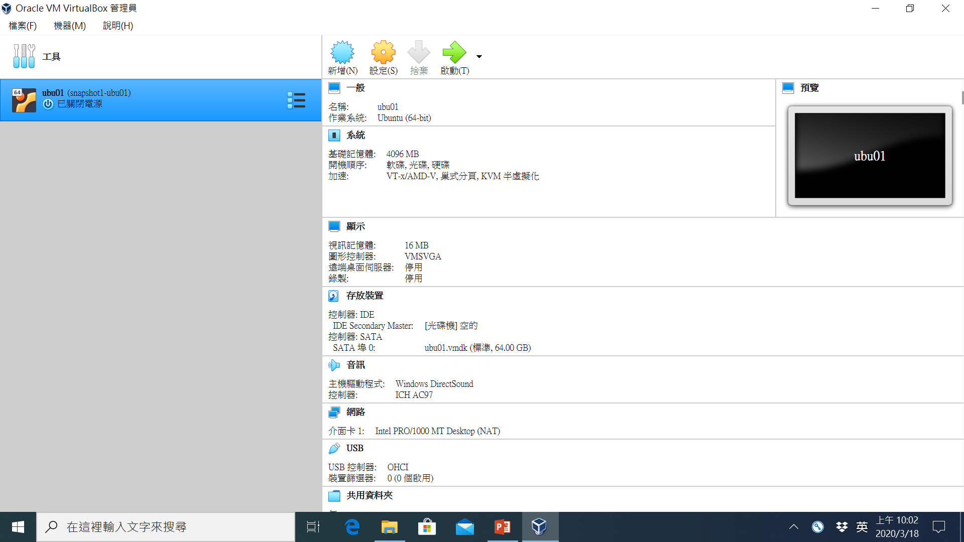

Slide 9
Example: Linux Virtual Machine
http://cs.westminstercollege.edu/~greg/osc10e/vm/index.html
a command-line based Ubuntu Server running version 4.4 of the Linux kernel
Standard development tools are included with this software
This will run using the freely-available VirtualBox software
The virtual machine includes the source code for the 10th edition of Operating System Concepts

Slide 10
Qemu
Qemu homepage:
  https://www.qemu.org/
  Latest version: 10.2.1
VirtualBox images can be converted to Qemu images by qemu-img command

Slide 11
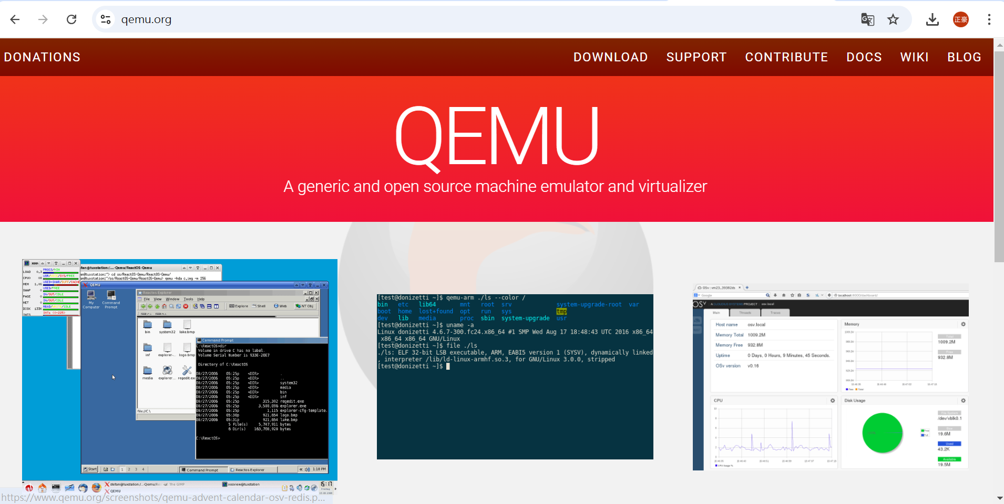

Slide 12
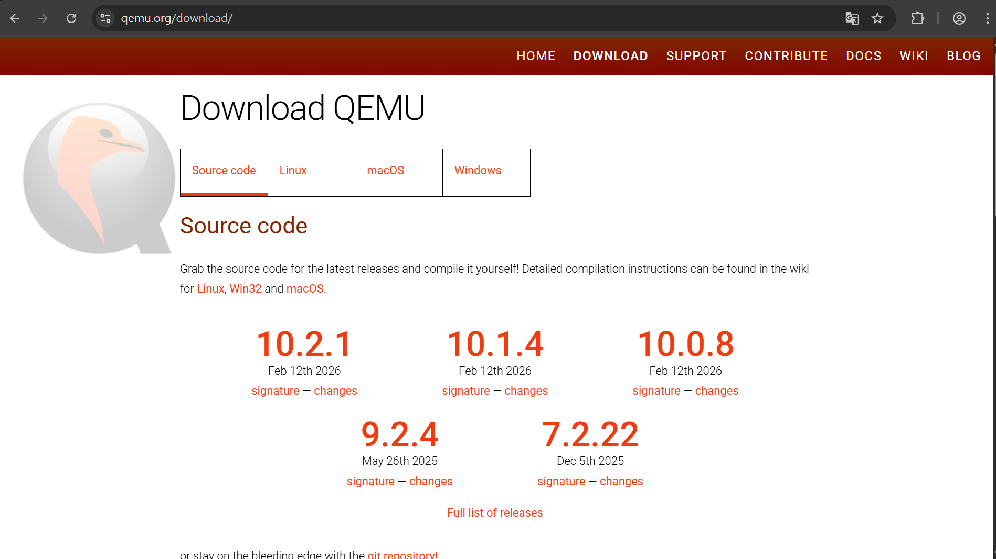

Slide 13
VMWare
VMware was acquired by Broadcom Inc. in 2023
VMware Workstation Player
  Latest version: (discontinued)
  → Vmware Workstation Pro is free for personal use

Slide 14
Obtaining the Latest Linux Kernel Source Code
http://www.kernel.org/
  The latest version: 6.19.7
  Uncompress the downloaded file by: tar, gzip/gunzip or bzip2/bunzip2
    tar xjf linux-6.19.7.tar.xz

Slide 15
A Tour of Linux Source Code
Under /usr/src
  Maybe /usr/src/linux or /usr/src/linux-x.y.z
Different modules
  drivers/
  fs/
  mm/
  net/
  …
Procedures of Building a New Kernel
  (See Programming Project)

Slide 16
Further Reading
Programming Project in Chap.2
  Creating Linux kernel modules and loading it into the Linux kernel

