Slide 1
MapReduce Algorithm Design
(Modified from the slides by Jimmy Lin in his course of Big Data Infrastructure, Session 3: MapReduce – Basic Algorithm Design)
This work is licensed under a Creative Commons Attribution-Noncommercial-Share Alike 3.0 United States See http://creativecommons.org/licenses/by-nc-sa/3.0/us/ for details

Slide 2
Outline
MapReduce algorithm design
How do you express everything in terms of m, r, c, p?
Toward “design patterns”
Real-world word counting: language models
How to break all the rules and get away with it

Slide 3
MapReduce: Recap
Programmers must specify:
map (k, v) → <k’, v’>*
reduce (k’, v’) → <k’, v’>*
All values with the same key are reduced together
Optionally, also:
partition (k’, number of partitions) → partition for k’
Often a simple hash of the key, e.g., hash(k’) mod n
Divides up key space for parallel reduce operations
combine (k’, v’) → <k’, v’>*
Mini-reducers that run in memory after the map phase
Used as an optimization to reduce network traffic
The execution framework handles everything else…

Slide 4
k₁
v₁
k₂
v₂
k₃
v₃
k₄
v₄
k₅
v₅
k₆
v₆
map
map
map
map
a
1
b
2
c
3
c
6
a
5
c
2
b
7
c
8
combine
combine
combine
combine
a
1
b
2
c
9
a
5
c
2
b
7
c
8
partition
partition
partition
partition
Shuffle and Sort: aggregate values by keys
a
1
5
b
2
7
c
2
9
8
reduce
reduce
reduce
r₁
s₁
r₂
s₂
r₃
s₃

Slide 5
“Everything Else”
The execution framework handles everything else…
Scheduling: assigns workers to map and reduce tasks
“Data distribution”: moves processes to data
Synchronization: gathers, sorts, and shuffles intermediate data
Errors and faults: detects worker failures and restarts
Limited control over data and execution flow
All algorithms must be expressed in m, r, c, p
You don’t know:
Where mappers and reducers run
When a mapper or reducer begins or finishes
Which input a particular mapper is processing
Which intermediate key a particular reducer is processing

Slide 6
Tools for Synchronization
Cleverly-constructed data structures
Bring partial results together
Sort order of intermediate keys
Control order in which reducers process keys
Partitioner
Control which reducer processes which keys
Preserving state in mappers and reducers
Capture dependencies across multiple keys and values

Slide 7
Preserving State
Mapper object
Reducer object
one object per task
state
state
setup
API initialization hook
setup
map
one call per input key-value pair
reduce
one call per intermediate key
cleanup
API cleanup hook
close

Slide 8
Scalable Hadoop Algorithms: Themes
Avoid object creation
Inherently costly operation
Garbage collection
Avoid buffering
Limited heap size
Works for small datasets, but won’t scale!

Slide 9
Importance of Local Aggregation
Ideal scaling characteristics:
Twice the data, twice the running time
Twice the resources, half the running time
Why can’t we achieve this?
Synchronization requires communication
Communication kills performance
Thus… avoid communication!
Reduce intermediate data via local aggregation
Combiners can help

Slide 10
Shuffle and Sort
Mapper
intermediate files (on disk)
merged spills (on disk)
Combiner
Reducer
circular buffer (in memory)
Combiner
other reducers
spills (on disk)
other mappers

Slide 11
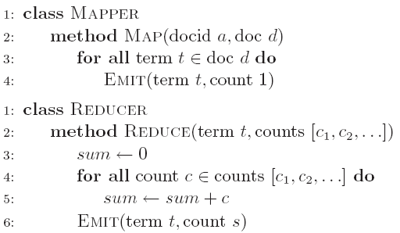
Word Count: Baseline
What’s the impact of combiners?

Slide 12
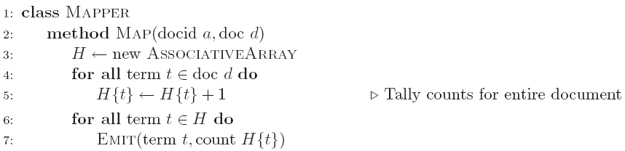
Word Count: Version 1
Are combiners still needed?

Slide 13
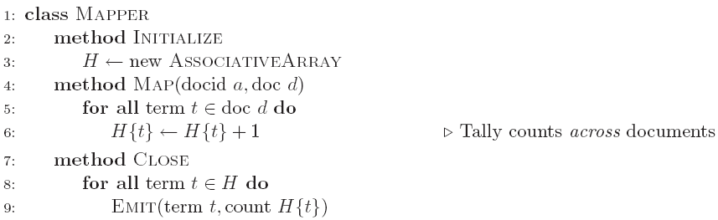
Word Count: Version 2
Key idea: preserve state across input key-value pairs!
Are combiners still needed?

Slide 14
Design Pattern for Local Aggregation
“In-mapper combining”
Fold the functionality of the combiner into the mapper by preserving state across multiple map calls
Advantages
Speed
Why is this faster than actual combiners?
Disadvantages
Explicit memory management required
Potential for order-dependent bugs

Slide 15
Combiner Design
Combiners and reducers share same method signature
Sometimes, reducers can serve as combiners
Often, not…
Remember: combiners are optional optimizations
Should not affect algorithm correctness
May be run 0, 1, or multiple times
Example: find average of integers associated with the same key

Slide 16
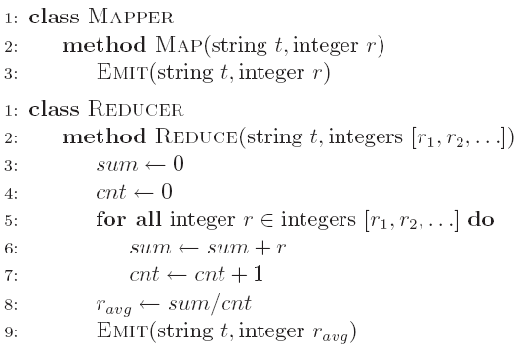
Computing the Mean: Version 1
Why can’t we use reducer as combiner?

Slide 17
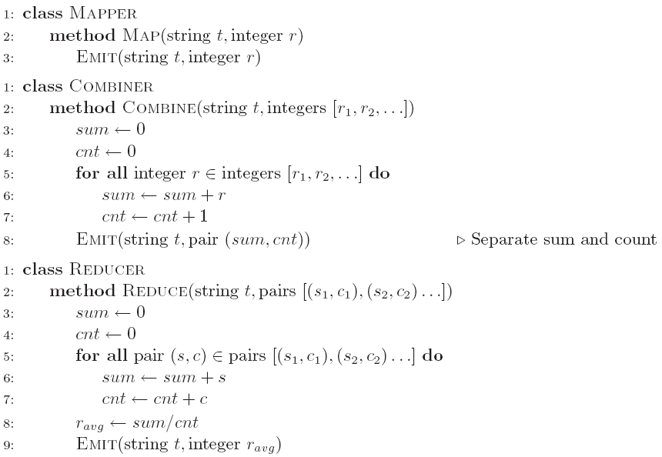
Computing the Mean: Version 2
Why doesn’t this work?

Slide 18
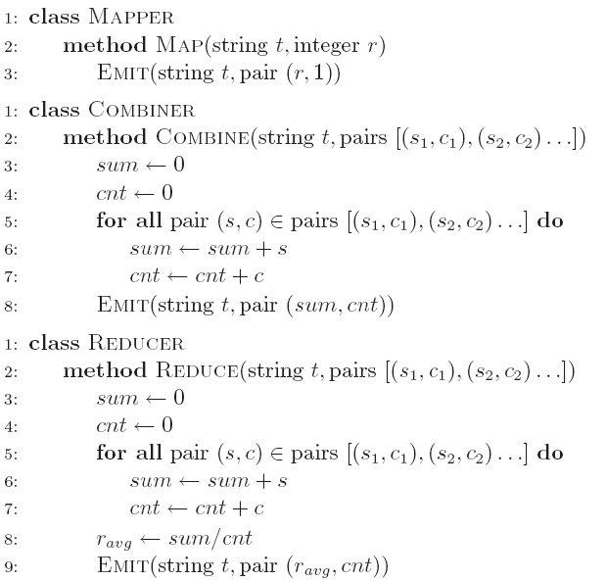
Computing the Mean: Version 3
Fixed?

Slide 19
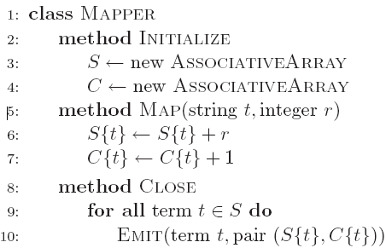
Computing the Mean: Version 4
Are combiners still needed?

Slide 20
Algorithm Design: Running Example
Term co-occurrence matrix for a text collection
M = N x N matrix (N = vocabulary size)
M_{ij}: number of times i and j co-occur in some context (for concreteness, let’s say context = sentence)
Why?
Distributional profiles as a way of measuring semantic distance
Semantic distance useful for many language processing tasks

Slide 21
MapReduce for Large Counting Problems
Term co-occurrence matrix for a text collection = specific instance of a large counting problem
A large event space (number of terms)
A large number of observations (the collection itself)
Goal: keep track of interesting statistics about the events
Basic approach
Mappers generate partial counts
Reducers aggregate partial counts
How do we aggregate partial counts efficiently?

Slide 22
First Try: “Pairs”
Each mapper takes a sentence:
Generate all co-occurring term pairs
For all pairs, emit (a, b) → count
Reducers sum up counts associated with these pairs
Use combiners!

Slide 23
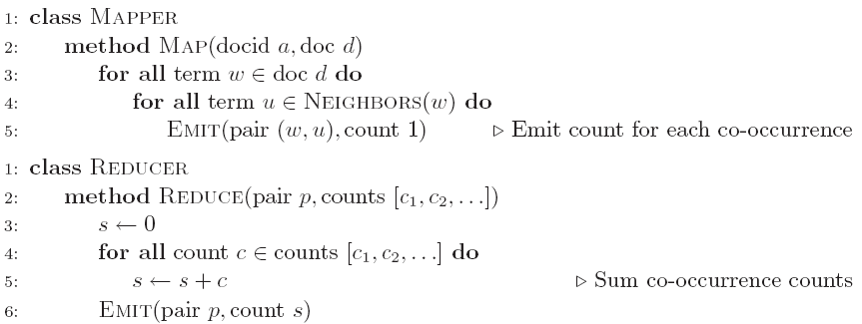
Pairs: Pseudo-Code

Slide 24
“Pairs” Analysis
Advantages
Easy to implement, easy to understand
Disadvantages
Lots of pairs to sort and shuffle around (upper bound?)
Not many opportunities for combiners to work

Slide 25
Another Try: “Stripes”
Idea: group together pairs into an associative array
Each mapper takes a sentence:
Generate all co-occurring term pairs
For each term, emit a → { b: count_{b}, c: count_{c}, d: count_{d} … }
Reducers perform element-wise sum of associative arrays
(a, b) → 1
(a, c) → 2
(a, d) → 5
(a, e) → 3
(a, f) → 2
a → { b: 1, c: 2, d: 5, e: 3, f: 2 }
a → { b: 1, d: 5, e: 3 }
a → { b: 1, c: 2, d: 2, f: 2 }
a → { b: 2, c: 2, d: 7, e: 3, f: 2 }
+
Key idea: cleverly-constructed data structure
brings together partial results

Slide 26
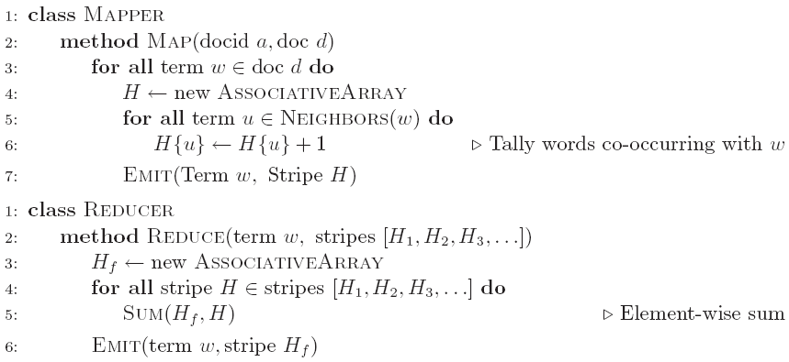
Stripes: Pseudo-Code

Slide 27
“Stripes” Analysis
Advantages
Far less sorting and shuffling of key-value pairs
Can make better use of combiners
Disadvantages
More difficult to implement
Underlying object more heavyweight
Fundamental limitation in terms of size of event space

Slide 28
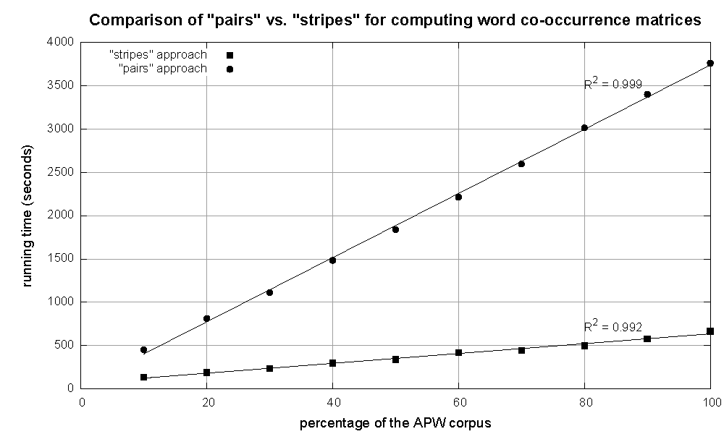
Cluster size: 38 cores
Data Source: Associated Press Worldstream (APW) of the English Gigaword Corpus (v3), which contains 2.27 million documents (1.8 GB compressed, 5.7 GB uncompressed)

Slide 29
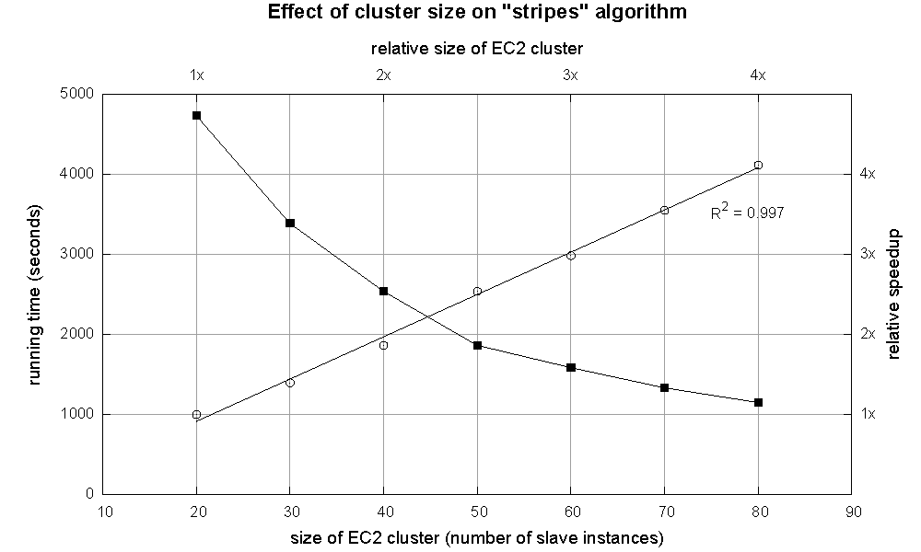

Slide 30
Relative Frequencies
How do we estimate relative frequencies from counts?
Why do we want to do this?
How do we do this with MapReduce?

Slide 31
f(B|A): “Stripes”
Easy!
One pass to compute (a, *)
Another pass to directly compute f(B|A)
a → {b₁:3, b₂ :12, b₃ :7, b₄ :1, … }

Slide 32
f(B|A): “Pairs”
What’s the issue?
Computing relative frequencies requires marginal counts
But the marginal cannot be computed until you see all counts
Buffering is a bad idea!
Solution:
What if we could get the marginal count to arrive at the reducer first?

Slide 33
f(B|A): “Pairs”
For this to work:
Must emit extra (a, *) for every b_{n} in mapper
Must make sure all a’s get sent to same reducer (use partitioner)
Must make sure (a, *) comes first (define sort order)
Must hold state in reducer across different key-value pairs
(a, *) → 32
Reducer holds this value in memory
(a, b₁) → 3
(a, b₂) → 12
(a, b₃) → 7
(a, b₄) → 1
…
(a, b₁) → 3 / 32
(a, b₂) → 12 / 32
(a, b₃) → 7 / 32
(a, b₄) → 1 / 32
…

Slide 34
“Order Inversion”
Common design pattern:
Take advantage of sorted key order at reducer to sequence computations
Get the marginal counts to arrive at the reducer before the joint counts
Optimization:
Apply in-memory combining pattern to accumulate marginal counts

Slide 35
Synchronization: Pairs vs. Stripes
Approach 1: turn synchronization into an ordering problem
Sort keys into correct order of computation
Partition key space so that each reducer gets the appropriate set of partial results
Hold state in reducer across multiple key-value pairs to perform computation
Illustrated by the “pairs” approach
Approach 2: construct data structures that bring partial results together
Each reducer receives all the data it needs to complete the computation
Illustrated by the “stripes” approach

Slide 36
Secondary Sorting
MapReduce sorts input to reducers by key
Values may be arbitrarily ordered
What if want to sort value also?
E.g., k → (v₁, r), (v₃, r), (v₄, r), (v₈, r)…

Slide 37
Secondary Sorting: Solutions
Solution 1:
Buffer values in memory, then sort
Why is this a bad idea?
Solution 2:
“Value-to-key conversion” design pattern: form composite intermediate key, (k, v₁)
Let execution framework do the sorting
Preserve state across multiple key-value pairs to handle processing
Anything else we need to do?

Slide 38
Recap: Tools for Synchronization
Cleverly-constructed data structures
Bring data together
Sort order of intermediate keys
Control order in which reducers process keys
Partitioner
Control which reducer processes which keys
Preserving state in mappers and reducers
Capture dependencies across multiple keys and values

Slide 39
Issues and Tradeoffs
Number of key-value pairs
Object creation overhead
Time for sorting and shuffling pairs across the network
Size of each key-value pair
De/serialization overhead
Local aggregation
Opportunities to perform local aggregation varies
Combiners make a big difference
Combiners vs. in-mapper combining
RAM vs. disk vs. network

Slide 40
Debugging at Scale
Works on small datasets, won’t scale… why?
Memory management issues (buffering and object creation)
Too much intermediate data
Mangled input records
Real-world data is messy!
There’s no such thing as “consistent data”
Watch out for corner cases
Isolate unexpected behavior, bring local

Slide 41
Non-Toy Applications of Word Count
Language Models
Statistical Machine Translation

Slide 42
Count.
What’s the non-toy application of word count?

Slide 43

Language Models
[chain rule]
Is this tractable?
Notes:
Sentence with T words - assign a probability to it

Slide 44
Approximating Probabilities
Basic idea: limit history to fixed number of words N
(Markov Assumption)
N=1: Unigram Language Model

Slide 45
Approximating Probabilities
Basic idea: limit history to fixed number of words N
(Markov Assumption)
N=2: Bigram Language Model
Notes:
Since we also want to include the first word in the bigram model, we need a dummy beginning of sentence marker <s>. We usually also have an end of sentence marker but for the sake of brevity, I don’t show that here.

Slide 46
Approximating Probabilities
Basic idea: limit history to fixed number of words N
(Markov Assumption)
N=3: Trigram Language Model

Slide 47



Building N-Gram Language Models
Compute maximum likelihood estimates (MLE) for individual n-gram probabilities
Unigram:
Bigram:
Generalizes to higher-order n-grams
We already know how to do this in MapReduce!
Notes:
N-gram probability estimates. Derive the conditional probability expression on board ! Given that the occurrence of an n-gram is a random variable with a binomial distribution i.e. each n-gram is independent of the next. Untrue: (a) n-grams are overlapping (b) content words tend to clump (used once, likely to get used again)

Slide 48
Thou shalt smooth!
Zeros are bad for any statistical estimator
Need better estimators because MLEs give us a lot of zeros
A distribution without zeros is “smoother”
The Robin Hood Philosophy: Take from the rich (seen n-grams) and give to the poor (unseen n-grams)
And thus also called discounting
Make sure you still have a valid probability distribution!
Lots of techniques:
Laplace, Good-Turing, Katz backoff, Jelinek-Mercer
Kneser-Ney represents best practice

Slide 49
Stupid Backoff
Let’s break all the rules:
But throw lots of data at the problem!
Source: Brants et al. (EMNLP 2007)

Slide 50
Stupid Backoff Implementation
Same basic idea as “pairs” approach discussed previously
A few optimizations:
Convert words to integers, ordered by frequency (take advantage of VByte compression)
Replicate unigram counts to all shards

Slide 51
Stupid Backoff Implementation
Straightforward approach: count each order separately
More clever approach: count all orders together
A B
A B C
A B D
A B E
…
remember this value
A B
A B C
A B C P
A B C Q
A B D
A B D X
A B D Y
…
remember this value
remember this value
remember this value

Slide 52
Different Ways of Smoothing
State-of-the-art Smoothing (less data)
Count and normalize (more data)

Slide 53
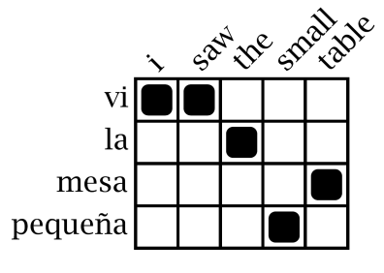
Statistical Machine Translation
Word Alignment
Phrase Extraction
Training Data
i saw the small table
(vi, i saw)
(la mesa pequeña, the small table)
…
vi la mesa pequeña
Parallel Sentences
he sat at the table
the service was good
Language Model
Translation Model
Target-Language Text
Decoder
maria no daba una bofetada a la bruja verde
mary did not slap the green witch
Foreign Input Sentence
English Output Sentence

Slide 54
Translation as a Tiling Problem
Maria
no
dio
una
bofetada
a
la
bruja
verde
Mary
Mary
not
give
a
slap
to
the
witch
green
did not
by
did not
a slap
green witch
green witch
no
slap
to the
slap
did not give
to
the
the
slap
the witch

Slide 55

English
French
channel
Source: http://www.flickr.com/photos/johnmueller/3814846567/in/pool-56226199@N00/

Slide 56
Results: Running Time
 | target | webnews | Web
# tokens | 237M | 31G | 1.8T
Vocab size # n-grams LM size (SB) | 200k 257M 2G | 5M 21G 89G | 16M 300G 1.8T
Time (SB) Time (KN) # machines | 20 min 2.5 hours 100 | 8 hours 2 days 400 | 1 day - 1500
Source: Brants et al. (EMNLP 2007)

Slide 57
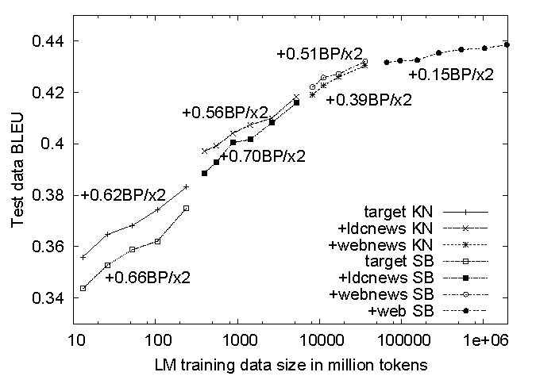
Results: Translation Quality
Source: Brants et al. (EMNLP 2007)

Slide 58
Any Questions?

