Slide 1
Introduction to Natural Language Processing
By J. H. Wang
Feb. 21, 2024

Slide 2
Outline
What is NLP?
Example Tasks
The state-of-the-art

Slide 3
What is Natural Language Processing
(speech and) language processing
Human language technology
Computational linguistics
To give computers ability to process human language
To enable human-machine communication
E.g. conversational agent

Slide 4
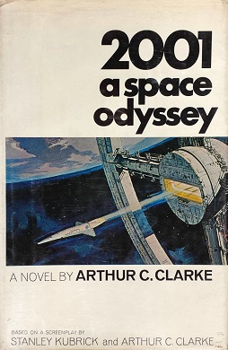

Example: 2001: A Space Odyssey
A 1968 epic science fiction film produced and directed by Stanley Kubrick
Based on a novel by Arthur C. Clarke
HAL 9000 computer
Speaking and understanding English
Even reading lips
Conversational agent, dialog system
Input: automatic speech recognition, natural language understanding
Output: dialogue and response planning, speech synthesis

Slide 5





Modern Examples: Chatbots
ChatGPT, Gemini (Bard)
Mobile phone assistants
Apple Siri, …
Smart speakers
Google Home, Amazon Alexa, LINE Clova, …
Other applications:
Social networking platforms
Healthcare
Banking
…

Slide 6
Example Language-related Tasks
Machine Translation
Automatically translate a document from one language to another
Web-based question answering, for example:
What year was Abraham Lincoln born?
How many states were in the United States that year?
How much Chinese silk was exported to England by the end of the 18th century?
What do scientists think about the ethics of human cloning?
Information extraction, word sense disambiguation
Spelling correction, grammar checking, …

Slide 7
Question Answering: IBM’s Watson
Won Jeopardy on February 16, 2011!
WILLIAM WILKINSON’S
“AN ACCOUNT OF THE PRINCIPALITIES OF WALLACHIA AND MOLDOVIA”
INSPIRED THIS AUTHOR’S
MOST FAMOUS NOVEL
Bram Stoker

Slide 8
Information Extraction
Event: Curriculum mtg
Date: Jan-16-2012
Start: 10:00am
End: 11:30am
Where: Gates 159
Subject: curriculum meeting
Date: January 15, 2012
To: Dan Jurafsky
Hi Dan, we’ve now scheduled the curriculum meeting.
It will be in Gates 159 tomorrow from 10:00-11:30.
-Chris
Create new Calendar entry

Slide 9
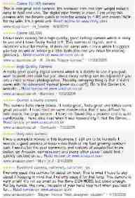

Information Extraction & Sentiment Analysis
Attributes:
zoom
affordability
size and weight
flash
ease of use
Size and weight
✓
nice and compact to carry!
since the camera is small and light, I won't need to carry around those heavy, bulky professional cameras either!
the camera feels flimsy, is plastic and very light in weight you have to be very delicate in the handling of this camera
✓
✗

Slide 10
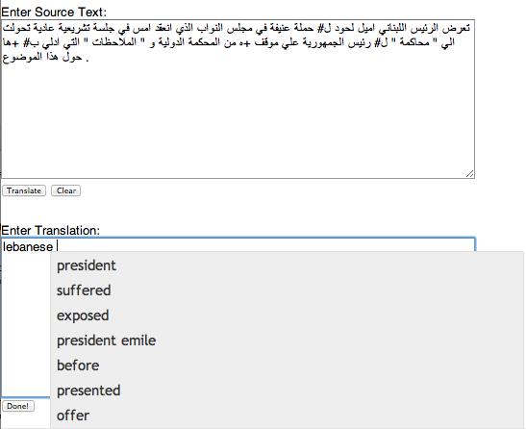
Machine Translation
Helping human translators
Fully automatic
Enter Source Text:
這 不過 是 一 個 時間 的 問題 .
Translation from Stanford’s Phrasal:
This is only a matter of time.

Slide 11




Language Technology
making good progress
Sentiment analysis
still really hard
mostly solved
Best roast chicken in San Francisco!
Question answering (QA)
The waiter ignored us for 20 minutes.
Spam detection
Coreference resolution
Q. How effective is ibuprofen in reducing fever in patients with acute febrile illness?
✓
Let’s go to Agra!
Paraphrase
✗
Carter told Mubarak he shouldn’t run again.
Buy V1AGRA …
Word sense disambiguation (WSD)
XYZ acquired ABC yesterday
Part-of-speech (POS) tagging
I need new batteries for my mouse.
ABC has been taken over by XYZ
ADJ ADJ NOUN VERB ADV
Summarization
Colorless green ideas sleep furiously.
Parsing
The Dow Jones is up
Economy is good
I can see Alcatraz from the window!
The S&P500 jumped
Named entity recognition (NER)
Machine translation (MT)
Housing prices rose
PERSON ORG LOC
第13届上海国际电影节开幕…
Dialog
Where is Citizen Kane playing in SF?
Einstein met with UN officials in Princeton
The 13th Shanghai International Film Festival…
Information extraction (IE)
Castro Theatre at 7:30. Do you want a ticket?
You’re invited to our dinner party, Friday May 27 at 8:30
Party May 27 add

Slide 12
Knowledge of Language
Phonetics and Phonology - knowledge about linguistic sounds
Morphology - knowledge of the meaningful components of words
Syntax - knowledge of the structural relationships between words
Semantics - knowledge of meaning
Pragmatics - knowledge of the relationship of meaning to the goals and intentions of the speaker
Discourse - knowledge about linguistic units larger than a single utterance

Slide 13
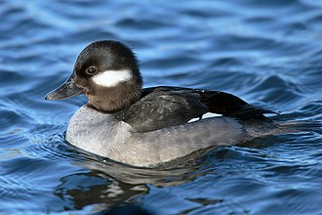
Ambiguity
Some input is ambiguous if multiple, alternative linguistic structures can be built for it
For example: I made her duck.
What’s the meaning?
?

Slide 14
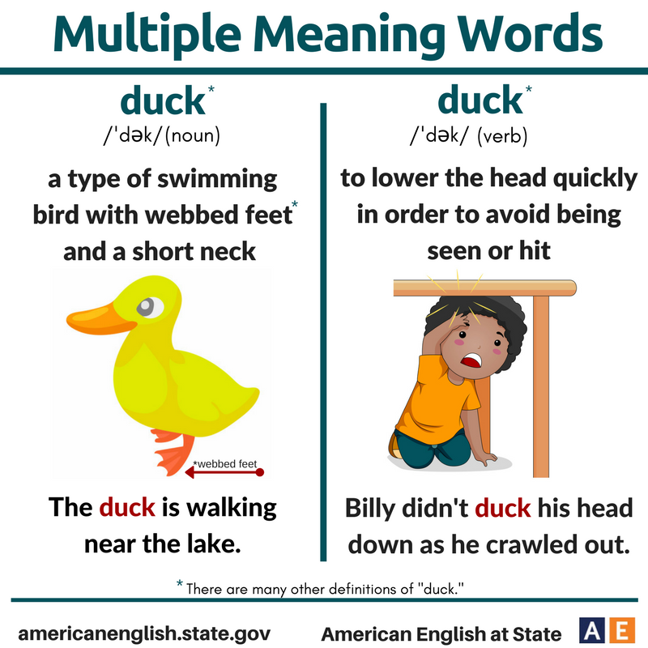
Possible Answers:
(1.5) I cooked waterfowl for her.
(1.6) I cooked waterfowl belonging to her.
(1.7) I created the (plaster?) duck she owns.
(1.8) I caused her to quickly lower her head or body.
(1.9) I waved my magic wand and turned her into undifferentiated waterfowl.

Slide 15
Resolving Ambiguities
Lexical disambiguation
Part-of-Speech (POS) Tagging
E.g. duck: noun vs. verb
Word sense disambiguation
E.g. make: create vs. cook
Syntactic disambiguation
Parsing

Slide 16
Why else is natural language understanding difficult?
non-standard English
segmentation issues
idioms
Great job @justinbieber! Were SOO PROUD of what youve accomplished! U taught us 2 #neversaynever & you yourself should never give up either♥
dark horse
get cold feet
lose face
throw in the towel
the New York-New Haven Railroad
the New York-New Haven Railroad
neologisms
world knowledge
tricky entity names
unfriend
Retweet
bromance
Mary and Sue are sisters.
Mary and Sue are mothers.
Where is A Bug’s Life playing …
Let It Be was recorded …
… a mutation on the for gene …
But that’s what makes it fun!

Slide 17
Models and Algorithms
State machines, rule systems, logic, probabilistic models, vector-space models
State space search algorithm: dynamic programming
Machine learning algorithm: classification, expectation-maximization (EM), …
Deterministic and non-deterministic finite state automata, finite-state transducers
Regular grammars, context free grammars, …

Slide 18
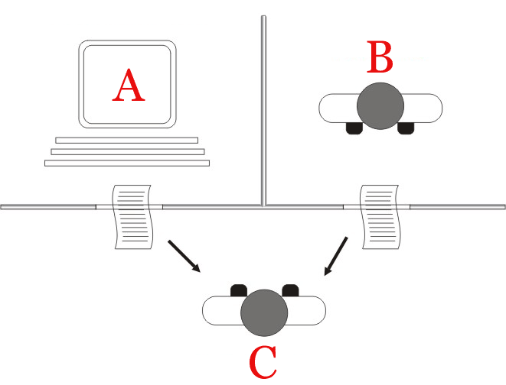
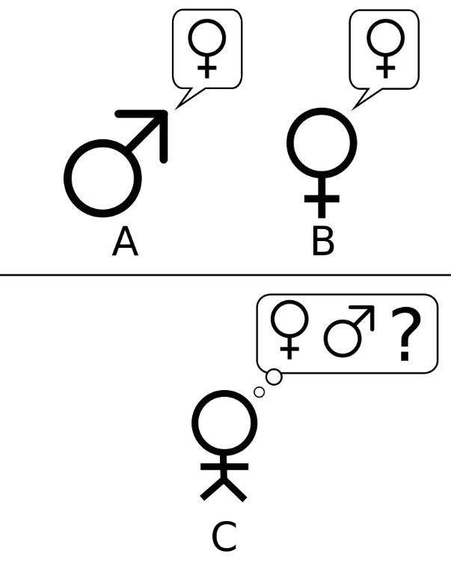
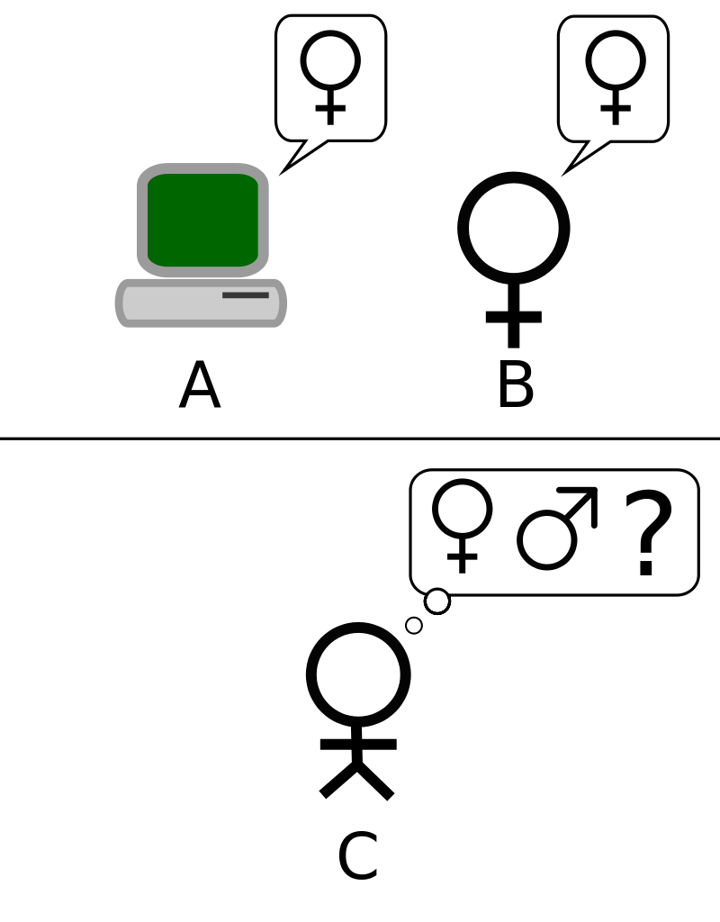
Language, Thought, Understanding
The ability to process language as skillfully as humans do
“Can machines think?”
Turing test: by Alan Turing (1950)
“Imitation game”
“Can machines do what we can do?”
Conversational agents

Slide 19
Q: Please write me a sonnet on the topic of the Forth Bridge.
A: Count me out on this one. I never could write poetry.
Q: Add 34957 to 70764.
A: (Pause about 30 seconds and then give answer as) 105621.

Slide 20
Example dialog of ELIZA (1966)
Rogerian Psychotherapy (person-centered therapy)
User1: You are like my father in some ways.
ELIZA1: WHAT RESEMBLANCE DO YOU SEE
User2: You are not very aggressive but I think you don’t want me to notice that.
ELIZA2: WHAT MAKES YOU THINK I AM NOT AGGRESSIVE
User3: You don’t argue with me.
ELIZA3: WHY DO YOU THINK I DON’T ARGUE WITH YOU
User4: You are afraid of me.
ELIZA4: DOES IT PLEASE YOU TO BELIEVE I AM AFRAID OF YOU

Slide 21
The State of the Art
Travelers calling travel providers interact with conversational agents
Cars that allow drivers to control by voice
Searching video on the Web by speech
Cross-language information retrieval and translation by Google
Grading and assessing student essays by automated systems
Interactive virtual agents
Automated measurement of user opinions, preferences, attitudes in social media
…

Slide 22
Brief History of NLP
Different fields in different departments
Computational linguistics: in linguistics
Natural language processing: in computer science
Speech recognition: in electrical engineering
Computational psycholinguistics: in psychology

Slide 23
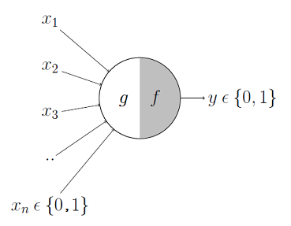
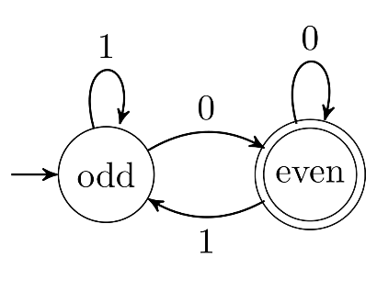
Foundational Insights: 1940s and 1950s
Automaton: 1950s
Turing (1936)
McCulloch-Pitts neuron (1943)
Finite automata, regular expressions (1951, 1956)
Shannon (1948)
Context-free grammar: Chomsky (1956), Backus (1959), Naur (1960)
Probabilistic or information-theoretic models
Shannon: communication, entropy
Koenig: sound spectrogram (1946)

Slide 24
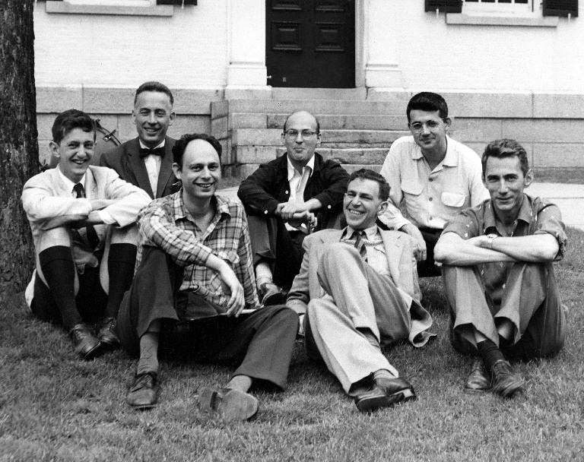
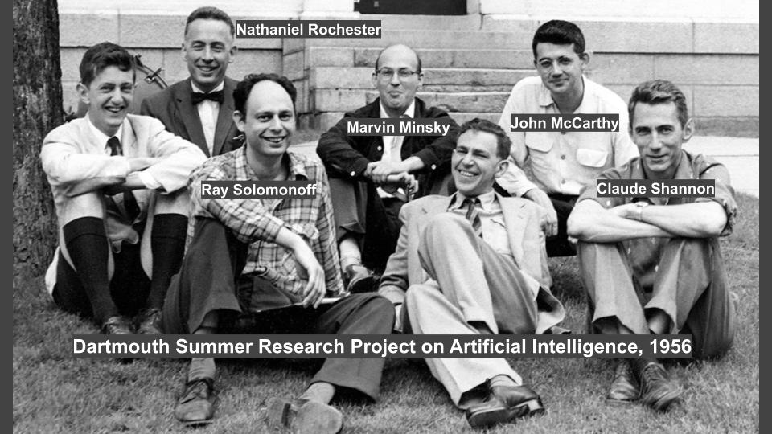
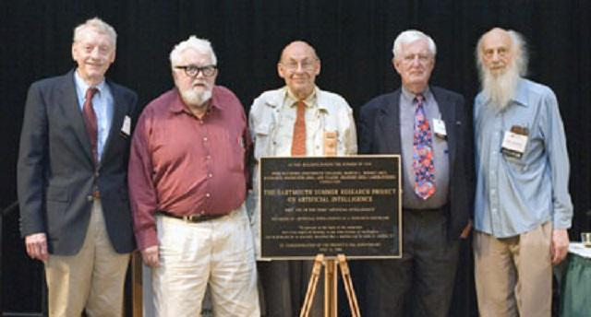
The Two Camps: 1957–1970
Two paradigms
Symbolic
Formal language theory, parsing
Artificial intelligence: John McCarthy, Marvin Minsky, Claude Shannon, and Nathaniel Rochester (1956)
Stochastic
Bayesian method

Slide 25
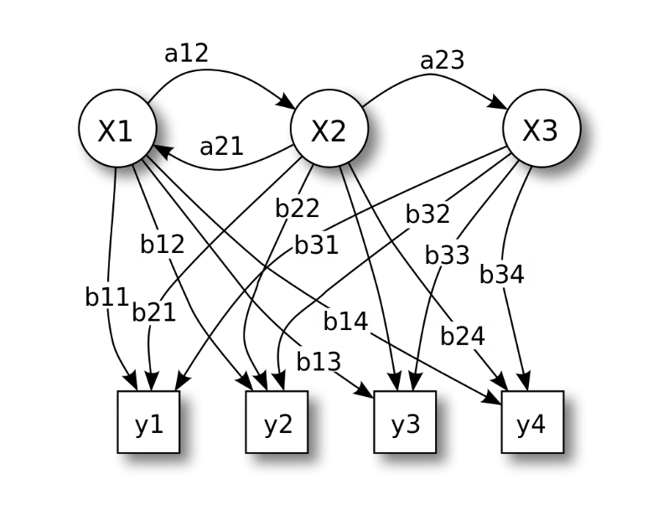
Four Paradigms: 1970–1983
Stochastic
Hidden Markov model
Logic-based
Natural language understanding
Discourse modeling

Slide 26
Empiricism and Finite-State Models Redux: 1983–1993
Finite-state models
Probabilistic models

Slide 27
The Field Comes Together: 1994–1999
Probabilistic and data-driven models had become quite standard throughout natural language processing
The increases in the speed and memory of computers had allowed commercial exploitation of a number of subareas of speech and language processing, in particular, speech recognition, and spelling and grammar correction
The rise of the Web emphasized the need for language-based information retrieval and information extraction

Slide 28
The Rise of Machine Learning: 2000–2008
Large amounts of spoken and written material became widely available through the auspices of the Linguistic Data Consortium (LDC) and other similar organizations
This increased focus on learning led to a more serious interplay with the statistical machine learning community
SVM, maximum entropy, multinomial logistic regression, graphical Bayesian models
The widespread availability of high-performance computing systems facilitated the training and deployment of systems that could not have been imagined a decade earlier
Near the end of this period, largely unsupervised statistical approaches began to receive renewed attention
Topic modeling, …

Slide 29
New Potentials for NLP
Powerful computing resources
Web as the massive source of information
Availability of wireless mobile access
Many new application scenarios

Slide 30
Thanks for Your Attention!

