Slide 1
MapReduce Basics & Algorithm Design
By J. H. Wang
Dec. 12, 2023

Slide 2
Outline
Introduction
MapReduce Basics
MapReduce Algorithm Design

Slide 3
Reference
Jimmy Lin and Chris Dyer, “Data-Intensive Text Processing with MapReduce”, Ch.1-3
Slides from Jimmy Lin’s “Big Data Infrastructure” course, Univ. Maryland (and Univ. Waterloo)

Slide 4
Divide and Conquer
“Work”
Partition
w₁
w₂
w₃
worker
worker
worker
r₁
r₂
r₃
Combine
“Result”

Slide 5
Parallelization Challenges
How do we assign work units to workers?
What if we have more work units than workers?
What if workers need to share partial results?
How do we aggregate partial results?
How do we know all the workers have finished?
What if workers die?
What's the common theme of all of these problems?

Slide 6
Common Theme?
Parallelization problems arise from:
Communication between workers (e.g., to exchange state)
Access to shared resources (e.g., data)
Thus, we need a synchronization mechanism

Slide 7
Managing Multiple Workers
Difficult because
We don’t know the order in which workers run
We don’t know when workers interrupt each other
We don’t know when workers need to communicate partial results
We don’t know the order in which workers access shared data
Thus, we need:
Semaphores (lock, unlock)
Conditional variables (wait, notify, broadcast)
Barriers
Still, lots of problems:
Deadlock, livelock, race conditions...
Dining philosophers, sleeping barbers, cigarette smokers...
Moral of the story: be careful!

Slide 8
Current Tools
Programming models
Shared memory (pthreads)
Message passing (MPI)
Design Patterns
Master-slaves
Producer-consumer flows
Shared work queues
Shared Memory
Message Passing
Memory
P₁
P₂
P₃
P₄
P₅
P₁
P₂
P₃
P₄
P₅
master
producer
consumer
work queue
slaves
producer
consumer

Slide 9
Where the rubber meets the road
Concurrency is difficult to reason about
Concurrency is even more difficult to reason about
At the scale of datacenters and across datacenters
In the presence of failures
In terms of multiple interacting services
Not to mention debugging…
The reality:
Lots of one-off solutions, custom code
Write you own dedicated library, then program with it
Burden on the programmer to explicitly manage everything

Slide 10
Big Ideas behind MapReduce
Scale “out”, not “up”
A large number of commodity low-end servers is preferred over a small number of high-end servers
Assume failures are common
Fault-tolerant service must cope with failures without impacting the quality of service
Moving processing to the data
MapReduce assumes an architecture where processors and storage are co-located

Slide 11
Processing data sequentially and avoid random access
MapReduce is primarily designed for batch processing over large datasets
Hide system-level details from the application developer
Simple and well-defined interfaces between a small number of components
Seamless scalability

Slide 12
MapReduce Basics

Slide 13
MapReduce Programming Model
Functional programming roots
Map and fold
Mappers and reducers
Execution framework
Combiners and partitioners
Distributed file system

Slide 14
Typical Big Data Problem
Map
Iterate over a large number of records
Extract something of interest from each
Shuffle and sort intermediate results
Aggregate intermediate results
Generate final output
Reduce
Key idea: provide a functional abstraction for these two operations

Slide 15
Roots in Functional Programming
Map
f
f
f
f
f
Fold
g
g
g
g
g

Slide 16
MapReduce
Programmers specify two functions:
map (k₁, v₁) → [<k₂, v₂>]
reduce (k₂, [v₂]) → [<k₃, v₃>]
All values with the same key are sent to the same reducer
The execution framework handles everything else…

Slide 17
k₁
v₁
k₂
v₂
k₃
v₃
k₄
v₄
k₅
v₅
k₆
v₆
map
map
map
map
a
1
b
2
c
3
c
6
a
5
c
2
b
7
c
8
Shuffle and Sort: aggregate values by keys
a
1
5
b
2
7
c
2
3
6
8
reduce
reduce
reduce
r₁
s₁
r₂
s₂
r₃
s₃

Slide 18
MapReduce
Programmers specify two functions:
map (k, v) → <k’, v’>*
reduce (k’, v’) → <k’, v’>*
All values with the same key are sent to the same reducer
The execution framework handles everything else…
What’s “everything else”?

Slide 19
MapReduce “Runtime”
Handles scheduling
Assigns workers to map and reduce tasks
Handles “data distribution”
Moves processes to data
Handles synchronization
Gathers, sorts, and shuffles intermediate data
Handles errors and faults
Detects worker failures and restarts
Everything happens on top of a distributed FS

Slide 20
MapReduce
Programmers specify two functions:
map (k, v) → <k’, v’>*
reduce (k’, v’) → <k’, v’>*
All values with the same key are reduced together
The execution framework handles everything else…
Not quite…usually, programmers also specify:
partition (k’, number of partitions) → partition for k’
Often a simple hash of the key, e.g., hash(k’) mod n
Divides up key space for parallel reduce operations
combine (k’, v’) → <k’, v’>*
Mini-reducers that run in memory after the map phase
Used as an optimization to reduce network traffic

Slide 21
k₁
v₁
k₂
v₂
k₃
v₃
k₄
v₄
k₅
v₅
k₆
v₆
map
map
map
map
a
1
b
2
c
3
c
6
a
5
c
2
b
7
c
8
combine
combine
combine
combine
a
1
b
2
c
9
a
5
c
2
b
7
c
8
partition
partition
partition
partition
Shuffle and Sort: aggregate values by keys
a
1
5
b
2
7
c
c
2
2
9
3
8
6
reduce
reduce
reduce
r₁
s₁
r₂
s₂
r₃
s₃

Slide 22
Two more details…
Barrier between map and reduce phases
But we can begin copying intermediate data earlier
Keys arrive at each reducer in sorted order
No enforced ordering across reducers

Slide 23
MapReduce can refer to…
The programming model
The execution framework (aka “runtime”)
The specific implementation
Usage is usually clear from context!

Slide 24
Google MapReduce Framework
User Program
(1) submit
Master
(2) schedule map
(2) schedule reduce
worker
split 0
(6) write
output
file 0
split 1
(5) remote read
worker
split 2
(3) read
(4) local write
split 3
worker
split 4
worker
output
file 1
worker
Input
files
Map
phase
Intermediate files
(on local disk)
Reduce
phase
Output
files
Adapted from (Dean and Ghemawat, OSDI 2004)

Slide 25
Basic Hadoop API*
Mapper
void setup(Mapper.Context context) Called once at the beginning of the task
void map(K key, V value, Mapper.Context context) Called once for each key/value pair in the input split
void cleanup(Mapper.Context context) Called once at the end of the task
Reducer/Combiner
void setup(Reducer.Context context) Called once at the start of the task
void reduce(K key, Iterable<V> values, Reducer.Context context) Called once for each key
void cleanup(Reducer.Context context) Called once at the end of the task
*Note that there are two versions of the API!

Slide 26
Basic Hadoop API*
Partitioner
int getPartition(K key, V value, int numPartitions) Get the partition number given total number of partitions
Job
Represents a packaged Hadoop job for submission to cluster
Need to specify input and output paths
Need to specify input and output formats
Need to specify mapper, reducer, combiner, partitioner classes
Need to specify intermediate/final key/value classes
Need to specify number of reducers (but not mappers, why?)
Don’t depend of defaults!
*Note that there are two versions of the API!

Slide 27
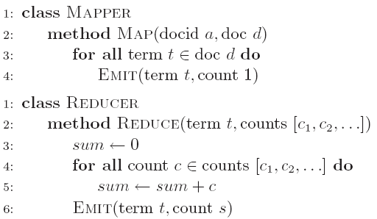
“Hello World”: Word Count - Pseudo code
Map(String docid, String text):
for each word w in text:
Emit(w, 1);
Reduce(String term, Iterator<Int> values):
int sum = 0;
for each v in values:
sum += v;
Emit(term, sum);

Slide 28
“Hello World”: Word Count in Java
private static class MyMapper
extends Mapper<LongWritable, Text, Text, IntWritable> {
private final static IntWritable ONE = new IntWritable(1);
private final static Text WORD = new Text();
@Override
public void map(LongWritable key, Text value, Context context)
throws IOException, InterruptedException {
String line = ((Text) value).toString();
StringTokenizer itr = new StringTokenizer(line);
while (itr.hasMoreTokens()) {
WORD.set(itr.nextToken());
context.write(WORD, ONE);
}
}
}

Slide 29
“Hello World”: Word Count in Java
private static class MyReducer
extends Reducer<Text, IntWritable, Text, IntWritable> {
private final static IntWritable SUM = new IntWritable();
@Override
public void reduce(Text key, Iterable<IntWritable> values,
Context context) throws IOException, InterruptedException {
Iterator<IntWritable> iter = values.iterator();
int sum = 0;
while (iter.hasNext()) {
sum += iter.next().get();
}
SUM.set(sum);
context.write(key, SUM);
}
}

Slide 30
Input File
Input File
InputSplit
InputSplit
InputSplit
InputSplit
InputSplit
InputFormat
RecordReader
RecordReader
RecordReader
RecordReader
RecordReader
Mapper
Mapper
Mapper
Mapper
Mapper
Intermediates
Intermediates
Intermediates
Intermediates
Intermediates
Source: redrawn from a slide by Cloduera, cc-licensed

Slide 31
Client
Records
…
…
InputSplit
InputSplit
InputSplit
RecordReader
RecordReader
RecordReader
Mapper
Mapper
Mapper

Slide 32
Mapper
Mapper
Mapper
Mapper
Mapper
Intermediates
Intermediates
Intermediates
Intermediates
Intermediates
Partitioner
Partitioner
Partitioner
Partitioner
Partitioner
(combiners omitted here)
Intermediates
Intermediates
Intermediates
Reducer
Reducer
Reduce
Source: redrawn from a slide by Cloduera, cc-licensed

Slide 33
Reducer
Reducer
Reduce
OutputFormat
RecordWriter
RecordWriter
RecordWriter
Output File
Output File
Output File
Source: redrawn from a slide by Cloduera, cc-licensed

Slide 34
Shuffle and Sort in Hadoop
Probably the most complex aspect of MapReduce
Map side
Map outputs are buffered in memory in a circular buffer
When buffer reaches threshold, contents are “spilled” to disk
Spills merged in a single, partitioned file (sorted within each partition): combiner runs during the merges
Reduce side
First, map outputs are copied over to reducer machine
“Sort” is a multi-pass merge of map outputs (happens in memory and on disk): combiner runs during the merges
Final merge pass goes directly into reducer

Slide 35
Shuffle and Sort
Mapper
intermediate files (on disk)
merged spills (on disk)
Combiner
Reducer
circular buffer (in memory)
Combiner
other reducers
spills (on disk)
other mappers

Slide 36

Hadoop Workflow
1. Load data into HDFS
2. Develop code locally
3. Submit MapReduce job
3a. Go back to Step 2
Hadoop Cluster
You
4. Retrieve data from HDFS

Slide 37
Recommended Workflow
Here’s how I work:
Develop code in Eclipse on host machine
Build distribution on host machine
Check out copy of code on VM
Copy (i.e., scp) jars over to VM (in same directory structure)
Run job on VM
Iterate
…
Commit code on host machine and push
Pull from inside VM, verify
Avoid using the UI of the VM
Directly ssh into the VM

Slide 38
Debugging Hadoop
First, take a deep breath
Start small, start locally
Build incrementally

Slide 39
Code Execution Environments
Different ways to run code:
Plain Java
Local (standalone) mode
Pseudo-distributed mode
Fully-distributed mode
Learn what’s good for what

Slide 40
Hadoop Debugging Strategies
Good ol’ System.out.println
Learn to use the webapp to access logs
Logging preferred over System.out.println
Be careful how much you log!
Fail on success
Throw RuntimeExceptions and capture state
Programming is still programming
Use Hadoop as the “glue”
Implement core functionality outside mappers and reducers
Independently test (e.g., unit testing)
Compose (tested) components in mappers and reducers

Slide 41
Example: WordCount in Action
Environment variables setting:
export JAVA_HOME=/usr/java/default
export PATH=${JAVA_HOME}/bin:${PATH}
export HADOOP_CLASSPATH=${JAVA_HOME}/lib/tools.jar
Compiling java code to create a jar:
cd ${HADOOP_HOME}/src/examples
${HADOOP_HOME}/bin/hadoop com.sun.tools.javac.Main org/apache/hadoop/examples/WordCount.java
jar cf wc.jar org/apache/hadoop/examples/WordCount*.class
Running the application in jar:
${HADOOP_HOME}/bin/hadoop jar wc.jar org.apache.hadoop.examples.WordCount <in> <out>
* NOTE: <in> and <out> are directories in HDFS

Slide 42
MapReduce Algorithm Design

Slide 43
Major Issues in MapReduce Algorithm Design
Synchronization
The most tricky aspect of designing MapReduce algorithms
The only cluster-wide synchronization during shuffle and sort stage: from mapper to reducer
Techniques to control execution and data flow in MapReduce
Scalability
Efficiency

Slide 44
Limited control over data and execution flow
Where mappers and reducers run
When a mapper or reducer begins or finishes
Which input a particular mapper is processing
Which intermediate key a particular reducer is processing

Slide 45
Tools for Synchronization
Cleverly-constructed data structures
Bring partial results together
Sort order of intermediate keys
Control order in which reducers process keys
Partitioner
Control which reducer processes which keys
Preserving state in mappers and reducers
Capture dependencies across multiple keys and values

Slide 46
Preserving State
Mapper object
Reducer object
one object per task
state
state
setup
API initialization hook
setup
map
one call per input key-value pair
reduce
one call per intermediate key
cleanup
API cleanup hook
close

Slide 47
Scalable Hadoop Algorithms: Themes
Avoid object creation
Inherently costly operation
Garbage collection
Avoid buffering
Limited heap size
Works for small datasets, but won’t scale!

Slide 48
Importance of Local Aggregation
Ideal scaling characteristics:
Twice the data, twice the running time
Twice the resources, half the running time
Why can’t we achieve this?
Synchronization requires communication
Communication kills performance
Thus… avoid communication!
Reduce intermediate data via local aggregation
Combiners can help

Slide 49
Local Aggregation
The single most important aspect of synchronization in data-intensive distributed processing
The exchange of intermediate results
Intermediate results: mapper -> reducer
written to disk, and sent over the network
Expensive
Local aggregation of intermediate results
Using the combiner
To preserve state across multiple inputs

Slide 50
Shuffle and Sort
Mapper
intermediate files (on disk)
merged spills (on disk)
Combiner
Reducer
circular buffer (in memory)
Combiner
other reducers
spills (on disk)
other mappers

Slide 51
Word Count: Baseline
What’s the impact of combiners?

Slide 52
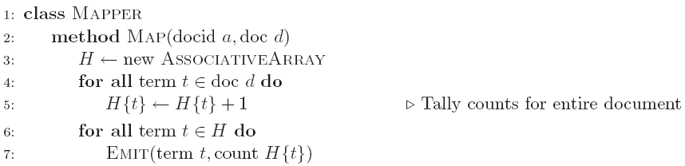
Word Count: Version 1
Are combiners still needed?

Slide 53
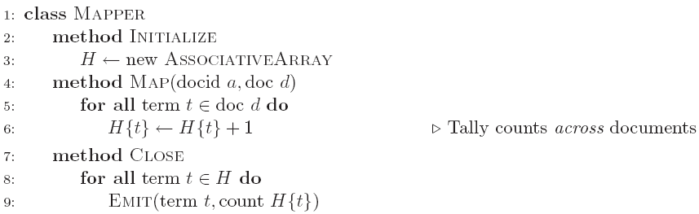
Word Count: Version 2
Key idea: preserve state across input key-value pairs!
Are combiners still needed?

Slide 54
The “in-mapper combining” Design Pattern
Combiners: to reduce the amount of intermediate results generated by mappers
Mini-reducers: mapper -> combiner -> reducer
In-mapper combining
Provide control over when local aggregation occurs and how it exactly takes place
Advantages
Speed
Why is this faster than actual combiners?
Disadvantages
Explicit memory management required
Potential for order-dependent bugs

Slide 55
Drawbacks of in-mapper combining
Breaks the functional programming underpinnings of MapReduce
Preserving state across multiple input instances means that algorithmic behavior may depend on the order of input key-value pairs
Fundamental scalability bottleneck
Memory usage in the mapper
The associative array might not fit in memory

Slide 56
Solution
Limiting the memory usage when using the in-mapper combining technique
To block input key-value pairs
To flush in-memory data structures periodically
Emitting intermediate results every n key-value pairs
Counter
Threshold on memory usage

Slide 57
Factors affecting the efficiency improvement with local aggregation
Size of the intermediate key space
Distribution of keys
Number of key-value pairs that are emitted by each map task
Opportunities from aggregation come from having multiple values associated with the same key
Effective for reduce stragglers that result from a highly skewed distribution of values

Slide 58
Algorithm correctness with local aggregation
Reducer input key-value type must match mapper output key-value type
Combiner input and output key-value types must match mapper output key-value type
Mapper -> combiner -> reducer
In general, combiners and reducers are not interchangeable
Reducers can be used as combiners when the reduce operation is both commutative and associative

Slide 59
Combiner Design
Combiners and reducers share same method signature
Sometimes, reducers can serve as combiners
Often, not…
Remember: combiner are optional optimizations
Should not affect algorithm correctness
May be run 0, 1, or multiple times
Example: find average of integers associated with the same key

Slide 60
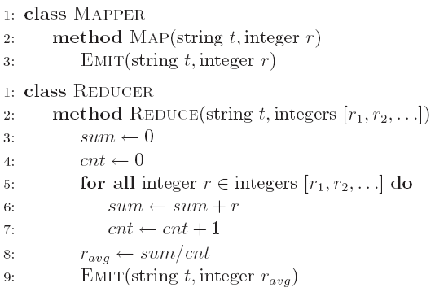
Computing the Mean: Version 1
Why can’t we use reducer as combiner?

Slide 61
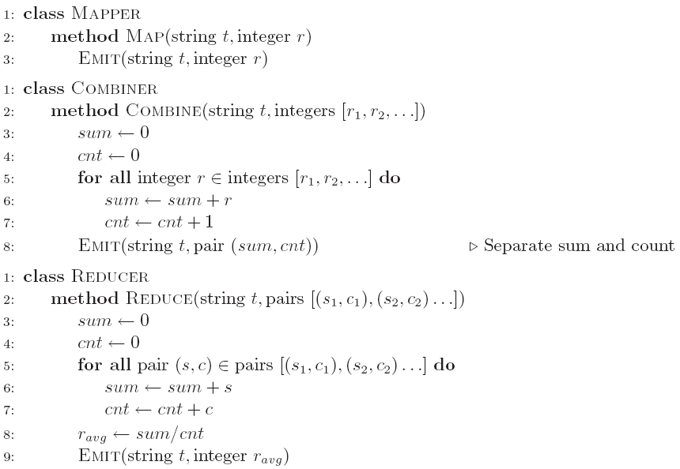
Computing the Mean: Version 2
Why doesn’t this work?

Slide 62
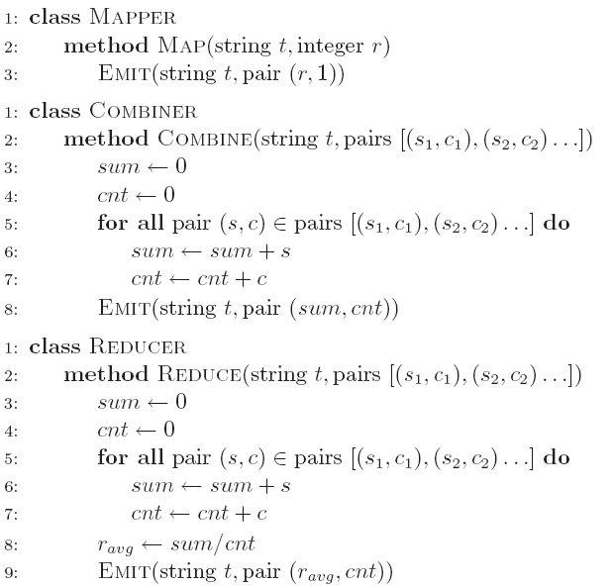
Computing the Mean: Version 3
Fixed?

Slide 63
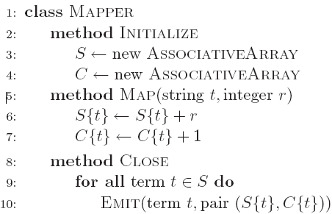
Computing the Mean: Version 4
Are combiners still needed?

Slide 64
Pairs and Stripes
References:
Chris Dyer, Aaron Cordova, Alex Mont, and Jimmy Lin, “Fast, easy, and cheap: Construction of statistical machine translation models with MapReduce,” Proceedings of the 3rd workshop on Statistical Machine Translation at ACL 2008, pp.199-207, 2008.
Jimmy Lin, “Scalable language processing algorithms for the masses: A case study in computing word co-occurrence matrices with MapReduce,” Proceedings of the 2008 Conference on Empirical Methods in Natural Language Processing (EMNLP 2008), pp.419-428, 2008.

Slide 65
Algorithm Design: Running Example
Term co-occurrence matrix for a text collection
M = N x N matrix (N = vocabulary size)
M_{ij}: number of times w_{i} and w_{j} co-occur in some context (for concreteness, let’s say context = sentence)
Why?
Distributional profiles as a way of measuring semantic distance
Semantic distance useful for many language processing tasks

Slide 66
MapReduce: Large Counting Problems
Term co-occurrence matrix for a text collection = specific instance of a large counting problem
A large event space (number of terms)
A large number of observations (the collection itself)
Goal: keep track of interesting statistics about the events
Basic approach
Mappers generate partial counts
Reducers aggregate partial counts
How do we aggregate partial counts efficiently?

Slide 67
First Try: “Pairs”
The use of complex keys to coordinate distributed computations
Each mapper takes a sentence:
Generate all co-occurring term pairs
For all pairs, emit (a, b) → count
Reducers sum up counts associated with these pairs
Use combiners!

Slide 68
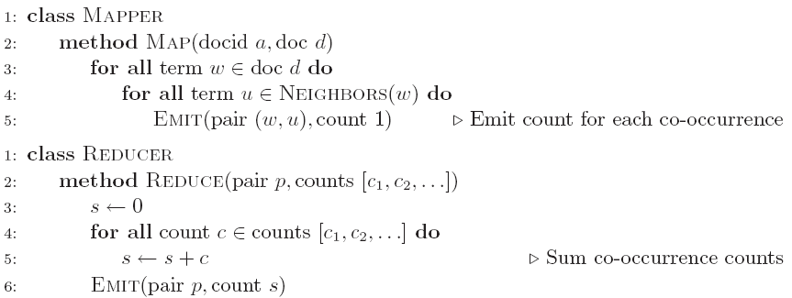
Pairs: Pseudo-Code

Slide 69
“Pairs” Analysis
Advantages
Easy to implement, easy to understand
Disadvantages
Lots of pairs to sort and shuffle around (upper bound?)
Not many opportunities for combiners to work

Slide 70
Another Try: “Stripes”
Idea: group together pairs into an associative array
Each mapper takes a sentence:
Generate all co-occurring term pairs
For each term, emit a → { b: count_{b}, c: count_{c}, d: count_{d} … }
Reducers perform element-wise sum of associative arrays
(a, b) → 1
(a, c) → 2
(a, d) → 5
(a, e) → 3
(a, f) → 2
a → { b: 1, c: 2, d: 5, e: 3, f: 2 }
+
Key idea: cleverly-constructed data structure
brings together partial results
a → { b: 1, d: 5, e: 3 }
a → { b: 1, c: 2, d: 2, f: 2 }
a → { b: 2, c: 2, d: 7, e: 3, f: 2 }

Slide 71
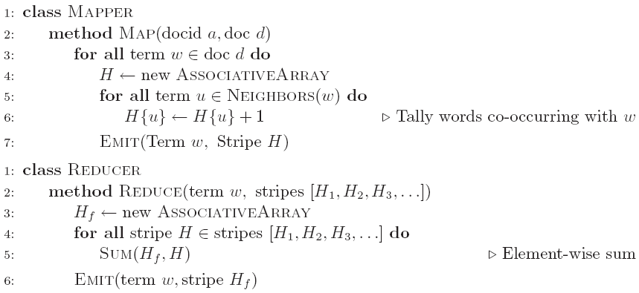
Stripes: Pseudo-Code

Slide 72
“Stripes” Analysis
Advantages
Far less sorting and shuffling of key-value pairs
Can make better use of combiners
Disadvantages
More difficult to implement
Underlying object more heavyweight
Fundamental limitation in terms of size of event space

Slide 73
Comparisons
Pairs:
Huge number of key-value pairs
Stripes:
More compact representation
Fewer intermediate keys, less sorting
More complex values, more serialization and deserialization overhead

Slide 74
Both can benefit from the use of combiners
But, stripes approach can have more opportunities to perform local aggregation since the key space is the vocabulary
In-mapper combining optimization can both be applied
But, far fewer opportunities for partial aggregation in the pairs approach due to the sparsity of the intermediate key space
Memory management will be more complex for the stripes approach
Assumption: each associative array is small enough to fit into memory

Slide 75
A Brief Summary
Pairs
Individually records each co-occurring event
Stripes
Records all co-occurring events with respect to a conditioning event

Slide 76
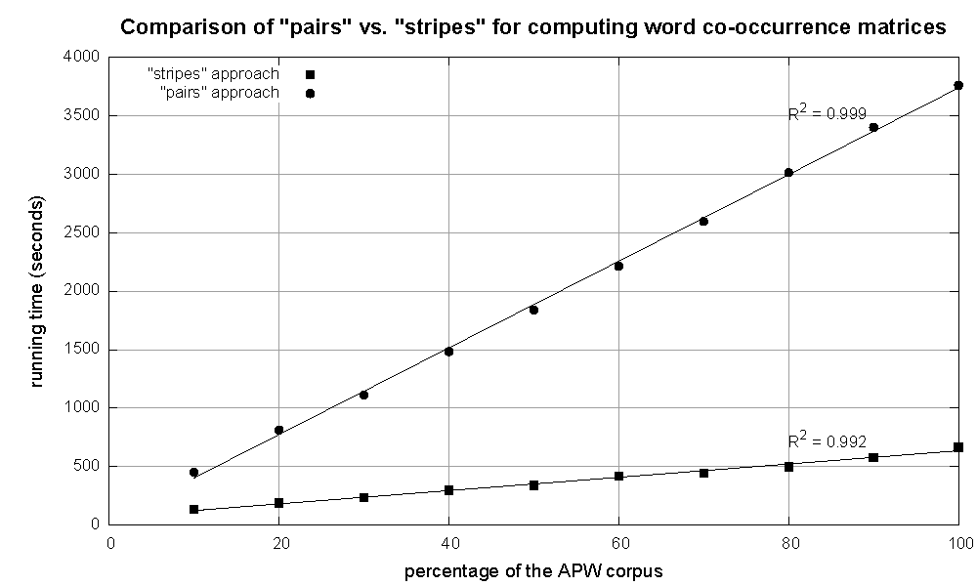
Cluster size: 38 cores
Data Source: Associated Press Worldstream (APW) of the English Gigaword Corpus (v3), which contains 2.27 million documents (1.8 GB compressed, 5.7 GB uncompressed)

Slide 77
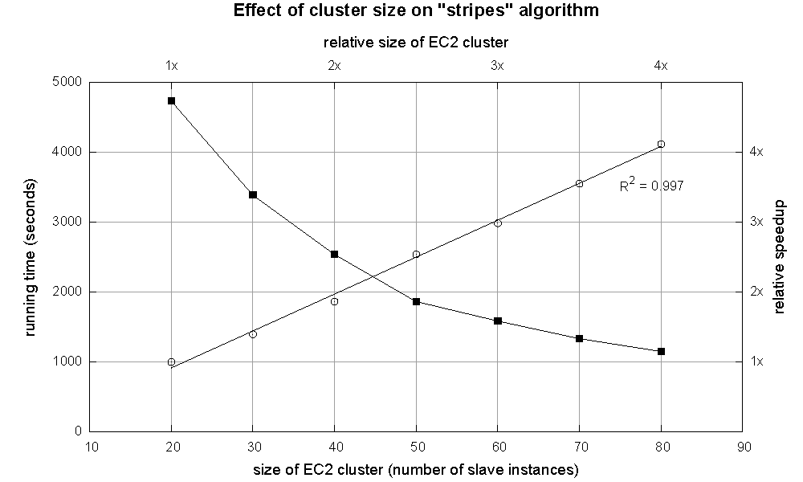

Slide 78
Computing Relative Frequencies
To convert absolute counts into relative frequencies f(wj|wi)
Straightforward in the stripes approach
Pairs:
We have to properly sequence data presented to the reducer
The programmer can define the sort order of keys so that data needed earlier is presented to the reducer before other data
In the reducer, we have to define the sort order of the keys so that pairs with special symbol (wi,*) are ordered before any other key-value pairs with wi

Slide 79
Relative Frequencies
How do we estimate relative frequencies from counts?
Why do we want to do this?
How do we do this with MapReduce?

Slide 80
f(B|A): “Stripes”
Easy!
One pass to compute (a, *)
Another pass to directly compute f(B|A)
a → {b₁:3, b₂ :12, b₃ :7, b₄ :1, … }

Slide 81
f(B|A): “Pairs”
What’s the issue?
Computing relative frequencies requires marginal counts
But the marginal cannot be computed until you see all counts
Buffering is a bad idea!
Solution:
What if we could get the marginal count to arrive at the reducer first?

Slide 82
f(B|A): “Pairs”
(a, *) → 32
Reducer holds this value in memory
For this to work:
Must emit extra (a, *) for every b_{n} in mapper
Must make sure all a’s get sent to same reducer (use partitioner)
Must make sure (a, *) comes first (define sort order)
Must hold state in reducer across different key-value pairs
(a, b₁) → 3
(a, b₂) → 12
(a, b₃) → 7
(a, b₄) → 1
…
(a, b₁) → 3 / 32
(a, b₂) → 12 / 32
(a, b₃) → 7 / 32
(a, b₄) → 1 / 32
…

Slide 83
“Order Inversion”
Common design pattern:
Take advantage of sorted key order at reducer to sequence computations
Get the marginal counts to arrive at the reducer before the joint counts
Optimization:
Apply in-memory combining pattern to accumulate marginal counts

Slide 84
Synchronization: Pairs vs. Stripes
Approach 1: turn synchronization into an ordering problem
Sort keys into correct order of computation
Partition key space so that each reducer gets the appropriate set of partial results
Hold state in reducer across multiple key-value pairs to perform computation
Illustrated by the “pairs” approach
Approach 2: construct data structures that bring partial results together
Each reducer receives all the data it needs to complete the computation
Illustrated by the “stripes” approach

Slide 85
Order inversion
Through proper coordination, we can access the result of a computation in the reducer before processing the data needed for that computation
To convert the sequencing of computations into a sorting problem

Slide 86
A brief summary
Requirements of order inversion:
Emitting a special key-value pair for each co-occurring word pair in the mapper
Controlling the sort order of the intermediate key so that the key-value pairs representing the marginal contributions are processed by the reducer before any other pairs
Defining a custom partitioner to ensure that all pairs with the same left word are shuffled to the same reducer
Preserving state across multiple keys in the reducer

Slide 87
Secondary Sorting
MapReduce sorts input to reducers by key
Values may be arbitrarily ordered
What if we want to sort by value also?
E.g., k → (v₁, r), (v₃, r), (v₄, r), (v₈, r)…

Slide 88
Secondary Sorting: Solutions
Solution 1:
Buffer values in memory, then sort
Why is this a bad idea?
Solution 2:
“Value-to-key conversion” design pattern: form composite intermediate key, (k, v₁)
Let execution framework do the sorting
Preserve state across multiple key-value pairs to handle processing
Anything else we need to do?

Slide 89
Secondary Sorting
What if we need to sort by value in addition to sorting by key?
Google’s MapReduce provides built-in functionality for this, but Hadoop doesn’t
We need “value-to-key conversion”
To move part of the value into the intermediate key to form a composite key, and let MapReduce execution framework handle the sorting

Slide 90
Basic tradeoff between buffer and in-memory sort vs. value-to-key conversion
Where sorting is performed
In Reducer: scalability bottleneck
In MapReduce execution framework: distributed sorting

Slide 91
Value-to-Key Conversion
Before
k → (v₁, r), (v₄, r), (v₈, r), (v₃, r)…
Values arrive in arbitrary order…
After
(k, v₁) → (v₁, r)
Values arrive in sorted order…
(k, v₃) → (v₃, r)
Process by preserving state across multiple keys
(k, v₄) → (v₄, r)
Remember to partition correctly!
(k, v₈) → (v₈, r)
…

Slide 92
Working Scenario
Two tables:
User demographics (gender, age, income, etc.)
User page visits (URL, time spent, etc.)
Analyses we might want to perform:
Statistics on demographic characteristics
Statistics on page visits
Statistics on page visits by URL
Statistics on page visits by demographic characteristic
…

Slide 93
Relational Algebra
Primitives
Projection (π)
Selection (σ)
Cartesian product (×)
Set union (∪)
Set difference (−)
Rename (ρ)
Other operations
Join (⋈)
Group by… aggregation
…

Slide 94
Projection
R₁
R₁
R₂
R₂
R₃
R₃
R₄
R₄
R₅
R₅

Slide 95
Projection in MapReduce
Easy!
Map over tuples, emit new tuples with appropriate attributes
No reducers, unless for regrouping or resorting tuples
Alternatively: perform in reducer, after some other processing
Basically limited by HDFS streaming speeds
Speed of encoding/decoding tuples becomes important
Take advantage of compression when available
Semistructured data? No problem!

Slide 96
Selection
R₁
R₂
R₁
R₃
R₃
R₄
R₅

Slide 97
Selection in MapReduce
Easy!
Map over tuples, emit only tuples that meet criteria
No reducers, unless for regrouping or resorting tuples
Alternatively: perform in reducer, after some other processing
Basically limited by HDFS streaming speeds
Speed of encoding/decoding tuples becomes important
Take advantage of compression when available
Semistructured data? No problem!

Slide 98
Group by… Aggregation
Example: What is the average time spent per URL?
In SQL:
SELECT url, AVG(time) FROM visits GROUP BY url
In MapReduce:
Map over tuples, emit time, keyed by url
Framework automatically groups values by keys
Compute average in reducer
Optimize with combiners

Slide 99
Relational Joins
R₁
S₁
R₂
S₂
R₃
S₃
R₄
S₄
R₁
S₂
R₂
S₄
R₃
S₁
R₄
S₃

Slide 100
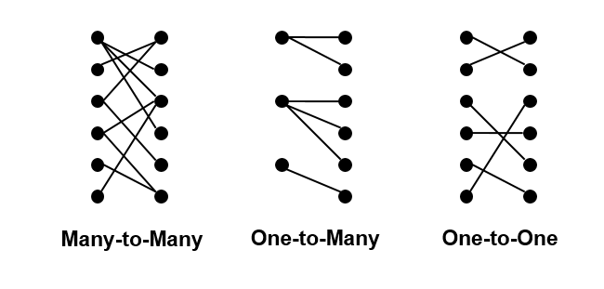
Types of Relationships

Slide 101
Relational Joins
Reduce-side Join
Map-side Join
Memory-backed Join
Striped variant
Memcached variant

Slide 102
Reduce-Side Join
Reduce-Side Join
“parallel sort-merge join”: Map over both datasets, emit the join key as the intermediate key, and the tuple itself as the intermediate value
3 cases:
One-to-one
one-to-many: scalability, secondary sort needed
many-to-many
Basic idea: to repartition the two datasets by the join key
Not efficient: shuffling both datasets across the network

Slide 103
Reduce-side Join
Basic idea: group by join key
Map over both sets of tuples
Emit tuple as value with join key as the intermediate key
Execution framework brings together tuples sharing the same key
Perform actual join in reducer
Similar to a “sort-merge join” in database terminology
Two variants
1-to-1 joins
1-to-many and many-to-many joins

Slide 104
Reduce-side Join: 1-to-1
Map
keys
values
R₁
R₁
R₄
R₄
S₂
S₂
S₃
S₃
Reduce
keys
values
R₁
S₂
S₃
R₄
Note: no guarantee if R is going to come first or S

Slide 105
Reduce-side Join: 1-to-many
Map
keys
values
R₁
R₁
S₂
S₂
S₃
S₃
S₉
S₉
Reduce
keys
values
R₁
S₂
S₃
…
What’s the problem?

Slide 106
Reduce-side Join: V-to-K Conversion
In reducer…
keys
values
R₁
New key encountered: hold in memory
S₂
Cross with records from other set
S₃
S₉
R₄
New key encountered: hold in memory
S₃
Cross with records from other set
S₇

Slide 107
Reduce-side Join: many-to-many
In reducer…
keys
values
R₁
R₅
Hold in memory
R₈
S₂
Cross with records from other set
S₃
S₉
What’s the problem?

Slide 108
Map-side Join: Basic Idea
Assume two datasets are sorted by the join key:
R₁
S₂
R₂
S₄
R₄
S₃
R₃
S₁
A sequential scan through both datasets to join (called a “merge join” in database terminology)

Slide 109
Map-Side Join
Map-side Join
Scanning through both datasets simultaneously (merge join) in the mapper
Both partitioned and sorted in the same manner by the join key
Map over the larger dataset, and inside the mapper read the corresponding part of the other dataset to perform the merge join
Far more efficient than reduce-side join
Restriction: it depends on consistent partitioning and sorting of keys

Slide 110
Map-side Join: Parallel Scans
If datasets are sorted by join key, join can be accomplished by a scan over both datasets
How can we accomplish this in parallel?
Partition and sort both datasets in the same manner
In MapReduce:
Map over one dataset, read from other corresponding partition
No reducers necessary (unless to repartition or resort)
Consistently partitioned datasets: realistic to expect?

Slide 111
In-Memory Join
Basic idea: load one dataset into memory, stream over other dataset
Works if R << S and R fits into memory
Called a “hash join” in database terminology
MapReduce implementation
Distribute R to all nodes
Map over S, each mapper loads R in memory, hashed by join key
For every tuple in S, look up join key in R
No reducers, unless for regrouping or resorting tuples

Slide 112
In-Memory Join: Variants
Striped variant:
R too big to fit into memory?
Divide R into R₁, R₂, R₃, … s.t. each R_{n} fits into memory
Perform in-memory join: ∀n, R_{n} ⋈ S
Take the union of all join results
Memcached join:
Load R into memcached, a distributed key-value store
Replace in-memory hash lookup with memcached lookup

Slide 113
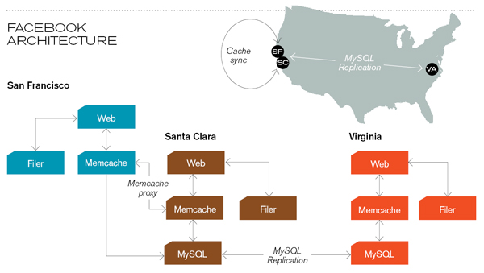
Memcached
Circa 2008 Architecture
Caching servers: 15 million requests per second, 95% handled by memcache (15 TB of RAM)
Database layer: 800 eight-core Linux servers running MySQL (40 TB user data)
Source: Technology Review (July/August, 2008)

Slide 114
Memcached Join
Memcached join:
Load R into memcached
Replace in-memory hash lookup with memcached lookup
Capacity and scalability?
Memcached capacity >> RAM of individual node
Memcached scales out with cluster
Latency?
Memcached is fast (basically, speed of network)
Batch requests to amortize latency costs
Source: See tech report by Lin et al. (2009)

Slide 115
Which join to use?
In-memory join > map-side join > reduce-side join
Why?
Limitations of each?
In-memory join: memory
Map-side join: sort order and partitioning
Reduce-side join: general purpose

Slide 116
Processing Relational Data: Summary
MapReduce algorithms for processing relational data:
Group by, sorting, partitioning are handled automatically by shuffle/sort in MapReduce
Selection, projection, and other computations (e.g., aggregation), are performed either in mapper or reducer
Multiple strategies for relational joins
Complex operations require multiple MapReduce jobs
Example: top ten URLs in terms of average time spent
Opportunities for automatic optimization

Slide 117
Summary
Design patterns:
In-mapper combining: local aggregation
Pairs and stripes
Order inversion
Value-to-key conversion: secondary sort

Slide 118
Limitations of MapReduce
Many examples of algorithms depend crucially on the existence of shared global state during processing -> difficult to implement in MapReduce
Online learning
The model parameters in a learning algorithm can be viewed as shared global state
The framework must be altered to support faster processing of smaller datasets
MapReduce was specially optimized for “batch” operations over large amounts of data
Monte Carlo simulations

Slide 119
Possible solution: distributed datastore capable of maintaining global state
Google’s BigTable (or Hbase)
Amazon’s Dynamo (or Cassandra)
Alternative computing paradigms
Dryad: arbitrary dataflow graphs
Pregel: large-scale graph processing
BSP model

Slide 120
Thanks for Your Attention!

