Slide 1
Introduction to Distributed Platforms
J. H. Wang
Dec. 5, 2023

Slide 2
Outline
Motivation
Why Distribution?
Distributed Computing
Popular distributed platforms
Hadoop
Spark

Slide 3
Motivation
Why distribution?
Big data: volume, velocity, variety
We need more storage space
Space efficiency
We need more computing power
Time efficiency

Slide 4
Distributed Computing
Distributed computing is the study of distributed systems
A distributed system is a collection of autonomous computing elements that appears to its users as a single coherent system
A distributed system is a model in which components located on networked computers communicate and coordinate their actions by passing messages

Slide 5
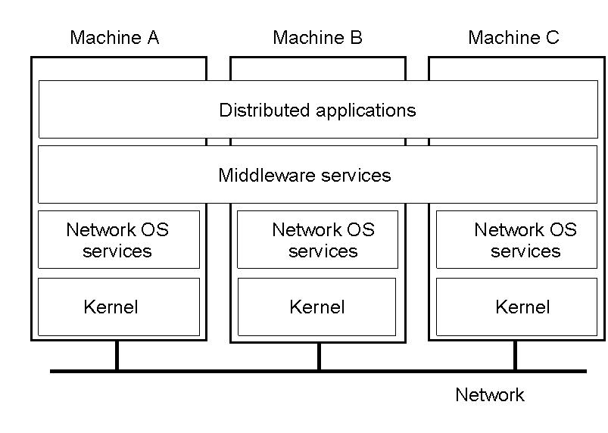
Distributed Systems as Middleware

Slide 6
Three characteristics
Concurrency of components
Lack of a global clock: synchronization
Independent failure of components: fault tolerance
Goals
Resource availability
Distribution transparency
Openness
Scalability

Slide 7
Example architectures
Centralized: client-server
Multi-tiered
Decentralized: peer-to-peer
Hybrid

Slide 8
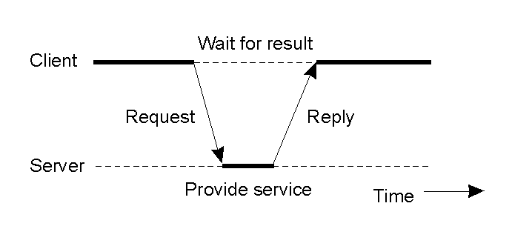
Clients and Servers
General interaction between a client and a server

Slide 9
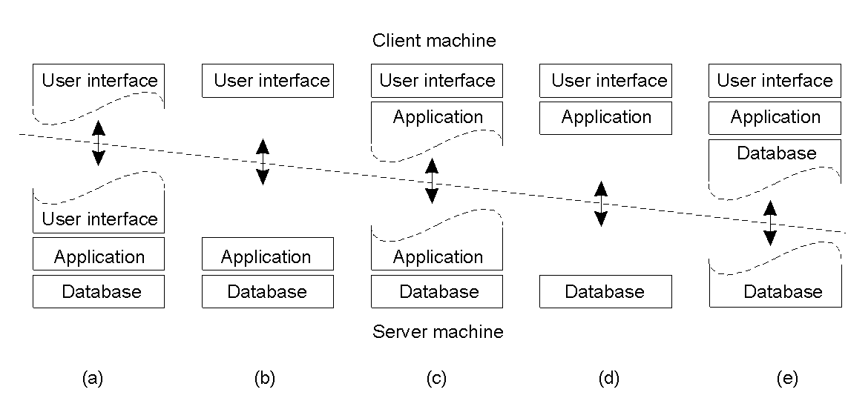
Multi-tiered Architectures
Alternative client-server organizations (a) – (e)
1-29

Slide 10
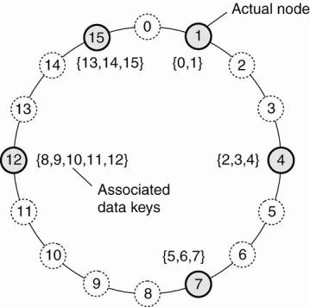
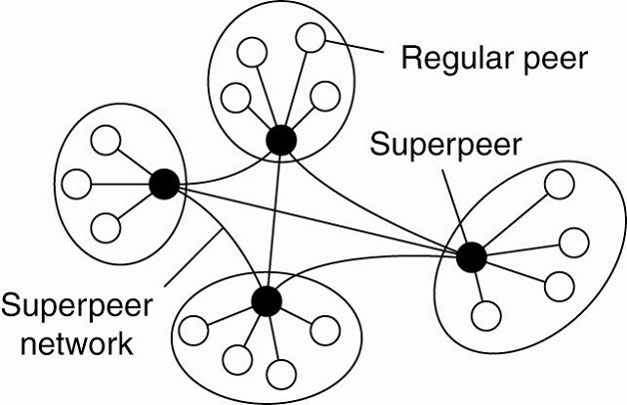
Peer-to-Peer vs. Hybrid

Slide 11
Parallel vs. Distributed
Parallel computing
Tightly coupled
Shared memory
Distributed computing
Loosely coupled
Message passing

Slide 12
Distributed Computing Systems
Cluster computing
Homogeneous
Connected through a LAN
Grid computing
Heterogeneous
Dispersed across WAN
Cloud computing
IaaS, PaaS, SaaS

Slide 13
Cloud Enabling Technology: Virtualization
User
User
User
User
User
User
User
User
App1
App2
App3
App4
OS1
OS2
OS3
Browser
Editor
Player
Database
VM1
VM2
VM3
Operating System
Virtual Machine Manager
Computer Hardware
Computer Hardware

Slide 14
Popular Distributed Platforms
Hadoop
Spark

Slide 15
Apache Hadoop Project
For reliable, scalable, distributed computing
Hadoop has been demonstrated on GNU/Linux clusters with 2000 nodes
Windows is also supported
http://Hadoop.apache.org/
Current version:
3.3.6: production ready
Required software
Java
Ssh

Slide 16
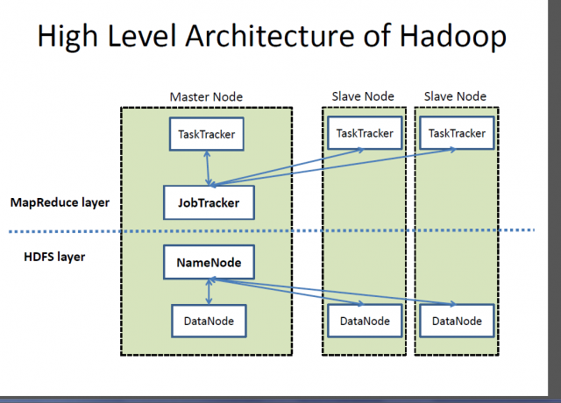
Hadoop Architecture

Slide 17
MapReduce
Software framework for easily writing applications which process vast amounts of data in-parallel on large clusters of commodity hardware in a reliable, fault-tolerant manner
HDFS: Hadoop Distributed File System
A distributed file system designed to run on commodity hardware
Fault-tolerant
Low-cost
High throughput

Slide 18
Assumptions and Goals of HDFS
Hardware failure
Detection of faults and quick, automatic recovery from them is a core architectural goal
Streaming data access
Batch processing, high throughput
Large data sets
Simple coherency model
Write-once-read-many access model
Moving computation is cheaper than moving data
Portability across heterogeneous hardware and software platforms

Slide 19

HDFS Architecture – Master/Slave

Slide 20
NameNode and DataNodes
Master/slave architecture
A single NameNode: master server that manages the file system namespace and regulates access to files by clients
A number of DataNodes: manage storage attached to the nodes that they run on
NameNode: file system namespace operations: opening, closing, renaming files and directories, determining the mapping of blocks to DataNodes
DataNodes: serving read and write requests from clients, block creation, deletion, replication

Slide 21
Data Replication
Each file as a sequence of blocks, which are replicated for fault tolerance
Block size, replication factor: configurable
All blocks except the last are the same size
Files in HDFS are write-once (except for appends and truncates) and have strictly one writer at any time
NameNode makes all decisions regarding replication of blocks
It periodically receives a Heartbeat and a Blockreport from each of the DataNodes

Slide 22
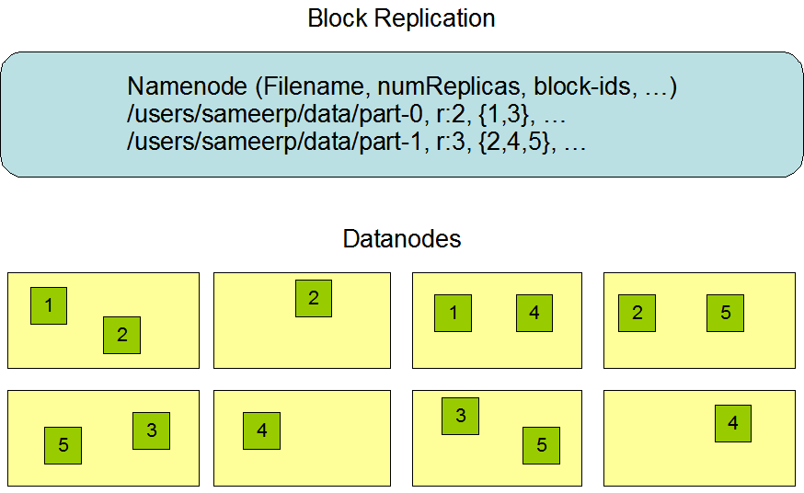

Slide 23
Architecture of Google File Systems
[Source: Sanjay Ghemawat, Howard Gobioff, Shun-Tak Leung, The Google File System, Proceedings of the 19th ACM Symposium on Operating Systems Principles (SOSP), pp. 20-43, 2003.]

Slide 24
MapReduce
Map tasks
Reduce tasks
A single master ResourceManager
One worker NodeManager per cluster node
MRAppMaster per application

Slide 25
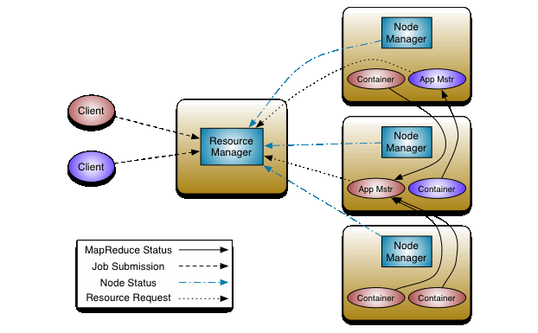
YARN: from Hadoop 2

Slide 26
Major Differences between Hadoop 1 and 2
HDFS Federation
Resource manager YARN

Slide 27
Hadoop 2: HDFS Federation
Two major components in HDFS
Namespaces
Blocks storage service
Hadoop 1
A single namenode manages the entire namespace
HDFS federation
Multiple namenode servers manage namespaces
Horizontal scaling, performance improvement, multiple namespaces

Slide 28
Hadoop 2: YARN
Brings significant performance improvements for some applications
Supports additional processing models
Implements a more flexible execution engine

Slide 29
What is YARN?
A resource manager separated from MapReduce in Hadoop 1
The operating system of Hadoop
Managing and monitoring workloads
Maintaining a multi-tenant environment
Implementing security controls
Managing high-availability features of Hadoop
No longer limited to the I/O intensive, high-latency MapReduce model

Slide 30
Issues of MapReduce on HDFS
Hard to manage
MapReduce API was verbose and required a lot of setup code, with brittle fault tolerance
Intermediate result is written to the local disk for the subsequent stage of operation
Disk I/O is very time-consuming
It falls short for workloads such as machine learning, streaming, or interactive SQL-like queries
→ Is there a way to make Hadoop and MapReduce simpler and faster?

Slide 31
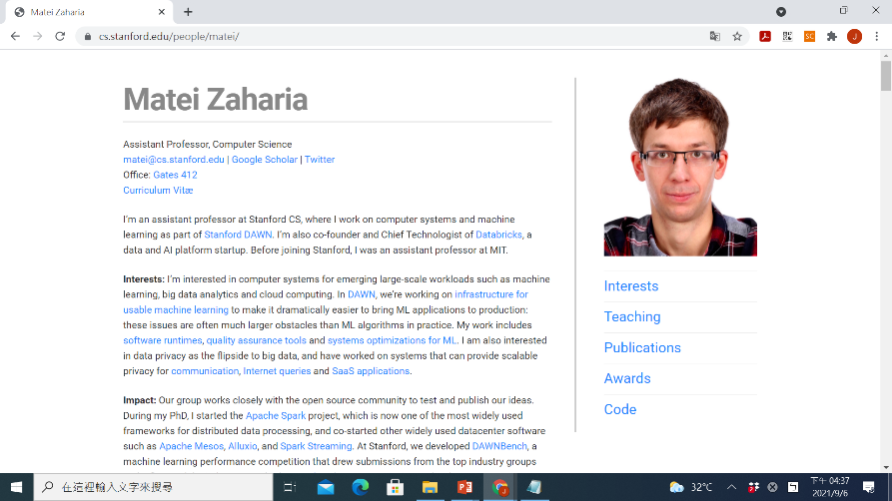
Spark
Research project at UC Berkeley
Matei Zaharia, Mosharaf Chowdhury, Michael J. Franklin, Scott Shenker, Ion Stoica, Spark: Cluster Computing with Working Sets, HotCloud 2010, June 2010.

Slide 32
Apache Spark
http://spark.apache.org/
Current version: 3.5.0
For large-scale data processing
It provides high-level APIs in Java, Scala, Python and R, and an optimized engine that supports general execution graphs
Spark runs on Java 8/11/17, Scala 2.12/2.13, Python 3.8+ and R 3.5+
It also supports a rich set of higher-level tools
Spark SQL and DataFrames for structured data processing
MLlib for machine learning
GraphX for graph processing
Spark Streaming
SparkR: Spark in R
PySpark: Spark in Python
Spark runs on both Windows and UNIX-like systems (e.g. Linux, Mac OS)

Slide 33
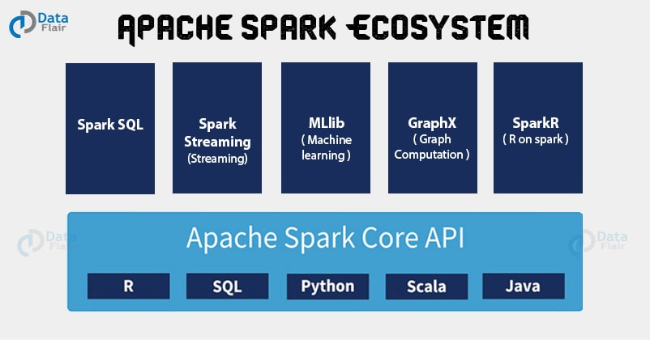
Components in Spark Platform

Slide 34

Spark Architecture

Slide 35
Components
Spark applications
Independent sets of processes on a cluster, coordinated by the SparkContext object in main (Driver) program
Cluster managers
Allocate resources across applications
Executors
Processes that run computations and store data
Spark sends your application code (JAR or python files) to executors, and SparkContext sends tasks to executors to run

Slide 36
Note about the architecture
Each application has its own executor processes
Benefit: isolating applications from each other
Cons: data cannot be shared across different applications without writing to external storage
Spark is agnostic to the underlying cluster manager
Driver program must listen for and accept incoming connections from its executors throughout its lifetime
Driver must be network addressable from the workers
Driver program should be run close to the worker nodes, since it schedules tasks on the cluster

Slide 37
Cluster Manager Types
Standalone: a simple cluster manager included in Spark
Faster job startup, but it doesn’t support communication with an HDFS secured with Kerberos authentication protocol
Apache Mesos: a general cluster manager that can also runs Hadoop MapReduce (deprecated after Spark 3.2.0)
A scalable and fault-tolerant “distributed systems kernel” written in C++, which also supports C++ and Python applications
It is actually a “scheduler of scheduler frameworks” because of its two-level scheduling architecture
Hadoop YARN: resource manager in Hadoop 2
YARN lets you run different types of Java applications, not just Spark
It also provides methods for isolating and prioritizing applications among users and organizations
Kubernetes: open-source system for automating deployment, scaling, and management of containerized applications

Slide 38
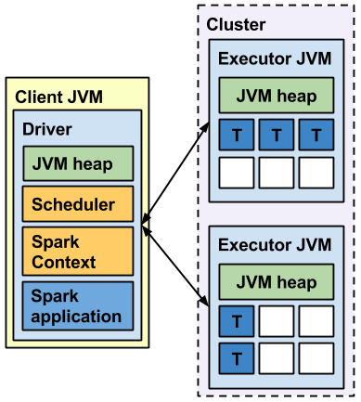
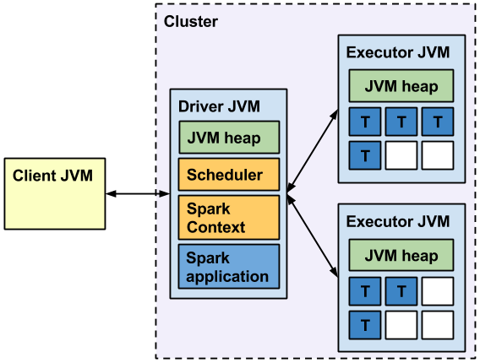
Spark Standalone Cluster
Two deploy modes for Spark Standalone cluster
Client mode: driver is launched in the same process as the client that submits the application
Cluster mode: driver is launched from one of the Worker processes in the cluster, and the client exits as soon as it fulfills its submission of application

Slide 39
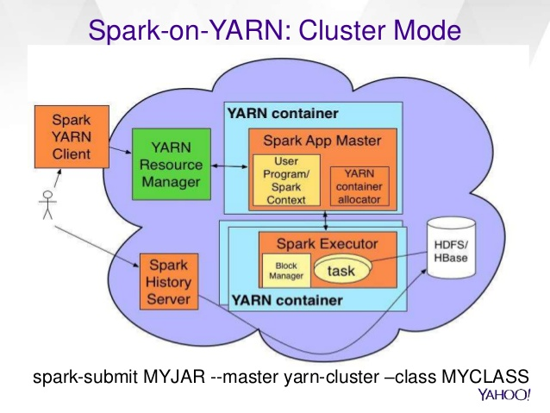
Spark on YARN cluster mode

Slide 40
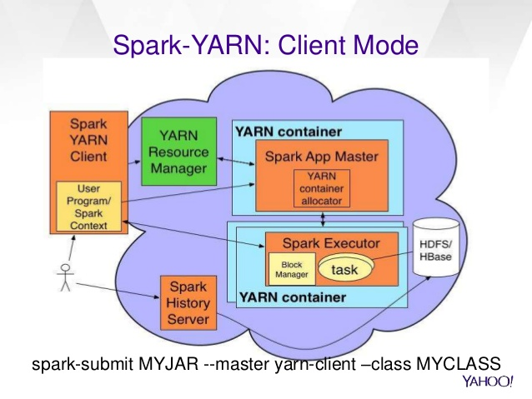
Spark on YARN client mode

Slide 41
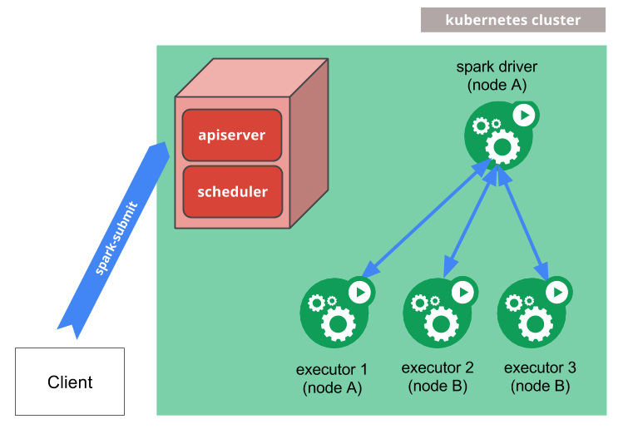
Spark on Kubernetes

Slide 42
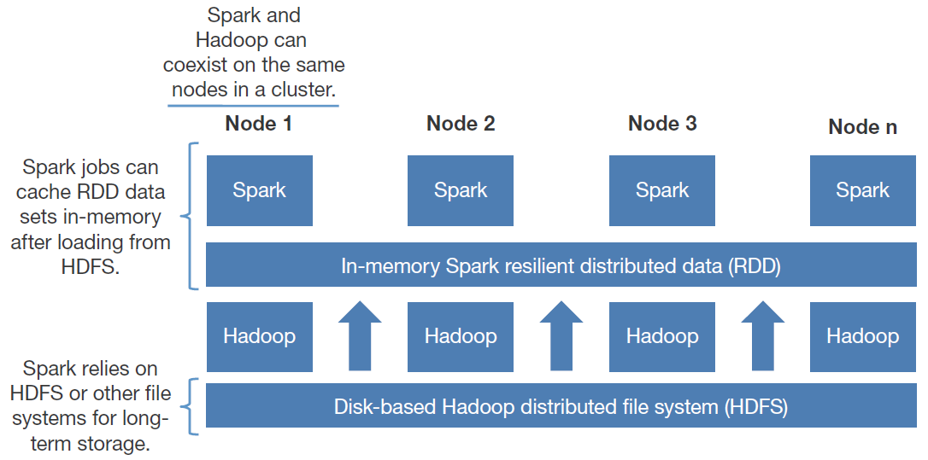
Spark and Hadoop

Slide 43
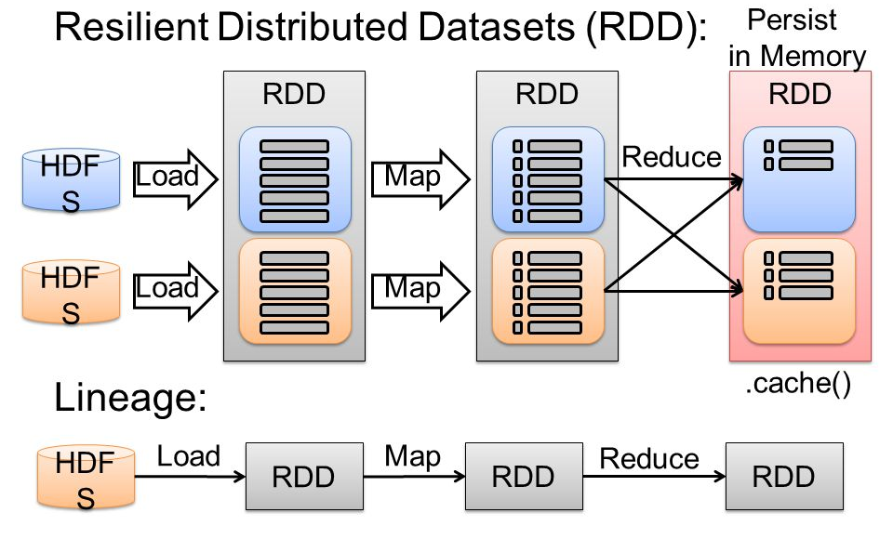
RDD
[source: Zaharia et.al, NSDI 2012]

Slide 44
References
MapReduce:
Jeffrey Dean and Sanjay Ghemawat, MapReduce: Simplied Data Processing on Large Clusters, Proceedings of OSDI 2004.
Google File System:
Sanjay Ghemawat, Howard Gobioff, and Shun-Tak Leung, “The Google File System,” Proceedings of SOSP 2003.
Spark:
Matei Zaharia, Mosharaf Chowdhury, Michael J Franklin, Scott Shenker, Ion Stoica, Spark: Cluster computing with working sets, Proceedings of the 2nd USENIX conference on Hot topics in cloud computing (HotCloud 2010).
RDDs:
Matei Zaharia, Mosharaf Chowdhury, Tathagata Das, Ankur Dave, Justin Ma, Murphy McCauley, Michael J. Franklin, Scott Shenker, Ion Stoica, Resilient distributed datasets: a fault-tolerant abstraction for in-memory cluster computing, Proceedings of the 9th USENIX conference on Networked Systems Design and Implementation (NSDI 2012) (Best Paper Award)

Slide 45
Thanks for Your Attention!

