Slide 1
Pattern Mining: Advanced Methods
Mining Various Kinds of Patterns
Mining Compressed or Approximate Patterns
Constraint-based Pattern Mining
Mining Sequential Patterns
Mining Subgraph Patterns
Pattern Mining: Application Examples
Summary

Slide 2
Mining Various Kinds of Patterns
Mining Multilevel Associations
Mining Multidimensional Associations
Mining Quantitative Association Rules
Mining High-dimensional Data
Mining Rare Patterns and Negative Patterns

Slide 3
Mining Multiple-Level Frequent Patterns
Items often form hierarchies
  Milk: Dairyland 2% milk
  Bread: Wonder wheat bread
Uniform support
Reduced support
Level 1
min_sup = 5%
Milk
[support = 10%]
Level 1
min_sup = 5%
Level 2
min_sup = 5%
2% Milk
[support = 6%]
Skim Milk
[support = 2%]
Level 2
min_sup = 1%
Min-support thresholds for items following concept hierarchies
  Uniform min-support across multiple levels (reasonable?)
  Level-reduced min-support:
    Items at the lower level are expected to have lower support
Efficient mining: Shared multi-level mining
  Use the lowest min-support to pass down the set of candidates
Notes:
Yitong:
Items often form hierarchies E.g.: Dairyland 2% milk; Wonder wheat bread

Slide 4
Redundancy Filtering at Mining Multi-Level Associations
Redundancy filtering: redundant due to “ancestor” relationships
  milk ⇒ wheat bread [support = 8%, confidence = 70%] (1)
  2% milk ⇒ wheat bread [support = 2%, confidence = 72%] (2)
    Suppose the 2% milk sold is about ¼ of milk sold in gallons
      (2) should be able to be “derived” from (1)
In general: A rule is redundant if its support is close to the “expected” value, according to its “ancestor” rule, and it has a similar confidence as its “ancestor”
Q: If rule (1) is an ancestor of rule (2), which one to prune?
Notes:
Yitong:
- Multi-level association mining may generate many redundant rules
- Redundancy filtering: Some rules may be redundant due to “ancestor” relationships between items

Slide 5
Customized Min-Supports for Different Kinds of Items
We have used the same min-support threshold for all the items or itemsets to be mined in each association mining
  In reality, some items (e.g., diamond, watch, …) are valuable but less frequent
  It’s necessary to have customized min-support settings for different kinds of items
One Method: Use group-based “individualized” min-support
  E.g., {diamond, watch}: 0.05%; {bread, milk}: 5%; …
  How to mine such rules efficiently?
    Existing scalable mining algorithms can be easily extended to cover such cases

Slide 6
Mining Multi-Dimensional Associations
Single-dimensional rules (e.g., items are all in “product” dimension)
  buys(X, “milk”) ⇒ buys(X, “bread”)
Multi-dimensional rules (i.e., items in ≥ 2 dimensions or predicates)
  Inter-dimension association rules (no repeated predicates)
    age(X, “18-25”) ∧ occupation(X, “student”) ⇒ buys(X, “coke”)
  Hybrid-dimension association rules (repeated predicates)
    age(X, “18-25”) ∧ buys(X, “popcorn”) ⇒ buys(X, “coke”)
Attributes can be categorical or numerical
  Categorical Attributes (e.g., profession, product: no ordering among values): Data cube for inter-dimension association
  Quantitative Attributes: Numeric, implicit ordering among values—discretization, clustering, and gradient approaches

Slide 7
Mining Quantitative Associations
Mining associations with numerical attributes
  E.g.: Numerical attributes: age and salary
Methods
  Static discretization based on predefined concept hierarchies
    Discretization on each dimension with hierarchy
      age: {0-10, 10-20, …, 90-100} → {young, mid-aged, old}
  Dynamic discretization based on data distribution
  Clustering: Distance-based association
    First one-dimensional clustering, then association
  Deviation analysis:
    Gender = female ⇒ Wage: mean=$7/hr (overall mean = $9)

Slide 8
Mining Extraordinary Phenomena in Quantitative Association Mining
Mining extraordinary (i.e., interesting) phenomena
  E.g.: Gender = female ⇒ Wage: mean=$7/hr (overall mean = $9)
  LHS: a subset of the population
  RHS: an extraordinary behavior of this subset
The rule is accepted only if a statistical test (e.g., Z-test) confirms the inference with high confidence
Subrule: Highlights the extraordinary behavior of a subset of the population of the super rule
  E.g.: (Gender = female) ^ (South = yes) ⇒ mean wage = $6.3/hr
Rule condition can be categorical or numerical (quantitative rules)
  E.g.: Education in [14-18] (yrs) ⇒ mean wage = $11.64/hr
  Efficient methods have been developed for mining such rules (e.g., Aumann and Lindell@KDD’99)

Slide 9
Rare Patterns vs. Negative Patterns
Rare patterns
  Very low support, but interesting (e.g., buying Rolex watches)
  How to mine them? Setting individualized, group-based min-support thresholds for different groups of items
Negative patterns
  Negatively correlated: Unlikely to happen together
  Ex.: Since it is unlikely that the same customer buys both a Ford Expedition (an SUV car) and a Ford Fusion (a hybrid car), buying a Ford Expedition and buying a Ford Fusion are likely negatively correlated patterns
  How to define negative patterns?

Slide 10
Defining Negative Correlated Patterns
A support-based definition
  If itemsets A and B are both frequent, but rarely occur together, i.e.,
    sup(A U B) << sup (A) × sup(B)
  Then A and B are negatively correlated
Is this a good definition for large transaction datasets?
Ex.: Suppose a store sold two needle packages A and B 100 times each, but only one transaction contained both A and B
  When there are 200 transactions in total, we have
    s(A U B) = 0.005, s(A) × s(B) = 0.25, s(A U B) << s(A) × s(B)
  But when there are 10⁵ transactions, we have
    s(A U B) = 1/10⁵, s(A) × s(B) = 1/10³ × 1/10³, s(A U B) > s(A) × s(B)
What is the problem here?
    —Null transactions: The support-based definition is not null-invariant!
Does this remind you the definition of lift?

Slide 11
Defining Negative Correlation: Need Null-Invariance in Definition
A good definition on negative correlation should be null-invariant!
  Intuition: Whether two itemsets A and B are negatively correlated should not be influenced by the number of null-transactions
A Kulczynski measure-based definition
  If itemsets A and B are frequent but (s(A U B)/s(A) + s(A U B)/s(B))/2 < є,
        then A and B are negatively correlated
For the same needle package problem:
  No matter there are 200 or 10⁵ transactions in total
    If є = 0.01, we have
        (s(A U B)/s(A) + s(A U B)/s(B))/2 = (0.01 + 0.01)/2 < є
є is a negative
pattern threshold

Slide 12
Pattern Mining: Advanced Methods
Mining Various Kinds of Patterns
Mining Compressed or Approximate Patterns
Constraint-based Pattern Mining
Mining Sequential Patterns
Mining Subgraph Patterns
Pattern Mining: Application Examples
Summary

Slide 13

Mining Compressed Patterns
Pat-ID | Item-Sets | Support
P1 | {38,16,18,12} | 205227
P2 | {38,16,18,12,17} | 205211
P3 | {39,38,16,18,12,17} | 101758
P4 | {39,16,18,12,17} | 161563
P5 | {39,16,18,12} | 161576
Why mining compressed patterns? Too many scattered patterns but not so meaningful
Pattern distance measure
δ-clustering: For each pattern P, find all patterns which can be expressed by P and whose distance to P is within δ (δ-cover)
All patterns in the cluster can be represented by P
Closed patterns
  P1, P2, P3, P4, P5
  Emphasizes too much on support
Max-patterns
  P3: information loss
Desired output (a good balance):
  P2, P3, P4

Slide 14
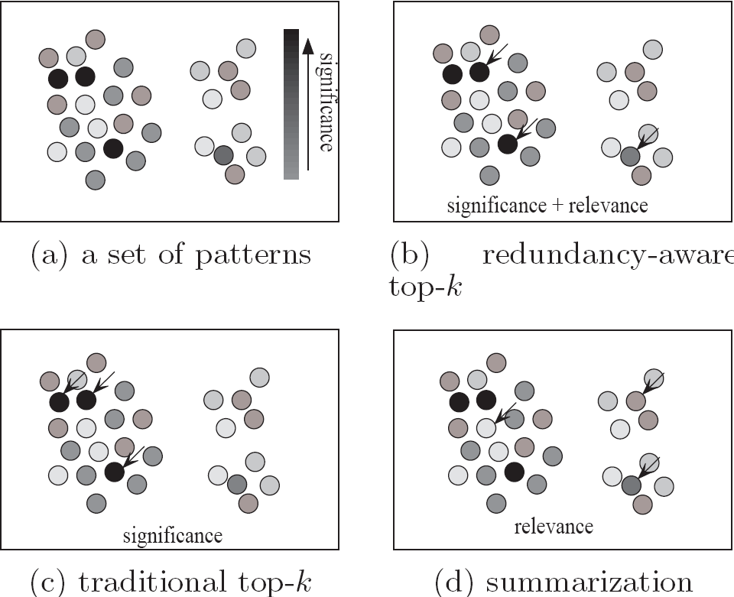
Redundancy-Aware Top-k Patterns
Desired patterns: high significance & low redundancy
Method: Use MMS (Maximal Marginal Significance) for measuring the combined significance of a pattern set
Xin et al., Extracting Redundancy-Aware Top-K Patterns, KDD’06

Slide 15
Pattern Mining: Advanced Methods
Mining Various Kinds of Patterns
Mining Compressed or Approximate Patterns
Constraint-based Pattern Mining
Mining Sequential Patterns
Mining Subgraph Patterns
Pattern Mining: Application Examples
Summary

Slide 16
Why Constraint-Based Mining?
Pattern mining in practice: Often a user-guided, interactive process
  User directs what to be mined using a data mining query language (or a graphical user interface), specifying various kinds of constraints
What is constraint-based mining?
  Mine together with user-provided constraints
Why constraint-based mining?
  User flexibility: User provides constraints on what to be mined
  Optimization: System explores such constraints for mining efficiency
    E.g., Push constraints deeply into the mining process

Slide 17
Various Kinds of User-Specified Constraints in Data Mining
Knowledge type constraint—Specifying what kinds of knowledge to mine
  E.g.: Classification, association, clustering, outlier finding, …
Data constraint—using SQL-like queries
  E.g.: Find products sold together in NY stores this year
Dimension/level constraint—similar to projection in relational database
  E.g.: In relevance to region, price, brand, customer category
Interestingness constraint—various kinds of thresholds
  E.g.: Strong rules: min_sup ≥ 0.02, min_conf ≥ 0.6, min_correlation ≥ 0.7
Rule (or pattern) constraint
  E.g.: Small sales (price < $10) triggers big sales (sum > $200)
The focus of this study
Notes:
10/29/18 EMH– maybe don’t list the other kinds of constraints, if we’re not covering them? Were skipped in lecture

Slide 18
Pattern Space Pruning with Pattern Anti-Monotonicity
TID | Transaction
10 | a, b, c, d, f, h
20 | b, c, d, f, g, h
30 | b, c, d, f, g
40 | a, c, e, f, g
A constraint c is anti-monotone
  If an itemset S violates constraint c, so does any of its superset
  That is, mining on itemset S can be terminated
Ex. 1: c₁: sum(S.price) ≤ v is anti-monotone
Ex. 2: c₂: range(S.profit) ≤ 15 is anti-monotone
  Itemset ab violates c₂ (range(ab) = 40)
  So does every superset of ab
Ex. 3. c₃: sum(S.Price) ≥ v is not anti-monotone
Ex. 4. Is c₄: support(S) ≥ σ anti-monotone?
  Yes! Apriori pruning is essentially pruning with an anti-monotonic constraint!
min_sup = 2
Item | Price | Profit
a | 100 | 40
b | 40 | 0
c | 150 | −20
d | 35 | −15
e | 55 | −30
f | 45 | −10
g | 80 | 20
h | 10 | 5
Note: item.price > 0
Profit can be negative

Slide 19
Pattern Monotonicity and Its Roles
TID | Transaction
10 | a, b, c, d, f, h
20 | b, c, d, f, g, h
30 | b, c, d, f, g
40 | a, c, e, f, g
A constraint c is monotone: If an itemset S satisfies the constraint c, so does any of its superset
  That is, we do not need to check c in subsequent mining
  Not as beneficial as anti-monotone
E.g. 1: c₁: sum(S.Price) ≥ v is monotone
E.g. 2: c₂: min(S.Price) ≤ v is monotone
E.g. 3: c₃: range(S.profit) ≥ 15 is monotone
  Itemset ab satisfies c₃
  So does every superset of ab
min_sup = 2
Item | Price | Profit
a | 100 | 40
b | 40 | 0
c | 150 | −20
d | 35 | −15
e | 55 | −30
f | 45 | −10
g | 80 | 20
h | 10 | 5

Slide 20
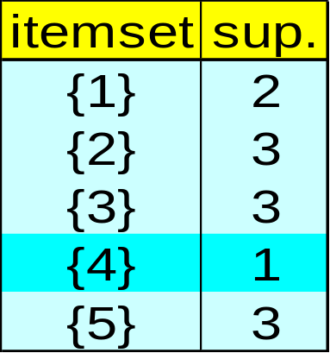
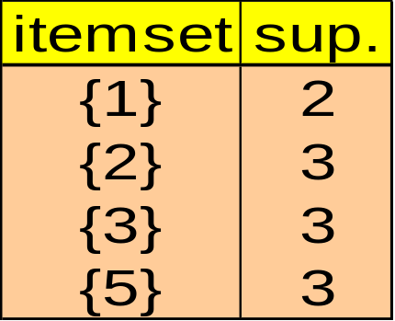
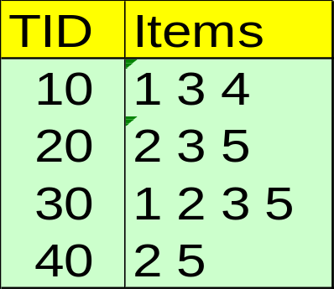
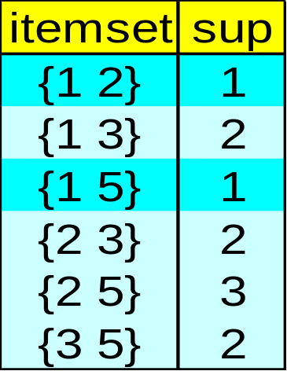
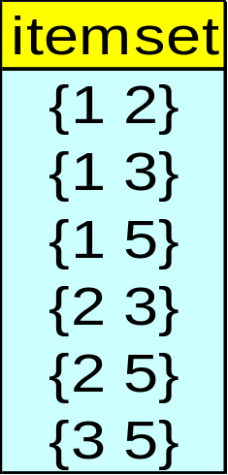
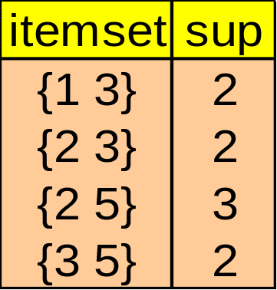
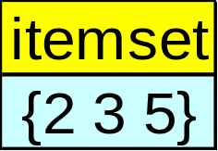
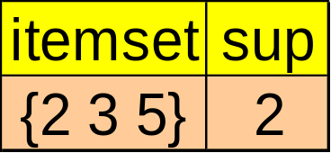
Apriori for Pattern Anti-Monotone Constraint
Item | Price
1 | 1
2 | 2
3 | 3
4 | 4
5 | 5
Database D
F₁
C₁
Can be chopped early
Scan D
C₂
C₂
F₂
Scan D
Min_sup=2
Constraint:
Sum{S.price} < 5
C₃
Scan D
F₃
Notes:
Pattern pruning; anti-monotone
Assume 5.price=5

Slide 21
Convertible Constraints: Ordering Data in Transactions
TID | Transaction
10 | a, b, c, d, f, h
20 | a, b, c, d, f, g, h
30 | b, c, d, f, g
40 | a, c, e, f, g
Convert tough constraints into (anti-)monotone by proper ordering of items in transactions
Examine c₁: avg(S.profit) > 20
  Order items in (profit) value-descending order
    <a, g, h, b, f, d, c, e>
  An itemset ab violates c₁ (avg(ab) = 20)
    So does ab* (i.e., ab-projected DB)
    C₁: anti-monotone if patterns grow in the right order!
min_sup = 2
Item | Price | Profit
a | 100 | 40
b | 40 | 0
c | 150 | −20
d | 35 | −15
e | 55 | −30
f | 45 | −5
g | 80 | 30
h | 10 | 5
Notes:
Edited 10/29/18 EMH– corrected order of sorted items

Slide 22
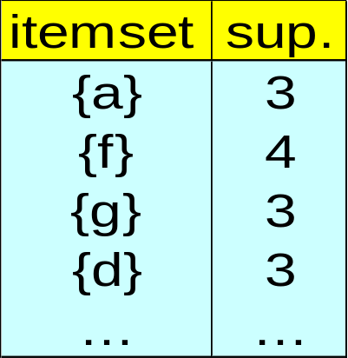
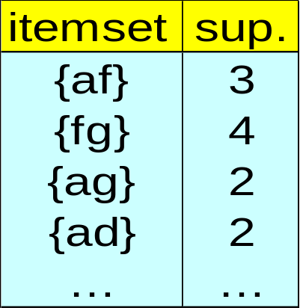
Can item-reordering work for Apriori?
TID | Transaction
10 | a, b, c, d, f, h
20 | a, b, c, d, f, g, h
30 | b, c, d, f, g
40 | a, c, e, f, g
constraint: avg(S.profit) > 20
F₁
F₂
Scan D
Chopped too early
min_sup = 2
Item | Price | Profit
a | 100 | 40
b | 40 | 0
c | 150 | −20
d | 35 | −15
e | 55 | −30
f | 45 | −5
g | 80 | 30
h | 10 | 5
avg(gf) = 12.5 < 20, avg(af) = 17.5 < 20, avg(ag) = 35 > 20
But avg(agf) = 21.7 > 20
Apriori will not generate “agf” as a candidate

Slide 23
Data Space Pruning with Data Anti-Monotonicity
TID | Transaction
10 | a, b, c, d, f, h
20 | b, c, d, f, g, h
30 | b, c, d, f, g
40 | a, c, e, f, g
A constraint c is data anti-monotone: In the mining process, if a data entry t cannot satisfy a pattern p under c, t cannot satisfy p’s superset either
  Data space pruning: Data entry t can be pruned
Ex. 1: c₁: sum(S.Profit) ≥ v is data anti-monotone
  Let constraint c₁ be: sum(S.Profit) ≥ 25
    T₃₀: {b, c, d, f, g} can be removed since none of their combinations can make an S whose sum of the profit is ≥ 25
Ex. 2: c₂: min(S.Price) ≤ v is data anti-monotone
    Consider v = 5 but every item in a transaction, say T₅₀ , has a price higher than 10
Ex. 3: c₃: range(S.Profit) > 25 is data anti-monotone
min_sup = 2
Item | Price | Profit
a | 100 | 40
b | 40 | 0
c | 150 | −20
d | 35 | −15
e | 55 | −30
f | 45 | −10
g | 80 | 20
h | 10 | 5

Slide 24
Data Space Pruning Should Be Explored Recursively
b’s-proj. DB
TID | Transaction
10 | a, b, c, d, f, h
20 | b, c, d, f, g, h
30 | b, c, d, f, g
40 | a, c, e, f, g
Item | Profit
a | 40
b | 0
c | −20
d | −15
e | −30
f | −10
g | 20
h | 5
Example. c₃: range(S.Profit) > 25
  We check b’s projected database
    But item “a” is infrequent (sup = 1)
  After removing “a (40)” from T₁₀
    T₁₀ cannot satisfy c₃ any more
      Since “b (0)” and “c (−20), d (−15), f (−10), h (5)”
    By removing T₁₀, we can also prune “h” in T₂₀
TID | Transaction
10 | a, c, d, f, h
20 | c, d, f, g, h
30 | c, d, f, g
min_sup = 2
b’s-proj. DB
TID | Transaction
10 | a, c, d, f, h
20 | c, d, f, g, h
30 | c, d, f, g

Slide 25
Data Space Pruning Explored Recursively (Continued)
Constraint:
range{S.profit} > 25
b’s-proj. DB
TID | Transaction
10 | a, c, d, f, h
20 | c, d, f, g, h
30 | c, d, f, g
Recursive
Data
Pruning
b’s FP-tree
single branch: cdfg: 2
Only a single branch “cdfg: 2” to be mined in b’s projected DB
Note: c₃ prunes T₁₀ effectively only after “a” is pruned (by min-sup) in b’s projected DB

Slide 26
Succinctness: Pruning Both Data and Pattern Spaces
Succinctness: If the constraint c can be enforced by directly manipulating the data
E.g. 1: To find those patterns containing item i
  Mine only i-projected DB (data space pruning)
E.g. 2: To find those patterns without item i
  Remove i from DB and then mine (pattern space pruning)
E.g. 3: c₃: min(S.Price) ≤ v is succinct
  Start with only items whose price ≤ v and remove transactions with high-price items only (pattern + data space pruning)
E.g. 4: c₄: sum(S.Price) ≥ v is not succinct
  It cannot be determined beforehand since sum of the price of itemset S keeps increasing
Notes:
Edited 10/29/18 EMH– swapped examples 1 and 2 to fit order used in lecture

Slide 27
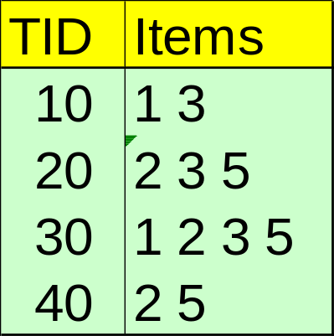
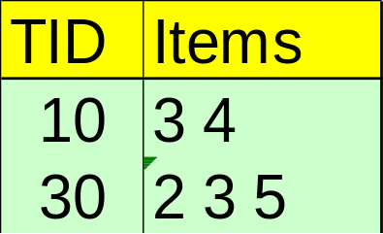
Constrained FP-Growth: Push a Succinct Constraint Deep
Item | Price
1 | 1
2 | 2
3 | 3
4 | 4
5 | 5
Min_sup=2
Constraint:
min{S.price} <= 2
Remove
infrequent
length 1
No Need to project on 3 or 5
1-Projected DB
2-Projected DB
TID | Items
20 | 3 5
30 | 1 3 5
40 | 5
Notes:
Edited 10/29/18 EMH-- added missing table row

Slide 28
Different Kinds of Constraints Lead to Different Pruning Strategies
In summary, constraints can be categorized as pattern space pruning constraints vs. data space pruning constraints
Pattern space pruning constraints | Data space pruning constraints
Anti-monotonic: If constraint c is violated, its further mining can be terminated Monotonic: If c is satisfied, no need to check c again Convertible: c can be converted to monotonic or anti-monotonic if items can be properly ordered in processing Succinct: If the constraint c can be enforced by directly manipulating the data | Data succinct: Data space can be pruned at the initial pattern mining process Data anti-monotonic: If a transaction t does not satisfy c, then t can be pruned to reduce data processing effort
Notes:
Edited 10/19/18 EMH

Slide 29
How to Handle Multiple Constraints?
It is beneficial to use multiple constraints in pattern mining
But different constraints may require potentially conflicting item-ordering
  If there exists conflict ordering between c₁ and c₂
    Try to sort data and enforce one constraint first (which one?)
    Then enforce the other constraint when mining the projected databases
E.g. c₁: avg(S.profit) > 20, and c₂: avg(S.price) < 50
  Assume c₁ has more pruning power
    Sort in profit descending order and use c₁ first
  For each project DB, sort trans. in price ascending order and use c₂ at mining

Slide 30
Pattern Mining: Advanced Methods
Mining Various Kinds of Patterns
Mining Compressed or Approximate Patterns
Constraint-based Pattern Mining
Mining Sequential Patterns
Mining Subgraph Patterns
Pattern Mining: Application Examples
Summary

Slide 31
Sequential Pattern Mining
Sequential Pattern and Sequential Pattern Mining
GSP: Apriori-Based Sequential Pattern Mining
SPADE: Sequential Pattern Mining in Vertical Data Format
PrefixSpan: Sequential Pattern Mining by Pattern-Growth
CloSpan: Mining Closed Sequential Patterns
Constraint-Based Sequential-Pattern Mining

Slide 32
Sequential Pattern Mining
What kind of patterns are sequential?
Sequential: The order really matters
  You cannot swap two items in a sequence and have the same sequence
Example: The English language is sequential: Subject → Verb → Object
Other points:
  For Sequential Pattern Mining, the time which the items occur is not considered
  Time Series Analysis does take into account the time in which an item occurred

Slide 33
Sequential Pattern Examples
Application of Sequential pattern Mining
  Customer shopping: Purchase a laptop first, then a digital camera, and then a smartphone
  Medical treatments: Go to see a doctor, get drugs, doctor monitors progress, doctor reacts accordingly → more/less drugs
  Natural disasters: Before the disaster, during the disaster, after the disaster
  Scientific Experiments: Step 1, Step 2, Step 3
  Stocks Markets: A set of stocks go up and down together
  Biological sequences, DNA /Protein: If you change the order of a protein, it likely results in a different gene

Slide 34
Sequential Pattern and Sequential Pattern Mining
Sequential pattern mining: Given a set of sequences, find the complete set of frequent subsequences (i.e., satisfying the min_sup threshold)
element (unordered within “(..)”)
A sequence: < (ef) (ab) (df) c b >
A sequence database
SID | Sequence
10 | <a(abc)(ac)d(cf)>
20 | <(ad)c(bc)(ae)>
30 | <(ef)(ab)(df)cb>
40 | <eg(af)cbc>
An element may contain a set of items (also called events)
* Items within an element are unordered and we list them alphabetically

Slide 35
Sequential Pattern and Sequential Pattern Mining
Sequential pattern mining: Given a set of sequences, find the complete set of frequent subsequences (i.e., satisfying the min_sup threshold)
<a(bc)dc> is a subsequence of <a(abc)(ac)d(cf)>
A sequence database
SID | Sequence
10 | <a(abc)(ac)d(cf)>
20 | <(ad)c(bc)(ae)>
30 | <(ef)(ab)(df)cb>
40 | <eg(af)cbc>
Given support threshold min_sup = 2, <(ab)c> is a sequential pattern

Slide 36
Sequential Pattern Mining Algorithms
Algorithm requirement: Efficient, scalable, finding complete set, incorporating various kinds of user-specific constraints
The Apriori property still holds: If a subsequence s₁ is infrequent, none of s₁’s super-sequences can be frequent
Representative algorithms
  GSP (Generalized Sequential Patterns): Srikant & Agrawal @ EDBT’96)
  Vertical format-based mining: SPADE (Zaki@Machine Leanining’00)
  Pattern-growth methods: PrefixSpan (Pei, et al. @TKDE’04)
Mining closed sequential patterns: CloSpan (Yan, et al. @SDM’03)
Constraint-based sequential pattern mining

Slide 37
GSP: Apriori-Based Sequential Pattern Mining
Initial candidates: All 8-singleton sequences
  <a>, <b>, <c>, <d>, <e>, <f>, <g>, <h>
Scan DB once, count support for each candidate
x
min_sup = 2
SID | Sequence
10 | <(bd)cb(ac)>
20 | <(bf)(ce)b(fg)>
30 | <(ah)(bf)abf>
40 | <(be)(ce)d>
50 | <a(bd)bcb(ade)>
Cand. | sup
<a> | 3
<b> | 5
<c> | 4
<d> | 3
<e> | 3
<f> | 2
<g> | 1
<h> | 1
  GSP (Generalized Sequential Patterns): Srikant & Agrawal @ EDBT’96)

Slide 38
GSP: Apriori-Based Sequential Pattern Mining
Example: Generate length-2 candidate sequences
singleton * singleton – Total: (6 * 6)
 | <a> | <b> | <c> | <d> | <e> | <f>
<a> | <aa> | <ab> | <ac> | <ad> | <ae> | <af>
<b> | <ba> | <bb> | <bc> | <bd> | <be> | <bf>
<c> | <ca> | <cb> | <cc> | <cd> | <ce> | <cf>
<d> | <da> | <db> | <dc> | <dd> | <de> | <df>
<e> | <ea> | <eb> | <ec> | <ed> | <ee> | <ef>
<f> | <fa> | <fb> | <fc> | <fd> | <fe> | <ff>
min_sup = 2
Apriori Pruning
Cand. | sup
<a> | 3
<b> | 5
<c> | 4
<d> | 3
<e> | 3
<f> | 2
<g> | 1
<h> | 1
w/o pruning (includes g and h):
  8*8 + 8*7/2 = 92
  length-2 candidates
w/ pruning:
  6*6 + 6*5/2 = 51
  length-2 candidates
Sets (unordered) – Total: (6*5) / 2
 | <a> | <b> | <c> | <d> | <e> | <f>
<a> |  | <(ab)> | <(ac)> | <(ad)> | <(ae)> | <(af)>
<b> |  |  | <(bc)> | <(bd)> | <(be)> | <(bf)>
<c> |  |  |  | <(cd)> | <(ce)> | <(cf)>
<d> |  |  |  |  | <(de)> | <(df)>
<e> |  |  |  |  |  | <(ef)>
<f>

Slide 39
GSP Mining and Pruning
length
5th scan: 1 cand. 1 length-5 seq. pat.
<(bd)cba>
Remove Candidates not in DB or Candidates < min_sup
5
4
3
2
1
4th scan: 8 cand. 7 length-4 seq. pat.
<abba> <(bd)bc> …
3rd scan: 46 cand. 20 length-3 seq. pat. 20 cand. not in DB at all
<abb> <aab> <aba> <baa> <bab> …
2nd scan: 51 cand. 19 length-2 seq. pat. 10 cand. not in DB at all
<aa> <ab> … <af> <ba> <bb> … <ff> <(ab)> … <(ef)>
1st scan: 8 cand. 6 length-1 seq. pat.
<a> <b> <c> <d> <e> <f> <g> <h>
  6*6 + 6*5/2 = 51
min_sup = 2
The GPS algorithm
SID | Sequence
10 | <(bd)cb(ac)>
20 | <(bf)(ce)b(fg)>
30 | <(ah)(bf)abf>
40 | <(be)(ce)d>
50 | <a(bd)bcb(ade)>
Repeat, starting at k = 1 until k <= length
  Scan DB to find “length-k” frequent sequences
  Generate “length-(k+1)” candidate sequences from “length-k” frequent sequences using Apriori
  set k = k+1
Until no frequent sequence or no candidate can be found

Slide 40
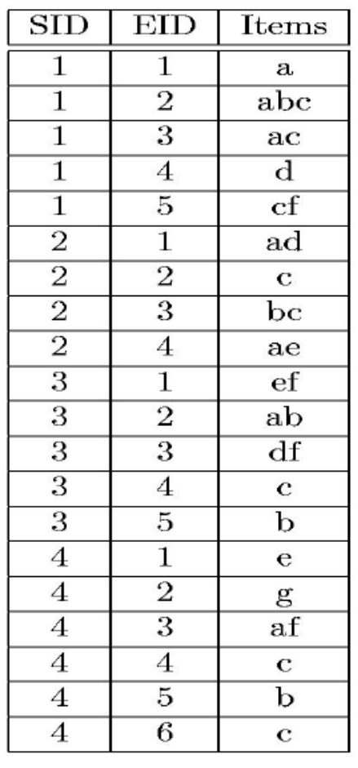
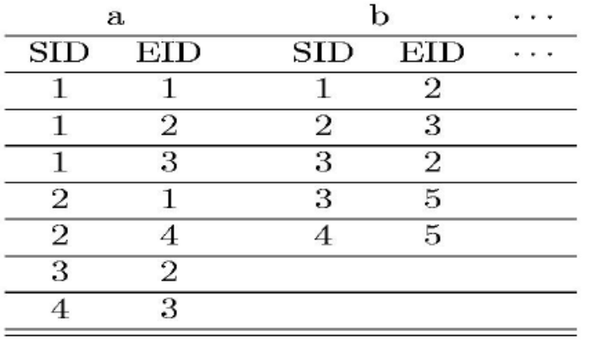
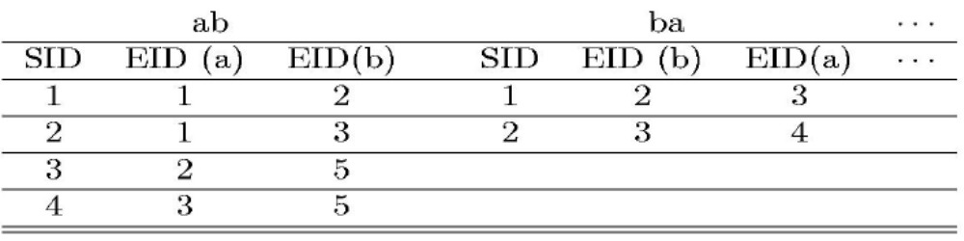
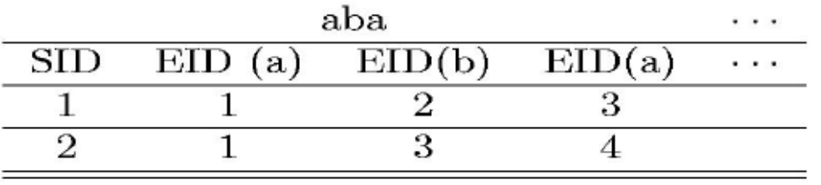
Sequential Pattern Mining in Vertical Data Format: The SPADE Algorithm
  A sequence database is mapped to: <SID, EID>
  Grow the subsequences (patterns) one item at a time by Apriori candidate generation
SID | Sequence
1 | <a(abc)(ac)d(cf)>
2 | <(ad)c(bc)(ae)>
3 | <(ef)(ab)(df)cb>
4 | <eg(af)cbc>
EID (b) < EID (a):
Corresponds to:
<a(abc)(ac)d(cf)>
min_sup = 2
Ref: SPADE (Sequential PAttern Discovery using Equivalent Class) [M. Zaki 2001]

Slide 41
PrefixSpan: A Pattern-Growth Approach
SID | Sequence
10 | <a(abc)(ac)d(cf)>
20 | <(ad)c(bc)(ae)>
30 | <(ef)(ab)(df)cb>
40 | <eg(af)cbc>
min_sup = 2
Prefix and suffix
  Given <a(abc)(ac)d(cf)>
  Prefixes: <a>, <aa>, <a(ab)>, <a(abc)>, …
  Suffix: Prefixes-based projection
Prefix | Suffix (Projection)
<a> | <(abc)(ac)d(cf)>
<aa> | <(_bc)(ac)d(cf)>
<ab> | <(_c)(ac)d(cf)>
PrefixSpan Mining: Prefix Projections
  Step 1: Find length-1 sequential patterns
    <a>, <b>, <c>, <d>, <e>, <f>
  Step 2: Divide search space and mine each projected DB
    <a>-projected DB,
    <b>-projected DB,
    …
    <f>-projected DB, …
“_” is placeholder for prefix
PrefixSpan (Prefix-projected Sequential pattern mining) Pei, et al. @TKDE’04

Slide 42
PrefixSpan: Mining Prefix-Projected DBs
SID | Sequence
10 | <a(abc)(ac)d(cf)>
20 | <(ad)c(bc)(ae)>
30 | <(ef)(ab)(df)cb>
40 | <eg(af)cbc>
min_sup = 2
Length-1 sequential patterns
<a>, <b>, <c>, <d>, <e>, <f>
prefix <a>
prefix <b>
prefix <c>, …, <f>
<a>-projected DB
<(abc)(ac)d(cf)>
<(_d)c(bc)(ae)>
<(_b)(df)cb>
<(_f)cbc>
<b>-projected DB
<(_c)(ac)d(cf)>
<(_c)(ae)>
<(df)cb>
<c>
…
Length-2 sequential
patterns
<aa>, <ab>, <(ab)>,
<ac>, <ad>, <af>
… …
prefix <aa>
prefix <af>
Major strength of PrefixSpan:
No candidate subseqs. to be generated
Projected DBs keep shrinking
<aa>-projected DB
…
<af>-projected DB

Slide 43
Implementation Consideration: Pseudo-Projection vs. Physical Projection
Major cost of PrefixSpan: Constructing projected DBs
  Suffixes largely repeating in recursive projected DBs
When DB can be held in main memory, use pseudo projection
Pointers save memory usage
2 5
  No physically copying suffixes
  Pointer to the sequence
  Offset of the suffix
But if it does not fit in memory
  Physical projection
Suggested approach:
  Integration of physical and pseudo-projection
  Swapping to pseudo-projection when the data fits in memory
s = <a(abc)(ac)d(cf)>
<a>
s|<a>: ( , 2)
<(abc)(ac)d(cf)>
<ab>
s|<ab>: ( , 5)
<(_c)(ac)d(cf)>

Slide 44
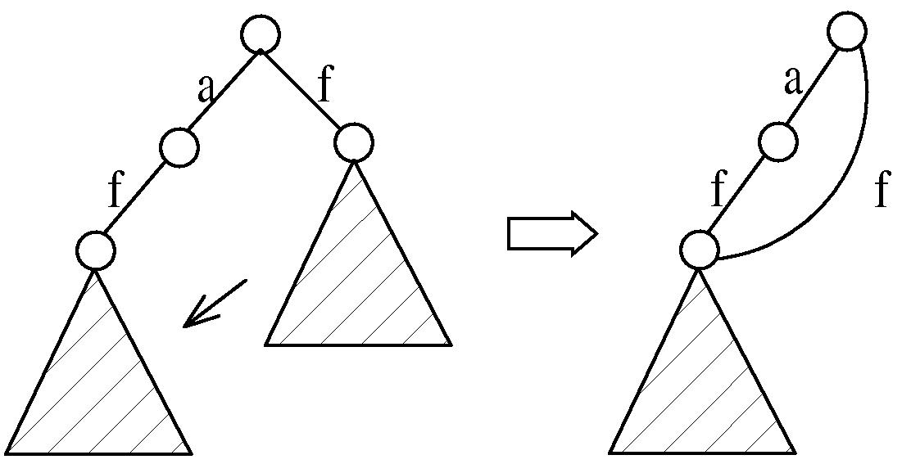
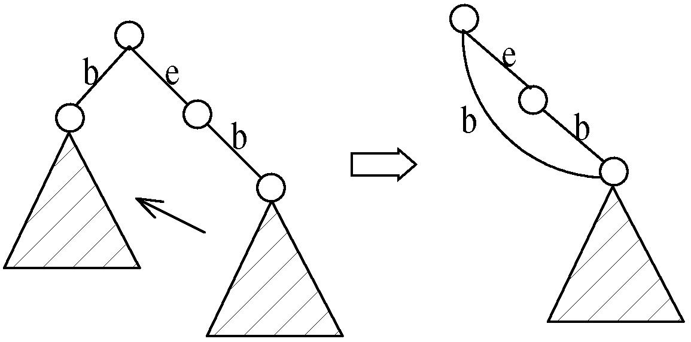
CloSpan: Mining Closed Sequential Patterns
A closed sequential pattern s: There exists no superpattern s’ such that s’ כ s, and s’ and s have the same support
Which ones are closed? <abc>: 20, <abcd>:20, <abcde>: 15
Why directly mine closed sequential patterns?
  Reduce # of (redundant) patterns
  Attain the same expressive power
Property P: Given two sequences s and s’, if s is a subsequence of s’, then the projected database of s = the projected database of s’ iff the size of the two projected databases are the same.
Explore Backward Subpattern and Backward Superpattern pruning to prune redundant search space
Greatly enhances efficiency (Yan, et al., SDM’03)

Slide 45
CloSpan: When Two Projected DBs Have the Same Size
Exploring Property P for closed pattern mining
When two projected sequence DBs have the same size?
    Here is one example:
ID | Sequence
1 | <aefbcg>
2 | <afegb(ac)>
3 | <afea>
min_sup = 2
<a>
<b>
<e>
<f>
<efbcg>
<fegb(ac)>
<fea>
<cg>
<(ac)>
<fbcg>
<gb(ac)>
<a>
<bcg>
<egb(ac)>
<ea>
<f>
size = 6
Backward subpattern pruning
<bcg>
<egb(ac)>
<ea>
<b>
Only need to keep size = 12 (including parentheses)
<cg>
<(ac)>
Backward superpattern pruning

Slide 46
Constraint-Based Sequential-Pattern Mining
Share many similarities with constraint-based itemset mining
Anti-monotonic: If S violates c, the super-sequences of S also violate c
  sum(S.price) < 150; min(S.value) > 10
Monotonic: If S satisfies c, the super-sequences of S also do so
  element_count (S) > 5; S ⊇ {PC, digital_camera}
Data anti-monotonic: If a sequence s₁ with respect to S violates c₃, s₁ can be removed
  c₃: sum(S.price) ≥ v
Succinct: Enforce constraint c by explicitly manipulating data
  S ⊇ {i-phone, MacAir}
Convertible: Projection based on the sorted value not sequence order
  value_avg(S) < 25; profit_sum (S) > 160
  max(S)/avg(S) < 2; median(S) – min(S) > 5

Slide 47
Timing-Based Constraints in Seq.-Pattern Mining
Order constraint: Some items must happen before the other
  {algebra, geometry} → {calculus} (where “→” indicates ordering)
  Anti-monotonic: Constraint-violating sub-patterns pruned
Min-gap/max-gap constraint: Confines two elements in a pattern
  E.g., mingap = 1, maxgap = 4
  Succinct: Enforced directly during pattern growth
Max-span constraint: Maximum allowed time difference between the 1st and the last elements in the pattern
  E.g., maxspan (S) = 60 (days)
  Succinct: Enforced directly when the 1st element is determined
Window size constraint: Events in an element do not have to occur at the same time: Enforce max allowed time difference
  E.g., window-size = 2: Various ways to merge events into elements

Slide 48
Episodes and Episode Pattern Mining
Episodes and regular expressions: Alternative to seq. patterns
  Serial episodes: AB
  Parallel episodes: A|B
  Regular expressions: (A|B)C*(DE)
E.g. Given a large shopping sequence database, one may like to find
    Suppose the pattern order follows the template (A|B)C*(D E), and
    Sum of the prices of A, B, C*, D, and E is greater than $100, where C* means C appears *-times
  How to efficiently mine such episode patterns?
a total order relationship: first A then B
a partial order relationship: A and B can be in any order
(DE) means D, E happen in the same time window

Slide 49
Pattern Mining: Advanced Methods
Mining Various Kinds of Patterns
Mining Compressed or Approximate Patterns
Constraint-based Pattern Mining
Mining Sequential Patterns
Mining Subgraph Patterns
Pattern Mining: Application Examples
Summary

Slide 50
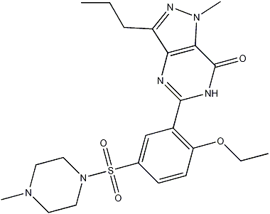
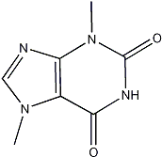
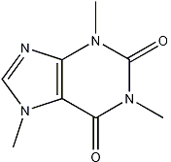
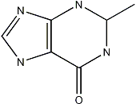
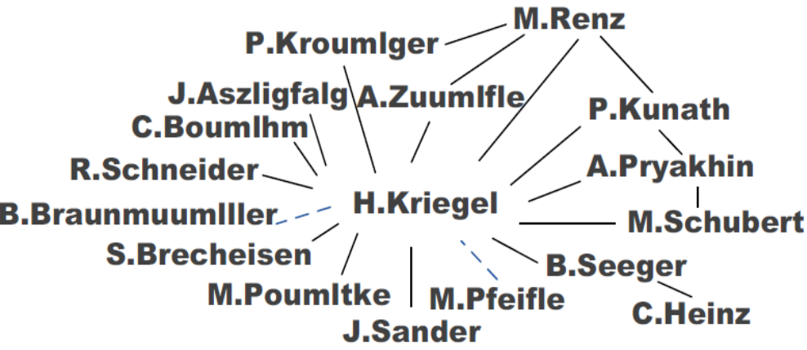
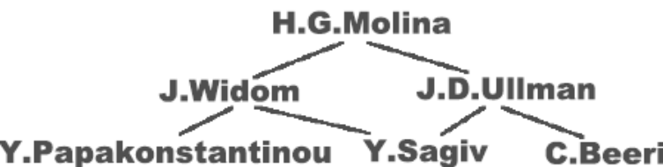
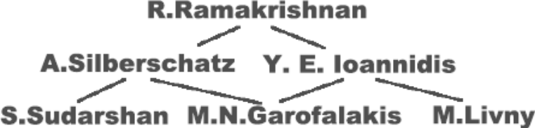
What Is Graph Pattern Mining?
Chem-informatics:
  Mining frequent chemical compound structures
Social networks, web communities, tweets, …
  Finding frequent research collaboration subgraphs

Slide 51
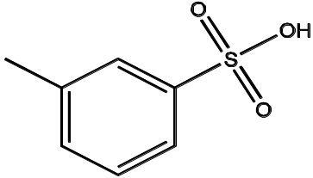
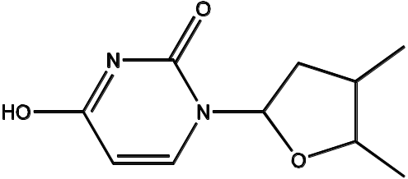
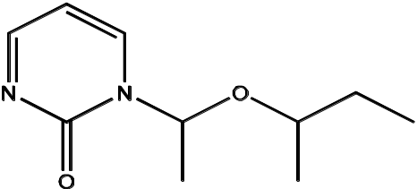
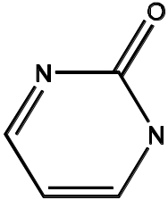
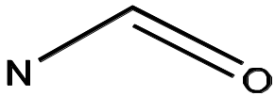
Frequent (Sub)Graph Patterns
Given a labeled graph dataset D = {G₁, G₂, …, G_{n}), the supporting graph set of a subgraph g is D_{g} = {G_{i} | g ⊆ G_{i}, G_{i} ∈D}
  support(g) = |D_{g}|/ |D|
A (sub)graph g is frequent if support(g) ≥ min_sup
Ex.: Chemical structures
Graph Dataset
Alternative:
  Mining frequent subgraph patterns from a single large graph or network
(A)
(B)
(C)
min_sup = 2
Frequent Graph Patterns
(1)
(2)
support = 67%

Slide 52
Applications of Graph Pattern Mining
Bioinformatics
  Gene networks, protein interactions, metabolic pathways
Chem-informatics: Mining chemical compound structures
Social networks, web communities, tweets, …
Cell phone networks, computer networks, …
Web graphs, XML structures, Semantic Web, information networks
Software engineering: Program execution flow analysis
Building blocks for graph classification, clustering, compression, comparison, and correlation analysis
Graph indexing and graph similarity search

Slide 53
Graph Pattern Mining Algorithms: Different Methodologies
Generation of candidate subgraphs
  Apriori vs. pattern growth (e.g., FSG vs. gSpan)
Search order
  Breadth vs. depth
Elimination of duplicate subgraphs
  Passive vs. active (e.g., gSpan [Yan & Han, 2002])
Support calculation
  Store embeddings (e.g., GASTON [Nijssen & Kok, 2004], FFSM [Huan, Wang, & Prins, 2003], MoFa [Borgelt & Berthold, ICDM’02])
Order of pattern discovery
  Path → tree → graph (e.g., GASTON [Nijssen & Kok, 2004])

Slide 54
Apriori-Based Approach
The Apriori property (anti-monotonicity): A size-k subgraph is frequent if and only if all of its subgraphs are frequent
A candidate size-(k+1) edge/vertex subgraph is generated if its corresponding two k-edge/vertex subgraphs are frequent
Iterative mining process:
  Candidate-generation → candidate pruning → support counting → candidate elimination
(k+1)-edge
k-edge
G₁
G
G₂
G’
…
G’’
G_{n}
Join

Slide 55
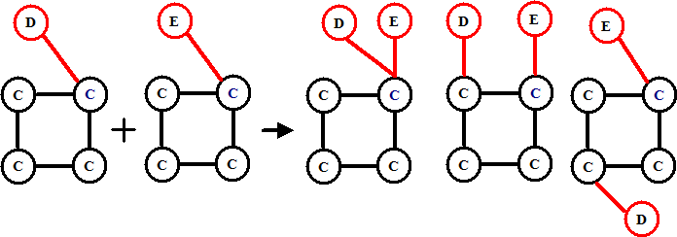
Candidate Generation:
Vertex Growing vs. Edge Growing
Methodology: Breadth-search, Apriori joining two size-k graphs
  Many possibilities at generating size-(k+1) candidate graphs
Generating new graphs with one more vertex
  AGM (Inokuchi, Washio, & Motoda, PKDD’00)
Generating new graphs with one more edge
  FSG (Kuramochi & Karypis, ICDM’01)
Performance shows via edge growing is more efficient

Slide 56
Pattern-Growth Approach
Depth-first growth of subgraphs from k-edge to (k+1)-edge, then (k+2)-edge subgraphs
(k+2)-edge
Major challenge
  Generating many duplicate subgraphs
Major idea to solve the problem
  Define an order to generate subgraphs
  DFS spanning tree: Flatten a graph into a sequence using depth-first search
  gSpan (Yan & Han, ICDM’02)
(k+1)-edge
G₁
…
k-edge
G₂
duplicate
graphs
G
…
G_{n}
…
Notes:
Apriori:
Step1: Join two k-1 edge graphs (these two graphs share a same k-2 edge subgraph) to generate a k-edge graph
Step2: Join the tid-list of these two k-1 edge graphs, then see whether its count is larger than the minimum support
Step3: Check all k-1 subgraph of this k-edge graph to see whether all of them are frequent
Step4: After G successfully pass Step1-3, do support computation of G in the graph dataset, See whether it is really frequent.
gSpan:
Step1: Right-most extend a k-1 edge graph to several k edge graphs.
Step2: Enumerate the occurrence of this k-1 edge graph in the graph dataset, meanwhile, counting these k edge graphs.
Step3: Output those k edge graphs whose support is larger than the minimum support.
Pros:
1: gSpan avoid the costly candidate generation and testing some infrequent subgraphs.
2: No complicated graph operations, like joining two graphs and calculating its k-1 subgraphs.
3. gSpan is very simple
The key is how to do right most extension efficiently in graph. We invented DFS code for graph.

Slide 57
gSPAN: Graph Pattern Growth in Order
Right-most path extension in subgraph pattern growth
  Right-most path: The path from root to the right-most leaf (choose the vertex with the smallest index at each step)
  Reduce generation of duplicate subgraphs
Completeness: The enumeration of graphs using right-most path extension is complete
DFS code: Flatten a graph into a sequence using depth-first search
e₀: (0,1)
0
e₁: (1,2)
1
e₂: (2,3)
2
e₃: (3,0)
4
e₄: (2,4)
3

Slide 58
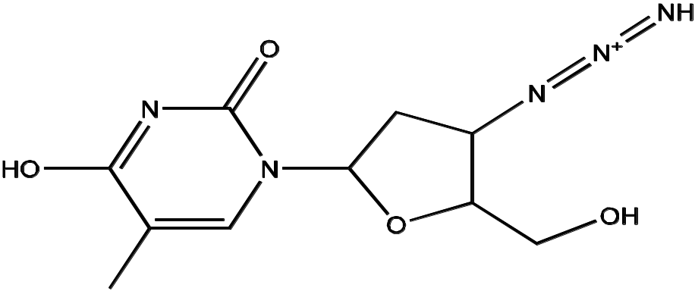
Why Mine Closed Graph Patterns?
2^{n} subgraphs -> closed frequent subgraphs
A frequent graph G is closed if there exists no supergraph of G that carries the same support as G
Lossless compression: Does not contain non-closed graphs, but still ensures that the mining result is complete
Algorithm CloseGraph: Mines closed graph patterns directly
If this subgraph is closed in the graph dataset, it implies that none of its frequent super-graphs carries the same support
Notes:
- Challenge: An n-edge frequent graph may have 2^{n} subgraphs

Slide 59
CloseGraph: Directly Mining Closed Graph Patterns
CloseGraph: Mining closed graph patterns by extending gSpan (Yan & Han, KDD’03)
At what condition can we
stop searching their children,
i.e., early termination?
G₁
k-edge
G₂
Suppose G and G₁ are frequent, and G is a subgraph of G₁
If in any part of the graph in the dataset where G occurs, G₁ also occurs, then we need not grow G (except some special, subtle cases), since none of G’s children will be closed except those of G₁
G
…
G_{n}
(k+1)-edge
Notes:
Apriori:
Step1: Join two k-1 edge graphs (these two graphs share a same k-2 edge subgraph) to generate a k-edge graph
Step2: Join the tid-list of these two k-1 edge graphs, then see whether its count is larger than the minimum support
Step3: Check all k-1 subgraph of this k-edge graph to see whether all of them are frequent
Step4: After G successfully pass Step1-3, do support computation of G in the graph dataset, See whether it is really frequent.
gSpan:
Step1: Right-most extend a k-1 edge graph to several k edge graphs.
Step2: Enumerate the occurrence of this k-1 edge graph in the graph dataset, meanwhile, counting these k edge graphs.
Step3: Output those k edge graphs whose support is larger than the minimum support.
Pros:
1: gSpan avoid the costly candidate generation and testing some infrequent subgraphs.
2: No complicated graph operations, like joining two graphs and calculating its k-1 subgraphs.
3. gSpan is very simple
The key is how to do right most extension efficiently in graph. We invented DFS code for graph.

Slide 60
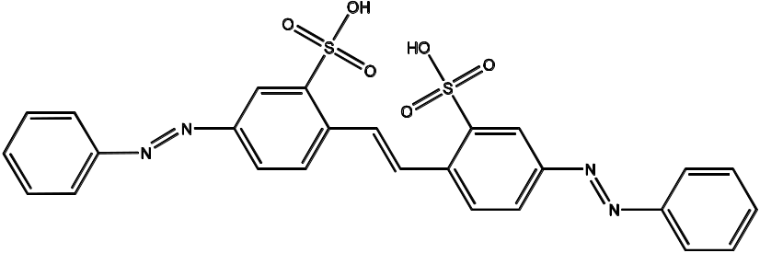
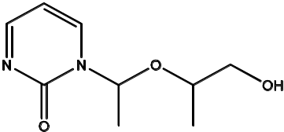
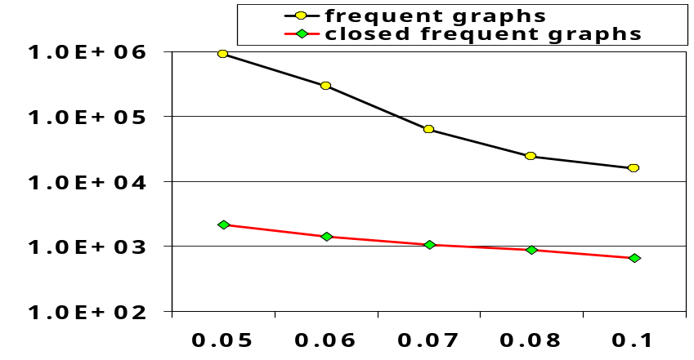
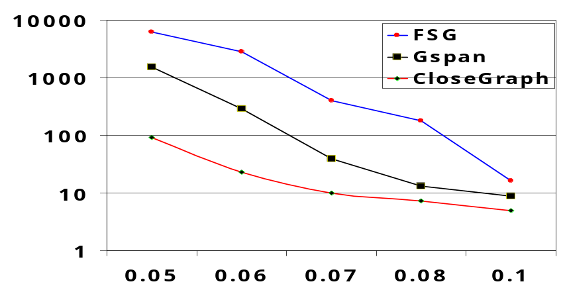
Experiment and Performance Comparison
The AIDS antiviral screen compound dataset from NCI/NIH
The dataset contains 43,905 chemical compounds
Discovered patterns: The smaller minimum support, the bigger and more interesting subgraph patterns discovered
20%
10%
5%
# of Patterns: Frequent vs. Closed
Runtime: Frequent vs. Closed
Run time (sec)
Number of patterns
Minimum support
Minimum support

Slide 61
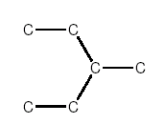
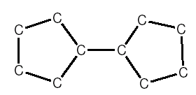
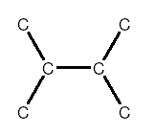
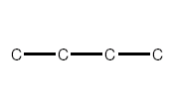
Application of Pattern Mining I: Graph Indexing
Graph query: Find all the graphs in a graph DB containing a given query graph
Index should be a powerful tool
Path-index may not work well
Solution: Index directly on substructures (i.e., graphs)
Query graph (Q)
Graph (G)
Substructure
Query Q:
Graph DB:
(a)
(b)
(c)
Only graph (c) contains Q
Path-indices: C, C-C, C-C-C, C-C-C-C cannot prune (a) & (b)

Slide 62
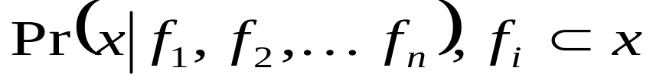
gIndex: Indexing Frequent and Discriminative Substructures
Why index frequent substructures?
  Too many substructures to index
  Size-increasing support threshold
  Large structures will likely be indexed well by their substructures
Why discriminative substructures?
support
min-support threshold
size
  Reduce the index size by an order of magnitude
Selection: Given a set of selected structures f₁, f₂, .. f_{n}, and a new structure x, the extra indexing power is measured by
when Pr(x|f₁, f₂, …, f_{n}) is small enough, x is a discriminative structure and should be included in the index
Experiments show that gIndex is small, effective, and stable

Slide 63
Application II: Support Substructure Similarity Search
Find graphs in a graph DB containing substructures similar to a given query graph
Ex. Data: A chemical compound DB
  A query graph q:
(a)
(b)
How to do similarity search efficiently?
  No indexing? – Sequential scan + computing subgraph similarity – too costly!
(c)
  Build graph indices to support approximate search?
    Need an explosive number of subgraphs to cover all the similar subgraphs!
An elegant solution (Yan, Yu, & Han, SIGMOD’05):
  Keep the graph index structure, but select features in the query space

Slide 64
Feature-Based Similarity Search
Decompose a query graph into a set of features
Query (q)
Feature-based similarity measure
  Each graph is represented as a feature vector X = {x₁, x₂, …, x_{n}}
  Similarity is defined by the distance of their corresponding vectors
Graph (G₁)
Substructure
Graph (G₂)
If graph G contains the major part of a query graph q, G should share a number of common features with q
  Given a relaxation ratio, one can calculate the maximal number of features that can be missed!
Graphs in database
 | G₁ | G₂ | G₃ | G₄ | G₅
f₁ | 0 | 1 | 0 | 1 | 1
f₂ | 0 | 1 | 0 | 0 | 1
f₃ | 1 | 0 | 1 | 1 | 1
f₄ | 1 | 0 | 0 | 0 | 1
f₅ | 0 | 0 | 1 | 1 | 0
features
Assume: Query graph has 5 features
Relaxation threshold: Can miss at most 2 features
Then: G₁, G₂, G₃ are pruned
A feature-graph matrix

Slide 65
Pattern Mining: Advanced Methods
Mining Various Kinds of Patterns
Mining Compressed or Approximate Patterns
Constraint-based Pattern Mining
Mining Sequential Patterns
Mining Subgraph Patterns
Pattern Mining: Application Examples
Summary

Slide 66
Pattern Mining Application I: Software Bug Detection
Mining rules from source code
  Bugs as deviant behavior (e.g., by statistical analysis)
  Mining programming rules (e.g., by frequent itemset mining)
  Mining function precedence protocols (e.g., by frequent subsequence mining)
  Revealing neglected conditions (e.g., by frequent itemset/subgraph mining)
Mining rules from revision histories
  By frequent itemset mining
Mining copy-paste patterns from source code
  Find copy-paste bugs (e.g., CP-Miner [Li et al., OSDI’04]) (to be discussed here)
    Reference: Z. Li, S. Lu, S. Myagmar, Y. Zhou, “CP-Miner: A Tool for Finding Copy-paste and Related Bugs in Operating System Code”, OSDI’04

Slide 67
Application Example: Mining Copy-and-Paste Bugs
Copy-pasting is common
  12% in Linux file system
  19% in X Window system
Copy-pasted code is error-prone
Mine “forget-to-change” bugs by sequential pattern mining
  Build a sequence database from source code
  Mining sequential patterns
  Finding mismatched identifier names & bugs
void __init prom_meminit(void)
{
……
for (i=0; i<n; i++) {
total[i].adr = list[i].addr;
total[i].bytes = list[i].size;
total[i].more = &total[i+1];
}
……
Code copy-and- pasted but forget to change “id”!
for (i=0; i<n; i++) {
taken[i].adr = list[i].addr;
taken[i].bytes = list[i].size;
taken[i].more = &total[i+1];
}
(Simplified example from linux-2.6.6/arch/sparc/prom/memory.c)
Courtesy of Yuanyuan Zhou@UCSD

Slide 68
Building Sequence Database from Source Code
(mapped to)
Hash values
Statement → number
Tokenize each component
  Different operators, constants, key words → different tokens
  Same type of identifiers → same token
Program → A long sequence
  Cut the long sequence by blocks
65
16
16
71
…
65
16
16
71
for (i=0; i<n; i++) {
total[i].adr = list[i].addr;
total[i].bytes = list[i].size;
total[i].more = &total[i+1];
}
……
for (i=0; i<n; i++) {
taken[i].adr = list[i].addr;
taken[i].bytes = list[i].size;
taken[i].more = &total[i+1];
}
old = 3;
new = 3;
Map a statement to a number
Tokenize
Final sequence DB:
(65)
(16, 16, 71)
…
(65)
(16, 16, 71)
5 61 20
5 61 20
Hash
16
16
Courtesy of Yuanyuan Zhou@UCSD

Slide 69
Sequential Pattern Mining & Detecting “Forget-to-Change” Bugs
Modification to the sequence pattern mining algorithm
  Constrain the max gap
Composing Larger Copy-Pasted Segments
  Combine the neighboring copy-pasted segments repeatedly
Find conflicts: Identify names that cannot be mapped to the corresponding ones
      E.g., 1 out of 4 “total” is unchanged, unchanged ratio = 0.25
  If 0 < unchanged ratio < threshold, then report it as a bug
CP-Miner reported many C-P bugs in Linux, Apache, … out of millions of LOC (lines of code)
(16, 16, 71)
……
(16, 16, 10, 71)
Allow a maximal gap: inserting statements in copy-and-paste
f (a1);
f (a2);
f (a3);
f1 (b1);
f1 (b2);
f2 (b3);
conflict
Courtesy of Yuanyuan Zhou@UCSD

Slide 70
Why Phrase Mining?
Unigrams vs. phrases
  Unigrams (single words) are often ambiguous
    Example: “United”: United States? United Airline? United Parcel Service?
  Phrase: A natural, meaningful, unambiguous semantic unit
    Example: “United States” vs. “United Airline”
Mining semantically meaningful phrases
  Transform text data from word granularity to phrase granularity
  Enhance the power and efficiency at manipulating unstructured data

Slide 71
From Frequent Pattern Mining to Phrase Mining
General principle
  Exploit information redundancy and data-driven criteria to determine phrase boundaries and salience
Methodology: Exploring three ideas
  Frequent pattern mining and colocation analysis
  Phrasal segmentation
  Quality phrase assessment
Recent developments of phrase mining methods
  ToPMine: Mining quality phrase without training (A. El-Kishky, et al., 2015)
  SegPhrase: Mining quality phrase with tiny training sets (J. Liu, et al., 2015)
  AutoPhrase: Mining quality phrases with distant supervision (e.g., Wikipedia) (Shang, et al., 2018)

Slide 72
ToPMine: Phrase Mining before Topic Modeling
ToPMine [El-Kishky et al. VLDB’15]: Phrase mining, then phrase-based topic modeling
Phrase mining
  Frequent contiguous pattern mining: Extract candidate phrases and their counts
  Agglomerative merging of adjacent unigrams as guided by a significance score
  Document segmentation to count phrase occurrence
      Calculate rectified (i.e., true) phrase frequency
  Phrase ranking (using the criteria proposed in KERT)
    Popularity, concordance, informativeness, completeness
Phrase-based topic modeling
  The mined bag-of-phrases are passed as input to PhraseLDA, an extension of LDA, that constrains all words in a phrase to each sharing the same latent topic
Phrase | Raw frequency | Rectified frequency
[support vector machine] | 90 | 80
[vector machine] | 95 | 0
[support vector] | 100 | 5

Slide 73
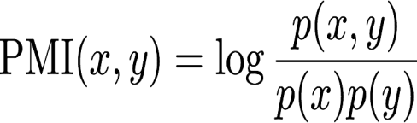

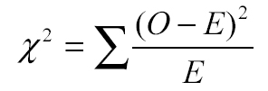
Collocation Mining
Collocation: A sequence of words that occur more frequently than expected
  Often “interesting”, relay information not portrayed by their constituent terms
    Ex. “made an exception”, “strong tea”
Many different measures used to extract collocations from a corpus [Dunning 93, Pederson 96]
  E.g., mutual information, t-test, z-test, chi-squared test, likelihood ratio
Many of these measures can be used to guide the agglomerative phrase-segmentation algorithm

Slide 74
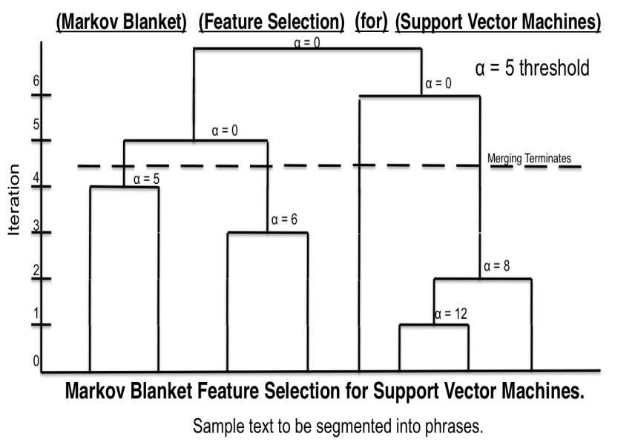
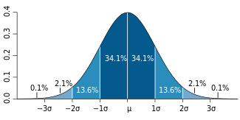
Phrase Candidate Generation: Frequent Pattern Mining + Statistical Analysis
Quality phrases
Based on significance score [Church et al.’91]:
α(P₁, P₂) ≈ (f(P₁●P₂) ̶ µ₀(P₁,P₂))/√ f(P₁●P₂)
Note for the first title:
[feature selection] forms phrase but not [selection for] based on the significant scores computed
[support vector machine] does not contribute to the counts of [support], [vector], [support vector], [vector machine]
[Markov blanket] [feature selection] for [support vector machines]
[knowledge discovery] using [least squares] [support vector machine] [classifiers]
…[support vector] for [machine learning]…

Slide 75
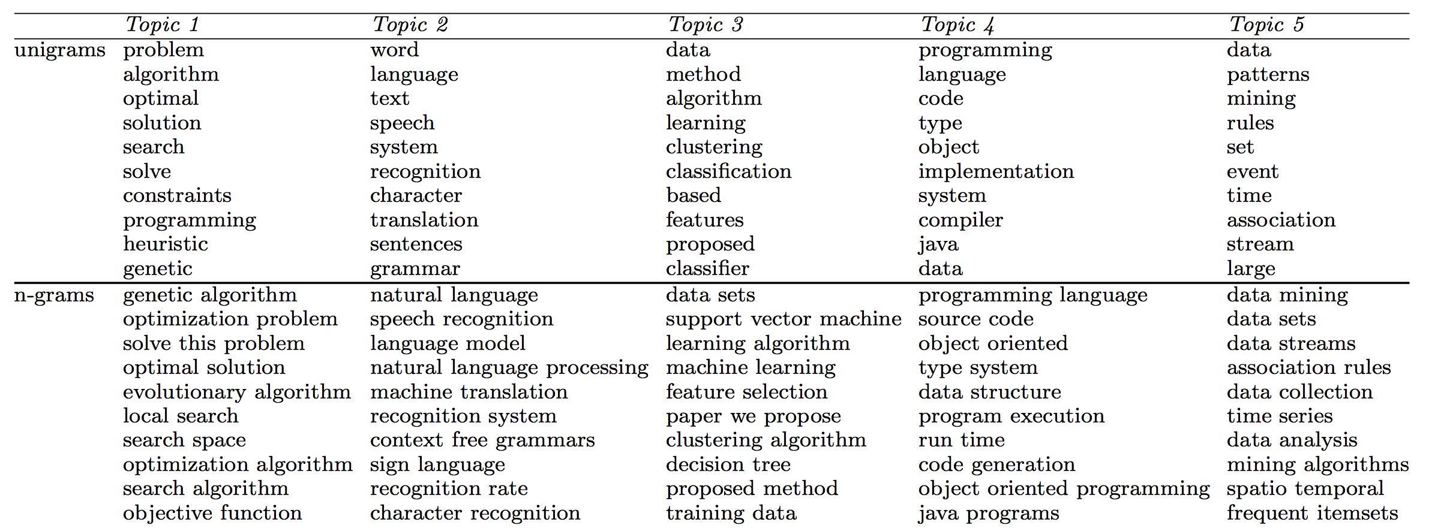
ToPMine: Experiments on DBLP Abstracts
  ToPMine is efficient and generates high-quality topics and phrases without any training data
Notes:
An interesting comparison
A state of the art phrase-discovering topic model

Slide 76
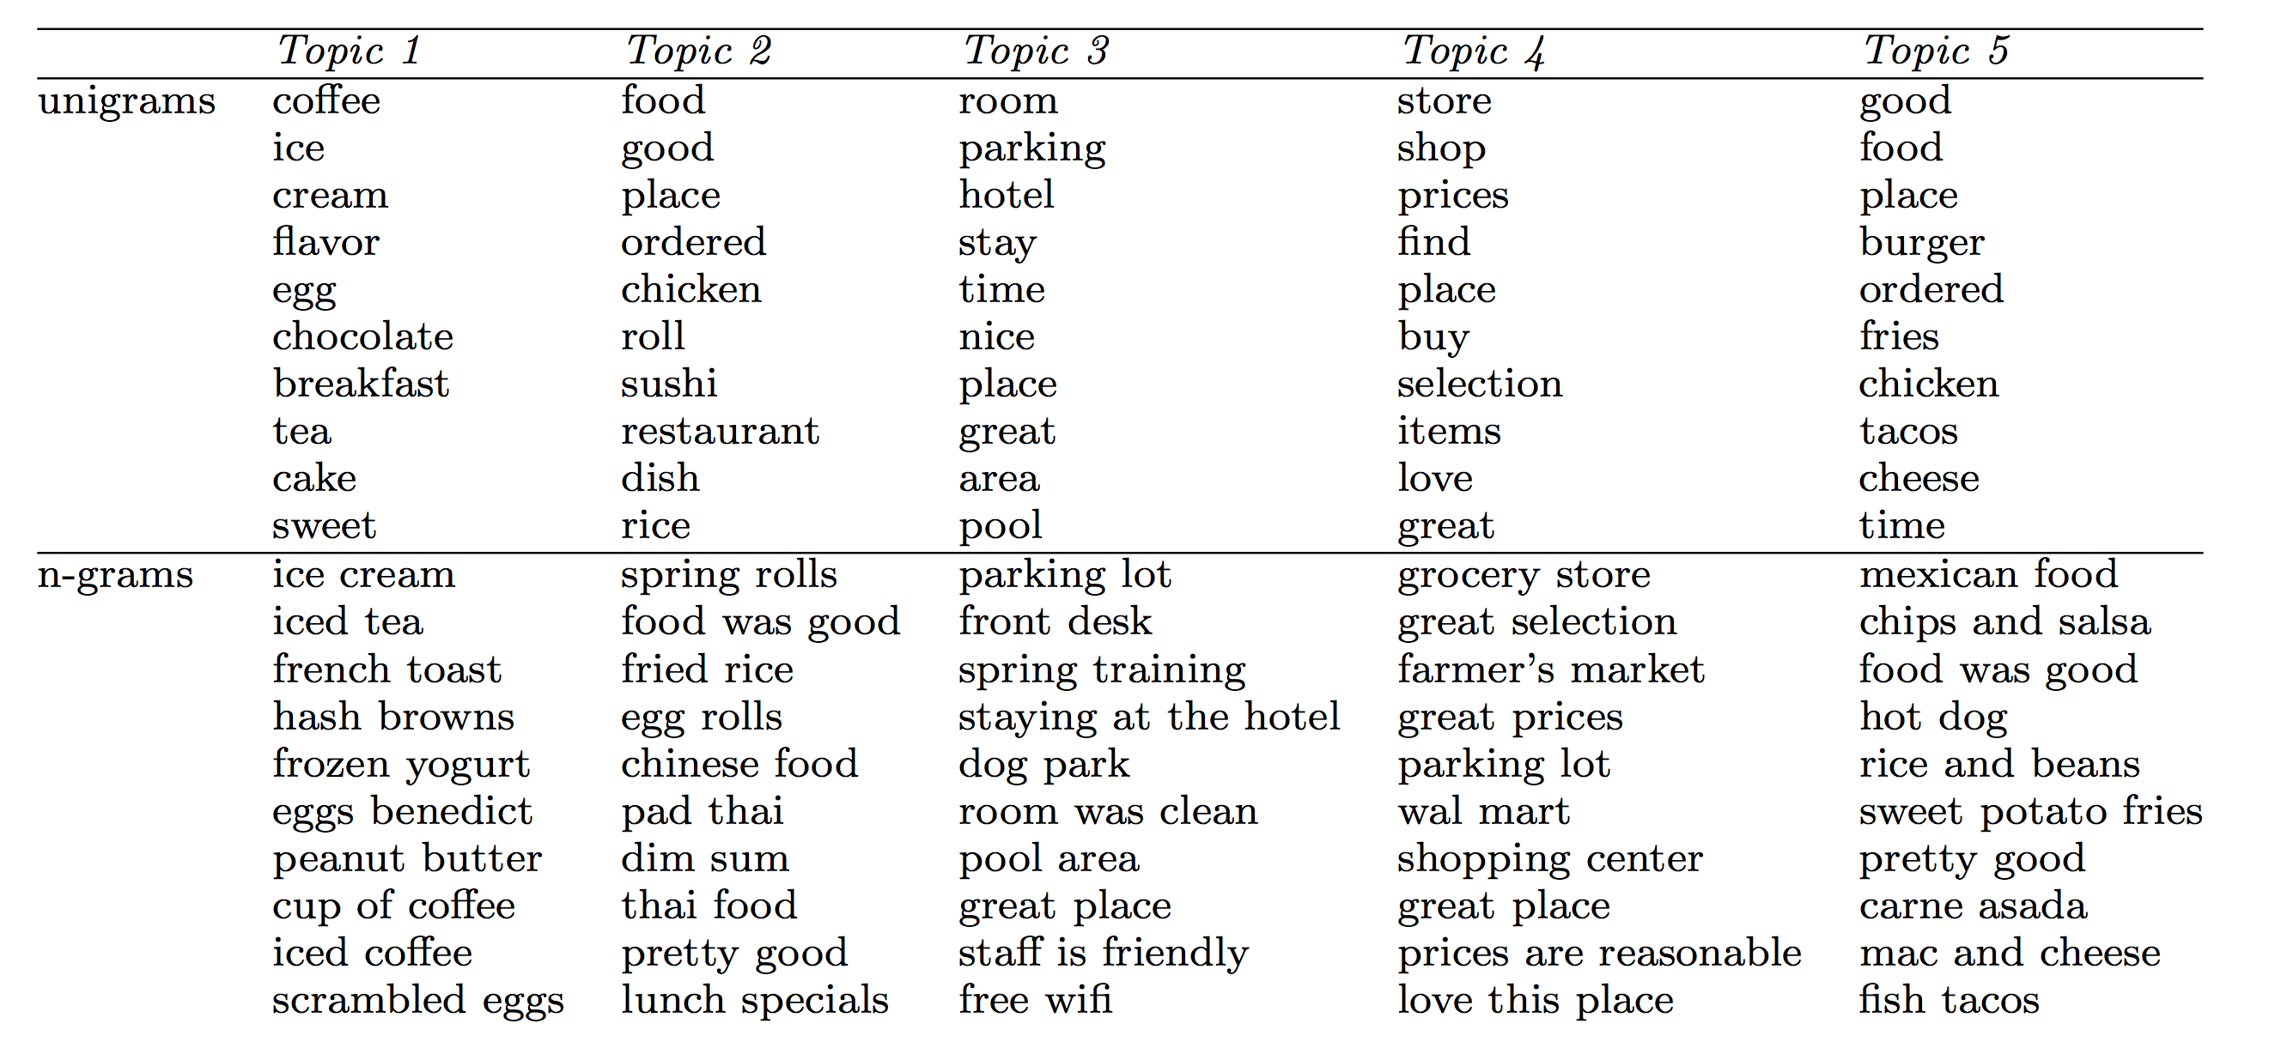

ToPMine: Experiments on Yelp Reviews
  ToPMine works well for phrase and topic mining in social media data
Notes:
An interesting comparison
A state of the art phrase-discovering topic model

Slide 77
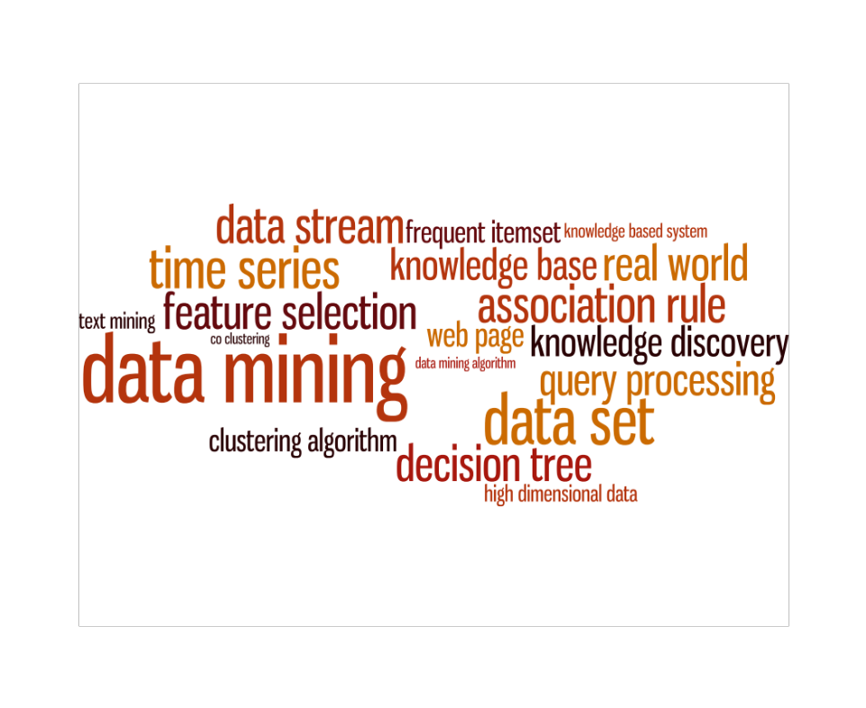


SagPhrase: Phrase Mining with Tiny Training Sets
A small set of training data may enhance the quality of phrase mining
J. Liu et al., Mining Quality Phrases from Massive Text Corpora. In SIGMOD’15
Raw Corpus
Quality Phrases
Segmented Corpus
Document 1
Citation recommendation is an interesting but challenging research problem in data mining area.
Document 2
In this study, we investigate the problem in the context of heterogeneous information networks using data mining technique.
Document 3
Principal Component Analysis is a linear dimensionality reduction technique commonly used in machine learning applications.
+ A small set of labels by human or a general KB
Input Raw Corpus
Quality Phrases
Segmented Corpus
Phrase Mining
Phrasal Segmentation
Integrating phrase mining with phrasal segmentation and classification

Slide 78
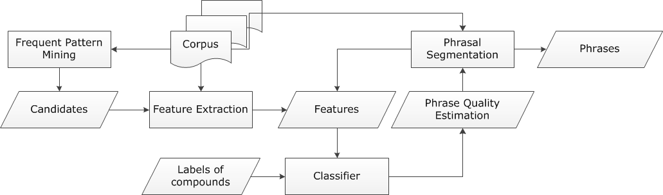
SegPhrase+: The Overall Framework
ClassPhrase: Frequent pattern mining, feature extraction, classification
SegPhrase: Phrasal segmentation and phrase quality estimation
SegPhrase+: One more round to enhance mined phrase quality
SegPhrase (a classifier is used)
Small labeled dataset
provided by experts
or
a distant supervised KB (e.g., Wikipedia / DBPedia)
ClassPhrase
SegPhrase(+)

Slide 79
SegPhrase: Pattern Mining and Feature Extraction
Pattern Mining for Candidate Set
  Build a candidate phrases set by frequent pattern mining
    Mining frequent k-grams (k is typically small, e.g., 6 in the experiments)
    Popularity measured by raw frequent words and phrases mined from the corpus
Feature Extraction: Concordance
  Partition a phrase into two parts to check whether the co-occurrence is significantly higher than pure random
Feature Extraction: Informativeness
  Quality phrases typically start and end with a non-stopword
    “machine learning is” vs. “machine learning”
  Use average IDF over words in the phrase to measure the semantics
  Usually, the probabilities of a quality phrase in quotes, brackets, or connected by hyphen should be higher (punctuations information)
      e.g., “state-of-the-art”

Slide 80
SegPhrase: Classification Using Tiny Training Sets
  Use tiny training sets (300 labels for 1GB corpus; can also use phrases extracted from KBs)
  Label: indicating whether a phrase is a high quality one
    E.g., “support vector machine”: 1; “the experiment shows”: 0
Classification: Construct models to distinguish quality phrases from poor ones
  Use Random Forest algorithm to bootstrap different datasets with limited labels
Phrasal segmentation can tell which phrase is more appropriate
  Ex: “A standard [feature vector] [machine learning] setup is used to describe ......”
  Partition a sequence of words by maximizing the likelihood
  Consider length penalty and filter out phrases with low rectified frequency
Process: Classification → Phrasal segmentation // SegPhrase
        Classification → Phrasal segmentation // SegPhrase+
Not counted towards the rectified frequency

Slide 81


Performance: Precision Recall Curves on DBLP
Datasets:
Evaluation
  Wiki Phrases (based on internal links, ~7K high quality phrases)
  Sampled 500*7 Wiki-uncovered phrases: Results evaluated by 3 reviewers
Compared with other phrase-mining methods
  TF-IDF, C-Value, ConExtr, KEA, and ToPMine
Also, Segphrase+ is efficient, linearly scalable
Dataset | #docs | #words | #labels
DBLP | 2.77M | 91.6M | 300
Yelp | 4.75M | 145.1M | 300
Use only 300 human labeled phrases for training
Precision-Recall Curves on DBLP Data (Wiki Phrases)
Precision-Recall Curves on DBLP Data (Non Wiki-phrases)
Notes:
Then the picky audience might ask how to project phrase mining methods back to the corpus so we can get mention-level chunking results? Maybe during presentation we can emphasize that's not the goal, we think it's more interesting to discover important phrases from a large corpus without any manual annotations.

Slide 82
Experimental Results: Interesting Phrases
Generated (From Titles & Abstracts of SIGKDD)
Query | SIGKDD
Method | SegPhrase+ | Chunking (TF-IDF & C-Value)
1 | data mining | data mining
2 | data set | association rule
3 | association rule | knowledge discovery
4 | knowledge discovery | frequent itemset
5 | time series | decision tree
… | … | …
51 | association rule mining | search space
52 | rule set | domain knowledge
53 | concept drift | important problem
54 | knowledge acquisition | concurrency control
55 | gene expression data | conceptual graph
… | … | …
201 | web content | optimal solution
202 | frequent subgraph | semantic relationship
203 | intrusion detection | effective way
204 | categorical attribute | space complexity
205 | user preference | small set
… | … | …
Only in Chunking
Only in SegPhrase+

Slide 83
Mining Quality Phrases in Multiple Languages
Both ToPMine and SegPhrase+ are extensible to mining quality phrases in multiple languages
  SegPhrase+ on Chinese (From Chinese Wikipedia)
  ToPMine on Arabic (From Quran (Fus7a Arabic)(no preprocessing)
    Experimental results of Arabic phrases:
    كفروا → Those who disbelieve
    بسم الله الرحمن الرحيم→ In the name of God the Gracious and Merciful
Rank | Phrase | In English
… | … | …
62 | 首席_执行官 | CEO
63 | 中间_偏右 | Middle-right
… | … | …
84 | 百度_百科 | Baidu Pedia
85 | 热带_气旋 | Tropical cyclone
86 | 中国科学院_院士 | Fellow of Chinese Academy of Sciences
… | … | …
1001 | 十大_中文_金曲 | Top-10 Chinese Songs
1002 | 全球_资讯网 | Global News Website
1003 | 天一阁_藏_明代_科举_录_选刊 | A Chinese book name
… | … | …
9934 | 国家_戏剧_院 | National Theater
9935 | 谢谢_你 | Thank you
… | … | …

Slide 84

AutoPhrase: Automated Phrase Mining by Distant Supervision
AutoPhrase: Automatic extraction of high-quality phrases (e.g., scientific terms and general entity names) in a given corpus (e.g., research papers and news)
Major features:
  No human efforts; multiple languages; high performance—precision, recall, efficiency
  Distant training: Utilize quality phrases in KBs (e.g., Wiki) as positive phrase labels
Innovation: Sampling-based label generation for robust, positive-only distant training

Slide 85

Robust Positive-Only Distant Training
In each base classifier, randomly sample K positive (e.g., wiki titles, keywords, links) and K noisy negative labels from the pools
Noisy negative pool: may still have δ quality phrases among the K negative labels
They form “perturbed training set”: size-2K subset of the full set of all phrases where the labels of some quality phrases are switched from positive to negative
Each base classifier can be viewed as randomly drawn K phrase candidates with replacement from the positive pool and the negative pool respectively
  Grow an unpruned decision tree to the point of separating all phrases to meet this requirement
Use an ensemble classifier that averages the results of independently trained base classifiers

Slide 86



Why Is Positive-Only Distant Training Robust?
Theoretical Analysis
  T base classifiers
  Exponentially decreasing
Empirical Performance
  AUC to evaluate the ranking
Note: AUC (Area Under Curve), with value range [0,1], is a classification measure to be introduced in the classification module

Slide 87
Modeling Single-Word Phrases: Enhancing Recall
AutoPhrase simultaneously models single-word and multi-word phrases
  A phrase can also be a single word, as long as it functions as a constituent in the syntax of a sentence, e.g., “UIUC”, “Illinois”
  Based on our experiments: 10%~30% quality phrases are single-word phrases
Criteria for modeling single-word phrases
  Popularity: Sufficiently frequent in a given corpus
  Informativeness: Indicative of a specific topic or concept
  Independence: A quality single-word phrase is more likely a complete semantic unit in a given document
Example: Is the following good single-word phrase?
  “CMU”? Yes (frequent, informative, independent)
  “this”? No (not informative)
  “united”? No (not independent, may be in “United States”, “United Airline”,…)

Slide 88
AutoPhrase: Cross-Domain Evaluation Results
Computer Science Papers
Yelp Business Reviews
Wikipedia Articles
AutoPhrase (TKDE’18): Best performing and generating multi-word and single word phrases
SegPhrase (SIGMOD’15): Outperformed TopMine (VLDB’15) and many other methods
TF-IDF: Stanford NLP Parser (LREC’16) + Ranked by TF-IDF
TextRank (ACL’04): Stanford NLP Parser (LREC’16) + Ranked by TextRank
Notes:
As we mentioned in the introduction, our methods are designed to be effective in multiple domains and languages.
We first evaluate the results in three domains: CS papers, Yelp reviews, and Wiki articles.
We mainly compared AutoPhrase with SegPhrase and Stanford NLP Parser.
SegPhrase has outperformed many unsupervised methods like TopMine. So we didn’t include the results here.
The Stanford NLP parser can extract noun phrases and verb phrases from sentences.
We use the popular TF-IDF and TextRank to rank the extracted phrases.
TF-IDF is a popular measurement in information retrieval. TF is term frequency and IDF is the inverse document frequency.
TextRank is similar to the PageRank. We construct a graph of phrases and build edges as their co-occurrence within a given sliding window. Then we run the random walk on this graph and compute the page rank.
As you can see here, AutoPhrase always has the best performance.
The compared methods include
AutoPhrase: distantly supervised
SegPhrase: weakly supervised (outperformed ToPMine, ConExtr, KEA, NLP-based + ranking, …)
NLP-based methods + TF-IDF/TextRank ranking

Slide 89

AutoPhrase: Cross-Language Evaluation Results
English
Spanish
Chinese
AutoPhrase (TKDE’18): Best performing and generating multi-word and single word phrases
WrapSegPhrase: non-English characters → English letters & SegPhrase
JiebaSeg: Specifically for Chinese; Dictionaries & Hidden Markov Models
AnsjSeg: Specifically for Chinese; Dictionaries & Conditional Random Fields
Notes:
We further conducted experiments in different languages.
Since SegPhrase is originally designed for English, we introduce its variant WrapSegPhrase for other languages.
We encode the non-English tokens using English letters. The first token is marked as ‘a’, the second as ‘b’, and so on.
I would like to highlight here, on the Chinese dataset, we compare with the popular, supervised Chinese phrase mining methods, Jieba Segmentation and Ansj Segmentation. They are using conditional random fields and hidden markov models trained on annotated corpora.
As you can see here, AutoPhrase performs the best.
Compared Methods:
WrapSegPhrase: encoding/decoding process for non-English languages + SegPhrase
NLP-based methods + TF-IDF/TextRank ranking
Pre-trained Chinese Segmenters: AnsjSeg and JiebaPSeg

Slide 90
AutoPhrase: An Example Run From Chinese Wikipedia
Phrase’s Rank | Phrase | Translation (Explanation)
1 | 江苏_舜_天 | (the name of a soccer team)
2 | 苦_艾_酒 | Absinthe
3 | 白发_魔_女 | (the name of a novel/TV-series)
4 | 笔记_型_电脑 | notebook computer, laptop
5 | 首席_执行官 | CEO
… | … | …
99,994 | 计算机_科学技术 | Computer Science and Technology
99,995 | 恒_天然 | Fonterra (a company)
99,996 | 中国_作家_协会_副_主席 | The Vice President of Writers Association of China
99,997 | 维他命_b | Vitamin B
99,998 | 舆论_导向 | controlled guidance of the media
… | … | …
The size of positive pool is about 29,000
AutoPhrase finds more than 116,000 quality phrases (quality score > 0.5)
Notes:
After the quantitative evaluation, I would like to show you some example results.
The Chinese dataset is one of the most challenging datasets. As you may know, the tokenization is also very hard in Chinese, because there is no whitespace. Meanwhile, the volume of Chinese Wiki is much smaller than English and Spanish Wikis. This makes the distant supervision hard.
So let’s take a look at the Chinese phrase results. The first column is the rank, the second column is the phrase, and the third column is the translation.
The underscores are inserted by the tokenizer, although some of them are not accurate. AutoPhrase can find many high-quality phrases, for example, around the rank of a hundred thousand, we can still find phrases like “Computer Science and Technology”.
Most of these high-quality phrases are not covered by the Wikipedia: Only about twenty-nine thousand phrases can be found in the positive pool, while AutoPhrase has found more than a hundred and sixteen thousand phrases.

Slide 91
Pattern Mining: Advanced Methods
Mining Various Kinds of Patterns
Mining Compressed or Approximate Patterns
Constraint-based Pattern Mining
Mining Sequential Patterns
Mining Subgraph Patterns
Pattern Mining: Application Examples
Summary

Slide 92
Summary: Pattern Mining: Advanced Methods (I)
Mining Diverse Patterns
  Mining Multiple-Level Associations
  Mining Multi-Dimensional Associations
  Mining Quantitative Associations
  Mining Negative Correlations
  Mining Compressed and Redundancy-Aware Patterns
Constraint-Based Frequent Pattern Mining
  Why Constraint-Based Mining?
  Constrained Mining with Pattern Anti-Monotonicity
  Constrained Mining with Pattern Monotonicity
  Constrained Mining with Data Anti-Monotonicity
  Constrained Mining with Succinct Constraints
  Constrained Mining with Convertible Constraints
  Handling Multiple Constraints
  Constraint-Based Sequential-Pattern Mining

Slide 93
Summary: Pattern Mining: Advanced Methods (II)
Sequential Pattern Mining
  Sequential Pattern and Sequential Pattern Mining
  GSP: Apriori-Based Sequential Pattern Mining
  SPADE: Sequential Pattern Mining in Vertical Data Format
  PrefixSpan: Sequential Pattern Mining by Pattern-Growth
  CloSpan: Mining Closed Sequential Patterns
  Constraint-Based Sequential Pattern Mining
Graph Pattern Mining
  Graph Pattern and Graph Pattern Mining
  Apriori-Based Graph Pattern Mining Methods
  gSpan: A Pattern-Growth-Based Method
  CloseGraph: Mining Closed Graph Patterns
  Graph Pattern Applications
Application I: Mining Software Copy-and-Paste Bugs
Application II: Phrase Mining

Slide 94
References: Mining Diverse Patterns
R. Srikant and R. Agrawal, “Mining generalized association rules”, VLDB'95
Y. Aumann and Y. Lindell, “A Statistical Theory for Quantitative Association Rules”, KDD'99
K. Wang, Y. He, J. Han, “Pushing Support Constraints Into Association Rules Mining”, IEEE Trans. Knowledge and Data Eng. 15(3): 642-658, 2003
D. Xin, J. Han, X. Yan and H. Cheng, "On Compressing Frequent Patterns", Knowledge and Data Engineering, 60(1): 5-29, 2007
D. Xin, H. Cheng, X. Yan, and J. Han, "Extracting Redundancy-Aware Top-K Patterns", KDD'06
J. Han, H. Cheng, D. Xin, and X. Yan, "Frequent Pattern Mining: Current Status and Future Directions", Data Mining and Knowledge Discovery, 15(1): 55-86, 2007
F. Zhu, X. Yan, J. Han, P. S. Yu, and H. Cheng, “Mining Colossal Frequent Patterns by Core Pattern Fusion”, ICDE'07

Slide 95
References: Constraint-Based Frequent Pattern Mining
R. Srikant, Q. Vu, and R. Agrawal, “Mining association rules with item constraints”, KDD'97
R. Ng, L.V.S. Lakshmanan, J. Han & A. Pang, “Exploratory mining and pruning optimizations of constrained association rules”, SIGMOD’98
G. Grahne, L. Lakshmanan, and X. Wang, “Efficient mining of constrained correlated sets”, ICDE'00
J. Pei, J. Han, and L. V. S. Lakshmanan, “Mining Frequent Itemsets with Convertible Constraints”, ICDE'01
J. Pei, J. Han, and W. Wang, “Mining Sequential Patterns with Constraints in Large Databases”, CIKM'02
F. Bonchi, F. Giannotti, A. Mazzanti, and D. Pedreschi, “ExAnte: Anticipated Data Reduction in Constrained Pattern Mining”, PKDD'03
F. Zhu, X. Yan, J. Han, and P. S. Yu, “gPrune: A Constraint Pushing Framework for Graph Pattern Mining”, PAKDD'07

Slide 96
References: Sequential Pattern Mining
R. Srikant and R. Agrawal, “Mining sequential patterns: Generalizations and performance improvements”, EDBT’96
M. Zaki, “SPADE: An Efficient Algorithm for Mining Frequent Sequences”, Machine Learning, 2001
J. Pei, J. Han, B. Mortazavi-Asl, J. Wang, H. Pinto, Q. Chen, U. Dayal, and M.-C. Hsu, "Mining Sequential Patterns by Pattern-Growth: The PrefixSpan Approach", IEEE TKDE, 16(10), 2004
X. Yan, J. Han, and R. Afshar, “CloSpan: Mining Closed Sequential Patterns in Large Datasets”, SDM'03
J. Pei, J. Han, and W. Wang, "Constraint-based sequential pattern mining: the pattern-growth methods", J. Int. Inf. Sys., 28(2), 2007
M. N. Garofalakis, R. Rastogi, K. Shim: Mining Sequential Patterns with Regular Expression Constraints. IEEE Trans. Knowl. Data Eng. 14(3), 2002
H. Mannila, H. Toivonen, and A. I. Verkamo, “Discovery of frequent episodes in event sequences”, Data Mining and Knowledge Discovery, 1997

Slide 97
References: Graph Pattern Mining
C. Borgelt and M. R. Berthold, Mining molecular fragments: Finding relevant substructures of molecules, ICDM'02
J. Huan, W. Wang, and J. Prins. Efficient mining of frequent subgraph in the presence of isomorphism, ICDM'03
A. Inokuchi, T. Washio, and H. Motoda. An apriori-based algorithm for mining frequent substructures from graph data, PKDD'00
M. Kuramochi and G. Karypis. Frequent subgraph discovery, ICDM'01
S. Nijssen and J. Kok. A Quickstart in Frequent Structure Mining can Make a Difference. KDD'04
N. Vanetik, E. Gudes, and S. E. Shimony. Computing frequent graph patterns from semistructured data, ICDM'02
X. Yan and J. Han, gSpan: Graph-Based Substructure Pattern Mining, ICDM'02
X. Yan and J. Han, CloseGraph: Mining Closed Frequent Graph Patterns, KDD'03
X. Yan, P. S. Yu, J. Han, Graph Indexing: A Frequent Structure-based Approach, SIGMOD'04
X. Yan, P. S. Yu, and J. Han, Substructure Similarity Search in Graph Databases, SIGMOD'05

Slide 98
References: Phrase Mining
S. Bergsma, E. Pitler, D. Lin, Creating Robust Supervised Classifiers via Web-scale N-gram Data, ACL’2010
D. M. Blei and J. D. Lafferty. Visualizing Topics with Multi-word Expressions. arXiv:0907.1013, 2009
D.M. Blei, A. Y. Ng, M. I. Jordan, J. D. Lafferty, Latent Dirichlet Allocation. JMLR 2003
M. Danilevsky, C. Wang, N. Desai, X. Ren, J. Guo, J. Han. Automatic Construction and Ranking of Topical Keyphrases on Collections of Short Documents. SDM’14
A. El-Kishky, Y. Song, C. Wang, C. R. Voss, and J. Han. Scalable Topical Phrase Mining from Text Corpora. VLDB’15
R. V. Lindsey, W. P. Headden, III, M. J. Stipicevic. A Phrase-Discovering Topic Model Using Hierarchical Pitman-Yor Processes. EMNLP-CoNLL’12.
J. Liu, J. Shang, C. Wang, X. Ren, J. Han, Mining Quality Phrases from Massive Text Corpora. SIGMOD’15
A. Parameswaran, H. Garcia-Molina, and A. Rajaraman. Towards the Web of Concepts: Extracting Concepts from Large Datasets. VLDB’10
X. Wang, A. McCallum, X. Wei. Topical N-grams: Phrase and Topic Discovery, With and Application to Information Retrieval. ICDM’07
J. Shang, J. Liu, M. Jiang, X. Ren, C. R Voss, J. Han, "Automated Phrase Mining from Massive Text Corpora", IEEE Transactions on Knowledge and Data Engineering, 30(10):1825-1837 (2018)

