Slide 1
Course Overview:
Big Data Analytics – Part I
(IFM, Fall 2026)
J. H. Wang
Sep. 29, 2026

Slide 2
About the Course
It’s offered by two instructors
  Part I: Jenq-Haur Wang (CSIE)
    The first 6 weeks (Wk4-10: Sep. 29 – Nov. 10, except Wk6)
      Wk10 (Nov. 10): Midterm exam
  Part II: Li-Chen Cheng (IFM)
    The last 12 weeks (Wk1-3, & Wk11-18)
The remaining overview focuses on the first part

Slide 3
Instructor & TA for Part I
Instructor
  J. H. Wang (王正豪)
  Professor, CSIE, NTUT
  Office: R1534, Technology Building
  E-mail: jhwang@ntut.edu.tw
  Tel: ext. 4238
  Office Hour: 9:10-12:00am, every Tuesday and Friday
TA
  Mr. Wang @R1424 (TBD)

Slide 4
Course Information
Time: 9:10am-12:00pm, Tue.
Classroom: R240, Technology Building
Course Website:
  https://chriswjh.github.io/BDA_IFM/
iSchool+:
  https://istudy.ntut.edu.tw/learn/
Microsoft Teams: has been created for the course number
  [NTUT-Sync]115-1_366648_大數據分析
Check the above for the latest announcements and updates of the schedule, slides, and homeworks

Slide 5
Course Communication Channel
Course sessions will be recorded and put in i-School+
For those who cannot attend in person, class sessions will also be broadcast and recorded using Microsoft Teams, which will also be put in i-School+
Other communication channels: e-mail

Slide 6
Course Materials
Textbooks:
  Jiawei Han, Jian Pei, and Hanghang Tong, Data Mining: Concepts and Techniques, 4th ed., Morgan Kaufmann Publishers, Oct. 2022. [DM4] (selected chapters)
  The 3rd edition is also acceptable, since the major concepts are similar
    https://hanj.cs.illinois.edu/bk3/
References:
  Holden Karau, Andy Konwinski, Patrick Wendell, Matei Zaharia, Learning Spark: Lightning-Fast Big Data Analysis, O'Reilly Media, January 2015.
  Related papers and documents

Slide 7
Target Audience
IFM & IMBA students
Students who are interested in big data analytics and willing to learn both basic concepts and practical skills

Slide 8
Additional Reading References
Official online documents: Hadoop, Spark, …
Open datasets and competitions: UCI ML repository, Kaggle, …
Academic papers in related fields: data mining, machine learning, big data

Slide 9
Teaching
Lecture: about one chapter / week
About two written assignments
  Concepts for the major topics: frequent pattern mining, classification, and clustering
Midterm exam
  For major concepts
In-class demos (if time permits)
  Examples for the Spark programming framework, and the major techniques: classification, clustering

Slide 10
Grading Policy
The total score will be a weighted average of your scores in both parts
  ~30% for Part I
  ~70% for Part II
Score for the first part:
  Homework assignments: ~60%
  Mid-term exam: ~40%
The final weights of score will be determined by the teachers

Slide 11
About the Midterm Exam
Date: Nov. 10, 2026
Time: 9:10am-12:00pm
Location: R240, Technology Building
Range: [DM3] Ch. 1, 2, 3, 6, 8, 10 (TBD)
  Data preprocessing, Frequent Pattern Mining, Classification, Clustering
Question Types: Calculation, Short Answer, True-False, Multiple Choice
It will be closed-book

Slide 12
Homework Submission
Written exercises are to be submitted in class
Results of data analysis tasks in labs such as programs and outputs in electronic files must be submitted to iSchool+
Your score will be deducted when there’s delay in homework submission
  The longer the delay, the higher the deduction

Slide 13
What This Course is about
This course can help you
  Learn the general idea of big data
  Understand the basic concepts of data mining
  Know what distributed analytics platforms can help
And learn technical and practical skills in:
  Data mining methods
  Data analysis using public datasets
  (Environment setup of distributed platforms, if time permits)

Slide 14
Big Data: Some Examples
Topic detection and tracking in news
Social network analysis
PageRank: Web page importance ranking
Trend analysis of financial markets
Predictive analytics for smart factories
Many others: healthcare, natural resources, education, public sector, insurance, transportation, finance and crime detection, …

Slide 15
What is Big Data?
Big data is a term for data sets that are so large or complex that traditional data processing application softwares are inadequate to deal with them
Challenges include capture, storage, analysis, data curation, search, sharing, transfer, visualization, querying, updating and information privacy [source: Wikipedia]

Slide 16
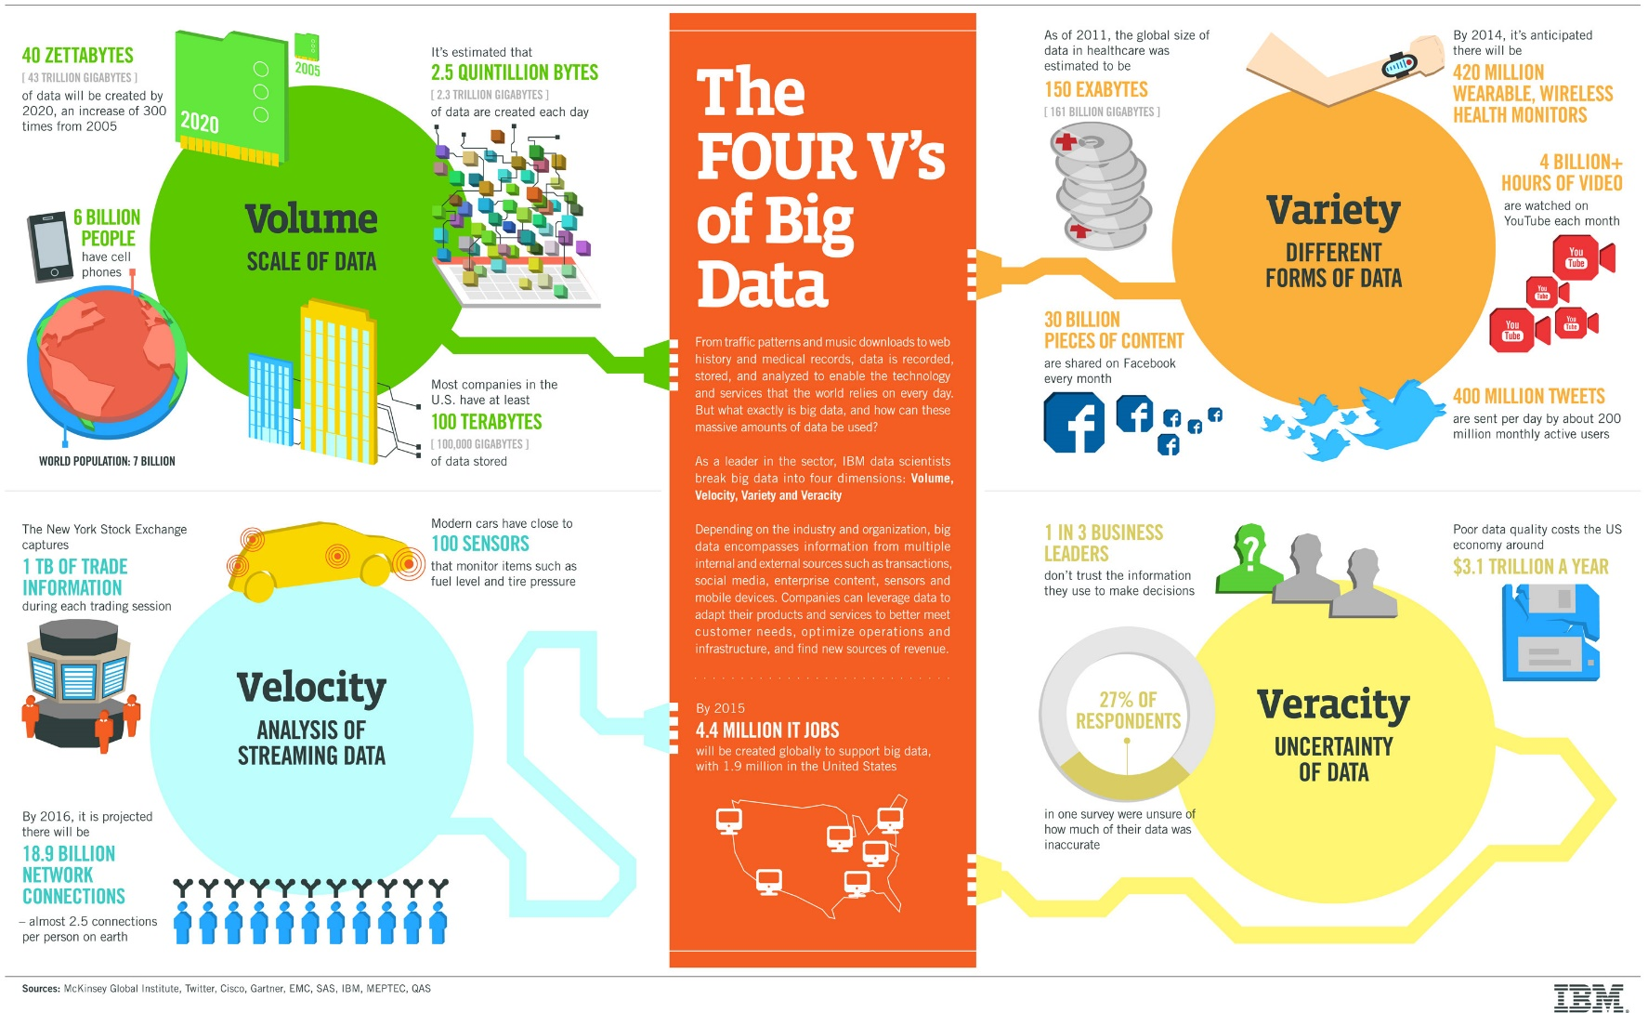
The Four V’s of Big Data
[source: IBM]

Slide 17
Data analysis vs. Data analytics
“Analysis is the separation of a whole into its component parts, and analytics is the method of logical analysis.” [source: Merriam-Webster dictionary]
“Analysis is really a heuristic activity, where scanning through all the data the analyst gains some insight. “ [source: Quora.com]
“Analytics is about applying a mechanical or algorithmic process to derive the insights for example running through various data sets looking for meaningful correlations between them. ” [source: Quora.com]

Slide 18
The Major Focus in Big Data Analytics
The management of complete data lifecycle
  Collecting
  Cleansing
  Organizing
  Storing
  Analyzing
  Visualization
  Governing

Slide 19
The Goal of the Course
Big Data Analytics is to analyze huge amount of diverse data with effective algorithms in an efficient way
  Data preprocessing
  Data mining
  Parallel programming in distributed platforms

Slide 20
Topics to be Covered
Introduction
Data mining concepts
  Data preprocessing
  Frequent pattern mining
  Data classification
  Data clustering
Distributed processing (if time permits)
  Introducing distributed platforms: Hadoop, Spark
  Programming paradigms: MapReduce, TensorFlow, …

Slide 21
Tentative Schedule
Before midterm
  Introduction to big data & data preprocessing (1 wk)
  Frequent pattern mining (1 wk)
  Data classification (2 wks)
  Data clustering (1 wk)
  Midterm exam (1 wk)
If time permits
  Introduction of the distributed framework: Hadoop, Spark (1 wk)

Slide 22
Some Tools for Data Mining
Tools for data mining
  Weka, RapidMiner, …
Programming languages
  Python, R, …
Programming frameworks for machine learning and deep learning
  TensorFlow, Keras, PyTorch, …
Distributed Frameworks for Big Data Analytics
  Hadoop, Spark, …

Slide 23

Why Python?
One of the most popular interpreted programming languages for building websites
  They can be used to quickly write small programs or scripts to automate other tasks
A large scientific computing and data analysis community
  Improved support for libraries: numpy, scikit-learn, …
  Strength for general-purpose software engineering
  Easy to integrate with other codes such as C, C++, Fortran
Suitable for doing research and prototyping, and also for building production systems

Slide 24
Thanks for Your Attention!

