Slide 1
Course Overview: Educational Data Mining and Applications
J. H. Wang
Sep. 9, 2025

Slide 2
Instructor & TA
Instructor
J. H. Wang (王正豪)
Professor, CSIE, NTUT
Office: R1534, Technology Building
E-mail: jhwang@ntut.edu.tw
Tel: ext. 4238
Office Hour: 9:10-12:00am, every Tuesday and Friday
TA
Miss Chung (@ R1424, Technology Building)
E-mail: (TBA)

Slide 3
About this Course
Course Web Page:
https://chriswjh.github.io/EDM/
Time: 13:10-15:00pm, Tue., 10:10-11:00am, Thu.
Classroom: R301, Third Teaching Building
Classes will be in-person
The teacher and the TA can be reached via e-mails, Teams, or Facebook group if needed

Slide 4
Other Communication Channels
Class sessions will be recorded using i-School+
Online class sessions using Microsoft Teams will also be provided when possible
Team created for the course number:
[NTUT-Sync] 114-1_348012_教育數據探勘與應用
Online communication channels: Teams, iSchool+, course web page, e-mails

Slide 5
Course Materials
Textbook:
Jiawei Han, Jian Pei, and Hanghang Tong, Data Mining: Concepts and Techniques, 4th ed., Morgan Kaufmann Publishers, Oct. 2022. [DM4] (selected chapters)
Prerequisites:
Basic knowledge of data structures (and algorithms), database systems, and discrete math (probability)
Programming experience is *required* for completing homeworks & projects

Slide 6
Target Audience
CSIE juniors and above
Students who are interested in learning data mining concepts and tools
Applying data mining techniques for analyzing educational data

Slide 7
Should I Take this Course?
This course is part of the Micro Courses on Educational Big Data (教育大數據微學程)
Rules: https://oaa.ntut.edu.tw/p/412-1008-17153.php?Lang=zh-tw
Web: https://course-map-fcf13.web.app/
Facebook: https://www.facebook.com/profile.php?id=100089037155805
NOTE: For CS students, this course might NOT be credited as cross-domain credits

Slide 8
Differences between Courses with Similar Names
CS:
Basics: Introduction to Big Data Analytics
Concepts of data mining & big data
Application: Educational Data Mining and Applications (This course)
Data mining concept + educational data analysis
Advanced: Big Data Mining and Applications
Mining different types of big data + distributed platform
IFM:
Basics: Big Data Analytics
Data mining concepts

Slide 9
Additional Reading Materials
Reference Books
Tom White, Hadoop: The Definitive Guide, 4th ed., O’Reilly Media, 2015.
Jules S. Damji, Brooke Wenig, Tathagata Das, Denny Lee, Learning Spark: Lightning-Fast Big Data Analysis, 2nd ed., O'Reilly Media, Jul. 2020.
Jimmy Lin and Chris Dyer, Data-Intensive Text Processing with MapReduce, Morgan & Claypool Publishers, 2010.
Jure Leskovec, Anand Rajaraman, Jeffrey David Ullman, Mining of Massive Datasets, 3rd Edition, Cambridge University Press, 2020.
http://www.mmds.org/
Official online documents: Hadoop, Spark, …
Academic papers

Slide 10
Grading Policy
Homework assignments and programming exercises: ~40%
Mid-term exam: ~25%
Term project: ~35%
Including proposal, presentation, and final report
All homeworks, projects, and reports must be submitted before the deadline
Late submission has to be done *before* the end of the semester (Jan. 9, 2026), if not specified otherwise

Slide 11
Homeworks and Projects
About 3~4 written assignments
Data mining concepts
About 3 team-based programming exercises
Maximum number of students per team: 4
One term project for educational data analysis or system development
Team-based (the same as programming exercises)
e.g. given interesting educational datasets, find appropriate methods to analyze
Responsibility of each member must be specified in the document for team-based projects

Slide 12
About the Midterm Exam
Date: (TBD) Nov. 4, 2025
Time: 13:10-15:00
Location: R301, Third Teaching Building
Range: (TBD) [DM4] Ch.1-2, 4-5, 6, 7 (part), 8
Question Types: Calculation, Short Answer, True-False, Multiple Choice
Closed-book

Slide 13
About the Term Project
Proposals, presentations, and reports are *required* for each team, and will be counted in the score
The score you’ll get depends on the functionality, difficulty, and quality of your project
Proposal: A one-page description of your idea on how you are going analyze which dataset
You can either write your own program, or call existing open source code or library (but NOT executing binary code only)
Presentation: ~20 minutes per team
Focus on analytical methods, results and interpretations
Reports: slides, source code, and document

Slide 14
Example Topics for Term Projects
分析教育資源現狀
跨平臺學習資源對學習成效的影響探討
E化教育對現代教育影響
來台外籍生與台灣籍留學生
依家庭狀況及平時活動評估學生學習表現
探討師生和師資進修狀況與學生成績之關聯
學生平板使用與學業成績的關聯性
…

Slide 15
Homework Submission
How to Submit:
Written exercises are to be submitted in paper
Electronic version is also acceptable in iSchool+
Systems, programs & documentation, project proposals, and project reports in electronic files must be submitted online to iSchool+
You will get deducted score when there’s delay in homework submission
The longer the delay, the higher the deduction

Slide 16
What This Course is about
This course can help you
Understand the general techniques of data mining
Apply data mining tools in analyzing educational data
Get an idea of what distributed platforms like Hadoop/Spark can do (if time permits)
And MORE…
Technical and practical skills for:
Educational data analysis
Environment setup of distributed computing (if time permits)

Slide 17
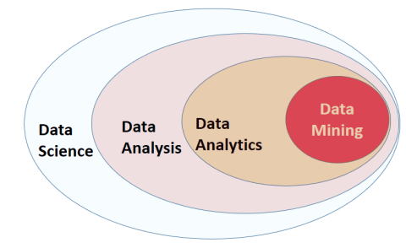
Related Topics

Slide 18
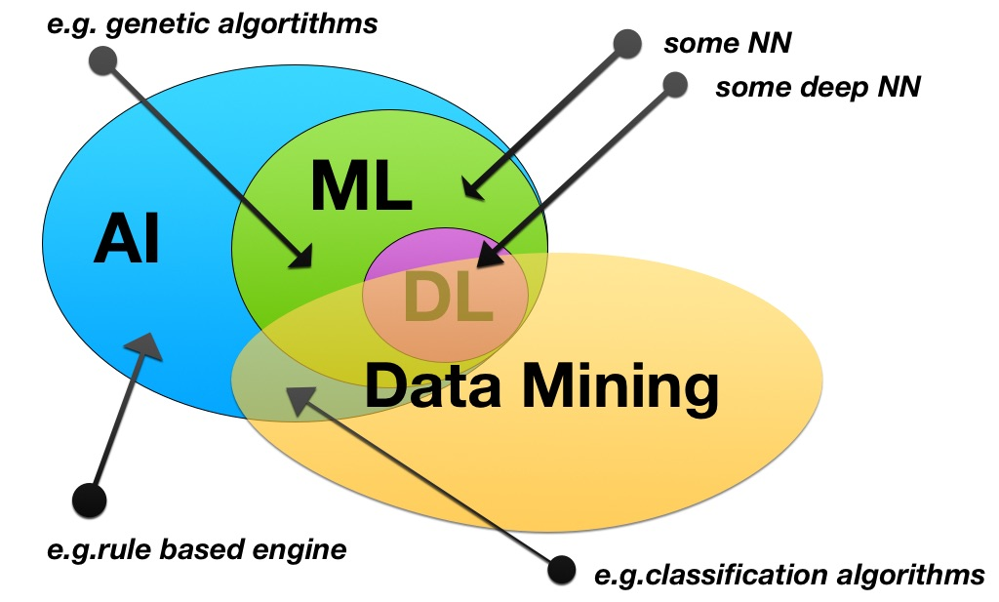
Related Topics

Slide 19
Focus in Educational Data Mining
The management of complete data lifecycle
Collecting
Cleansing
Organizing
Storing
Analyzing
Visualization & Interpretation
Governing

Slide 20
The Goal of the Course
To help students learn the basic concepts & principles of data mining
To get students familiar with data mining tools and their application on educational data
To interpret the analytic results of data mining

Slide 21
The Topics to be Covered
Introduction
Data mining concepts
Data preprocessing
Frequent pattern mining
Data classification
Data clustering
Applications
Characteristics of educational data
Analysis result interpretation
Distributed platform for big data
Introducing distributed platforms: Hadoop, Spark
MapReduce programming

Slide 22
Tentative Schedule
Before midterm
Introduction (1 wk)
Data characteristics & preprocessing (2 wks)
Frequent pattern mining (2 wks)
Data classification (2-3 wks)
After midterm
Data clustering (2 wks)
Introducing distributed platforms: Hadoop, Spark (1 wk)
MapReduce programming (1-2 wks)
Term Project Presentation (3-4 wks)

Slide 23
Tentative Schedule
Week | Date | Content | Note
1 | 9/9 9/11 | Course Overview Ch.1, Introduction
2 | 9/16 9/18 | Ch.2, Data, Measurements, and Data Preprocessing
3 | 9/23 9/25 | (Case Study: Preprocessing Educational Open Data)
4 | 9/30 10/2 | Ch.4, Pattern Mining: Basic Concepts and Methods | HW#1
5 | 10/7 10/9 | Term Project Proposal & Team Registration
6 | 10/14 10/16 | Ch.5, Pattern Mining: Advanced Methods | Due: HW#1 HW#2
7 | 10/21 10/23 | Ch.6, Classification: Basic Concepts

Slide 24
Week | Date | Content | Note
8 | 10/28 10/30 | Ch.6 | Due: HW#2 HW#3
9 | 11/4 11/6 | (11/4: Midterm)
10 | 11/11 11/13 | Ch.7, Classification: Advanced Methods | Due: HW#3 Due: Proposal
11 | 11/18 11/20 | Ch.8, Cluster Analysis: Basic Concepts and Methods
12 | 11/25 11/27 | Ch.9, Cluster Analysis: Advanced Methods | HW#4
13 | 12/2 12/4 | Distributed Platforms: Hadoop, Spark MapReduce Programming
14 | 12/9 12/11 | Spark Programming | Due: HW#4

Slide 25
Week | Date | Content | Note
15 | 12/16 12/18 | Term Project Presentation: Week 1
16 | 12/23 12/25 | Term Project Presentation: Week 2
17 | 12/30 1/1 | Term Project Presentation: Week 3 (Leave for New Year’s Day)
18 | 1/6 1/8 | Term Project Presentation: Week 4 | 1/9 Due: Final report

Slide 26
Notes on Homeworks
Rule 1: Plagiarism is prohibited
Near-duplicate codes will get equal and deducted scores
Rule 2: Clear documentation is required in your system projects
Instructions on downloading, installing, configuring, and executing your code, open source library, APIs, or codes must be included in the documentation
Package control is recommended

Slide 27
More on Term Projects
Tentative schedule for all teams:
Proposal: *required* one week after midterm (Nov. 11, 2025)
Presentations (including demos): *required* in the last three-four weeks (starting as early as Dec. 16, 2025)
Final report: *required* before the end of the semester (Jan. 9, 2026)
Slides, source code, documentation

Slide 28
Notes on System Development
You can write your own code in any programming language
Python, R, …
You can also call existing open source APIs or libraries
E.g. Hadoop, Spark, TensorFlow, Keras, PyTorch, …
But simply running existing binary codes or commercial tools is NOT acceptable
Any application on educational data
Public datasets: eduLRS, kaggle, NERDA, …

Slide 29
Examples of Open Educational Datasets
均一平台教育基金會 Junyi Academy Online Learning Activity Dataset
https://www.kaggle.com/datasets/junyiacademy/learning-activity-public-dataset-by-junyi-academy
教育數據應用黑客松 2020 EDUATHON
https://bhuntr.com/tw/competitions/90g27lhlrrcu6xta2x
2024教育大數據分析競賽
https://pads.moe.edu.tw/pads_front/index.php?action=plan&uuid=5bc1d60c-eb62-41c2-8b21-254109a4c602

Slide 30
Research Information about Data Mining
KDD Conferences
ACM SIGKDD Int. Conf. on Knowledge Discovery in Databases and Data Mining (KDD)
SIAM Data Mining Conf. (SDM)
(IEEE) Int. Conf. on Data Mining (ICDM)
European Conf. on Machine Learning and Principles and practices of Knowledge Discovery and Data Mining (ECML-PKDD)
Pacific-Asia Conf. on Knowledge Discovery and Data Mining (PAKDD)
Int. Conf. on Web Search and Data Mining (WSDM)

Slide 31
Other related conferences
DB conferences: ACM SIGMOD, VLDB, ICDE, EDBT, ICDT, …
Web and IR conferences: WWW, SIGIR, WSDM
ML conferences: ICML, NIPS
PR conferences: CVPR,
Journals
Data Mining and Knowledge Discovery (DAMI or DMKD)
IEEE Trans. On Knowledge and Data Eng. (TKDE)
KDD Explorations
ACM Trans. on KDD

Slide 32
Where to Find References? DBLP, CiteSeer, Google
Data mining and KDD:
Conferences: ACM-SIGKDD, IEEE-ICDM, SIAM-DM, PKDD, PAKDD, etc.
Journal: Data Mining and Knowledge Discovery, KDD Explorations, ACM TKDD, ACM TKDE
Database systems
Conferences: ACM-SIGMOD, ACM-PODS, VLDB, IEEE-ICDE, EDBT, ICDT, DASFAA
Journals: IEEE-TKDE, ACM-TODS/TOIS, JIIS, J. ACM, VLDB J., Info. Sys., etc.
AI & Machine Learning
Conferences: Machine learning (ML), AAAI, IJCAI, COLT (Learning Theory), CVPR, NIPS, etc.
Journals: Machine Learning, Artificial Intelligence, Knowledge and Information Systems, IEEE-PAMI, etc.

Slide 33
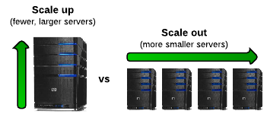
When it comes to Big Data…
It’s all about scalability!
Scale up (vertical scalability)
Scale out (horizontal scalability)

Slide 34
Summary
Introducing data mining concepts and tools
Analyzing real world educational data
Learning how to interpret the analysis results

