Slide 1
Course Overview: An Introduction to Information Retrieval and Applications
J. H. Wang
Sep. 9, 2026

Slide 2
Instructor & TA
Instructor
J. H. Wang (王正豪)
Professor, CSIE, NTUT
Office: R1534, Technology Building
E-mail: jhwang@ntut.edu.tw
Tel: ext. 4238
Office Hours: 9:10-12:00 am, every Tuesday and Thursday
TA
Miss Hsu & Miss Liao (@ R1424, Technology Building)

Slide 3
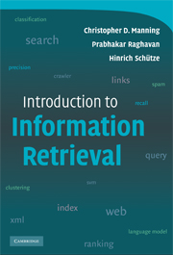
Course Description
Course Web Page: https://chriswjh.github.io/IR/
for the latest announcements and updates of schedule, slides, and homeworks
Time: 9:10am-12:00pm, Wed.
Classroom: R501, Pioneer Building (changed from R202, Third Teaching Building on Sep.8)
Classes will be in-person
Course sessions will be recorded using i-School+ and Teams whenever possible

Slide 4
For Online Recording of Course Sessions
Online course sessions will be setup as possible using Microsoft Teams, which will be recorded and put in i-School+
Teams will be created for the course numbers:
[NTUT-Sync]115-1_361351_資訊檢索與應用
[NTUT-Sync]115-1_364153_資訊檢索與應用-> the major link to our online course
And our online communication channels
Other communication channels:
E-mails, iSchool+, and our course Web site

Slide 5
Target Audience
CSIE seniors and graduate students
IEECS (International Program of Electrical Engineering and Computer Science)
Those who are interested in applying retrieval techniques

Slide 6
Course Materials
Textbook:
Christopher D. Manning, Prabhakar Raghavan and Hinrich Schuetze, Introduction to Information Retrieval, Cambridge University Press, 2008. (Available online)
International Student Edition, imported by Kai-Fa (開發) Publishing
Available online at: https://www.informationretrieval.org/
Prerequisites:
Basic knowledge of data structures and algorithms, linear algebra, and probability theory
Programming experience is *required* for homeworks & projects

Slide 7
Additional References
References:
Ricardo Baeza-Yates and Berthier Ribeiro-Neto, Modern Information Retrieval: The Concepts and Technology behind Search (2nd ed.), Addison-Wesley, 2011
The first edition of their book Modern Information Retrieval was published in 1999 (華通)
Bruce Croft, Donald Metzler, and Trevor Strohman, Search Engines: Information Retrieval in Practice, Addison-Wesley, 2010. (全華)
Now also available for free download
Stefan Buettcher, Charles L.A. Clarke, and Gordon V. Cormack, Information Retrieval: Implementing and Evaluating Search Engines, MIT Press, 2010.

Slide 8
Some Classic Books on IR
Gerard Salton, Automatic information organization and retrieval, McGraw-Hill, 1968.
Gerard Salton and M.J. McGill, Introduction to modern information retrieval, McGraw-Hill, 1983.
Two classics, but out-of-print.
C. J. van Rijsbergen, Information Retrieval, Butterworths, 1979.
The classic. More than 40 years old, but still worth reading.
K. Sparck Jones, P. Willett, Readings in Information Retrieval, Morgan Kaufmann, 1997.
A collection of classical IR papers. (out of print)
I.H. Witten, A. Moffat, T.C. Bell. Morgan Kaufmann, Managing Gigabytes, 2nd edition, 1999.
The authority on index construction and compression.

Slide 9
What Is Information Retrieval?
Formal definition: “Information retrieval is a field concerned with the structure, analysis, organization, storage, searching, and retrieval of information.” (Salton, 1968)
Information vs. data

Slide 10
Goal
Information retrieval (IR): a research field that targets at effectively and efficiently searching information in text and multimedia documents
Google mission statement: “to organize the world's information and make it universally accessible and useful.”
In this course, we will introduce the basic text and query models in IR, retrieval evaluation, indexing and searching, and applications for retrieval techniques

Slide 11
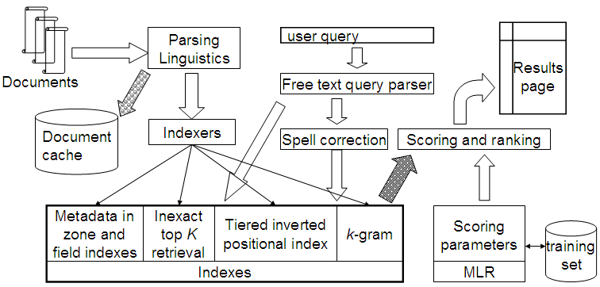
A Big Picture

Slide 12
Another View
User
Interface
user need
Text
Text Operations
logical view
Doc representation
Query
Expansion
Indexing
user feedback
query
inverted file
Inverted Index
Retrieval
Document Collection
retrieved docs
Ranking
ranked docs

Slide 13
Topics
Text IR
Indexing and searching
Query languages and operations
Retrieval evaluation
Modeling
Boolean model
Vector space model
Probabilistic model
Applications for IR
Multimedia IR
Web search

Slide 14
Organization of the Textbook
Basics in IR (focus)
Inverted indexes for boolean queries (Ch.1-5)
Term weighting and vector space model (Ch. 6-7)
Evaluation in IR (Ch. 8)
Advanced Topics
Relevance feedback (Ch. 9)
XML retrieval (Ch. 10) -- skipped
Probabilistic IR (Ch. 11)
Language models (Ch. 12)
Machine learning in IR
Text classification (Ch. 13-15)
Document clustering (Ch. 16-18)
Web Search
Web crawling and indexes (Ch. 19-20)
Link analysis (Ch. 21)

Slide 15
Tentative Schedule
Before midterm
Boolean retrieval (1 wk)
Indexing (2 wks)
Vector space model and evaluation (2 wks)
Relevance feedback (1 wk)
Probabilistic IR and language models (2 wks)
After midterm
Text classification and document clustering (1-2 wks)
Web search (2 wks)
Advanced topics: link analysis, RAG, … (1 wk)
Term Project Presentation (3-4 wks)

Slide 16
Tentative Schedule (1/3)
Week | Date | Content | Note
1 | 9/9 | Course Overview Ch.1, Boolean retrieval
2 | 9/16 | (Leave for Czech project)
3 | 9/23 | (Leave for Czech project)
4 | 9/30 | Chap. 2, The term vocabulary and postings lists Chap. 3, Dictionaries and tolerant retrieval
5 | 10/7 | Chap. 4, Index construction | HW#1
6 | 10/14 | Chap. 5, Index compression (selected) Chap. 6, Scoring, term weighting, and the vector space model
7 | 10/21 | Chap. 7, Computing scores in a complete search system | Due: HW#1 HW#2

Slide 17
Tentative Schedule (2/3)
Week | Date | Content | Note
8 | 10/28 | Chap. 8, Evaluation in information retrieval Chap. 9, Relevance feedback and query expansion
9 | 11/4 | Chap.11, Probabilistic Information Retrieval Chap.12, Language Model | Due: HW#2
10 | 11/11 | (Midterm exam): to be confirmed
11 | 11/18 | Chap.18, Matrix decomposition & latent semantic indexing Introduction to Word Embeddings | Due: Proposal
12 | 11/25 | Introduction to LLM Introduction to RAG | HW#3
13 | 12/2 | Chap. 19, Web search basics

Slide 18
Tentative Schedule (3/3)
Week | Date | Content | Note
14 | 12/9 | Chap. 20, Web crawling and indexes Chap. 21, Link analysis Advanced topics: social network analysis | Due: HW#3
15 | 12/16 | Term Project Presentation: Week 1
16 | 12/23 | Term Project Presentation: Week 2
17 | 12/30 | Term Project Presentation: Week 3 (online)
18 | 1/6 | Term Project Presentation: Week 4 (online) | 1/8 Due: Final Report

Slide 19
Grading Policy
Homework assignments and programming exercises: ~40%
Mid-term exam: ~25%
Term project: ~35%
Including proposal, presentation, and final report
All homeworks, reports, and projects must be submitted before the deadlines
Late submission has to be done *before* the end of this semester (Jan. 8, 2027), if not specified otherwise

Slide 20
Programming Exercises and Term Project
About 3 team-based programming exercises
Maximum number of students per team:
4 for undergraduates
2 for graduate students
You can either write your own program or call existing open source APIs or libraries (to be detailed later)
Two options for the term project (to be detailed later)
Either team-based system development
The same as programming exercises
Or academic paper presentation
Only one person per team allowed

Slide 21
About the Term Project
The score you’ll get depends on the functions, difficulty and quality of your project
For system development
System functions and correctness
You can either write your own program, or call existing open APIs/libraries (but NOT executing existing binary code only)
For academic paper presentation
Quality and your presentation of the paper
Major methods/experimental results *must* be presented
Papers from top conferences are strongly suggested
E.g. SIGIR, CIKM, WSDM, ACL, KDD, WWW, …
Proposals, presentations, and reports are *required* for each team, and will be counted in the score

Slide 22
Academic Resources
Google Scholar, ACM Digital Library, IEEE Xplore, DBLP, …
Journals
ACM TOIS: Transactions on Information Systems
JASIST: Journal of the American Society of Information Sciences
IP&M: Information Processing and Management
IEEE TKDE: Transactions on Knowledge and Data Engineering
Conferences
ACM SIGIR: International Conference on Information Retrieval
WWW: World Wide Web Conference
ACM CIKM: Conference on Information Knowledge and Management
ACL: Annual meeting of the Association for Computational Linguistics
KDD: ACM SIGKDD conference on Knowledge Discovery and Data Mining

Slide 23
Online Submission
Submission instructions
Systems, programs, project proposals, and project reports in electronic files must be submitted to the website.
Submissions website : iSchool+
You will get deducted score when there’s delay in homework submission
The longer the delay, the higher the deduction

Slide 24
Notes on Homeworks and Programming Projects
Rule 1: Plagiarism is prohibited.
Near-duplicate codes will get equal and minimum basic scores
Rule 2: Clear documentation is required in each programming project
Instructions on downloading, installing, configuring, compiling, and executing your code and open source library, APIs, and codes must be submitted
Package control is recommended

Slide 25
More on Term Projects
Options for term projects
Option 1: team-based system project
e. g., extension to programming exercises
Option 2: academic paper presentation
Only one person, NOT team-based
Tentative schedule for all teams:
Proposal: *required* one week after midterm (Nov. 18, 2026)
Presentations (including demos): *required* in the last four weeks (starting from Dec. 16, 2026)
~20 minutes per team
Final report: *required* before the end of the semester (Jan. 8, 2027)
Slides, source code, documentation

Slide 26
For System Development
You can write your own code in any programming language
Calling open source codes, APIs or library functions is OK, but simply running existing binary executables is NOT acceptable
You have to explain the major part of your code
Any topic relevant to information retrieval
Retrieval, analysis, or application of the semantic meanings from various resources from the documents, Web, social media
Recommender systems, QA systems, …

Slide 27
Some Examples of Open Source Tools
Apache Lucene/Solr or ElasticSearch (in Java)
for indexing/search engine
The Lemur Project, Indri, Galago – by CMU/Umass, (in C++)
For search engine, text analysis
Terrier – by U. Glasgow (in Java)
For search engine
Apache Hadoop, Spark (in Java, Scala, Python, R)
For distributed computing and data analysis
…
You are encouraged to explore more!

Slide 28
Notes on Signing up the Course
The vacancy depends on the classroom capacity
In case there’re not enough seats, the priority of signing up the course:
CSIE (資工) students first
Senior (大四) students
Minor/double major (輔系/雙主修) in CS
External students
USTP (University System of Taipei, 北聯大)
Auditor (隨班附讀)
Others

Slide 29
What this Course is NOT about
This course will NOT teach you
How to use search engines effectively, although power users might have better ideas on how to improve them
There’re plenty of books and websites on that…
How to find books in libraries, although it’s related to the basic IR concepts
How to make money on the Web, although successfully advertisement needs search engine optimization (SEO) techniques

Slide 30
Do I still need to learn IR?
Yes, because retrieval techniques are still useful in many applications
Web search engines
Retrieval-augmented Generation (RAG) for LLMs
Information retrieval started as finding books in libraries
It’s important to search for relevant information from all kinds of sources in an efficient way

Slide 31
So, What Exactly are Covered in Information Retrieval?
Information Retrieval is to do what you have been doing everyday
Searching for something interesting: Web pages, news, tweets, e-mails, images, videos, …
Asking for advices: shopping, restaurants, movies, …
…

Slide 32
Example: Figuring out changing user interests…
2011: New Zealand Earthquake
2012: Jeremy Lin
2013: Meteor Russia
2014: Ukraine riots
2015: TransAsia Airways Flight 235
2016: Tainan Earthquake
2017: Kim Jong-Nam
2019: Donald Trump
2020: COVID-19
2022: Queen Elizabeth II
2026: ?

Slide 33
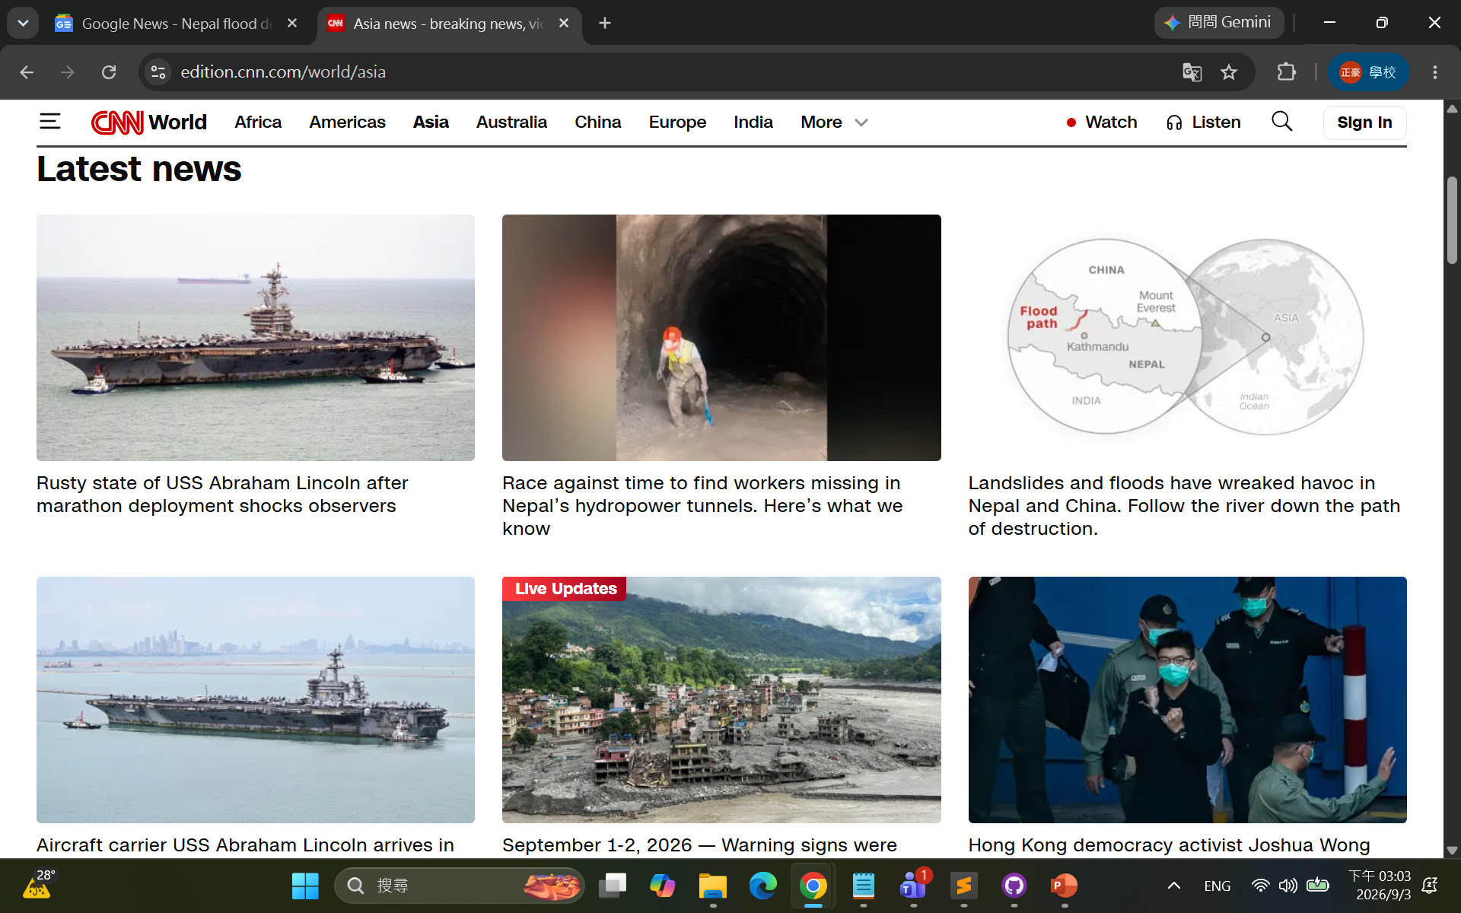
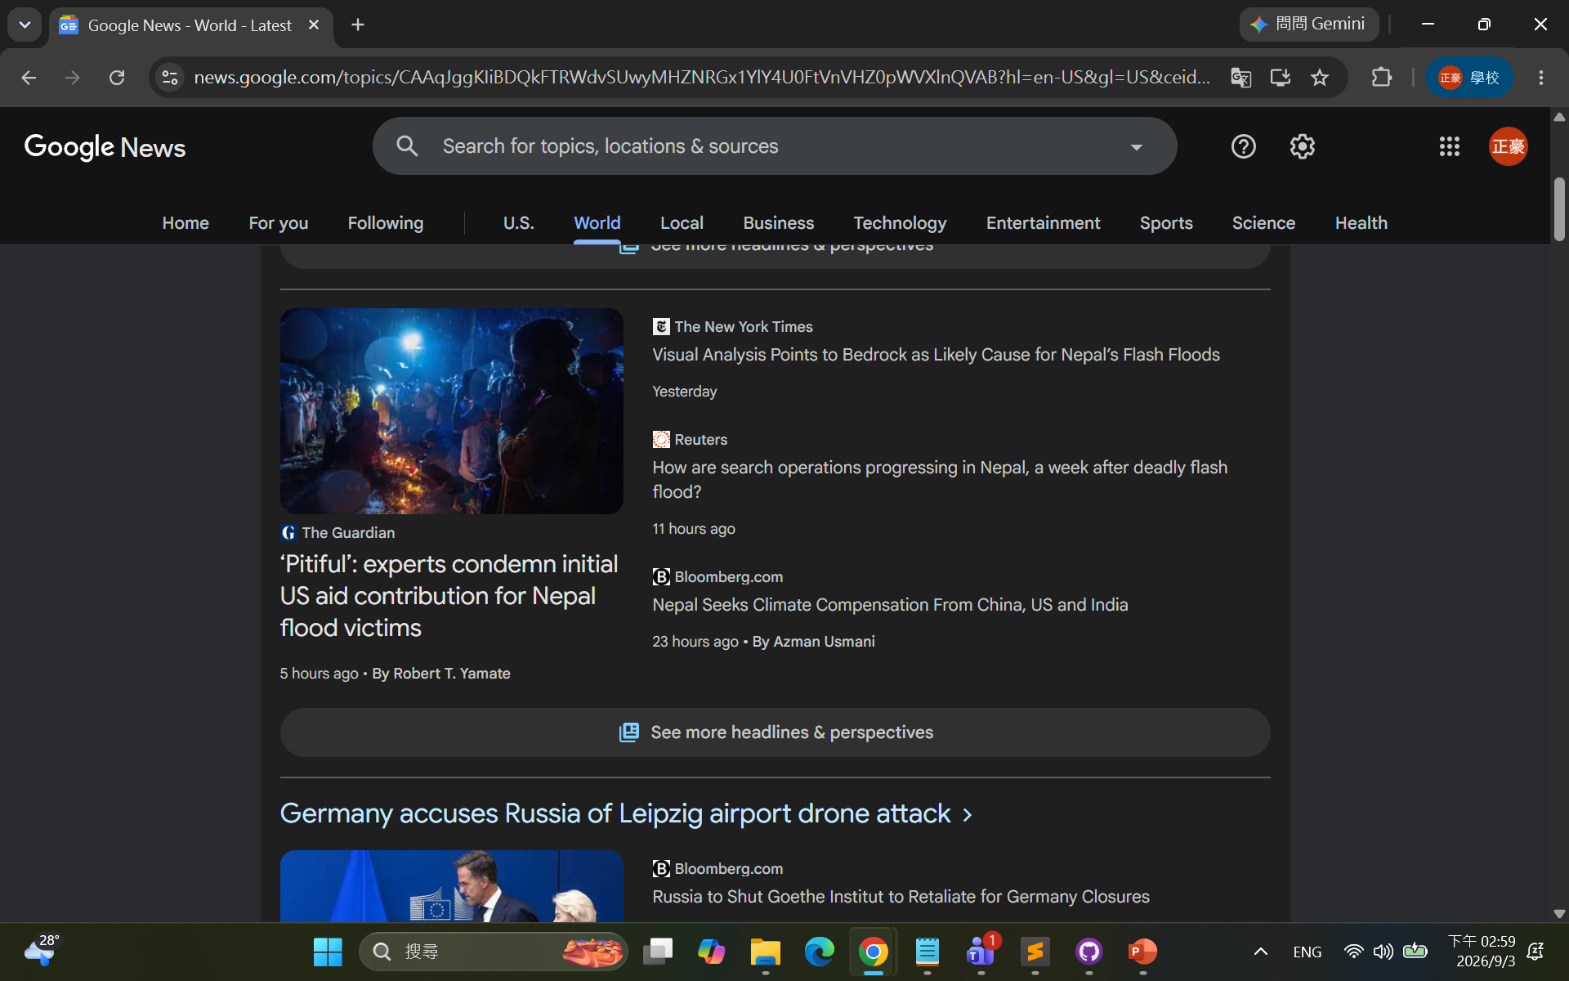
What’s Going on?

Slide 34
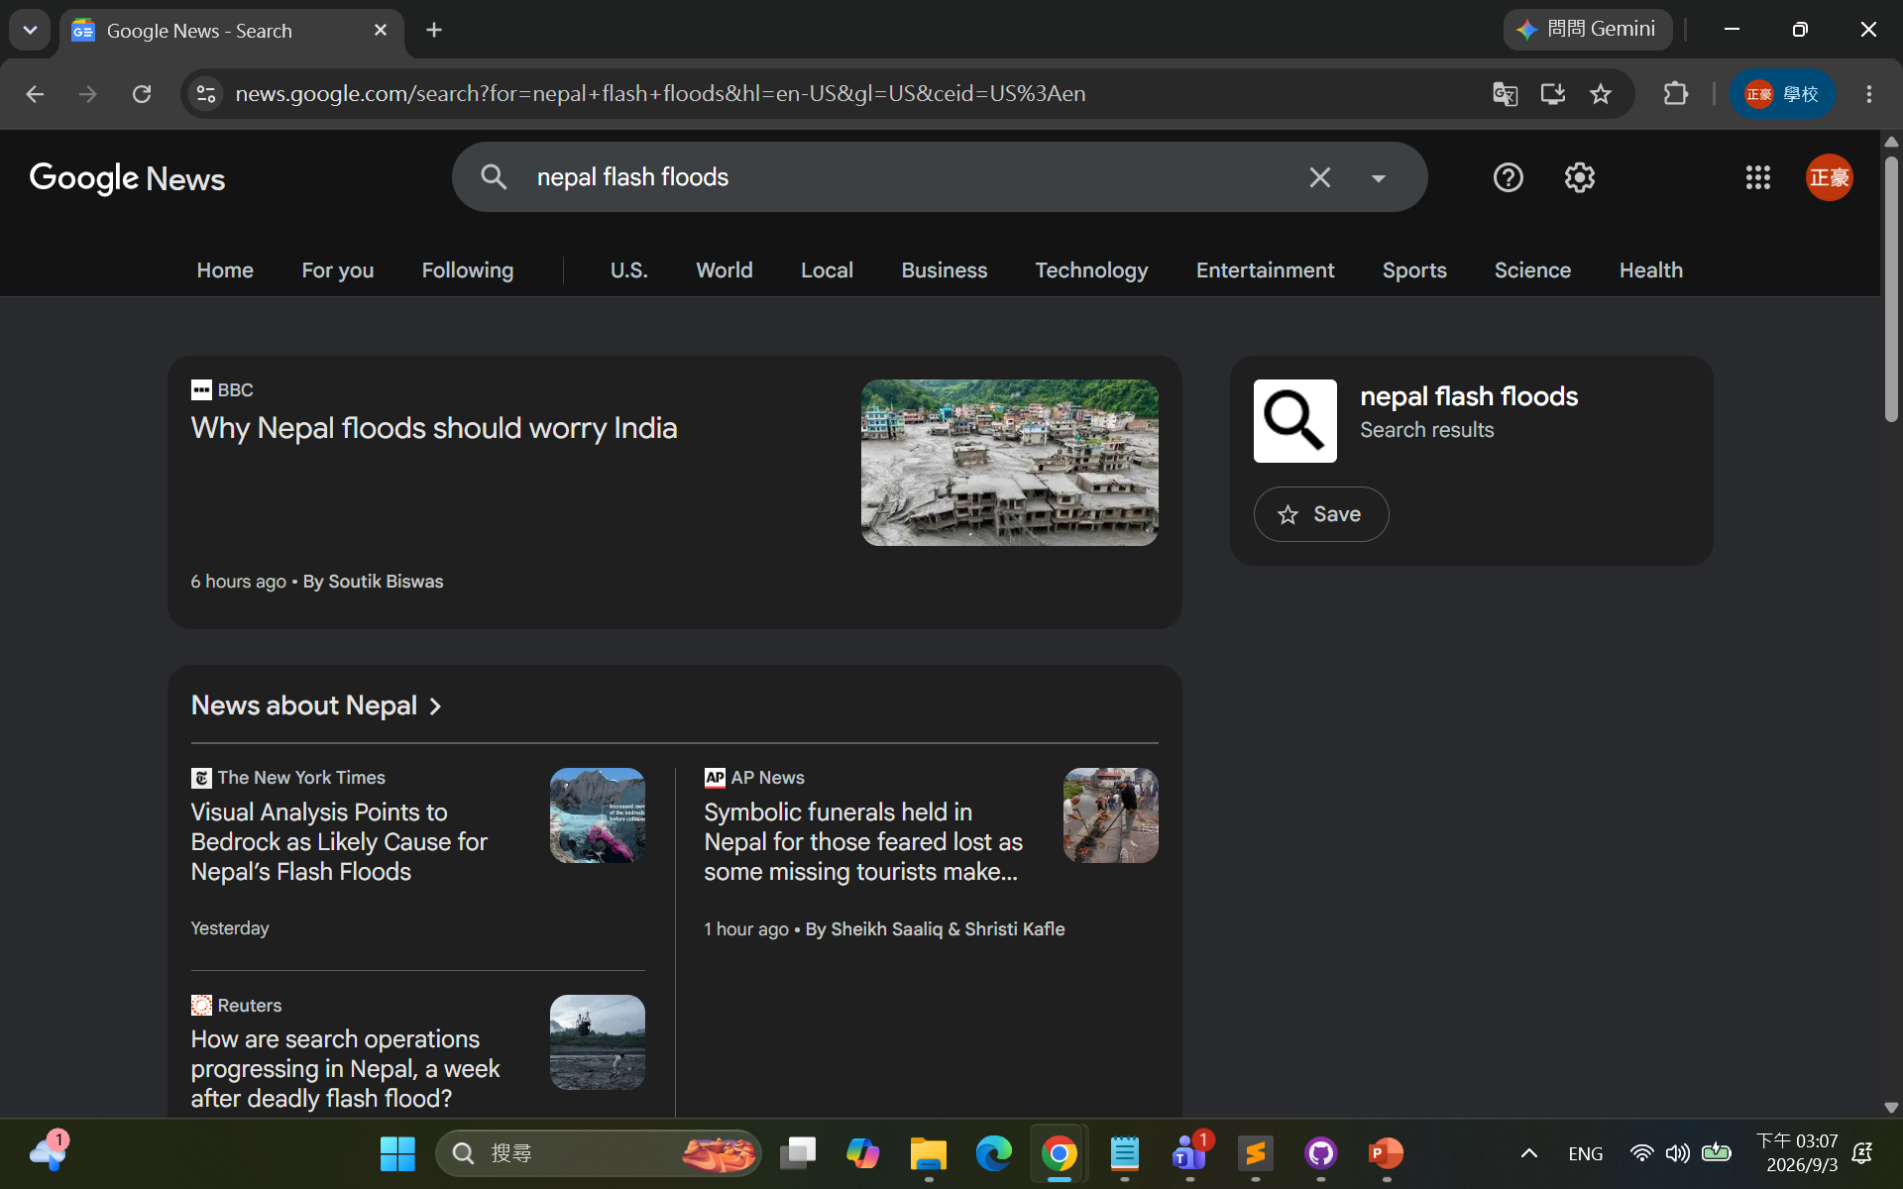
News

Slide 35
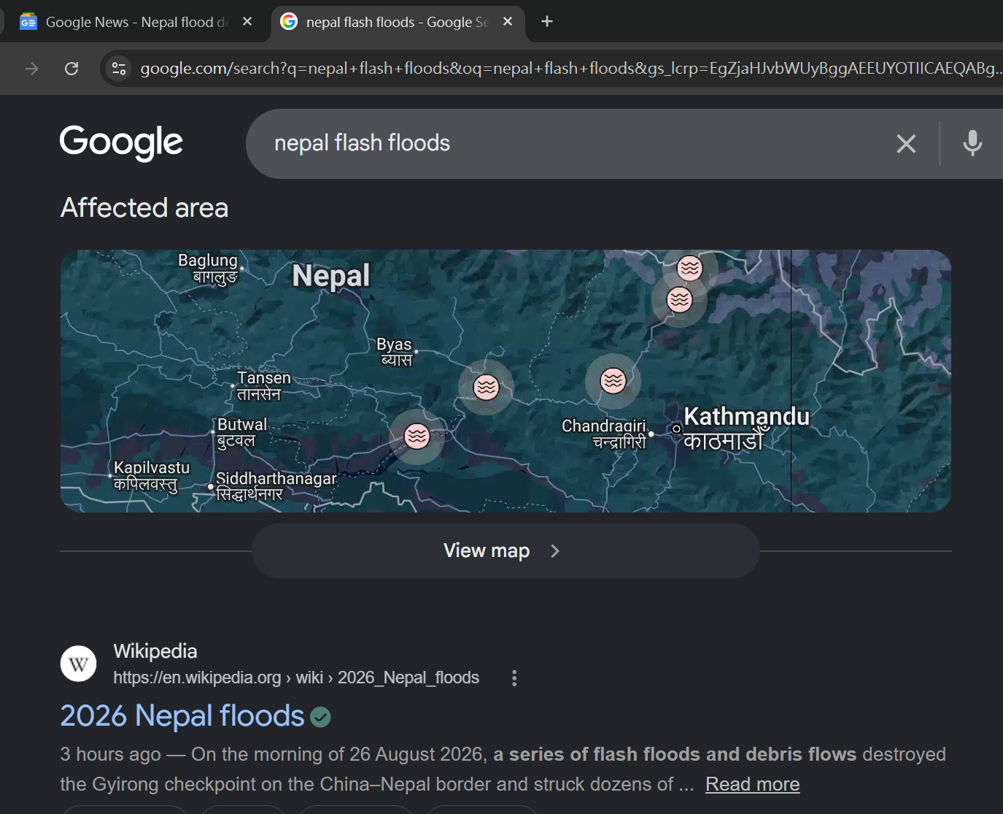
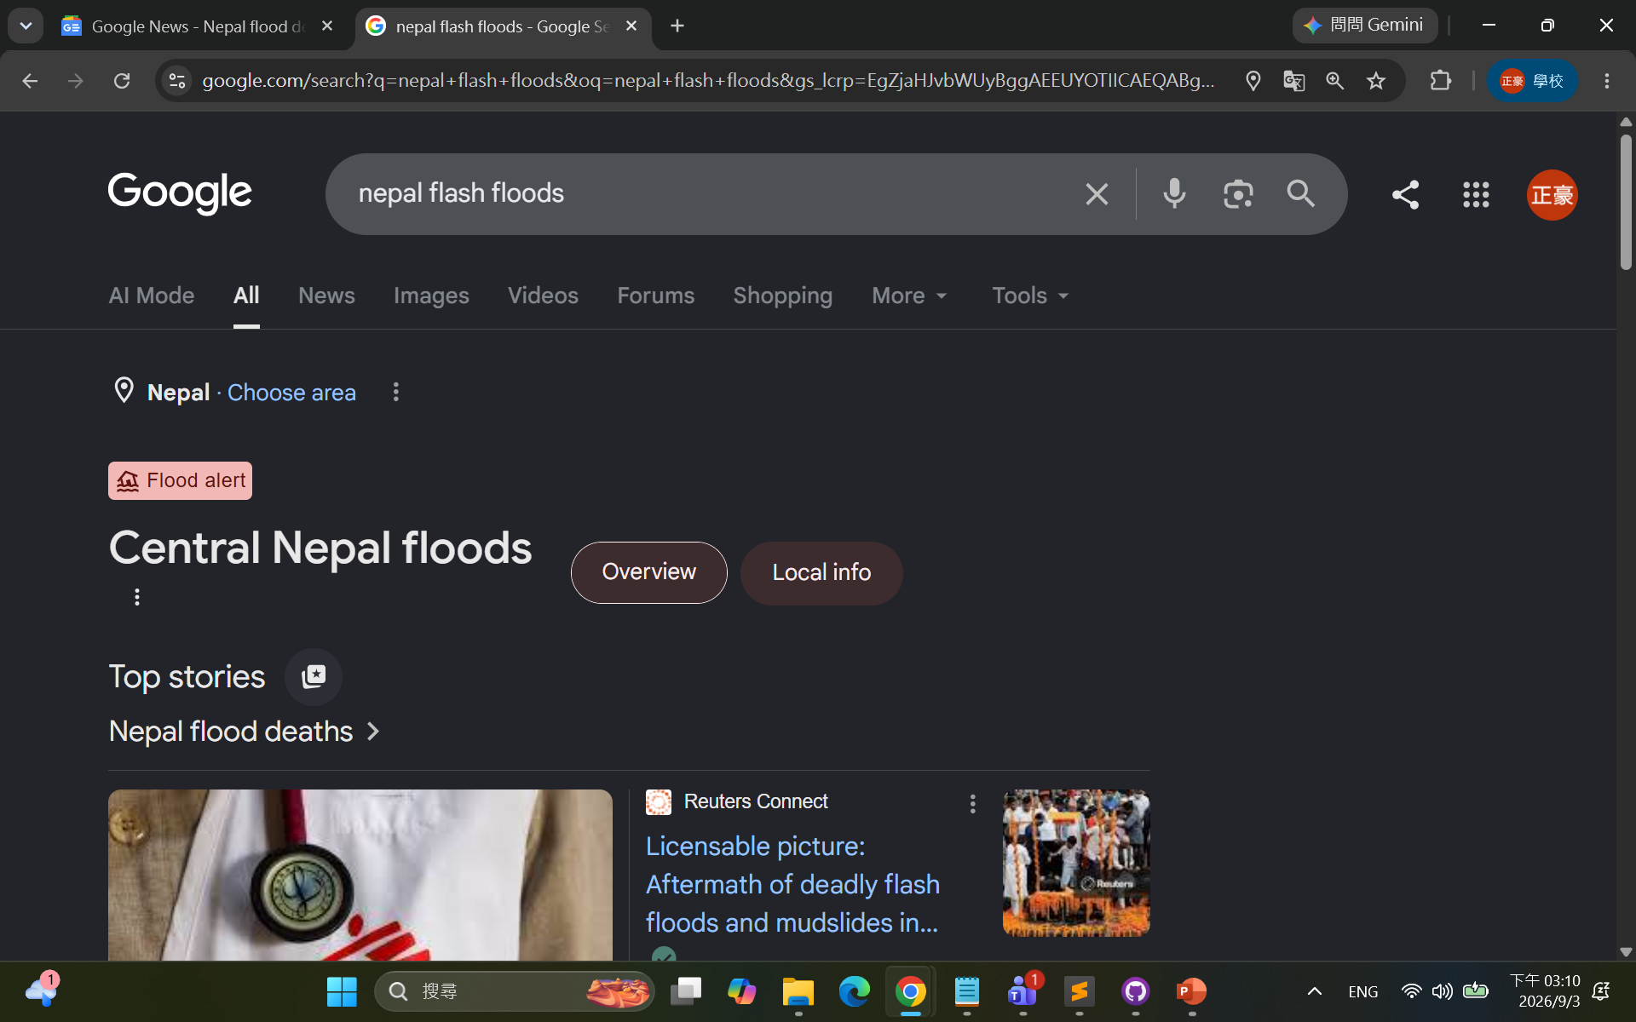
Web Search

Slide 36
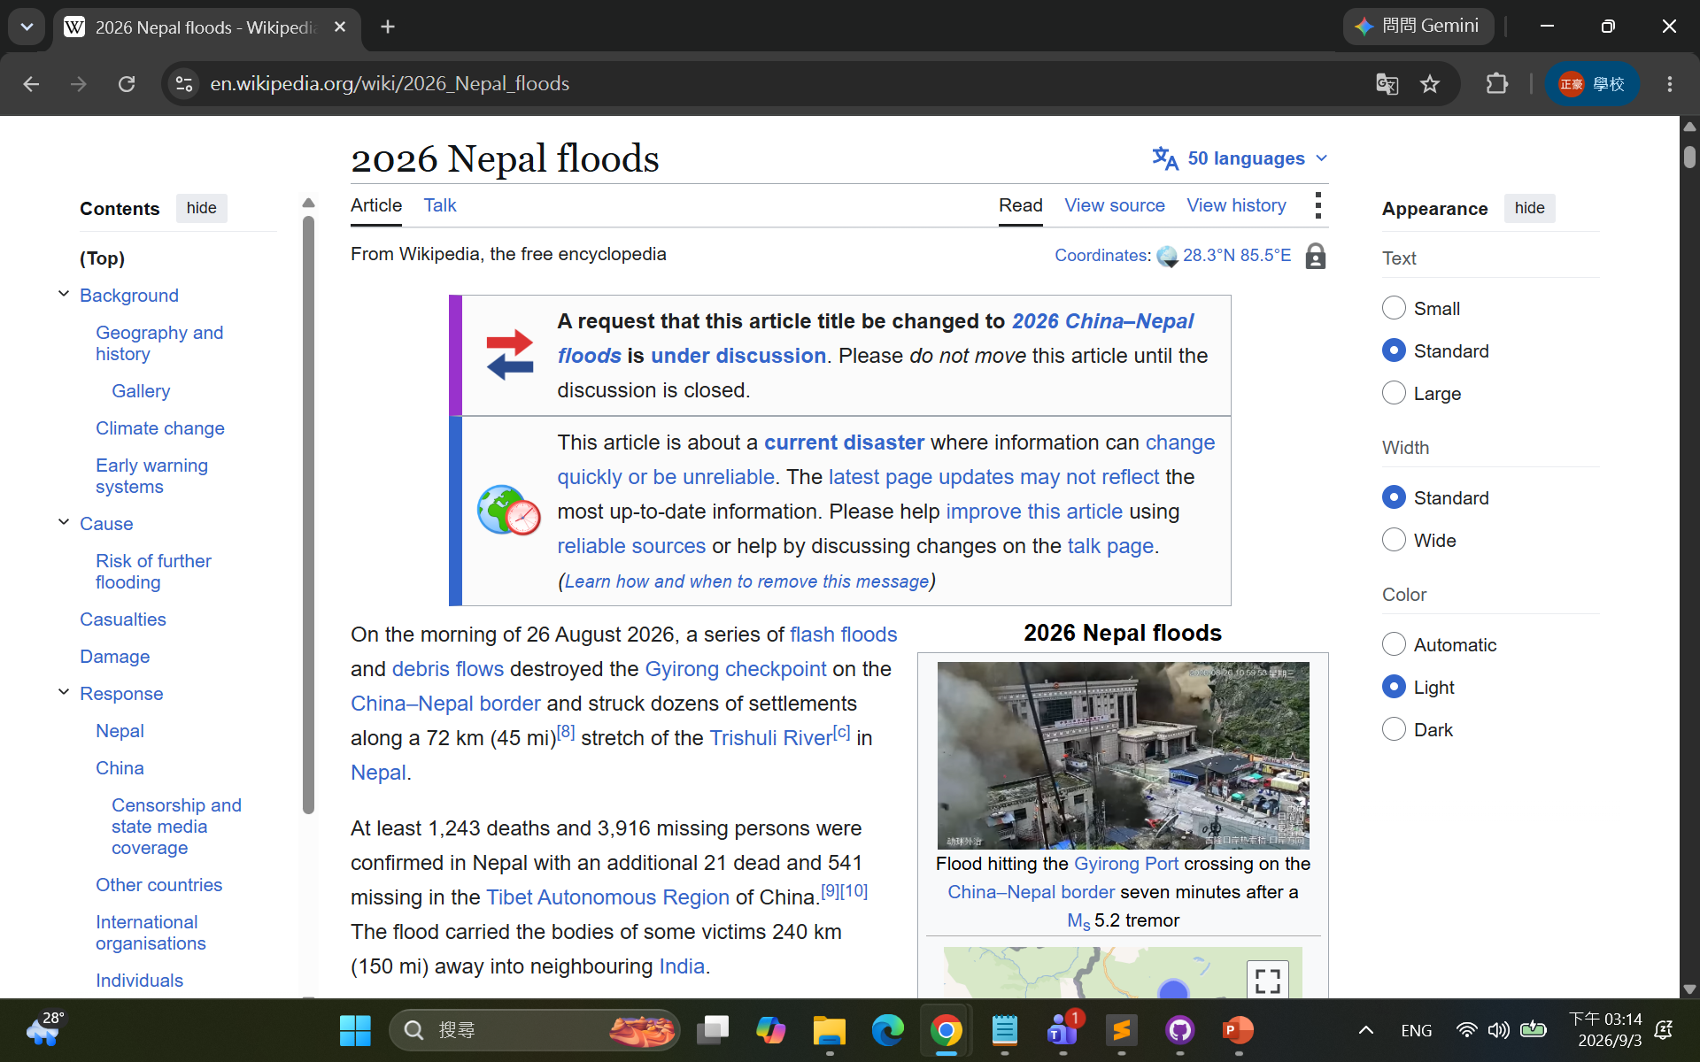
Wikipedia

Slide 37
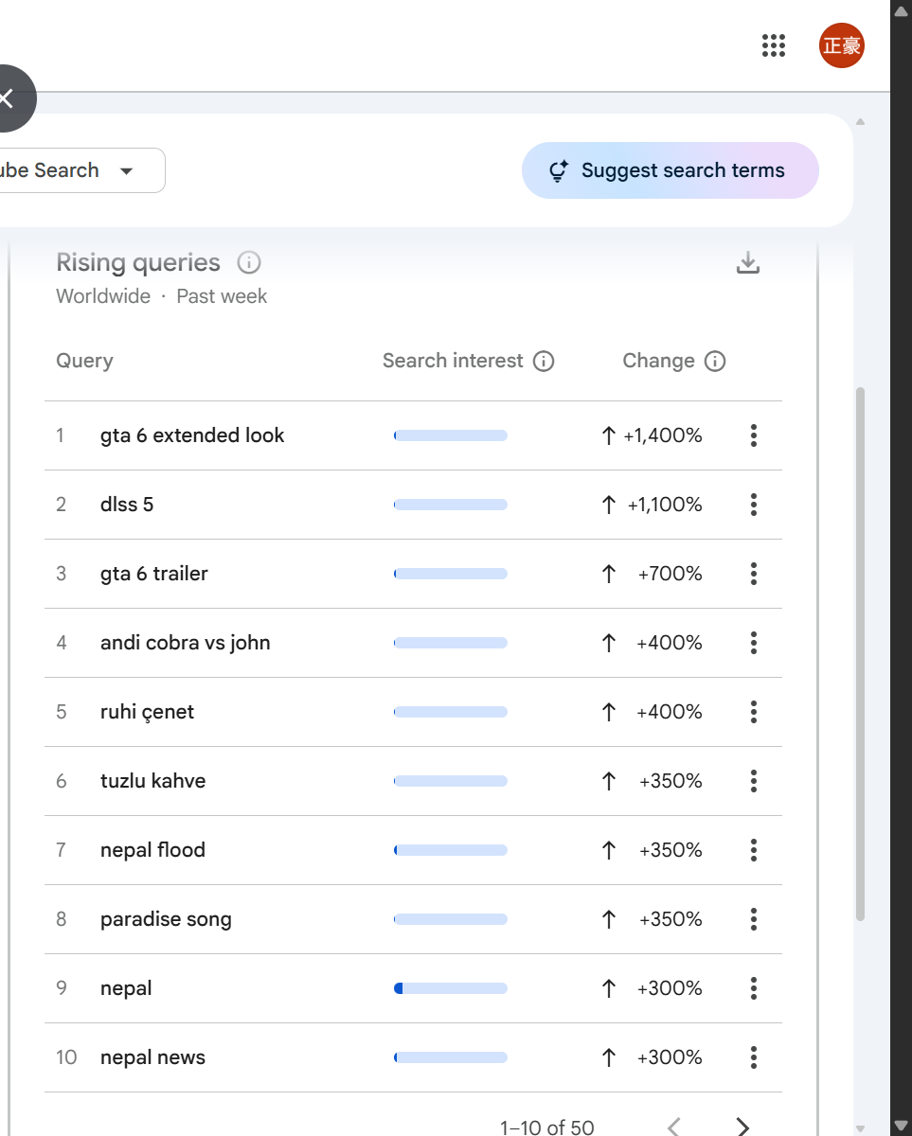
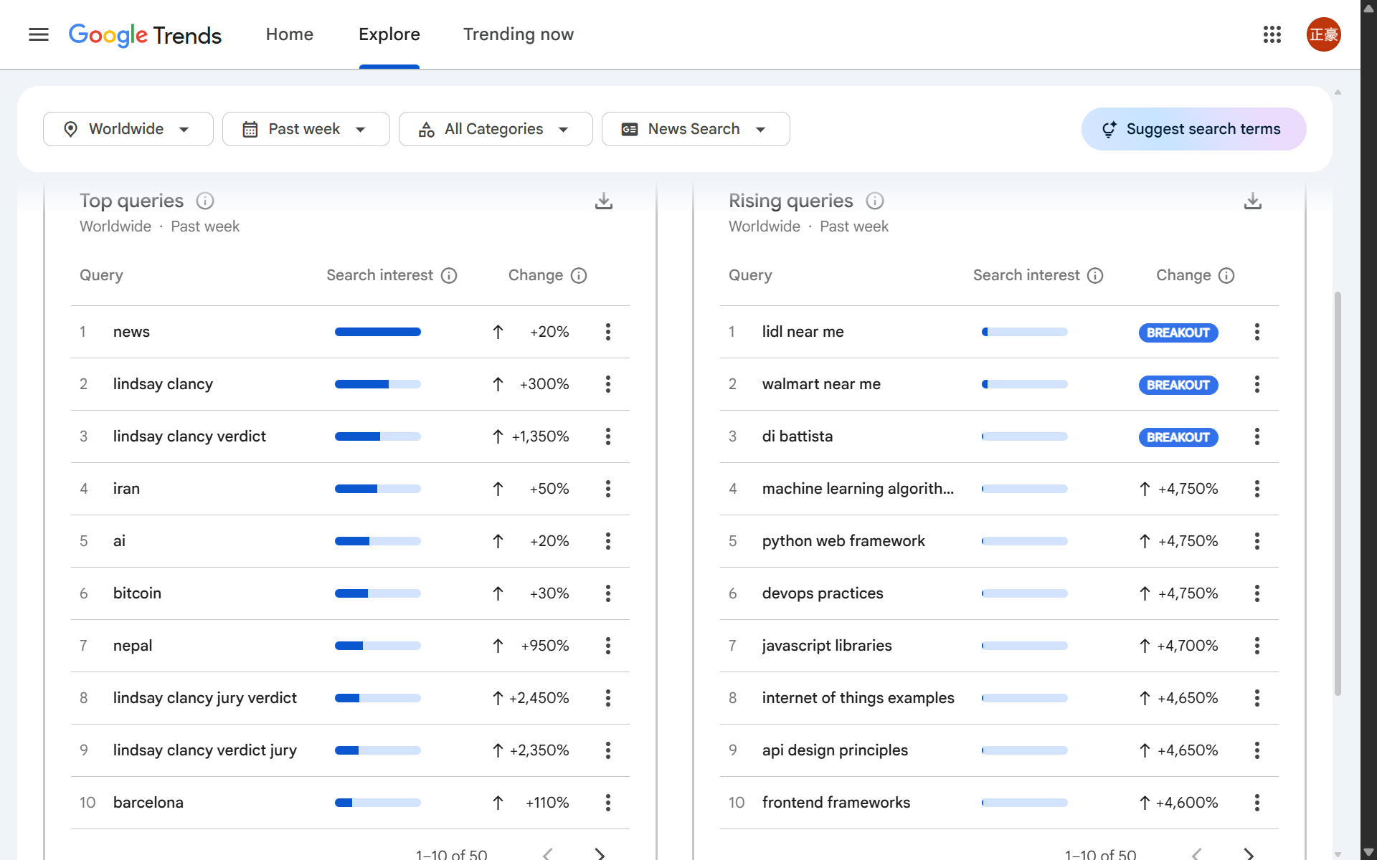
Google HotTrends – Daily Trending Searches

Slide 38
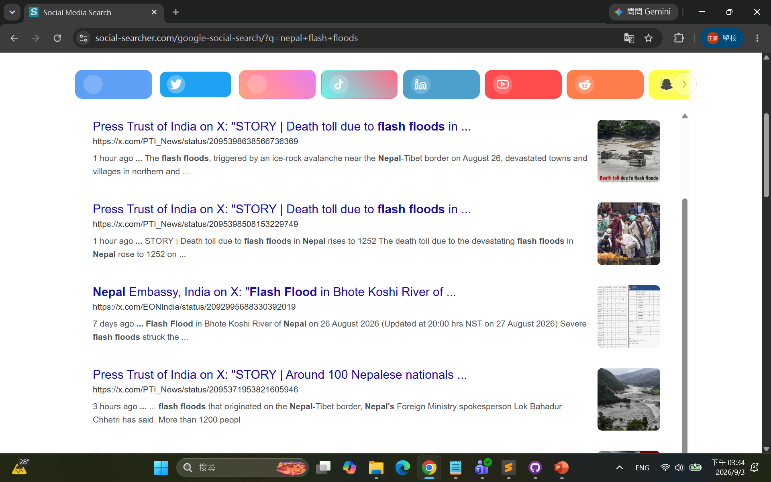
Social Search

Slide 39
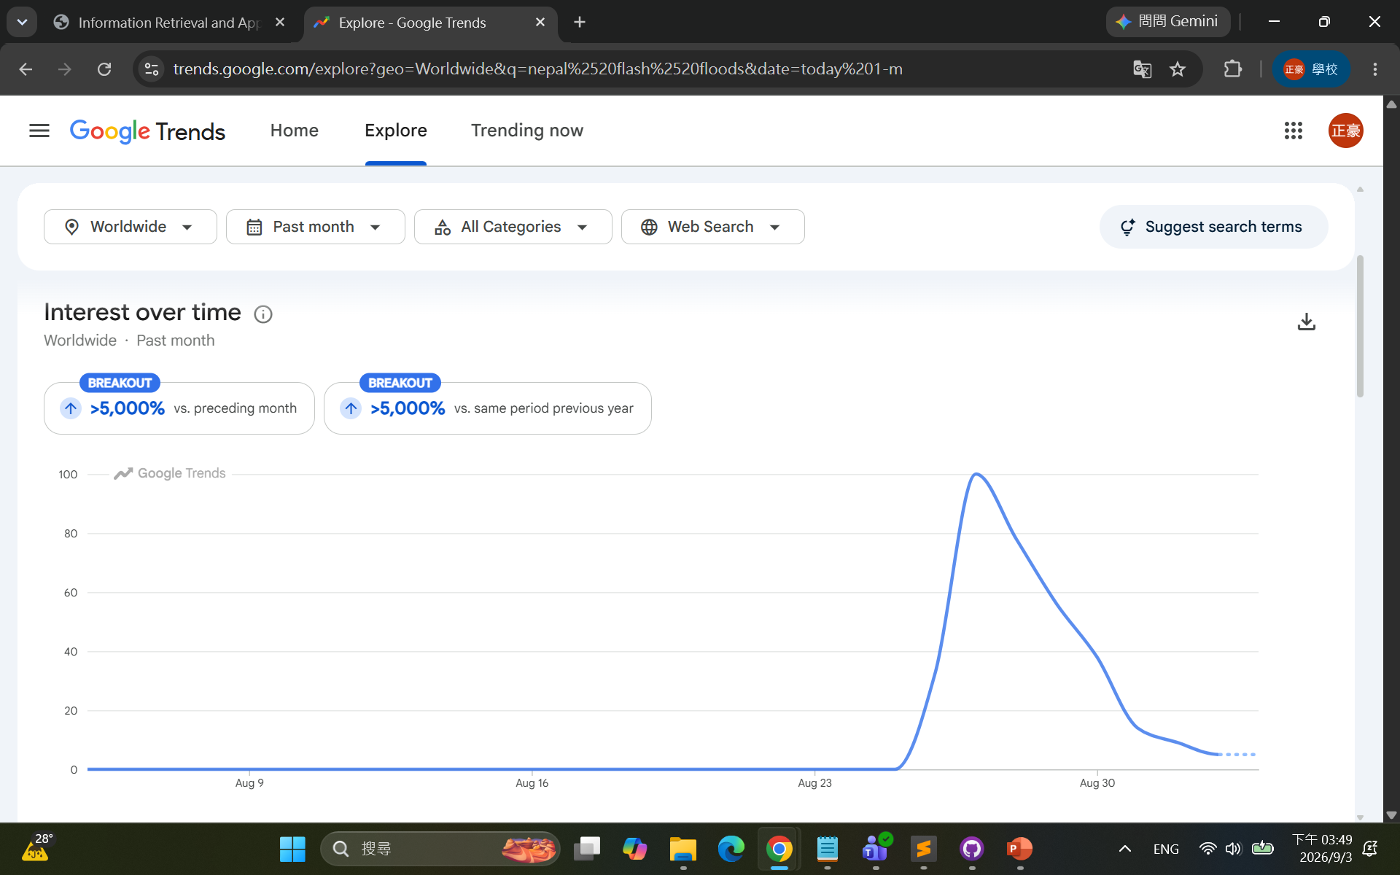
Google Trends

Slide 40
Related Keyword Extraction
Nepal, China-Nepal border, Gyirong checkpoint, …
Flash Floods, debris flows, Trishuli River, Himalaya, …
Glacier collapse, landslide, …
Casualties, damage, rescue,
尼泊爾, 中尼邊境, 吉隆口岸, …
土石流, 洪災, 特里蘇里河,喜馬拉雅山脈, …
冰川崩塌, 滑坡, …
人員傷亡, 災害影響, 救援行動, …

Slide 41
Some IR-Related Tasks from this Example
Search: Web, news, image, video, social
Keyword (keyterm, keyphrase) extraction
Named entity recognition
People, events, time, location, objects
Topic detection and tracking
Trend analysis
…

Slide 42
Recent Topics in Information Retrieval
Machine learning for IR
New deep learning, or generative IR models
Large Language Models for IR
IR for LLMs
Retrieval augmented generation
Agentic IR

Slide 43
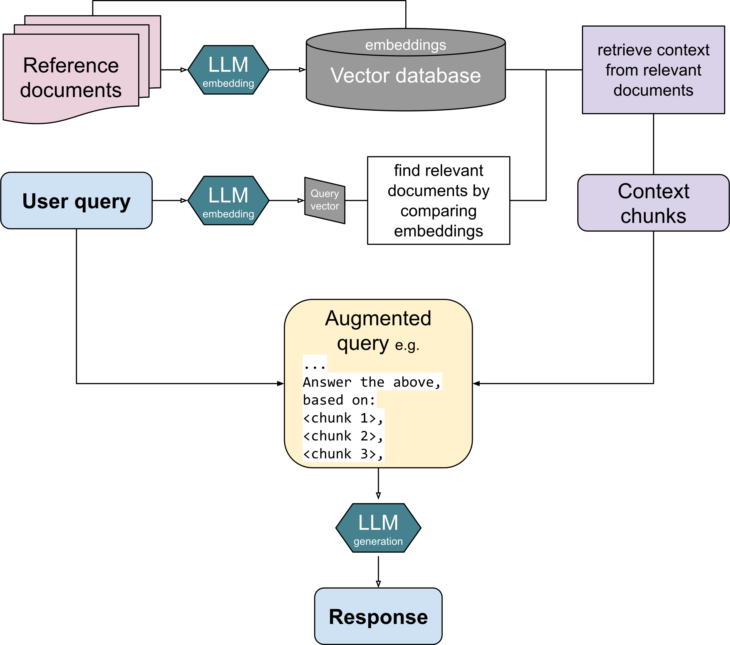
What is Retrieval Augmented Generation?
[source: Wikipedia]

Slide 44
Some Overlap with Other Fields
Text mining, Data mining, Information Extraction
Natural Language Processing
Machine Learning
Social Network Analysis
…

Slide 45
Pointers to Other Topics
Natural language processing techniques
Cross-lingual, multi-lingual IR
Multimedia IR
Image, video, and audio (speech, music)
User interfaces
HCIR, Interactive retrieval
Mobile IR
Parallel, distributed, and P2P IR
Digital libraries
Information science perspective
Social computing
…

Slide 46
Generic Resources
Wikipedia page on Information Retrieval:
https://en.wikipedia.org/wiki/Information_retrieval
Information Retrieval Resources:
https://nlp.stanford.edu/IR-book/information-retrieval.html

Slide 47
Summary
Learning representations of words in text documents for search
Conventional
Bag-of-words model
TF-IDF weighting
Cosine similarity
Recent progress
Embeddings
Information retrieval tools and applications
Multimedia indexing, searching
Social Web mining
Text classification, clustering
RAG in LLMs
…

Slide 48
Thanks for Your Attention!
Any question or comment? Please feel free to send e-mails to me, or setup a time for discussion

