Slide 1
Modified from Stanford CS276 slides
Chap. 1: Boolean retrieval

Slide 2
Information Retrieval
Information Retrieval (IR) is finding material (usually documents) of an unstructured nature (usually text) that satisfies an information need from within large collections (usually stored on computers)
Usually, we think of Web search first, but many other cases
E-mail search
Searching your laptop
Corporate knowledge bases
Legal information retrieval

Slide 3
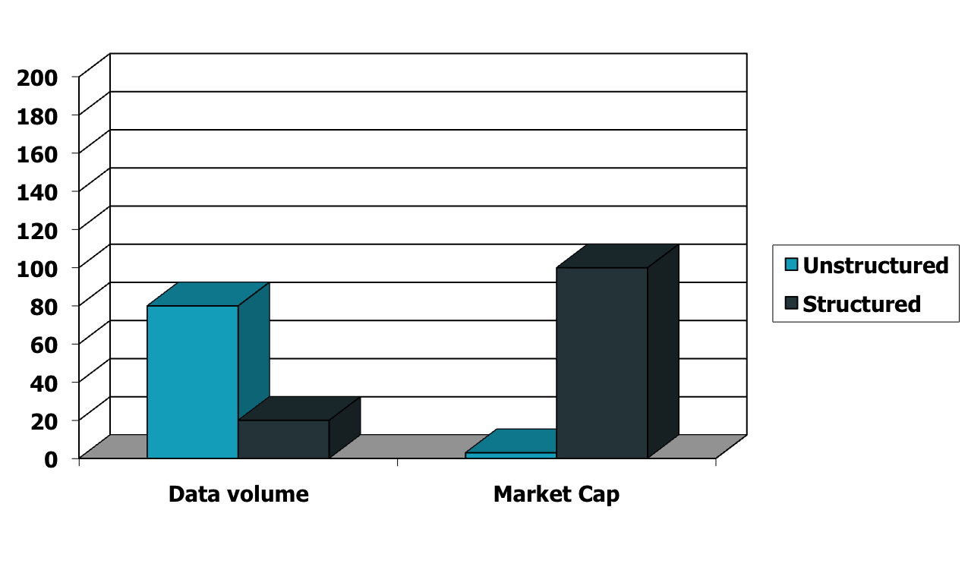
Unstructured (text) vs. structured (database) data in the mid-nineties

Slide 4
Unstructured (text) vs. structured (database) data today

Slide 5
Unstructured data in 1620
Sec. 1.1
Which plays of Shakespeare contain the words Brutus AND Caesar but NOT Calpurnia?
One could grep all of Shakespeare’s plays for Brutus and Caesar, then strip out lines containing Calpurnia?
Why is that not the answer?
Slow (for large corpora)
NOT Calpurnia is non-trivial
Other operations (e.g., find the word Romans near countrymen) not feasible
Ranked retrieval (best documents to return)
Later lectures
Notes:
Grep is line-oriented; IR is document oriented.

Slide 6
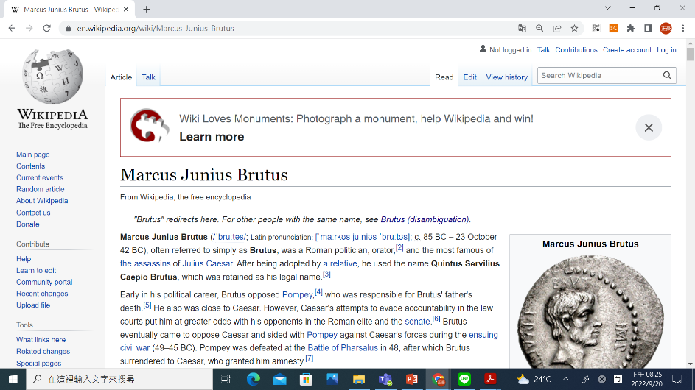
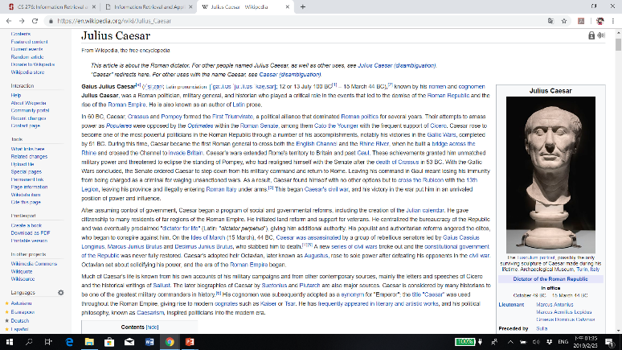
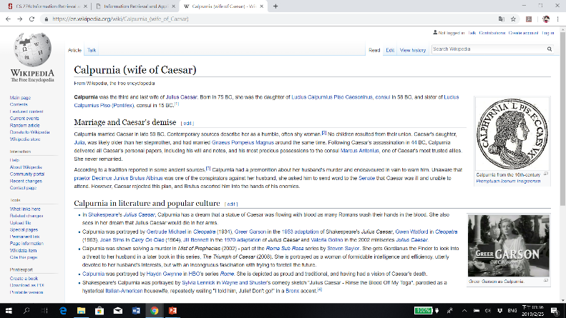
Who is Brutus, Caesar, and Calpurnia?
Julius Caesar: Roman dictator
Calpurnia: wife of Caesar
Marcus Junius Brutus: the most famous of the assassins of Caesar
Assassination of Caesar: on the Ides of March (March 15) of 44 BC by a group of senators

Slide 7
Term-document incidence matrix
Sec. 1.1
Plays (documents)
Words (terms)
1 if play contains word, 0 otherwise
Brutus AND Caesar BUT NOT Calpurnia

Slide 8
Incidence vectors
Sec. 1.1
So we have a 0/1 vector for each term
To answer query: take the vectors for Brutus, Caesar and Calpurnia (complemented) ➔ bitwise AND
110100 AND 110111 AND 101111 = 100100
The so-called “one-hot” encoding

Slide 9
One-hot encoding
Nominal, categorical (or discrete) values, ex.:
[“red”, “green”, “blue”]
But, most machine learning algorithms require numeric values
Numeric (or integer) representation: (still discrete)
[1, 2, 3]
But for categorical values with no ordinal relationship, integer encoding is not enough
Poor performance or unexpected results in some cases!
One-hot encoding
One binary variable for each unique value
[100, 010, 001]

Slide 10
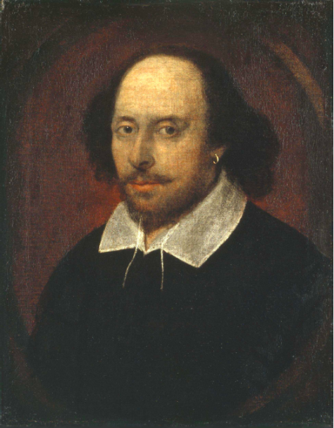
Answers to query
Sec. 1.1
Antony and Cleopatra, Act III, Scene ii
Agrippa [Aside to DOMITIUS ENOBARBUS]: Why, Enobarbus,
When Antony found Julius Caesar dead,
He cried almost to roaring; and he wept
When at Philippi he found Brutus slain.
Hamlet, Act III, Scene ii
Lord Polonius: I did enact Julius Caesar I was killed i' the
Capitol; Brutus killed me.

Slide 11
Basic assumptions of Information Retrieval
Sec. 1.1
Collection: Fixed set of documents
Goal: Retrieve documents with information that is relevant to the user’s information need and helps the user complete a task

Slide 12

The classic search model
Task
Get rid of mice in a politically correct way
Misconception?
Info Need
Info about removing mice
without killing them
Mistranslation?
Verbal form
How do I trap mice alive?
Misformulation?
Query
mouse trap
Search Engine
Query Refinement
Results
Corpus

Slide 13
How good are the retrieved docs?
Sec. 1.1
Precision : Fraction of retrieved docs that are relevant to user’s information need
Recall : Fraction of relevant docs in collection that are retrieved
More precise definitions and measurements to follow in later lectures

Slide 14
Bigger collections
Sec. 1.1
Consider N = 1 million documents, each with about 1000 words
Avg 6 bytes/word including spaces/punctuation
6GB of data in the documents
Say there are M = 500K distinct terms among these (1 billion words in total)

Slide 15
Can’t build the term-document matrix
Sec. 1.1
500K x 1M matrix has half-a-trillion 0’s and 1’s
But it has no more than one billion 1’s
matrix is extremely sparse
What’s a better representation?
We only record the 1 positions
Why?

Slide 16
Inverted index
Sec. 1.2
For each term t, we must store a list of all documents that contain t
Identify each by a docID, a document serial number
Can we used fixed-size arrays for this?
Brutus
1
2
4
11
31
45
173
174
Caesar
1
2
4
5
6
16
57
132
Calpurnia
2
31
54
101
What happens if the word Caesar is added to document 14?

Slide 17
Inverted index
Sec. 1.2
We need variable-size postings lists
On disk, a continuous run of postings is normal and best
In memory, can use linked lists or variable-length arrays
Some tradeoffs in size/ease of insertion
Posting
Brutus
1
2
4
11
31
45
173
174
Caesar
1
2
4
5
6
16
57
132
Calpurnia
2
31
54
101
Dictionary
Postings
Sorted by docID (more later on why)
Notes:
Linked lists generally preferred to arrays
Dynamic space allocation
Insertion of terms into documents easy
Space overhead of pointers

Slide 18





Inverted index construction
Sec. 1.2
Documents to
be indexed
Friends, Romans, countrymen.
Tokenizer
Token stream
Friends
Romans
Countrymen
More on
these later
Linguistic modules
Modified tokens
friend
roman
countryman
Indexer
friend
2
4
roman
1
2
Inverted index
countryman
13
16

Slide 19
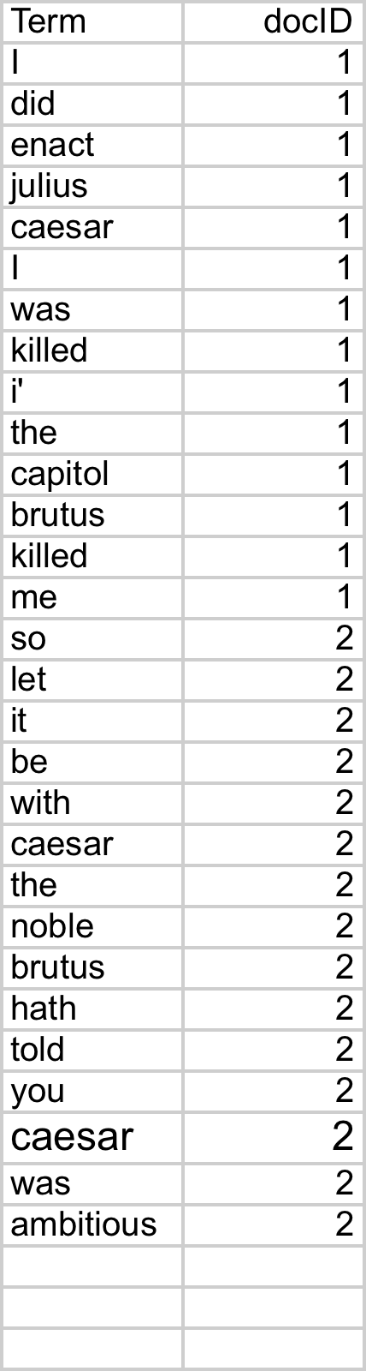
Indexer steps: Token sequence
Sec. 1.2
Sequence of (Modified token, Document ID) pairs
Doc 1
Doc 2
I did enact Julius
Caesar I was killed
i' the Capitol;
Brutus killed me.
So let it be with
Caesar. The noble
Brutus hath told you
Caesar was ambitious

Slide 20
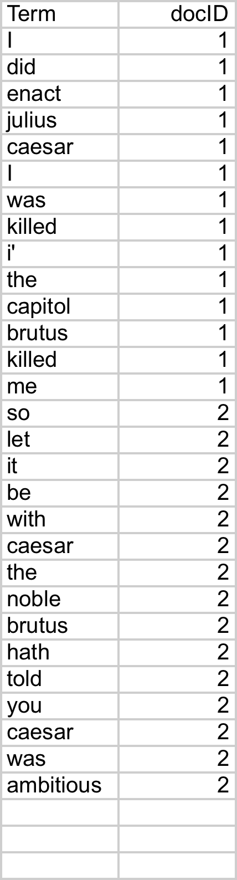
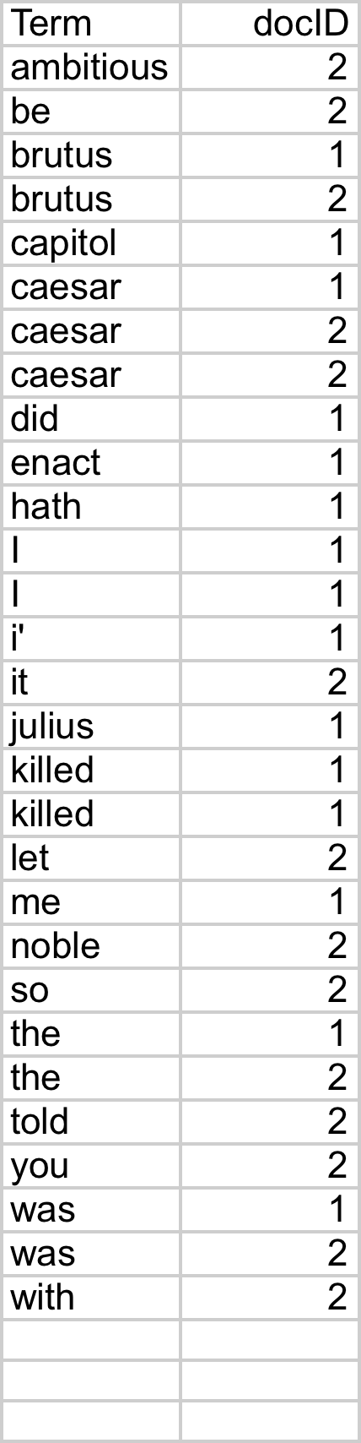
Indexer steps: Sort
Sec. 1.2
Sort by terms
And then docID
Core indexing step

Slide 21
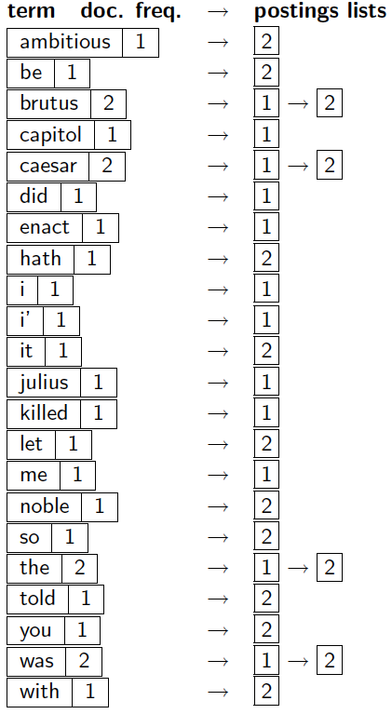
Indexer steps: Dictionary & Postings
Sec. 1.2
Multiple term entries in a single document are merged
Split into dictionary and postings
Doc. frequency information is added
Why frequency?
Will discuss later

Slide 22
Where do we pay in storage?
Sec. 1.2
Lists of docIDs
Terms and counts
Later in the course:
How do we index efficiently?
How much storage do we need?
Pointers

Slide 23
The index we just built
Sec. 1.3
How do we process a query?
Later - what kinds of queries can we process?
Our focus

Slide 24
Query processing: AND
Sec. 1.3
Consider processing the query:
Brutus AND Caesar
Locate Brutus in the dictionary;
Retrieve its postings
Locate Caesar in the dictionary;
Retrieve its postings
“Merge” the two postings:
2
4
8
16
32
64
128
Brutus
1
2
3
5
8
13
21
34
Caesar

Slide 25
The merge
Sec. 1.3
Walk through the two postings simultaneously, in time linear in the total number of postings entries
2
2
4
4
8
8
16
16
32
64
128
32
64
128
Brutus
2
8
1
Caesar
1
2
2
3
5
5
8
8
13
13
21
21
34
3
34
If the list lengths are x and y, the merge takes O(x+y)
operations
Crucial: postings sorted by docID

Slide 26
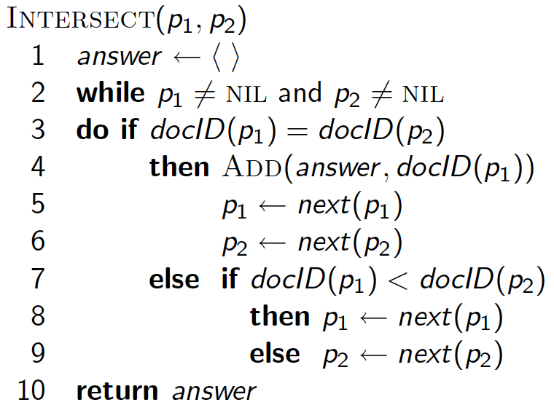
Intersecting two postings lists (a “merge” algorithm)

Slide 27
Boolean queries: Exact match
Sec. 1.3
Boolean retrieval model: being able to ask a query that is a Boolean expression:
Boolean Queries: using AND, OR and NOT to join query terms
Views each document as a set of words
Is precise: document either matches condition or not
Perhaps the simplest model to build an IR system on
Primary commercial retrieval tool for 3 decades
Many search systems you still use are Boolean:
Email, library catalog, Mac OS X Spotlight

Slide 28
Example: WestLaw http://www.westlaw.com/
Sec. 1.4
Largest commercial (paying subscribers) legal search service (started 1975; ranking added 1992)
Tens of terabytes of data; 700,000 users
Majority of users still use boolean queries
Example query:
What is the statute of limitations in cases involving the federal tort claims act?
LIMIT! /3 STATUTE ACTION /S FEDERAL /2 TORT /3 CLAIM
! = wildcard, /3 = within 3 words, /S = in same sentence

Slide 29
Example: WestLaw http://www.westlaw.com/
Sec. 1.4
Another example query:
Requirements for disabled people to be able to access a workplace
disabl! /p access! /s work-site work-place (employment /3 place)
Note that SPACE is disjunction, not conjunction!
Long, precise queries; proximity operators; incrementally developed; not like web search
Many professional searchers still like Boolean search
You know exactly what you are getting
But that doesn’t mean it actually works better….

Slide 30
Boolean queries: More general merges
Sec. 1.3
Exercise: Adapt the merge for the queries:
Brutus AND NOT Caesar
Brutus OR NOT Caesar
Can we still run through the merge in time O(x+y)?
What can we achieve?

Slide 31
Merging
Sec. 1.3
What about an arbitrary Boolean formula?
(Brutus OR Caesar) AND NOT
(Antony OR Cleopatra)
Can we always merge in “linear” time?
Linear in what?
Can we do better?

Slide 32
Query optimization
Sec. 1.3
What is the best order for query processing?
Consider a query that is an AND of n terms
For each of the n terms, get its postings, then AND them together
Brutus
2
4
8
16
32
64
128
Caesar
1
2
3
5
8
16
21
34
Calpurnia
13
16
Query: Brutus AND Calpurnia AND Caesar
32

Slide 33
Query optimization example
Sec. 1.3
Process in order of increasing freq:
start with smallest set, then keep cutting further
This is why we kept
document freq. in dictionary
Brutus
2
4
8
16
32
64
128
Caesar
1
2
3
5
8
16
21
34
Calpurnia
13
16
Execute the query as (Calpurnia AND Brutus) AND Caesar

Slide 34
More general optimization
Sec. 1.3
e.g., (madding OR crowd) AND (ignoble OR strife)
Get doc. freq.’s for all terms
Estimate the size of each OR by the sum of its doc. freq.’s (conservative)
Process in increasing order of OR sizes

Slide 35
Exercise
Recommend a query processing order for
(tangerine OR trees) AND
(marmalade OR skies) AND
(kaleidoscope OR eyes)

Slide 36
Query processing exercises
Exercise: If the query is friends AND romans AND (NOT countrymen), how could we use the freq of countrymen?
Exercise: Extend the merge to an arbitrary Boolean query. Can we always guarantee execution in time linear in the total postings size?
Hint: Begin with the case of a Boolean formula query: in this, each query term appears only once in the query.

Slide 37
Exercise
Try the search feature at http://www.rhymezone.com/shakespeare/
Write down five search features you think it could do better

Slide 38
What’s ahead in IR? Beyond term search
What about phrases?
Stanford University
Proximity: Find Gates NEAR Microsoft
Need index to capture position information in docs
Zones in documents: Find documents with (author = Ullman) AND (text contains automata)

Slide 39
Evidence accumulation
1 vs. 0 occurrence of a search term
2 vs. 1 occurrence
3 vs. 2 occurrences, etc.
Usually more seems better
Need term frequency information in docs

Slide 40
Ranking search results
Boolean queries give inclusion or exclusion of docs
Often we want to rank/group results
Need to measure proximity from query to each doc
Need to decide whether docs presented to user are singletons, or a group of docs covering various aspects of the query

Slide 41
IR vs. databases: Structured vs unstructured data
Structured data tends to refer to information in “tables”
Employee
Manager
Salary
Smith
Jones
50000
Chang
Smith
60000
Ivy
Smith
50000
Typically allows numerical range and exact match
(for text) queries, e.g.,
Salary < 60000 AND Manager = Smith.

Slide 42
Unstructured data
Typically refers to free text
Allows
Keyword queries including operators
More sophisticated “concept” queries e.g.,
find all web pages dealing with drug abuse
Classic model for searching text documents

Slide 43
Semi-structured data
In fact almost no data is “unstructured”
E.g., this slide has distinctly identified zones such as the Title and Bullets
Facilitates “semi-structured” search such as
Title contains data AND Bullets contain search
… to say nothing of linguistic structure

Slide 44
More sophisticated semi-structured search
Title is about Object Oriented Programming AND Author something like stro*rup
where * is the wild-card operator
Issues:
how do you process “about”?
how do you rank results?
The focus of XML search (IIR chapter 10)
Will be skipped in our class

Slide 45
Thanks for Your Attention!
Any questions?

