Slide 1
Modified from Stanford CS276 slides
Chap. 2: The term vocabulary and postings lists

Slide 2
Outline
Elaborate basic indexing
Preprocessing to form the term vocabulary
Documents
Tokenization
What terms do we put in the index?
Postings
Faster merges: skip lists
Positional postings and phrase queries

Slide 3





Recall the basic indexing pipeline
Documents to
be indexed.
Friends, Romans, countrymen.
Tokenizer
Token stream.
Friends
Romans
Countrymen
Linguistic modules
Modified tokens.
friend
roman
countryman
Indexer
friend
2
4
roman
1
2
Inverted index.
countryman
13
16

Slide 4
Parsing a document
Sec. 2.1
What format is it in?
pdf/word/excel/html?
What language is it in?
What character set is in use?
(Big5, UTF-8, …)
Each of these is a classification problem, which we will study later in the course.
But these tasks are often done heuristically …

Slide 5
Complications: Format/language
Sec. 2.1
Documents being indexed can be written in many different languages
A single index may have to contain terms of several languages.
Sometimes a document or its components can contain multiple languages/formats
French email with a German PDF attachment.
What is a unit document?
A file?
An email? (Perhaps one of many in an mbox.)
An email with 5 attachments?
A group of files (PPT or LaTeX as HTML pages)
Notes:
Nontrivial issues. Requires some design decisions.

Slide 6
Tokens and Terms

Slide 7
Tokenization
Sec. 2.2.1
Input: “Friends, Romans and Countrymen”
Output: Tokens
Friends
Romans
Countrymen
A token is an instance of a sequence of characters
Each such token is now a candidate for an index entry, after further processing
Described below
But what are valid tokens to emit?

Slide 8
Tokenization
Sec. 2.2.1
Issues in tokenization:
Finland’s capital →
Finland? Finlands? Finland’s?
Hewlett-Packard → Hewlett and Packard as two tokens?
state-of-the-art: break up hyphenated sequence.
co-education
lowercase, lower-case, lower case ?
It can be effective to get the user to put in possible hyphens
San Francisco: one token or two?
How do you decide it is one token?

Slide 9
Numbers
Sec. 2.2.1
3/20/91 Mar. 20, 1991 20/3/91
55 B.C.
B-52
My PGP key is 324a3df234cb23e
(800) 234-2333
Often have embedded spaces
Older IR systems may not index numbers
But often very useful: think about things like looking up error codes/stacktraces on the web
(One answer is using n-grams: Chap. 3)
Will often index “meta-data” separately
Creation date, format, etc.

Slide 10
Tokenization: language issues
Sec. 2.2.1
French
L'ensemble → one token or two?
L ? L’ ? Le ?
Want l’ensemble to match with un ensemble
Until at least 2003, it didn’t on Google
Internationalization!
German noun compounds are not segmented
Lebensversicherungsgesellschaftsangestellter
‘life insurance company employee’
German retrieval systems benefit greatly from a compound splitter module
Can give a 15% performance boost for German

Slide 11
Tokenization: language issues
Sec. 2.2.1
Chinese and Japanese have no spaces between words: (word segmentation)
莎拉波娃现在居住在美国东南部的佛罗里达。
Not always guaranteed a unique tokenization
Further complicated in Japanese, with multiple alphabets intermingled
Dates/amounts in multiple formats
フォーチュン500社は情報不足のため時間あた$500K(約6,000万円)
Katakana
Hiragana
Kanji
Romaji
End-user can express query entirely in hiragana!

Slide 12
Tokenization: language issues
Sec. 2.2.1
Arabic (or Hebrew) is basically written right to left, but with certain items like numbers written left to right
Words are separated, but letter forms within a word form complex ligatures
← → ← → ← start
‘Algeria achieved its independence in 1962 after 132 years of French occupation.’
With Unicode, the surface presentation is complex, but the stored form is straightforward

Slide 13
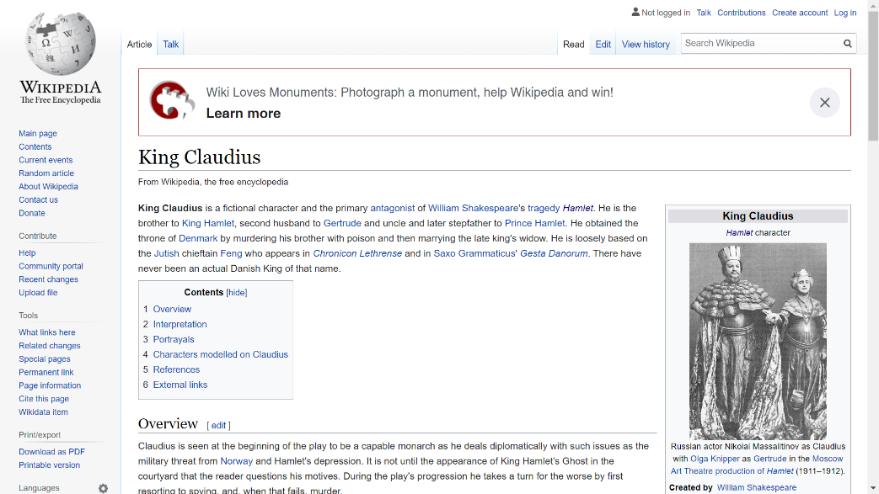
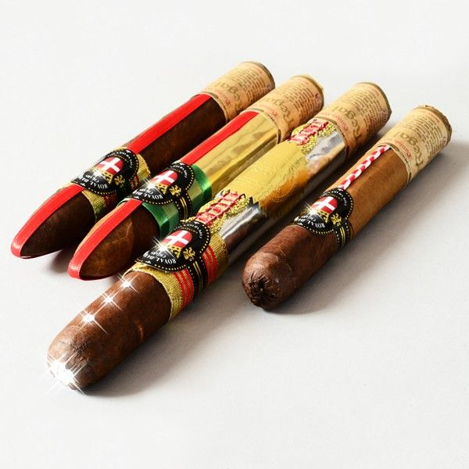
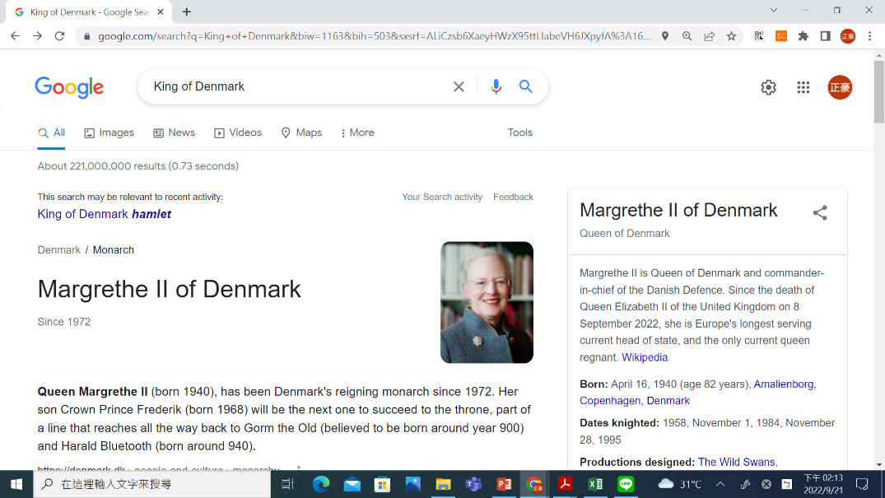
Stop words
Sec. 2.2.2
With a stop list, you exclude from the dictionary entirely the commonest words. Intuition:
They have little semantic content: the, a, and, to, be
There are a lot of them: ~30% of postings for top 30 words
But the trend is away from doing this:
Good compression techniques (Ch. 5) means the space for including stopwords in a system is very small
Good query optimization techniques (Ch. 7) mean you pay little at query time for including stop words.
You need them for:
Phrase queries: “King of Denmark”
Various song titles, etc.: “Let it be”, “To be or not to be”
“Relational” queries: “flights to London”
One of the most expensive cigars by Royal Danish Cigar company
Notes:
Nevertheless: “Google ignores common words and characters such as where, the, how, and other digits and letters which slow down your search without improving the results.” (Though you can explicitly ask for them to remain.)

Slide 14
Normalization to terms
Sec. 2.2.3
We need to “normalize” words in indexed text as well as query words into the same form
We want to match U.S.A. and USA
Result is terms: a term is a (normalized) word type, which is an entry in our IR system dictionary
We most commonly implicitly define equivalence classes of terms by, e.g.,
deleting periods to form a term
U.S.A., USA ◊ USA
deleting hyphens to form a term
anti-discriminatory, antidiscriminatory ◊ antidiscriminatory

Slide 15
Normalization: other languages
Sec. 2.2.3
Accents: e.g., French résumé vs. resume.
Umlauts: e.g., German: Tuebingen vs. Tübingen
Should be equivalent
Most important criterion:
How are your users like to write their queries for these words?
Even in languages that standardly have accents, users often may not type them
Often best to normalize to a de-accented term
Tuebingen, Tübingen, Tubingen ◊ Tubingen

Slide 16
Normalization: other languages
Sec. 2.2.3
Normalization of things like date forms
7月30日 vs. 7/30
Japanese use of kana vs. Chinese characters
Tokenization and normalization may depend on the language and so is intertwined with language detection
Crucial: Need to “normalize” indexed text as well as query terms into the same form
Is this
German “mit”?
Morgen will ich in MIT …

Slide 17
Case folding
Sec. 2.2.3
Reduce all letters to lower case
exception: upper case in mid-sentence?
e.g., General Motors
Fed vs. fed
SAIL vs. sail
Often best to lower case everything, since users will use lowercase regardless of ‘correct’ capitalization…
Google example: [fixed in 2011…]
Query C.A.T.
#1 result is for “cat” (well, Lolcats) not Caterpillar Inc.

Slide 18
Normalization to terms
Sec. 2.2.3
An alternative to equivalence classing is to do asymmetric expansion
An example of where this may be useful
Enter: window Search: window, windows
Enter: windows Search: Windows, windows, window
Enter: Windows Search: Windows
Potentially more powerful, but less efficient
Notes:
Why not the reverse?

Slide 19
Thesauri and soundex
Do we handle synonyms and homonyms?
E.g., by hand-constructed equivalence classes
car = automobile color = colour
We can rewrite to form equivalence-class terms
When the document contains automobile, index it under car-automobile (and vice-versa)
Or we can expand a query
When the query contains automobile, look under car as well
What about spelling mistakes?
One approach is soundex, which forms equivalence classes of words based on phonetic heuristics
More in Chaps. 3 and 9

Slide 20
Lemmatization
Sec. 2.2.4
Reduce inflectional/variant forms to base form
E.g.,
am, are, is → be
car, cars, car's, cars' → car
the boy's cars are different colors → the boy car be different color
Lemmatization implies doing “proper” reduction to dictionary headword form

Slide 21
Stemming
Sec. 2.2.4
Reduce terms to their “roots” before indexing
“Stemming” suggest crude affix chopping
language dependent
e.g., automate(s), automatic, automation all reduced to automat.
for example compressed
and compression are both
accepted as equivalent to
compress.
for exampl compress and
compress ar both accept
as equival to compress

Slide 22
Porter’s algorithm
Sec. 2.2.4
Commonest algorithm for stemming English
Results suggest it’s at least as good as other stemming options
Conventions + 5 phases of reductions
phases applied sequentially
each phase consists of a set of commands
sample convention: Of the rules in a compound command, select the one that applies to the longest suffix.

Slide 23
Typical rules in Porter
Sec. 2.2.4
sses → ss
ies → i
ational → ate
tional → tion
Weight of word sensitive rules
(m>1) EMENT →
replacement → replac
cement → cement

Slide 24
Other stemmers
Sec. 2.2.4
Other stemmers exist, e.g., Lovins stemmer
http://www.comp.lancs.ac.uk/computing/research/stemming/general/lovins.htm
Single-pass, longest suffix removal (about 250 rules)
Paice/Husk stemmer
Snowball
Full morphological analysis – at most modest benefits for retrieval

Slide 25
Language-specificity
Sec. 2.2.4
Many of the above features embody transformations that are
Language-specific, and often
Application-specific
These are “plug-in” addenda to the indexing process
Both open source and commercial plug-ins are available for handling these

Slide 26
Does stemming help?
Sec. 2.2.4
English: very mixed results. Helps recall for some queries but harms precision on others
E.g., operative (dentistry) ⇒ oper
Definitely useful for Spanish, German, Finnish, …
30% performance gains for Finnish!

Slide 27
Dictionary entries – first cut
Sec. 2.2
ensemble.french
時間.japanese
MIT.english
mit.german
guaranteed.english
entries.english
sometimes.english
tokenization.english
These may be grouped by language (or not…).
More on this in ranking/query processing.

Slide 28
Faster postings merges: Skip pointers/Skip lists

Slide 29
Recall basic merge
Sec. 2.3
Walk through the two postings simultaneously, in time linear in the total number of postings entries
2
4
8
41
48
64
128
Brutus
2
8
1
2
3
8
11
17
21
31
Caesar
If the list lengths are m and n, the merge takes O(m+n)
operations.
Can we do better?
Yes (if index isn’t changing too fast)

Slide 30
Augment postings with skip pointers (at indexing time)
Sec. 2.3
41
128
2
4
8
41
48
64
128
11
31
1
2
3
8
11
17
21
31
Why?
To skip postings that will not figure in the search results.
How?
Where do we place skip pointers?

Slide 31
Query processing with skip pointers
Sec. 2.3
41
128
2
4
8
41
48
64
128
11
31
1
2
3
8
11
17
21
31
Suppose we’ve stepped through the lists until we process 8 on each list. We match it and advance
We then have 41 and 11 on the lower. 11 is smaller
But the skip successor of 11 on the lower list is 31, so
we can skip ahead past the intervening postings

Slide 32
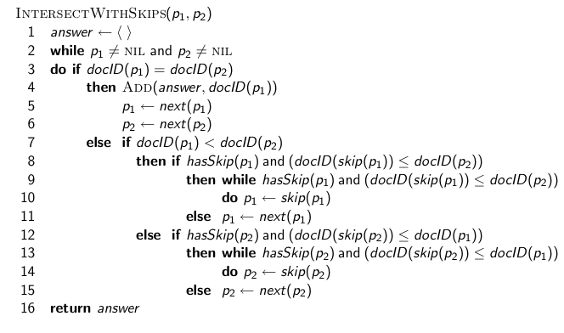
Postings lists intersection with skip pointers

Slide 33
Where do we place skips?
Sec. 2.3
Tradeoff:
More skips → shorter skip spans ⇒ more likely to skip. But lots of comparisons to skip pointers
Fewer skips → few pointer comparison, but then long skip spans ⇒ few successful skips

Slide 34
Placing skips
Sec. 2.3
Simple heuristic: for postings of length L, use √L evenly-spaced skip pointers
This ignores the distribution of query terms
Easy if the index is relatively static; harder if L keeps changing because of updates
This definitely used to help; with modern hardware it may not (Bahle et al. 2002) unless you’re memory-based
The I/O cost of loading a bigger postings list can outweigh the gains from quicker in memory merging!

Slide 35
Phrase queries and positional indexes

Slide 36
Phrase queries
Sec. 2.4
Want to be able to answer queries such as “stanford university” – as a phrase
Thus the sentence “I went to university at Stanford” is not a match
The concept of phrase queries has proven easily understood by users; one of the few “advanced search” ideas that works
Many more queries are implicit phrase queries
For this, it no longer suffices to store only
<term : docs> entries

Slide 37
A first attempt: Biword indexes
Sec. 2.4.1
Index every consecutive pair of terms in the text as a phrase
For example the text “Friends, Romans, Countrymen” would generate the biwords
friends romans
romans countrymen
Each of these biwords is now a dictionary term
Two-word phrase query-processing is now immediate

Slide 38
Longer phrase queries
Sec. 2.4.1
Longer phrases are processed as we did with wild-cards:
stanford university palo alto can be broken into the Boolean query on biwords:
stanford university AND university palo AND palo alto
Without the docs, we cannot verify that the docs matching the above Boolean query do contain the phrase
Can have false positives!

Slide 39
Extended biwords
Sec. 2.4.1
Parse the indexed text and perform part-of-speech-tagging (POST)
Bucket the terms into (say) Nouns (N) and articles/prepositions (X)
Call any string of terms of the form NX*N an extended biword
Each such extended biword is now made a term in the dictionary
Example: catcher in the rye
N X X N
Query processing: parse it into N’s and X’s
Segment query into extended biwords
Look up in index: catcher rye

Slide 40
Issues for biword indexes
Sec. 2.4.1
False positives, as noted before
Index blowup due to bigger dictionary
Infeasible for more than biwords, big even for them
Biword indexes are not the standard solution (for all biwords) but can be part of a compound strategy

Slide 41
Solution 2: Positional indexes
Sec. 2.4.2
In the postings, store, for each term the position(s) in which tokens of it appear:
<term, number of docs containing term;
doc1: position1, position2 … ;
doc2: position1, position2 … ;
etc.>

Slide 42
Positional index example
Sec. 2.4.2
<be: 993427;
1: 7, 18, 33, 72, 86, 231;
2: 3, 149;
4: 17, 191, 291, 430, 434;
5: 363, 367, …>
Which of docs 1,2,4,5
could contain “to be
or not to be”?
For phrase queries, we use a merge algorithm recursively at the document level
But we now need to deal with more than just equality

Slide 43
Processing a phrase query
Sec. 2.4.2
Extract inverted index entries for each distinct term: to, be, or, not
Merge their doc:position lists to enumerate all positions with “to be or not to be”
to:
2:1,17,74,222,551; 4:8,16,190,429,433; 7:13,23,191; ...
be:
1:17,19; 4:17,191,291,430,434; 5:14,19,101; ...
Same general method for proximity searches

Slide 44
Proximity queries
Sec. 2.4.2
LIMIT! /3 STATUTE /3 FEDERAL /2 TORT
Again, here, /k means “within k words of”
Clearly, positional indexes can be used for such queries; biword indexes cannot
Exercise: Adapt the linear merge of postings to handle proximity queries. Can you make it work for any value of k?
This is a little tricky to do correctly and efficiently
See Figure 2.12 of IIR
There’s likely to be a problem on it!

Slide 45
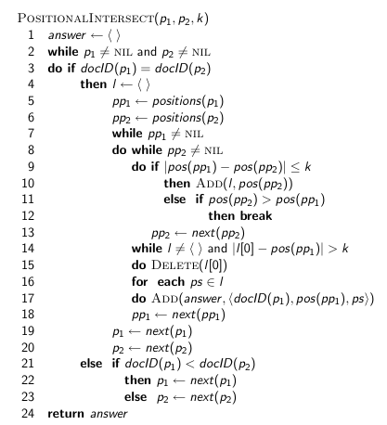
Proximity intersection

Slide 46
Positional index size
Sec. 2.4.2
You can compress position values/offsets (in Chap. 5)
Nevertheless, a positional index expands postings storage substantially
Nevertheless, a positional index is now standardly used because of the power and usefulness of phrase and proximity queries … whether used explicitly or implicitly in a ranking retrieval system

Slide 47
Positional index size
Sec. 2.4.2
Need an entry for each occurrence, not just once per document
Index size depends on average document size
Average web page has <1000 terms
SEC filings, books, even some epic poems … easily 100,000 terms
Consider a term with frequency 0.1%
Why?
Document size
Postings
Positional postings
1000
1
1
100,000
1
100

Slide 48
Rules of thumb
Sec. 2.4.2
A positional index is 2–4 times as large as a non-positional index
Compressed positional index size 35–50% of volume of original text
Caveat: all of this holds for “English-like” languages

Slide 49
Combination schemes
Sec. 2.4.3
These two approaches can be profitably combined
For particular phrases (“Michael Jackson”, “Britney Spears”) it is inefficient to keep on merging positional postings lists
Even more so for phrases like “The Who”
Williams et al. (2004) evaluate a more sophisticated mixed indexing scheme
A typical web query mixture was executed in ¼ of the time of using just a positional index
It required 26% more space than having a positional index alone

Slide 50
Resources
IIR 2
MG 3.6, 4.3; MIR 7.2
Porter’s stemmer: http://www.tartarus.org/~martin/PorterStemmer/
Skip Lists theory: Pugh (1990)
Multilevel skip lists give same O(log n) efficiency as trees
H.E. Williams, J. Zobel, and D. Bahle. 2004. “Fast Phrase Querying with Combined Indexes”, ACM Transactions on Information Systems.
http://www.seg.rmit.edu.au/research/research.php?author=4
D. Bahle, H. Williams, and J. Zobel. Efficient phrase querying with an auxiliary index. SIGIR 2002, pp. 215-221.

