Slide 1
Data Mining: Concepts and Principles Chapter 3. Data Preprocessing
Slightly modified from the slides by Prof. Jiawei Han, UIUC CS412 Course (Introduction to Data Mining)

Slide 2
Chapter 3: Data Preprocessing
Data Preprocessing: An Overview
Data Cleaning
Data Integration
Data Reduction and Transformation
Dimensionality Reduction
Summary

Slide 3
What is Data Preprocessing? — Major Tasks
Data cleaning
Handle missing data, smooth noisy data, identify or remove outliers, and resolve inconsistencies
Data integration
Integration of multiple databases, data cubes, or files
Data reduction
Dimensionality reduction
Numerosity reduction
Data compression
Data transformation and data discretization
Normalization
Concept hierarchy generation

Slide 4
Why Preprocess the Data? — Data Quality Issues
Measures for data quality: A multidimensional view
Accuracy: correct or wrong, accurate or not
Completeness: not recorded, unavailable, …
Consistency: some modified but some not, dangling, …
Timeliness: timely update?
Believability: how trustable the data are correct?
Interpretability: how easily the data can be understood?

Slide 5
Chapter 3: Data Preprocessing
Data Preprocessing: An Overview
Data Cleaning
Data Integration
Data Reduction and Transformation
Dimensionality Reduction
Summary

Slide 6
Data Cleaning
Data in the Real World Is Dirty: Lots of potentially incorrect data, e.g., instrument faulty, human or computer error, and transmission error
Incomplete: lacking attribute values, lacking certain attributes of interest, or containing only aggregate data
e.g., Occupation = “ ” (missing data)
Noisy: containing noise, errors, or outliers
e.g., Salary = “−10” (an error)
Inconsistent: containing discrepancies in codes or names, e.g.,
Age = “42”, Birthday = “03/07/2010”
Was rating “1, 2, 3”, now rating “A, B, C”
Discrepancy between duplicate records
Intentional (e.g., disguised missing data)
Jan. 1 as everyone’s birthday?

Slide 7
Incomplete (Missing) Data
Data is not always available
E.g., many tuples have no recorded value for several attributes, such as customer income in sales data
Missing data may be due to
Equipment malfunction
Inconsistent with other recorded data and thus deleted
Data were not entered due to misunderstanding
Certain data may not be considered important at the time of entry
Did not register history or changes of the data
Missing data may need to be inferred

Slide 8
How to Handle Missing Data?
Ignore the tuple: usually done when class label is missing (when doing classification)—not effective when the % of missing values per attribute varies considerably
Fill in the missing value manually: tedious + infeasible?
Fill in it automatically with
a global constant : e.g., “unknown”, a new class?!
the attribute mean
the attribute mean for all samples belonging to the same class: smarter
the most probable value: inference-based such as Bayesian formula or decision tree

Slide 9
Noisy Data
Noise: random error or variance in a measured variable
Incorrect attribute values may be due to
Faulty data collection instruments
Data entry problems
Data transmission problems
Technology limitation
Inconsistency in naming convention
Other data problems
Duplicate records
Incomplete data
Inconsistent data
Notes:
9

Slide 10
How to Handle Noisy Data?
Binning
First sort data and partition into (equal-frequency) bins
Then one can smooth by bin means, smooth by bin median, smooth by bin boundaries, etc.
Regression
Smooth by fitting the data into regression functions
Clustering
Detect and remove outliers
Semi-supervised: Combined computer and human inspection
Detect suspicious values and check by human (e.g., deal with possible outliers)
Notes:
Enrich using data integration research!!

Slide 11
Data Cleaning as a Process
Data discrepancy detection
Use metadata (e.g., domain, range, dependency, distribution)
Check field overloading
Check uniqueness rule, consecutive rule and null rule
Use commercial tools
Data scrubbing: use simple domain knowledge (e.g., postal code, spell-check) to detect errors and make corrections
Data auditing: by analyzing data to discover rules and relationship to detect violators (e.g., correlation and clustering to find outliers)
Data migration and integration
Data migration tools: allow transformations to be specified
ETL (Extraction/Transformation/Loading) tools: allow users to specify transformations through a graphical user interface
Integration of the two processes
Iterative and interactive (e.g., Potter’s Wheels)

Slide 12
Chapter 3: Data Preprocessing
Data Preprocessing: An Overview
Data Cleaning
Data Integration
Data Reduction and Transformation
Dimensionality Reduction
Summary

Slide 13
Data Integration
Data integration
Combining data from multiple sources into a coherent store
Schema integration: e.g., A.cust-id ≡ B.cust-#
Integrate metadata from different sources
Entity identification:
Identify real world entities from multiple data sources, e.g., Bill Clinton = William Clinton
Detecting and resolving data value conflicts
For the same real world entity, attribute values from different sources are different
Possible reasons: different representations, different scales, e.g., metric vs. British units
Notes:
Should ask students to do some survey on data integration. -JH

Slide 14
Handling Redundancy in Data Integration
Redundant data occur often when integration of multiple databases
Object identification: The same attribute or object may have different names in different databases
Derivable data: One attribute may be a “derived” attribute in another table, e.g., annual revenue
Redundant attributes may be able to be detected by correlation analysis and covariance analysis
Careful integration of the data from multiple sources may help reduce/avoid redundancies and inconsistencies and improve mining speed and quality

Slide 15
Correlation Analysis (for Categorical Data)
Χ² (chi-square) test:
Null hypothesis: The two distributions are independent
The cells that contribute the most to the Χ² value are those whose actual count is very different from the expected count
The larger the Χ² value, the more likely the variables are related
Note: Correlation does not imply causality
# of hospitals and # of car-theft in a city are correlated
Both are causally linked to the third variable: population

Slide 16
Chi-Square Calculation: An Example
 | Play chess | Not play chess | Sum (row)
Like science fiction | 250 (90) | 200 (360) | 450
Not like science fiction | 50 (210) | 1000 (840) | 1050
Sum(col.) | 300 | 1200 | 1500
How to derive 90?
450/1500 * 300 = 90
We can reject the
null hypothesis of
independence at a confidence level of 0.001
Χ² (chi-square) calculation (numbers in parenthesis are expected counts calculated based on the data distribution in the two categories)
It shows that like_science_fiction and play_chess are correlated in the group

Slide 17

Variance for Single Variable (Numerical Data)
The variance of a random variable X provides a measure of how much the value of X deviates from the mean or expected value of X:
where σ² is the variance of X, σ is called standard deviation
µ is the mean, and µ = E[X] is the expected value of X
That is, variance is the expected value of the square deviation from the mean
It can also be written as:
Sample variance is the average squared deviation of the data value x_{i} from the sample mean
$${\hat{σ}}^{2}=\frac{1}{n}\sum_{i=1}^{n}{(x_{i}−\hat{μ})^{2}}$$

Slide 18
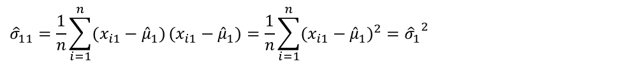
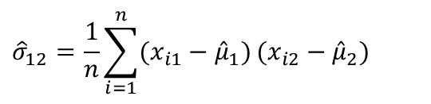
Covariance for Two Variables
Covariance between two variables X₁ and X₂
where µ₁ = E[X₁] is the respective mean or expected value of X₁; similarly for µ₂
Sample covariance between X₁ and X₂:
Sample covariance is a generalization of the sample variance:
Positive covariance: If σ₁₂ > 0
Negative covariance: If σ₁₂ < 0
Independence: If X₁ and X₂ are independent, σ₁₂ = 0; but the reverse is not true
Some pairs of random variables may have a covariance 0 but are not independent
Only under some additional assumptions (e.g., the data follow multivariate normal distributions) does a covariance of 0 imply independence
$${\hat{σ}}_{12}=\frac{1}{n}\sum_{i=1}^{n}{(x_{i1}−{\hat{μ}}_{1})}(x_{i2}−{\hat{μ}}_{2})$$
$${\hat{σ}}_{11}=\frac{1}{n}\sum_{i=1}^{n}{(x_{i1}−{\hat{μ}}_{1})}(x_{i1}−{\hat{μ}}_{1})=\frac{1}{n}\sum_{i=1}^{n}{(x_{i1}−{\hat{μ}}_{1})^{2}}={{\hat{σ}}_{1}}^{2}$$

Slide 19
Example: Calculation of Covariance
Suppose two stocks X₁ and X₂ have the following values in one week:
(2, 5), (3, 8), (5, 10), (4, 11), (6, 14)
Question: If the stocks are affected by the same industry trends, will their prices rise or fall together?
Covariance formula
Its computation can be simplified as:
E(X₁) = (2 + 3 + 5 + 4 + 6)/ 5 = 20/5 = 4
E(X₂) = (5 + 8 + 10 + 11 + 14) /5 = 48/5 = 9.6
σ₁₂ = (2×5 + 3×8 + 5×10 + 4×11 + 6×14)/5 − 4 × 9.6 = 4
Thus, X₁ and X₂ rise together since σ₁₂ > 0

Slide 20
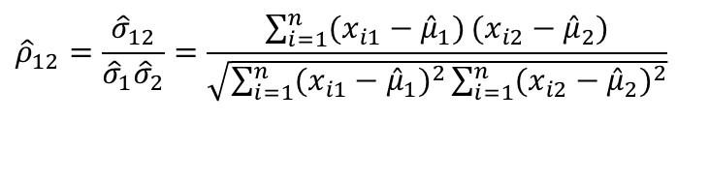
Correlation between Two Numerical Variables
Correlation between two variables X₁ and X₂ is the standard covariance, obtained by normalizing the covariance with the standard deviation of each variable
Sample correlation for two attributes X₁ and X₂:
where n is the number of tuples, µ₁ and µ₂ are the respective means of X₁ and X₂ , σ₁ and σ₂ are the respective standard deviation of X₁ and X₂
If ρ₁₂ > 0: A and B are positively correlated (X₁’s values increase as X₂’s)
The higher, the stronger correlation
If ρ₁₂ = 0: independent (under the same assumption as discussed in co-variance)
If ρ₁₂ < 0: negatively correlated
$${\hat{ρ}}_{12}=\frac{{\hat{σ}}_{12}}{{\hat{σ}}_{1}{\hat{σ}}_{2}}=\frac{\sum_{i=1}^{n}{(x_{i1}−{\hat{μ}}_{1})}(x_{i2}−{\hat{μ}}_{2})}{\sqrt{\sum_{i=1}^{n}{(x_{i1}−{\hat{μ}}_{1})^{2}}\sum_{i=1}^{n}{(x_{i2}−{\hat{μ}}_{2})^{2}}}}$$

Slide 21
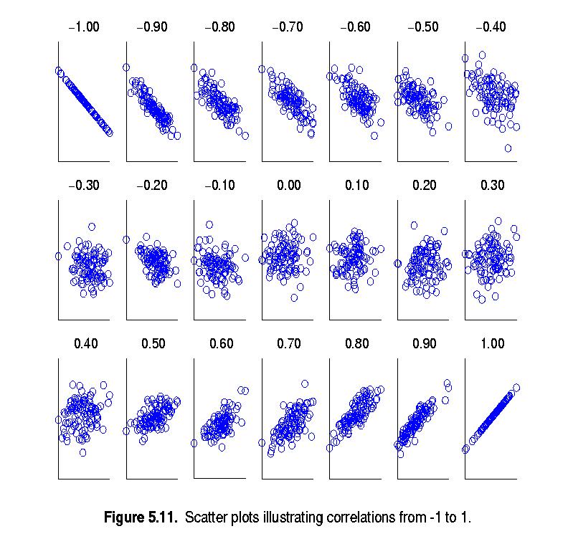
Visualizing Changes of Correlation Coefficient
Correlation coefficient value range: [–1, 1]
A set of scatter plots shows sets of points and their correlation coefficients changing from –1 to 1

Slide 22
Covariance Matrix
The variance and covariance information for the two variables X₁ and X₂ can be summarized as 2 X 2 covariance matrix as
Generalizing it to d dimensions, we have,

Slide 23
Chapter 3: Data Preprocessing
Data Preprocessing: An Overview
Data Cleaning
Data Integration
Data Reduction and Transformation
Dimensionality Reduction
Summary

Slide 24
Data Reduction
Data reduction:
Obtain a reduced representation of the data set
Much smaller in volume, but yet produces almost the same analytical results
Why data reduction?—A database/data warehouse may store terabytes of data
Complex analysis may take a very long time to run on the complete data set
Methods for data reduction (also data size reduction or numerosity reduction)
Regression and Log-Linear Models
Histograms, clustering, sampling
Data cube aggregation
Data compression
Notes:
MK 09/09/05: Wiki has dimensionality reduction as feature extraction (PCA) and feature subset selection. It states both wavelet transforms and PCA as forms of data compression. It does not have any pages for "numerosity reduction". We claim there are many different ways to organize data reduction strategies, which is true, so this presentation below should be OK. Let’s discuss.

Slide 25
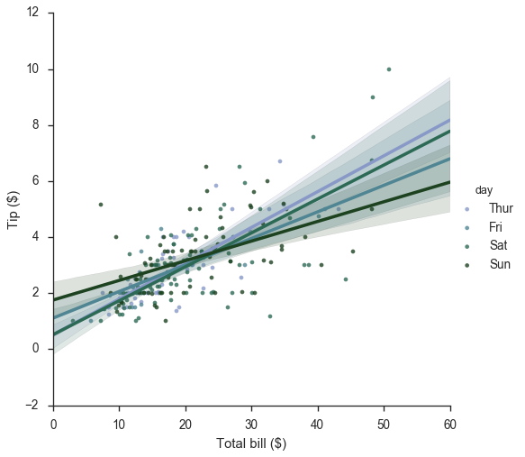
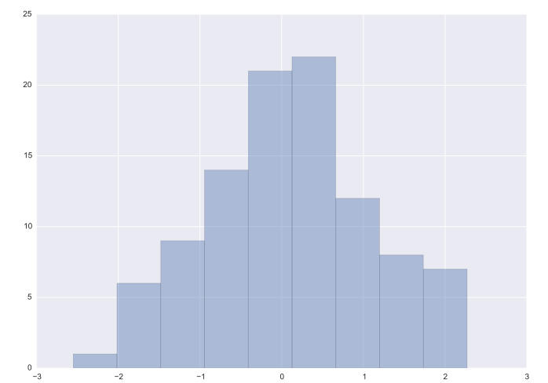
Data Reduction: Parametric vs. Non-Parametric Methods
Reduce data volume by choosing alternative, smaller forms of data representation
Parametric methods (e.g., regression)
Assume the data fits some model, estimate model parameters, store only the parameters, and discard the data (except possible outliers)
Ex.: Log-linear models—obtain value at a point in m-D space as the product on appropriate marginal subspaces
Non-parametric methods
Do not assume models
Major families: histograms, clustering, sampling, …
tip vs. bill
Clustering on the Raw Data
Stratified Sampling
Histogram

Slide 26
Parametric Data Reduction: Regression Analysis
Regression analysis: A collective name for techniques for the modeling and analysis of numerical data consisting of values of a dependent variable (also called response variable or measurement) and of one or more independent variables (also known as explanatory variables or predictors)
The parameters are estimated so as to give a "best fit" of the data
Most commonly the best fit is evaluated by using the least squares method, but other criteria have also been used
y
Y₁
Y₁’
y = x + 1
X₁
x
Used for prediction (including forecasting of time-series data), inference, hypothesis testing, and modeling of causal relationships

Slide 27
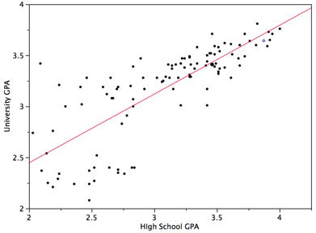
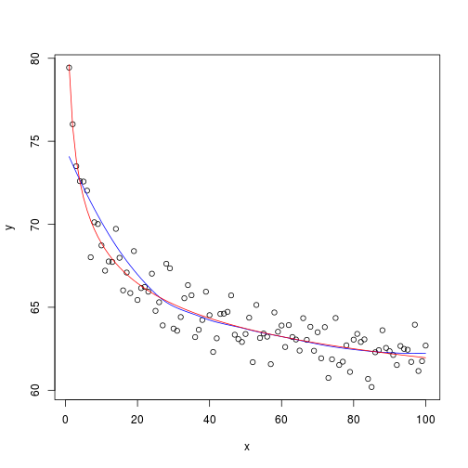
Linear and Multiple Regression
Linear regression: Y = w X + b
Data modeled to fit a straight line
Often uses the least-square method to fit the line
Two regression coefficients, w and b, specify the line and are to be estimated by using the data at hand
Using the least squares criterion to the known values of Y₁, Y₂, …, X₁, X₂, …
Nonlinear regression:
Data are modeled by a function which is a nonlinear combination of the model parameters and depends on one or more independent variables
The data are fitted by a method of successive approximations

Slide 28
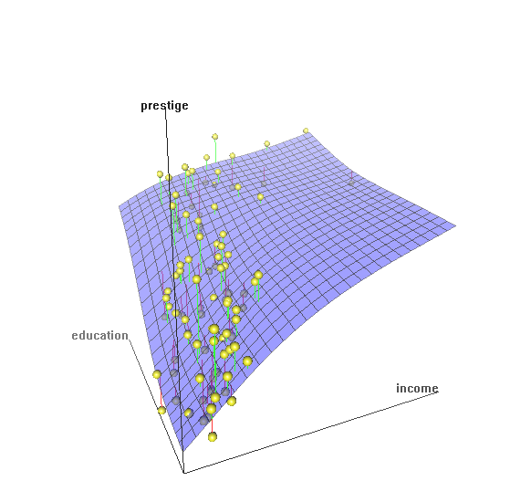
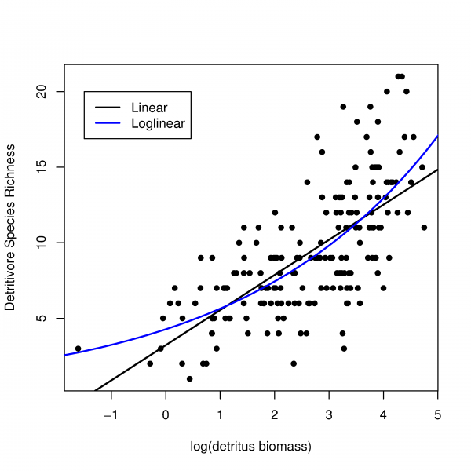
Multiple Regression and Log-Linear Models
Multiple regression: Y = b₀ + b₁ X₁ + b₂ X₂
Allows a response variable Y to be modeled as a linear function of multidimensional feature vector
Many nonlinear functions can be transformed into the above
Log-linear model:
A math model that takes the form of a function whose logarithm is a linear combination of the parameters of the model, which makes it possible to apply (possibly multivariate) linear regression
Estimate the probability of each point (tuple) in a multi-dimen. space for a set of discretized attributes, based on a smaller subset of dimensional combinations
Useful for dimensionality reduction and data smoothing

Slide 29
Histogram Analysis
Divide data into buckets and store average (sum) for each bucket
Partitioning rules:
Equal-width: equal bucket range
Equal-frequency (or equal-depth)
Notes:
Removed 09/09/10: V-optimal: with the least histogram variance (weighted sum of the original values that each bucket represents)

Slide 30
Clustering
Partition data set into clusters based on similarity, and store cluster representation (e.g., centroid and diameter) only
Can be very effective if data is clustered but not if data is “smeared”
Can have hierarchical clustering and be stored in multi-dimensional index tree structures
There are many choices of clustering definitions and clustering algorithms
Cluster analysis will be studied in depth in Chapter 10

Slide 31
Sampling
Sampling: obtaining a small sample s to represent the whole data set N
Allow a mining algorithm to run in complexity that is potentially sub-linear to the size of the data
Key principle: Choose a representative subset of the data
Simple random sampling may have very poor performance in the presence of skew
Develop adaptive sampling methods, e.g., stratified sampling:
Note: Sampling may not reduce database I/Os (page at a time)

Slide 32
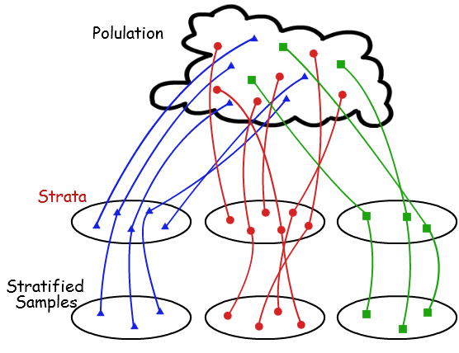
Types of Sampling
Simple random sampling: equal probability of selecting any particular item
Sampling without replacement
Once an object is selected, it is removed from the population
Sampling with replacement
A selected object is not removed from the population
Stratified sampling
Partition (or cluster) the data set, and draw samples from each partition (proportionally, i.e., approximately the same percentage of the data)
Raw Data
SRSWOR
(simple random
sample without
replacement)
SRSWR
Stratified sampling

Slide 33
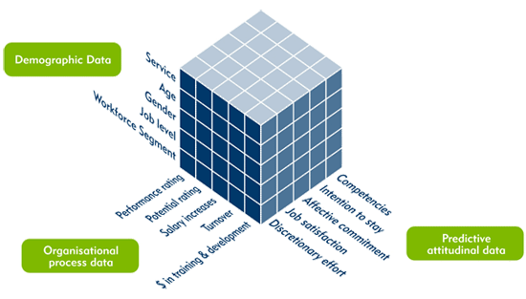
Data Cube Aggregation
The lowest level of a data cube (base cuboid)
The aggregated data for an individual entity of interest
E.g., a customer in a phone calling data warehouse
Multiple levels of aggregation in data cubes
Further reduce the size of data to deal with
Reference appropriate levels
Use the smallest representation which is enough to solve the task
Queries regarding aggregated information should be answered using data cube, when possible
Notes:
33

Slide 34
Data Compression
String compression
There are extensive theories and well-tuned algorithms
Typically lossless, but only limited manipulation is possible without expansion
Audio/video compression
Typically lossy compression, with progressive refinement
Sometimes small fragments of signal can be reconstructed without reconstructing the whole
Time sequence is not audio
Typically short and vary slowly with time
Data reduction and dimensionality reduction may also be considered as forms of data compression
Original Data
Compressed
Data
lossless
Original Data
Approximated
lossy
Lossy vs. lossless compression
Notes:
34
PCA and Wavelet are forms of data compression also.

Slide 35
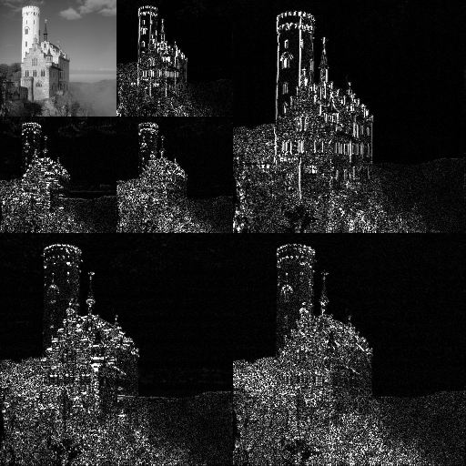
Wavelet Transform: A Data Compression Technique
Wavelet Transform
Decomposes a signal into different frequency subbands
Applicable to n-dimensional signals
Data are transformed to preserve relative distance between objects at different levels of resolution
Allow natural clusters to become more distinguishable
Used for image compression
Notes:
35

Slide 36
Wavelet Transformation
Haar2
Daubechie4
Discrete wavelet transform (DWT) for linear signal processing, multi-resolution analysis
Compressed approximation: Store only a small fraction of the strongest of the wavelet coefficients
Similar to discrete Fourier transform (DFT), but better lossy compression, localized in space
Method:
Length, L, must be an integer power of 2 (padding with 0’s, when necessary)
Each transform has 2 functions: smoothing, difference
Applies to pairs of data, resulting in two set of data of length L/2
Applies two functions recursively, until reaches the desired length
Notes:
36

Slide 37
Why Wavelet Transform?
Use hat-shape filters
Emphasize region where points cluster
Suppress weaker information in their boundaries
Effective removal of outliers
Insensitive to noise, insensitive to input order
Multi-resolution
Detect arbitrary shaped clusters at different scales
Efficient
Complexity O(N)
Only applicable to low dimensional data
Notes:
37

Slide 38
Data Transformation
A function that maps the entire set of values of a given attribute to a new set of replacement values s.t. each old value can be identified with one of the new values
Methods
Smoothing: Remove noise from data
Attribute/feature construction
New attributes constructed from the given ones
Aggregation: Summarization, data cube construction
Normalization: Scaled to fall within a smaller, specified range
min-max normalization
z-score normalization
normalization by decimal scaling
Discretization: Concept hierarchy climbing
Notes:
38

Slide 39
Normalization
Min-max normalization: to [new_min_{A}, new_max_{A}]
Ex. Let income range $12,000 to $98,000 normalized to [0.0, 1.0]
Then $73,000 is mapped to
Z-score normalization (μ: mean, σ: standard deviation):
Ex. Let μ = 54,000, σ = 16,000. Then
Normalization by decimal scaling
Z-score: The distance between the raw score and the population mean in the unit of the standard deviation
Where j is the smallest integer such that Max(|ν’|) < 1

Slide 40
Discretization
Three types of attributes
Nominal—values from an unordered set, e.g., color, profession
Ordinal—values from an ordered set, e.g., military or academic rank
Numeric—real numbers, e.g., integer or real numbers
Discretization: Divide the range of a continuous attribute into intervals
Interval labels can then be used to replace actual data values
Reduce data size by discretization
Supervised vs. unsupervised
Split (top-down) vs. merge (bottom-up)
Discretization can be performed recursively on an attribute
Prepare for further analysis, e.g., classification
Notes:
08.09.12 MK: Slide moved here from Ch. 3. Added examples.

Slide 41
Data Discretization Methods
Binning
Top-down split, unsupervised
Histogram analysis
Top-down split, unsupervised
Clustering analysis
Unsupervised, top-down split or bottom-up merge
Decision-tree analysis
Supervised, top-down split
Correlation (e.g., χ²) analysis
Unsupervised, bottom-up merge
Note: All the methods can be applied recursively
Notes:
41

Slide 42
Simple Discretization: Binning
Equal-width (distance) partitioning
Divides the range into N intervals of equal size: uniform grid
if A and B are the lowest and highest values of the attribute, the width of intervals will be: W = (B –A)/N
The most straightforward, but outliers may dominate presentation
Skewed data is not handled well
Equal-depth (frequency) partitioning
Divides the range into N intervals, each containing approximately same number of samples
Good data scaling
Managing categorical attributes can be tricky

Slide 43
Example: Binning Methods for Data Smoothing
Sorted data for price (in dollars): 4, 8, 9, 15, 21, 21, 24, 25, 26, 28, 29, 34
* Partition into equal-frequency (equal-depth) bins:
- Bin 1: 4, 8, 9, 15
- Bin 2: 21, 21, 24, 25
- Bin 3: 26, 28, 29, 34
* Smoothing by bin means:
- Bin 1: 9, 9, 9, 9
- Bin 2: 23, 23, 23, 23
- Bin 3: 29, 29, 29, 29
* Smoothing by bin boundaries:
- Bin 1: 4, 4, 4, 15
- Bin 2: 21, 21, 25, 25
- Bin 3: 26, 26, 26, 34

Slide 44
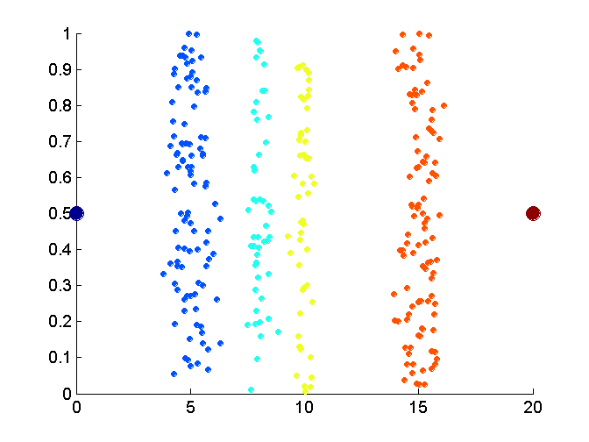
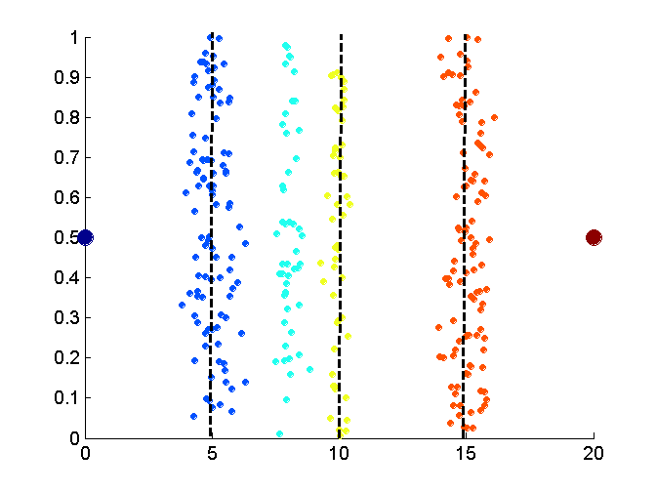
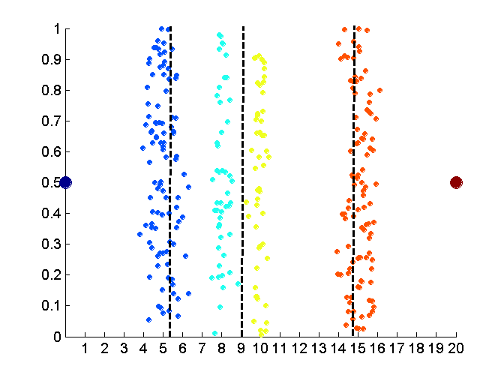
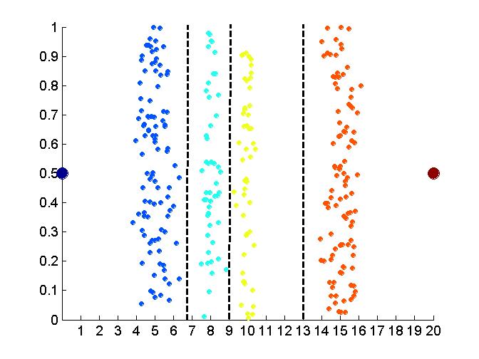
Discretization Without Supervision: Binning vs. Clustering
Data
Equal width (distance) binning
Equal depth (frequency) (binning)
K-means clustering leads to better results
Notes:
44

Slide 45
Discretization by Classification & Correlation Analysis
Classification (e.g., decision tree analysis)
Supervised: Given class labels, e.g., cancerous vs. benign
Using entropy to determine split point (discretization point)
Top-down, recursive split
Details to be covered in Chapter “Classification”
Correlation analysis (e.g., Chi-merge: χ²-based discretization)
Supervised: use class information
Bottom-up merge: Find the best neighboring intervals (those having similar distributions of classes, i.e., low χ² values) to merge
Merge performed recursively, until a predefined stopping condition
Notes:
45

Slide 46
Chapter 3: Data Preprocessing
Data Preprocessing: An Overview
Data Cleaning
Data Integration
Data Reduction and Transformation
Dimensionality Reduction
Summary

Slide 47
Dimensionality Reduction
Curse of dimensionality
When dimensionality increases, data becomes increasingly sparse
Density and distance between points, which is critical to clustering, outlier analysis, becomes less meaningful
The possible combinations of subspaces will grow exponentially
Dimensionality reduction
Reducing the number of random variables under consideration, via obtaining a set of principal variables
Advantages of dimensionality reduction
Avoid the curse of dimensionality
Help eliminate irrelevant features and reduce noise
Reduce time and space required in data mining
Allow easier visualization
Notes:
47
JH: put SVD at clustering high-D reduction.

Slide 48
Dimensionality Reduction Techniques
Dimensionality reduction methodologies
Feature selection: Find a subset of the original variables (or features, attributes)
Feature extraction: Transform the data in the high-dimensional space to a space of fewer dimensions
Some typical dimensionality methods
Principal Component Analysis
Supervised and nonlinear techniques
Feature subset selection
Feature creation
Notes:
48
JH: put SVD at clustering high-D reduction.

Slide 49
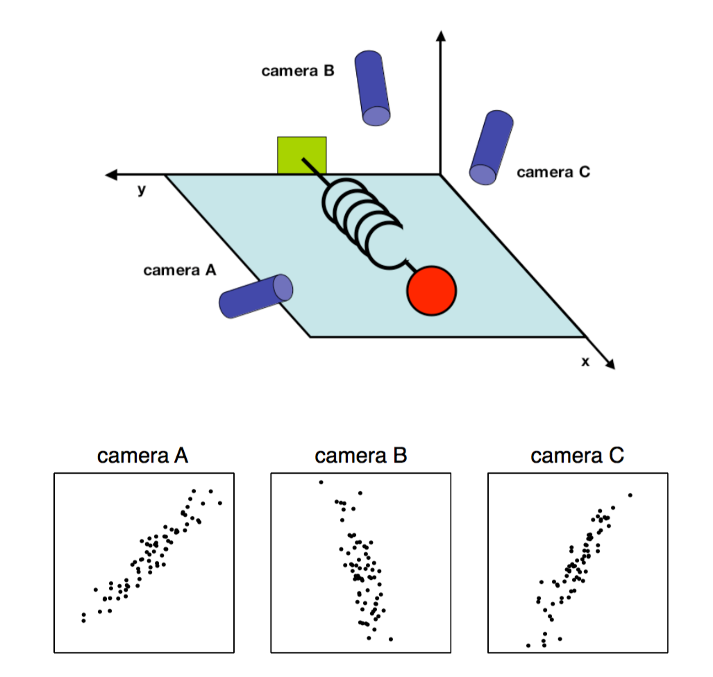
Principal Component Analysis (PCA)
PCA: A statistical procedure that uses an orthogonal transformation to convert a set of observations of possibly correlated variables into a set of values of linearly uncorrelated variables called principal components
The original data are projected onto a much smaller space, resulting in dimensionality reduction
Method: Find the eigenvectors of the covariance matrix, and these eigenvectors define the new space
Ball travels in a straight line. Data from three cameras contain much redundancy

Slide 50
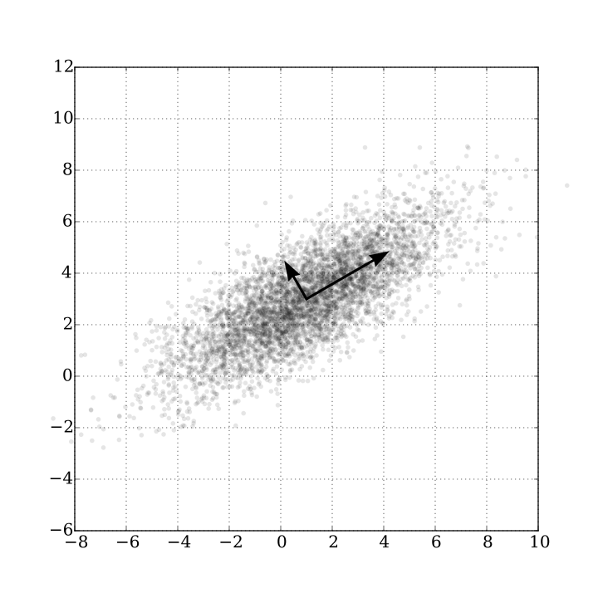
Principal Component Analysis (Method)
Given N data vectors from n-dimensions, find k ≤ n orthogonal vectors (principal components) best used to represent data
Normalize input data: Each attribute falls within the same range
Compute k orthonormal (unit) vectors, i.e., principal components
Each input data (vector) is a linear combination of the k principal component vectors
The principal components are sorted in order of decreasing “significance” or strength
Since the components are sorted, the size of the data can be reduced by eliminating the weak components, i.e., those with low variance (i.e., using the strongest principal components, to reconstruct a good approximation of the original data)
Works for numeric data only
Ack. Wikipedia: Principal Component Analysis

Slide 51
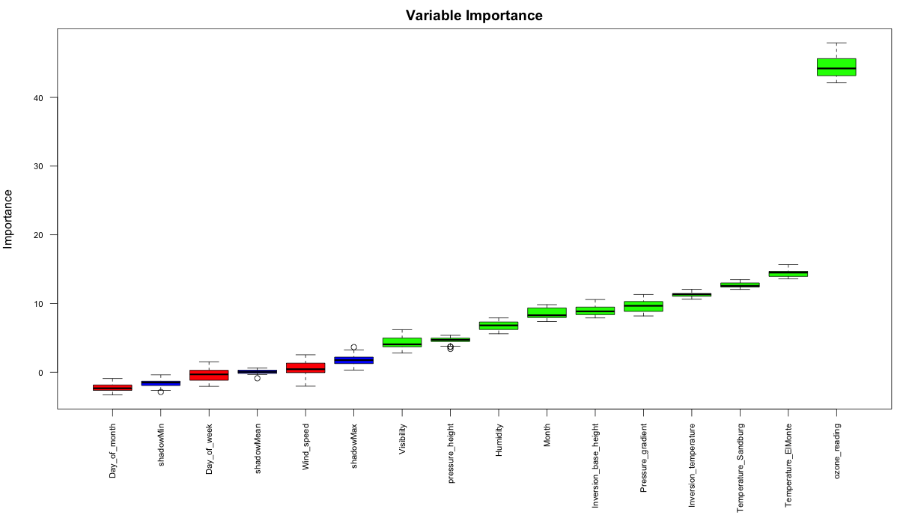
Attribute Subset Selection
Another way to reduce dimensionality of data
Redundant attributes
Duplicate much or all of the information contained in one or more other attributes
E.g., purchase price of a product and the amount of sales tax paid
Irrelevant attributes
Contain no information that is useful for the data mining task at hand
Ex. A student’s ID is often irrelevant to the task of predicting his/her GPA

Slide 52
Heuristic Search in Attribute Selection
There are 2^{d} possible attribute combinations of d attributes
Typical heuristic attribute selection methods:
Best single attribute under the attribute independence assumption: choose by significance tests
Best step-wise feature selection:
The best single-attribute is picked first
Then next best attribute condition to the first, ...
Step-wise attribute elimination:
Repeatedly eliminate the worst attribute
Best combined attribute selection and elimination
Optimal branch and bound:
Use attribute elimination and backtracking

Slide 53
Attribute Creation (Feature Generation)
Create new attributes (features) that can capture the important information in a data set more effectively than the original ones
Three general methodologies
Attribute extraction
Domain-specific
Mapping data to new space (see: data reduction)
E.g., Fourier transformation, wavelet transformation, manifold approaches (not covered)
Attribute construction
Combining features (see: discriminative frequent patterns in Chapter on “Advanced Classification”)
Data discretization
Notes:
53

Slide 54
Summary
Data quality: accuracy, completeness, consistency, timeliness, believability, interpretability
Data cleaning: e.g. missing/noisy values, outliers
Data integration from multiple sources:
Entity identification problem; Remove redundancies; Detect inconsistencies
Data reduction, data transformation and data discretization
Numerosity reduction; Data compression
Normalization; Concept hierarchy generation
Dimensionality reduction

Slide 55
References
D. P. Ballou and G. K. Tayi. Enhancing data quality in data warehouse environments. Comm. of ACM, 42:73-78, 1999
T. Dasu and T. Johnson. Exploratory Data Mining and Data Cleaning. John Wiley, 2003
T. Dasu, T. Johnson, S. Muthukrishnan, V. Shkapenyuk. Mining Database Structure; Or, How to Build a Data Quality Browser. SIGMOD’02
H. V. Jagadish et al., Special Issue on Data Reduction Techniques. Bulletin of the Technical Committee on Data Engineering, 20(4), Dec. 1997
D. Pyle. Data Preparation for Data Mining. Morgan Kaufmann, 1999
E. Rahm and H. H. Do. Data Cleaning: Problems and Current Approaches. IEEE Bulletin of the Technical Committee on Data Engineering. Vol.23, No.4
V. Raman and J. Hellerstein. Potters Wheel: An Interactive Framework for Data Cleaning and Transformation, VLDB’2001
T. Redman. Data Quality: Management and Technology. Bantam Books, 1992
R. Wang, V. Storey, and C. Firth. A framework for analysis of data quality research. IEEE Trans. Knowledge and Data Engineering, 7:623-640, 1995
Notes:
MK 08.11.02: This needs to be updated to reflect changes.

