Slide 1
Introduction to Big Data Analytics
By J. H. Wang
Sep. 16, 2025

Slide 2
Outline
What is Big Data?
What makes Big Data different from other related “buzzwords”?
What are we going to focus in this course?

Slide 3
An Example Scenario: Ten Predictions for the First Hour of 2020 [Siegel, 2013]
Antitheft: identity recognition
Entertainment: music playing
Traffic: navigating and routing prediction
Breakfast: recommendation system
Social: feeds selection and filtering
Deals: sales discount
Internet search: store, speech recognition
Drive inattention: sensors
Collision avoidance: sensors, vision
Reliability: predictive maintenance

Slide 4
What is Big Data?
“Big data is data whose scale, distribution, diversity, and/or timeliness require the use of new technical architectures and analytics to enable insights that unlock new sources of business value.”
[source: C. Manyika, Big Data: The next frontier for innovation, competition, and productivity, McKinsey Global Institute, 2011]

Slide 5
Characteristics of Big Data
Five V’s:
Volume: scale
Velocity: streaming
Variety: different forms
Veracity: uncertainty
Value

Slide 6
Data Structures
Variety: different forms
Structured: databases, spreadsheets, …
Semi-structured: textual files such as Web pages, XML, …
Unstructured: text documents, images, videos, …
Data growth is increasingly unstructured
Social media: Facebook, Twitter, …

Slide 7
Differences from traditional data analysis
Distinct requirements
Combining of multiple unrelated datasets
Processing of large amounts of unstructured data
Harvesting of hidden information in a time-sensitive manner
Newer techniques that leverage computational resources
Interdisciplinary
Mathematics, statistics, computer science, subject matter expertise
Benefits
Optimization, predictions, fault or fraud detection, improved decision making, discoveries

Slide 8
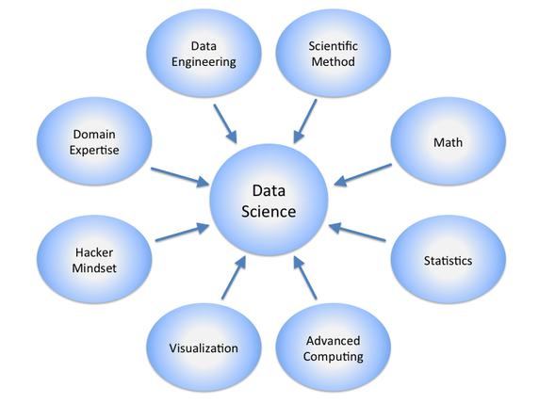
What is Data Science?

Slide 9
Data Engineering vs. Data Analysis
Data engineering: designing and building infrastructure for integrating and managing data from various resources
MySQL, NoSQL, Hadoop, MapReduce
Data analysis: querying and processing data, providing reports, summarizing and visualizing data
Statistics, visualization, Excel, SAS, SPSS, …
Data science: applying statistics, machine learning and analytic approaches to solve critical business problems, and turning data into valuable and actionable insights
Advanced data analysis
Data mining tools, machine learning, statistics, …

Slide 10
Big Data vs. Data Mining
Data mining is the computational process of discovering patterns in large data sets involving methods at the intersection of artificial intelligence, machine learning, statistics, and database systems [source: Wikipedia]

Slide 11
Data Mining in Business Intelligence
Increasing potential
to support
business decisions
End User
Decision Making
Data Presentation
Business
Analyst
Visualization Techniques
Data Mining
Data
Analyst
Information Discovery
Data Exploration
Statistical Summary, Querying, and Reporting
Data Preprocessing/Integration, Data Warehouses
DBA
[source: Han 2011]
Data Sources
Paper, Files, Web documents, Scientific experiments, Database Systems

Slide 12
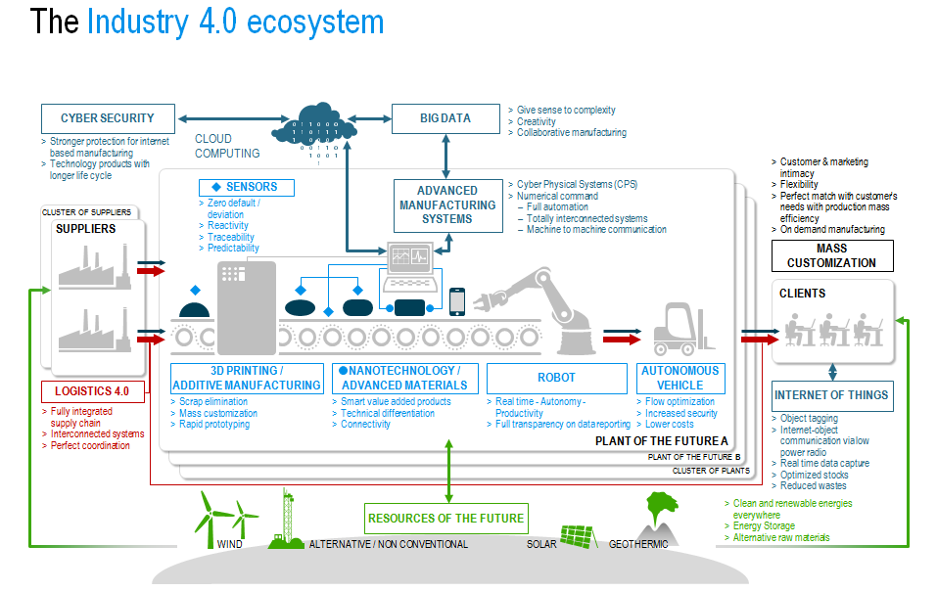
Big Data vs. Industry 4.0
[source: Roland Berger]

Slide 13
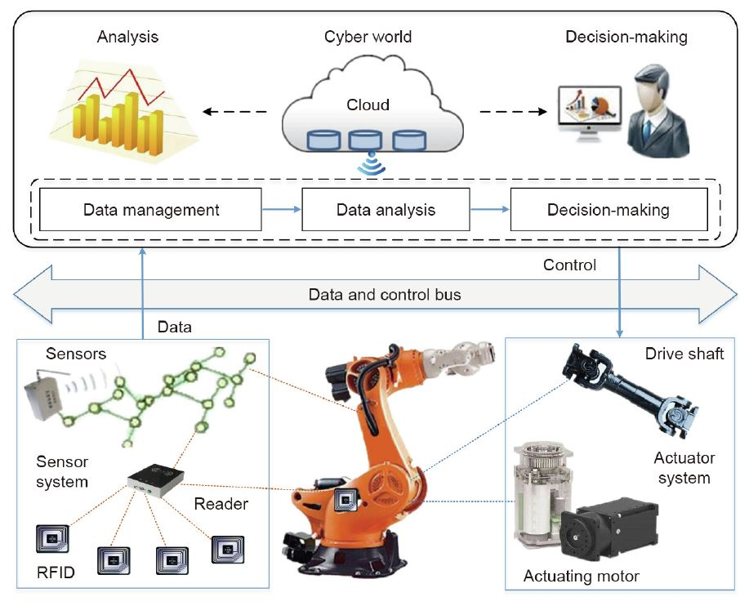
Data analytics in Cyber-Physical Systems
[source: http://www.engineering.org.cn/en/10.1016/j.eng.2019.01.014]

Slide 14
Knowledge Discovery (KDD) Process
Knowledge
This is a view from typical database systems and data warehousing communities
Data mining plays an essential role in the knowledge discovery process
Pattern Evaluation
Data Mining
Task-relevant Data
Data Warehouse
Selection
Data Cleaning
Data Integration
[source: Han 2011]
Databases

Slide 15
Big Data vs. Data-Intensive Computing
Data-intensive computing is a class of parallel computing applications which use a data parallel approach to process large volumes of data typically terabytes or petabytes in size and typically referred to as big data [source: Wikipedia]

Slide 16
Data Analytics
Four general categories of analytics
Descriptive analytics
Diagnostic analytics
Predictive analytics
Prescriptive analytics

Slide 17
Descriptive analytics
To answer questions about events that have already occurred
Sample questions:
What was the sales volume over the past 12 months?
What is the number of support calls received as categorized by severity and geographic location?
What is the monthly commission earned by each sales agent?
描述性分析

Slide 18
Diagnostic analytics
To determine the cause of a phenomenon that occurred in the past
Sample questions:
Why were Q2 sales less than Q1 sales?
Why have there been more support calls originating from the Eastern region than from the Western region?
Why was there an increase in patient re-admission rates over the past three months?
診斷性分析

Slide 19
Predictive analytics
To determine the outcome of an event that might occur in the future
Sample questions:
What are the chances that a customer will default on a loan if they have missed a monthly payment?
What will be the patient survival rate if Drug B is administered instead of Drug A?
If a customer has purchased Products A and B, what are the chances that they will also purchase Product C?
預測性分析

Slide 20
Prescriptive analytics
To prescribe actions that should be taken
Sample questions:
Among three drugs, which one provide the best results?
When is the best time to trade a particular stock?
建議性分析, (指導性分析、處方分析、規範性分析、時效性分析)

Slide 21
Limits of Predictions
Predictive analytics: technology that learns from experience (data) to predict the future behavior of individuals in order to drive better decisions
Accurate prediction is generally not possible
But predictions need not be accurate to bring value
E.g. direct mail marketing
The prediction effect: predicting better than pure guess delivers value

Slide 22
Be Cautious! It’s not almighty
Some challenges
Big data requires “big judgement”
If the systems dynamics of the future change, the past can say little about the future
e.g.: Google Flu Trends
Privacy
Bias, subjective, shallow

Slide 23
What are we going to focus in this course?
Data mining
Frequent pattern mining
Classification
Clustering
Parallel programming in distributed platforms
Hadoop, Spark
MapReduce programming

Slide 24
KDD Process: A Typical View from ML and Statistics
Pattern
Information
Knowledge
Input Data
Data Pre-Processing
Data Mining
Post-Processing
Data integration
Normalization
Feature selection
Dimension reduction
Pattern discovery
Association & correlation
Classification
Clustering
Outlier analysis
… … … …
Pattern evaluation
Pattern selection
Pattern interpretation
Pattern visualization
This is a view from typical machine learning and statistics communities
[source: Han 2011]

Slide 25
Data Mining Function: Association and Correlation Analysis
Frequent patterns (or frequent itemsets)
What items are frequently purchased together in your Walmart?
Association, correlation vs. causality
A typical association rule
Diaper → Beer [0.5%, 75%] (support, confidence)
Are strongly associated items also strongly correlated?
How to mine such patterns and rules efficiently in large datasets?
How to use such patterns for classification, clustering, and other applications?

Slide 26
Data Mining Function: Classification
Classification and label prediction
Construct models (functions) based on some training examples
Describe and distinguish classes or concepts for future prediction
E.g., classify countries based on (climate), or classify cars based on (gas mileage)
Predict some unknown class labels
Typical methods
Decision trees, naïve Bayesian classification, support vector machines, neural networks, rule-based classification, pattern-based classification, logistic regression, …
Typical applications:
Credit card fraud detection, direct marketing, classifying stars, diseases, web-pages, …

Slide 27
Data Mining Function: Cluster Analysis
Unsupervised learning (i.e., Class label is unknown)
Group data to form new categories (i.e., clusters), e.g., cluster houses to find distribution patterns
Principle: Maximizing intra-class similarity & minimizing interclass similarity
Many methods and applications

Slide 28
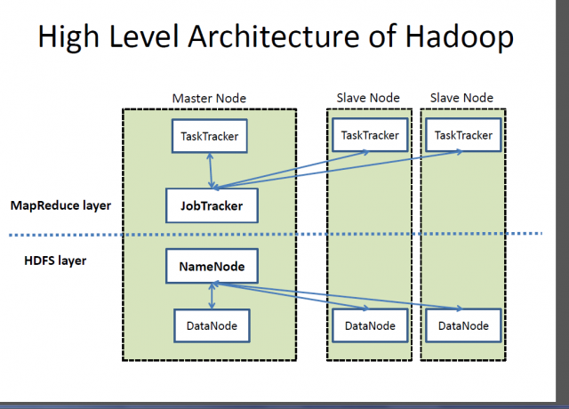
Hadoop Architecture

Slide 29
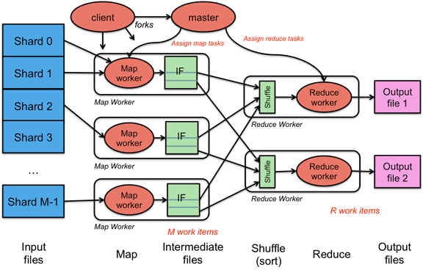
MapReduce

Slide 30
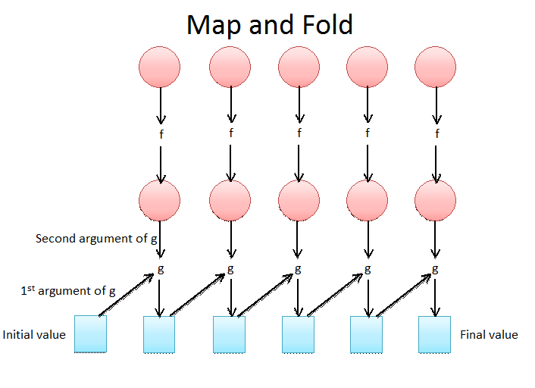
Functional Programming

Slide 31
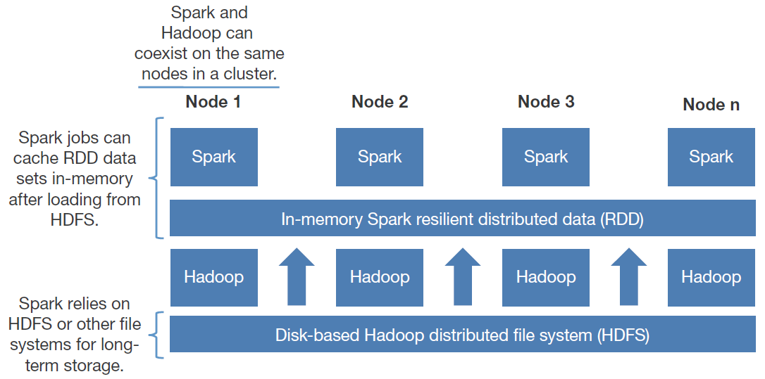
Spark and Hadoop

Slide 32
Some Example Applications of Big Data Analytics
Web query analysis
Financial data analysis
Social network analysis

Slide 33
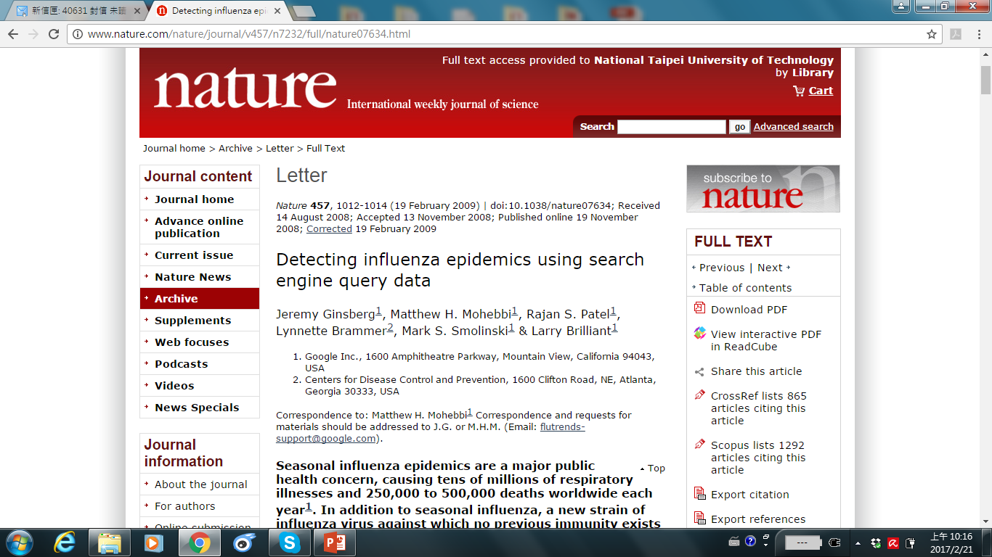
Example: Google FluTrends (GFT)

Slide 34
“Traps in Big Data Analysis?”
GFT failed missing at the peak of the 2013 flu season by 140 percent
It’s dangerous to rely on Google Flu Trends for any decision-making
For example, their algorithm is vulnerable to overfitting to seasonal terms unrelated to the flu, like “high school basketball.”
Google also did not take into account changes in search behavior over time
[Source: David Lazer, Ryan Kennedy, Gary King, and Alessandro Vespignani, The Parable of Google Flu: Traps in Big Data Analysis, Science, Vol 343, Issue 6176, pp. 1203-1205, 14 Mar 2014,DOI: 10.1126/science.1248506]

Slide 35
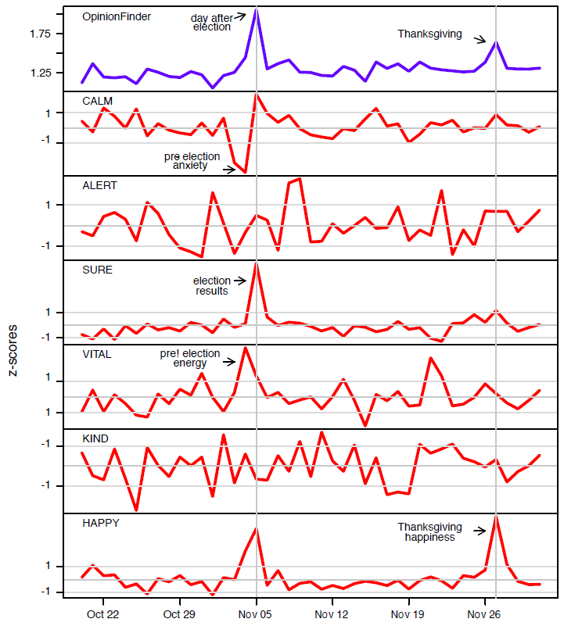
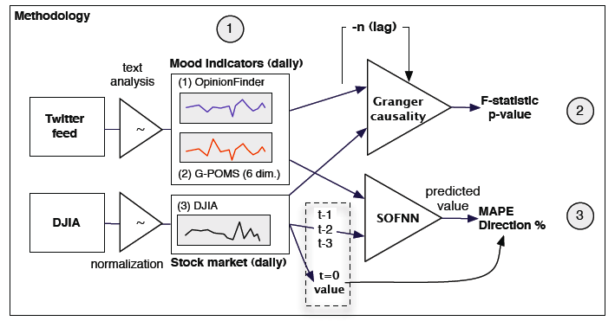
Example: Twitter Mood vs. Stock Market
[Source: Joshua Bollen, Huina Mao, and Xiao-Jun Zeng,
“Twitter Mood Predicts the Stock Market,” Journal of Computational Science, 2(1), 2011]

Slide 36
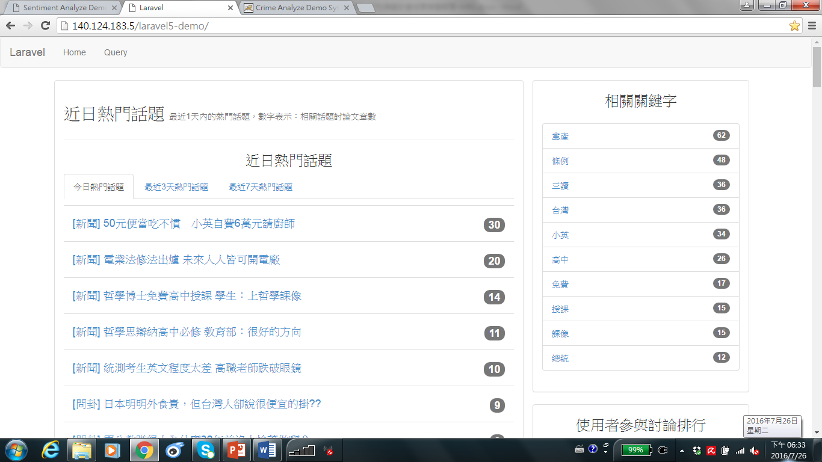
Example: Hot Topic Detection in Online Forums

Slide 37
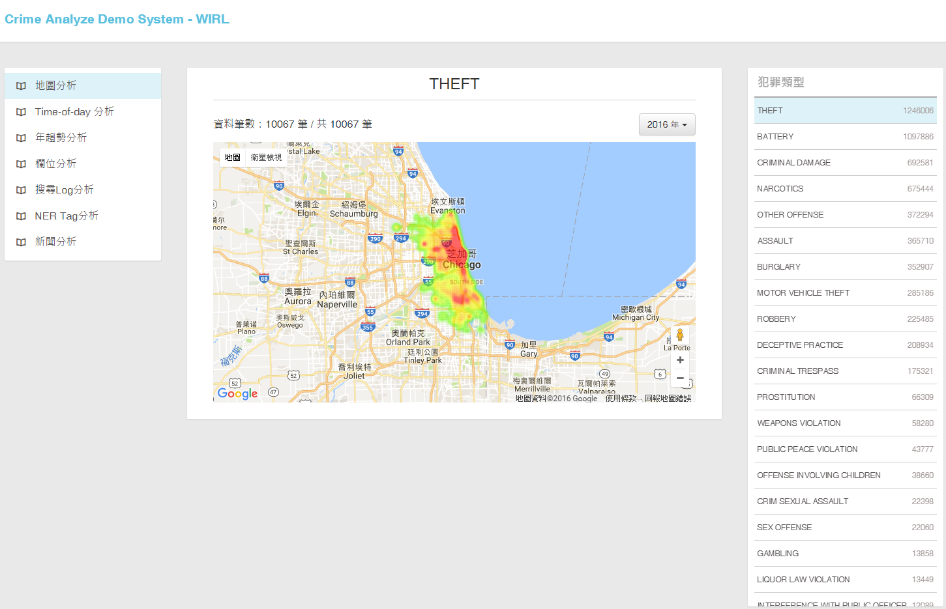
Example: Visualization of Crime Data Analysis Result
[Data source: US City Open Data Census]

Slide 38
References
Eric Siegel, Predictive Analytics: the power to predict who will click, buy, lie, or die, Wiley, 2013.
EMC Education services, Data Science and Big Data Analytics: discovering, analyzing, visualizing and presenting data, Wiley, 2015.
Jiawei Han, Micheline Kamber and Jian Pei, Data Mining: Concepts and Techniques, 3rd ed., Morgan Kaufmann Publishers, July 2011. (Chap. 1)

Slide 39
Thanks for Your Attention!

