Slide 1
Introduction to
Natural Language Processing and Text Mining
J. H. Wang
Feb. 12, 2026
NLP & TM, Spring 2026 (undergraduates)
NTUT CSIE

Slide 2
Outline
Course Information
What are you going to learn in this course?
  What is Natural Language Processing (NLP)?
  Tasks in NLP
  What is Text Mining?
  Tasks in text mining
Summary
NLP & TM, Spring 2026 (undergraduates)
NTUT CSIE

Slide 3
Instructor and TA
Instructor
  Jenq-Haur Wang (王正豪)
  Professor, CSIE, NTUT
  Office: R1534, Technology Building
  E-mail: jhwang@ntut.edu.tw
  Tel: ext. 4238
  Office Hour: 9:10-12:00am on Tuesdays and Fridays
TA
  Mr.Chiu & Mr. Ke (@ R1424, Technology Building)
NLP & TM, Spring 2026 (undergraduates)
NTUT CSIE

Slide 4
Course Overview
Course: Natural Language Processing and Text Mining
  For computer science undergraduates (elective course)
Time:
  15:10-16:00pm on Mondays, 10:10-12:00am on Thursdays
Classroom: R325, Sixth Teaching Building
Course webpage: https://chriswjh.github.io/NLP_TM/
iSchool+: https://istudy.ntut.edu.tw/learn/
Microsoft Teams:
  [NTUT-Sync]114-2_354664_自然語言處理與文件探勘
NLP & TM, Spring 2026 (undergraduates)
NTUT CSIE

Slide 5
Target Students
For
  CSIE Juniors and above, and
  Are familiar with basic data structures, and high-level programming language, and
  Are willing to investigate the concepts and techniques in natural language processing and text mining (and large language models!)
Prerequisite:
  Data Structures
  Working knowledge of a high-level programming language for (programming exercises and) projects
NLP & TM, Spring 2026 (undergraduates)
NTUT CSIE

Slide 6
Resources
Textbook: Dan Jurafsky and James H. Martin. Speech and Language Processing (3rd ed. draft) [SLP3]
  https://web.stanford.edu/~jurafsky/slp3/
  Current edition of the draft: Jan. 6, 2026
References:
  Chris Manning and Hinrich Schütze, Foundations of Statistical Natural Language Processing, MIT Press. Cambridge, MA: May 1999. [FSNLP]
    https://nlp.stanford.edu/fsnlp/
  Stanford Course CS224N: Natural Language Processing with Deep Learning
    http://web.stanford.edu/class/cs224n/
  UIUC Course CS447: Natural Language Processing
    https://courses.grainger.illinois.edu/cs447/sp2023/
  UIUC Course CS512: Data Mining: Principles and Algorithms [Han]
    https://wiki.illinois.edu//wiki/display/cs512/Lectures
  Papers, online documents, and other related materials
NLP & TM, Spring 2026 (undergraduates)
NTUT CSIE

Slide 7
Resources
  More references
    Charu C. Aggarwal, Machine Learning for Text, Springer 2017
    Chao Zhang and Jiawei Han, Multidimensional Mining of Massive Text Data, Morgan & Claypool Publishers, 2019
    Xiang Ren and Jiawei Han, Mining Structures of Factual Knowledge from Text: An Effort-Light Approach, Morgan & Claypool Publishers, 2018
    Jialu Liu, Jingbo Shang and Jiawei Han, Phrase Mining from Massive Text and Its Applications, Morgan & Claypool, 2017
NLP & TM, Spring 2026 (undergraduates)
NTUT CSIE

Slide 8
Teaching
Lectures: in PowerPoint slides
About 3-4 homework and program assignments
  Should be turned in within two weeks
    Late submissions are penalized at a fixed rate determined by the TA, e.g. 10% per week
    No submission allowed after reference solution is announced
  Submission site: i-School+
One mid-term exam
Term project: applying NLP and mining techniques on text documents
NLP & TM, Spring 2026 (undergraduates)
NTUT CSIE

Slide 9
Grading Policy
(Tentative) Grading policy
  Written and programming exercises: ~35-40%
  Midterm exam: ~30%
  Term project: ~30-35%
  No submission of homeworks and programs allowed *after* the end of the semester (Jun. 26, 2026)
For those not familiar with the “midterm alert”,
  Rule#1: ! (∀x, alerted(x) => failed(x))
  Rule#2: ! (∀x, !alerted(x) => !failed(x)
  Conclusion: pay attention to your own potential score range as early as possible!
NLP & TM, Spring 2026 (undergraduates)
NTUT CSIE

Slide 10
Textbook Outline
Textbook Outline: [SLP3]
  Vol. I: Large Language Models (Ch. 1-16)
    Introduction
    Words and Tokens
    N-gram Language Models
    Logistic Regression and Text Classification
    Embeddings
    Neural Networks
    Large Language Models
    Transformers
    Post-training: Instruction Tuning, Alignment, and Test-Time Compute
    Masked Language Models
    Information Retrieval and Retrieval-Augmented Generation
NLP & TM, Spring 2026 (undergraduates)
NTUT CSIE

Slide 11
Textbook Outline (Cont’d)
Outline (cont’d)
    Machine Translation
    RNNs and LSTMs
    Phonetics and Speech Feature Extraction
    Automatic Speech Recognition
    Text-to-Speech
  Vol. II: Annotating linguistic structures (Ch. 17-25) (skipped)
    Sequence Labeling for Parts of Speech and Named Entities
    Context-Free Grammars and Constituency Parsing
    Dependency Parsing
    Information Extraction: Relations, Events, and Time
    Semantic Role Labeling and Argument Structure
NLP & TM, Spring 2026 (undergraduates)
NTUT CSIE

Slide 12
Textbook Outline (Cont’d)
Outline (cont’d)
    Lexicons for Sentiment, Affect, and Connotation
    Coreference Resolution and Entity Linking
    Discourse Coherence
    Conversation and its Structure
  Appendix: on the Web (A-K, skipped)
    Hidden Markov Models
    Naïve Bayes Classification
    Kneser-Ney Smoothing
    Spelling Correction and the Noisy Channel
    Statistical Constituency Parsing
    Context-Free Grammars
    Combinatory Categorical Grammar
    Logical Representations of Sentence Meaning
    Word Senses and WordNet
    PPMI
    Frame-based Dialogue Systems
NLP & TM, Spring 2026 (undergraduates)
NTUT CSIE

Slide 13
Textbook Outline (Cont’d)
Outline: (cont’d) [Han]
  UIUC CS512: (Case studies)
    Embeddings
    Phrase Mining
    Named Entity Recognition
    Pattern-based Text Mining
    Taxonomy Mining
    Mining Heterogeneous Information Networks
    Truth Finding
NLP & TM, Spring 2026 (undergraduates)
NTUT CSIE

Slide 14
Course Schedule
(Tentative) Course schedule
  Introduction: 1-2 wks
  Fundamental NLP algorithms: 6-7 wks
  Midterm
  Deep learning for NLP: 2-3 wks
  Text mining case studies: 3-4 wks
  Term project presentation: 2-3 wks
NLP & TM, Spring 2026 (undergraduates)
NTUT CSIE

Slide 15
About Programming Exercises
Programming exercises are team-based
  Maximum number of students allowed in a team: two
  Any programming language is acceptable
Selected topics from basic natural language processing stages, for example,
  Sentiment classification
  Named entity recognition
  Semantics analysis
  …
NLP & TM, Spring 2026 (undergraduates)
NTUT CSIE

Slide 16
Notes on Homeworks
Rule 1: Plagiarism is prohibited
  Near-duplicate codes will get equal and minimum basic scores
Rule 2: Clear documentation is required for your program
  Instructions on downloading, installing, configuring, and executing your code and open source library, APIs, or codes must be submitted
NLP & TM, Spring 2026 (undergraduates)
NTUT CSIE

Slide 17
About the Midterm Exam
Date: Apr. 23, 2026 (TBD)
Time: 10:10-12:00am, Thursday
Location: R325, Sixth Teaching Building
Range: Ch.1-7, 17 (TBD)
Question Types: Calculation, Short Answer, True-False, Multiple Choice
NLP & TM, Spring 2026 (undergraduates)
NTUT CSIE

Slide 18
About Term Project
Proposals, presentations, and reports are *required* for each team, and will be counted in the score
  Proposal: A one-page description of your idea on how you are going to apply NLP/mining techniques on what kinds of data
    You can either write your own program, or call existing open source code or library (but NOT executing binary code only)
  Presentation: 20 minutes per team
    Data description, system functions, and result interpretation
  Reports: slides, source code, and document
NLP & TM, Spring 2026 (undergraduates)
NTUT CSIE

Slide 19
More on Term Projects
Tentative schedule for all teams:
  Proposal: *required* one week after midterm (Apr. 30, 2026)
  Presentations (including demos): *required* in the last three weeks (starting as early as Jun. 8, 2026)
  Final report: *required* before the end of the semester (Jun. 26, 2026)
    Slides, source code, documentation
NLP & TM, Spring 2026 (undergraduates)
NTUT CSIE

Slide 20
Notes on Signing up the Course
The vacancy depends on the classroom capacity
The priority of signing up the course:
  CSIE (資工) majors first
  NTUT Seniors (大四)
  Interdisciplinary micro programs (跨域微學程)
  Minors/double majors (輔系/雙主修) in CS
  External students
    USTP (University System of Taipei, 北聯大)
    Auditor (隨班附讀)
    Others
NLP & TM, Spring 2026 (undergraduates)
NTUT CSIE

Slide 21
Outline
Course Information
What are you going to learn in this course?
  What is Natural Language Processing (NLP)?
  Tasks in NLP
  What is Text Mining?
  Tasks in text mining
Summary
NLP & TM, Spring 2026 (undergraduates)
NTUT CSIE

Slide 22
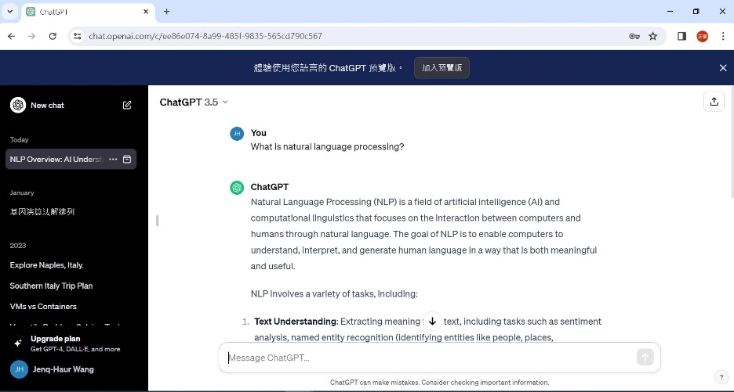
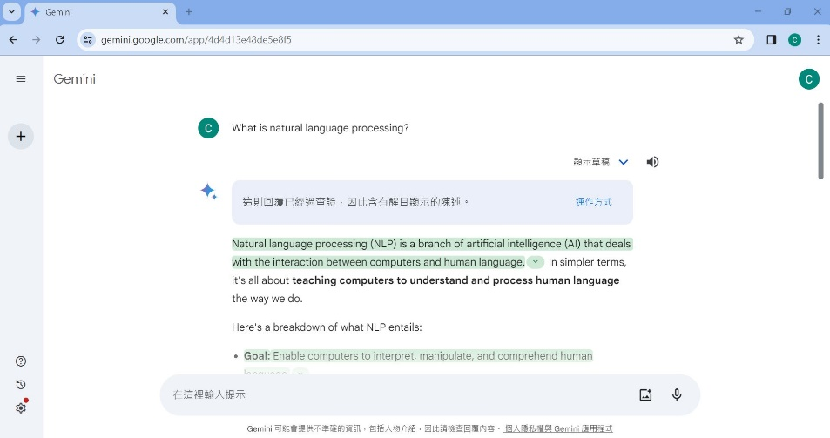


What you might think This Course is about
ChatGPT?
Gemini? (previously Bard)
How to use LLMs?
NLP & TM, Spring 2026 (undergraduates)
NTUT CSIE

Slide 23
Natural Language Processing
Natural language processing (NLP) is an interdisciplinary subfield of linguistics, computer science, and artificial intelligence concerned with the interactions between computers and human language, in particular how to program computers to process and analyze large amounts of natural language data
Natural language processing is largely equivalent with (applied) computational linguistics
[source: Wikipedia]
NLP & TM, Spring 2026 (undergraduates)
NTUT CSIE

Slide 24
What is Language?
Language is a structured system of communication that consists of grammar and vocabulary
It is the primary means by which humans convey meaning, both in spoken and written forms, and may also be conveyed through sign languages
Linguistics is the scientific study of human language
[source: Wikipedia]
NLP & TM, Spring 2026 (undergraduates)
NTUT CSIE

Slide 25
What is Natural Language?
A natural language or ordinary language is any language that has evolved naturally in humans through use and repetition without conscious planning or premeditation
Different from
  Constructed languages (e.g. programming languages)
  Formal languages (e.g. regular expressions)
[source: Wikipedia]
NLP & TM, Spring 2026 (undergraduates)
NTUT CSIE

Slide 26
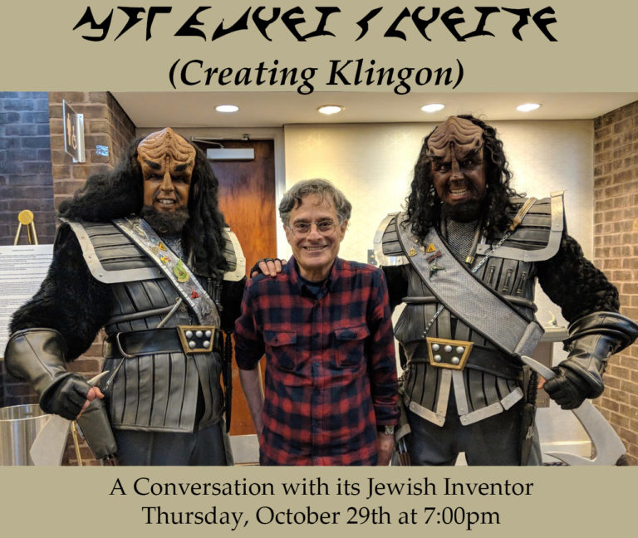
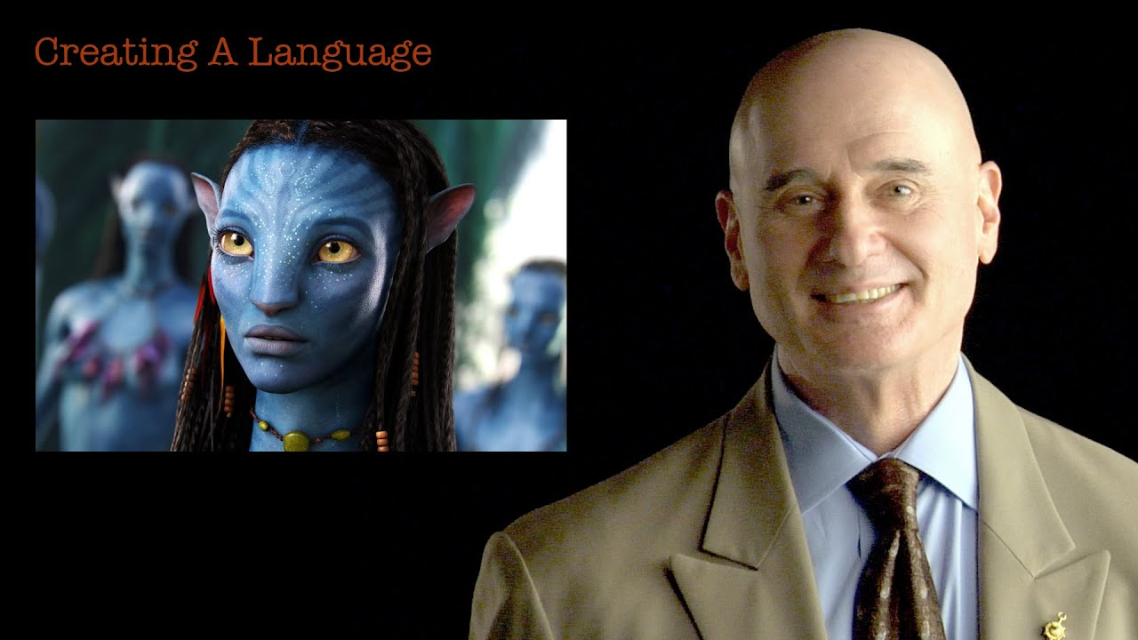
Constructed languages
A constructed language is a language whose phonology, grammar, and vocabulary, instead of having developed naturally, are consciously devised for some purpose, which may include being devised for a work of fiction.
E.g.
  Klingon in Star Treks
  Na’vi in Avatar
  …
  [source: Wikipedia]
  [source: https://jewishmuseummd.org/events/creating-klingon-members-only/]
  [source: https://omniglot.com/conscripts/nav.htm]
NLP & TM, Spring 2026 (undergraduates)
NTUT CSIE

Slide 27
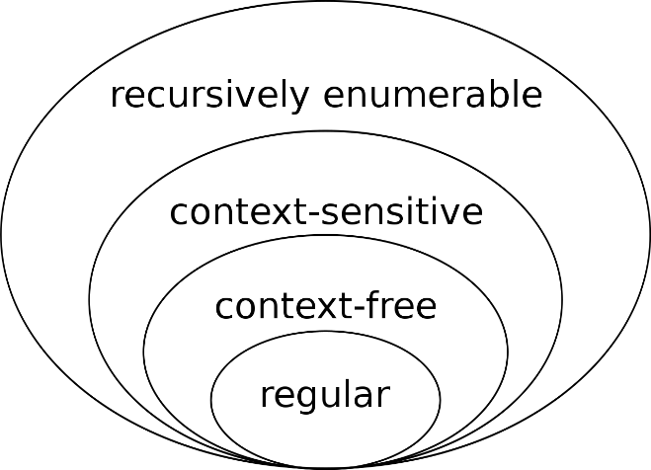
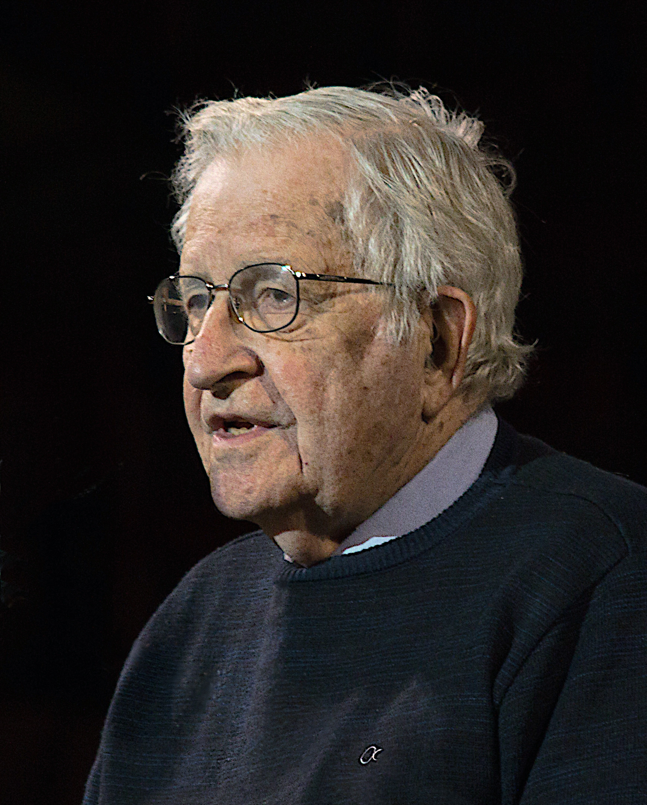
Formal Languages
In logic, mathematics, computer science, and linguistics, a formal language consists of words whose letters are taken from an alphabet and are well-formed according to a specific set of rules
  Regular expressions
  Context-free languages
  …
[source: Wikipedia]
NLP & TM, Spring 2026 (undergraduates)
NTUT CSIE

Slide 28
Typical Tasks in NLP
Part-of-Speech (POS) tagging
Named Entity Recognition (NER)
Word Sense Disambiguation
Co-reference resolution
Dependency parsing
Sentiment Analysis
…
NLP & TM, Spring 2026 (undergraduates)
NTUT CSIE

Slide 29
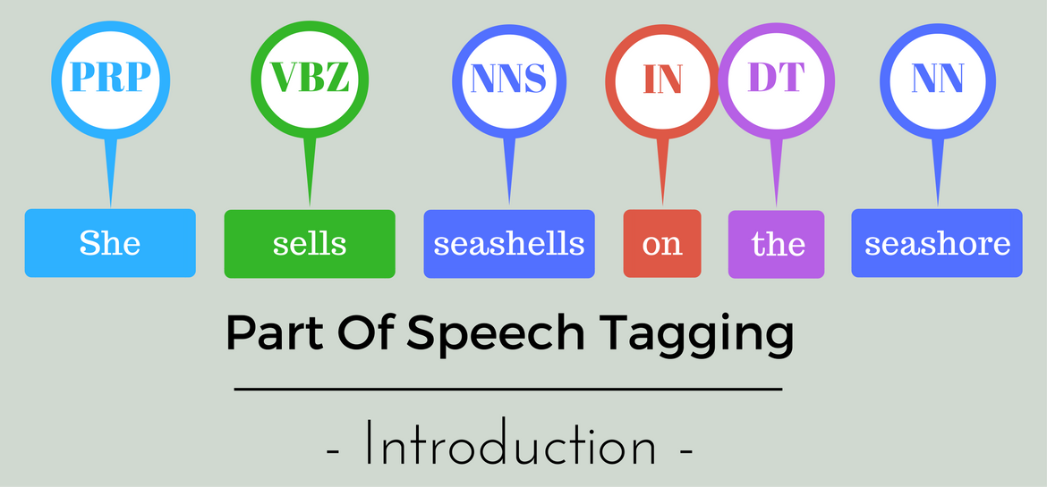
Some Examples
POS tagging
[source: https://nlpforhackers.io/training-pos-tagger/]
NLP & TM, Spring 2026 (undergraduates)
NTUT CSIE

Slide 30
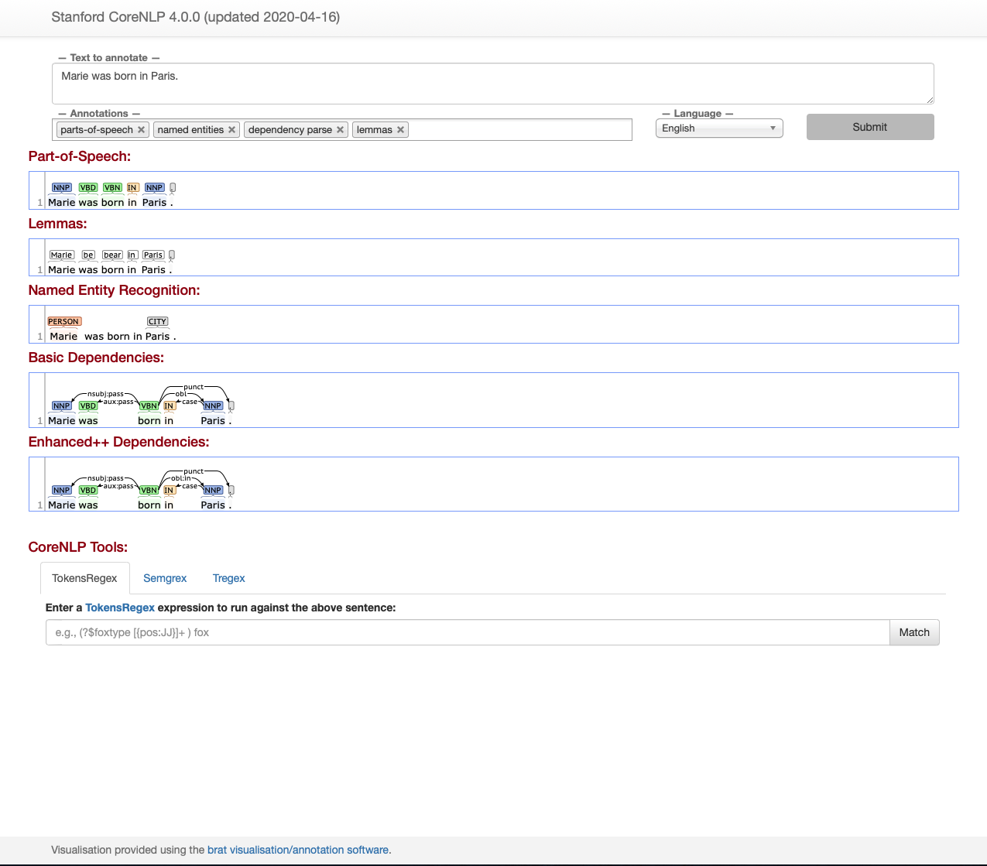
Some Examples
Marie was born in Paris.
[source: https://stanfordnlp.github.io/CoreNLP/]
NLP & TM, Spring 2026 (undergraduates)
NTUT CSIE

Slide 31
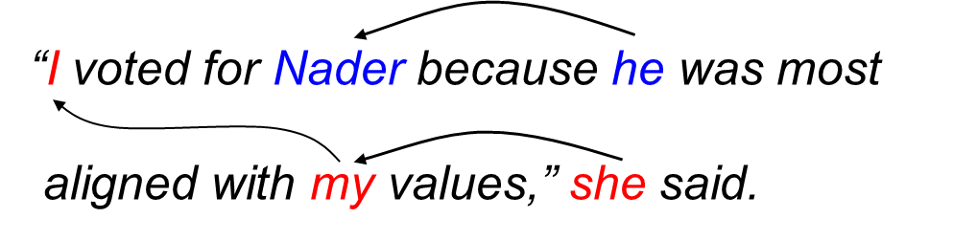
Some Examples
Coreference resolution
[source: The Stanford Natural Language Processing Group]
NLP & TM, Spring 2026 (undergraduates)
NTUT CSIE

Slide 32
What is Text Mining?
Text mining, text data mining (TDM) or text analytics is the process of deriving high-quality information from text
  Structuring the input text
  Deriving patterns
  Evaluation and
  interpretation of the output
NLP
IR
statistics
TDM
IE
DM
NLP & TM, Spring 2026 (undergraduates)
NTUT CSIE

Slide 33
Knowledge Discovery (KDD) Process
This is a view from typical database systems and data warehousing communities
Data mining plays an essential role in the knowledge discovery process
Knowledge
Pattern Evaluation
Data Mining
Task-relevant Data
Data Warehouse
Selection
Data Cleaning
Data Integration
Databases
[source: Han 2011]
NLP & TM, Spring 2026 (undergraduates)
NTUT CSIE

Slide 34
An Example Text Mining Process
What’s different for text mining?
Knowledge
Pattern Evaluation
Text Mining
Task-relevant Text
Structured format
Selection
Preprocessing
Data Integration
Text docs
Unstructured data
[source: modified from Han 2011]
NLP & TM, Spring 2026 (undergraduates)
NTUT CSIE

Slide 35
Typical Tasks in Text Mining
Text categorization (classification)
Text clustering
Concept/term extraction
Taxonomy generation
Sentiment analysis
Document summarization
Entity relation modeling
…
NLP & TM, Spring 2026 (undergraduates)
NTUT CSIE

Slide 36
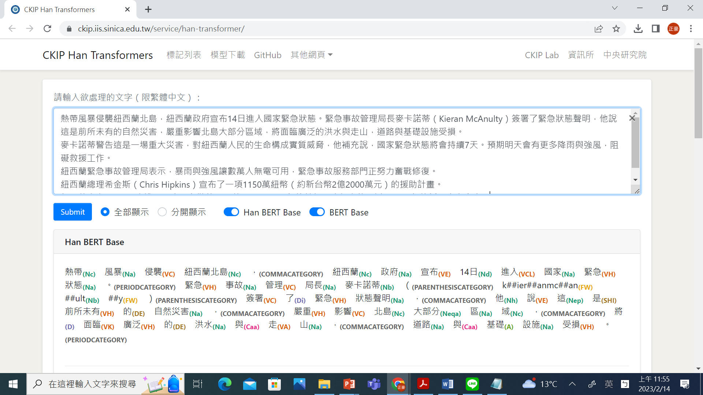
Some Examples
[source: https://ckip.iis.sinica.edu.tw/demo]
NLP & TM, Spring 2026 (undergraduates)
NTUT CSIE

Slide 37


Some Examples
Email spam filter
Spam filter
[source: flaticon]
NLP & TM, Spring 2026 (undergraduates)
NTUT CSIE

Slide 38

Some Examples
Google news
NLP & TM, Spring 2026 (undergraduates)
NTUT CSIE

Slide 39
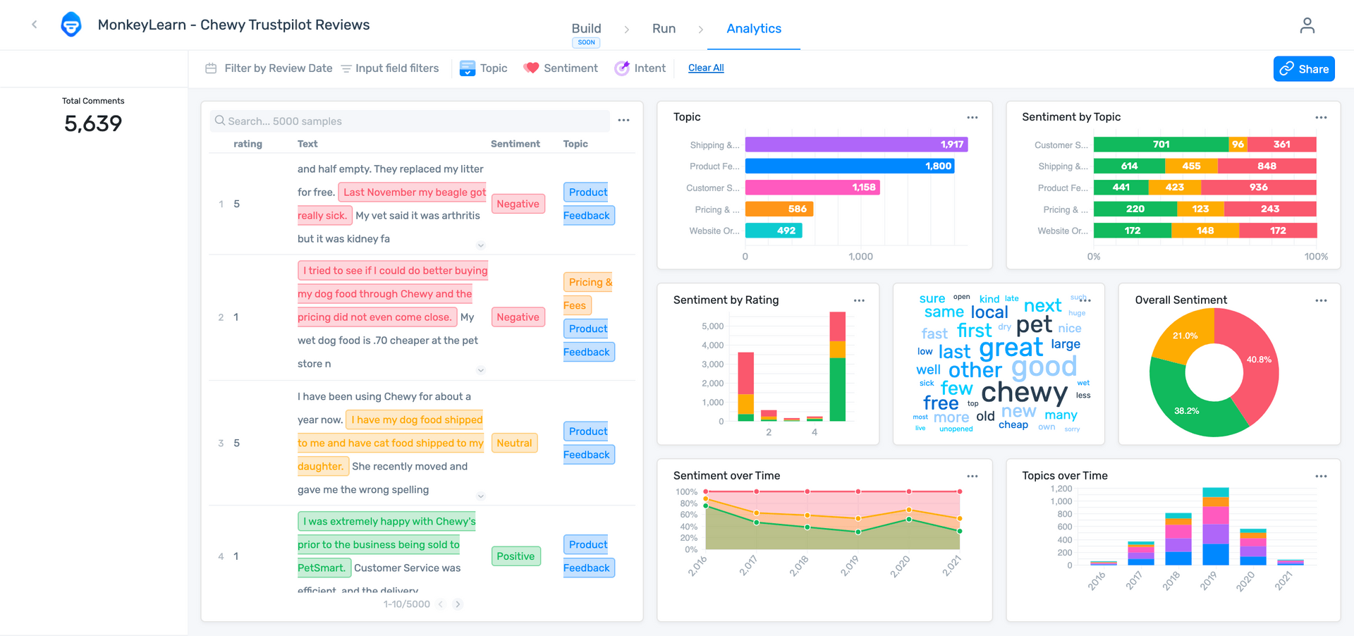
Some Examples
Sentiment analysis
[source: https://monkeylearn.com/sentiment-analysis/]
NLP & TM, Spring 2026 (undergraduates)
NTUT CSIE

Slide 40

What is This Course about?
Introduction to concepts of natural language processing
  Structure: syntax and morphology
  Sounds: phonetics and phonology
  Meaning: semantics and pragmatics
Introduction to statistical and neural methods for text mining
AI
DM
IR
NLP
Computer Science
Human Language
NLP & TM, Spring 2026 (undergraduates)
NTUT CSIE

Slide 41
Examples in Morphological Analysis
Morphology is the study of words, how they are formed, and their relationship to other words in the same language
What is a word?
  Lexeme, word-form
  E.g.: eat, eats, eaten, ate
Tasks: lemmatization, stemming, POS tagging, word segmentation, …
NLP & TM, Spring 2026 (undergraduates)
NTUT CSIE

Slide 42
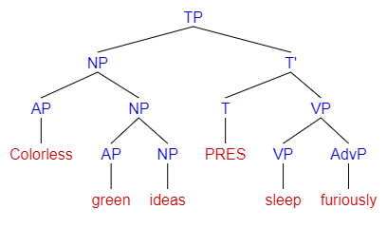
Examples in Syntactic Analysis
Syntax is the study of how words and morphemes combine to form larger units such as phrases and sentences
E.g.: “Colorless green ideas sleep furiously.” (by Noam Chomsky, 1957)
Tasks: parsing, …
[source: Wikipedia]
NLP & TM, Spring 2026 (undergraduates)
NTUT CSIE

Slide 43
Examples in Semantic Analysis
Semantics is the study of lexical and grammatical aspects of meaning
  Lexical semantics is the study of word meanings
    It includes the study of how words structure their meaning, how they act in grammar and compositionality, and the relationships between the distinct senses and uses of a word
    E.g.: hyponym, hypernym, synonym, antonym, homonym, polyseme
  Tasks: Named entity recognition (NER), term extraction, Word sense disambiguation (WSD), sentiment analysis, …
NLP & TM, Spring 2026 (undergraduates)
NTUT CSIE

Slide 44
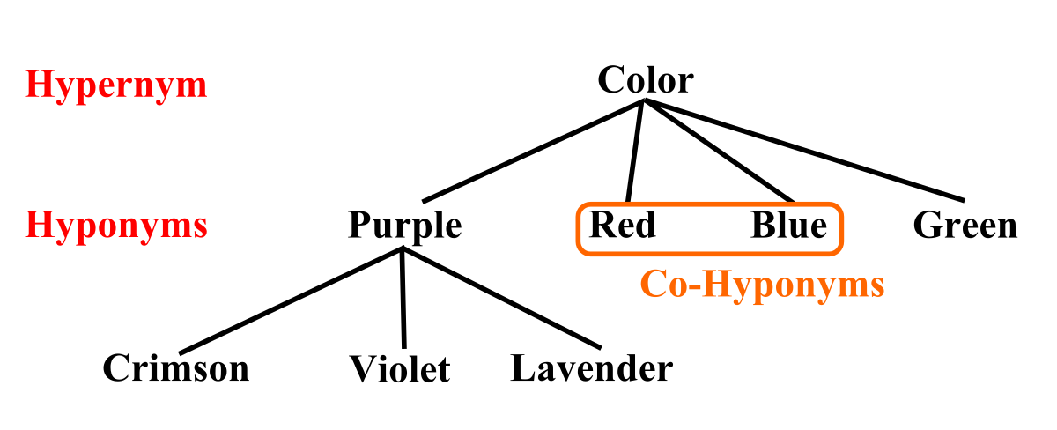
Hypernyms and Hyponyms
[source: Wikipedia]
NLP & TM, Spring 2026 (undergraduates)
NTUT CSIE

Slide 45
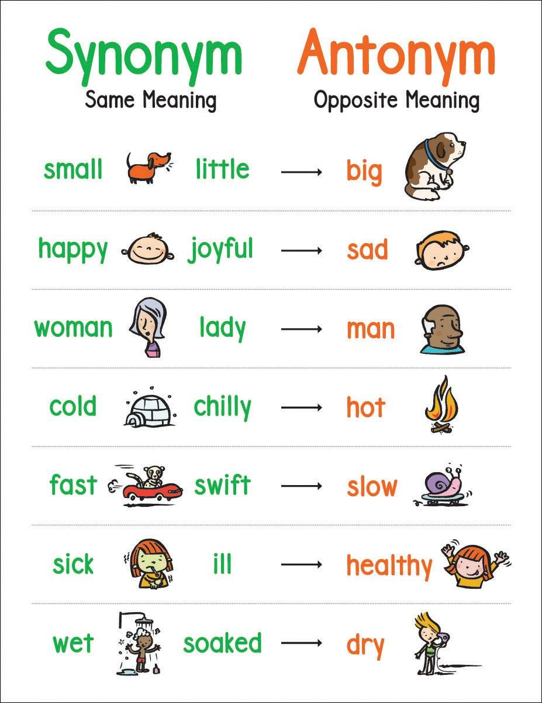
Synonyms and Antonyms
[source: Amazon.in]
NLP & TM, Spring 2026 (undergraduates)
NTUT CSIE

Slide 46
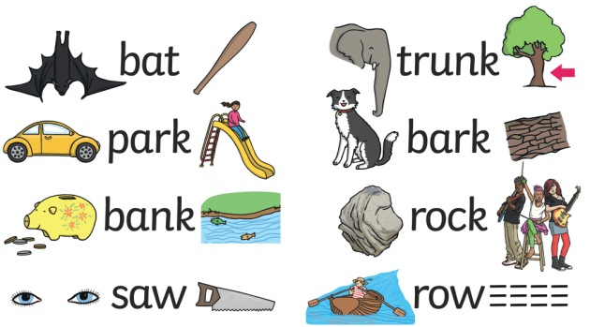
Homonyms
[source: Twinkl]
NLP & TM, Spring 2026 (undergraduates)
NTUT CSIE

Slide 47
Why do you need to learn NLP and text mining techniques?
It’s useful in many applications
Huge amount of unstructured data in social networks and all industries
Text data are everywhere
To gain deeper meaning and understanding of information more efficiently
NLP & TM, Spring 2026 (undergraduates)
NTUT CSIE

Slide 48

Example Use Cases of NLP in Healthcare
[source: https://marutitech.com/use-cases-of-natural-language-processing-in-healthcare/]
NLP & TM, Spring 2026 (undergraduates)
NTUT CSIE

Slide 49
With LLMs, do I Still Need to Learn NLP?
Answer: Yes.
To learn how LLMs work
To know the limitations of LLMs
To judge if answers from LLMs are correct, and know how to correct them
To tell if LLMs are lying, or hallucinating
NLP & TM, Spring 2026 (undergraduates)
NTUT CSIE

Slide 50
Thanks for Your Attention!
NLP & TM, Spring 2026 (undergraduates)
NTUT CSIE

