Slide 1
Chap. 8: Sequence Labeling for Parts of Speech and Named Entities

Slide 2
Reference
Ch.8: Sequence Labelling for Parts of Speech and Named Entities, Dan Jurafsky and James H. Martin. Speech and Language Processing (3rd ed. draft)

Slide 3
Outline
Part of Speech Tagging
Named Entity Recognition (NER)

Slide 4
Sequence Labeling for Part of Speech and Named Entities
Part of Speech Tagging
Notes:
Let's introduce the task of part-of-speech tagging

Slide 5
Parts of Speech
From the earliest linguistic traditions (Yaska and Panini 5th C. BCE, Aristotle 4th C. BCE), the idea that words can be classified into grammatical categories
part of speech, word classes, POS, POS tags
8 parts of speech attributed to Dionysius Thrax of Alexandria (c. 1st C. BCE):
noun, verb, pronoun, preposition, adverb, conjunction, participle, article
These categories are relevant for NLP today
Notes:
5
From the earliest linguistic traditions (the Sanskrit grammarians Yaska and Panini in India, the Aristotle and the Stoics in Greece), came idea that words can be classified into grammatical categories, what we now call parts of speech, word classes, or sometimes just for short, POS or POS tags.
By 100 BCE, Dionysius Thrax settled on a set of eight that became the basis for descriptions of European languages for the next 2000 years.
The durability of parts of speech through two millennia speaks to their centrality in models of human language.

Slide 6
Two classes of words: Open vs. Closed
Closed class words
Relatively fixed membership
Usually function words: short, frequent words with grammatical function
determiners: a, an, the
pronouns: she, he, I
prepositions: on, under, over, near, by, …
Open class words
Usually content words: Nouns, Verbs, Adjectives, Adverbs
Plus interjections: oh, ouch, uh-huh, yes, hello
New nouns and verbs like iPhone or to fax
Notes:
6
Let's talk about some parts of speech. While these word classes do have semantic tendencies—adjectives, for example, often describe properties and nouns people— parts of speech are defined instead based on their grammatical relationship with neighboring words or the morphological properties about their affixes.
Parts of speech fall into two broad categories: closed class and open class. Closed classes are those with relatively fixed membership, such as prepositions— new prepositions are rarely coined. By contrast, nouns and verbs are open classes— new nouns and verbs like iPhone or to fax are continually being created or borrowed. Closed class words are generally function words like of, it, and, or you, which tend to be very short, occur frequently, and often have structuring uses in grammar.
Four major open classes occur in the languages of the world: nouns (including proper nouns), verbs, adjectives, and adverbs, as well as the smaller open class of interjections. English has all five, although not every language does.

Slide 7
Open class ("content") words
Nouns
Verbs
Adjectives
old green tasty
Proper
Common
Main
Adverbs
slowly yesterday
Janet
Italy
cat, cats
mango
eat
went
Interjections
Ow hello
Numbers
… more
122,312
one
Closed class ("function")
Auxiliary
Determiners
the some
can
had
Prepositions
to with
Conjunctions
and or
Particles
off up
… more
Pronouns
they its
Notes:
Nouns are words for people, places, or things, but include others as well. Common nouns include concrete terms like cat and mango, abstractions like algorithm and beauty, and verb-like terms like pacing as in His pacing to and fro became quite annoying.
Verbs refer to actions and processes, including open-class main verbs like draw, provide, and go. and closed-class auxiliary verbs like "can", "will", "had" Auxiliary verbs can mark semantic features of a main verb such as its tense, aspect, or made.
Adjectives often describe properties or qualities of nouns, like color (white, black), age (old, young), and value (good, bad)
Other closed class or function words include Pronouns act as a shorthand for referring to an entity or event, or
conjunctions that join two phrases, clauses, or sentences, including Coordinating conjunc- tions like and, or, and but, or subordinating conjunctions like that in “I thought that you might like some milk” that links "the verb thought" with the clause "you might like some milk".

Slide 8
Part-of-Speech Tagging
Assigning a part-of-speech to each word in a text
Words often have more than one POS
book:
VERB: (Book that flight)
NOUN: (Hand me that book)
Notes:
Part-of-speech tagging is the process of assigning a part-of-speech to each word in a text.
Tagging is a disambiguation task; words are ambiguous —have more than one possible part-of-speech—and the goal is to find the correct tag for the situation.
For example, book can be a verb (book that flight) or a noun (hand me that book).

Slide 9
Part-of-Speech Tagging
Map from sequence x₁,…,x_{n} of words to y₁,…,y_{n} of POS tags
Notes:
Here's a sketch of part of speech tagging. The input is a sequence x1,x2,...,xn of (tokenized) words and a tagset, and the output is a sequence y1,y2,...,yn of tags, each output yi corresponding exactly to one input xi,

Slide 10
"Universal Dependencies" Tagset
Nivre et al. 2016

Slide 11
Sample "Tagged" English sentences
There/PRO were/VERB 70/NUM children/NOUN there/ADV ./PUNC
Preliminary/ADJ findings/NOUN were/AUX reported/VERB in/ADP today/NOUN ’s/PART New/PROPN England/PROPN Journal/PROPN of/ADP Medicine/PROPN
Notes:
Here are some sample tagged sentences. Notice that we have to make decisions about segmentation (punctuation, or the English 's is often segmented off as a particular), and the same word can have different tags in different sentences.

Slide 12
Why Part of Speech Tagging?
Can be useful for other NLP tasks
Parsing: POS tagging can improve syntactic parsing
MT: reordering of adjectives and nouns (say from Spanish to English)
Sentiment or affective tasks: may want to distinguish adjectives or other POS
Text-to-speech (how do we pronounce “lead” or "object"?)
Or linguistic or language-analytic computational tasks
Need to control for POS when studying linguistic change like creation of new words, or meaning shift
Or control for POS in measuring meaning similarity or difference
Notes:
Part of speech tagging is useful for NLP tasks, most notably for parsing, where it has long played a part, but also for machine translation, sentiment, or even text-to-speech systems. For example "lead" is pronounced "lead" when it is a noun, but "lead" when it is a verb, or "object" is pronounced OBject when it is a noun, but object when it is a verb.
Tagging is also important for linguistic or language-analytic computational tasks, like studying the creation of new words, or measuring meaning similarity or difference.

Slide 13
How difficult is POS tagging in English?
Roughly 15% of word types are ambiguous
Hence 85% of word types are unambiguous
Janet is always PROPN, hesitantly is always ADV
But those 15% tend to be very common
So ~60% of word tokens are ambiguous
E.g., back
earnings growth took a back/ADJ seat
a small building in the back/NOUN
a clear majority of senators back/VERB the bill
enable the country to buy back/PART debt
I was twenty-one back/ADV then
Notes:
How hard is POS tagging. In English, only 15% of word types are ambiguous. So 85% of words don't need any disambiguating; Janet is always a proper noun, hesitantly is always an adverb.
But those 15% ambiguous words tend to be common words, and so they occur far more than 15% of the time; indeed around 60% of word tokens in running text are ambiguous. So for example the word "back" can have one of 5 part of speech tags.

Slide 14
POS tagging performance in English
How many tags are correct? (Tag accuracy)
About 97%
Hasn't changed in the last 10+ years
HMMs, CRFs, BERT perform similarly
Human accuracy about the same
But baseline is 92%!
Baseline is performance of stupidest possible method
"Most frequent class baseline" is an important baseline for many tasks
Tag every word with its most frequent tag
(and tag unknown words as nouns)
Partly easy because
Many words are unambiguous
Notes:
How accurate are modern POS taggers? Quite accurate; for English, and a for a few other languages where we have sufficient hand-labeled training data, and which have sufficiently simple morphology, tagging is a mostly solved problem.
The accuracy, that is, the percentage of tokens that the tagger assigns the correct tag to, is about 97%
Of course, for English, the baseline itself is quite high. What's called the most frequent class baesline is simply to tag every word with its most frequent tag. For unknown words, tag them as nouns. This baseline gets around 92% accuracy, simply because, as we've seen, many words are not ambiguous.

Slide 15
Sources of information for POS tagging
Janet will back the bill
AUX/NOUN/VERB? NOUN/VERB?
Prior probabilities of word/tag
"will" is usually an AUX
Identity of neighboring words
"the" means the next word is probably not a verb
Morphology and wordshape:
Prefixes unable: un- → ADJ
Suffixes importantly: -ly → ADJ
Capitalization Janet: CAP → PROPN
Notes:
Part of speech taggers generally make use of three sources of information: let's consider disambiguating the words in the sentence "Janet will back the bill".
One source is the prior probability of the word having that tag; so the word "will" is usually an AUX, less frequently a Noun (like someone "of strong will") or VERB. Another source is the neighboring words. "the" usually precedes adjectives and nouns, not verbs. And the final is the makeup of the word itself; the prefex "un" often indicates an adjective, the suffix "ly" almost always an adverb, and capitalization is a strong hint word proper nouns.

Slide 16
Standard algorithms for POS tagging
Supervised Machine Learning Algorithms:
Hidden Markov Models
Conditional Random Fields (CRF)/ Maximum Entropy Markov Models (MEMM)
Neural sequence models (RNNs or Transformers)
Large Language Models (like BERT), finetuned
All required a hand-labeled training set, all about equal performance (97% on English)
All make use of information sources we discussed
Via human created features: HMMs and CRFs
Via representation learning: Neural LMs
Notes:
POS tagging can be done with classic supervised machine learning algorithms like Hidden Markov Models or Conditional Random Fields, or with neural models, either neural sequence models trained from scratch, or large language models, finetuned.
For English, with sufficient training data, all achieve about equal performance.
And all make use of the information sources we discussed; HMMs and CRFs via human-created features, and the neural models by inducing these features via representation learning.

Slide 17
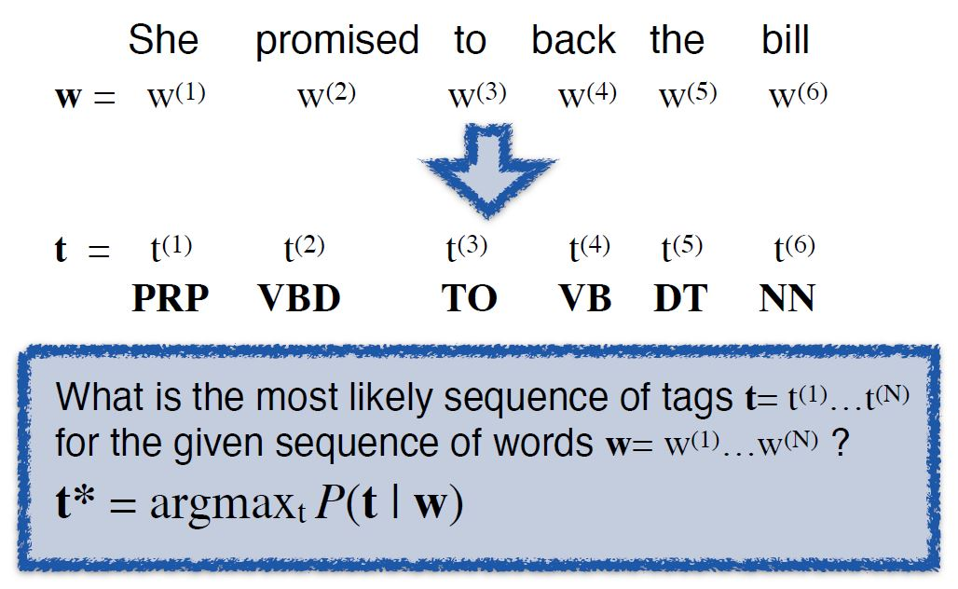
Statistical POS Tagging
[Source: UIUC CS447 Slides by Julia Hockenmaier]

Slide 18
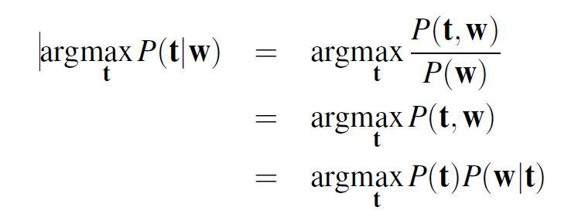
POS tagging with generative models
P(t): the probability that generates the label
P(w|t): the probability that generates the word, based on the label
[Source: UIUC CS447 Slides by Julia Hockenmaier]

Slide 19
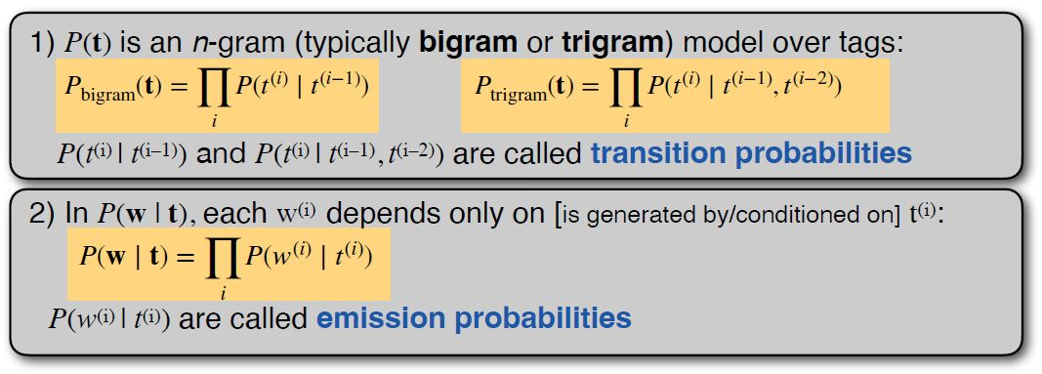
Hidden Markov Models (HMMs)
HMMs: the most commonly used generative models for POS tagging (and other tasks)
Independence assumptions:
[Source: UIUC CS447 Slides by Julia Hockenmaier]

Slide 20
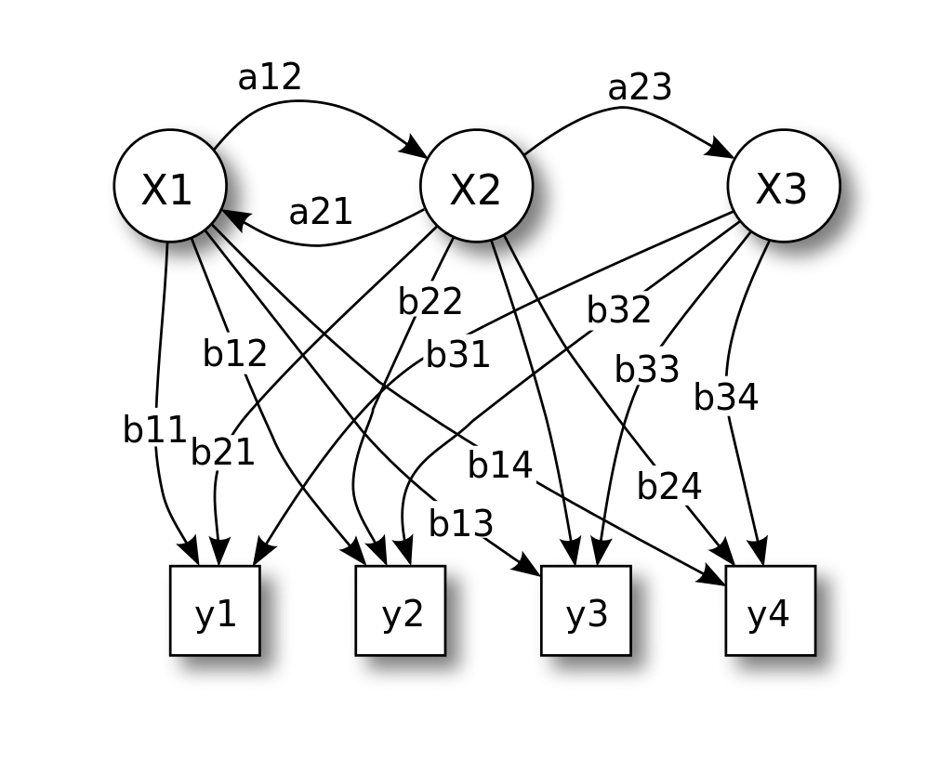
Hidden Markov Model

Slide 21
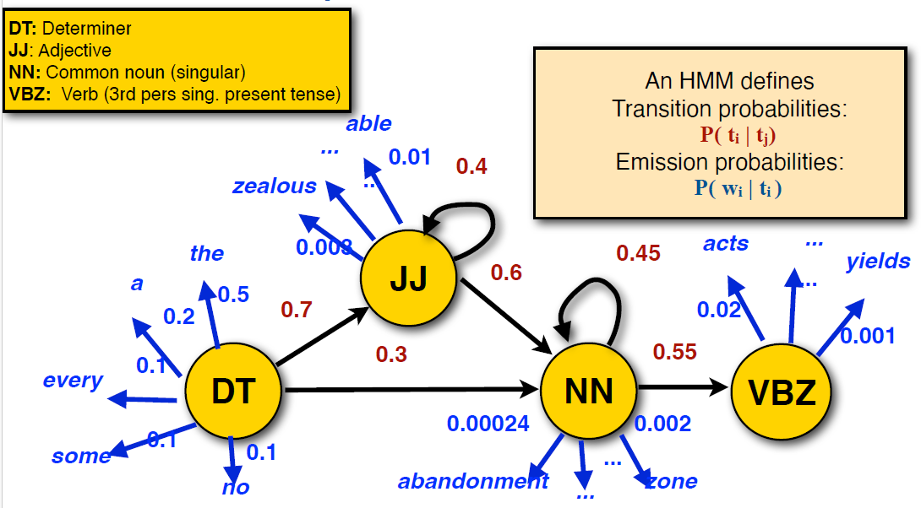
HMMs as probabilistic automata
[Source: UIUC CS447 Slides by Julia Hockenmaier]

Slide 22
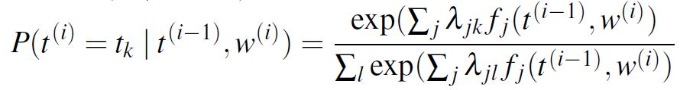
Maximum Entropy Markov Models (MEMMs)
MEMMs: logistic regression classifier
feature function f(t(i−1), w(i)): returns an n-dimensional feature vector for predicting label t(i)=tj given inputs t(i−1) and w(i)

Slide 23
Conditional Random Fields (CRFs)
CRFs have the same mathematical definition as MEMMs, but:
CRFs are trained globally to maximize the probability of the overall sequence,
MEMMs are trained locally to maximize the probability of each individual label
This requires dynamic programming

Slide 24
HMM decoding
Too many combinations! O(T^{N})
how?
[Source: UIUC CS447 Slides by Julia Hockenmaier]

Slide 25
Viterbi Algorithm
Viterbi: a dynamic programming algorithm which finds the best (=most probable) tag sequence t* for an input sentence w: t* = argmax_{t} P(w | t)P(t)
Complexity: O(T²N)
- linear in sentence length

Slide 26
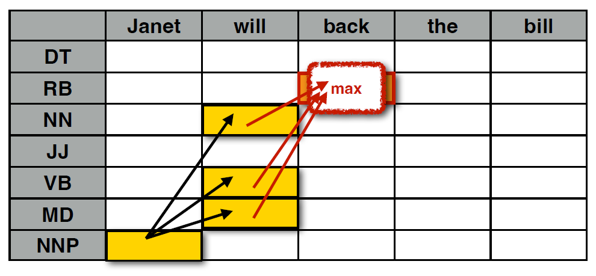
Viterbi
[Source: UIUC CS447 Slides by Julia Hockenmaier]

Slide 27
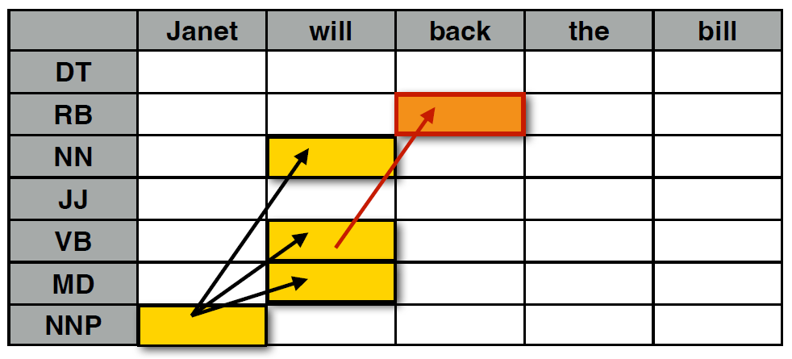
Viterbi
[Source: UIUC CS447 Slides by Julia Hockenmaier]

Slide 28
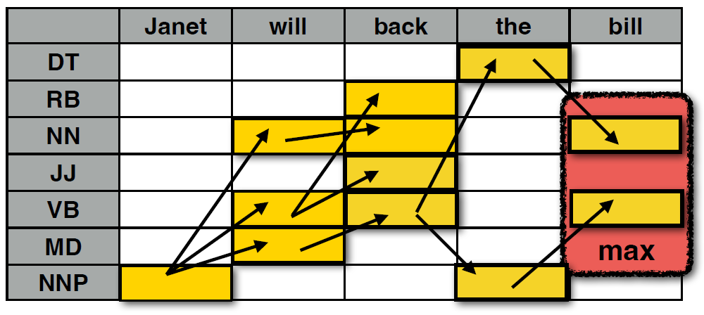
[Source: UIUC CS447 Slides by Julia Hockenmaier]

Slide 29
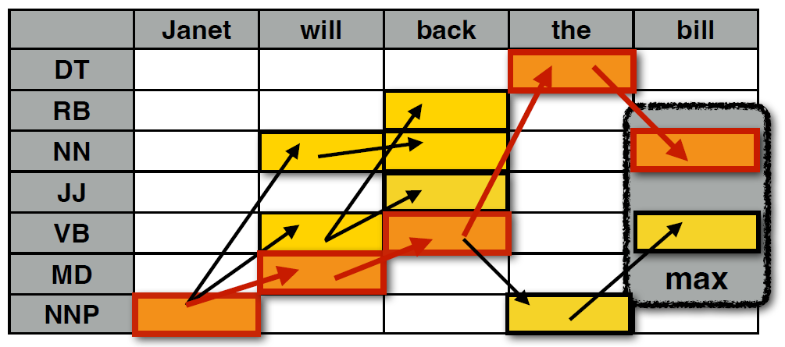
Viterbi
[Source: UIUC CS447 Slides by Julia Hockenmaier]

Slide 30
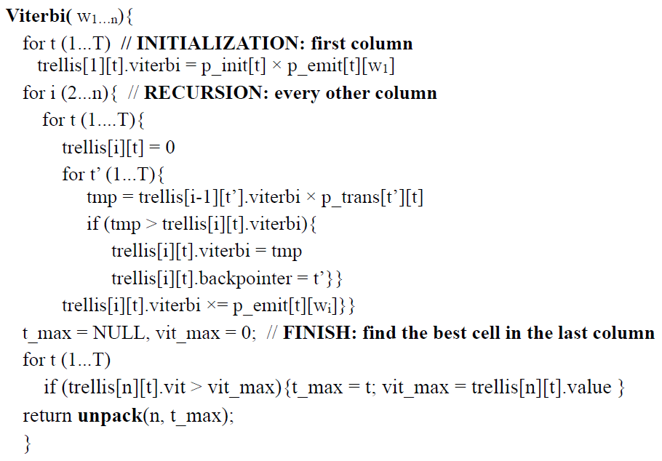
Viterbi Algorithm
[Source: UIUC CS447 Slides by Julia Hockenmaier]

Slide 31
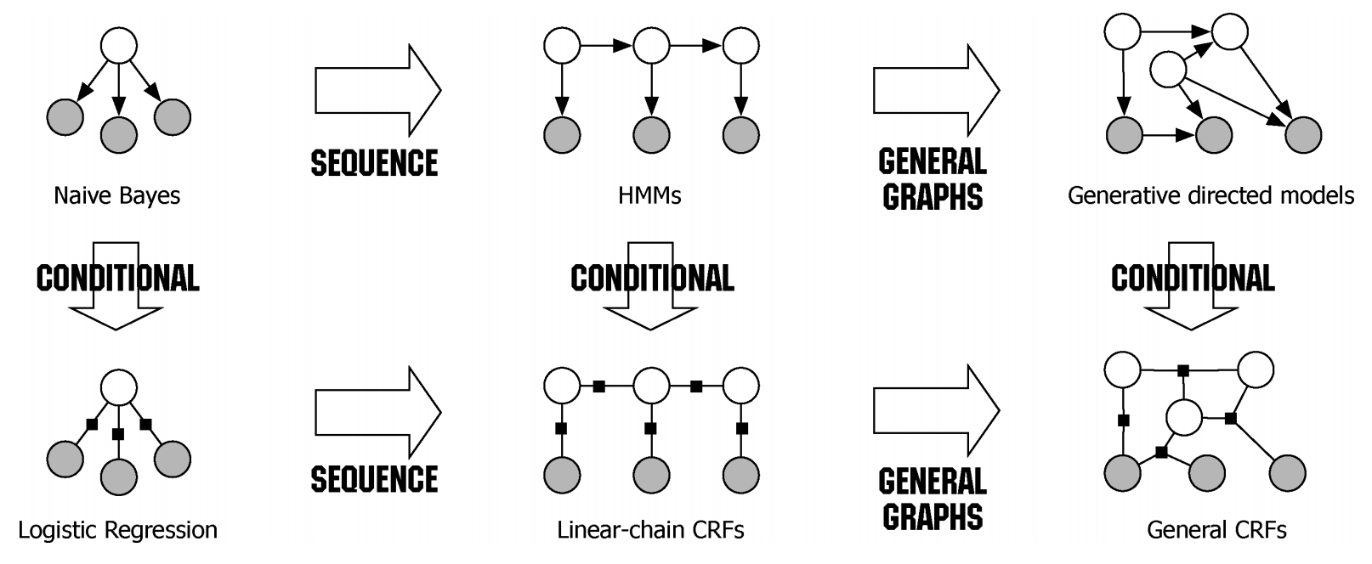
Conditional Random Fields

Slide 32
Sequence Labeling for Part of Speech and Named Entities
Named Entity Recognition (NER)
Notes:
Let's now introduce the task of named entity recognition.

Slide 33
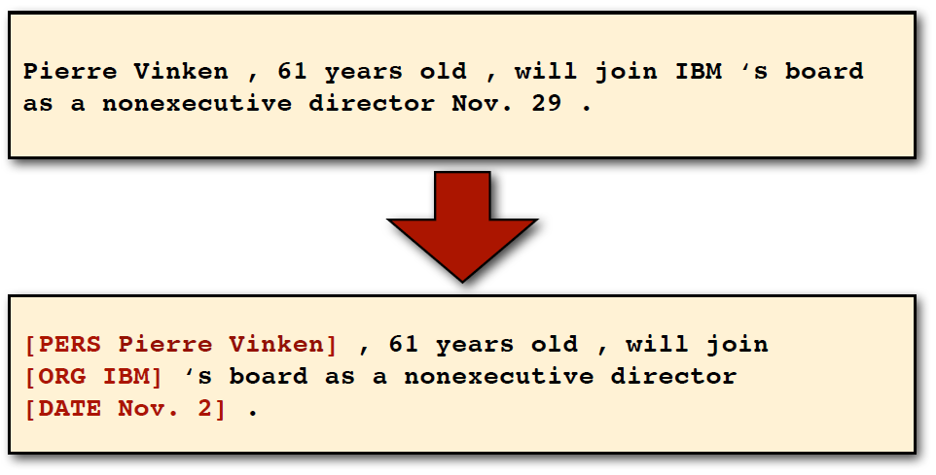
Named Entity Recognition (NER)
Task: Identify people, organization, locations, dates, …
[Source: UIUC CS447 Slides by Julia Hockenmaier]

Slide 34
Named Entities
Named entity, in its core usage, means anything that can be referred to with a proper name. Most common 4 tags:
PER (Person): “Marie Curie”
LOC (Location): “New York City”
ORG (Organization): “Stanford University”
GPE (Geo-Political Entity): "Boulder, Colorado"
Often multi-word phrases
But the term is also extended to things that aren't entities:
dates, times, prices
Notes:
Proper names are another important and anciently studied linguistic category. While parts of speech are generally assigned to individual words or morphemes, a proper name is often an entire multiword phrase, like the name “Marie Curie”, the location “New York City”, or the organization “Stanford University”.
Part of speech tagging can tell us that words like Janet, Stanford University, and Colorado are all proper nouns; being a proper noun is a grammatical property of these words. But viewed from a semantic perspective, these proper nouns refer to different kinds of entities: Janet is a person, Stanford University is an organization,.. and Colorado is a location. A named entity is, roughly speaking, anything that can be referred to with a proper name: a person, a location, an organization.
Four entity tags are most common: PER (person), LOC (location), ORG (organization), or GPE (geo-political entity). However, the term named entity is commonly extended to include things that aren’t entities per se, including dates, times, and other kinds of temporal expressions, and even numerical expressions like prices.

Slide 35
Named Entity tagging
The task of named entity recognition (NER):
find spans of text that constitute proper names
tag the type of the entity
Notes:
Four entity tags are most common: PER (person), LOC (location), ORG (organization), or GPE (geo-political entity). However, the term named entity is commonly extended to include things that aren’t entities per se, including dates, times, and other kinds of temporal expressions, and even numerical expressions like prices.

Slide 36
NER output
Notes:
Here's a text showing some sample Named Entity Recognition output. You'll see 13 mentions of named entities including 5 organizations, 4 locations, 2 times, 1 person, and 1 mention of money.

Slide 37
Why NER?
Sentiment analysis: consumer’s sentiment toward a particular company or person?
Question Answering: answer questions about an entity?
Information Extraction: Extracting facts about entities from text
Notes:
Named entity tagging is a useful first step in lots of natural language understand- ing tasks. In sentiment analysis we might want to know a consumer’s sentiment toward a particular entity. Entities are a useful first stage in question answering, or for linking text to information in structured knowledge sources like Wikipedia. And named entity tagging is also central to natural language understanding tasks of building semantic representations,

Slide 38
Why NER is hard
Segmentation
In POS tagging, no segmentation problem since each word gets one tag
In NER we have to find and segment the entities!
Type ambiguity
Notes:
Unlike part-of-speech tagging, where there is no segmentation problem since each word gets one tag, the task of named entity recognition is to find and label
spans of text, and is difficult partly because of the ambiguity of segmentation; we need to decide what’s an entity and what isn’t, and where the boundaries are.
Indeed, most words in a text will not be named entities.
Another difficulty is caused by type ambiguity the name Washington can refer to the educator Booker T Washington, the sports team, the location, or the geo-political entity.

Slide 39
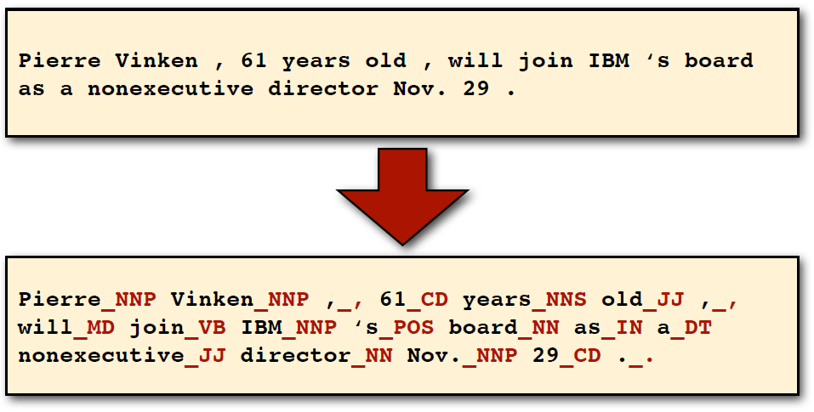
POS tagging revisited
Task: Identify POS tags, …
[Source: UIUC CS447 Slides by Julia Hockenmaier]

Slide 40
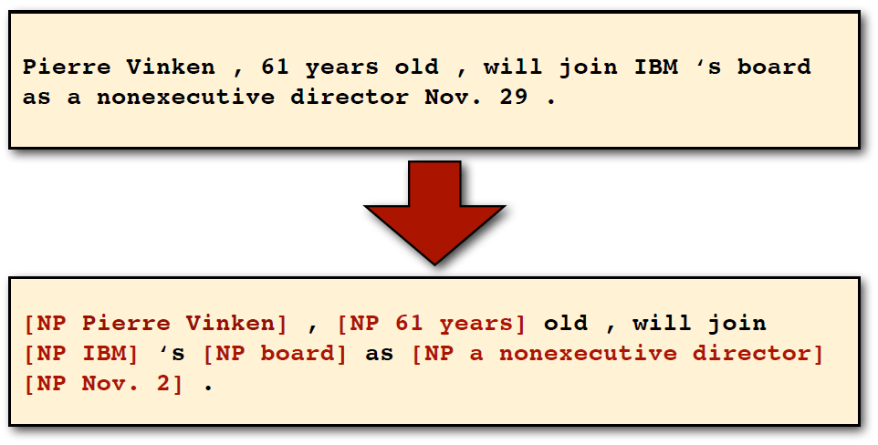
Noun phrase (NP) chunking
Task: Identify noun phrases
[Source: UIUC CS447 Slides by Julia Hockenmaier]

Slide 41
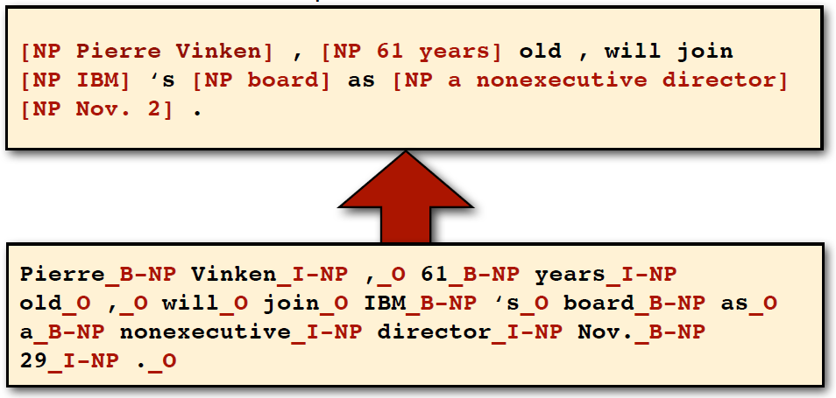
BIO encoding for NP chunking
B-NP: beginning
I-NP: inside
O: outside
[Source: UIUC CS447 Slides by Julia Hockenmaier]

Slide 42
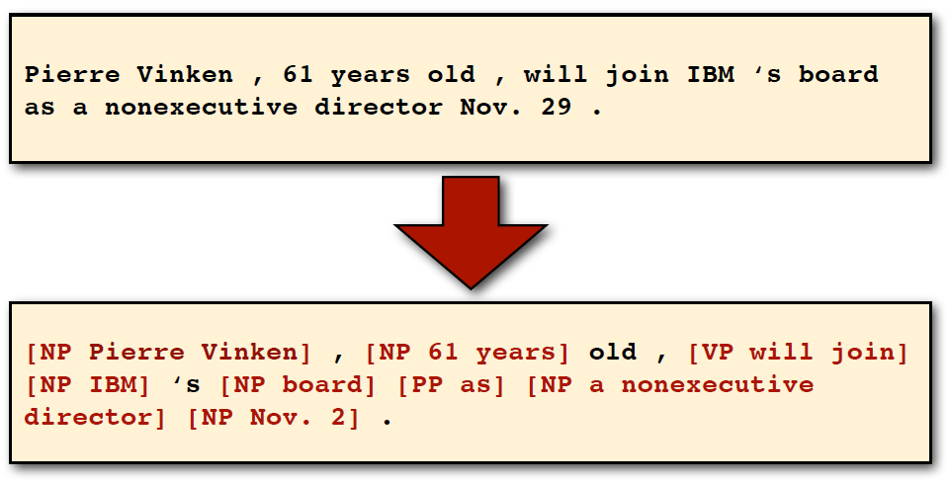
Shallow Parsing
Task: Identify NP, VP, PP
[Source: UIUC CS447 Slides by Julia Hockenmaier]

Slide 43
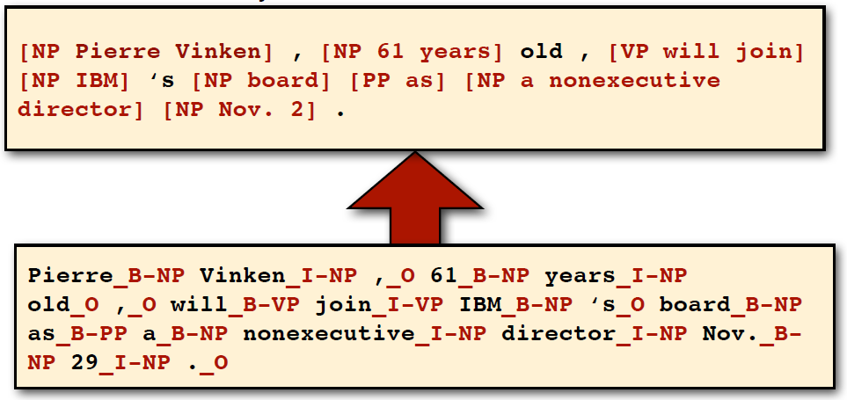
BIO encoding for shallow parsing
B-NP, B-VP, B-PP: beginning
I-NP, I-VP, I-PP: inside
O: outside
[Source: UIUC CS447 Slides by Julia Hockenmaier]

Slide 44
Named Entity Recognition (NER)
Task: Identify people, organization, locations, dates, …
[Source: UIUC CS447 Slides by Julia Hockenmaier]

Slide 45
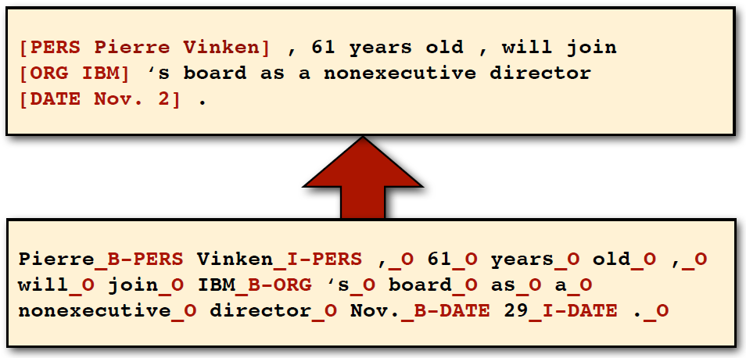
BIO encoding for NER
B-PERS, B-ORG: beginning
I-PERS, I-ORG: inside
O: outside
[Source: UIUC CS447 Slides by Julia Hockenmaier]

Slide 46
Sequence Labeling
Input: a sequence of n tokens/words
Output: a sequence of n labels, such that each token/word is associated with a label
BIO encoding for:
NP chunking
Shallow parsing
Named entity recognition

Slide 47
BIO Tagging
How can we turn this structured problem into a sequence problem like POS tagging, with one label per word?
[PER Jane Villanueva] of [ORG United] , a unit of [ORG United Airlines Holding] , said the fare applies to the [LOC Chicago ] route.
Notes:
The standard approach to sequence labeling for a span-recognition problem like NER is BIO tagging (Ramshaw and Marcus, 1995). This is a method that allows us to treat NER like a word-by-word sequence labeling task, via tags that capture both the boundary and the named entity type. Consider the following sentence:

Slide 48
BIO Tagging
[PER Jane Villanueva] of [ORG United] , a unit of [ORG United Airlines Holding] , said the fare applies to the [LOC Chicago ] route.
Now we have one tag per token!!!
Notes:
Here's shows the same sentence represented with BIO tagging. Notice we have tags corresponding to people, organizations, and locations. And now we have one tag per token.

Slide 49
BIO Tagging
B: token that begins a span
I: tokens inside a span
O: tokens outside of any span
# of tags (where n is #entity types):
1 O tag,
n B tags,
n I tags
total of 2n+1
Notes:
How does it work? In BIO tagging we label any token that begins a span of interest with the label B, tokens that occur inside a span are tagged with an I, and any tokens outside of any span of interest are labeled O. While there is only one O tag, we’ll have distinct B and I tags for each named entity class. The number of tags is thus 2n + 1 tags, where n is the number of entity types.
BIO tagging has the advantage that we can represent the task in the same simple sequence modeling way as part-of-speech tagging: assigning a single label yi to each input word xi:

Slide 50
BIO Tagging variants: IO and BIOES
[PER Jane Villanueva] of [ORG United] , a unit of [ORG United Airlines Holding] , said the fare applies to the [LOC Chicago ] route.
Notes:
There are variants of BIO tagging in which there is no B tag, or in which we add an End tag, or a Single tag for single-words

Slide 51
Standard algorithms for NER
Supervised Machine Learning given a human-labeled training set of text annotated with tags
Hidden Markov Models
Conditional Random Fields (CRF)/ Maximum Entropy Markov Models (MEMM)
Neural sequence models (RNNs or Transformers)
Large Language Models (like BERT), finetuned
Notes:
Like part of speech tagging, named entity recognition is done by supervised machine learning, where we have a human-labeled training set in which some text is marked up with named entity tags. We can use classic ML algorithms like HMMs or CRFs, or neural models.

Slide 52
Thanks for Your Attention!

