Slide 1
Introduction to
Operating Systems
J. H. Wang
Feb. 10, 2026
OS, Spring 2026 (undergraduates)
NTUT CSIE

Slide 2
Instructor and TA
Instructor
  Jenq-Haur Wang (王正豪)
  Professor, CSIE, NTUT
  Office: R1534, Technology Building
  E-mail: jhwang@ntut.edu.tw
  Tel: ext. 4238
  Office Hour: 9:10-12:00am on Tuesdays and Fridays
TA
  Mr.Chiu & Mr. Ke (@ R1424, Technology Building)
OS, Spring 2026 (undergraduates)
NTUT CSIE

Slide 3
Course Overview
Course: Operating Systems
  For computer science undergraduates (required course)
Time: 13:10-15:00pm on Tuesdays, 9:10-10:00am on Thursdays
Classroom: R501, Pioneer Building
Course webpage: https://chriswjh.github.io/OSu/
iSchool+
  https://istudy.ntut.edu.tw/learn/
Microsoft Teams
  [NTUT-Sync]114-2_354648_作業系統
OS, Spring 2026 (undergraduates)
NTUT CSIE

Slide 4
Target Students
For
  CSIE Juniors and above, and
  Are familiar with basic data structures, computer organization, and high-level programming language, and
  Are preparing to investigate the fundamental concepts in modern operating systems
Prerequisite:
  Data Structures, Computer Organization
  Working knowledge of a high-level programming language for programming exercises
OS, Spring 2026 (undergraduates)
NTUT CSIE

Slide 5
Resources
Textbook: Operating System Concepts, 10th ed., by Abraham Silberschatz, Peter Baer Galvin, and Greg Gagne, John Wiley & Sons, Inc. (Global Edition, imported by 新月) [OS10]
  https://os-book.com/
  Available at:
    https://www.tunghua.com.tw/portal_c1_cnt_page.php?owner_num=c1_81363&button_num=c1&folder_id=&cnt_id=672614&search_word=&up_page=
References:
  Modern Operating Systems, 5th ed., by Andrew S. Tanenbaum and Herbert Bos, Prentice-Hall, 2022. [MOS5]
  Ann McHoes, Ida M. Flynn, Understanding Operating Systems, 8th Ed., Cengage Learning, 2017.
  Understanding the Linux Kernel, 3rd ed., by Daniel P. Bovet and Marco Cesati, O'Reilly, 2005. [ULK3]
  Papers, online documents, and other related materials
OS, Spring 2026 (undergraduates)
NTUT CSIE

Slide 6
Teaching
Lectures: in PowerPoint
About 4-5 homework and program assignments
  Should be turned in within two weeks
    Late submissions are penalized at a fixed rate determined by the TA, e.g. 10% per week
    No submission allowed after reference solution is announced
  Submission site: i-School+
One mid-term exam
One final exam
OS, Spring 2026 (undergraduates)
NTUT CSIE

Slide 7
Grading Policy
(Tentative) Grading policy
  Written and programming exercises: ~40%
  Midterm exam: ~30%
  Final exam: ~30%
  No submission of homeworks and programs allowed *after* the end of the semester (Jun. 26, 2026)
For those not familiar with the “midterm alert”,
  Rule#1: ! (∀x, alerted(x) => failed(x))
  Rule#2: ! (∀x, !alerted(x) => !failed(x)
  Conclusion: pay attention to your own potential score range as early as possible!
OS, Spring 2026 (undergraduates)
NTUT CSIE

Slide 8
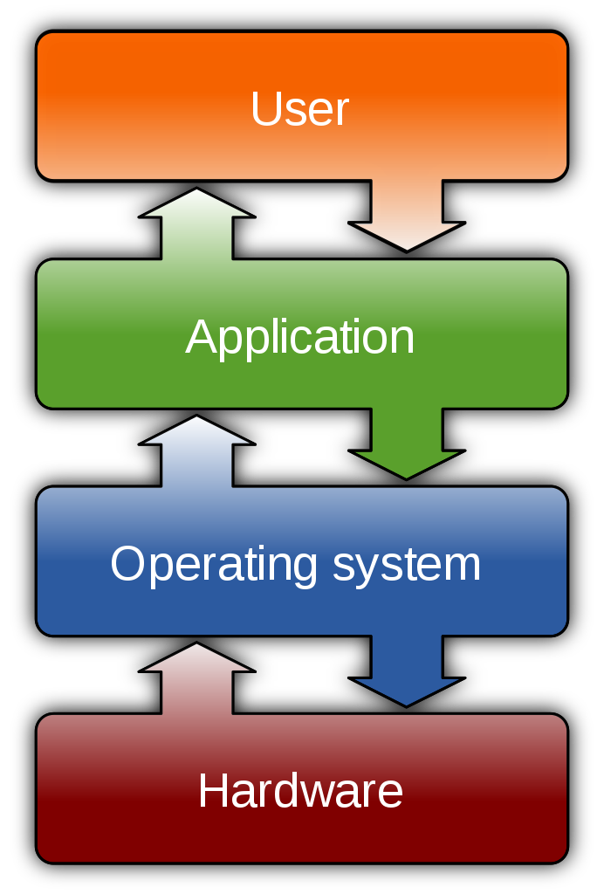
What is an Operating System?
“An operating system (OS) is system software that manages computer hardware, software resources, and provides common services for computer programs.“
[source: Wikipedia]
OS, Spring 2026 (undergraduates)
NTUT CSIE

Slide 9
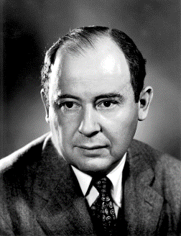
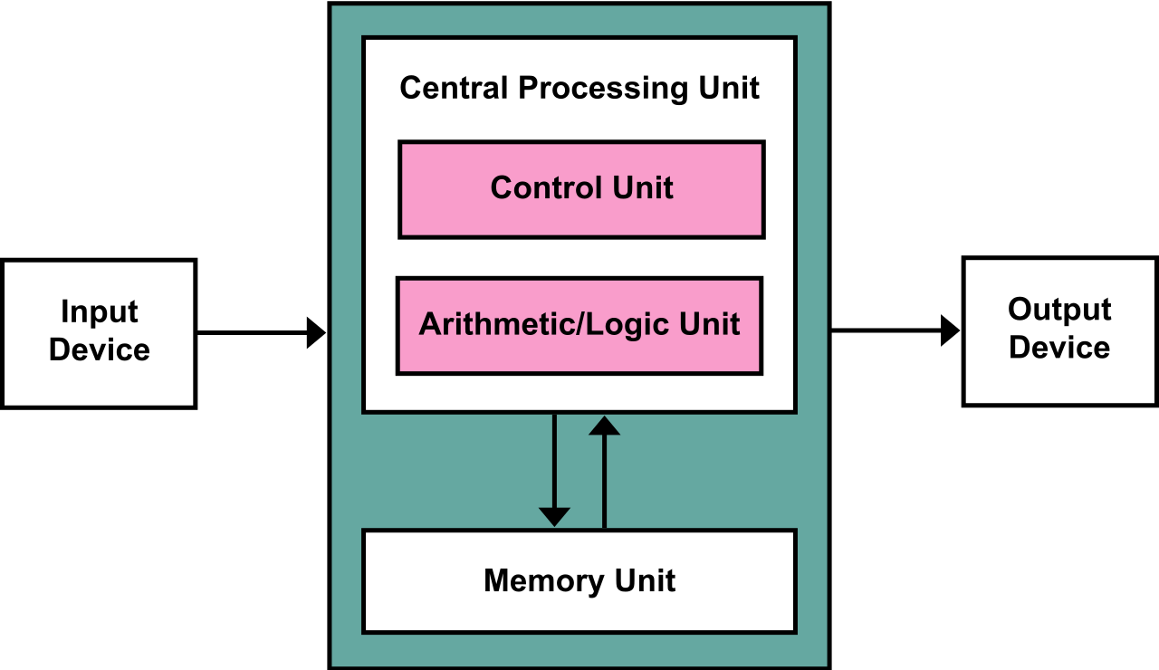
Von Neumann Architecture (1945)
Stored-program computer
Program, Input Data
Output Data
OS, Spring 2026 (undergraduates)
NTUT CSIE

Slide 10
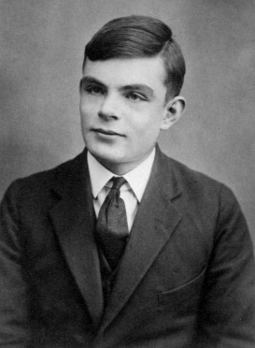
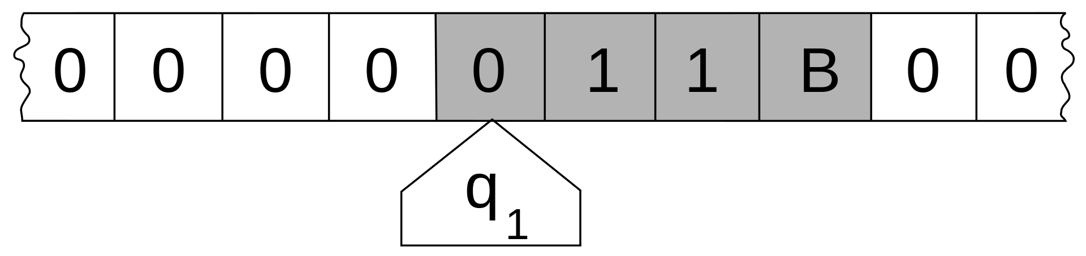
Universal Turing Machine (1936)
Turing machine
OS, Spring 2026 (undergraduates)
NTUT CSIE

Slide 11
What can you learn?
Basic components in operating systems
  Process management
  Process synchronization
  Memory management
  Storage management
  File system
program execution by CPU
program and data in memory
Input/output
OS, Spring 2026 (undergraduates)
NTUT CSIE

Slide 12
Why do you need an OS?
Why do you need computers?
  Getting jobs done correctly and efficiently
Major uses of an OS
  Managing limited resources
    Hardware: CPU time, memory, I/O devices
  Controlling program execution
    Correctness
    Efficiency
    Security
OS, Spring 2026 (undergraduates)
NTUT CSIE

Slide 13
Do you still need to learn it?
Early OS
  SHARE (1959), Multics (1963), OS/360 (1964), UNIX (1969), CP/M (1974), …
  Previous versions of OS textbooks (1983 - ):
    https://galvin.info/history-of-operating-system-concepts-textbook/
    https://codex.cs.yale.edu/avi/os-book/OS10/covers-dir/index.html
OS, Spring 2026 (undergraduates)
NTUT CSIE

Slide 14
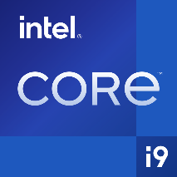






Recent growth in fundamental areas
  Multicore systems
  Mobile computing
  Virtualization
  Nonvolatile memory secondary storage
OS, Spring 2026 (undergraduates)
NTUT CSIE
[source: Wikipedia]

Slide 15
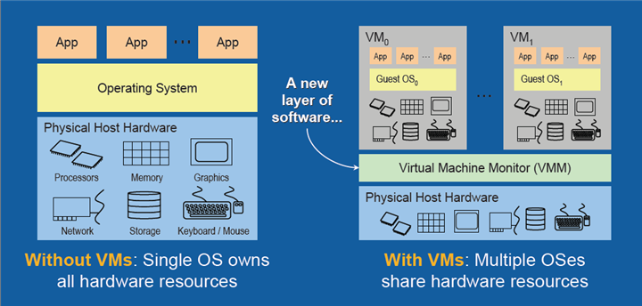
Virtualization
[Source: The Advantages of Using Virtualization Technology in the Enterprise, by Thomas Burger, Intel Developer Zone]
OS, Spring 2026 (undergraduates)
NTUT CSIE

Slide 16
Outline & Schedule
Outline: [OS10]
  Part I: Overview (Ch. 1-2)
    Introduction
    Operating System structures
  Part II: Process management (Ch. 3-5)
    Processes
    Threads and concurrency
    CPU scheduling
  Process synchronization (Ch. 6-8)
    Synchronization tools
    Synchronization examples
    Deadlocks
  Part III: Memory management (Ch. 9-10)
    Main memory
    Virtual memory
OS, Spring 2026 (undergraduates)
NTUT CSIE

Slide 17
Outline & Schedule (Cont’d)
Outline (cont’d)
  Part IV: Storage management (Ch. 11-12)
    Mass storage structure
    I/O systems
  File System (Ch. 13-15)
    File system interface
    File system implementation
    File system internals
  Part V: Security and protection (Ch. 16-17) (skipped)
  Part VI: Advanced topics (Ch. 18-19) (skimmed)
    Virtual machines
    Networks and distributed systems (skipped)
  Part VII: Case studies (Ch. 20-21) (skipped)
    Linux, Windows 10
OS, Spring 2026 (undergraduates)
NTUT CSIE

Slide 18
Outline & Schedule (Cont’d)
(Tentative) Schedule
  Basics: 1-2 wks
  Process management & synchronization : 5-6 wks
  Memory management: 3-4 wks
  Midterm
  Storage management: 2-3 wks
  File system: 2-3 wks
  Virtual machines: 1-2 wks
  Final exam
OS, Spring 2026 (undergraduates)
NTUT CSIE

Slide 19
About Programming Exercises
Every student is required to do all programming exercises on his/her own
  No team work allowed
  Any programming language is acceptable
Selected from “Programming Problems” at the end of each chapter, for example,
  Tracing system calls
  Modifying Linux kernel modules
  Process management
  Inter-process communication
  Multi-threaded programs
  Semaphores
  …
OS, Spring 2026 (undergraduates)
NTUT CSIE

Slide 20
Notes on Homeworks
Rule 1: Plagiarism is prohibited
  Near-duplicate codes will get equal and minimum basic scores
Rule 2: Clear documentation is required for your program
  Instructions on downloading, installing, configuring, and executing your code and open source library, APIs, or codes must be submitted
OS, Spring 2026 (undergraduates)
NTUT CSIE

Slide 21
About the Midterm Exam
Date: May 5, 2026 (TBD)
Time: 13:10-15:00pm, Tuesday
Location: R501, Pioneer Building
Range: Ch.1-9 (TBD)
Question Types: Calculation, Short Answer, True-False, Multiple Choice
OS, Spring 2026 (undergraduates)
NTUT CSIE

Slide 22
About the Final Exam
Date: Jun. 23, 2026
Time: 13:10-15:00pm, Tuesday
Location: R501, Pioneer Building
Range: Ch.1-15, 18 (TBD)
Question Types: Calculation, Short Answer, True-False, Multiple Choice
OS, Spring 2026 (undergraduates)
NTUT CSIE

Slide 23
Notes on Signing up the Course
The vacancy depends on the classroom capacity
The priority of signing up the course:
  CSIE (資工) majors first – required course
  NTUT Seniors (大四)
  Interdisciplinary micro programs (跨域微學程)
  Minors/double majors (輔系/雙主修) in CS
  External students
    USTP (University System of Taipei, 北聯大)
    Auditor (隨班附讀)
    Others
OS, Spring 2026 (undergraduates)
NTUT CSIE

Slide 24
Thanks for Your Attention!
OS, Spring 2026 (undergraduates)
NTUT CSIE

