Slide 1
Modified from Stanford CS276 slides
Chap. 6: Scoring, Term Weighting and the Vector Space Model

Slide 2
Recap of Chap. 5
Collection and vocabulary statistics: Heaps’ and Zipf’s laws
Dictionary compression for Boolean indexes
  Dictionary string, blocks, front coding
Postings compression: Gap encoding, prefix-unique codes
  Variable-Byte and Gamma codes
collection (text, xml markup etc) | 3,600.0
collection (text) | 960.0
Term-doc incidence matrix | 40,000.0
postings, uncompressed (32-bit words) | 400.0
postings, uncompressed (20 bits) | 250.0
postings, variable byte encoded | 116.0
postings, γ−encoded | 101.0
MB

Slide 3
This lecture; IIR Sections 6.2-6.4.3
Ranked retrieval
Scoring documents
Term frequency
Collection statistics
Weighting schemes
Vector space scoring

Slide 4
Ranked retrieval
Ch. 6
Thus far, our queries have all been Boolean
  Documents either match or don’t
Good for expert users with precise understanding of their needs and the collection
  Also good for applications: Applications can easily consume 1000s of results
Not good for the majority of users
  Most users incapable of writing Boolean queries (or they are, but they think it’s too much work)
  Most users don’t want to wade through 1000s of results
    This is particularly true of web search

Slide 5
Problem with Boolean search: feast or famine
Ch. 6
Boolean queries often result in either too few (=0) or too many (1000s) results
Query 1: “standard user dlink 650” → 200,000 hits
Query 2: “standard user dlink 650 no card found”: 0 hits
It takes a lot of skill to come up with a query that produces a manageable number of hits
  AND gives too few
  OR gives too many
Notes:
Cf. our discussion of how Westlaw Boolean queries didn’t actually outperform free text querying

Slide 6
Ranked retrieval models
Rather than a set of documents satisfying a query expression, in ranked retrieval models, the system returns an ordering over the (top) documents in the collection with respect to a query
Free text queries: Rather than a query language of operators and expressions, the user’s query is just one or more words in a human language
In principle, there are two separate choices here, but in practice, ranked retrieval models have normally been associated with free text queries and vice versa

Slide 7
Feast or famine: not a problem in ranked retrieval
Ch. 6
When a system produces a ranked result set, large result sets are not an issue
  Indeed, the size of the result set is not an issue
  We just show the top k ( ≈ 10) results
  We don’t overwhelm the user
  Premise: the ranking algorithm works

Slide 8
Scoring as the basis of ranked retrieval
Ch. 6
We wish to return in order the documents most likely to be useful to the searcher
How can we rank-order the documents in the collection with respect to a query?
Assign a score – say in [0, 1] – to each document
This score measures how well document and query “match”

Slide 9
Query-document matching scores
Ch. 6
We need a way of assigning a score to a query/document pair
Let’s start with a one-term query
If the query term does not occur in the document: score should be 0
The more frequent the query term in the document, the higher the score (should be)
We will look at a number of alternatives for this

Slide 10
Take 1: Jaccard coefficient
Ch. 6
Recall from Chap. 3: A commonly used measure of overlap of two sets A and B
  jaccard(A,B) = |A ∩ B| / |A ∪ B|
  jaccard(A,A) = 1
  jaccard(A,B) = 0 if A ∩ B = 0
A and B don’t have to be the same size
Always assigns a number between 0 and 1

Slide 11
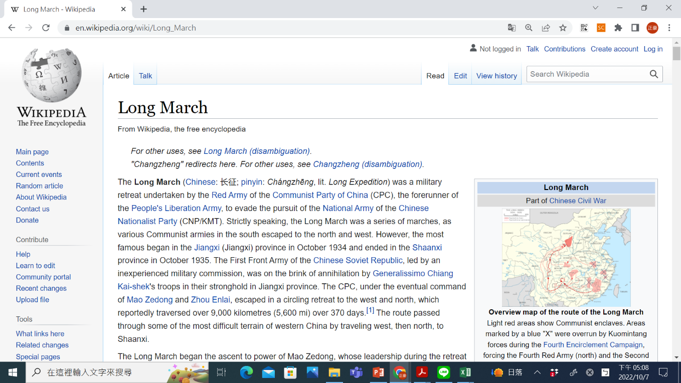
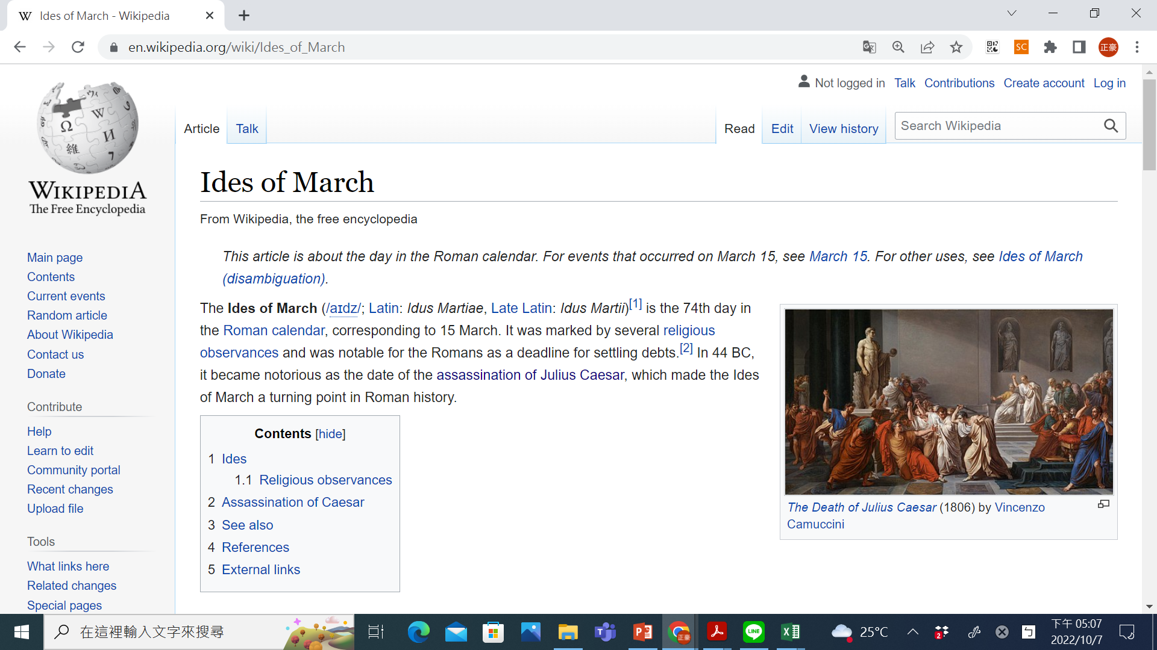
Jaccard coefficient: Scoring example
Ch. 6
What is the query-document match score that the Jaccard coefficient computes for each of the two documents below?
Query: ides of march
Document 1: caesar died in march
Document 2: the long march

Slide 12
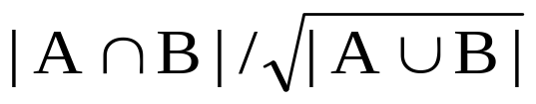
Issues with Jaccard for scoring
It doesn’t consider term frequency (how many times a term occurs in a document)
  Rare terms in a collection are more informative than frequent terms
  Jaccard doesn’t consider this information
We need a more sophisticated way of normalizing for length
Later in this lecture, we’ll use
. . . instead of |A ∩ B|/|A ∪ B| (Jaccard) for length normalization

Slide 13
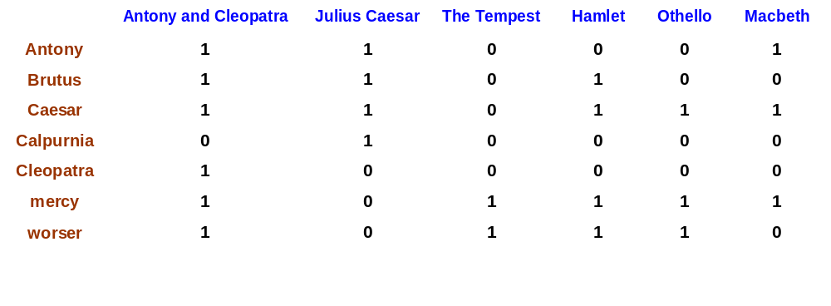
Recall (Chap. 1): Binary term-document incidence matrix
Sec. 6.2
Each document is represented by a binary vector ∈ {0,1}^{|V|}

Slide 14
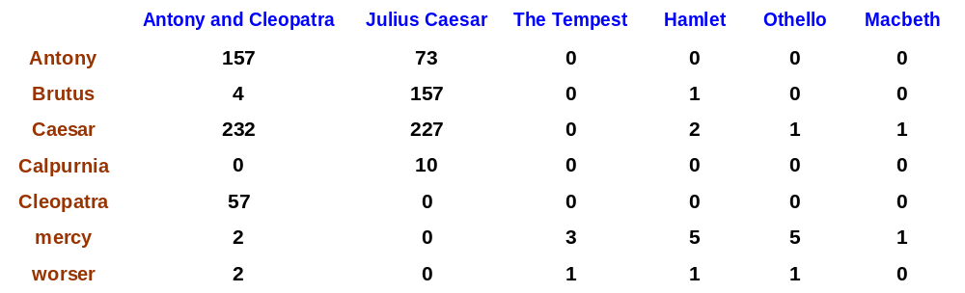
Term-document count matrices
Sec. 6.2
Consider the number of occurrences of a term in a document:
  Each document is a count vector in ℕ^{v}: a column below

Slide 15
Bag of words model
Vector representation doesn’t consider the ordering of words in a document
John is quicker than Mary and Mary is quicker than John have the same vectors
This is called the bag of words model
  In a sense, this is a step back: The positional index was able to distinguish these two documents
  We will look at “recovering” positional information later in this course
For now: bag of words model

Slide 16
Term frequency tf
The term frequency tf_{t,d} of term t in document d is defined as the number of times that t occurs in d
We want to use tf when computing query-document match scores. But how?
Raw term frequency is not what we want:
  A document with 10 occurrences of the term is more relevant than a document with 1 occurrence of the term
  But not 10 times more relevant
Relevance does not increase proportionally with term frequency
NB: frequency = count in IR

Slide 17
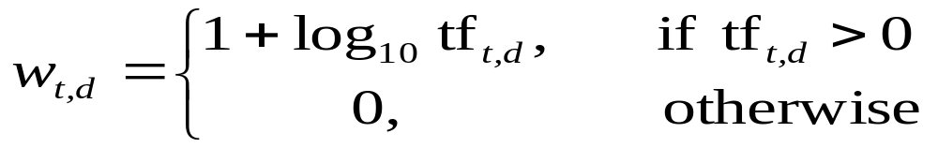
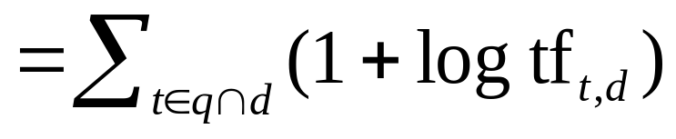
Log-frequency weighting
Sec. 6.2
The log frequency weight of term t in d is
0 → 0, 1 → 1, 2 → 1.3, 10 → 2, 1000 → 4, etc.
Score for a document-query pair: sum over terms t in both q and d:
score
The score is 0 if none of the query terms is present in the document

Slide 18
Document frequency
Sec. 6.2.1
Rare terms are more informative than frequent terms
  Recall stop words
Consider a term in the query that is rare in the collection (e.g., arachnocentric)
A document containing this term is very likely to be relevant to the query arachnocentric
→ We want a high weight for rare terms like arachnocentric

Slide 19
Document frequency, continued
Sec. 6.2.1
Frequent terms are less informative than rare terms
  Consider a query term that is frequent in the collection (e.g., high, increase, line)
  A document containing such a term is more likely to be relevant than a document that doesn’t
  But it’s not a sure indicator of relevance
  → For frequent terms, we want high positive weights for words like high, increase, and line
  But lower weights than for rare terms
We will use document frequency (df) to capture this

Slide 20
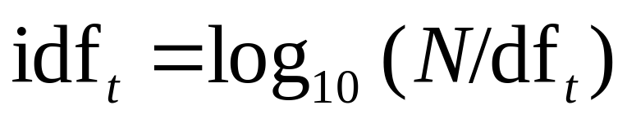
idf weight
Sec. 6.2.1
df_{t} is the document frequency of t: the number of documents that contain t
  df_{t} is an inverse measure of the informativeness of t
  df_{t} ≤ N
We define the idf (inverse document frequency) of t by
  We use log (N/df_{t}) instead of N/df_{t} to “dampen” the effect of idf
Will turn out the base of the log is immaterial

Slide 21
idf example, suppose N = 1 million
Sec. 6.2.1
term | df_{t} | idf_{t}
calpurnia | 1
animal | 100
sunday | 1,000
fly | 10,000
under | 100,000
the | 1,000,000
There is one idf value for each term t in a collection
Notes:
6 4 3 2 1 0

Slide 22
Effect of idf on ranking
Does idf have an effect on ranking for one-term queries, like
  iPhone
idf has no effect on ranking one-term queries
  idf affects the ranking of documents for queries with at least two terms
  For the query capricious person, idf weighting makes occurrences of capricious count for much more in the final document ranking than occurrences of person

Slide 23
Collection vs. Document frequency
Sec. 6.2.1
The collection frequency of t is the number of occurrences of t in the collection, counting multiple occurrences
Example:
Which word is a better search term (and should get a higher weight)?
Word | Collection frequency | Document frequency
insurance | 10440 | 3997
try | 10422 | 8760
Notes:
Why do you get these numbers?
Suggests df is better.

Slide 24
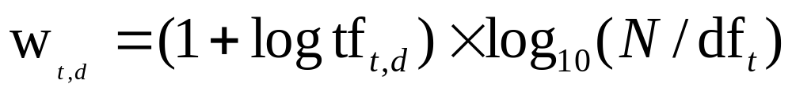
tf-idf weighting
Sec. 6.2.2
The tf-idf weight of a term is the product of its tf weight and its idf weight
Best known weighting scheme in information retrieval
  Note: the “-” in tf-idf is a hyphen, not a minus sign!
  Alternative names: tf.idf, tf x idf
Increases with the number of occurrences within a document
Increases with the rarity of the term in the collection

Slide 25
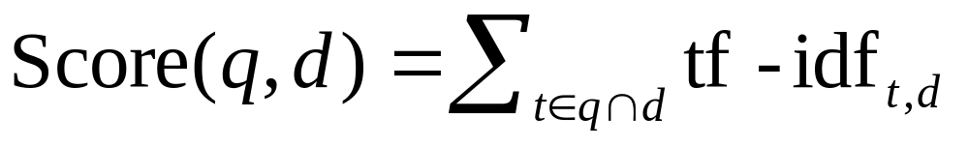
Final ranking of documents for a query
Sec. 6.2.2

Slide 26
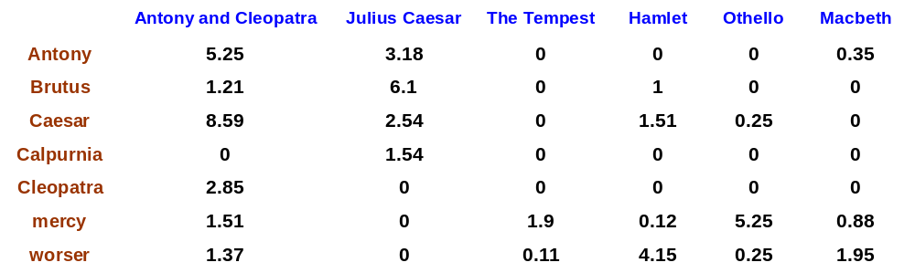
Binary → count → weight matrix
Sec. 6.3
Each document is now represented by a real-valued vector of tf-idf weights ∈ R^{|V|}

Slide 27
Documents as vectors
Sec. 6.3
So we have a |V|-dimensional vector space
  Terms are axes of the space
  Documents are points or vectors in this space
Very high-dimensional: tens of millions of dimensions when you apply this to a web search engine
These are very sparse vectors - most entries are zero

Slide 28
Queries as vectors
Sec. 6.3
Key idea 1: Do the same for queries: represent them as vectors in the space
Key idea 2: Rank documents according to their proximity to the query in this space
  proximity = similarity of vectors
  proximity ≈ inverse of distance
Recall: We do this because we want to get away from the you’re-either-in-or-out Boolean model
Instead: rank more relevant documents higher than less relevant documents

Slide 29
Formalizing vector space proximity
Sec. 6.3
First cut: distance between two points
  ( = distance between the end points of the two vectors)
What about Euclidean distance?
Euclidean distance is a bad idea . . .
. . . because Euclidean distance is large for vectors of different lengths

Slide 30
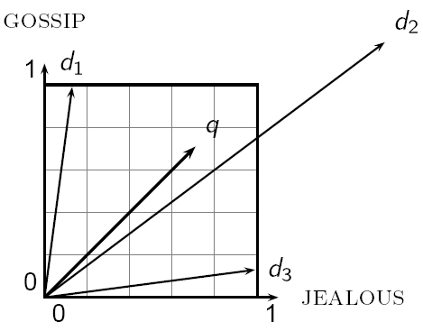
Why Euclidean distance is a bad idea
Sec. 6.3
The Euclidean distance between q
and d₂ is large even though the
distribution of terms in the query q and the distribution of
terms in the document d₂ are
very similar

Slide 31
Use angle instead of distance
Sec. 6.3
Thought experiment: take a document d and append it to itself. Call this document d′
“Semantically”, d and d′ have the same content
The Euclidean distance between the two documents can be quite large
The angle between the two documents is 0, corresponding to maximal similarity
Key idea: Rank documents according to angle with query

Slide 32
From angles to cosines
Sec. 6.3
The following two notions are equivalent
  Rank documents in decreasing order of the angle between query and document
  Rank documents in increasing order of cosine(query,document)
Cosine is a monotonically decreasing function for the interval [0º, 180º]

Slide 33
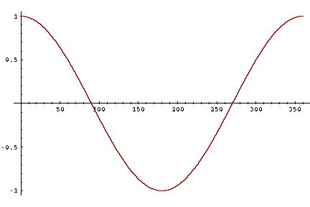
From angles to cosines
Sec. 6.3
But how – and why – should we compute cosines?

Slide 34
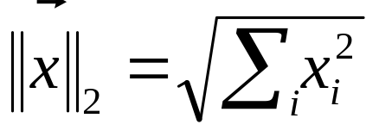
Length normalization
Sec. 6.3
A vector can be (length-) normalized by dividing each of its components by its length – for this we use the L₂ norm:
Dividing a vector by its L₂ norm makes it a unit (length) vector (on surface of unit hypersphere)
Effect on the two documents d and d′ (d appended to itself) from earlier slide
  They have identical vectors after length-normalization
  Long and short documents now have comparable weights

Slide 35
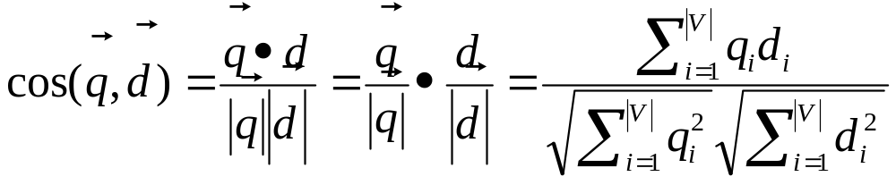
cosine(query,document)
Sec. 6.3
Dot product
Unit vectors
q_{i} is the tf-idf weight of term i in the query
d_{i} is the tf-idf weight of term i in the document
cos(q,d) is the cosine similarity of q and d … or,
equivalently, the cosine of the angle between q and d
Notes:
See Law of Cosines (Cosine Rule) wikipedia page

Slide 36
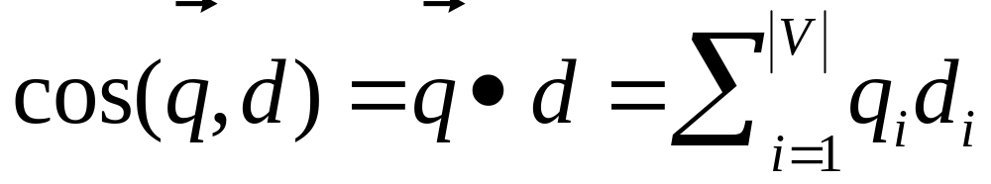
Cosine for length-normalized vectors
For length-normalized vectors, cosine similarity is simply the dot product (or scalar product):
for q, d length-normalized

Slide 37
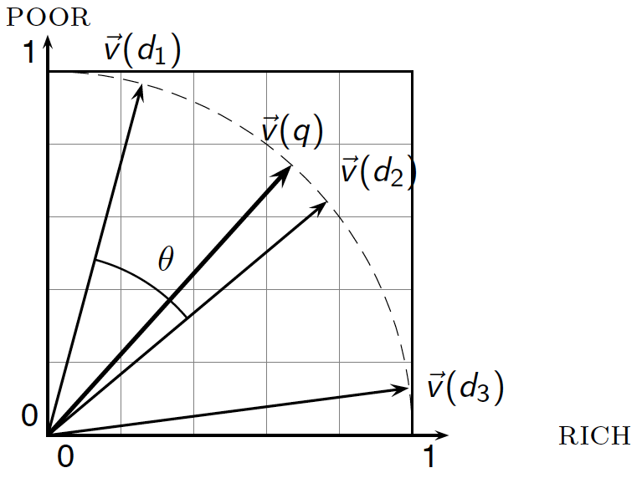
Cosine similarity illustrated

Slide 38
Cosine similarity amongst 3 documents
Sec. 6.3
How similar are
the novels
SaS: Sense and
Sensibility
PaP: Pride and
Prejudice, and
WH: Wuthering
Heights?
term | SaS | PaP | WH
affection | 115 | 58 | 20
jealous | 10 | 7 | 11
gossip | 2 | 0 | 6
wuthering | 0 | 0 | 38
Term frequencies (counts)
Note: To simplify this example, we don’t do idf weighting

Slide 39
3 documents example contd.
Sec. 6.3
Log frequency weighting
After length normalization
term | SaS | PaP | WH
affection | 3.06 | 2.76 | 2.30
jealous | 2.00 | 1.85 | 2.04
gossip | 1.30 | 0 | 1.78
wuthering | 0 | 0 | 2.58
term | SaS | PaP | WH
affection | 0.789 | 0.832 | 0.524
jealous | 0.515 | 0.555 | 0.465
gossip | 0.335 | 0 | 0.405
wuthering | 0 | 0 | 0.588
cos(SaS,PaP) ≈
0.789 × 0.832 + 0.515 × 0.555 + 0.335 × 0.0 + 0.0 × 0.0
≈ 0.94
cos(SaS,WH) ≈ 0.79
cos(PaP,WH) ≈ 0.69
Why do we have cos(SaS,PaP) > cos(SaS,WH)?

Slide 40
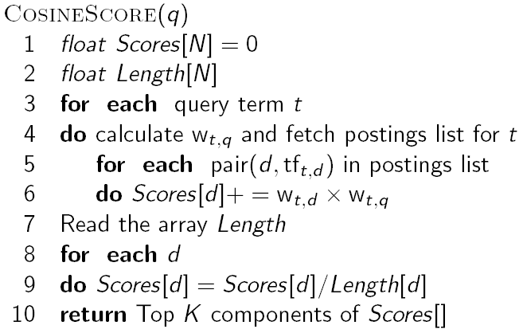
Computing cosine scores
Sec. 6.3

Slide 41
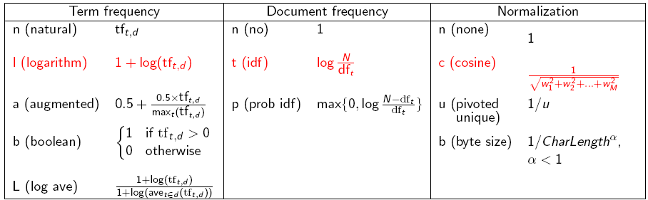
tf-idf weighting has many variants
Sec. 6.4
Columns headed ‘n’ are acronyms for weight schemes
Why is the base of the log in idf immaterial?
Notes:
n default is just term frequency
ltc is best known form of weighting

Slide 42
Weighting may differ in queries vs documents
Sec. 6.4
Many search engines allow for different weightings for queries vs. documents
SMART Notation: denotes the combination in use in an engine, with the notation ddd.qqq, using the acronyms from the previous table
A very standard weighting scheme is: lnc.ltc
Document: logarithmic tf (l as first character), no idf and cosine normalization
Query: logarithmic tf (l in leftmost column), idf (t in second column), no normalization …
A bad idea?
Notes:
Leaving off idf weighting on documents is good for both efficiency and system effectiveness reasons.

Slide 43

tf-idf example: lnc.ltc
Sec. 6.4
Document: car insurance auto insurance
Query: best car insurance
Term | Query |  |  |  |  |  | Document |  |  |  | Prod
 | tf-raw | tf-wt | df | idf | wt | n’lize | tf-raw | tf-wt | wt | n’lize
auto | 0 | 0 | 5000 | 2.3 | 0 | 0 | 1 | 1 | 1 | 0.52 | 0
best | 1 | 1 | 50000 | 1.3 | 1.3 | 0.34 | 0 | 0 | 0 | 0 | 0
car | 1 | 1 | 10000 | 2.0 | 2.0 | 0.52 | 1 | 1 | 1 | 0.52 | 0.27
insurance | 1 | 1 | 1000 | 3.0 | 3.0 | 0.78 | 2 | 1.3 | 1.3 | 0.68 | 0.53
Exercise: what is N, the number of docs?
Doc length =
Score = 0+0+0.27+0.53 = 0.8

Slide 44
Summary – vector space ranking
Represent the query as a weighted tf-idf vector
Represent each document as a weighted tf-idf vector
Compute the cosine similarity score for the query vector and each document vector
Rank documents with respect to the query by score
Return the top K (e.g., K = 10) to the user

Slide 45
Resources for today’s lecture
Ch. 6
IIR 6.2 – 6.4.3
http://www.miislita.com/information-retrieval-tutorial/cosine-similarity-tutorial.html
  Term weighting and cosine similarity tutorial for SEO folk!

