Slide 1
Chapter 6. Classification: Basic Concepts
Classification: Basic Concepts
Decision Tree Induction
Bayes Classification Methods
Lazy Learners (or learning from your neighbors)
Linear Classifiers
Model Evaluation and Selection
Techniques to Improve Classification Accuracy
Summary
Notes:
1

Slide 2
Supervised vs. Unsupervised Learning (1)
Supervised learning (classification)
  Supervision: The training data such as observations or measurements are accompanied by labels indicating the classes which they belong to
  New data is classified based on the models built from the training set
Training Data with class label:
Model
Learning
Outlook | Temp | Humidity | Windy | Play Golf
Rainy | Hot | High | False | No
Rainy | Hot | High | True | No
Overcast | Hot | High | False | Yes
Sunny | Mild | High | False | Yes
Sunny | Cool | Normal | False | Yes
Sunny | Cool | Normal | True | No
Overcast | Cool | Normal | True | Yes
Rainy | Mild | High | False | No
Training
Instances
Positive
Prediction
Model
Test
Instances
Negative

Slide 3
Supervised vs. Unsupervised Learning (2)
Unsupervised learning (clustering)
  The class labels of training data are unknown
  Given a set of observations or measurements, establish the possible existence of classes or clusters in the data

Slide 4
Prediction Problems: Classification vs. Numeric Prediction
Classification
  Predict categorical class labels (discrete or nominal)
  Construct a model based on the training set and the class labels (the values in a classifying attribute) and use it in classifying new data
Numeric prediction
  Model continuous-valued functions (i.e., predict unknown or missing values)

Slide 5
Classification—Model Construction, Validation and Testing
Model Construction and Training
  Model: Represented as decision trees, rules, mathematical formulas, or other forms
  Assumption: Each sample belongs to a predefined class /class label
  Training Set: The set of samples used for model construction

Slide 6
Classification—Model Construction, Validation and Testing
Model Validation and Testing:
  Test: Estimate accuracy of the model
    The known label of test sample VS. the classified result from the model
    Accuracy: % of test set samples that are correctly classified by the model
    Test set is independent of training set
  Validation: If the test set is used to select or refine models, it is called validation (or development) (test) set
Model Deployment: If the accuracy is acceptable, use the model to classify new data

Slide 7
Chapter 6. Classification: Basic Concepts
Classification: Basic Concepts
Decision Tree Induction
Bayes Classification Methods
Lazy Learners (or learning from your neighbors)
Linear Classifiers
Model Evaluation and Selection
Techniques to Improve Classification Accuracy
Summary
Notes:
7

Slide 8
Decision Tree Induction: An Example
Decision tree construction:
  A top-down, recursive, divide-and-conquer process
Resulting tree:
Training data set: Play Golf?
Outlook | Temp | Humidity | Windy | Play Golf
Rainy | Hot | High | False | No
Rainy | Hot | High | True | No
Overcast | Hot | High | False | Yes
Sunny | Mild | High | False | Yes
Sunny | Cool | Normal | False | Yes
Sunny | Cool | Normal | True | No
Overcast | Cool | Normal | True | Yes
Rainy | Mild | High | False | No
Rainy | Cool | Normal | False | Yes
Sunny | Mild | Normal | False | Yes
Rainy | Mild | Normal | True | Yes
Overcast | Mild | High | True | Yes
Overcast | Hot | Normal | False | Yes
Sunny | Mild | High | True | No
outlook?
Sunny
Rainy
Overcast
windy?
Yes
Humidity?
False
True
Normal
High
Yes
No
Yes
No
https://www.saedsayad.com/decision_tree.htm

Slide 9
Decision Tree Induction: Algorithm
Basic algorithm
  Tree is constructed in a top-down, recursive, divide-and-conquer manner
  At start, all the training examples are at the root
  Examples are partitioned recursively based on selected attributes
  On each node, attributes are selected based on the training examples on that node, and a heuristic or statistical measure (e.g., information gain, Gini index)

Slide 10
Decision Tree Induction: Algorithm
Conditions for stopping partitioning
  All samples for a given node belong to the same class
  There are no remaining attributes for further partitioning
  There are no samples left
Prediction
  Majority voting is employed for classifying the leaf

Slide 11
How to Handle Continuous-Valued Attributes?
Method 1: Discretize continuous values and treat them as categorical values
  E.g., age: < 20, 20..30, 30..40, 40..50, > 50
Method 2: Determine the best split point for continuous-valued attribute A
  Sort:, e.g. 15, 18, 21, 22, 24, 25, 29, 31, …
  Possible split point: (a_{i}+a_{i+1})/2
    e.g., (15+18)/2 = 16.5, 19.5, 21.5, 23, 24.5, 27, 30, …
  The point with the maximum information gain for A is selected as the split-point for A
Split: Based on split point P
  The set of tuples in D satisfying A ≤ P vs. those with A > P

Slide 12
Pro’s and Con’s
Pro’s
  Easy to explain (even for non-expert)
  Easy to implement (many software)
  Efficient
  Can tolerate missing data
  White box
  No need to normalize data
  Non-parametric: No assumption on data distribution, no assumption on attribute independency
  Can work on various attribute types

Slide 13
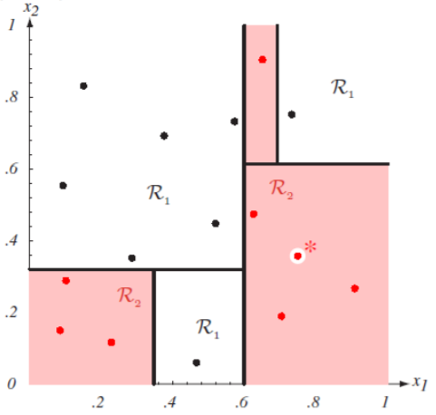
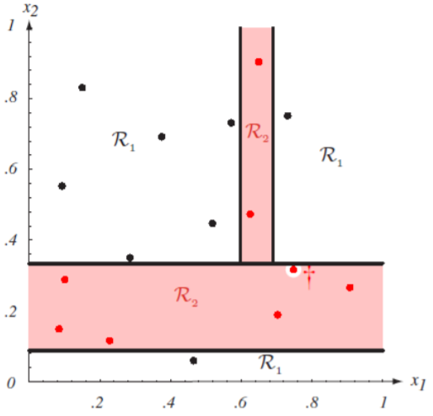
Con’s
Con’s
  Unstable, sensitive to noise
  Accuracy may not be good enough (depending on your data)
  The optimal splitting is NP, greedy algorithms are used
  Overfitting
Notes:
http://cse.msu.edu/~cse802/DecisionTrees.pdf

Slide 14
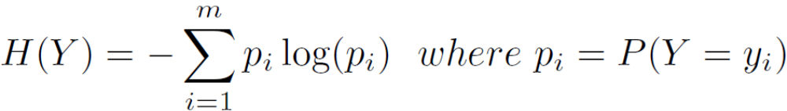
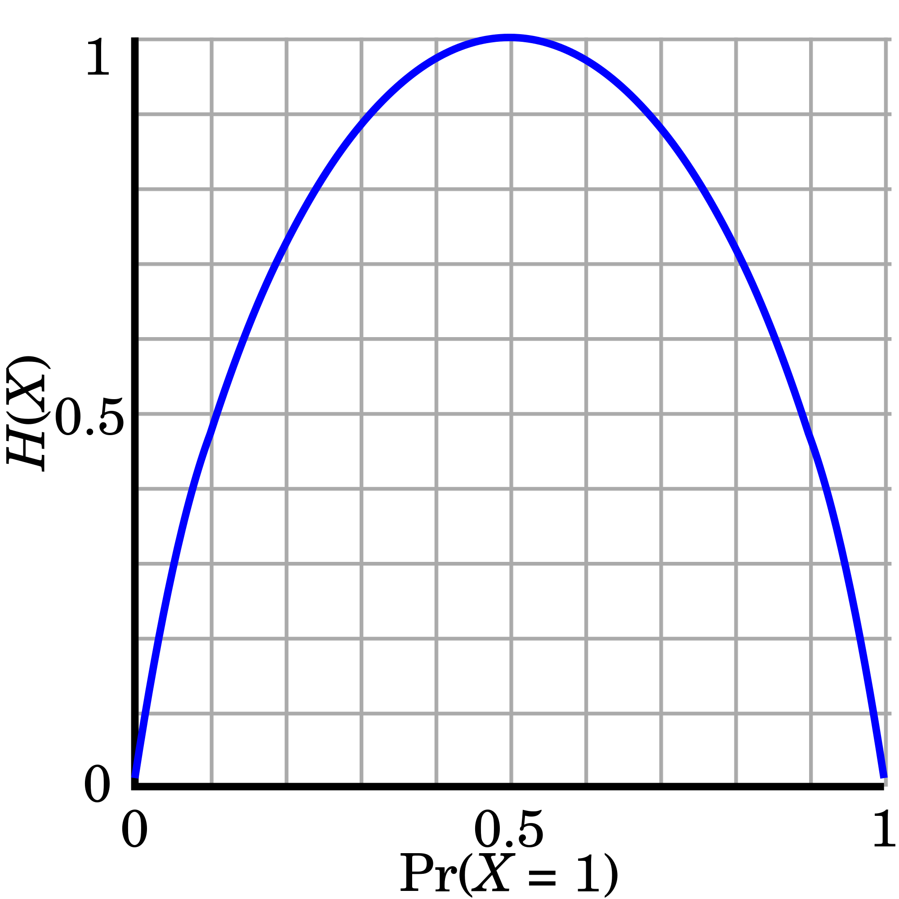
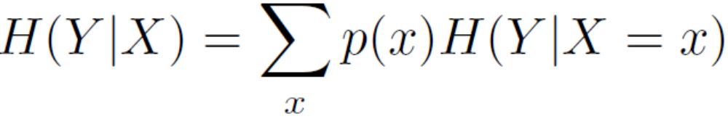
Splitting Measures: Information Gain
Entropy (Information Theory)
  A measure of uncertainty associated with a random number
  Calculation: For a discrete random variable Y taking m distinct values {y₁, y₂, …, y_{m}}
  Interpretation
    Higher entropy → higher uncertainty
    Lower entropy → lower uncertainty
Conditional entropy
m = 2

Slide 15
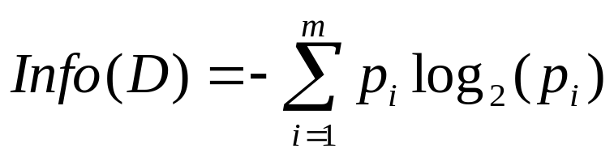
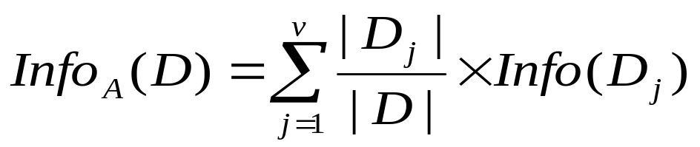
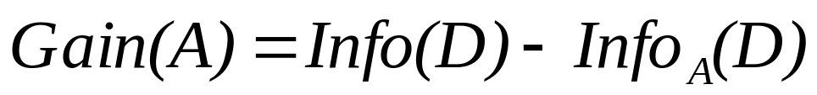
Information Gain: An Attribute Selection Measure
Select the attribute with the highest information gain (used in typical decision tree induction algorithm: ID3/C4.5)
Let p_{i} be the probability that an arbitrary tuple in D belongs to class C_{i}, estimated by |C_{i, D}|/|D|
Expected information (entropy) needed to classify a tuple in D:
Information needed (after using A to split D into v partitions) to classify D:
Information gained by branching on attribute A
Notes:
I : the expected information needed to classify a given sample
E (entropy) : expected information based on the partitioning into subsets by A

Slide 16
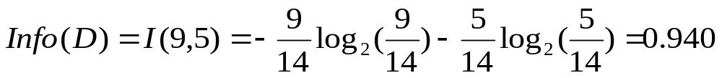
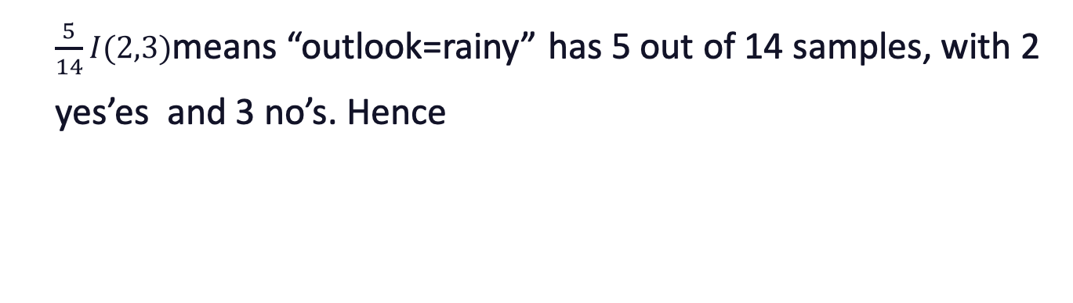
Example: Attribute Selection with Information Gain
Outlook | Temp | Humidity | Windy | Play Golf
Rainy | Hot | High | False | No
Rainy | Hot | High | True | No
Overcast | Hot | High | False | Yes
Sunny | Mild | High | False | Yes
Sunny | Cool | Normal | False | Yes
Sunny | Cool | Normal | True | No
Overcast | Cool | Normal | True | Yes
Rainy | Mild | High | False | No
Rainy | Cool | Normal | False | Yes
Sunny | Mild | Normal | False | Yes
Rainy | Mild | Normal | True | Yes
Overcast | Mild | High | True | Yes
Overcast | Hot | Normal | False | Yes
Sunny | Mild | High | True | No
outlook | yes | no | I(yes, no)
rainy | 2 | 3 | 0.971
overcast | 4 | 0 | 0
sunny | 3 | 2 | 0.971
outlook?
Sunny
Rainy
Overcast
$$Info_{outlook}\left(D\right)=\frac{5}{14}I\left(2,3\right)+\frac{4}{14}I\left(4,0\right)+\frac{5}{14}I\left(3,2\right)=0.694$$
$\frac{5}{14}I(2,3)$means “outlook=rainy” has 5 out of 14 samples, with 2 yes’es and 3 no’s. Hence
$$Gain(outlook)=Info(D)−Info_{outlook}(D)=0.246$$

Slide 17
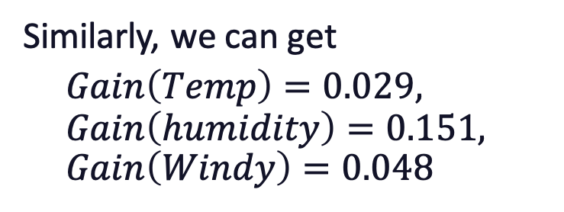
Example: Attribute Selection with Information Gain
Outlook | Temp | Humidity | Windy | Play Golf
Rainy | Hot | High | False | No
Rainy | Hot | High | True | No
Overcast | Hot | High | False | Yes
Sunny | Mild | High | False | Yes
Sunny | Cool | Normal | False | Yes
Sunny | Cool | Normal | True | No
Overcast | Cool | Normal | True | Yes
Rainy | Mild | High | False | No
Rainy | Cool | Normal | False | Yes
Sunny | Mild | Normal | False | Yes
Rainy | Mild | Normal | True | Yes
Overcast | Mild | High | True | Yes
Overcast | Hot | Normal | False | Yes
Sunny | Mild | High | True | No
Temp | Yes | No | I(Yes, No)
Hot | 2 | 2 | ?
Mild | 4 | 2 | ?
Cool | 3 | 1 | ?
Similarly, we can get
$Gain\left(Temp\right)=0.029, Gain\left(humidity\right)=0.151, Gain\left(Windy\right)=0.048$
Windy | Yes | No | I(Yes, No)
True | ? | ? | ?
False | ? | ? | ?
Humidity | Yes | No | I(Yes, No)
Normal | 6 | 1 | ?
High | 3 | 4 | ?

Slide 18
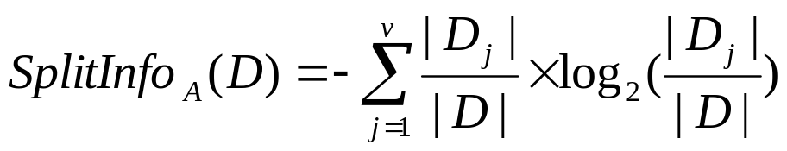
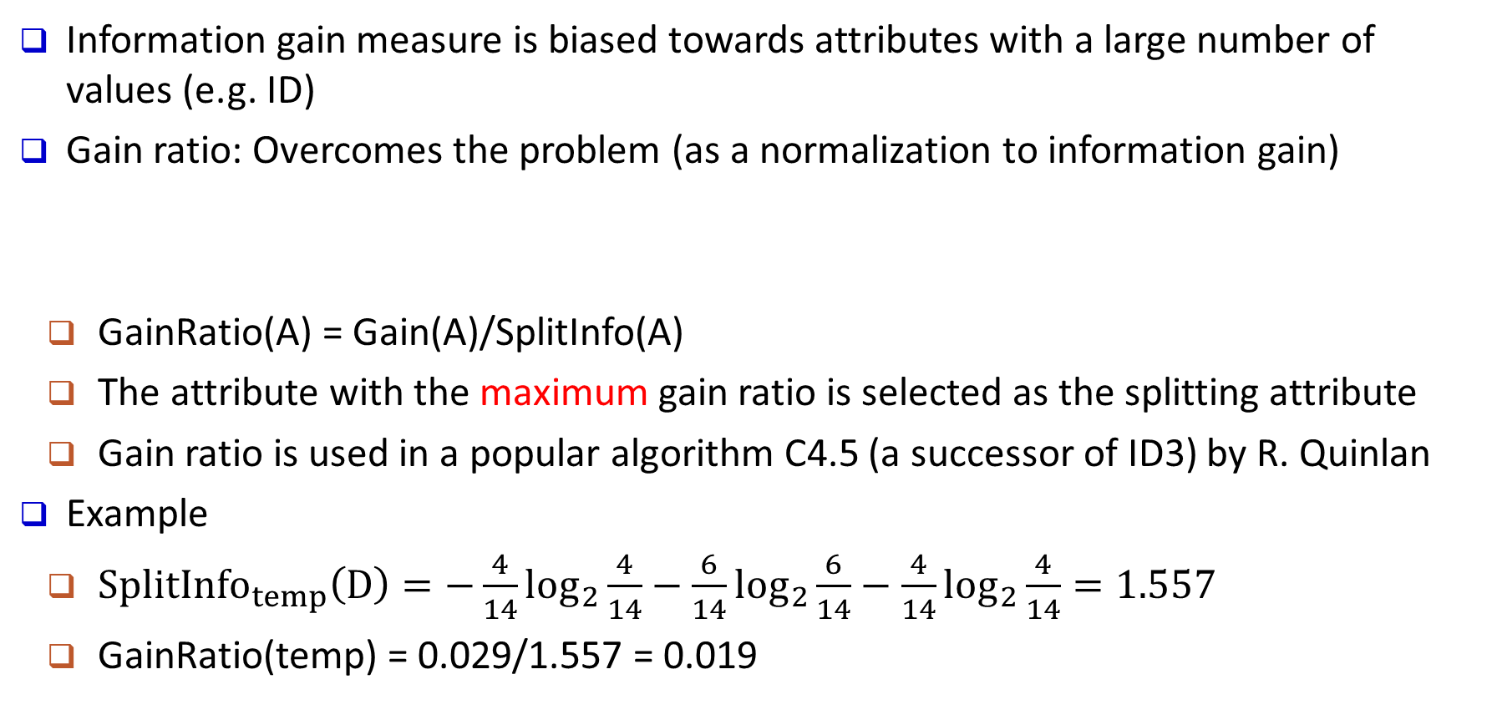
Gain Ratio: A Refined Measure for Attribute Selection
Information gain measure is biased towards attributes with a large number of values (e.g. ID)
Gain ratio: Overcomes the problem (as a normalization to information gain)
  GainRatio(A) = Gain(A)/SplitInfo(A)
  The attribute with the maximum gain ratio is selected as the splitting attribute
  Gain ratio is used in a popular algorithm C4.5 (a successor of ID3) by R. Quinlan
Example
  $SplitInfo_{temp}\left(D\right)=−\frac{4}{14}\log_{2}\frac{4}{14}−\frac{6}{14}\log_{2}\frac{6}{14}−\frac{4}{14}\log_{2}\frac{4}{14}=1.557$
  GainRatio(temp) = 0.029/1.557 = 0.019
Notes:
splitInfo is the entropy of A

Slide 19
Chapter 6. Classification: Basic Concepts
Classification: Basic Concepts
Decision Tree Induction
Bayes Classification Methods
Lazy Learners (or learning from your neighbors)
Linear Classifiers
Model Evaluation and Selection
Techniques to Improve Classification Accuracy
Summary
Notes:
19

Slide 20
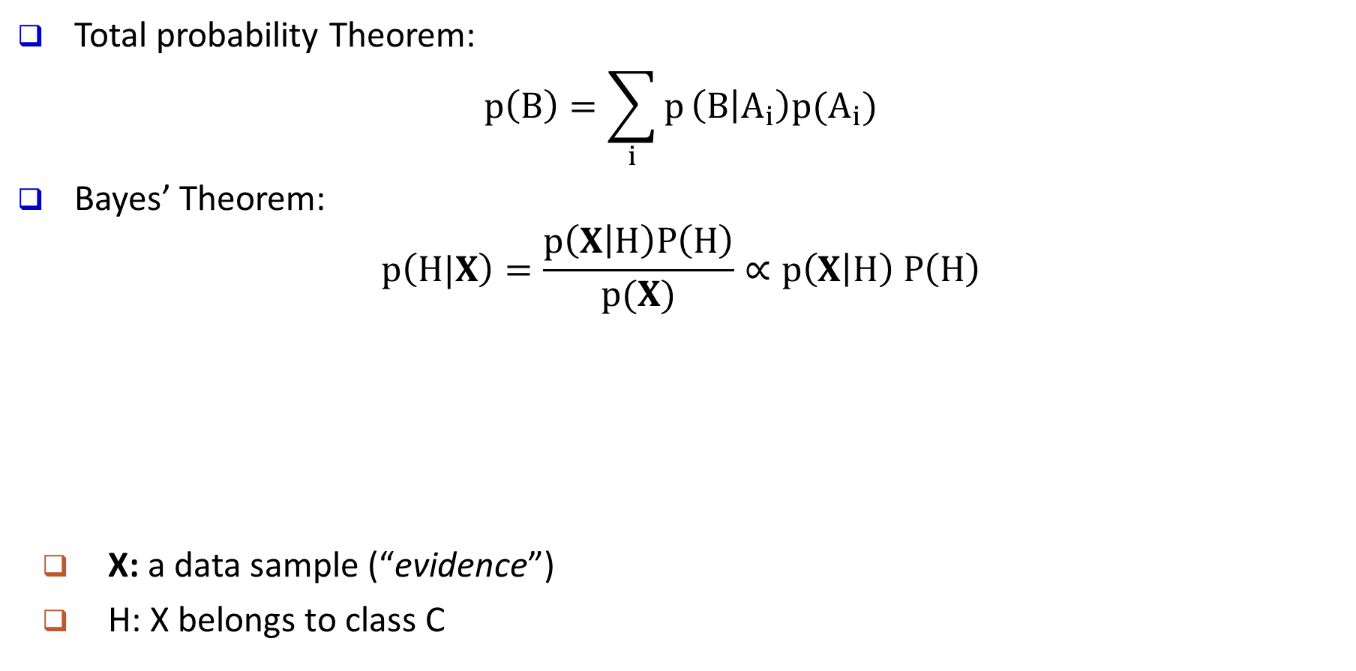
Bayes’ Theorem: Basics
Total probability Theorem:
$$p\left(B\right)=\sum_{i}{p}\left(B | A_{i}\right)p(A_{i})$$
Bayes’ Theorem:
$$p\left(H|X\right)=\frac{p\left(X | H\right)P\left(H\right)}{p(X)}∝p\left(X | H\right) P\left(H\right)$$
  X: a data sample (“evidence”)
  H: X belongs to class C
posteriori probability
likelihood
prior probability
What we should choose
What we just see
What we knew previously
Prediction can be done based on Bayes’ Theorem:
Classification is to derive the maximum posteriori

Slide 21
Bayes’ Theorem Example: Picnic Day
The morning is cloudy ☹
What is the chance of rain?
50% of all rainy days start off cloudy
Cloudy mornings are common (40% of days start cloudy)
This is usually a dry month (only 3 of 30 days tend to be rainy)
P(Rain | Cloud) = ?
P(Cloud | Rain) = 50%
P(Cloud) = 40%
P(Rain) = 10%
  P(Rain | Cloud) = P(Rain) P(Cloud | Rain) / P(Cloud) = 10% * 50% / 40% = 12.5%
The chance of rain is probably not as high as expected ☺
Bayes’ Theorem allows us to tell back and forth between posterior and likelihood
(e.g., P(Rain | Cloud) and P(Cloud | Rain)), tests the reality, which is the most important trick in Bayesian Inference

Slide 22
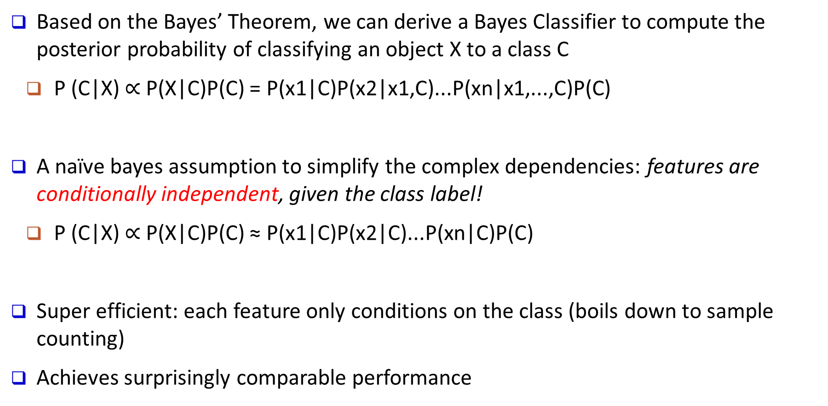
Naïve Bayes Classifier: Making a Naïve Bayes Assumption
Based on the Bayes’ Theorem, we can derive a Bayes Classifier to compute the posterior probability of classifying an object X to a class C
  P (C|X) $∝$ P(X|C)P(C) = P(x1|C)P(x2|x1,C)...P(xn|x1,...,C)P(C)
A naïve bayes assumption to simplify the complex dependencies: features are conditionally independent, given the class label!
  P (C|X) $∝$ P(X|C)P(C) ≈ P(x1|C)P(x2|C)...P(xn|C)P(C)
Super efficient: each feature only conditions on the class (boils down to sample counting)
Achieves surprisingly comparable performance
Notes:
What is naïve bayes

Slide 23
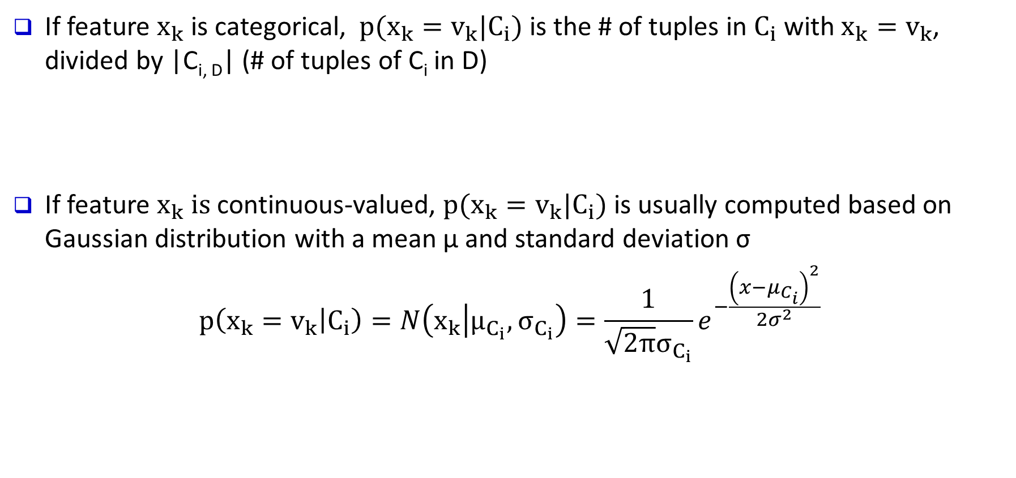
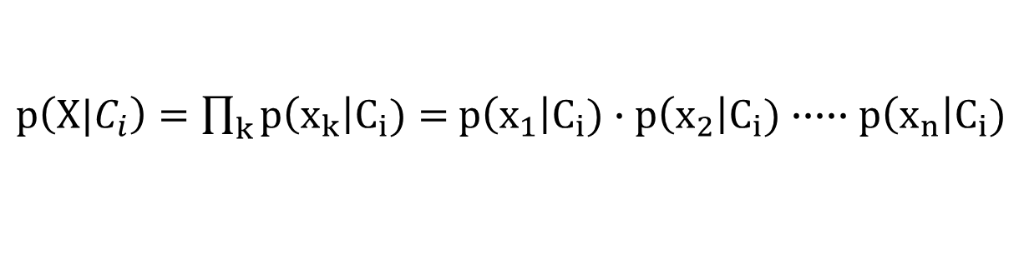
Naïve Bayes Classifier: Categorical vs. Continuous Valued Features
If feature $x_{k}$ is categorical, $p(x_{k}=v_{k}|C_{i})$ is the # of tuples in $C_{i}$ with $x_{k}=v_{k}$, divided by |C_{i, D}| (# of tuples of C_{i} in D)
If feature $x_{k} is$continuous-valued, $p(x_{k}=v_{k}|C_{i})$ is usually computed based on Gaussian distribution with a mean μ and standard deviation σ
$$p\left(x_{k}=v_{k} | C_{i}\right)=N\left(x_{k} | μ_{C_{i}}, σ_{C_{i}}\right)=\frac{1}{\sqrt{2π}σ_{C_{i}}}e^{−\frac{{\left(x−μ_{C_{i}}\right)}^{2}}{2σ^{2}}}$$
$p\left(X|C_{i}\right)=\prod_{k}{p\left(x_{k}\right|C_{i})}=$ $p\left(x_{1}\right|C_{i})∙p\left(x_{2}\right|C_{i})∙∙∙∙∙p\left(x_{n}\right|C_{i})$

Slide 24
Naïve Bayes Classifier Example 1: Training Dataset
Class:
play golf= ‘yes’
play golf = ‘no’
Notes:
https://www.saedsayad.com/naive_bayesian.htm

Slide 25
Naïve Bayes Classifier Example P(Yes | Sunny)

Slide 26
Naïve Bayes Classifier Example: P(No | Sunny)

Slide 27
Naïve Bayes Classifier Example: Likelihood Tables

Slide 28
Naïve Bayes Classifier Example: Likelihood Tables
/ P(x)
______________________
P(x)
/ P(x)
______________________
P(x)
P(x) = P( x | yes ) * P (yes) + P( x | no ) * P (no)

Slide 29
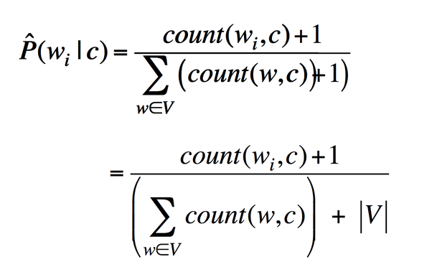
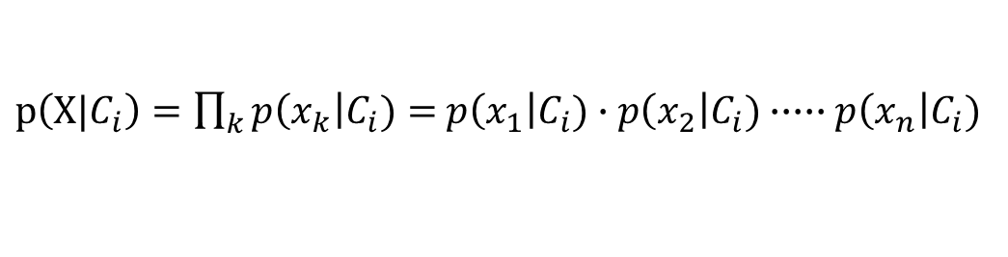
Avoiding the Zero-Probability Problem
Naïve Bayesian prediction requires each conditional probability be non-zero
  Otherwise, the predicted probability will be zero
Example. Suppose a dataset with 1,000 tuples:
      income = low (0), income= medium (990), and income = high (10)
Use Laplacian correction (or Laplacian estimator)
  Adding 1 (or a small integer) to each case
      Prob(income = low) = 1/(1000 + 3)
      Prob(income = medium) = (990 + 1)/(1000 + 3)
      Prob(income = high) = (10 + 1)/(1000 + 3)
  The “corrected” probability estimates are close to their “uncorrected” counterparts
$p\left(X|C_{i}\right)=\prod_{k}{p\left(x_{k}\right|C_{i})}=$ $p\left(x_{1}\right|C_{i})∙p\left(x_{2}\right|C_{i})∙∙∙∙∙p\left(x_{n}\right|C_{i})$
Notes:
For a given class, if there is no tuple whose income is low. Then given a test tuple whose income is low, its posterior probability by NB is zero and we will never predict this tuple to belong to this class

Slide 30
Naïve Bayes Classifier: Strength vs. Weakness
Strength
  Performance: A naïve Bayesian classifier, has comparable performance with decision tree and selected neural network classifiers
  Incremental: Each training example can incrementally increase/decrease the probability that a hypothesis is correct—prior knowledge can be combined with observed data

Slide 31
Naïve Bayes Classifier: Strength vs. Weakness
Weakness
  Assumption: attributes conditional independence, therefore loss of accuracy
    E.g., Patient’s Profile: (age, family history)
    Patient’s Symptoms: (fever, cough)
    Patient’s Disease: (lung cancer, diabetes)
    Dependencies among these cannot be modeled by Naïve Bayes Classifier
  How to deal with these dependencies?
    Use Bayesian Belief Networks (Chapter 7)

Slide 32
Chapter 6. Classification: Basic Concepts
Classification: Basic Concepts
Decision Tree Induction
Bayes Classification Methods
Lazy Learners (or learning from your neighbors)
Linear Classifiers
Model Evaluation and Selection
Techniques to Improve Classification Accuracy
Summary
Notes:
32

Slide 33
Lazy vs. Eager Learning
Lazy vs. eager learning
  Lazy learning (e.g., instance-based learning): Simply stores training data (or only minor processing) and waits until it is given a test tuple
  Eager learning (the above discussed methods): Given a set of training tuples, constructs a classification model before receiving new (e.g., test) data to classify
Lazy: less time in training but more time in predicting
Accuracy
  Lazy method effectively uses a richer hypothesis space since it uses many local linear functions to form an implicit global approximation to the target function
  Eager: must commit to a single hypothesis that covers the entire instance space

Slide 34
Lazy Learner: Instance-Based Methods
Instance-based learning:
  Store training examples and delay the processing (“lazy evaluation”) until a new instance must be classified
Typical approaches
  k-nearest neighbor approach
    Instances represented as points in a Euclidean space.
  Locally weighted regression
    Constructs local approximation
  Case-based reasoning
    Uses symbolic representations and knowledge-based inference

Slide 35
The k-Nearest Neighbor Algorithm
All instances correspond to points in the n-D space
The nearest neighbor are defined in terms of Euclidean distance, dist(X₁, X₂)
Target function could be discrete- or real- valued
For discrete-valued, k-NN returns the most common value among the k training examples nearest to x_{q}
Vonoroi diagram: the decision surface induced by 1-NN for a typical set of training examples
_
.
.
_
_
+
_
.
.
+
.
_
x_{q}
+
_
.
+

Slide 36
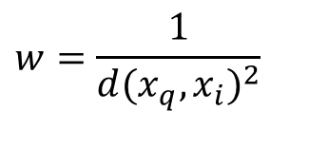
Discussion on the k-NN Algorithm
k-NN for real-valued prediction for a given unknown tuple
  Returns the mean values of the k nearest neighbors
Distance-weighted nearest neighbor algorithm
  Weight the contribution of each of the k neighbors according to their distance to the query x_{q}
    Give greater weight to closer neighbors
Robust to noisy data by averaging k-nearest neighbors
Curse of dimensionality: distance between neighbors could be dominated by irrelevant attributes
  To overcome it, axes stretch or elimination of the least relevant attributes
$$w=\frac{1}{d(x_{q},x_{i})^{2}}$$

Slide 37
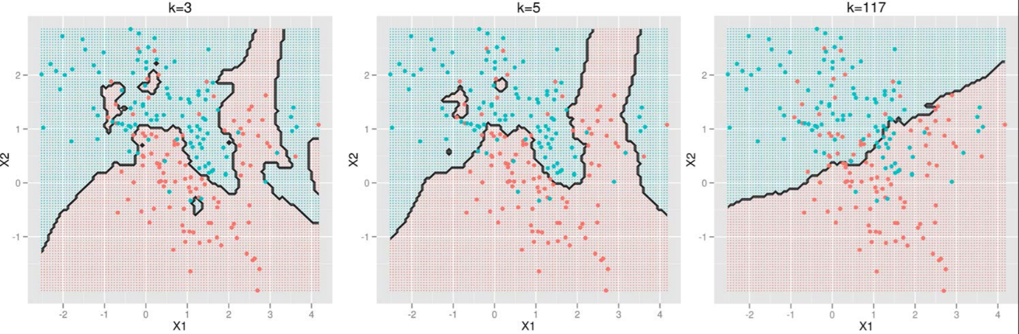
Selection of k for kNN
The number of neighbors k
  Small k: overfitting (high var., low bias)
  Big k: bringing too many irrelevant points (high bias, low var.)
http://scott.fortmann-roe.com/docs/BiasVariance.html

Slide 38
Case-Based Reasoning (CBR)
CBR: Uses a database of problem solutions to solve new problems
Store symbolic description (tuples or cases)—not points in a Euclidean space
Applications: Customer-service (product-related diagnosis), legal ruling
Methodology
  Instances represented by rich symbolic descriptions (e.g., function graphs)
  Search for similar cases, multiple retrieved cases may be combined
  Tight coupling between case retrieval, knowledge-based reasoning, and problem solving
Challenges
  Find a good similarity metric
  Indexing based on syntactic similarity measure, and when failure, backtracking, and adapting to additional cases

Slide 39
Chapter 6. Classification: Basic Concepts
Classification: Basic Concepts
Decision Tree Induction
Bayes Classification Methods
Lazy Learners (or learning from your neighbors)
Linear Classifiers
Model Evaluation and Selection
Techniques to Improve Classification Accuracy
Summary
Notes:
39

Slide 40
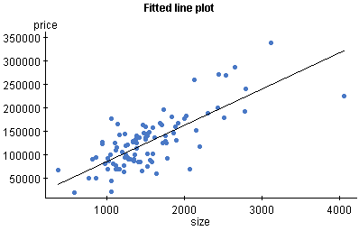
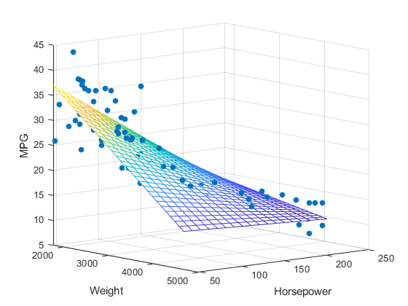
Linear Regression Problem: Example
Mapping from independent attributes to continuous value: x => y
{living area} => Price of the house
{college; major; GPA} => Future Income
Price of houses
Living Area

Slide 41
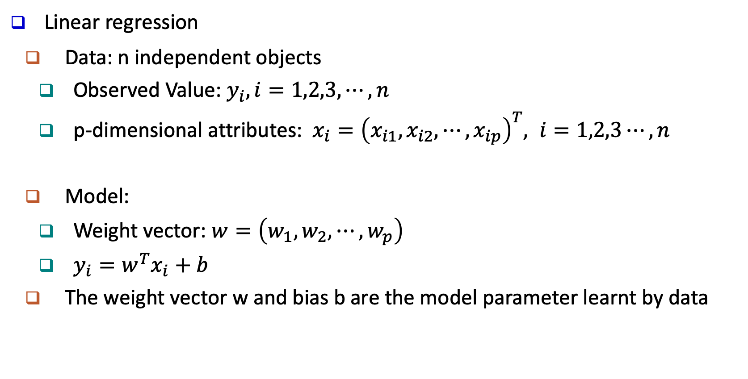
Linear Regression Problem: Model
Linear regression
  Data: n independent objects
    Observed Value: $y_{i}, i=1,2,3,⋯,n$
    p-dimensional attributes: $x_{i}={\left(x_{i1},x_{i2},⋯, x_{ip}\right)}^{T}, i=1,2,3⋯,n$
  Model:
    Weight vector: $w=\left(w_{1},w_{2},⋯,w_{p}\right)$
    $y_{i}=w^{T}x_{i}+b$
  The weight vector w and bias b are the model parameter learnt by data

Slide 42
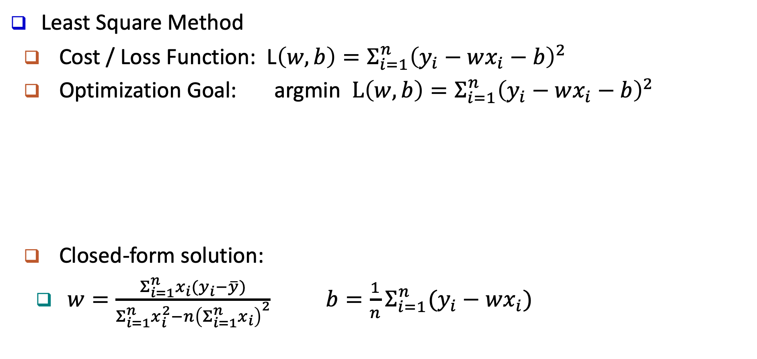
Linear Regression Model: Solution
Least Square Method
  Cost / Loss Function: L$\left(w,b\right)=Σ_{i=1}^{n}{\left(y_{i}−wx_{i}−b\right)}^{2}$
  Optimization Goal: argmin $L\left(w,b\right)=Σ_{i=1}^{n}{\left(y_{i}−wx_{i}−b\right)}^{2}$
  Closed-form solution:
    $w=\frac{Σ_{i=1}^{n}x_{i}(y_{i}−\overline{y})}{Σ_{i=1}^{n}x_{i}^{2}−n{\left(Σ_{i=1}^{n}x_{i}\right)}^{2}} b=\frac{1}{n}Σ_{i=1}^{n}(y_{i}−wx_{i})$
(w,b)

Slide 43
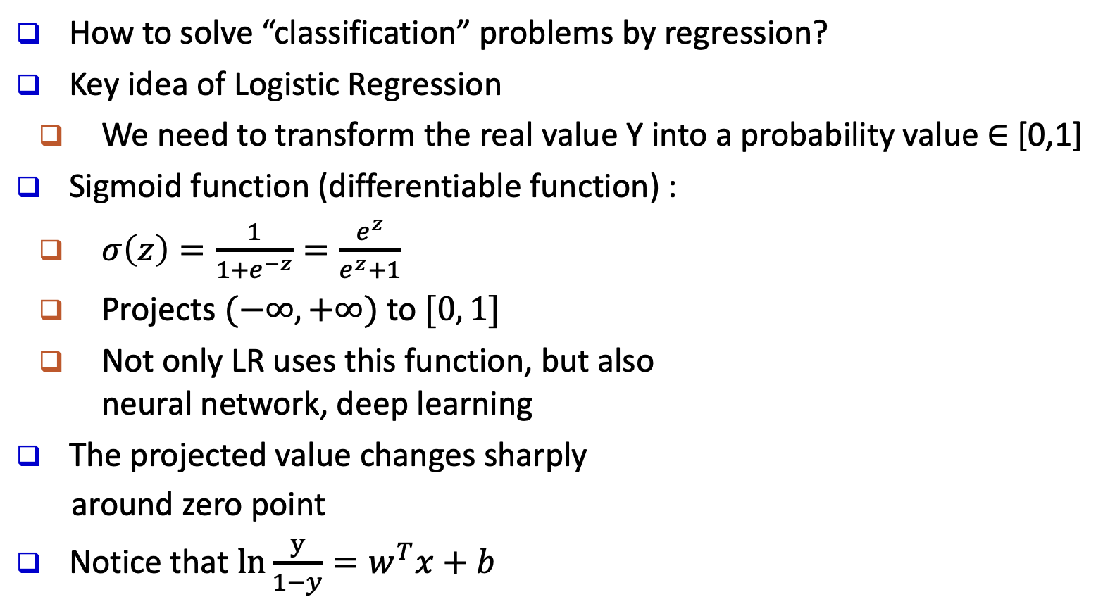
Logistic Regression: General Ideas
How to solve “classification” problems by regression?
Key idea of Logistic Regression
  We need to transform the real value Y into a probability value $∈$ [0,1]
Sigmoid function (differentiable function) :
  $σ\left(z\right)=\frac{1}{1+e^{−z}}=\frac{e^{z}}{e^{z}+1}$
  Projects $(−∞, +∞)$ to $[0, 1]$
  Not only LR uses this function, but also
  neural network, deep learning
The projected value changes sharply
around zero point
Notice that $ln\frac{y}{1−y}=w^{T}x+b$
Sigmoid
Function

Slide 44
Logistic Regression: An Example
Suppose we only consider the year as feature
  Data points are converted by sigmoid function (“activation” function)
1 (Tenured)
year
6

Slide 45
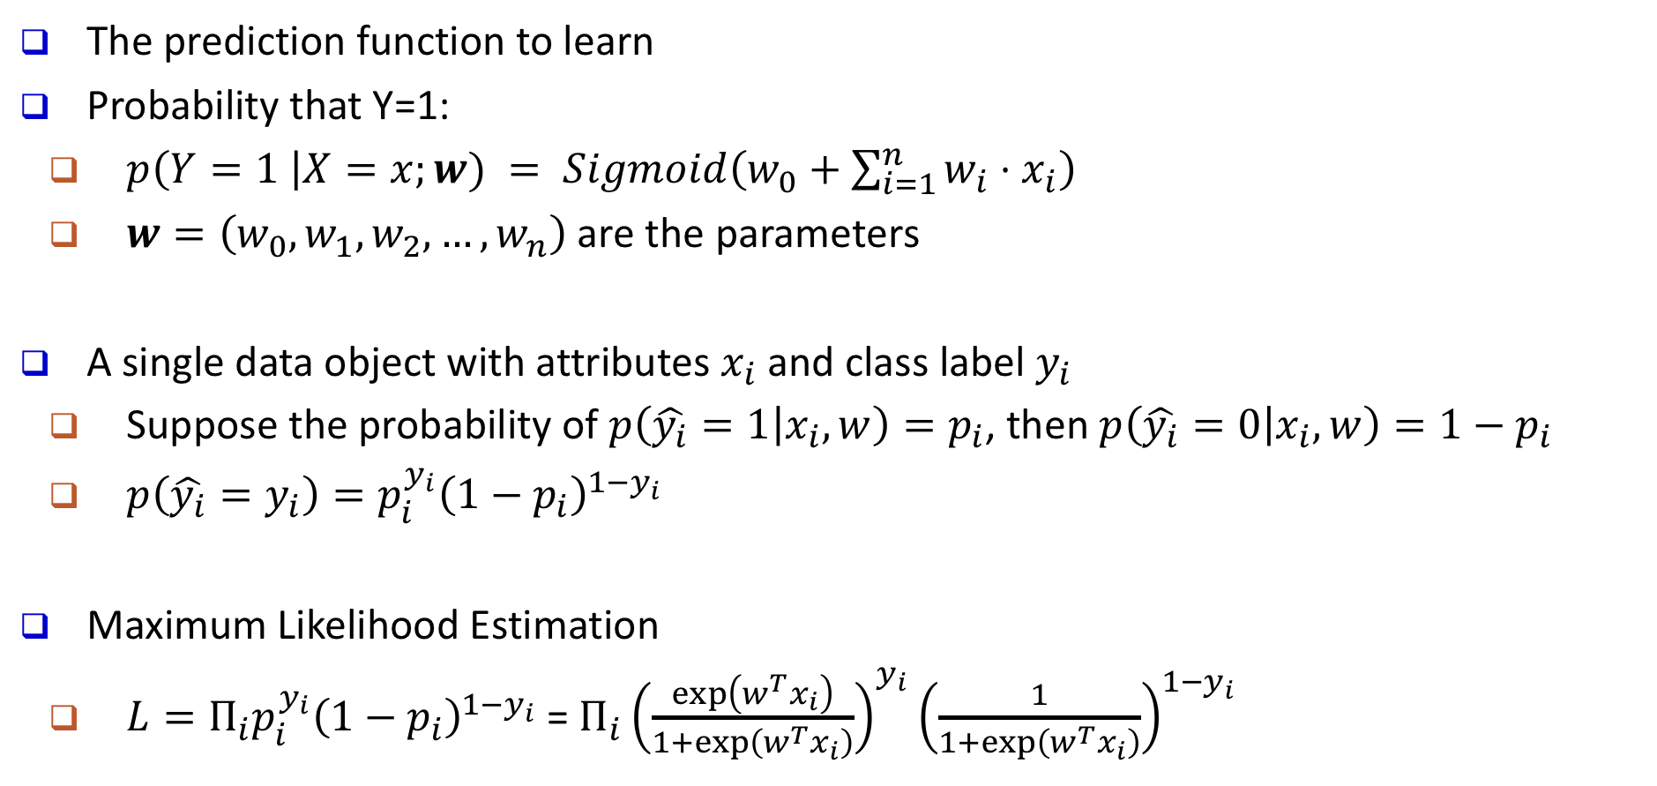
Logistic Regression: Model
The prediction function to learn
Probability that Y=1:
  $p\left(Y=1 \right|X=x;w) = Sigmoid\left(w_{0}+\sum_{i=1}^{n}{w_{i}⋅x_{i}}\right)$
  $w=\left(w_{0}, w_{1}, w_{2},…,w_{n}\right)$ are the parameters
A single data object with attributes $x_{i}$ and class label $y_{i}$
  Suppose the probability of $p\left(\hat{y_{i}}=1 | x_{i},w\right)=p_{i}$, then $p\left(\hat{y_{i}}=0 | x_{i},w\right)=1−p_{i}$
  $p\left(\hat{y_{i}}=y_{i}\right)=p_{i}^{y_{i}}{\left(1−p_{i}\right)}^{1−y_{i}}$
Maximum Likelihood Estimation
  $L=Π_{i}p_{i}^{y_{i}}{\left(1−p_{i}\right)}^{1−y_{i}}$ = $Π_{i}{\left(\frac{\exp\left(w^{T}x_{i}\right)}{1+\exp\left(w^{T}x_{i}\right)}\right)}^{y_{i}}{\left(\frac{1}{1+\exp\left(w^{T}x_{i}\right)}\right)}^{1−y_{i}}$

Slide 46
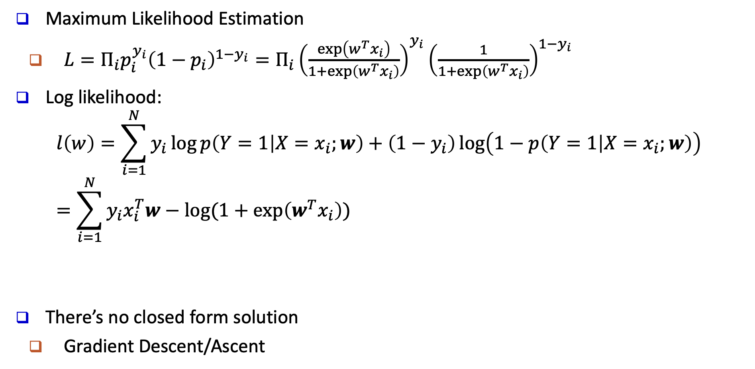
Logistic Regression: Optimization
Maximum Likelihood Estimation
  $L=Π_{i}p_{i}^{y_{i}}{\left(1−p_{i}\right)}^{1−y_{i}}=Π_{i}{\left(\frac{\exp\left(w^{T}x_{i}\right)}{1+\exp\left(w^{T}x_{i}\right)}\right)}^{y_{i}}{\left(\frac{1}{1+\exp\left(w^{T}x_{i}\right)}\right)}^{1−y_{i}}$
Log likelihood:
      $$l\left(w\right)=\sum_{i=1}^{N}{y_{i}}\log{p\left(Y=1 | X=x_{i};w\right)}+\left(1−y_{i}\right)\log\left(1−p\left(Y=1 | X=x_{i};w\right)\right)=\sum_{i=1}^{N}{y_{i}x_{i}^{T}w−log⁡(1+exp\left(w^{T}x_{i}\right))}$$
There’s no closed form solution
  Gradient Descent/Ascent

Slide 47

Gradient Descent
Gradient Descent is an iterative optimization algorithm for finding the minimum of a function (e.g., the negative log likelihood)
For a function F(x) at a point a, F(x) decreases fastest if we go in the direction of the negative gradient of a
Step size
When the gradient is zero, we arrive at the local minimum

Slide 48
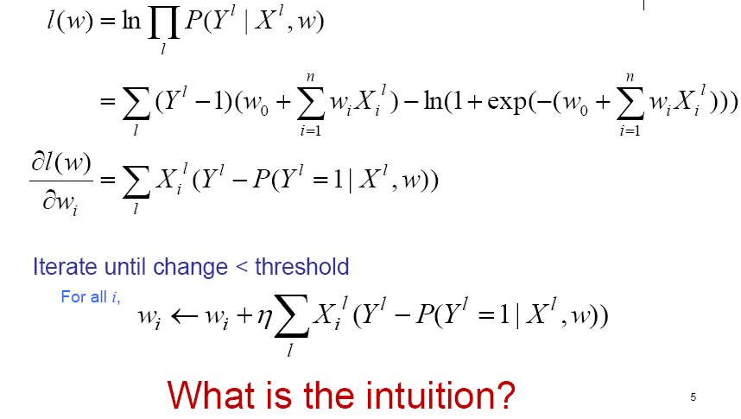
Gradient Descent
[footnote: It is gradient ascent for maximizing log likelihood]
Note we have switched the index i in the previous slides to l, and use i to refer to different components of weight vector w

Slide 49
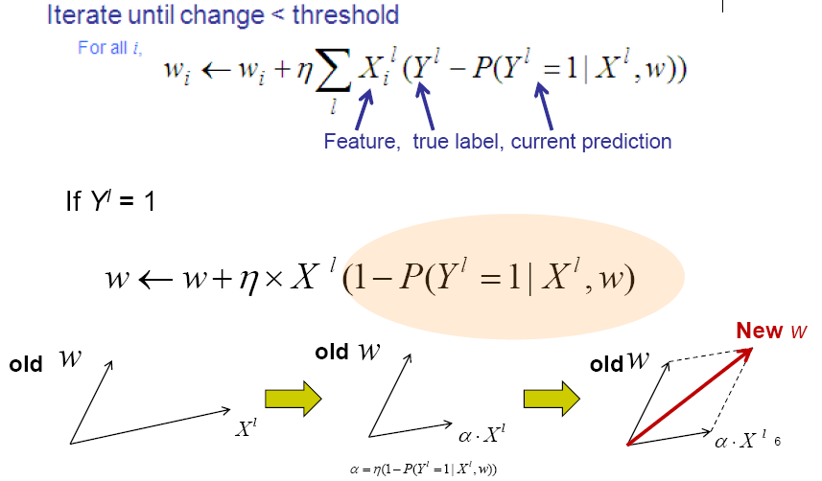
Gradient Descent
[footnote: It is gradient ascent for maximizing log likelihood]

Slide 50
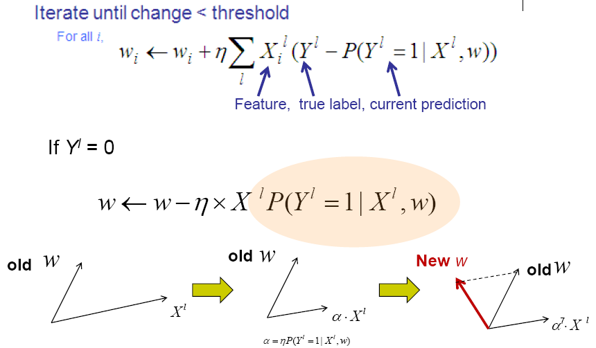
Gradient Descent
[footnote: It is gradient ascent for maximizing log likelihood]

Slide 51
Chapter 6. Classification: Basic Concepts
Classification: Basic Concepts
Decision Tree Induction
Bayes Classification Methods
Lazy Learners (or learning from your neighbors)
Linear Classifiers
Model Evaluation and Selection
Techniques to Improve Classification Accuracy
Summary
Notes:
51

Slide 52
Model Evaluation and Selection
Evaluation metrics
  How can we measure accuracy?
  Other metrics to consider?
Use validation test set of class-labeled tuples instead of training set when assessing accuracy
Methods for estimating a classifier’s accuracy
  Holdout method
  Cross-validation
  Bootstrap (not covered)
Comparing classifiers:
  ROC Curves

Slide 53
Classifier Evaluation Metrics: Confusion Matrix
Confusion Matrix:
In a confusion matrix w. m classes, CM_{i,j} indicates # of tuples in class i that were labeled by the classifier as class j
  May have extra rows/columns to provide totals
Example of Confusion Matrix:
Actual class\Predicted class | C₁ | ¬ C₁
C₁ | True Positives (TP) | False Negatives (FN)
¬ C₁ | False Positives (FP) | True Negatives (TN)
Actual class\Predicted class | play_golf = yes | play_golf = no | Total
play_golf = yes | 6954 | 46 | 7000
play_golf = no | 412 | 2588 | 3000
Total | 7366 | 2634 | 10000

Slide 54
Classifier Evaluation Metrics: Accuracy, Error Rate, Sensitivity and Specificity
A\P | C | ¬C
C | TP | FN | P
¬C | FP | TN | N
 | P’ | N’ | All
Class imbalance problem
  One class may be rare
    E.g., fraud, or HIV-positive
  Significant majority of the negative class and minority of the positive class
  Measures handle the class imbalance problem
    Sensitivity (recall): True positive recognition rate
      Sensitivity = TP/P
    Specificity: True negative recognition rate
      Specificity = TN/N
Real-world truth
Predictions
Classifier accuracy, or recognition rate
  Percentage of test set tuples that are correctly classified
      Accuracy = (TP + TN)/All
Error rate: 1 – accuracy, or
      Error rate = (FP + FN)/All

Slide 55
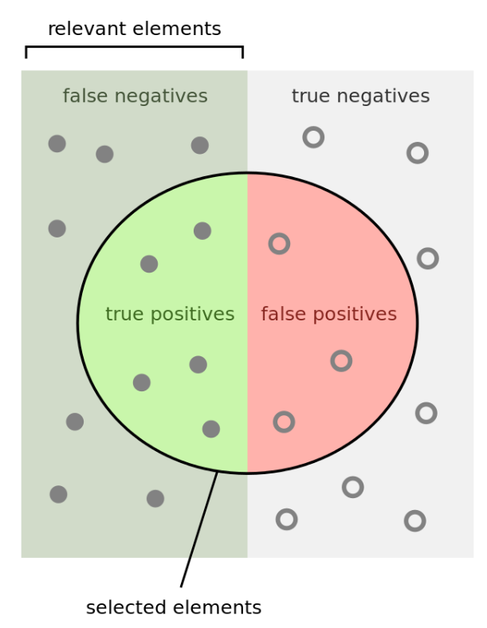
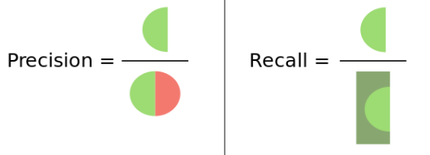


Classifier Evaluation Metrics:
Precision and Recall, and F-measures
A\P | C | ¬C
C | TP | FN | P
¬C | FP | TN | N
 | P’ | N’ | All
Precision: Exactness: what % of tuples that the classifier labeled as positive are actually positive?
Recall: Completeness: what % of positive tuples did the classifier label as positive?
  Range: [0, 1]
$$P=Precision=\frac{TP}{TP +FP}$$
$$R=Recall=\frac{TP}{TP +FN}$$
https://en.wikipedia.org/wiki/Precision_and_recall
Notes:
Left half: actual positives (P)
Right half: actual negatives (N)
Inside circle: predicted positive (P’)
Outside circle: predicted negative (N’)

Slide 56
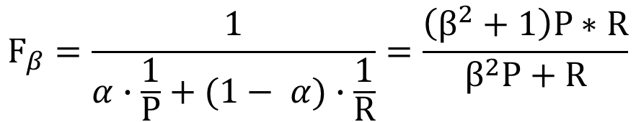
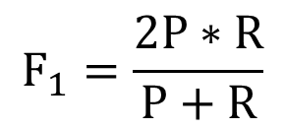
Classifier Evaluation Metrics:
Precision and Recall, and F-measures
The “inverse” relationship between precision & recall
We want one number to say if a classifier is good or not
F measure (or F-score): harmonic mean of precision and recall
  In general, it is the weighted measure of precision & recall
  F1-measure (balanced F-measure)
        That is, when β = 1,
$$F_{β}=\frac{1}{α∙\frac{1}{P}+(1− α)∙\frac{1}{R}}=\frac{\left(β^{2}+1\right)P∗R}{β^{2}P+R}$$
Assigning β times as much weight to recall as to precision
$$F_{1}=\frac{2P∗R}{P+R}$$
Notes:
1/alpha - 1 = beta^2

Slide 57
Classifier Evaluation Metrics: Example
Use the same confusion matrix, calculate the measure just introduced
    Sensitivity =
    Specificity =
    Accuracy =
    Error rate =
    Precision =
    Recall =
    F1 =
Actual Class\Predicted class | cancer = yes | cancer = no | Total
cancer = yes | 90 | 210 | 300
cancer = no | 140 | 9560 | 9700
Total | 230 | 9770 | 10000
Notes:
Sensitivity = TP/P = 90/300 = 30%
Specificity = TN/N = 9560/9700 = 98.56%
Accuracy = (TP + TN)/All = (90+9560)/10000 = 96.50%
Error rate = (FP + FN)/All = (140 + 210)/10000 = 3.50%
Precision = TP/(TP + FP) = 90/(90 + 140) = 90/230 = 39.13%
Recall = TP/ (TP + FN) = 90/(90 + 210) = 90/300 = 30.00%
F1 = 2 P × R /(P + R) = 2 × 39.13% × 30.00%/(39.13% + 30%) = 33.96%

Slide 58
Classifier Evaluation Metrics: Example
Use the same confusion matrix, calculate the measure just introduced
    Sensitivity = TP/P = 90/300 = 30%
    Specificity = TN/N = 9560/9700 = 98.56%
    Accuracy = (TP + TN)/All = (90+9560)/10000 = 96.50%
    Error rate = (FP + FN)/All = (140 + 210)/10000 = 3.50%
    Precision = TP/(TP + FP) = 90/(90 + 140) = 90/230 = 39.13%
    Recall = TP/ (TP + FN) = 90/(90 + 210) = 90/300 = 30.00%
    F1 = 2 P × R /(P + R) = 2 × 39.13% × 30.00%/(39.13% + 30%) = 33.96%
Actual Class\Predicted class | cancer = yes | cancer = no | Total
cancer = yes | 90 | 210 | 300
cancer = no | 140 | 9560 | 9700
Total | 230 | 9770 | 10000
Notes:
Sensitivity = TP/P = 90/300 = 30%
Specificity = TN/N = 9560/9700 = 98.56%
Accuracy = (TP + TN)/All = (90+9560)/10000 = 96.50%
Error rate = (FP + FN)/All = (140 + 210)/10000 = 3.50%
Precision = TP/(TP + FP) = 90/(90 + 140) = 90/230 = 39.13%
Recall = TP/ (TP + FN) = 90/(90 + 210) = 90/300 = 30.00%
F1 = 2 P × R /(P + R) = 2 × 39.13% × 30.00%/(39.13% + 30%) = 33.96%

Slide 59
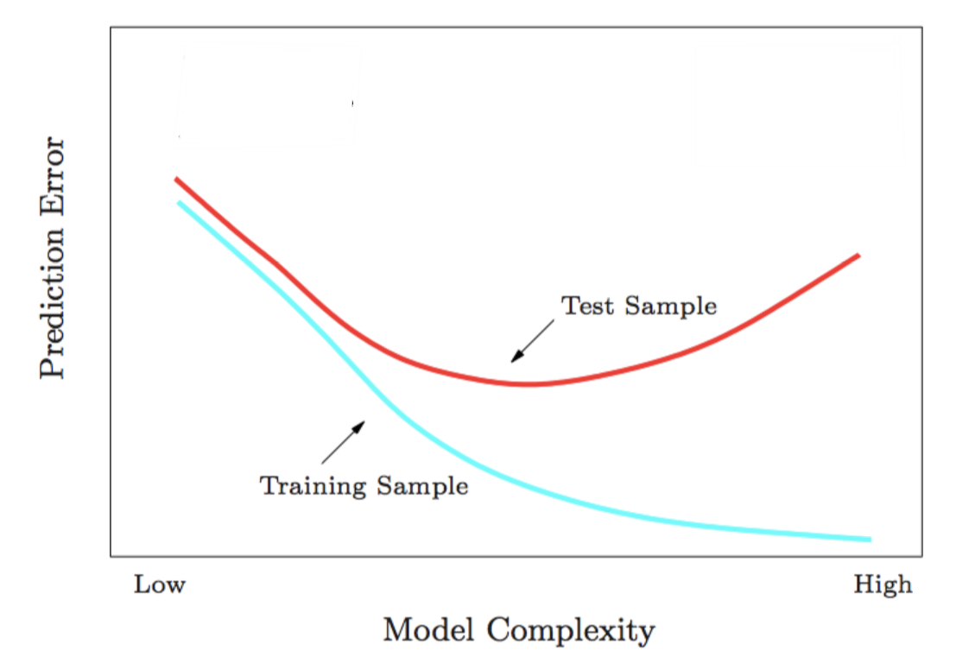
Training Error VS Testing Error
underfitting
overfitting

Slide 60
Classifier Evaluation: Holdout
Holdout method
  Given data is randomly partitioned into two independent sets
    Training set (e.g., 2/3) for model construction
    Test set (e.g., 1/3) for accuracy estimation
  Repeated random sub-sampling validation: a variation of holdout
    Repeat holdout k times, accuracy = avg. of the accuracies obtained

Slide 61
Classifier Evaluation: Cross-Validation
Cross-validation (k-fold, where k = 10 is most popular)
  Randomly partition the data into k mutually exclusive subsets, each approximately equal size
  At i-th iteration, use D_{i} as test set and others as training set
  Leave-one-out: k folds where k = # of tuples, for small sized data
  *Stratified cross-validation*: folds are stratified so that class distribution, in each fold is approximately the same as that in the initial data

Slide 62
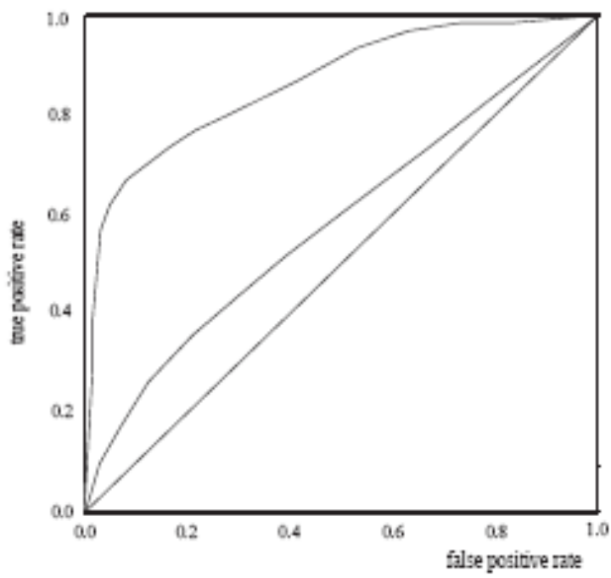
Model Selection: ROC Curves
ROC (Receiver Operating Characteristics) curves: for visual comparison of classification models
Originated from signal detection theory
Shows the trade-off between the true positive rate and the false positive rate
The area under the ROC curve (AUC: Area Under Curve) is a measure of the accuracy of the model
Rank the test tuples in decreasing order: the one that is most likely to belong to the positive class appears at the top of the list
The closer to the diagonal line (i.e., the closer the area is to 0.5), the less accurate is the model
True positive rate
False positive rate
Vertical axis represents the true positive rate (TP/P)
Horizontal axis rep. the false positive rate (FP/N)
The plot also shows a diagonal line
A model with perfect accuracy will have an area of 1.0

Slide 63
Chapter 6. Classification: Basic Concepts
Classification: Basic Concepts
Decision Tree Induction
Bayes Classification Methods
Lazy Learners (or learning from your neighbors)
Linear Classifiers
Model Evaluation and Selection
Techniques to Improve Classification Accuracy
Summary
Notes:
63

Slide 64
Techniques to Improve Classification Accuracy
Introducing Ensemble Methods
Bagging
Boosting
Random Forests
Imbalanced Classification
Notes:
64

Slide 65
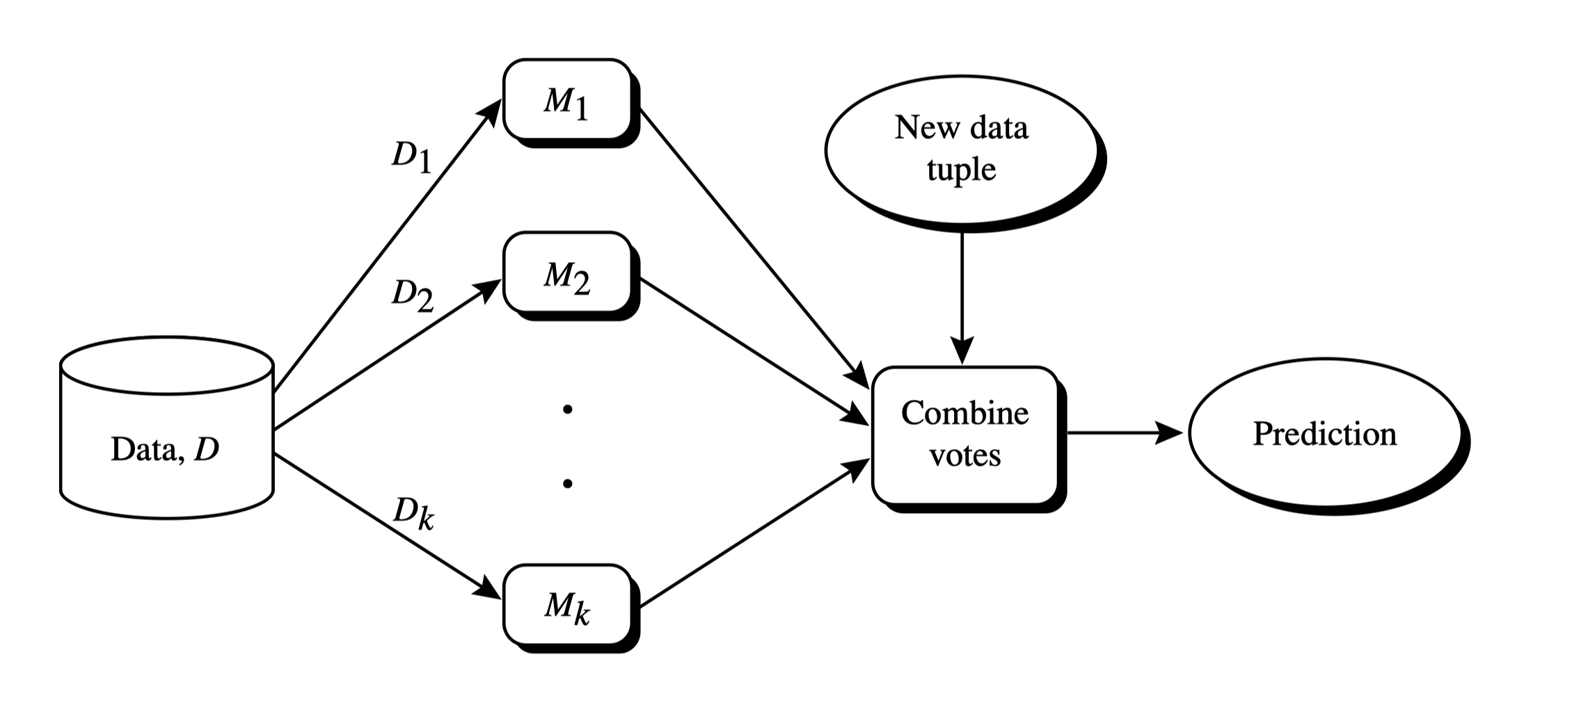
Ensemble Methods: Increasing the Accuracy
Ensemble methods
  Use a combination of models to increase accuracy
  Combine a series of k learned models, M₁, M₂, …, M_{k}, with the aim of creating an improved model M*

Slide 66
Ensemble Methods: Increasing the Accuracy
What are the requirements to generate an improved model?
  Example: majority voting
 | x₁ | x₂ | x₃
M₁ | ✓ | ✓ | ✗
M₂ | ✗ | ✓ | ✓
M₃ | ✓ | ✗ | ✓
Voting Ensemble | ✓ | ✓ | ✓
 | x₁ | x₂ | x₃
M₁ | ✓ | ✓ | ✗
M₂ | ✓ | ✓ | ✗
M₃ | ✓ | ✓ | ✗
Voting Ensemble | ✓ | ✓ | ✗
 | x₁ | x₂ | x₃
M₁ | ✓ | ✗ | ✗
M₂ | ✗ | ✓ | ✗
M₃ | ✗ | ✗ | ✓
Voting Ensemble | ✗ | ✗ | ✗
Base model performance
Ensemble performance
Case 1:
Ensemble has positive effect
Case 2:
Ensemble has no effect
Case 3:
Ensemble has negative effect
Base models should be
  Accurate
  Diverse

Slide 67
Ensemble Methods: Increasing the Accuracy
Popular ensemble methods
  Bagging: Trains each model using a subset of the training set, and models learned in parallel
  Boosting: Trains each new model instance to emphasize the training instances that previous models mis-classified, and models learned in order
Bagging
Boosting

Slide 68
Bagging: Bootstrap Aggregation
Analogy: Diagnosis based on multiple doctors’ majority vote
Training
  For i = 1 to k
    create bootstrap sample, D_{i}, by sampling D with replacement;
    use D_{i} and the learning scheme to derive a model, M_{i} ;
Classification: classify an unknown sample X
  let each of the k models classify X and return the majority vote
Prediction:
  To predict continuous variables, use average prediction instead of vote

Slide 69
Boosting
Analogy: Consult several doctors, based on a combination of weighted diagnoses—weight assigned based on the previous diagnosis accuracy
How boosting works?
  A series of k classifiers are iteratively learned
  After a classifier M_{i} is learned, set the subsequent classifier, M_{i+1}, to pay more attention to the training tuples that were misclassified by M_{i}
  The final M* combines the votes of each individual classifier, where the weight of each classifier's vote is a function of its accuracy
Boosting algorithm can be extended for numeric prediction

Slide 70
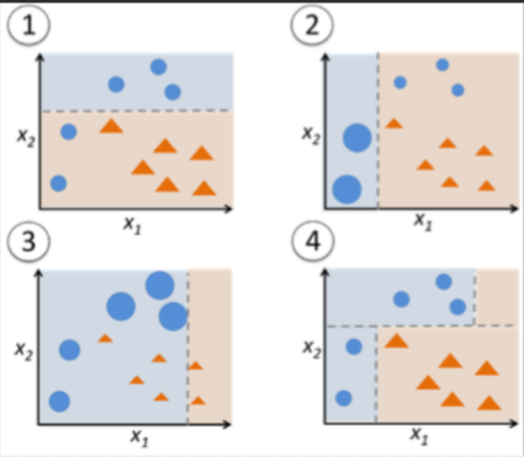
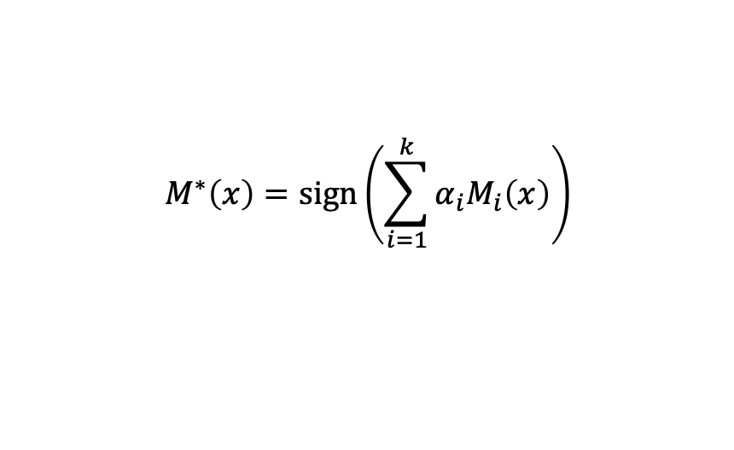
Adaboost (Freund and Schapire, 1997)
3. Update weights based on current model
1. Assign initial weights to each training tuple
{w_{n}⁽¹⁾}
{w_{n}⁽²⁾}
{w_{n}^{(k)}}
…
2. Train base classifier on weighted dataset
M₁
M₂
…
M_{k}
4. After base classifiers are trained, they are combined to give the final classifier
Two ‘weighting’ strategy:
Assign weights to each training example
Sample dataset based on weight distribution
$$M^{∗}\left(x\right)=sign\left(\sum_{i=1}^{k}{α_{i}M_{i}\left(x\right)}\right)$$

Slide 71
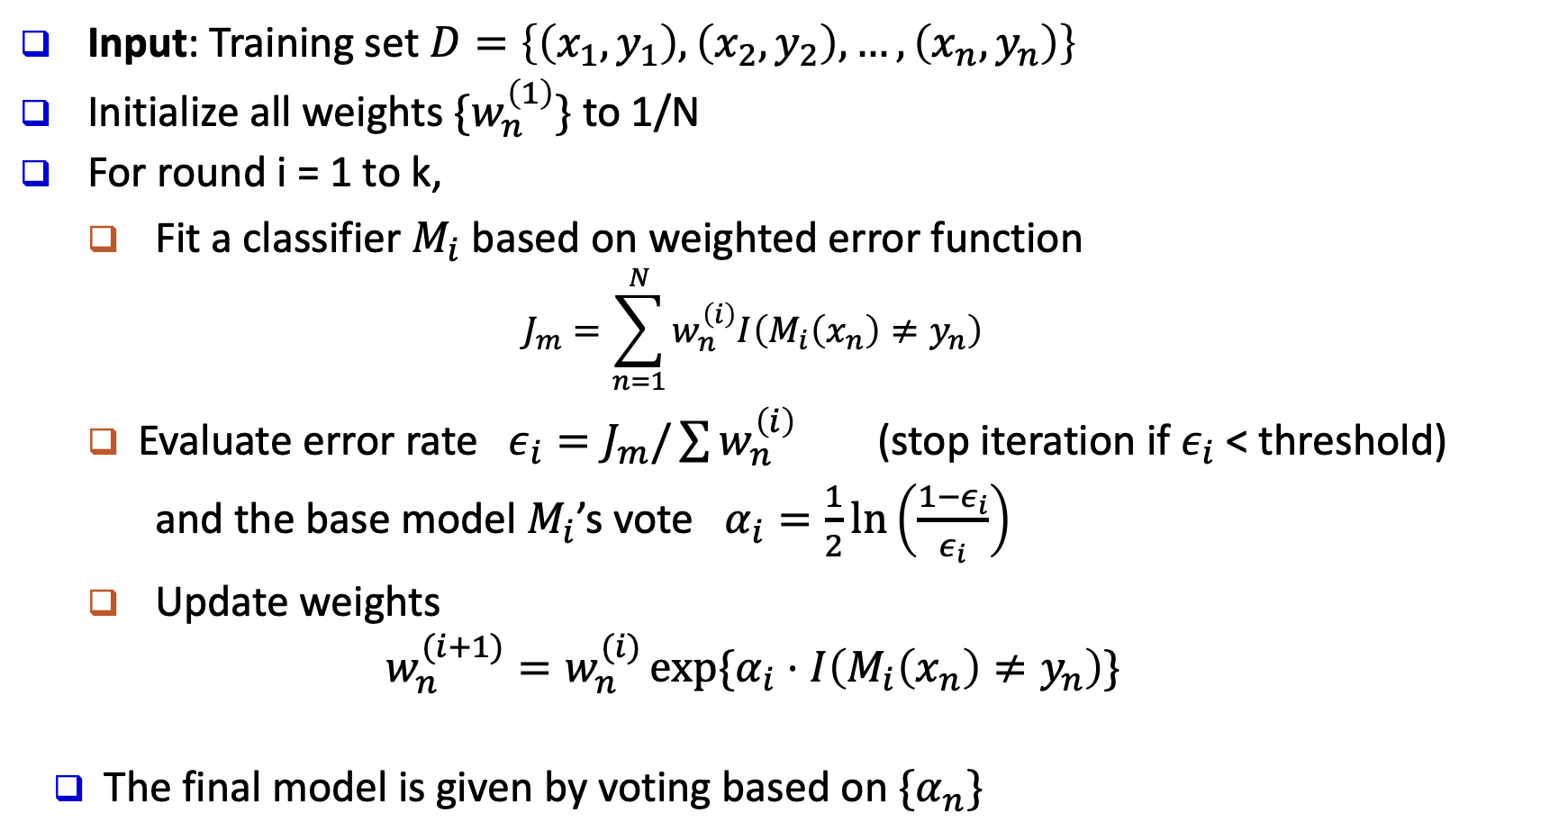
Adaboost (Freund and Schapire, 1997)
Input: Training set $D=\left\{\left(x_{1},y_{1}\right), \left(x_{2},y_{2}\right), …, \left(x_{n},y_{n}\right)\right\}$
Initialize all weights $\{w_{n}^{\left(1\right)}\}$ to 1/N
For round i = 1 to k,
  Fit a classifier $M_{i}$ based on weighted error function
  $$J_{m}=\sum_{n=1}^{N}{w_{n}^{\left(i\right)}I\left(M_{i}\left(x_{n}\right)≠y_{n}\right)}$$
  Evaluate error rate $ε_{i}=J_{m}/\sum{w_{n}^{\left(i\right)}}$ (stop iteration if $ε_{i}$ < threshold)
  and the base model $M_{i}$’s vote $α_{i}=\frac{1}{2}\ln\left(\frac{1−ε_{i}}{ε_{i}}\right)$
  Update weights
  $$w_{n}^{(i+1)}=w_{n}^{(i)}\exp{\{α_{i}⋅I\left(M_{i}\left(x_{n}\right)≠y_{n}\right)\}}$$
The final model is given by voting based on $\{α_{n}\}$

Slide 72
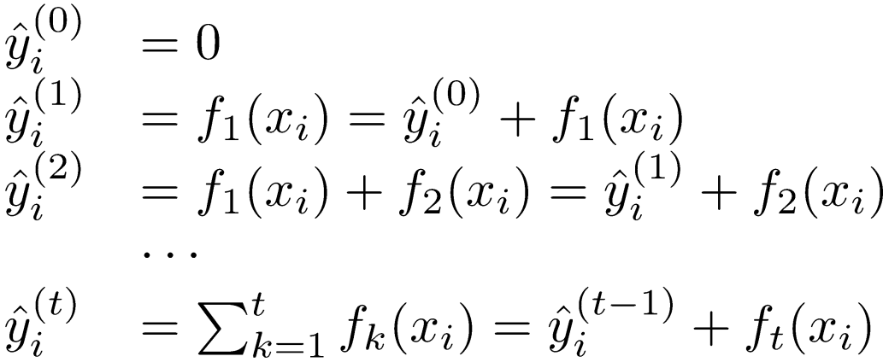
Gradient Boosting
Operates on:
  A differentiable loss function
  A weak learner to make predictions (usually trees)
  An additive model to add weak learners to minimize the loss function
Each time adds an additional weak learner
Scalable implementation: XGBoost
Previous model
New weak learner

Slide 73
Random Forest: Basic Concepts
Random Forest (first proposed by L. Breiman in 2001)
  Bagging with decision trees as base models
  Data bagging
    Use a subset of training data by sampling with replacement for each tree
  Feature bagging
    At each node use a random selection of attributes as candidates and split by the best attribute among them
  During classification, each tree votes and the most popular class is returned
Advantage of decision trees – more diversity

Slide 74
Random Forest
Two Methods to construct Random Forest:
  Forest-RI (random input selection): Randomly select, at each node, F attributes as candidates for the split at the node. The CART methodology is used to grow the trees to maximum size
  Forest-RC (random linear combinations): Creates new attributes (or features) that are a linear combination of the existing attributes (reduces the correlation between individual classifiers)
Comparable in accuracy to Adaboost, but more robust to errors and outliers
Insensitive to the number of attributes selected for consideration at each split, and faster than typical bagging or boosting

Slide 75
Ensemble Methods Recap
Random forest and XGBoost are the most commonly used algorithms for tabular data
Pros
  Good performance for tabular data, requires no data scaling
  Can scale to large datasets
  Can handle missing data to some extent
Cons
  Can overfit to training data if not tuned properly
  Lack of interpretability (compared to decision trees)

Slide 76
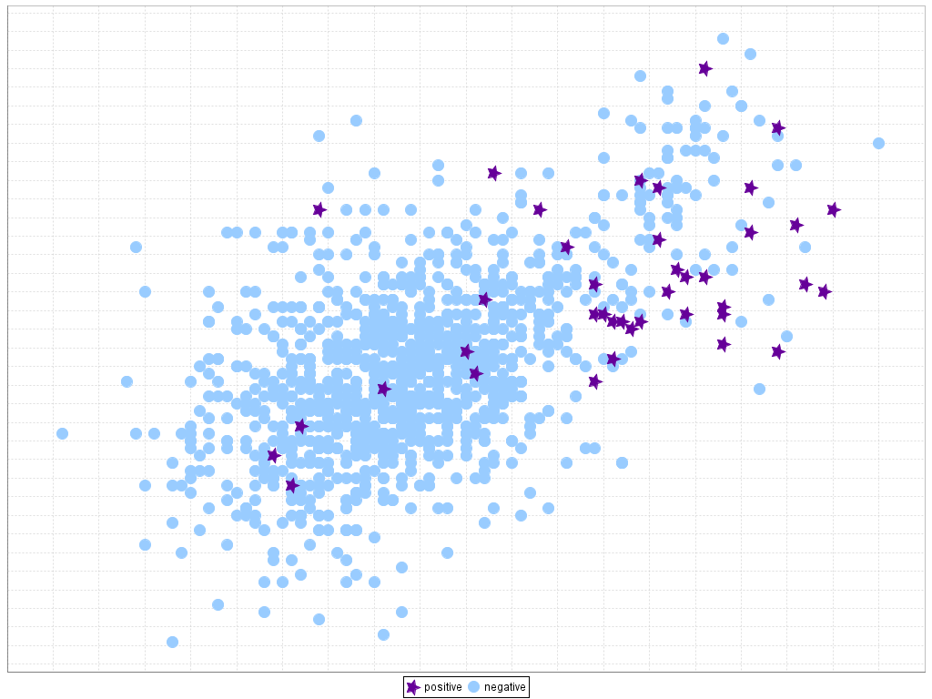
Classification of Class-Imbalanced Data Sets
Traditional methods assume a balanced distribution of classes and equal error costs. But in real world situations, we may face imbalanced data sets, which has rare positive examples but numerous negative ones.
  Medical diagnosis: Medical screening for a condition
  is usually performed on a large population of people
  without the condition, to detect a small minority
  with it (e.g., HIV prevalence in the USA is ~0.4%)
  Fraud detection: About 2% of credit card accounts
  are defrauded per year. (Most fraud detection domains are heavily imbalanced.)
  Product defect, accident (oil-spill), disk drive failures, etc.

Slide 77
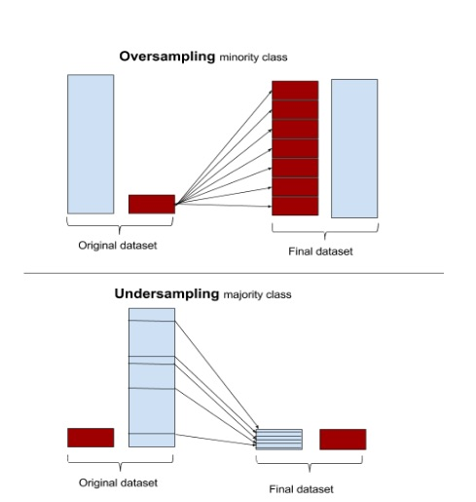
Classification of Class-Imbalanced Data Sets
Typical methods on imbalanced data (Balance the training set)
    Oversampling: Oversample the minority class.
    Under-sampling: Randomly eliminate tuples from majority class
    Synthesizing: Synthesize new minority classes

Slide 78
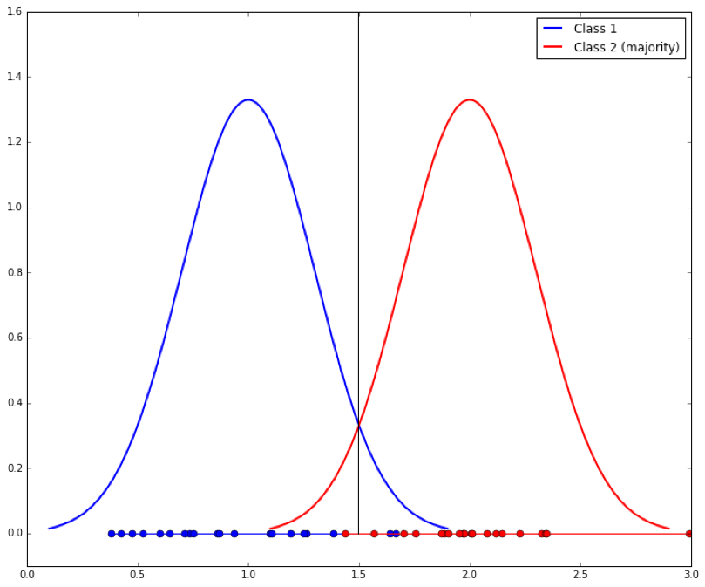
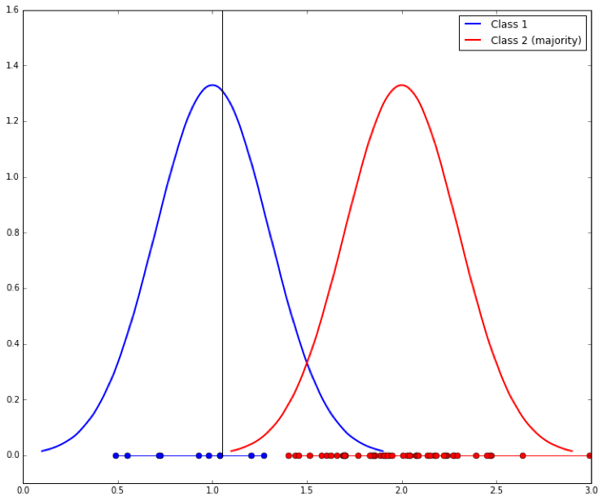
Classification of Class-Imbalanced Data Sets
Typical methods on imbalanced data (At the algorithm level)
    Threshold-moving: Move the decision threshold, t, so that the rare class tuples are easier to classify, and hence, less chance of costly false negative errors
    Class weight adjusting: Since false negative costs more than false positive, we can give larger weight to false negative
  Ensemble techniques: Ensemble multiple classifiers introduced in the following chapter
Threshold-moving

Slide 79
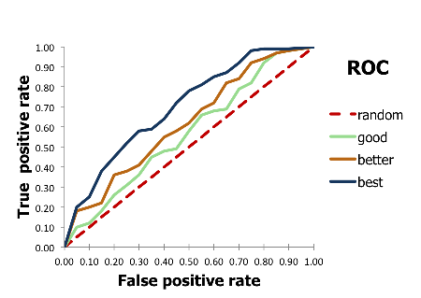
Evaluate imbalanced data classifier
Can we use Accuracy to evaluate imbalanced data classifier?
Accuracy simply counts the number of errors
  If a data set has 2% positive labels and 98% negative labels, a classifier that map all inputs to negative class will get an accuracy of 98%!
ROC Curve

Slide 80
Summary
Classification: Model construction from a set of training data
Effective and scalable methods
  Decision tree induction, Bayes classification methods, lazy learners, linear classifier
  No single method has been found to be superior over all others for all data sets
Evaluation metrics: Accuracy, sensitivity, specificity, precision, recall, F measure
Model evaluation: Holdout, cross-validation, bootstrapping, ROC curves (AUC)
Techniques to improve classification accuracy: Ensemble Methods (bagging, boosting, random forests), imbalanced classification

Slide 81
References (1)
C. Apte and S. Weiss. Data mining with decision trees and decision rules. Future Generation Computer Systems, 13, 1997
A. J. Dobson. An Introduction to Generalized Linear Models. Chapman & Hall, 1990.
R. O. Duda, P. E. Hart, and D. G. Stork. Pattern Classification, 2ed. John Wiley, 2001
U. M. Fayyad. Branching on attribute values in decision tree generation. AAAI’94.
Y. Freund and R. E. Schapire. A decision-theoretic generalization of on-line learning and an application to boosting. J. Computer and System Sciences, 1997.
J. Gehrke, R. Ramakrishnan, and V. Ganti. Rainforest: A framework for fast decision tree construction of large datasets. VLDB’98.
J. Gehrke, V. Gant, R. Ramakrishnan, and W.-Y. Loh, BOAT -- Optimistic Decision Tree Construction. SIGMOD'99.
T. Hastie, R. Tibshirani, and J. Friedman. The Elements of Statistical Learning: Data Mining, Inference, and Prediction. Springer-Verlag, 2001
J. Pan and D. Manocha. Bi-level locality sensitive hashing for k-nearest neighbor computation. IEEE ICDE 2012

Slide 82
References (2)
T.-S. Lim, W.-Y. Loh, and Y.-S. Shih. A comparison of prediction accuracy, complexity, and training time of thirty-three old and new classification algorithms. Machine Learning, 2000
J. Magidson. The Chaid approach to segmentation modeling: Chi-squared automatic interaction detection. In R. P. Bagozzi, editor, Advanced Methods of Marketing Research, Blackwell Business, 1994
M. Mehta, R. Agrawal, and J. Rissanen. SLIQ : A fast scalable classifier for data mining. EDBT'96
T. M. Mitchell. Machine Learning. McGraw Hill, 1997
S. K. Murthy, Automatic Construction of Decision Trees from Data: A Multi-Disciplinary Survey, Data Mining and Knowledge Discovery 2(4): 345-389, 1998
J. R. Quinlan. Induction of decision trees. Machine Learning, 1:81-106, 1986
J. R. Quinlan. C4.5: Programs for Machine Learning. Morgan Kaufmann, 1993
J. R. Quinlan. Bagging, boosting, and c4.5. AAAI’96
E. Alpaydin. Introduction to Machine Learning (2nd ed.). MIT Press, 2011

Slide 83
References (3)
R. Rastogi and K. Shim. Public: A decision tree classifier that integrates building and pruning. VLDB’98
J. Shafer, R. Agrawal, and M. Mehta. SPRINT : A scalable parallel classifier for data mining. VLDB’96
J. W. Shavlik and T. G. Dietterich. Readings in Machine Learning. Morgan Kaufmann, 1990
P. Tan, M. Steinbach, and V. Kumar. Introduction to Data Mining. Addison Wesley, 2005
S. M. Weiss and C. A. Kulikowski. Computer Systems that Learn: Classification and Prediction Methods from Statistics, Neural Nets, Machine Learning, and Expert Systems. Morgan Kaufman, 1991
S. M. Weiss and N. Indurkhya. Predictive Data Mining. Morgan Kaufmann, 1997
I. H. Witten and E. Frank. Data Mining: Practical Machine Learning Tools and Techniques, 2ed. Morgan Kaufmann, 2005
T. Chen and C. Guestrin. Xgboost: A Scalable Tree Boosting System. ACM SIGKDD 2016
C. Aggarwal. Data Classication. Morgan Springer, 2015

