Slide 1
Chapter 8
Cluster Analysis: Basic Concepts and Methods

Slide 2
Outline
Cluster analysis
Partitioning methods
Hierarchical methods
Density-based and grid-based methods
Evaluation of clustering

Slide 3
Outline
Cluster analysis
  What is cluster analysis?
  Requirements for cluster analysis
  Overview of basic clustering methods
Partitioning methods
Hierarchical methods
Density-based and grid-based methods
Evaluation of clustering

Slide 4
Cluster Analysis: A Quick Overview
When flying over a city, one can easily identify fields, forests, commercial areas, and residential areas based on their features, without anyone’s explicit “training”—This is the power of cluster analysis
This chapter and the next systematically study cluster analysis methods and help answer the following:
  What are the different proximity measures for effective clustering?
  Can we cluster a massive number of data points efficiently?
  Can we find clusters of arbitrary shape? At multiple levels of granularity?
  How can we judge the quality of the clusters discovered by our system?

Slide 5
The Value of Cluster Analysis
What is the value of cluster analysis?
  Cluster analysis helps you partition massive data into groups based on its features
  Cluster analysis will often help subsequent data mining processes such as pattern discovery, classification, and outlier analysis
What roles does cluster analysis play in the Data Mining Specialization?
  You will learn various scalable methods to find clusters from massive data
  You will learn how to mine different kinds of clusters effectively
  You will also learn how to evaluate the quality of the clusters you find
  Cluster analysis will help with classification, outlier analysis, and other data mining tasks

Slide 6
Broad Applications of Cluster Analysis
Data summarization, compression, and reduction
  Examples: Image processing or vector quantization
Collaborative filtering, recommendation systems, or customer segmentation
  Finding like-minded users or similar products
Dynamic trend detection
  Clustering stream data and detecting trends and patterns
Multimedia data analysis, biological data analysis, and social network analysis
  Examples: Clustering video/audio clips or gene/protein sequences
A key intermediate step for other data mining tasks
  Generating a compact summary of data for classification, pattern discovery, and hypothesis generation and testing
  Outlier detection: Outliers are those “far away” from any cluster

Slide 7
What Is Cluster Analysis?
What is a cluster?
  A cluster is a collection of data objects which are
    Similar (or related) to one another within the same group (i.e., cluster)
    Dissimilar (or unrelated) to the objects in other groups (i.e., clusters)
Cluster analysis (or clustering, data segmentation, …)
  Given a set of data points, partition them into a set of groups (i.e., clusters) which are as similar as possible
Cluster analysis is unsupervised learning (i.e., no predefined classes)
  This contrasts with classification (i.e., supervised learning)
Typical ways to use/apply cluster analysis
  As a stand-alone tool to get insight into data distribution, or
  As a preprocessing (or intermediate) step for other algorithms

Slide 8
Cluster Analysis: Applications
A key intermediate step for other data mining tasks
  Generating a compact summary of data for classification, pattern discovery, hypothesis generation and testing, etc.
  Outlier detection: Outliers—those “far away” from any cluster
Data summarization, compression, and reduction
  Ex. Image processing: Vector quantization
Collaborative filtering, recommendation systems, or customer segmentation
  Find like-minded users or similar products
Dynamic trend detection
  Clustering stream data and detecting trends and patterns
Multimedia data analysis, biological data analysis and social network analysis
  Ex. Clustering images or video/audio clips, gene/protein sequences, etc.

Slide 9
Considerations for Cluster Analysis
Partitioning criteria
  Single level vs. hierarchical partitioning (often, multi-level hierarchical partitioning is desirable, e.g., grouping topical terms)
Separation of clusters
  Exclusive (e.g., one customer belongs to only one region) vs. non-exclusive (e.g., one document may belong to more than one class)
Similarity measure
  Distance-based (e.g., Euclidean, road network, vector) vs. connectivity-based (e.g., density or contiguity)
Clustering space
  Full space (often when low dimensional) vs. subspaces (often in high-dimensional clustering)

Slide 10
Requirements and Challenges
Quality
  Ability to deal with different types of attributes: Numerical, categorical, text, multimedia, networks, and mixture of multiple types
  Discovery of clusters with arbitrary shape
  Ability to deal with noisy data
Scalability
  Clustering all the data instead of only on samples
  High dimensionality
  Incremental or stream clustering and insensitivity to input order
Constraint-based clustering
  User-given preferences or constraints; domain knowledge; user queries
Interpretability and usability

Slide 11
Cluster Analysis: A Multi-Dimensional Categorization
Technique-Centered
  Distance-based methods
  Density-based and grid-based methods
  Probabilistic and generative models
  Leveraging dimensionality reduction methods
  High-dimensional clustering
  Scalable techniques for cluster analysis
Data Type-Centered
  Clustering numerical data, categorical data, text data, multimedia data, time-series data, sequences, stream data, networked data, uncertain data
Additional Insight-Centered
  Visual insights, semi-supervised, ensemble-based, validation-based

Slide 12
Typical Clustering Methodologies
Distance-based methods
  Partitioning algorithms: K-Means, K-Medians, K-Medoids
  Hierarchical algorithms: Agglomerative vs. divisive methods
Density-based and grid-based methods
  Density-based: Data space is explored at a high-level of granularity and then post-processing to put together dense regions into an arbitrary shape
  Grid-based: Individual regions of the data space are formed into a grid-like structure
Probabilistic and generative models: Modeling data from a generative process
  Assume a specific form of the generative model (e.g., mixture of Gaussians)
  Model parameters are estimated with the Expectation-Maximization (EM) algorithm (using the available dataset, for a maximum likelihood fit)
  Then estimate the generative probability of the underlying data points
High-dimensional clustering

Slide 13
High-dimensional Clustering
Subspace clustering: Find clusters on various subspaces
  Bottom-up, top-down, correlation-based methods vs. δ-cluster methods
Dimensionality reduction: A vertical form (i.e., columns) of clustering
  Columns are clustered; may cluster rows and columns together (co-clustering)
  Probabilistic latent semantic indexing (PLSI) then LDA: Topic modeling of text data
    A cluster (i.e., topic) is associated with a set of words (i.e., dimensions) and a set of documents (i.e., rows) simultaneously
  Nonnegative matrix factorization (NMF) (as one kind of co-clustering)
    A nonnegative matrix A (e.g., word frequencies in documents) can be approximately factorized two non-negative low rank matrices U and V
  Spectral clustering: Use the spectrum of the similarity matrix of the data to perform dimensionality reduction for clustering in fewer dimensions

Slide 14
Clustering Different Types of Data (I)
Numerical data
  Most earliest clustering algorithms were designed for numerical data
Categorical data (including binary data)
  Discrete data, no natural order (e.g., sex, race, zip-code, and market-basket)
Text data: Popular in social media, Web, and social networks
  Features: High-dimensional, sparse, value corresponding to word frequencies
  Methods: Combination of k-means and agglomerative; topic modeling; co-clustering
Multimedia data: Image, audio, video (e.g., on Flickr, YouTube)
  Multi-modal (often combined with text data)
  Contextual: Containing both behavioral and contextual attributes
    Images: Position of a pixel represents its context, value represents its behavior
    Video and music data: Temporal ordering of records represents its meaning

Slide 15
Clustering Different Types of Data (II)
Time-series data: Sensor data, stock markets, temporal tracking, forecasting, etc.
  Data are temporally dependent
  Time: contextual attribute; data value: behavioral attribute
  Correlation-based online analysis (e.g., online clustering of stock to find stock tickers)
  Shape-based offline analysis (e.g., cluster ECG based on overall shapes)
Sequence data: Weblogs, biological sequences, system command sequences
  Contextual attribute: Placement (rather than time)
  Similarity functions: Hamming distance, edit distance, longest common subsequence
  Sequence clustering: Suffix tree; generative model (e.g., Hidden Markov Model)
Stream data:
  Real-time, evolution and concept drift, single pass algorithm
  Create efficient intermediate representation, e.g., micro-clustering

Slide 16
Clustering Different Types of Data (III)
Graphs and homogeneous networks
  Every kind of data can be represented as a graph with similarity values as edges
  Methods: Generative models; combinatorial algorithms (graph cuts); spectral methods; non-negative matrix factorization methods
Heterogeneous networks
  A network consists of multiple typed nodes and edges (e.g., bibliographical data)
  Clustering different typed nodes/links together (e.g., NetClus)
Uncertain data: Noise, approximate values, multiple possible values
  Incorporation of probabilistic information will improve the quality of clustering
Big data: Model systems may store and process very big data (e.g., weblogs)
  Ex. Google’s MapReduce framework
    Use Map function to distribute the computation across different machines
    Use Reduce function to aggregate results obtained from the Map step

Slide 17
User Insights and Interactions in Clustering
Visual insights: One picture is worth a thousand words
  Human eyes: High-speed processor linking with a rich knowledge-base
  A human can provide intuitive insights; HD-eye: visualizing HD clusters
Semi-supervised insights: Passing user’s insights or intention to system
  User-seeding: A user provides a number of labeled examples, approximately representing categories of interest
Multi-view and ensemble-based insights
  Multi-view clustering: Multiple clusterings represent different perspectives
  Multiple clustering results can be ensembled to provide a more robust solution
Validation-based insights: Evaluation of the quality of clusters generated
  May use case studies, specific measures, or pre-existing labels

Slide 18
Outline
Cluster analysis
Partitioning methods
  K-means: a centroid-based techniques
  Variations of k-means
Hierarchical methods
Density-based and grid-based methods
Evaluation of clustering

Slide 19
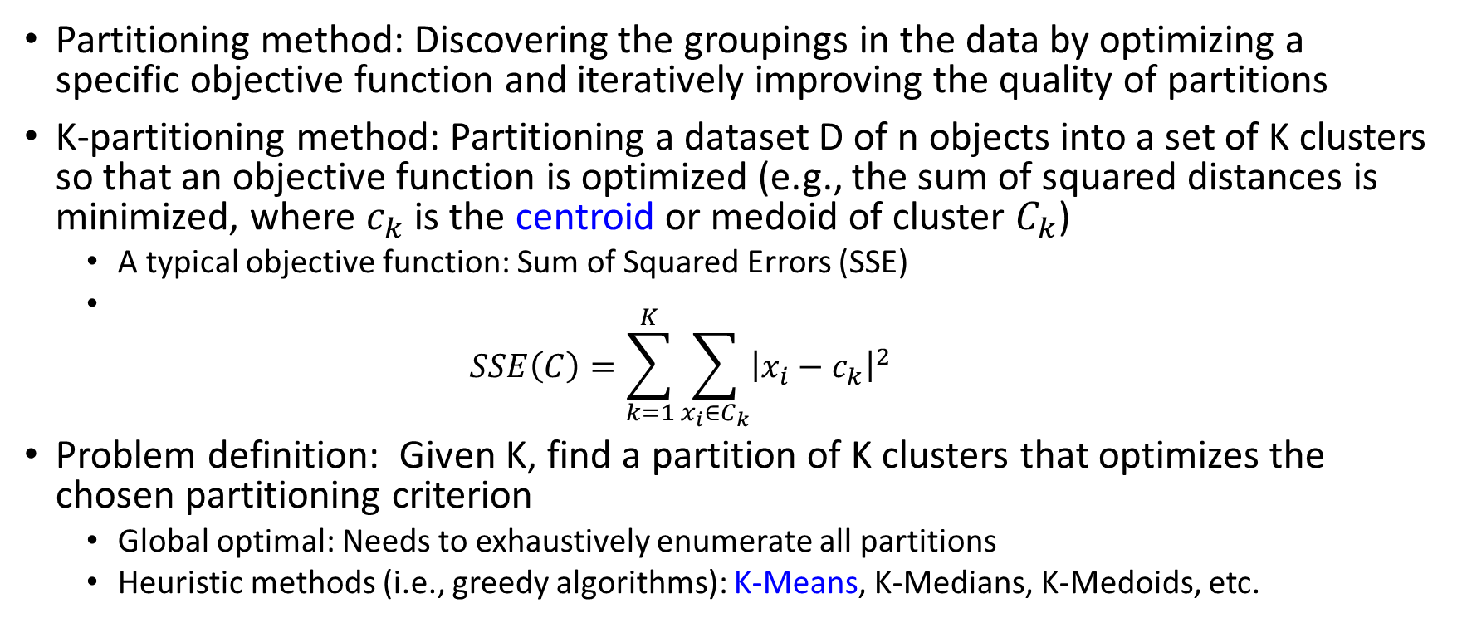
Partitioning Algorithms: Basic Concepts
Partitioning method: Discovering the groupings in the data by optimizing a specific objective function and iteratively improving the quality of partitions
K-partitioning method: Partitioning a dataset D of n objects into a set of K clusters so that an objective function is optimized (e.g., the sum of squared distances is minimized, where $c_{k}$ is the centroid or medoid of cluster $C_{k}$)
  A typical objective function: Sum of Squared Errors (SSE)
  $SSE\left(C\right)=\sum_{k=1}^{K}{\sum_{x_{i}∈C_{k}}{{\left|x_{i}−c_{k}\right|}^{2}}}$
Problem definition: Given K, find a partition of K clusters that optimizes the chosen partitioning criterion
  Global optimal: Needs to exhaustively enumerate all partitions
  Heuristic methods (i.e., greedy algorithms): K-Means, K-Medians, K-Medoids, etc.

Slide 20
The K-Means Clustering Method
K-Means (MacQueen’67, Lloyd’57/’82)
  Each cluster is represented by the center of the cluster
Given K, the number of clusters, the K-Means clustering algorithm is outlined as follows
    Select K points as initial centroids
    Repeat
      Form K clusters by assigning each point to its closest centroid
      Re-compute the centroids (i.e., mean point) of each cluster
    Until convergence criterion is satisfied
Different kinds of measures can be used
  Manhattan distance (L1 norm), Euclidean distance (L2 norm), Cosine similarity

Slide 21
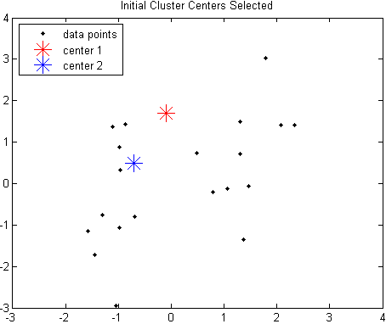
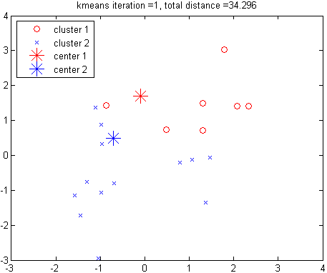
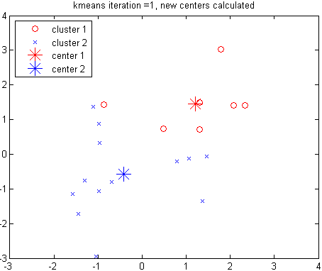
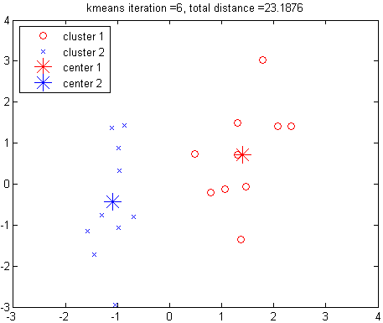
Example: K-Means Clustering
Assign points to clusters
Recompute cluster centers
The original data points & randomly select K = 2 centroids
Execution of the K-Means Clustering Algorithm
Redo point assignment
Select K points as initial centroids
Repeat
Form K clusters by assigning each point to its closest centroid
Re-compute the centroids (i.e., mean point) of each cluster
Until convergence criterion is satisfied

Slide 22
Discussion on the K-Means Method
Efficiency: O(tKn) where n: # of objects, K: # of clusters, and t: # of iterations
  Normally, K, t << n; thus, an efficient method
K-means clustering often terminates at a local optimal
  Initialization can be important to find high-quality clusters
Need to specify K, the number of clusters, in advance
  There are ways to automatically determine the “best” K
  In practice, one often runs a range of values and selected the “best” K value
Sensitive to noisy data and outliers
  Variations: Using K-medians, K-medoids, etc.
K-means is applicable only to objects in a continuous n-dimensional space
  Using the K-modes for categorical data
Not suitable to discover clusters with non-convex shapes
  Using density-based clustering, kernel K-means, etc.

Slide 23
Variations of K-Means
Choosing better initial centroid estimates
  K-means++, Intelligent K-Means, Genetic K-Means
Choosing different representative prototypes for the clusters
  K-Medoids, K-Medians, K-Modes
Applying feature transformation techniques
  Weighted K-Means, Kernel K-Means

Slide 24
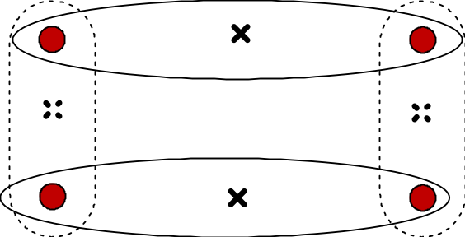
Initialization of K-Means
Different initializations may generate rather different clustering results (some could be far from optimal)
Original proposal (MacQueen’67): Select K seeds randomly
  Need to run the algorithm multiple times using different seeds
There are many methods proposed for better initialization of k seeds
K-Means++ (Arthur & Vassilvitskii’07):
  The first centroid is selected at random
  The next centroid selected is the one that is farthest from the currently selected (selection is based on a weighted probability score)
  The selection continues until K centroids are obtained

Slide 25
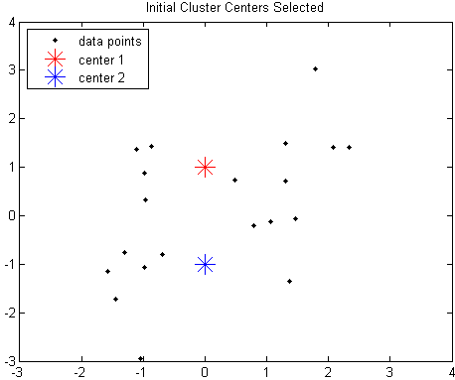
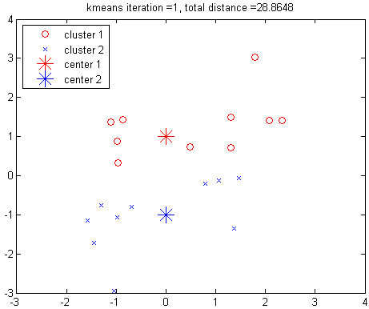
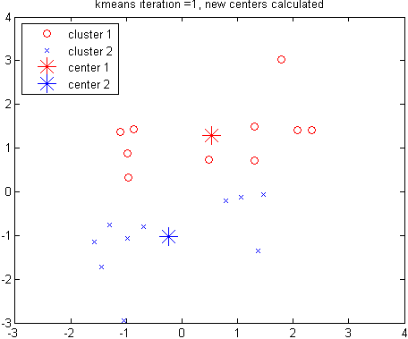
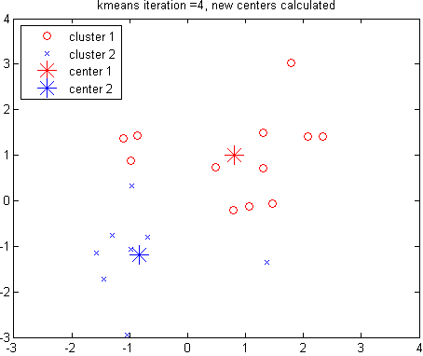
Example: Poor Initialization May Lead to Poor Clustering
Assign points to clusters
Recompute cluster centers
Another random selection of k centroids for the same data points
Rerun of the K-Means using another random K seeds
This run of K-Means generates a poor quality clustering

Slide 26
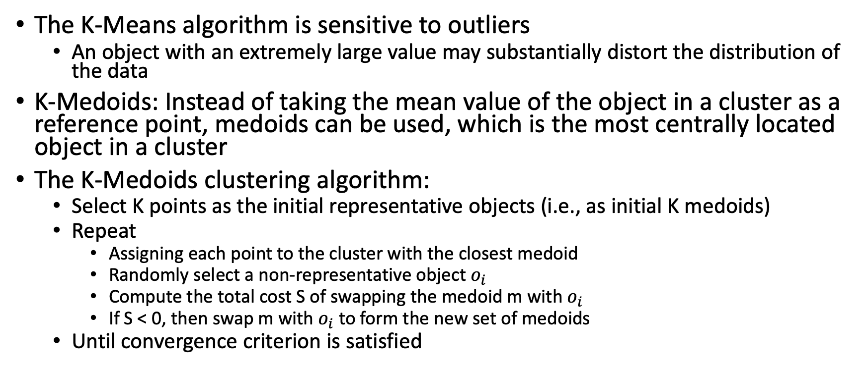
Handling Outliers: From K-Means to K-Medoids
The K-Means algorithm is sensitive to outliers
  An object with an extremely large value may substantially distort the distribution of the data
K-Medoids: Instead of taking the mean value of the object in a cluster as a reference point, medoids can be used, which is the most centrally located object in a cluster
The K-Medoids clustering algorithm:
  Select K points as the initial representative objects (i.e., as initial K medoids)
  Repeat
    Assigning each point to the cluster with the closest medoid
    Randomly select a non-representative object $o_{i}$
    Compute the total cost S of swapping the medoid m with $o_{i}$
    If S < 0, then swap m with $o_{i}$ to form the new set of medoids
  Until convergence criterion is satisfied

Slide 27
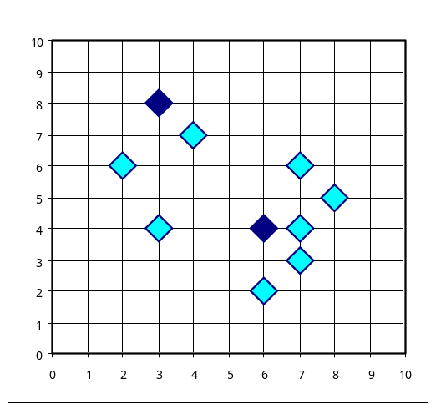
PAM: A Typical K-Medoids Algorithm
10
9
8
Arbitrary choose K object as initial medoids
Assign each remaining object to nearest medoids
7
6
5
4
3
2
1
0
0
1
2
3
4
5
6
7
8
9
10
K = 2
Randomly select a non-medoid object,O_{ramdom}
    Select initial K medoids randomly
Repeat
  Object re-assignment
  Swap medoid m with o_{i} if it improves the clustering quality
Until convergence criterion is satisfied
10
Compute total cost of swapping
10
Swapping O and O_{ramdom}
If quality is improved
9
9
8
8
7
7
6
6
5
5
4
4
3
3
2
2
1
1
0
0
1
2
3
4
5
6
7
8
9
10
0
0
1
2
3
4
5
6
7
8
9
10
Notes:
27

Slide 28
Discussion on K-Medoids Clustering
K-Medoids Clustering: Find representative objects (medoids) in clusters
PAM (Partitioning Around Medoids: Kaufmann & Rousseeuw 1987)
  Starts from an initial set of medoids, and
  Iteratively replaces one of the medoids by one of the non-medoids if it improves the total sum of the squared errors (SSE) of the resulting clustering
  PAM works effectively for small data sets but does not scale well for large data sets (due to the computational complexity)
  Computational complexity: PAM: O(K(n − K)2) (quite expensive!)
Efficiency improvements on PAM
  CLARA (Kaufmann & Rousseeuw, 1990):
    PAM on samples; O(Ks2 + K(n − K)), s is the sample size
  CLARANS (Ng & Han, 1994): Randomized re-sampling, ensuring efficiency + quality

Slide 29
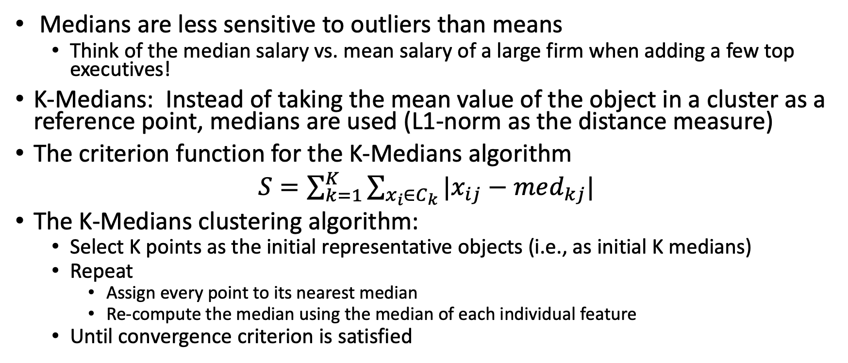
K-Medians: Handling Outliers by Computing Medians
Medians are less sensitive to outliers than means
  Think of the median salary vs. mean salary of a large firm when adding a few top executives!
K-Medians: Instead of taking the mean value of the object in a cluster as a reference point, medians are used (L1-norm as the distance measure)
The criterion function for the K-Medians algorithm
$S=\sum_{k=1}^{K}{\sum_{x_{i}∈C_{k}}{|x_{ij}−med_{kj}|}}$
The K-Medians clustering algorithm:
  Select K points as the initial representative objects (i.e., as initial K medians)
  Repeat
    Assign every point to its nearest median
    Re-compute the median using the median of each individual feature
  Until convergence criterion is satisfied

Slide 30
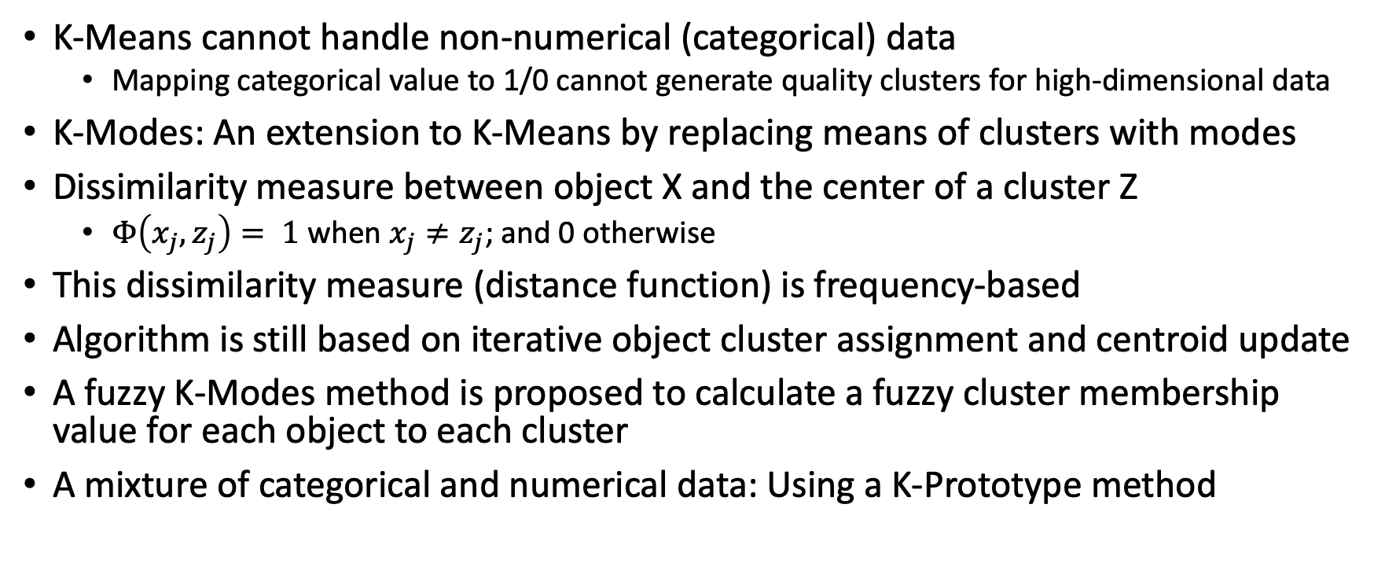
K-Modes: Clustering Categorical Data
K-Means cannot handle non-numerical (categorical) data
  Mapping categorical value to 1/0 cannot generate quality clusters for high-dimensional data
K-Modes: An extension to K-Means by replacing means of clusters with modes
Dissimilarity measure between object X and the center of a cluster Z
  $Φ\left(x_{j}, z_{j}\right)= 1$ when $x_{j}≠z_{j}$; and 0 otherwise
This dissimilarity measure (distance function) is frequency-based
Algorithm is still based on iterative object cluster assignment and centroid update
A fuzzy K-Modes method is proposed to calculate a fuzzy cluster membership value for each object to each cluster
A mixture of categorical and numerical data: Using a K-Prototype method

Slide 31
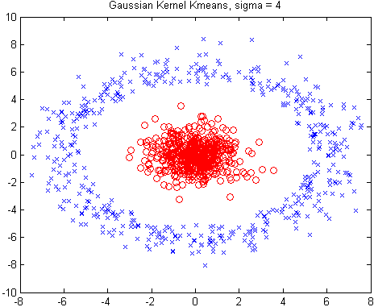
Kernel K-Means Clustering
Kernel K-Means can be used to detect non-convex clusters
  K-Means can only detect clusters that are linearly separable
Idea: Project data onto the high-dimensional kernel space, and then perform K-Means clustering
  Map data points in the input space onto a high-dimensional feature space using the kernel function
  Perform K-Means on the mapped feature space
Computational complexity is higher than K-Means
  Need to compute and store n x n kernel matrix generated from the kernel function on the original data
The widely studied spectral clustering can be considered as a variant of Kernel K-Means clustering

Slide 32
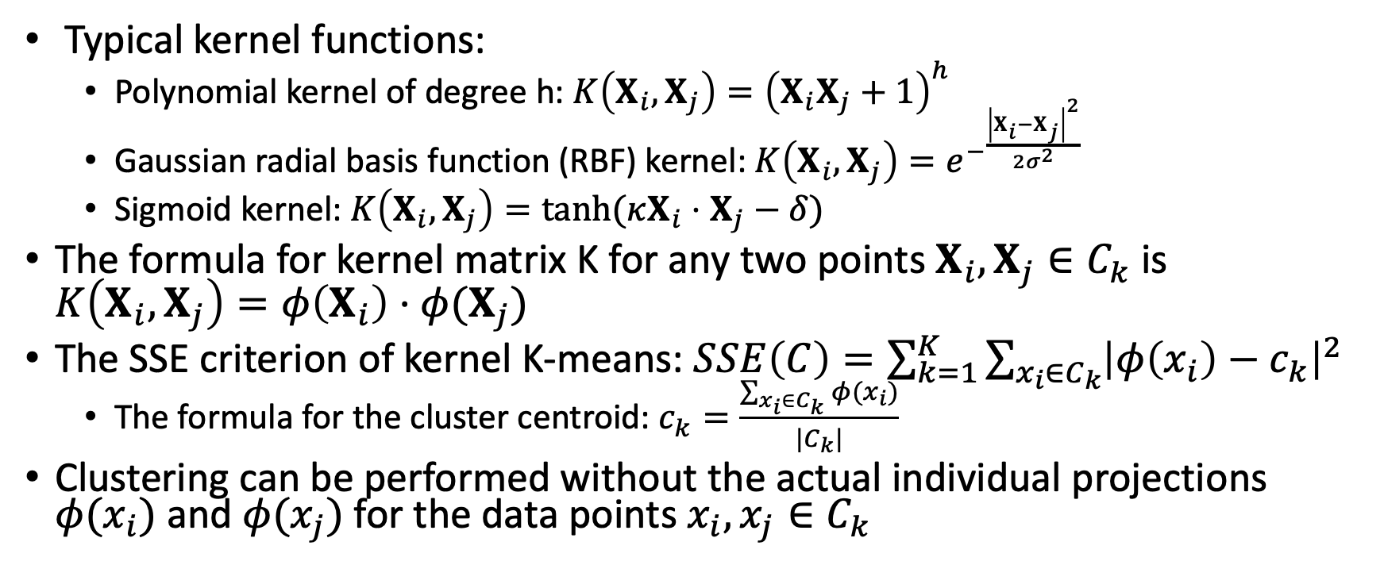
Kernel Functions and Kernel K-Means Clustering
Typical kernel functions:
  Polynomial kernel of degree h: $K\left(X_{i},X_{j}\right)={\left(X_{i}X_{j}+1\right)}^{h}$
  Gaussian radial basis function (RBF) kernel: $K\left(X_{i},X_{j}\right)={e^{−}}^{\frac{{\left|X_{i}−X_{j}\right|}^{2}}{2σ^{2}}}$
  Sigmoid kernel: $K\left(X_{i},X_{j}\right)=tanh⁡(κX_{i}⋅X_{j}−δ)$
The formula for kernel matrix K for any two points $X_{i},X_{j}∈C_{k}$ is $K\left(X_{i},X_{j}\right)=φ\left(X_{i}\right)⋅φ(X_{j})$
The SSE criterion of kernel K-means: $SSE\left(C\right)=\sum_{k=1}^{K}{\sum_{x_{i}∈C_{k}}{{\left|φ\left(x_{i}\right)−c_{k}\right|}^{2}}}$
  The formula for the cluster centroid: $c_{k}=\frac{\sum_{x_{i}∈C_{k}}{φ(x_{i})}}{|C_{k}|}$
Clustering can be performed without the actual individual projections $φ(x_{i})$ and $φ(x_{j})$for the data points $x_{i}, x_{j}∈C_{k}$

Slide 33
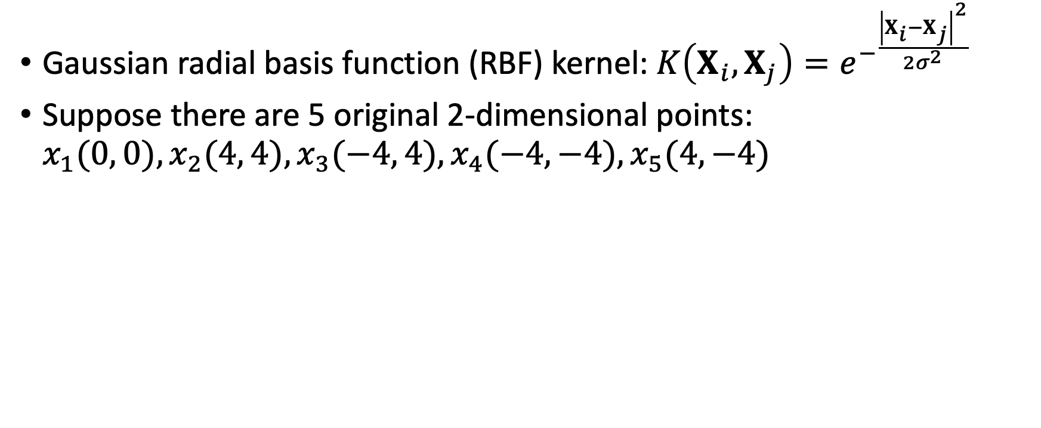
Example: Kernel Functions and Kernel K-Means Clustering
Gaussian radial basis function (RBF) kernel: $K\left(X_{i},X_{j}\right)={e^{−}}^{\frac{{\left|X_{i}−X_{j}\right|}^{2}}{2σ^{2}}}$
Suppose there are 5 original 2-dimensional points: $x_{1}(0, 0), x_{2}(4, 4), x_{3}(−4, 4), x_{4}(−4, −4), x_{5}(4, −4)$

Slide 34
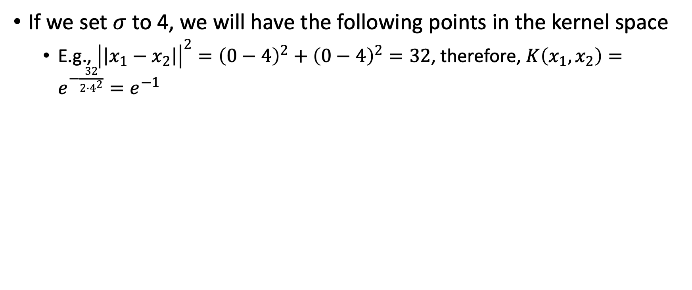

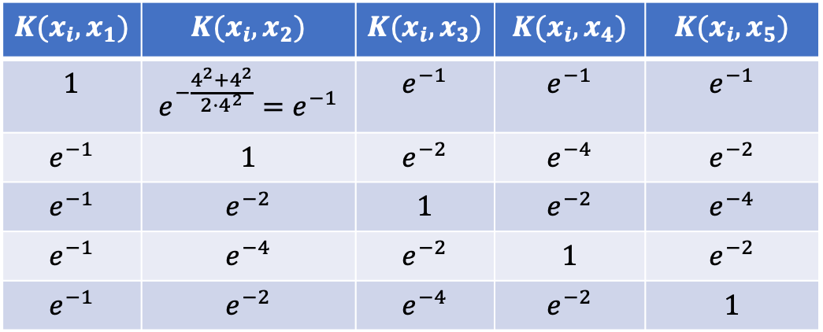
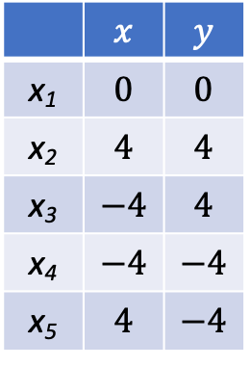
Example: Kernel Functions and Kernel K-Means Clustering
If we set $σ$ to 4, we will have the following points in the kernel space
  E.g., ${\left|\left|x_{1}−x_{2}\right|\right|}^{2}={\left(0−4\right)}^{2}+{\left(0−4\right)}^{2}=32$, therefore, $K\left(x_{1},x_{2}\right)=e^{−\frac{32}{2⋅4^{2}}}=e^{−1}$
Original Space
RBF Kernel Space ($σ=4$)
 | $$x$$ | $$y$$
x₁ | $$0$$ | $$0$$
x₂ | $$4$$ | $$4$$
x₃ | $$−4$$ | $$4$$
x₄ | $$−4$$ | $$−4$$
x₅ | $$4$$ | $$−4$$
$$K(x_{i},x_{1})$$ | $$K(x_{i},x_{2})$$ | $$K(x_{i},x_{3})$$ | $$K(x_{i},x_{4})$$ | $$K(x_{i},x_{5})$$
$$1$$ | $$e^{−\frac{4^{2}+4^{2}}{2⋅4^{2}}}=e^{−1}$$ | $$e^{−1}$$ | $$e^{−1}$$ | $$e^{−1}$$
$$e^{−1}$$ | $$1$$ | $$e^{−2}$$ | $$e^{−4}$$ | $$e^{−2}$$
$$e^{−1}$$ | $$e^{−2}$$ | $$1$$ | $$e^{−2}$$ | $$e^{−4}$$
$$e^{−1}$$ | $$e^{−4}$$ | $$e^{−2}$$ | $$1$$ | $$e^{−2}$$
$$e^{−1}$$ | $$e^{−2}$$ | $$e^{−4}$$ | $$e^{−2}$$ | $$1$$

Slide 35
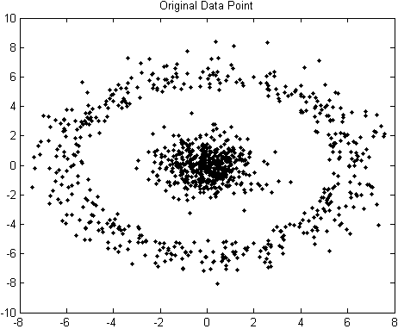
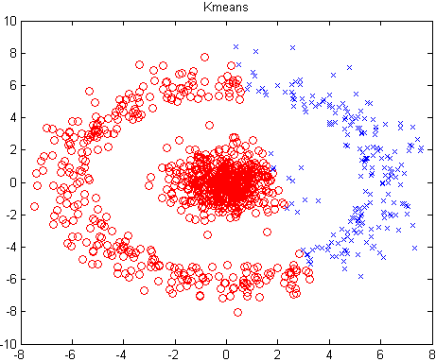
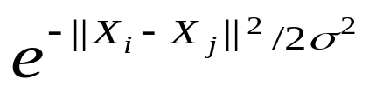

Example: Kernel K-Means Clustering
The original data set
The result of K-Means clustering
The result of Gaussian Kernel K-Means clustering
The above data set cannot generate quality clusters by K-Means since it contains non-covex clusters
  Gaussian RBF Kernel transformation maps data to a kernel matrix K for any two points x_{i}, x_{j}: and Gaussian kernel: K(X_{i}, X_{j}) =
K-Means clustering is conducted on the mapped data, generating quality clusters

Slide 36
Outline
Cluster analysis
Partitioning methods
Hierarchical methods
  Basic concepts of hierarchical clustering
  Agglomerative hierarchical clustering
  Divisive hierarchical clustering
  BIRCH: scalable hierarchical clustering using clustering feature trees
  Probabilistic hierarchical clustering
Density-based and grid-based methods
Evaluation of clustering

Slide 37
Hierarchical Clustering: Basic Concepts
Hierarchical clustering
  Generate a clustering hierarchy (drawn as a dendrogram)
  Not required to specify K, the number of clusters
  More deterministic
  No iterative refinement
Two categories of algorithms
  Agglomerative: Start with singleton clusters, continuously merge two clusters at a time to build a bottom-up hierarchy of clusters
  Divisive: Start with a huge macro-cluster, split it continuously into two groups, generating a top-down hierarchy of clusters

Slide 38
Agglomerative vs. Divisive Clustering
Step 0
Step 1
Step 2
Step 3
Step 4
agglomerative
(AGNES)
a
a b
b
a b c d e
c
c d e
d
d e
e
divisive
(DIANA)
Step 4
Step 3
Step 2
Step 1
Step 0

Slide 39
Dendrogram: How Clusters are Merged
Dendrogram: Decompose a set of data objects into a tree of clusters by multi-level nested partitioning
A clustering of the data objects is obtained by cutting the dendrogram at the desired level, then each connected component forms a cluster
Hierarchical clustering generates a dendrogram (a hierarchy of clusters)

Slide 40
Agglomerative Clustering Algorithm
AGNES (AGglomerative NESting) (Kaufmann and Rousseeuw, 1990)
  Use the single-link method and the dissimilarity matrix
  Continuously merge nodes that have the least dissimilarity
  Eventually all nodes belong to the same cluster
Agglomerative clustering varies on different similarity measures among clusters
  Single link (nearest neighbor)
  Complete link (diameter)
  Average link (group average)
  Centroid link (centroid similarity)

Slide 41
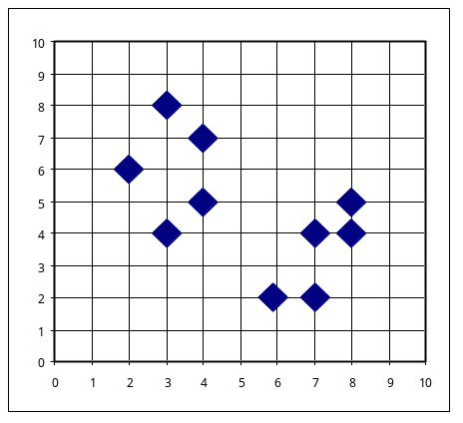
Agglomerative Clustering Algorithm

Slide 42
Single Link vs. Complete Link in Hierarchical Clustering
X
X
Single link (nearest neighbor)
  The similarity between two clusters is the similarity between their most similar (nearest neighbor) members
  Local similarity-based: Emphasizing more on close regions, ignoring the overall structure of the cluster
  Capable of clustering non-elliptical shaped group of objects
  Sensitive to noise and outliers
Complete link (diameter)
  The similarity between two clusters is the similarity between their most dissimilar members
  Merge two clusters to form one with the smallest diameter
  Nonlocal in behavior, obtaining compact shaped clusters
  Sensitive to outliers
X
X

Slide 43
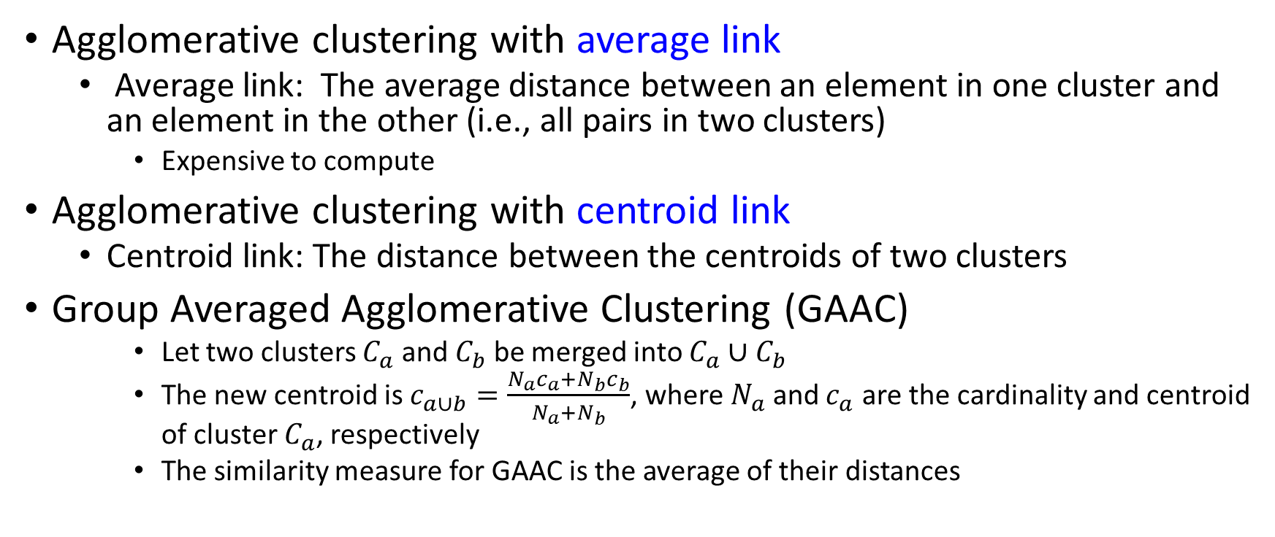
Agglomerative Clustering: Average vs. Centroid Links
X
X
Agglomerative clustering with average link
  Average link: The average distance between an element in one cluster and an element in the other (i.e., all pairs in two clusters)
    Expensive to compute
Agglomerative clustering with centroid link
  Centroid link: The distance between the centroids of two clusters
Group Averaged Agglomerative Clustering (GAAC)
    Let two clusters $C_{a}$ and $C_{b}$ be merged into $C_{a}∪C_{b}$
    The new centroid is $c_{a∪b}=\frac{N_{a}c_{a}+N_{b}c_{b}}{N_{a}+N_{b}}$, where $N_{a}$ and $c_{a}$ are the cardinality and centroid of cluster $C_{a}$, respectively
    The similarity measure for GAAC is the average of their distances
C_{b}: N_{b}
C_{a}: N_{a}
X
X

Slide 44
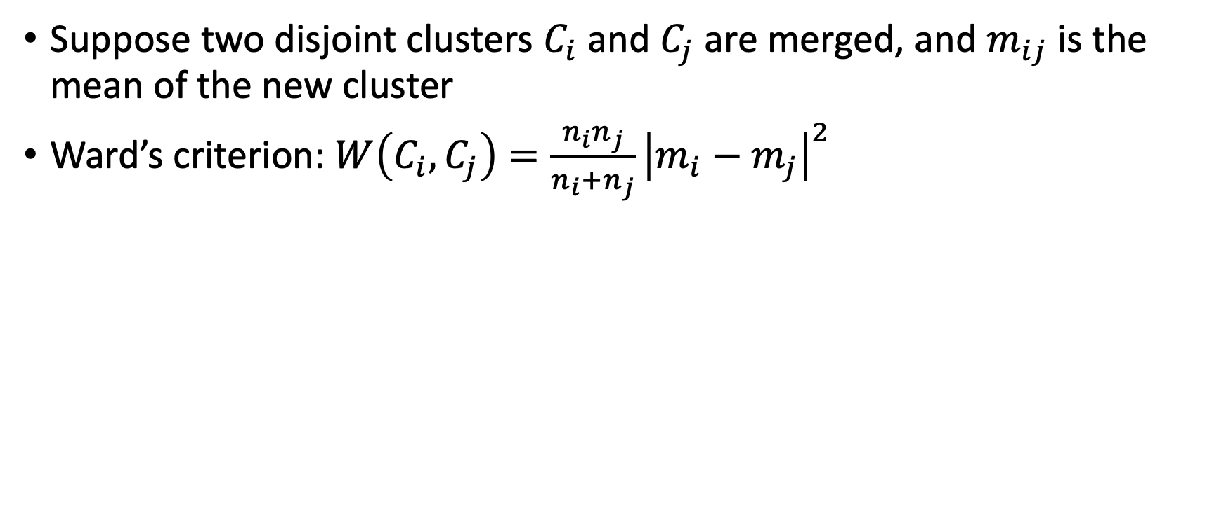
Agglomerative Clustering with Ward’s Criterion
Suppose two disjoint clusters $C_{i}$ and $C_{j}$ are merged, and $m_{ij}$ is the mean of the new cluster
Ward’s criterion: $W\left(C_{i},C_{j}\right)=\frac{n_{i}n_{j}}{n_{i}+n_{j}}{\left|m_{i}−m_{j}\right|}^{2}$

Slide 45
Divisive Clustering
DIANA (Divisive Analysis) (Kaufmann and Rousseeuw,1990)
  Implemented in some statistical analysis packages, e.g., Splus
Inverse order of AGNES: Eventually each node forms a cluster on its own

Slide 46
Divisive Clustering Is a Top-down Approach
The process starts at the root with all the points as one cluster
It recursively splits the higher level clusters to build the dendrogram
Can be considered as a global approach
More efficient when compared with agglomerative clustering

Slide 47
More on Algorithm Design for Divisive Clustering
Choosing which cluster to split
  Check the sums of squared errors of the clusters and choose the one with the largest value
Splitting criterion: Determining how to split
  One may use Ward’s criterion to chase for greater reduction in the difference in the SSE criterion as a result of a split
  For categorical data, Gini-index can be used
Handling the noise
  Use a threshold to determine the termination criterion (do not generate clusters that are too small because they contain mainly noises)

Slide 48
Extensions to Hierarchical Clustering
Weakness of the agglomerative & divisive hierarchical clustering methods
  No revisit: cannot undo any merge/split decisions made before
  Scalability bottleneck: Each merge/split needs to examine many possible options
    Time complexity: at least O(n²), where n is the number of total objects
Several other hierarchical clustering algorithms
  BIRCH (1996): Use CF-tree and incrementally adjust the quality of sub-clusters
  CURE (1998): Represent a cluster using a set of well-scattered representative points
  CHAMELEON (1999): Use graph partitioning methods on the K-nearest neighbor graph of the data

Slide 49
BIRCH: A Multi-Phase Hierarchical Clustering Method
BIRCH (Balanced Iterative Reducing and Clustering Using Hierarchies)
  Developed by Zhang, Ramakrishnan & Livny (SIGMOD’96)
  Impact many new clustering methods and applications (received 2006 SIGMOD Test of Time award)
Major innovation
  Integrating hierarchical clustering (initial micro-clustering phase) and other clustering methods (at the later macro-clustering phase)
Multi-phase hierarchical clustering
  Phase1 (initial micro-clustering): Scan DB to build an initial CF tree, a multi-level compression of the data to preserve the inherent clustering structure of the data
  Phase 2 (later macro-clustering): Use an arbitrary clustering algorithm (e.g., iterative partitioning) to cluster flexibly the leaf nodes of the CF-tree

Slide 50
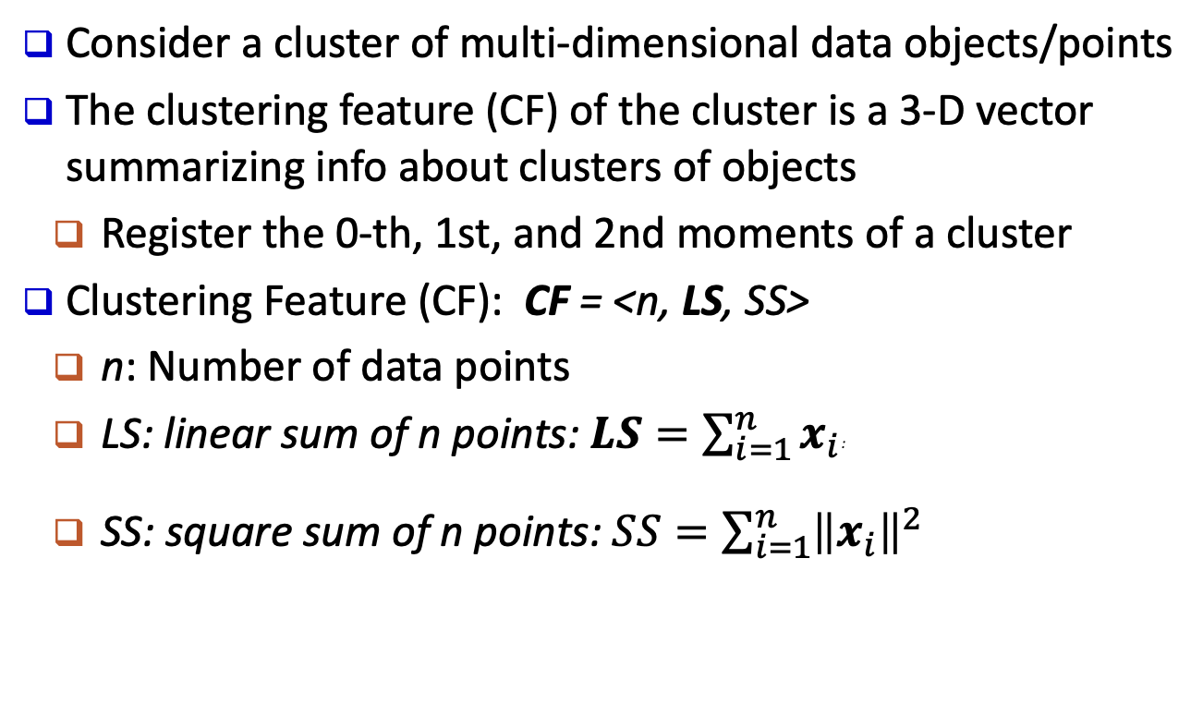
Clustering Feature Vector
Consider a cluster of multi-dimensional data objects/points
The clustering feature (CF) of the cluster is a 3-D vector summarizing info about clusters of objects
  Register the 0-th, 1st, and 2nd moments of a cluster
Clustering Feature (CF): CF = <n, LS, SS>
  n: Number of data points
  LS: linear sum of n points: $LS=\sum_{i=1}^{n}{x_{i}}$:
  SS: square sum of n points: $SS=\sum_{i=1}^{n}{{\left\|x_{i}\right\|}^{2}}$
CF₁ = <5, (16,30), 244>
(3,4)
(2,6)
(4,5)
(4,7)
(3,8)
n = 5; LS = ((3+2+4+4+3), (4+6+5+7+8)) = (16, 30);
SS=(3²+2²+4²+4²+3²) + (4²+6²+5²+7²+8²)= 54+190=244

Slide 51
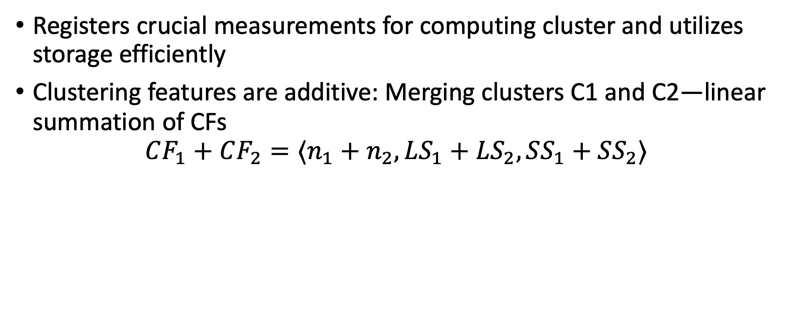
Clustering Feature: a Summary of the Statistics for the Given Cluster
Registers crucial measurements for computing cluster and utilizes storage efficiently
Clustering features are additive: Merging clusters C1 and C2—linear summation of CFs
$CF_{1}+CF_{2}=⟨n_{1}+n_{2},LS_{1}+LS_{2},SS_{1}+SS_{2}⟩$
CF₁ = <5, (16,30), 244>
(3,4)
(2,6)
(4,5)
(4,7)
(3,8)
n = 5; LS = ((3+2+4+4+3), (4+6+5+7+8)) = (16, 30);
SS=(3²+2²+4²+4²+3²) + (4²+6²+5²+7²+8²)= 54+190=244

Slide 52
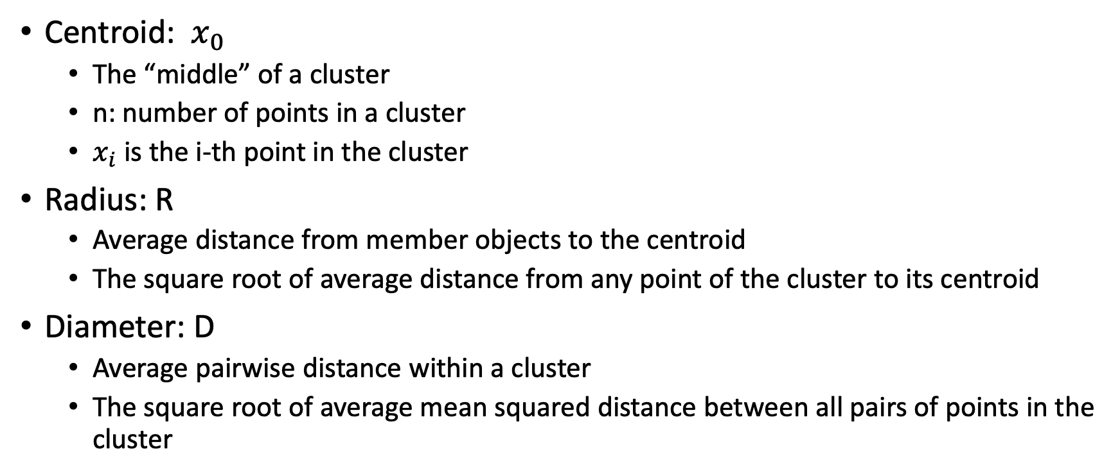
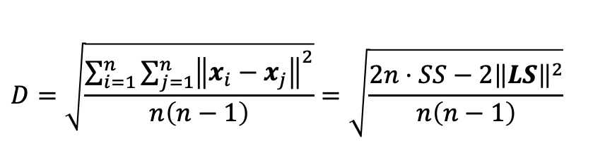
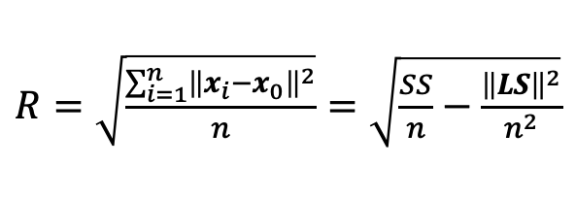
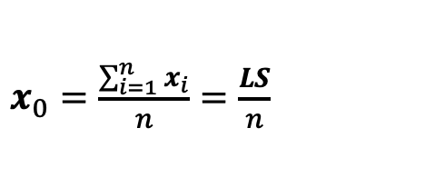
Essential Measures of Cluster: Centroid, Radius and Diameter
$x_{0}=\frac{\sum_{i=1}^{n}{x_{i}}}{n}=\frac{LS}{n}$
Centroid: $x_{0}$
  The “middle” of a cluster
  n: number of points in a cluster
  $x_{i}$ is the i-th point in the cluster
Radius: R
  Average distance from member objects to the centroid
  The square root of average distance from any point of the cluster to its centroid
Diameter: D
  Average pairwise distance within a cluster
  The square root of average mean squared distance between all pairs of points in the cluster
$R=\sqrt{\frac{\sum_{i=1}^{n}{{\left\|x_{i}−x_{0}\right\|}^{2}}}{n}}=\sqrt{\frac{SS}{n}−\frac{{\left\|LS\right\|}^{2}}{n^{2}}}$
X
$$D=\sqrt{\frac{\sum_{i=1}^{n}{\sum_{j=1}^{n}{{\left\|x_{i}−x_{j}\right\|}^{2}}}}{n\left(n−1\right)}}=\sqrt{\frac{2n⋅SS−2{\left\|LS\right\|}^{2}}{n\left(n−1\right)}}$$

Slide 53
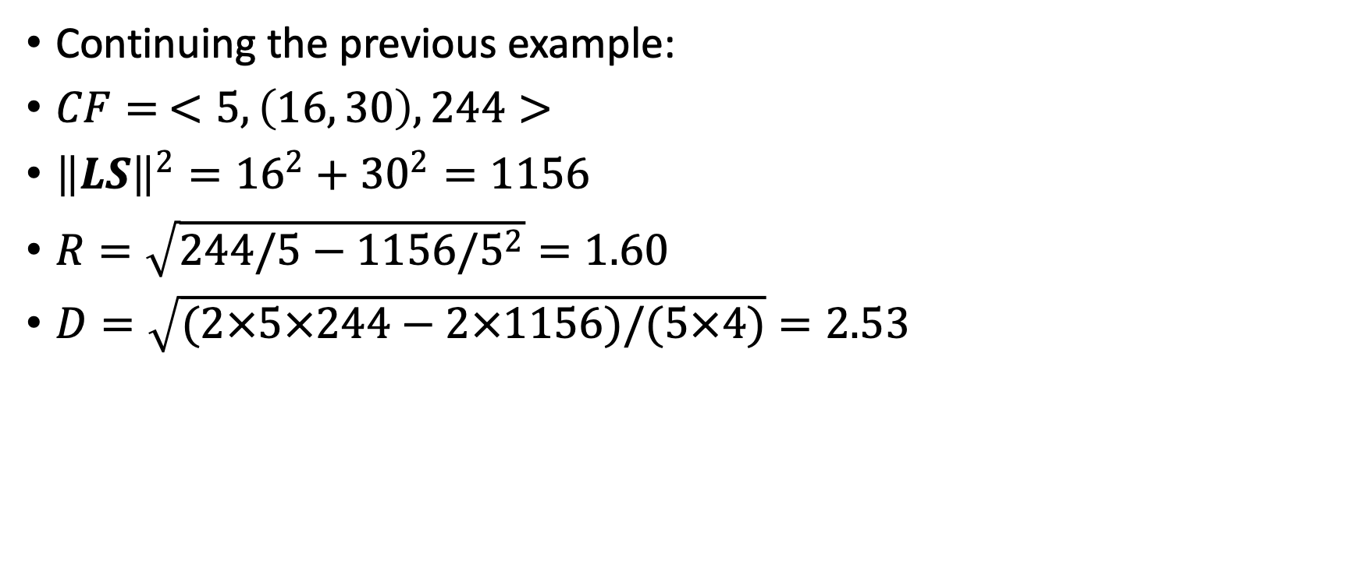
Example
Continuing the previous example:
$CF= <5,\left(16, 30\right),244>$
${\left\|LS\right\|}^{2}={16}^{2}+{30}^{2}=1156$
$R=\sqrt{244/5−1156/5^{2}}=1.60$
$D=\sqrt{(2×5×244−2×1156)/(5×4)}=2.53$

Slide 54
CF Tree: A Height-Balanced Tree Storing Clustering Features for Hierarchical Clustering
Incremental insertion of new points (similar to B+-tree)
For each point in the input
  Find its closest leaf entry
  Add point to leaf entry and update CF
  If entry diameter > max_diameter
    Split leaf, and possibly parents
A CF tree has two parameters
  Branching factor: Maximum number of children
  Maximum diameter of sub-clusters stored at the leaf nodes
A CF tree: A height-balanced tree that stores the clustering features (CFs)
The non-leaf nodes store sums of the CFs of their children

Slide 55
CF Tree: A Height-Balanced Tree Storing Clustering Features for Hierarchical Clustering
Root
B = 7
L = 6
CF₁
CF₂
CF₃
CF₆
child₁
child₂
child₃
child₆
Non-leaf node
CF₁₁
CF₁₂
CF₁₃
CF₁₅
child₁₁
child₁₂
child₁₃
child₁₅
Leaf node
Leaf node
prev
CF_{x1}
CF_{x2}
CF_{x6}
next
prev
CF_{y1}
CF_{y2}
CF_{y5}
next

Slide 56
BIRCH: A Scalable and Flexible Clustering Method
An integration of agglomerative clustering with other (flexible) clustering methods
Low-level micro-clustering
  Exploring CF-feature and BIRCH tree structure
  Preserving the inherent clustering structure of the data
Higher-level macro-clustering
  Provide sufficient flexibility for integration with other clustering methods

Slide 57
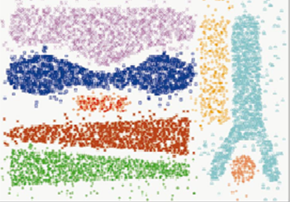
BIRCH: Pros and Cons
Strength: Good quality of clustering; linear scalability in large/stream databases; effective for incremental and dynamic clustering of incoming objects
Weaknesses
  Due to the fixed size of leaf nodes, clusters so formed may not be very natural
  Clusters tend to be spherical given the radius and diameter measures
Images like this may give BIRCH a hard time

Slide 58
Probabilistic Hierarchical Clustering
Algorithmic hierarchical clustering
  Nontrivial to choose a good distance measure
  Hard to handle missing attribute values
  Optimization goal not clear: heuristic, local search
Probabilistic hierarchical clustering
  Use probabilistic models to measure distances between clusters
  Generative model: Regard the set of data objects to be clustered as a sample of the underlying data generation mechanism to be analyzed
  Easy to understand, same efficiency as algorithmic agglomerative clustering method, can handle partially observed data
In practice, assume the generative models adopt common distribution functions, e.g., Gaussian distribution or Bernoulli distribution, governed by parameters

Slide 59
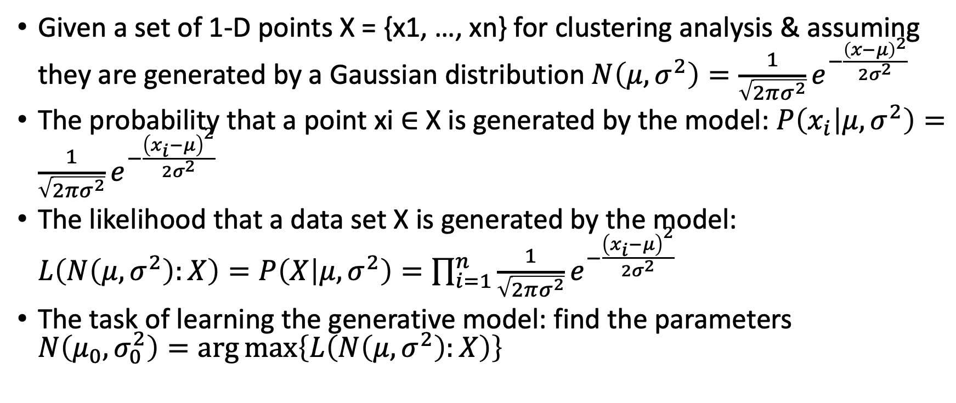
Generative Model
Given a set of 1-D points X = {x1, …, xn} for clustering analysis & assuming they are generated by a Gaussian distribution $N\left(μ,σ^{2}\right)=\frac{1}{\sqrt{2πσ^{2}}}e^{−\frac{{\left(x−μ\right)}^{2}}{2σ^{2}}}$
The probability that a point xi ∈ X is generated by the model: $P\left(x_{i} | μ,σ^{2}\right)=\frac{1}{\sqrt{2πσ^{2}}}e^{−\frac{{\left(x_{i}−μ\right)}^{2}}{2σ^{2}}}$
The likelihood that a data set X is generated by the model: $L\left(N\left(μ,σ^{2}\right):X\right)=P\left(X | μ,σ^{2}\right)=\prod_{i=1}^{n}{\frac{1}{\sqrt{2πσ^{2}}}e^{−\frac{{\left(x_{i}−μ\right)}^{2}}{2σ^{2}}}}$
The task of learning the generative model: find the parameters $N\left(μ_{0},σ_{0}^{2}\right)=\arg{\max\left\{L\left(N\left(μ,σ^{2}\right):X\right)\right\}}$

Slide 60
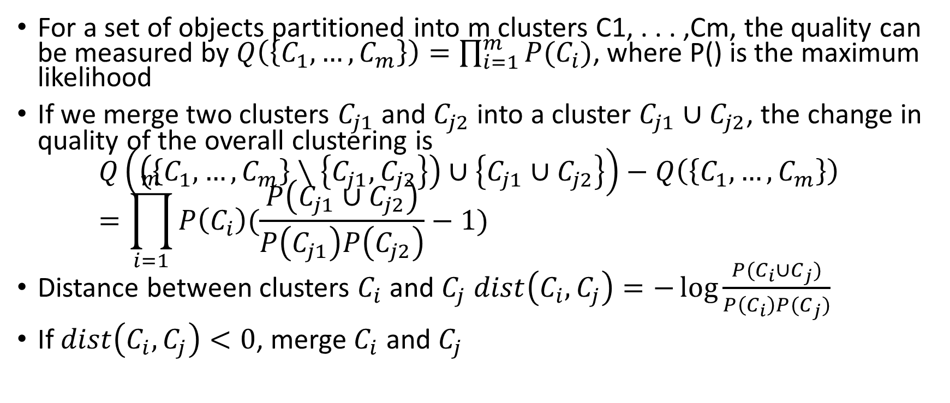
A Probabilistic Hierarchical Clustering Algorithm
For a set of objects partitioned into m clusters C1, . . . ,Cm, the quality can be measured by $Q\left(\left\{C_{1},…, C_{m}\right\}\right)=\prod_{i=1}^{m}{P(C_{i})}$, where P() is the maximum likelihood
If we merge two clusters $C_{j1}$ and $C_{j2}$ into a cluster $C_{j1}∪C_{j2}$, the change in quality of the overall clustering is
$Q\left(\left(\left\{C_{1},…, C_{m}\right\}∖\left\{C_{j1},C_{j2}\right\}\right)∪\left\{C_{j1}∪C_{j2}\right\}\right)−Q\left(\left\{C_{1},…, C_{m}\right\}\right)=\prod_{i=1}^{m}{P\left(C_{i}\right)(\frac{P\left(C_{j1}∪C_{j2}\right)}{P\left(C_{j1}\right)P\left(C_{j2}\right)}−1)}$
Distance between clusters $C_{i}$ and $C_{j}$ $dist\left(C_{i},C_{j}\right)=−\log{\frac{P(C_{i}∪C_{j})}{P\left(C_{i}\right)P(C_{j})}}$
If $dist\left(C_{i},C_{j}\right)<0$, merge $C_{i}$ and $C_{j}$

Slide 61
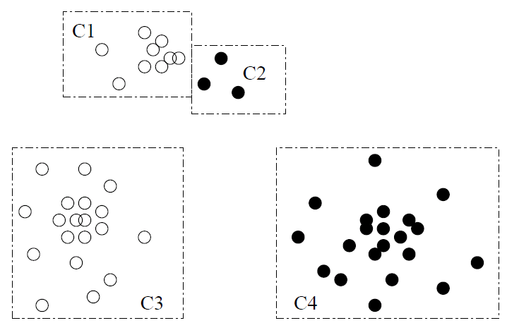
Example

Slide 62
Outline
Cluster analysis
Partitioning methods
Hierarchical methods
Density-based and grid-based methods
  DBSCAN: density-based clustering based on connected regions with high density
  DENCLUE: clustering based on density distribution functions
  Grid-based methods
Evaluation of clustering

Slide 63
Density-Based Clustering Methods
Clustering based on density (a local cluster criterion), such as density-connected points
Major features:
  Discover clusters of arbitrary shape
  Handle noise
  One scan (only examine the local region to justify density)
  Need density parameters as termination condition
Several interesting studies:
  DBSCAN: Ester, et al. (KDD’96)
  OPTICS: Ankerst, et al (SIGMOD’99)
  DENCLUE: Hinneburg & D. Keim (KDD’98)
  CLIQUE: Agrawal, et al. (SIGMOD’98) (also, grid-based)

Slide 64
DBSCAN: A Density-Based Spatial Clustering Algorithm
p
DBSCAN (M. Ester, H.-P. Kriegel, J. Sander, and X. Xu, KDD’96)
  Discovers clusters of arbitrary shape: Density-Based Spatial Clustering of Applications with Noise
A density-based notion of cluster
  A cluster is defined as a maximal set of density-connected points
  Two parameters:
  Eps (ε): Maximum radius of the neighborhood
  MinPts: Minimum number of points in the
      Eps-neighborhood of a point
The Eps(ε)-neighborhood of a point q:
  NEps(q): {p belongs to D | dist(p, q) ≤ Eps}
MinPts = 5
Eps = 1 cm
q
Outlier
Outlier/noise: not in a cluster
Border
Core point: dense neighborhood
Core
Border point: in cluster but neighborhood is not dense

Slide 65
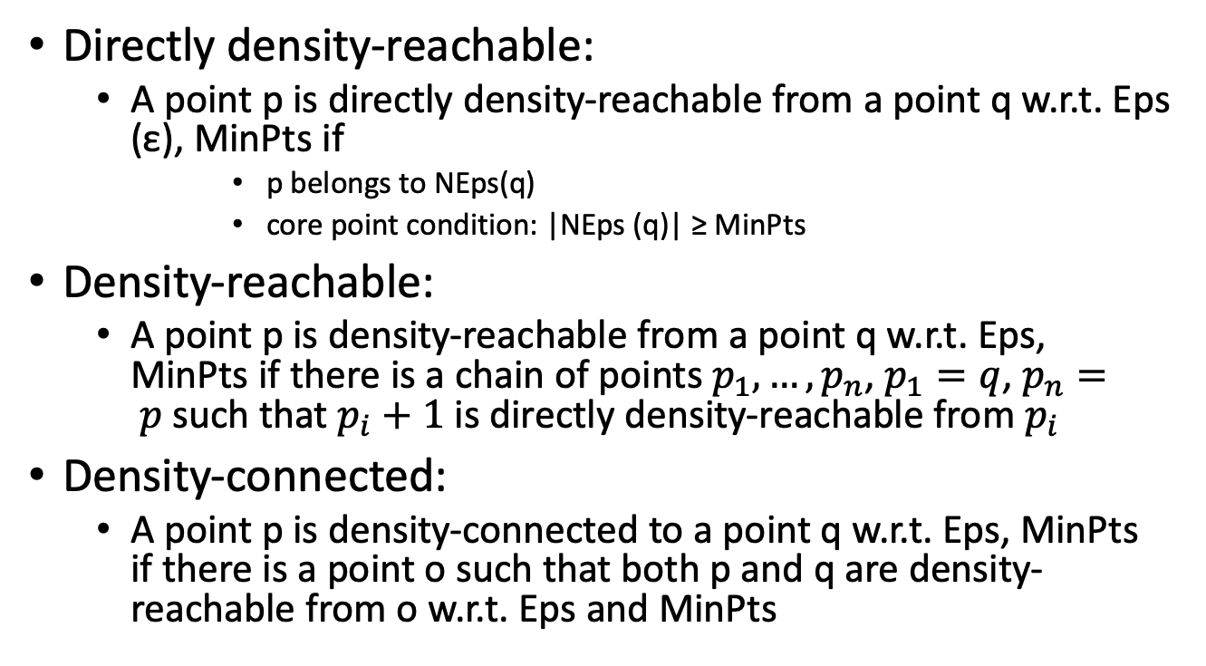
DBSCAN: Density-Reachable and Density-Connected
p
Directly density-reachable:
  A point p is directly density-reachable from a point q w.r.t. Eps (ε), MinPts if
      p belongs to NEps(q)
      core point condition: |NEps (q)| ≥ MinPts
Density-reachable:
  A point p is density-reachable from a point q w.r.t. Eps, MinPts if there is a chain of points $p_{1}, …, p_{n}$, $p_{1}=q$, $p_{n}= p$such that $p_{i}+1$ is directly density-reachable from $p_{i}$
Density-connected:
  A point p is density-connected to a point q w.r.t. Eps, MinPts if there is a point o such that both p and q are density-reachable from o w.r.t. Eps and MinPts
MinPts = 5
Eps = 1 cm
q
p
p₂
q
p
q
o

Slide 66
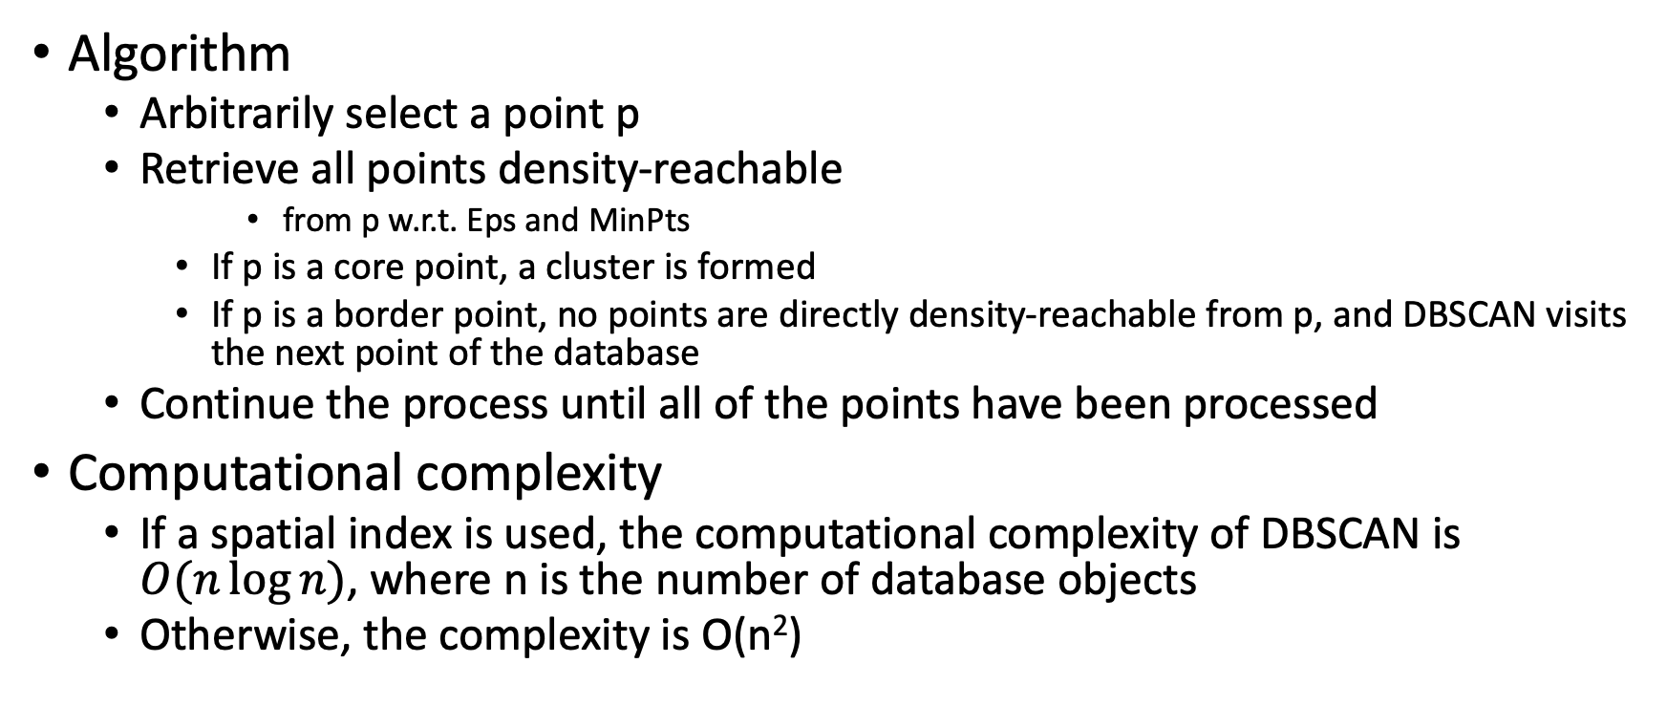
DBSCAN: The Algorithm
Outlier
Outlier/noise: not in a cluster
Border
Algorithm
  Arbitrarily select a point p
  Retrieve all points density-reachable
      from p w.r.t. Eps and MinPts
    If p is a core point, a cluster is formed
    If p is a border point, no points are directly density-reachable from p, and DBSCAN visits the next point of the database
  Continue the process until all of the points have been processed
Computational complexity
  If a spatial index is used, the computational complexity of DBSCAN is $O(n\log{n})$, where n is the number of database objects
  Otherwise, the complexity is O(n²)
Core point: dense neighborhood
Core
Border point: in cluster but neighborhood is not dense

Slide 67
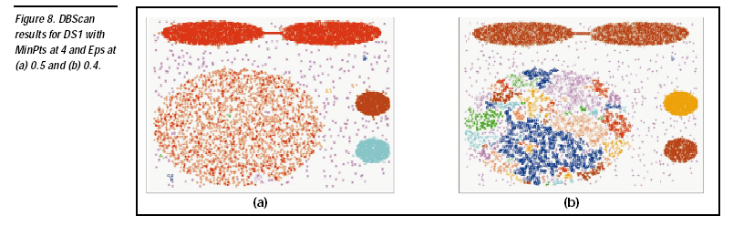
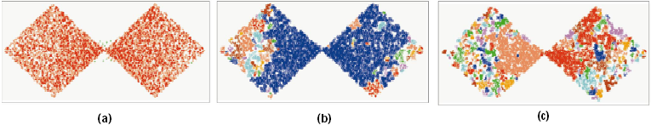

DBSCAN Is Sensitive to the Setting of Parameters
Ack. Figures from G. Karypis, E.-H. Han, and V. Kumar, COMPUTER, 32(8), 1999

Slide 68
OPTICS: Ordering Points To Identify Clustering Structure
OPTICS (Ankerst, Breunig, Kriegel, and Sander, SIGMOD’99)
  DBSCAN is sensitive to parameter setting
  An extension: finding clustering structure
Observation: Given a MinPts, density-based clusters w.r.t. a higher density are completely contained in clusters w.r.t. to a lower density
Idea: Higher density points should be processed first—find high-density clusters first
OPTICS stores such a clustering order using two pieces of information:
  Core distance and reachability distance

Slide 69


Visualization
Since points belonging to a cluster have a low reachability distance to their nearest neighbor, valleys correspond to clusters
The deeper the valley, the denser the cluster
Reachability-distance
Reachability plot for a dataset
undefined
Cluster-order of the objects

Slide 70
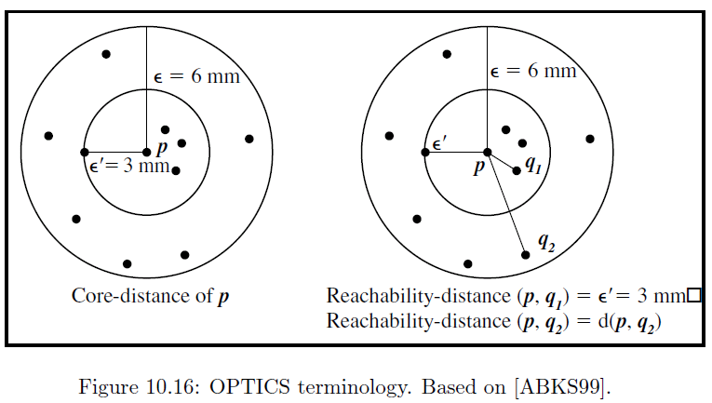
OPTICS: An Extension from DBSCAN
Core distance of an object p: The smallest value ε such
    that the ε-neighborhood of p has at least MinPts objects
  Let Nε(p): ε-neighborhood of p, where ε is a distance value
  Core-distanceε, MinPts(p) = Undefined if card(Nε(p)) < MinPts; MinPts-distance(p), otherwise
Reachability
distance
undefined
Cluster-order of the objects

Slide 71
OPTICS: An Extension from DBSCAN
Reachability distance of object q from core object p is the min. radius value that makes q density-reachable from p
    Reachability-distance_{ε, MinPts}(p, q) =
        Undefined, if p is not a core object
        max(core-distance(p), distance (p, q)), otherwise
Complexity: O(N logN) (if index-based), where N: # of points

Slide 72
OPTICS: Finding Hierarchically Nested Clustering Structures
OPTICS produces a special cluster-ordering of the data points with respect to its density-based clustering structure
The cluster-ordering contains information equivalent to the density-based clusterings corresponding to a broad range of parameter settings
Good for both automatic and interactive cluster analysis—finding intrinsic, even hierarchically nested clustering structures

Slide 73
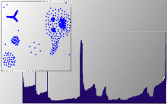
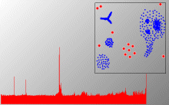
OPTICS: Finding Hierarchically Nested Clustering Structures
Finding nested clustering structures with different parameter settings

Slide 74
Grid-Based Clustering Methods
Grid-Based Clustering: Explore multi-resolution grid data structure in clustering
  Partition the data space into a finite number of cells to form a grid structure
  Find clusters (dense regions) from the cells in the grid structure
Features and challenges of a typical grid-based algorithm
  Efficiency and scalability: # of cells << # of data points
  Uniformity: Uniform, hard to handle highly irregular data distributions
  Locality: Limited by predefined cell sizes, borders, and the density threshold
  Curse of dimensionality: Hard to cluster high-dimensional data
Methods to be introduced
  STING (a STatistical INformation Grid approach) (Wang, Yang and Muntz, VLDB’97)
  CLIQUE (Agrawal, Gehrke, Gunopulos, and Raghavan, SIGMOD’98)
    Both grid-based and subspace clustering

Slide 75
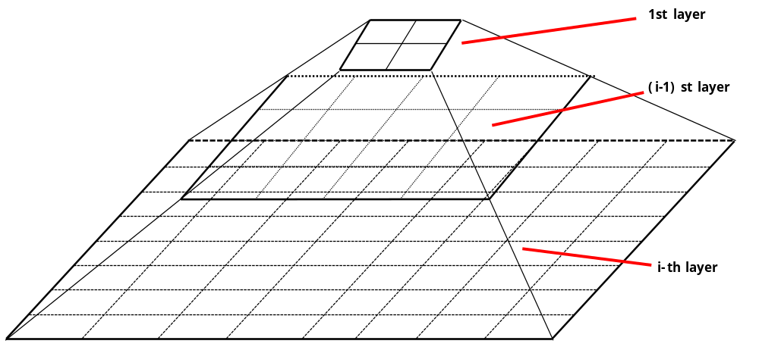
STING: A Statistical Information Grid Approach
STING (Statistical Information Grid) (Wang, Yang and Muntz, VLDB’97)
The spatial area is divided into rectangular cells at different levels of resolution, and these cells form a tree structure
A cell at a high level contains a number of smaller cells of the next lower level

Slide 76
STING: A Statistical Information Grid Approach
Statistical information of each cell is calculated and stored beforehand and is used to answer queries
Parameters of higher level cells can be easily calculated from that of lower level cell, including
  count, mean, s(standard deviation), min, max
  type of distribution—normal, uniform, etc.

Slide 77
Query Processing in STING and Its Analysis
To process a region query
  Start at the root and proceed to the next lower level, using the STING index
  Calculate the likelihood that a cell is relevant to the query at some confidence level using the statistical information of the cell
  Only children of likely relevant cells are recursively explored
  Repeat this process until the bottom layer is reached
Advantages
  Query-independent, easy to parallelize, incremental update
  Efficiency: Complexity is O(K)
    K: # of grid cells at the lowest level, and K << N (i.e., # of data points)
Disadvantages
  Its probabilistic nature may imply a loss of accuracy in query processing

Slide 78
CLIQUE: Grid-Based Subspace Clustering
CLIQUE (Clustering In QUEst) (Agrawal, Gehrke, Gunopulos, Raghavan: SIGMOD’98)
CLIQUE is a density-based and grid-based subspace clustering algorithm
  Grid-based: It discretizes the data space through a grid and estimates the density by counting the number of points in a grid cell
  Density-based: A cluster is a maximal set of connected dense units in a subspace
    A unit is dense if the fraction of total data points contained in the unit exceeds the input model parameter
  Subspace clustering: A subspace cluster is a set of neighboring dense cells in an arbitrary subspace. It also discovers some minimal descriptions of the clusters
It automatically identifies subspaces of a high dimensional data space that allow better clustering than original space using the Apriori principle

Slide 79
CLIQUE: SubSpace Clustering with Aprori Pruning
Start at 1-D space and discretize numerical intervals in each axis into grid
Find dense regions (clusters) in each subspace and generate their minimal descriptions
  Use the dense regions to find promising candidates in 2-D space based on the Apriori principle
  Repeat the above in level-wise manner in higher dimensional subspaces

Slide 80
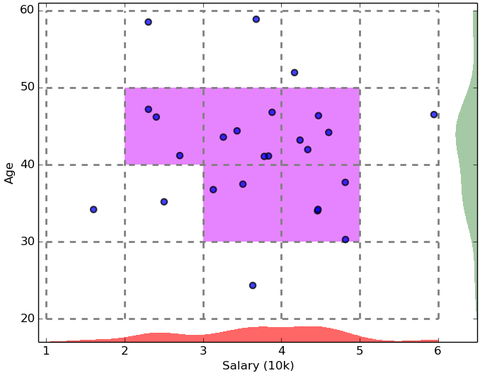
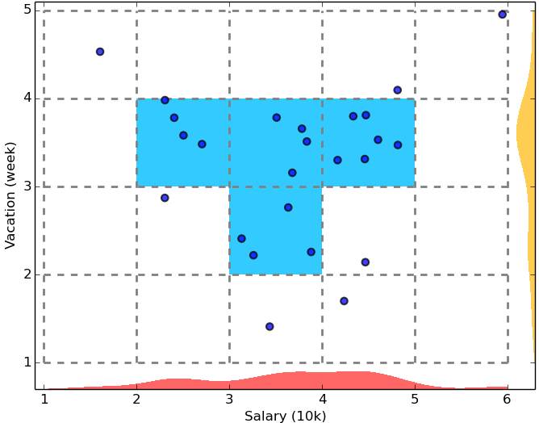
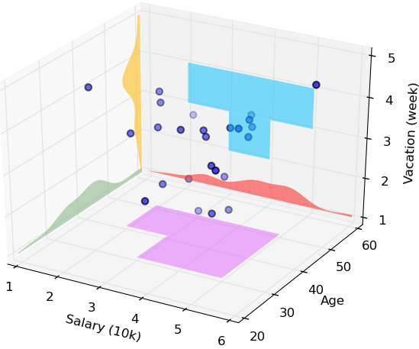
CLIQUE: SubSpace Clustering with Aprori Pruning

Slide 81
Major Steps of the CLIQUE Algorithm
Identify subspaces that contain clusters
  Partition the data space and find the number of points that lie inside each cell of the partition
  Identify the subspaces that contain clusters using the Apriori principle
Identify clusters
  Determine dense units in all subspaces of interests
  Determine connected dense units in all subspaces of interests
Generate minimal descriptions for the clusters
  Determine maximal regions that cover a cluster of connected dense units for each cluster
  Determine minimal cover for each cluster

Slide 82
Pros and Cons of CLIQUE
Strengths
  Automatically finds subspaces of the highest dimensionality as long as high density clusters exist in those subspaces
  Insensitive to the order of records in input and does not presume some canonical data distribution
  Scales linearly with the size of input and has good scalability as the number of dimensions in the data increases
Weaknesses
  As in all grid-based clustering approaches, the quality of the results crucially depends on the appropriate choice of the number and width of the partitions and grid cells

Slide 83
Outline
Cluster analysis
Partitioning methods
Hierarchical methods
Density-based and grid-based methods
Evaluation of clustering
  Assessing clustering tendency
  Determining the number of clusters
  Measuring clustering quality: extrinsic methods
  Intrinsic methods

Slide 84
Evaluation of Clustering: Basic Concepts
Evaluation of clustering
  Assess the feasibility of clustering analysis on a data set
  Evaluate the quality of the results generated by a clustering method
Major issues on clustering assessment and validation
  Clustering tendency: assessing the suitability of clustering: whether the data has any inherent grouping structure
  Determining the Number of Clusters: determining for a dataset the right number of clusters that may lead to a good quality clustering
  Clustering quality evaluation: evaluating the quality of the clustering results

Slide 85
Clustering Tendency: Whether the Data Contains Inherent Grouping Structure
Assess the suitability of clustering
  Whether the data has any “inherent grouping structure” — non-random structure that may lead to meaningful clusters
Determine clustering tendency or clusterability
  A hard task because there are so many different definitions of clusters
    Different definitions: Partitioning, hierarchical, density-based and graph-based
  Even fixing a type, still hard to define an appropriate null model for a data set
There are some clusterability assessment methods, such as
  Spatial histogram: Contrast the histogram of the data with that generated from random samples
  Distance distribution: Compare the pairwise point distance from the data with those from the randomly generated samples
  Hopkins Statistic: A sparse sampling test for spatial randomness

Slide 86
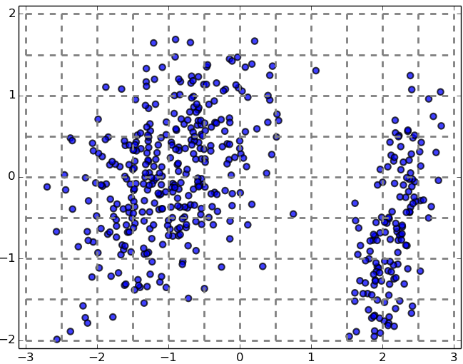
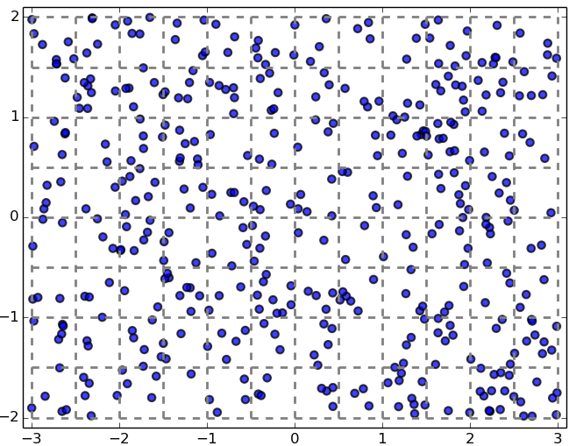
Testing Clustering Tendency: A Spatial Histogram Approach
Spatial Histogram Approach: Contrast the d-dimensional histogram of the input dataset D with the histogram generated from random samples
  Dataset D is clusterable if the distributions of two histograms are rather different
(a) Input dataset
(b) Data generated from random samples

Slide 87
Testing Clustering Tendency: A Spatial Histogram Approach
Method outline
  Divide each dimension into equi-width bins, count how many points lie in each cell, and obtain the empirical joint probability mass function (EPMF)
Do the same for the randomly sampled data
Compute how much they differ using the Kullback-Leibler (KL) divergence value

Slide 88
Determining the Number of Clusters
The appropriate number of clusters controls the proper granularity of cluster analysis
  Finding a good balance between compressibility and accuracy in cluster analysis
Two undesirable extremes
  The whole data set is one cluster: No value of clustering
  Treating each point as a cluster: No data summarization

Slide 89

Determining the Number of Clusters
The right number of clusters often depends on the distribution's shape and scale in the data set, as well as the clustering resolution required by the user
Methods for determining the number of clusters
An empirical method
  # of clusters: $k≈\sqrt{\frac{n}{2}}$ for a dataset of n points (e.g., n = 200, k = 10)
  Each cluster is expected to have about $\sqrt{2n}$ points

Slide 90

Finding the Number of Clusters: the Elbow Method
Use the turning point in the curve of the sum of within cluster variance with respect to the # of clusters
  Increasing the # of clusters can help reduce the sum of within-cluster variance of each cluster
  But splitting a cohesive cluster gives only a small reduction

Slide 91
Finding K, the Number of Clusters: A Cross Validation Method
Divide a given data set into m parts, and use m – 1 parts to obtain a clustering model
Use the remaining part to test the quality of the clustering
  For example, for each point in the test set, find the closest centroid, and use the sum of squared distance between all points in the test set and their closest centroids to measure how well the model fits the test set
For any k > 0, repeat it m times, compare the overall quality measure w.r.t. different k’s, and find # of clusters that fits the data the best

Slide 92
Measuring Clustering Quality
Clustering Evaluation: Evaluating how good the clustering results are
  No commonly recognized best suitable measure in practice
Extrinsic vs. intrinsic methods: depending on whether ground truth is used
  Ground truth: the ideal clustering built by using human experts
Extrinsic: Supervised, employ criteria not inherent to the dataset
  Compare a clustering against prior or expert-specified knowledge (i.e., the ground truth) using certain clustering quality measure
Intrinsic: Unsupervised, criteria derived from data itself
  Evaluate the goodness of a clustering by considering how well the clusters are separated and how compact the clusters are (e.g., silhouette coefficient)

Slide 93
General Criteria for Measuring Clustering Quality with Extrinsic Methods
Given the ground truth Cg, Q(C, Cg) is the quality measure for a clustering C
Q(C, Cg) is good if it satisfies the following four essential criteria
  Cluster homogeneity: the purer, the better
  Cluster completeness: assign objects belonging to the same category in the ground truth to the same cluster
  Rag bag better than alien: putting a heterogeneous object into a pure cluster should be penalized more than putting it into a rag bag (i.e., “miscellaneous” or “other” category)
  Small cluster preservation: splitting a small category into pieces is more harmful than splitting a large category into pieces
Ground truth partitioning G₁
G₂
Cluster C₁
Cluster C₂

Slide 94
Commonly Used Extrinsic Methods
Ground truth partitioning G₁
G₂
Matching-based methods
  Examine how well the clustering results match the ground truth in partitioning the objects in the data set
Information theory-based methods
  Compare the distribution of the clustering results and that of the ground truth
  Information theory (e.g., entropy) used to quantify the comparison
  Ex. Conditional entropy, normalized mutual information (NMI)
Pairwise comparison-based methods
  Treat each group in the ground truth as a class, and then check the pairwise consistency of the objects in the clustering results
  Ex. Four possibilities: TP, FN, FP, TN; Jaccard coefficient
Cluster C₁
Cluster C₂

Slide 95

Matching-Based Methods
Ground Truth G₁
G₂
G₃
Cluster C₁
C₂
C₃
The matching based methods compare clusters in the clustering results and the groups in the ground truth
Suppose a clustering method partitions D = {o₁, …, o_{n}} into m clusters C = {C₁, …, C_{m}}. The ground truth G partitions D into l groups G = {G₁, …, G_{l}}
Purity: the extent that cluster $C_{i}$ contains points only from one (ground truth) partition
  Purity for cluster $C_{i}$: $\frac{|C_{i}∩G_{j}|}{|C_{i}|}$, where $G_{j}$ matching $G_{j}$ maximizes ${|C}_{i}∩G_{j}|$
  Total purity of clustering C:
  $purity=\sum_{i=1}^{m}{\frac{|C_{i}|}{n}}{\max_{j=1}}^{l}\left\{\frac{\left|C_{i}∩G_{j}\right|}{\left|C_{i}\right|}\right\}=\frac{1}{n}\sum_{i=1}^{m}{{\max_{j=1}}^{l}\left\{{|C}_{i}∩G_{j}\right|\}{ }}$

Slide 96

Matching-Based Methods: Example
Ground Truth G₁
G₂
G₃
Cluster C₁
C₂
C₃
Consider 11 objects
Other methods:
  maximum matching; F-measure
Purity for clustering C₁ = 1/11 (4 + 2 + 4 + 1) = 11/11 = 1;
Purity for clustering C₂ = 1/11 (2 + 3 + 1) = 6/11

Slide 97
Information Theory-Based Methods (I)
Conditional Entropy
Ground Truth G₁
G₂
G₃
Cluster C₁
C₂
C₃
A clustering can be regarded as a compressed representation of a given set of objects
The better the clustering results approach the ground-truth, the less amount of information is needed
This idea leads to the use of conditional entropy

Slide 98

Information Theory-Based Methods (I)
Conditional Entropy
Entropy of clustering C: $H\left(C\right)=−\sum_{i=1}^{m}{\frac{|C_{i}|}{n}\log{\frac{|C_{i}|}{n}}}$
Entropy of ground truth G: $H\left(G\right)=−\sum_{i=1}^{l}{\frac{|G_{i}|}{n}\log{\frac{|G_{i}|}{n}}}$
Conditional entropy of G given cluster $C_{i}$:
$H\left(G | C_{i}\right)=−\sum_{j=1}^{l}{\frac{\left|C_{i}∩G_{j}\right|}{\left|C_{i}\right|}\log{\frac{\left|C_{i}∩G_{j}\right|}{\left|C_{i}\right|}}}$
Conditional entropy of G given clustering C:
$$H\left(G | C\right)=\sum_{i=1}^{m}{\frac{\left|C_{i}\right|}{n}H\left(G | C_{i}\right)}=−\sum_{i=1}^{m}{\sum_{j=1}^{l}{\frac{\left|C_{i}∩G_{j}\right|}{n}\log{\frac{\left|C_{i}∩G_{j}\right|}{\left|C_{i}\right|}}}}$$
Ground Truth G₁
G₂
G₃
Cluster C₁
C₂
C₃

Slide 99
Example
Ground Truth G₁
G₂
G₃
Cluster C₁
C₂
C₃
Consider 11 objects
Purity for clustering C₁ = 1/11 (4 + 2 + 4 + 1) = 11/11 = 1;
Purity for clustering C₂ = 1/11 (2 + 3 + 1) = 6/11
Note: conditional entropy cannot detect the issue that C₁ splits the objects in G into two clusters

Slide 100

Information Theory-Based Methods (II)
Normalized Mutual Information (NMI)
Mutual information $I\left(C, G\right)=−\sum_{i=1}^{r}{\sum_{j=1}^{k}{p_{ij}\log{\frac{p_{ij}}{p_{C_{i}}p_{G_{j} }}}}}$
  Quantify the amount of shared info between the clustering C and the ground-truth partitioning G
  Measure the dependency between the observed joint probability $p_{ij}$ of C and G, and the expected joint probability $p_{C_{i}}p_{G_{j} }$ under the independence assumption
  When C and G are independent, $p_{ij}=p_{C_{i}}p_{G_{j} }$, I(C, G) = 0
  However, there is no upper bound on the mutual information
Normalized mutual information $NMI\left(C,G\right)=\sqrt{\frac{I(C,G)}{H(C)}\frac{I(C,G)}{H(G)}}=\frac{I\left(C,G\right)}{\sqrt{H\left(C\right)H(G)}}$
  Value range of NMI: [0,1]
  Value close to 1 indicates a good clustering

Slide 101


Pairwise Comparison-Based Methods: Jaccard Coefficient
Pairwise comparison: treat each group in the ground truth as a class
For each pair of objects (o_{i}, o_{j}) in D, if they are assigned to the same cluster/group, the assignment is regarded as positive; otherwise, negative
  Depending on assignments, we have four possible cases:
  Jaccard coefficient: Ignoring the true negatives (thus asymmetric)
  Jaccard = TP/(TP + FN + FP) [i.e., denominator ignores TN]
    Jaccard = 1 if perfect clustering
Many other measures are based on the pairwise comparison statistics:
  Rand statistic
  Fowlkes-Mallows measure
Note: Total # of pairs of points

Slide 102


Intrinsic Methods (I): Dunn Index
Intrinsic methods (i.e., no ground truth) examine how compact clusters are and how well clusters are separated, based on similarity/distance measure between objects
Dunn Index:
  The compactness of clusters: the maximum distance between two points that belong to the same cluster: $Δ=\max_{C\left(o_{i}\right)=C(o_{j})}\left\{d\left(o_{i},o_{j}\right)\right\}$
  The degree of separation among different clusters: the minimum distance between two points that belong to different clusters: $δ=\min_{C\left(o_{i}\right)≠C(o_{j})}\left\{d\left(o_{i},o_{j}\right)\right\}$
  The Dunn index is simply the ratio: $DI=\frac{δ}{Δ}$, the larger the ratio, the farther away the clusters are separated comparing to the compactness of the clusters
Dunn index uses the extreme distances to measure the cluster compactness and inter-cluster separation and it can be affected by outliers

Slide 103

Intrinsic Methods (II): Silhouette Coefficient
Suppose D is partitioned into k clusters: $C_{1}, …, C_{k}$
For each object o in D, we calculate
  $a\left(o\right)=\frac{\sum_{o^{′}∈C_{i},o≠o′}{dist(o,o^{′})}}{\left|C_{i}\right|−1}$: avg distance between o and all other objects in the cluster to which o belongs, reflects the compactness of the cluster to which o belongs
  $b\left(o\right)=\min_{C_{j}:1≤j≤k,j≠i}\left\{\frac{\sum_{o^{′}∈C_{j}}{dist\left(o,o^{′}\right)}}{\left|C_{j}\right|}\right\}$: minimum avg distance from o to all clusters to which o does not belong, captures the degree to which o is separated from other clusters
Silhouette Coefficient: $s\left(o\right)=\frac{b\left(o\right)−a(o)}{\max\left\{a\left(o\right),b\left(o\right)\right\}}$, value range (-1, 1)
  When the value of o approaches 1, the cluster containing o is compact and o is far away from other clusters, which is the preferable case
  When the value is negative (i.e., b(o) < a(o)), o is closer to the objects in another cluster than to the objects in the same cluster as o: a bad situation to be avoided

