Slide 1
Homework Assignment #2
J. H. Wang
Apr. 14, 2026

Slide 2
Homework #2
Chap.4: 4.9, 4.14, 4.20
Chap.5: 5.14, 5.17, 5.22, 5.25
Chap.6: 6.7, 6.15, 6.18
Programming exercises:
    Programming problems: 4.24*, (4.28**, ) 6.33*
      [Individual]: Each student must complete all programming problems on your own
    Programming projects for Chap. 4* (*2) & Chap. 5*
      [Team-based]: select at least one programming project from each chapter
Due: two weeks (Apr. 30, 2026)

Slide 3
Chap. 4
  4.9: Under what circumstances does a multithreaded solution using multiple kernel threads provide better performance than a single-threaded solution on a single-processor system?
  4.14: Using Amdahl’s Law, calculate the speedup gain for the following applications:
    40 percent parallel with (a) eight processing cores and (b) sixteen processing cores
    67 percent parallel with (a) two processing cores and (b) four processing cores
    90 percent parallel with (a) four processing cores and (b) eight processing cores

Slide 4
  4.20: Consider a multicore system and a multithreaded program written using the many-to-many threading model
    Let the number of user-level threads in the program be greater than the number of processing cores in the system
    Discuss the performance implications of the following scenarios.
    (…to be continued)

Slide 5
(… continued from the previous slide)
    a. The number of kernel threads allocated to the program is less than the number of processing cores.
    b. The number of kernel threads allocated to the program is equal to the number of processing cores.
    c. The number of kernel threads allocated to the program is greater than the number of processing cores but less than the number of user-level threads.

Slide 6
Chap. 5:
  5.14: Most scheduling algorithms maintain a run queue, which lists processes eligible to run on a processor.
  On multicore systems, there are two general options:
    (1) each processing core has its own run queue, or
    (2) a single run queue is shared by all processing cores.
  What are the advantages and disadvantages of each of these approaches?

Slide 7
  5.17: Consider the following set of processes, with the length of the CPU burst given in milliseconds:
  (… to be continued)
Thread | Burst Time | Priority
P₁ | 5 | 4
P₂ | 3 | 1
P₃ | 1 | 2
P₄ | 7 | 2
P₅ | 4 | 3

Slide 8
  The processes are assumed to have arrived in the order P1, P2, P3, P4, P5, all at time 0.
    (a) Draw four Gantt charts that illustrate the execution of these processes using the following scheduling algorithms: FCFS, SJF, nonpreemptive priority (a larger priority number implies a higher priority), and RR (quantum = 2)
    (b) What is the turnaround time of each process for each of the scheduling algorithms in part (a)?
    (c) What is the waiting time of each process for each of these scheduling algorithms?
    (d) Which of the algorithms results in the minimum average waiting time (over all processes)?

Slide 9
  5.22: Consider a system running ten I/O-bound tasks and one CPU-bound task.
  Assume that the I/O-bound tasks issue an I/O operation once for every millisecond of CPU computing and that each I/O operation takes 10 milliseconds to complete.
  Also assume that the context-switching overhead is 0.1 millisecond and that all processes are long-running tasks.
  Describe the CPU utilization for a round-robin scheduler when:
  (a) The time quantum is 1 millisecond
  (b) The time quantum is 10 millisecond

Slide 10
  5.25: Explain the differences in how much the following scheduling algorithms discriminate in favor of short processes:
  (a) FCFS
  (b) RR
  (c) Multilevel feedback queues

Slide 11
Chap.6:
  6.7: The pseudocode of Figure 6.15 illustrates the basic push() and pop() operations of an array-based stack.
  Assuming that this algorithm could be used in a concurrent environment, answer the following questions:
    (a) What data have a race condition?
    (b) How could the race condition be fixed?

Slide 12
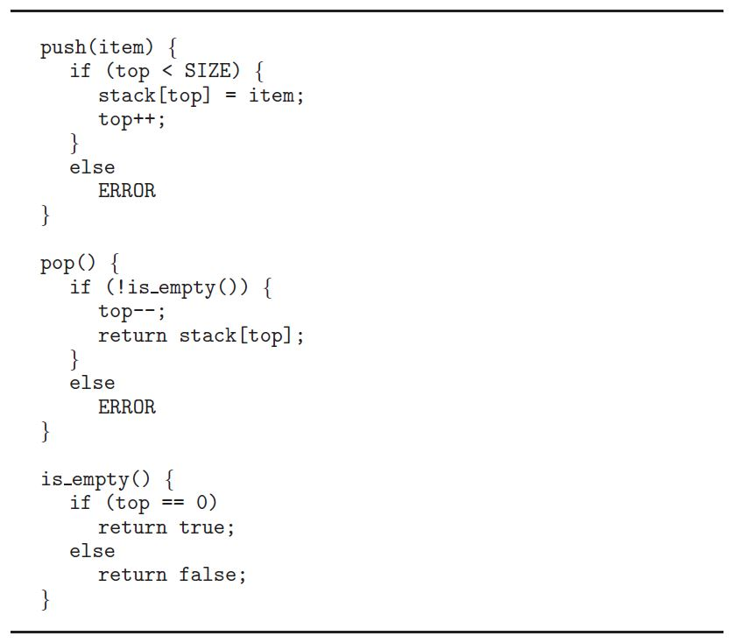
Fig. 6.15:

Slide 13
  6.15: Explain why implementing synchronization primitives by disabling interrupts is not appropriate in a single-processor system if the synchronization primitives are to be used in user-level programs.

Slide 14
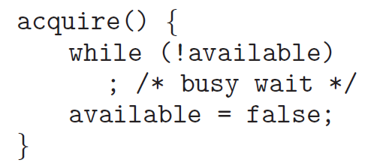
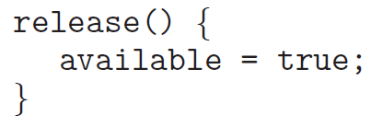
  6.18: The implementation of mutex locks provided in Section 6.5 suffers from busy waiting.
  Describe what changes would be necessary so that a process waiting to acquire a mutex lock would be blocked and placed into a waiting queue until the lock became available.

Slide 15
Programming Problems
[Individual]
  4.24*: An interesting way of calculating π is to use a technique known as Monte Carlo, which involves randomization. This technique works as follows:
    Suppose you have a circle inscribed within a square, as shown in Figure 4.25. (Assume that the radius of this circle is 1.)
  (… to be continued)

Slide 16
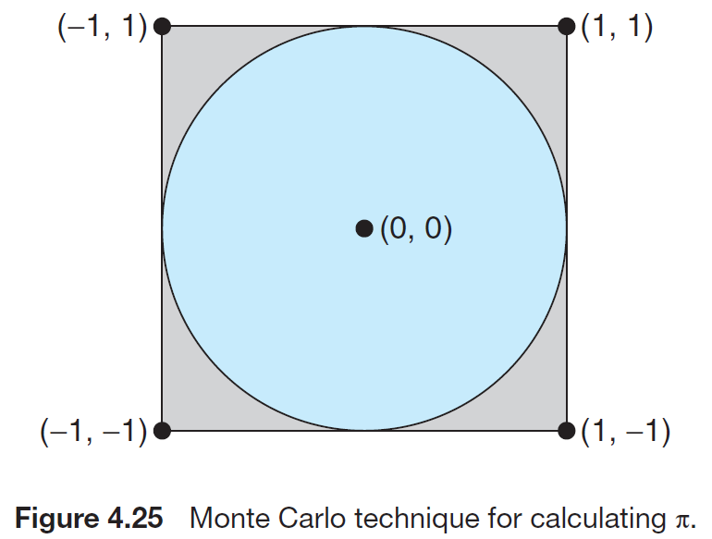
  (continued from the previous slide…)
    First, generate a series of random points as simple (x, y) coordinates.
      These points must fall within the Cartesian coordinates that bound the square.
      Of the total number of random points that are generated, some will occur within the circle.
    Next, estimate π by performing the following calculation:
    π = 4× (number of points in circle) / (total number of points)
  (… to be continued)

Slide 17
  (continued from the previous slide…)
  Write a multithreaded version of this algorithm that creates a separate thread to generate a number of random points.
    The thread will count the number of points that occur within the circle and store that result in a global variable.
    When this thread has exited, the parent thread will calculate and output the estimated value of π.
  It is worth experimenting with the number of random points generated.
  As a general rule, the greater the number of points, the closer the approximation to π.

Slide 18
  [optional] (4.28**): Modify programming problem Exercise 3.20 from Chapter 3, which asks you to design a pid manager.
  This modification will consist of writing a multithreaded program that tests your solution to Exercise 3.20.
  (… to be continued)

Slide 19
  You will create a number of threads—for example, 100—and each thread will request a pid, sleep for a random period of time, and then release the pid.
    (Sleeping for a random period of time approximates the typical pid usage in which a pid is assigned to a new process, the process executes and then terminates, and the pid is released on the process’s termination.)
    On UNIX and Linux systems, sleeping is accomplished through the sleep() function, which is passed an integer value representing the number of seconds to sleep.

Slide 20
6.33*: Assume that a finite number of resources of a single resource type must be managed.
  Processes may ask for a number of these resources and will return them once finished.
  As an example, many commercial software packages provide a given number of licenses, indicating the number of applications that may run concurrently.
    When the application is started, the license count is decremented.
    When the application is terminated, the license count is incremented.
    If all licenses are in use, requests to start the application are denied.
    Such a request will be granted only when an existing license holder terminates the application and a license is returned.

Slide 21
  #define MAX_RESOUCRES 5
  int available_resources = MAX_RESOURCES;
  int decrease count(int count) {
  if (available resources < count)
  return -1;
  else {
  available resources -= count;
  return 0;
  }
  }
  int increase count(int count) {
  available resources += count;
  return 0;
  }

Slide 22
  The preceding program segment produces a race condition. Do the following:
    (a) Identify the data involved in the race condition.
    (b) Identify the location (or locations) in the code where the race condition occurs.
    (c) Using a semaphore or mutex lock, fix the race condition. It is permissible to modify the decrease_count() function so that the calling process is blocked until sufficient resources are available.

Slide 23
Programming Projects
[Team-based]
Programming Projects for Chap. 4: (Choose one)
  Project 1. Sudoku solution validator
    To design a multithreaded application that determines whether the solution to a Sudoku puzzle is valid.
    Passing parameters to each thread
    Returning results to the parent thread
  Project 2. Multithreaded sorting application
    Write a multithreaded sorting program that works as follows: A list of integers is divided into two smaller lists of equal size. Two separate threads sort each sublist using a sorting algorithm of your choice. The two sublists are then merged by a third thread.

Slide 24
End-of-Chapter Programming Projects
Programming Projects for Chap. 5:
  Project. Scheduling Algorithms
    This project involves implementing several process scheduling algorithms
      FCFS
      SJF
      Priority-based
      Round-Robin
      Priority with round-robin
    The implementation of this project may be completed in either C or Java

Slide 25
Homework Submission
For hand-written exercises, please hand in your homework on paper in class
For programming exercises, please upload your program to the iSchool+ as follows:
  Program uploading: a compressed file (in .zip format) including source codes, execution snapshot, and documentation
  Documentation: containing -
    Team members and responsibility
    Compilation or configuration instructions if it needs special environment to compile or run
  Please contact with the TA if you are unable to upload your homework

Slide 26
Any Question or Comments?

