Slide 1
Modified from Stanford CS276 slides
Chap. 8: Evaluation

Slide 2
This lecture
Sec. 6.2
How do we know if our results are any good?
  Evaluating a search engine
    Benchmarks
    Precision and recall
Results summaries:
  Making our good results usable to a user

Slide 3
Evaluating search engines

Slide 4
Measures for a search engine
Sec. 8.6
How fast does it index
  Number of documents/hour
  (Average document size)
How fast does it search
  Latency as a function of index size
Expressiveness of query language
  Ability to express complex information needs
  Speed on complex queries
Uncluttered UI
Is it free?

Slide 5
Measures for a search engine
Sec. 8.6
All of the preceding criteria are measurable: we can quantify speed/size
  we can make expressiveness precise
The key measure: user happiness
  What is this?
  Speed of response/size of index are factors
  But blindingly fast, useless answers won’t make a user happy
Need a way of quantifying user happiness

Slide 6
Measuring user happiness
Sec. 8.6.2
Issue: who is the user we are trying to make happy?
  Depends on the setting
Web search engine:
  User finds what they want and return to the engine
    Can measure rate of return users
  User completes their task – search as a means, not end
  See Russell http://dmrussell.googlepages.com/JCDL-talk-June-2007-short.pdf
eCommerce site: user finds what they want and buy
  Is it the end-user, or the eCommerce site, whose happiness we measure?
  Measure time to purchase, or fraction of searchers who become buyers?

Slide 7
Measuring user happiness
Sec. 8.6.2
Enterprise (company/govt/academic): Care about “user productivity”
  How much time do my users save when looking for information?
  Many other criteria having to do with breadth of access, secure access, etc.

Slide 8
Happiness: elusive to measure
Sec. 8.1
Most common proxy: relevance of search results
  But how do you measure relevance?
  We will detail a methodology here, then examine its issues
Relevance measurement requires 3 elements:
  A benchmark document collection
  A benchmark suite of queries
  A usually binary assessment of either Relevant or Nonrelevant for each query and each document
    Some work on more-than-binary, but not the standard

Slide 9
Evaluating an IR system
Sec. 8.1
Note: the information need is translated into a query
Relevance is assessed relative to the information need not the query
E.g., Information need: I'm looking for information on whether drinking red wine is more effective at reducing your risk of heart attacks than white wine
Query: wine red white heart attack effective
You evaluate whether the doc addresses the information need, not whether it has these words

Slide 10
Standard relevance benchmarks
Sec. 8.2
TREC - National Institute of Standards and Technology (NIST) has run a large IR test bed for many years
Reuters and other benchmark doc collections used
“Retrieval tasks” specified
  sometimes as queries
Human experts mark, for each query and for each doc, Relevant or Nonrelevant
  or at least for subset of docs that some system returned for that query

Slide 11
Unranked retrieval evaluation:
Precision and Recall
Sec. 8.3
Precision: fraction of retrieved docs that are relevant = P(relevant|retrieved)
Recall: fraction of relevant docs that are retrieved = P(retrieved|relevant)
Precision P = tp/(tp + fp)
Recall R = tp/(tp + fn)
 | Relevant | Nonrelevant
Retrieved | tp | fp
Not Retrieved | fn | tn

Slide 12
Should we instead use the accuracy measure for evaluation?
Sec. 8.3
Given a query, an engine classifies each doc as “Relevant” or “Nonrelevant”
The accuracy of an engine: the fraction of these classifications that are correct
  Accuracy = (tp + tn) / (tp + fp + fn + tn)
Accuracy is a commonly used evaluation measure in machine learning classification work
Why is this not a very useful evaluation measure in IR?

Slide 13
Why not just use accuracy?
Sec. 8.3
How to build a 99.9999% accurate search engine on a low budget…
People doing information retrieval want to find something and have a certain tolerance for junk
Snoogle.com
Search for:
0 matching results found.

Slide 14
Precision/Recall
Sec. 8.3
You can get high recall (but low precision) by retrieving all docs for all queries!
Recall is a non-decreasing function of the number of docs retrieved
In a good system, precision decreases as either the number of docs retrieved or recall increases
  This is not a theorem, but a result with strong empirical confirmation

Slide 15
Difficulties in using precision/recall
Sec. 8.3
Should average over large document collection/query ensembles
Need human relevance assessments
  People aren’t reliable assessors
Assessments have to be binary
  Nuanced assessments?
Heavily skewed by collection/authorship
  Results may not translate from one domain to another

Slide 16
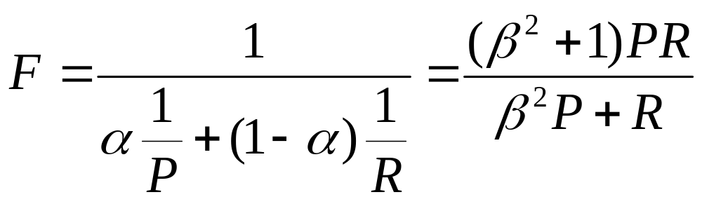
A combined measure: F
Sec. 8.3
Combined measure that assesses precision/recall tradeoff is F measure (weighted harmonic mean):
People usually use balanced F₁ measure
  i.e., with β = 1 or α = ½
Harmonic mean is a conservative average
  See CJ van Rijsbergen, Information Retrieval

Slide 17
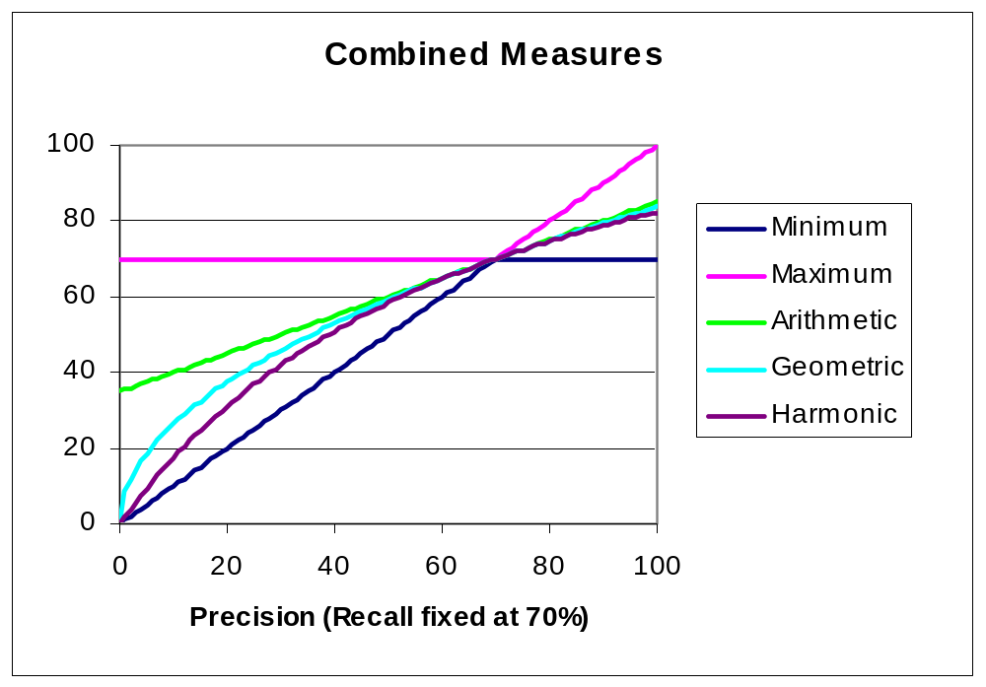
F₁ and other averages
Sec. 8.3

Slide 18
Evaluating ranked results
Sec. 8.4
Evaluation of ranked results:
  The system can return any number of results
  By taking various numbers of the top returned documents (levels of recall), the evaluator can produce a precision-recall curve

Slide 19
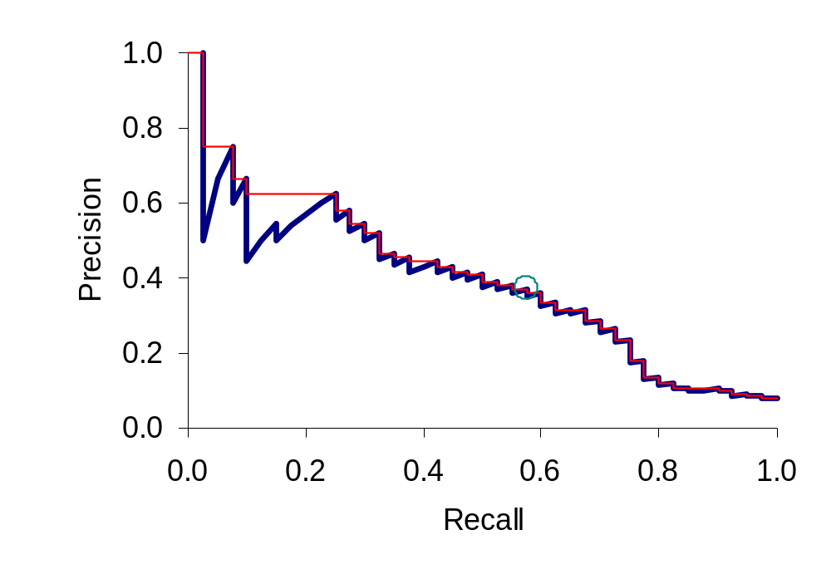
A precision-recall curve
Sec. 8.4

Slide 20
Averaging over queries
Sec. 8.4
A precision-recall graph for one query isn’t a very sensible thing to look at
You need to average performance over a whole bunch of queries
But there’s a technical issue:
  Precision-recall calculations place some points on the graph
  How do you determine a value (interpolate) between the points?

Slide 21
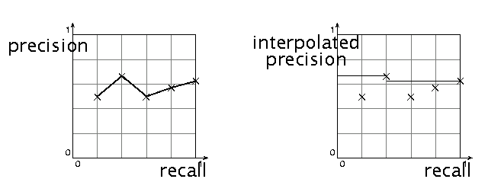
Interpolated precision
Sec. 8.4
Idea: If locally precision increases with increasing recall, then you should get to count that…
So you use max of precisions to right of value

Slide 22
Evaluation
Sec. 8.4
Graphs are good, but people want summary measures!
  Precision at fixed retrieval level
    Precision-at-k: Precision of top k results
    Perhaps appropriate for most of web search: all people want are good matches on the first one or two results pages
    But: averages badly and has an arbitrary parameter of k
  11-point interpolated average precision
    The standard measure in the early TREC competitions: you take the precision at 11 levels of recall varying from 0 to 1 by tenths of the documents, using interpolation (the value for 0 is always interpolated!), and average them
    Evaluates performance at all recall levels

Slide 23
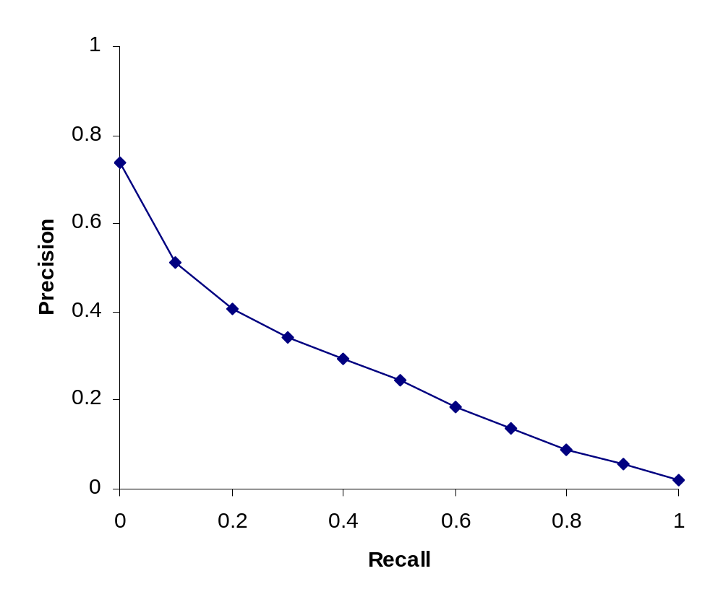
Typical (good) 11 point precisions
Sec. 8.4
SabIR/Cornell 8A1 11pt precision from TREC 8 (1999)

Slide 24
Yet more evaluation measures…
Sec. 8.4
Mean average precision (MAP)
  Average of the precision value obtained for the top k documents, each time a relevant doc is retrieved
  Avoids interpolation, use of fixed recall levels
  MAP for query collection is arithmetic ave.
    Macro-averaging: each query counts equally
R-precision
  If have known (though perhaps incomplete) set of relevant documents of size Rel, then calculate precision of top Rel docs returned
  Perfect system could score 1.0

Slide 25
Variance
Sec. 8.4
For a test collection, it is usual that a system does crummily on some information needs (e.g., MAP = 0.1) and excellently on others (e.g., MAP = 0.7)
Indeed, it is usually the case that the variance in performance of the same system across queries is much greater than the variance of different systems on the same query
That is, there are easy information needs and hard ones!

Slide 26
CREATING TEST COLLECTIONS
FOR IR EVALUATION

Slide 27
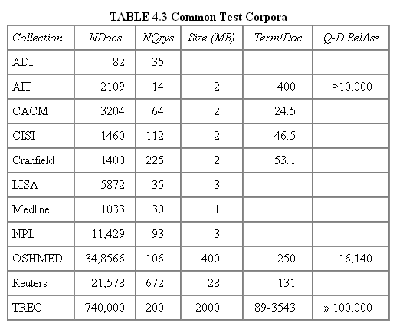
Test Collections
Sec. 8.5

Slide 28
Previous Test Collections
Test collections held at University of Glasgow: http://www.dcs.gla.ac.uk/idom/ir_resources/test_collections/
  LISA, NPL, CACM, CISI, Cranfield, Time, Medline, ADI
  Ex: The Time Collection: 423 documents (1.5MB)
Reuters-21578: http://www.daviddlewis.com/resources/testcollections/reuters21578/
  21,578 news articles in 1987 (28.0MB uncompressed)
Reuters-RCV1: (in the textbook) http://trec.nist.gov/data/reuters/reuters.html
  About 810,000 English news stories from 1996/08/20 to 1997/08/19 (2.5GB uncompressed)
  Needs to sign agreements

Slide 29
The Latest Web Test Collection
The ClueWeb22 dataset
  The newest dataset: https://www.lemurproject.org/clueweb22.php/
  10 billion Web pages, organized into three subsets: B (200M), A (2B), L (10B)
    Collected during the first half of 2022 (in Bing)
    1* 8TB disk (B), or on Azure
  A. Overwijk, C. Xiong, and J. Callan. ClueWeb22: 10 billion web documents with rich information. In Proceedings of the 45th International ACM SIGIR Conference on Research and Development in Information Retrieval, ACM, 2022.

Slide 30
Web Test Collections
The ClueWeb12 dataset
  a successor to the ClueWeb09 dataset
  http://lemurproject.org/clueweb12.php/
  733,019,372 English Web pages, in Feb.-May 2012
  5.5TB, compressed (27.3TB, uncompressed)
The ClueWeb09 dataset
  http://lemurproject.org/clueweb09.php/
  1,040,809,705 Web pages in 10 languages, in Jan.-Feb. 2009
  5TB, compressed (25TB, uncompressed)
TREC datasets:
WT2g, WT10g, .GOV, .GOV2, Blogs06, Blogs08
  http://ir.dcs.gla.ac.uk/test_collections/

Slide 31
From document collections to test collections
Sec. 8.5
Still need
  Test queries
  Relevance assessments
Test queries
  Must be germane to docs available
  Best designed by domain experts
  Random query terms generally not a good idea
Relevance assessments
  Human judges, time-consuming
  Are human panels perfect?

Slide 32
Unit of Evaluation
Sec. 8.5
We can compute precision, recall, F, and ROC curve for different units
Possible units
  Documents (most common)
  Facts (used in some TREC evaluations)
  Entities (e.g., car companies)
May produce different results. Why?

Slide 33
Kappa measure for inter-judge (dis)agreement
Sec. 8.5
Kappa measure
  Agreement measure among judges
  Designed for categorical judgments
  Corrects for chance agreement
Kappa = [ P(A) – P(E) ] / [ 1 – P(E) ]
  P(A) – proportion of time judges agree
  P(E) – what agreement would be by chance
Kappa = 0 for chance agreement, 1 for total agreement

Slide 34
Kappa Measure: Example
Sec. 8.5
P(A)? P(E)?
Number of docs | Judge 1 | Judge 2
300 | Relevant | Relevant
70 | Nonrelevant | Nonrelevant
20 | Relevant | Nonrelevant
10 | Nonrelevant | Relevant

Slide 35
Kappa Example
Sec. 8.5
P(A) = 370/400 = 0.925
P(nonrelevant) = (10+20+70+70)/800 = 0.2125
P(relevant) = (10+20+300+300)/800 = 0.7878
P(E) = 0.2125^2 + 0.7878^2 = 0.665
Kappa = (0.925 – 0.665)/(1-0.665) = 0.776
Kappa > 0.8 = good agreement
0.67 < Kappa < 0.8 -> “tentative conclusions” (Carletta ’96)
Depends on purpose of study
For >2 judges: average pairwise kappas

Slide 36
TREC
Sec. 8.2
TREC Ad Hoc task from first 8 TRECs is standard IR task
  50 detailed information needs a year
  Human evaluation of pooled results returned
  More recently other related things: Web track, HARD
A TREC query (TREC 5)
  <top>
  <num> Number: 225
  <desc> Description:
  What is the main function of the Federal Emergency Management Agency (FEMA) and the funding level provided to meet emergencies? Also, what resources are available to FEMA such as people, equipment, facilities?
  </top>

Slide 37
Standard relevance benchmarks: Others
Sec. 8.2
GOV2
  Another TREC/NIST collection
  25 million web pages
  Largest collection that is easily available
  But still 3 orders of magnitude smaller than what Google/Yahoo/MSN index
NTCIR
  East Asian language and cross-language information retrieval
Cross Language Evaluation Forum (CLEF)
  This evaluation series has concentrated on European languages and cross-language information retrieval
Many others

Slide 38
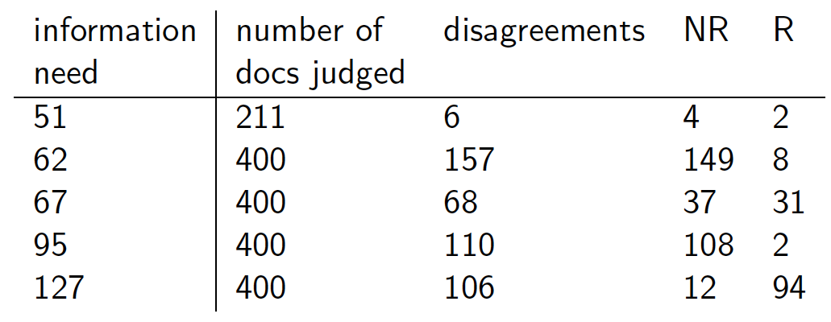
Interjudge Agreement: TREC 3
Sec. 8.5
Notes:
Topic is TREC topic
Judged is number of documents that human assessors judged
Diff is the number that they disagreed on.
NR and R are whether those were eventually classified as relevant or nonrelevant.

Slide 39
Impact of Inter-judge Agreement
Sec. 8.5
Impact on absolute performance measure can be significant (0.32 vs 0.39)
Little impact on ranking of different systems or relative performance
Suppose we want to know if algorithm A is better than algorithm B
A standard information retrieval experiment will give us a reliable answer to this question

Slide 40
Critique of pure relevance
Sec. 8.5.1
Relevance vs Marginal Relevance
  A document can be redundant even if it is highly relevant
  Duplicates
  The same information from different sources
  Marginal relevance is a better measure of utility for the user
Using facts/entities as evaluation units more directly measures true relevance
But harder to create evaluation set
See Carbonell reference

Slide 41
Can we avoid human judgment?
Sec. 8.6.3
No
Makes experimental work hard
  Especially on a large scale
In some very specific settings, can use proxies
  E.g.: for approximate vector space retrieval, we can compare the cosine distance closeness of the closest docs to those found by an approximate retrieval algorithm
But once we have test collections, we can reuse them (so long as we don’t overtrain too badly)

Slide 42
Evaluation at large search engines
Sec. 8.6.3
Search engines have test collections of queries and hand-ranked results
Recall is difficult to measure on the web
Search engines often use precision at top k, e.g., k = 10
. . . or measures that reward you more for getting rank 1 right than for getting rank 10 right
  NDCG (Normalized Cumulative Discounted Gain)
Search engines also use non-relevance-based measures
  Clickthrough on first result
    Not very reliable if you look at a single clickthrough … but pretty reliable in the aggregate
  Studies of user behavior in the lab
  A/B testing
Notes:
Not very reliable if you look at a single clickthrough (you may
realize after clicking that the summary was misleading and the
document is nonrelevant) . . .

Slide 43
A/B testing
Sec. 8.6.3
Purpose: Test a single innovation
Prerequisite: You have a large search engine up and running
Have most users use old system
Divert a small proportion of traffic (e.g., 1%) to the new system that includes the innovation
Evaluate with an “automatic” measure like clickthrough on first result
Now we can directly see if the innovation does improve user happiness
Probably the evaluation methodology that large search engines trust most
In principle less powerful than doing a multivariate regression analysis, but easier to understand

Slide 44
Results presentation
Sec. 8.7

Slide 45
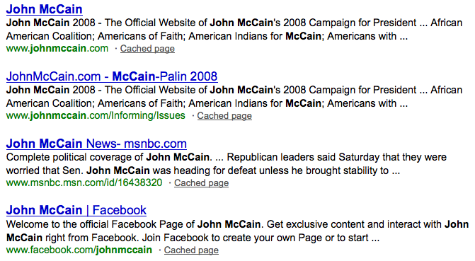
Result Summaries
Sec. 8.7
Having ranked the documents matching a query, we wish to present a results list
Most commonly, a list of the document titles plus a short summary, aka “10 blue links”

Slide 46
Summaries
Sec. 8.7
The title is often automatically extracted from document metadata. What about the summaries?
  This description is crucial
  User can identify good/relevant hits based on description
Two basic kinds:
  Static
  Dynamic
A static summary of a document is always the same, regardless of the query that hit the doc
A dynamic summary is a query-dependent attempt to explain why the document was retrieved for the query at hand

Slide 47
Static summaries
Sec. 8.7
In typical systems, the static summary is a subset of the document
Simplest heuristic: the first 50 (or so – this can be varied) words of the document
  Summary cached at indexing time
More sophisticated: extract from each document a set of “key” sentences
  Simple NLP heuristics to score each sentence
  Summary is made up of top-scoring sentences
Most sophisticated: NLP used to synthesize a summary
  Seldom used in IR; cf. text summarization work

Slide 48






Dynamic summaries
Sec. 8.7
Present one or more “windows” within the document that contain several of the query terms
  “KWIC” snippets: Keyword in Context presentation

Slide 49
Techniques for dynamic summaries
Sec. 8.7
Find small windows in doc that contain query terms
  Requires fast window lookup in a document cache
Score each window wrt query
  Use various features such as window width, position in document, etc.
  Combine features through a scoring function – methodology to be covered later
Challenges in evaluation: judging summaries
  Easier to do pairwise comparisons rather than binary relevance assessments

Slide 50

Quicklinks
For a navigational query such as united airlines user’s need likely satisfied on www.united.com
Quicklinks provide navigational cues on that home page

Slide 51



Slide 52
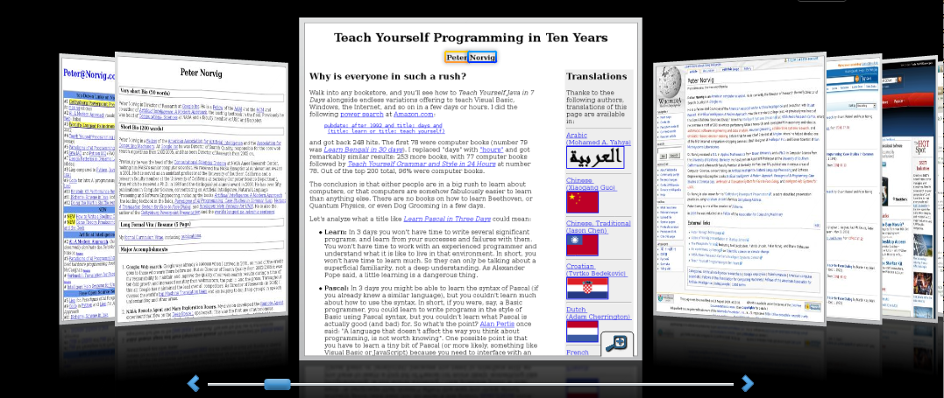
Alternative results presentations?
An active area of HCI research
An alternative: http://www.searchme.com / copies the idea of Apple’s Cover Flow for search results
  (searchme recently went out of business)
Notes:
For the moment, the search engine market has really coalesced around one dominant style (consistency has strong benefits – Jakob Nielsen.

Slide 53
Resources for this lecture
IIR 8
MIR Chapter 3
MG 4.5
Carbonell and Goldstein 1998. The use of MMR, diversity-based reranking for reordering documents and producing summaries. SIGIR 21.

