Slide 1
Modified from Stanford CS276 slides
Chap. 9: Query expansion

Slide 2
Recap of the last lecture
Evaluating a search engine
  Benchmarks
  Precision and recall
Results summaries

Slide 3
Recap: Unranked retrieval evaluation:
Precision and Recall
Precision: fraction of retrieved docs that are relevant = P(relevant|retrieved)
Recall: fraction of relevant docs that are retrieved = P(retrieved|relevant)
Precision P = tp/(tp + fp)
Recall R = tp/(tp + fn)
 | Relevant | Nonrelevant
Retrieved | tp | fp
Not Retrieved | fn | tn

Slide 4
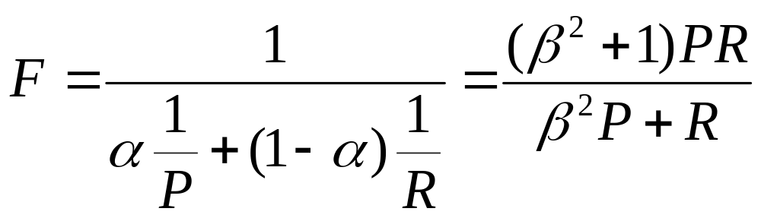
Recap: A combined measure: F
Combined measure that assesses precision/recall tradeoff is F measure (weighted harmonic mean):
People usually use balanced F₁ measure
  i.e., with β = 1 or α = ½
Harmonic mean is a conservative average
  See CJ van Rijsbergen, Information Retrieval

Slide 5
This lecture
Improving results
  For high recall. e.g., searching for aircraft doesn’t match with plane; nor thermodynamic with heat
Options for improving results…
  Global methods: independent of queries
    Query expansion
      Thesauri
      Automatic thesaurus generation
  Local methods
    Relevance feedback
    Pseudo relevance feedback
Notes:
The examples in the first bullet refer to the Cranfield data set which we have used as a programming exercise.

Slide 6
Relevance Feedback
Sec. 9.1
Relevance feedback: user feedback on relevance of docs in initial set of results
  User issues a (short, simple) query
  The user marks some results as relevant or non-relevant
  The system computes a better representation of the information need based on feedback
  Relevance feedback can go through one or more iterations
Idea: it may be difficult to formulate a good query when you don’t know the collection well, so iterate

Slide 7
Relevance feedback
Sec. 9.1
We will use ad hoc retrieval to refer to regular retrieval without relevance feedback
We now look at four examples of relevance feedback that highlight different aspects

Slide 8

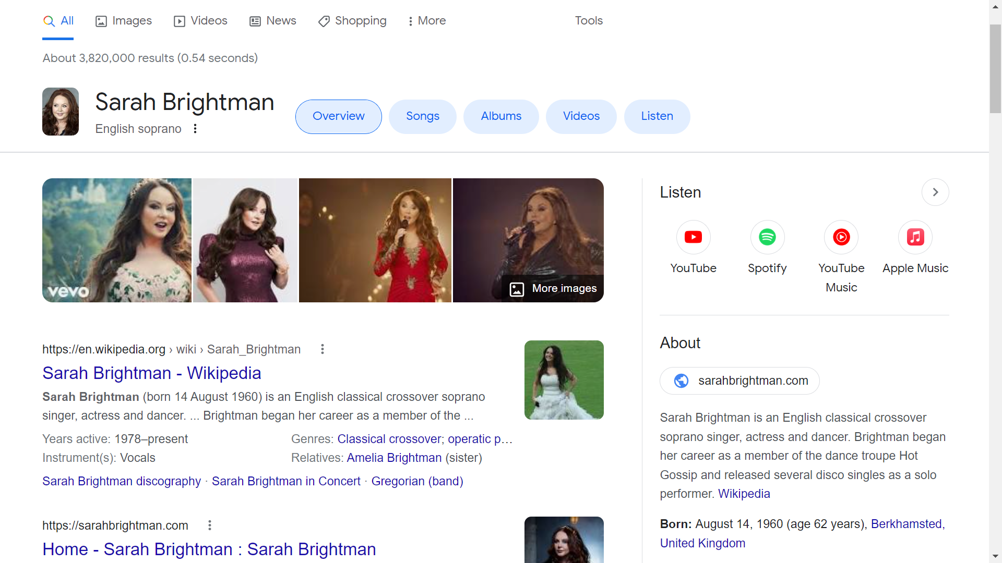
Similar pages

Slide 9
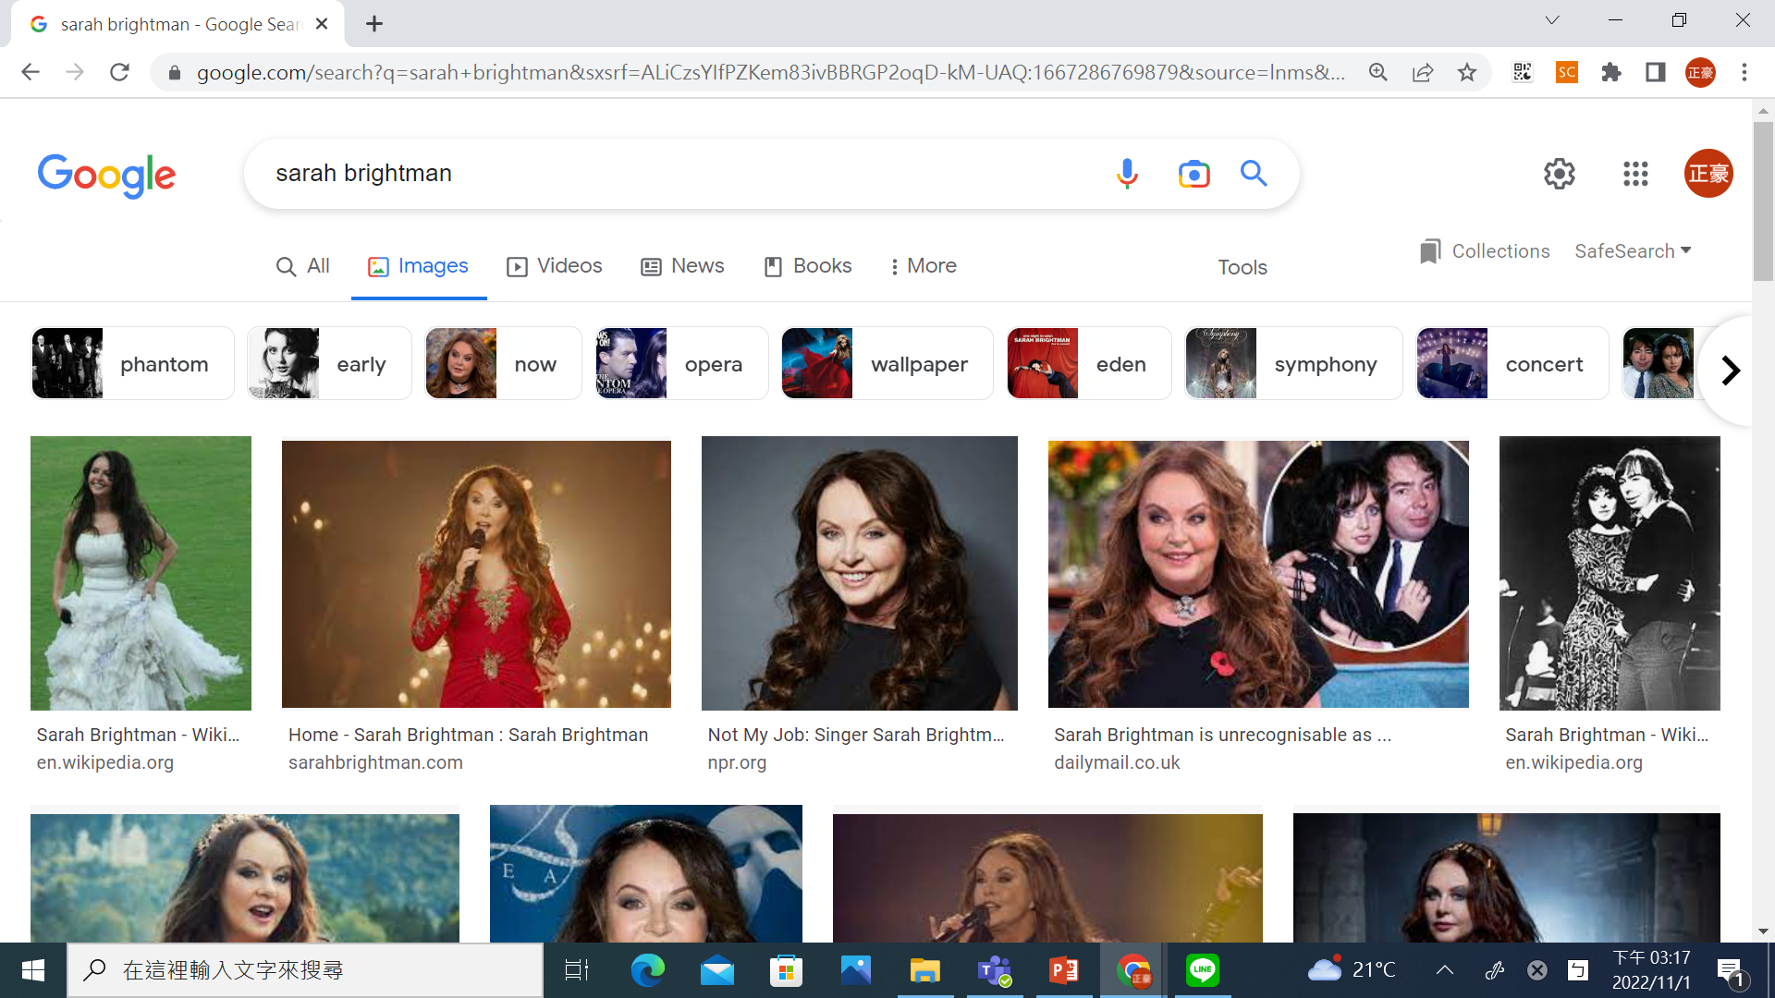
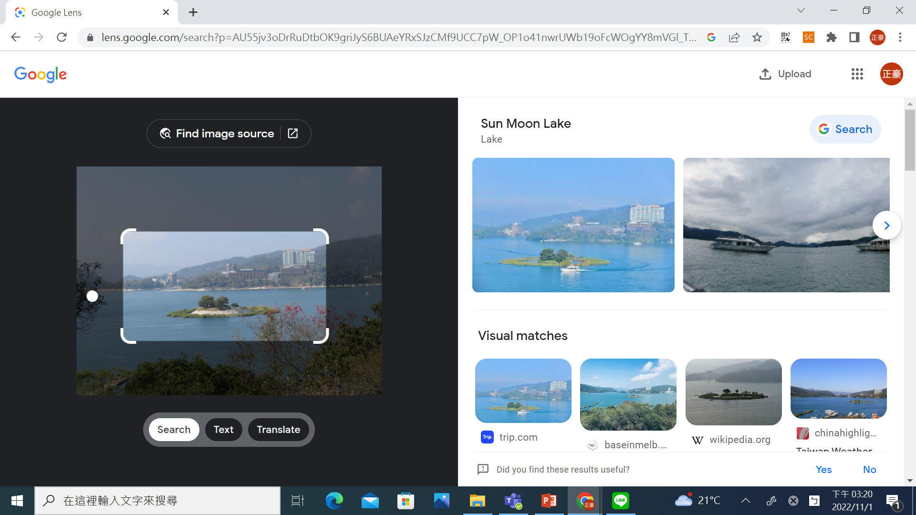
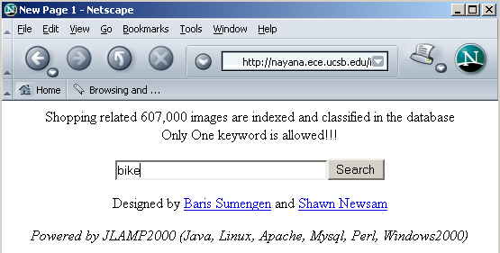
Relevance Feedback: Example
Sec. 9.1.1
Image search engine http://nayana.ece.ucsb.edu/imsearch/imsearch.html

Slide 10
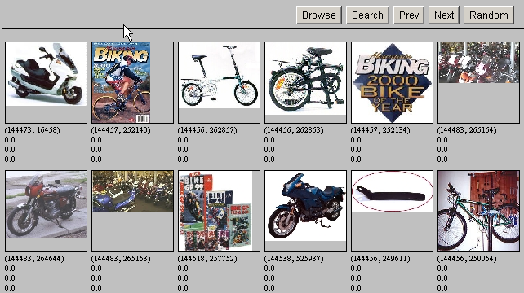
Results for Initial Query
Sec. 9.1.1

Slide 11
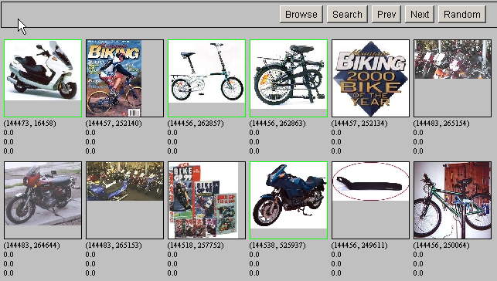
Relevance Feedback
Sec. 9.1.1

Slide 12
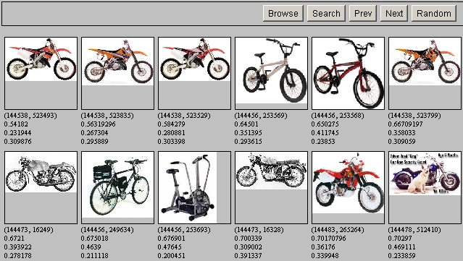
Results after Relevance Feedback
Sec. 9.1.1

Slide 13
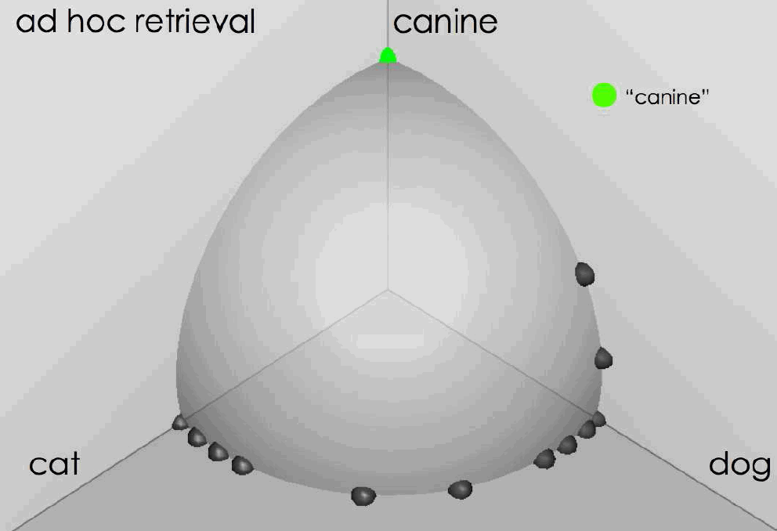
Ad hoc results for query canine source: Fernando Diaz

Slide 14
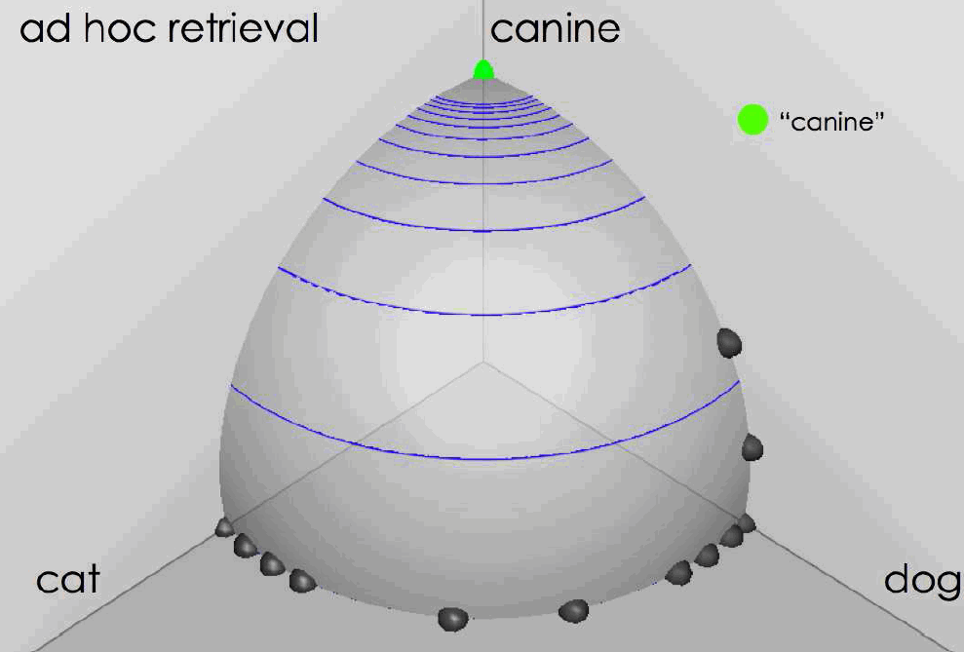
Ad hoc results for query canine
source: Fernando Diaz

Slide 15
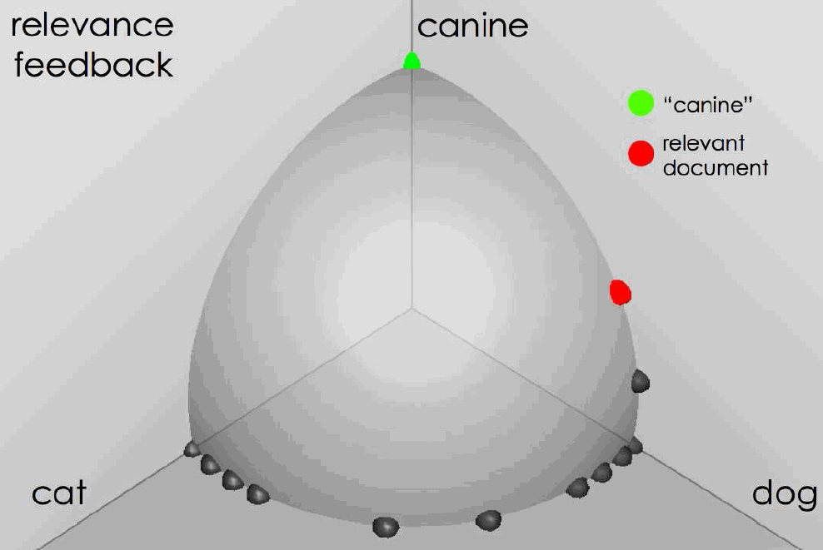
User feedback: Select what is relevant source: Fernando Diaz

Slide 16
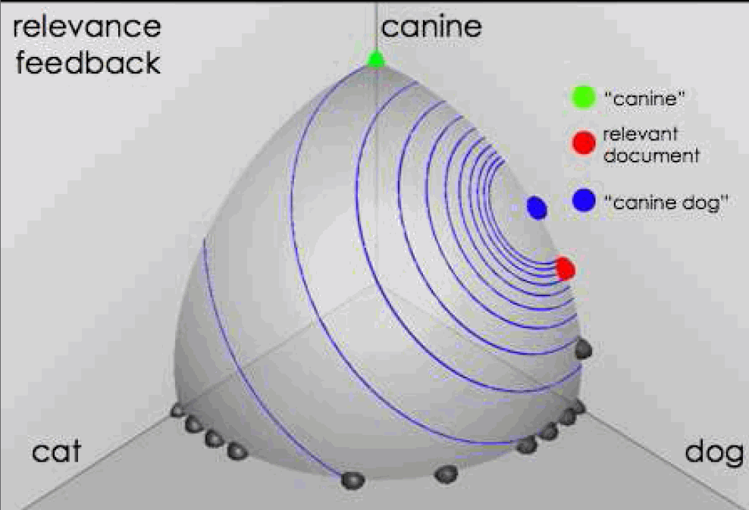
Results after relevance feedback source: Fernando Diaz

Slide 17
Initial query/results
Sec. 9.1.1
Initial query: New space satellite applications
  1. 0.539, 08/13/91, NASA Hasn’t Scrapped Imaging Spectrometer
  2. 0.533, 07/09/91, NASA Scratches Environment Gear From Satellite Plan
  3. 0.528, 04/04/90, Science Panel Backs NASA Satellite Plan, But Urges Launches of Smaller Probes
  4. 0.526, 09/09/91, A NASA Satellite Project Accomplishes Incredible Feat: Staying Within Budget
  5. 0.525, 07/24/90, Scientist Who Exposed Global Warming Proposes Satellites for Climate Research
  6. 0.524, 08/22/90, Report Provides Support for the Critics Of Using Big Satellites to Study Climate
  7. 0.516, 04/13/87, Arianespace Receives Satellite Launch Pact From Telesat Canada
  8. 0.509, 12/02/87, Telecommunications Tale of Two Companies
User then marks relevant documents with “+”
+
+
+

Slide 18
Expanded query after relevance feedback
Sec. 9.1.1
2.074 new 15.106 space
30.816 satellite 5.660 application
5.991 nasa 5.196 eos
4.196 launch 3.972 aster
3.516 instrument 3.446 arianespace
3.004 bundespost 2.806 ss
2.790 rocket 2.053 scientist
2.003 broadcast 1.172 earth
0.836 oil 0.646 measure

Slide 19
Results for expanded query
Sec. 9.1.1
2
1. 0.513, 07/09/91, NASA Scratches Environment Gear From Satellite Plan
2. 0.500, 08/13/91, NASA Hasn’t Scrapped Imaging Spectrometer
3. 0.493, 08/07/89, When the Pentagon Launches a Secret Satellite, Space Sleuths Do Some Spy Work of Their Own
4. 0.493, 07/31/89, NASA Uses ‘Warm’ Superconductors For Fast Circuit
5. 0.492, 12/02/87, Telecommunications Tale of Two Companies
6. 0.491, 07/09/91, Soviets May Adapt Parts of SS-20 Missile For Commercial Use
7. 0.490, 07/12/88, Gaping Gap: Pentagon Lags in Race To Match the Soviets In Rocket Launchers
8. 0.490, 06/14/90, Rescue of Satellite By Space Agency To Cost $90 Million
1
8

Slide 20
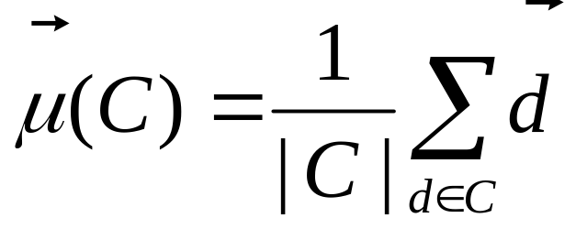
Key concept: Centroid
Sec. 9.1.1
The centroid is the center of mass of a set of points
Recall that we represent documents as points in a high-dimensional space
Definition: Centroid
where C is a set of documents

Slide 21
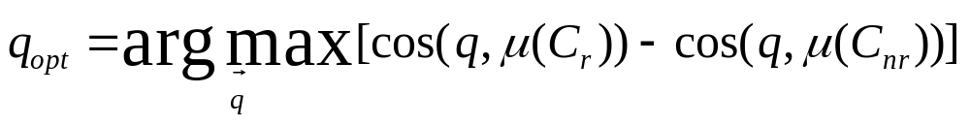
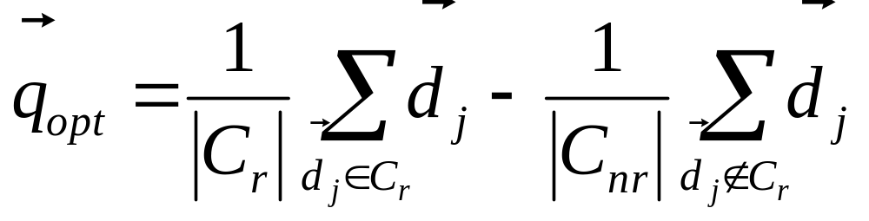
Rocchio Algorithm
Sec. 9.1.1
The Rocchio algorithm uses the vector space model to pick a relevance fed-back query
Rocchio seeks the query q_{opt} that maximizes
Tries to separate docs marked relevant and non-relevant
Problem: we don’t know the truly relevant docs

Slide 22
The Theoretically Best Query
Sec. 9.1.1
x
x
x
x
o
x
x
x
x
x
x
x
x
o
x
o
x
o
x
x
Δ
o
o
x
x
x non-relevant documents
o relevant documents
Optimal query

Slide 23
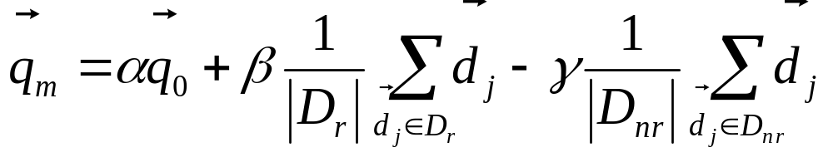
Rocchio 1971 Algorithm (SMART)
Sec. 9.1.1
Used in practice:
D_{r} = set of known relevant doc vectors
D_{nr} = set of known irrelevant doc vectors
  Different from C_{r} and C_{nr}
q_{m} = modified query vector; q₀ = original query vector;
α,β,γ: weights (hand-chosen or set empirically)
New query moves toward relevant documents and away from irrelevant documents
!
Notes:
SMART: Cornell (Salton) IR system of 1970s to 1990s.

Slide 24
Subtleties to note
Sec. 9.1.1
Tradeoff α vs. β/γ :
  If we have a lot of judged documents, we want a higher β/γ
Some weights in query vector can go negative
  Negative term weights are ignored (set to 0)

Slide 25
Relevance feedback on initial query
Sec. 9.1.1
Initial query
x
x
x
o
x
x
x
x
Δ
x
x
x
o
x
o
x
Δ
x
o
x
o
o
x
x
x
x
x known non-relevant documents
o known relevant documents
Revised query

Slide 26
Relevance Feedback in vector spaces
Sec. 9.1.1
We can modify the query based on relevance feedback and apply standard vector space model
  Use only the docs that were marked
Relevance feedback can improve recall and precision
Relevance feedback is most useful for increasing recall in situations where recall is important
  Users can be expected to review results and to take time to iterate
Notes:
Just as we modified the query in the vector space model, we can also modify it here. I’m not aware of work that uses language model based Ir this way.

Slide 27
Positive vs Negative Feedback
Sec. 9.1.1
Positive feedback is more valuable than negative feedback (so, set γ < β; e.g. γ = 0.25, β = 0.75)
Many systems only allow positive feedback (γ=0)
Why?
Notes:
It’s harder for user to give negative feedback (absence of evidence is not evidence of absence). It’s also harder to use since relevant documents can often form tight cluster, but non-relevant documents rarely do.

Slide 28
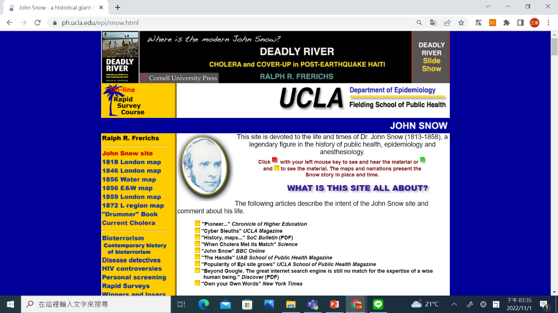
Aside: Vector Space can be Counterintuitive
Doc
“J. Snow
& Cholera”
x
x
x
x
x
x
o
x
x
x
x
x
x
x
q1
x
x
x
x
x
x
x
x
x
q1 query “cholera”
o www.ph.ucla.edu/epi/snow.html
x other documents
Query
“cholera”
Notes:
Snow document puts a lot of weird historical stuff into the vectory

Slide 29
High-dimensional Vector Spaces
The queries “cholera” and “john snow” are far from each other in vector space
How can the document “John Snow and Cholera” be close to both of them?
Our intuitions for 2- and 3-dimensional space don't work in >10,000 dimensions
3 dimensions: If a document is close to many queries, then some of these queries must be close to each other
Doesn't hold for a high-dimensional space
Notes:
Q = query, Cr = relevant documents Cnr = not relevant documents

Slide 30
Relevance Feedback: Assumptions
Sec. 9.1.3
A1: User has sufficient knowledge for initial query
A2: Relevance prototypes are “well-behaved”
  Term distribution in relevant documents will be similar
  Term distribution in non-relevant documents will be different from those in relevant documents
    Either: All relevant documents are tightly clustered around a single prototype
    Or: There are different prototypes, but they have significant vocabulary overlap
    Similarities between relevant and irrelevant documents are small

Slide 31
Violation of A1
Sec. 9.1.3
User does not have sufficient initial knowledge
Examples:
  Misspellings (Brittany Speers)
  Cross-language information retrieval (hígado)
  Mismatch of searcher’s vocabulary vs. collection vocabulary
    Cosmonaut/astronaut
    Carcinoma/cancer

Slide 32
Violation of A2
Sec. 9.1.3
There are several relevance prototypes
Examples:
  Burma/Myanmar
  Contradictory government policies
  Pop stars that worked at Burger King
Often: instances of a general concept
Good editorial content can address problem
  Report on contradictory government policies

Slide 33
Relevance Feedback: Problems
Long queries are inefficient for typical IR engine
  Long response times for user
  High cost for retrieval system
  Partial solution:
    Only reweight certain prominent terms
      Perhaps top 20 by term frequency
Users are often reluctant to provide explicit feedback
It’s often harder to understand why a particular document was retrieved after applying relevance feedback
Why?
Notes:
A long vector space query is like a disjunction: you have to consider documents with any of the words, and sum partial cosine similarities over the various terms.

Slide 34
Evaluation of relevance feedback strategies
Sec. 9.1.5
Use q₀ and compute precision-recall graph
Use q_{m} and compute precision-recall graph
  Assess on all documents in the collection
      Spectacular improvements, but … it’s cheating!
      Partly due to known relevant documents ranked higher
      Must evaluate with respect to documents not seen by user
  Use documents in residual collection (set of documents minus those assessed relevant)
      Measures usually then lower than for original query
      But a more realistic evaluation
      Relative performance can be validly compared
Empirically, one round of relevance feedback is often very useful
  Two rounds is sometimes marginally useful
Notes:
It’s lower because the results aren’t on the documents that came in top on the original query, which are the ones most likely to be relevant.

Slide 35
Evaluation of relevance feedback
Sec. 9.1.5
Second method – assess only the docs not rated by the user in the first round
  Could make relevance feedback look worse than it really is
  Can still assess relative performance of algorithms
Most satisfactory – use two collections each with their own relevance assessments
  q₀ and user feedback from first collection
  q_{m} run on second collection and measured

Slide 36
Evaluation: Caveat
Sec. 9.1.3
True evaluation of usefulness must compare to other methods taking the same amount of time
Alternative to relevance feedback: User revises and resubmits query
Users may prefer revision/resubmission to having to judge relevance of documents
There is no clear evidence that relevance feedback is the “best use” of the user’s time

Slide 37
Relevance Feedback on the Web
Sec. 9.1.4
Some search engines offer a similar/related pages feature (this is a trivial form of relevance feedback)
  Google (link-based)
  Altavista
  Stanford WebBase
But some don’t because it’s hard to explain to average user:
  Alltheweb
  Bing
  Yahoo
Excite initially had true relevance feedback, but abandoned it due to lack of use
α/β/γ ??

Slide 38
Excite Relevance Feedback
Sec. 9.1.4
Spink et al. 2000
Only about 4% of query sessions from a user used relevance feedback option
  Expressed as “More like this” link next to each result
But about 70% of users only looked at first page of results and didn’t pursue things further
  So 4% is about 1/8 of people extending search
Relevance feedback improved results about 2/3 of the time

Slide 39
Pseudo relevance feedback
Sec. 9.1.6
Pseudo-relevance feedback automates the “manual” part of true relevance feedback
Pseudo-relevance algorithm:
  Retrieve a ranked list of hits for the user’s query
  Assume that the top k documents are relevant
  Do relevance feedback (e.g., Rocchio)
Works very well on average
  But can go horribly wrong for some queries
Several iterations can cause query drift
  Why?

Slide 40
Query Expansion
Sec. 9.2.2
In relevance feedback, users give additional input (relevant/non-relevant) on documents, which is used to reweight terms in the documents
In query expansion, users give additional input (good/bad search term) on words or phrases

Slide 41

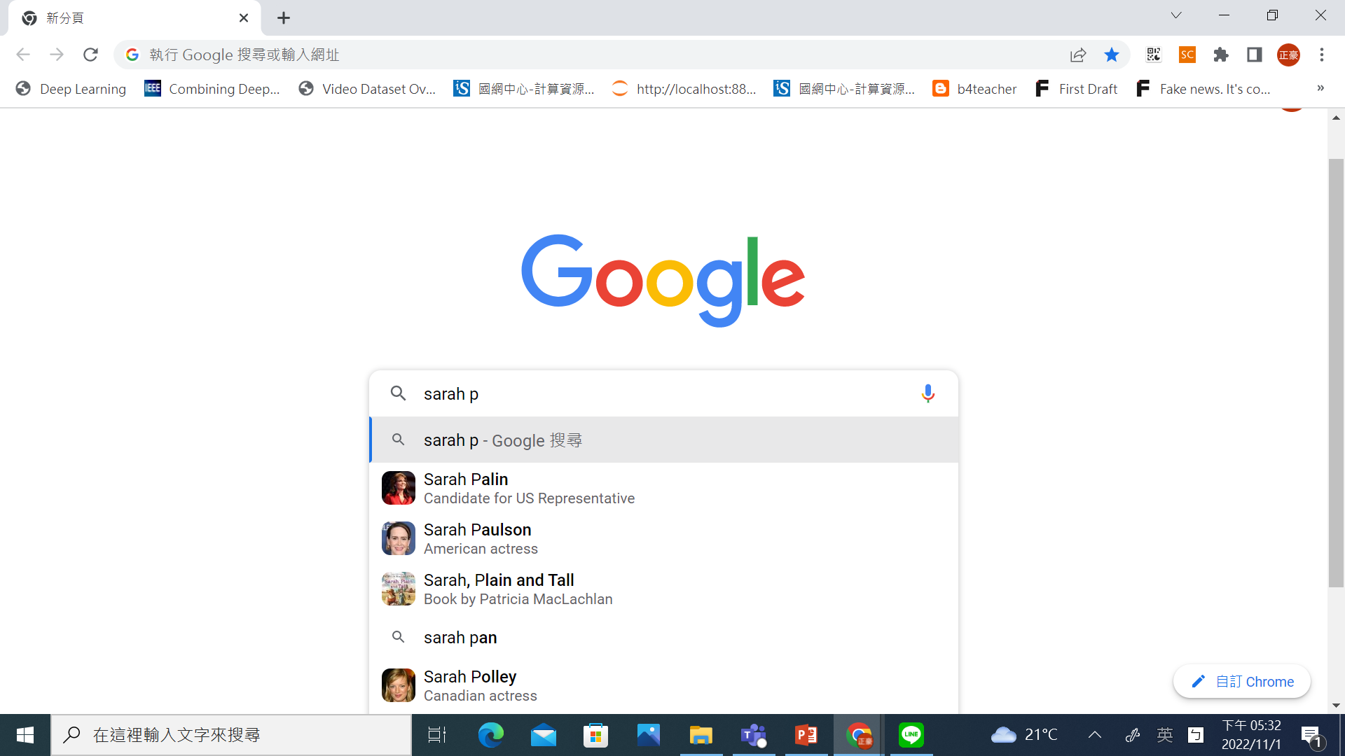
Query assist
Would you expect such a feature to increase the query
volume at a search engine?

Slide 42
How do we augment the user query?
Sec. 9.2.2
Manual thesaurus
  E.g. MedLine: physician, syn: doc, doctor, MD, medico
  Can be query rather than just synonyms
Global Analysis: (static; of all documents in collection)
  Automatically derived thesaurus
    e.g. co-occurrence statistics
  Refinements based on query log mining
    Common on the web
Local Analysis: (dynamic)
  Analysis of documents in result set

Slide 43
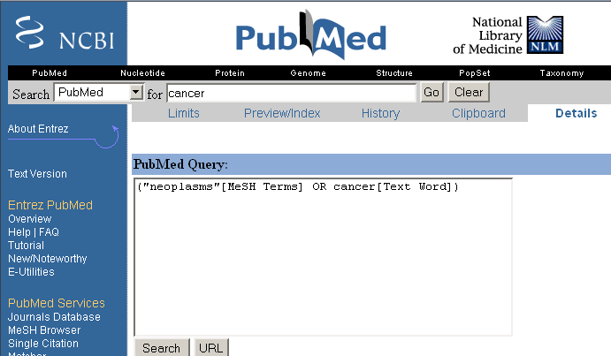
Example of manual thesaurus
Sec. 9.2.2

Slide 44
Thesaurus-based query expansion
Sec. 9.2.2
For each term, t, in a query, expand the query with synonyms and related words of t from the thesaurus
  feline → feline cat
  May weight added terms less than original query terms
Widely used in many science/engineering fields
Generally increases recall
May significantly decrease precision, particularly with ambiguous terms
  “interest rate” → “interest rate fascinate evaluate”
There is a high cost of manually producing a thesaurus
  And for updating it for scientific changes

Slide 45
Automatic Thesaurus Generation
Sec. 9.2.3
Attempt to generate a thesaurus automatically by analyzing the collection of documents
Fundamental notion: similarity between two words
Definition 1: Two words are similar if they co-occur with similar words
Definition 2: Two words are similar if they occur in a given grammatical relation with the same words
You can harvest, peel, eat, prepare, etc. apples and pears, so apples and pears must be similar
Co-occurrence based is more robust, grammatical relations are more accurate
Why?

Slide 46
Co-occurrence Thesaurus
Sec. 9.2.3
Simplest way to compute one is based on term-term similarities in C = AA^{T} where A is term-document matrix
w_{i,j} = (normalized) weight for (t_{i} ,d_{j})
For each t_{i}, pick terms with high values in C
d_{j}
N
What does C contain if A is a term-doc incidence (0/1) matrix?
t_{i}
M

Slide 47
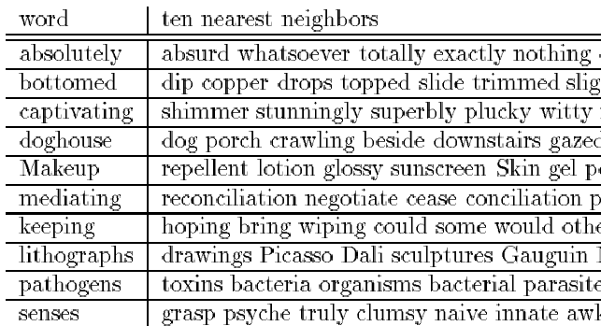
Automatic Thesaurus Generation
Example
Sec. 9.2.3

Slide 48
Automatic Thesaurus Generation
Discussion
Sec. 9.2.3
Quality of associations is usually a problem
Term ambiguity may introduce irrelevant statistically correlated terms
  “Apple computer” → “Apple red fruit computer”
Problems:
  False positives: Words deemed similar that are not
  False negatives: Words deemed dissimilar that are similar
Since terms are highly correlated anyway, expansion may not retrieve many additional documents

Slide 49
Indirect relevance feedback
On the web, DirectHit introduced a form of indirect relevance feedback
DirectHit ranked documents higher that users look at more often
  Clicked on links are assumed likely to be relevant
    Assuming the displayed summaries are good, etc.
Globally: Not necessarily user or query specific
  This is the general area of clickstream mining
Today – handled as part of machine-learned ranking
Notes:
Link analysis is kind of similar too.

Slide 50
Resources
IIR Ch 9
MG Ch. 4.7
MIR Ch. 5.2 – 5.4

