Slide 1
IR Homework #2
By J. H. Wang
Oct. 28, 2026

Slide 2
Programming Exercise #2:
Query Processing and Searching
Goal: to search documents that are relevant to a given user query
Input: a query (and the inverted index from HW#1)
Output: a ranked list of search results
  (details to be described later)

Slide 3
Input: User Query and Inverted Index
Simple queries
  Single keywords
    Ex: Microsoft, airplanes, …
  Free texts
    Ex: United States government, non-profit organization, …
  Simple Boolean search
    Ex: open source AND Linux, software engineer OR project manager, …
Inverted Index
  As generated from the ClueWeb09 collection in HW#1

Slide 4
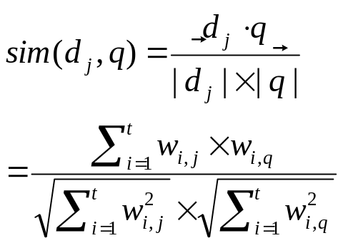
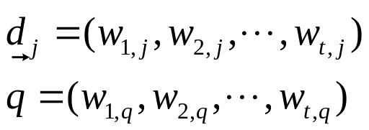
Output: Ranked Search Results
A ranked list of search results
  Ranking: vector space model
    Term weighting scheme: TF-IDF
    Similarity estimation: cosine similarity between query and document vectors
w_{ij} = (1+ log tf_{ij}) * log (N/df_{i})

Slide 5
Example Output
E.g.:
  Query from the command line:
    cmd> Hong Kong business
  Result: <doc#> <similarity score>
    61 0.872
    35 0.643
    248 0.235
    190 0.176
    …

Slide 6
Optional Features
Since we have positional information in our index, it’s possible to implement optional functions such as:
  Complex queries: phrase, wildcard, substring, proximity search, combinations of Boolean operators, … (Ch.2 & 3)
  Query processing: spell-correction, phonetic correction, … (Ch.3)
  Different term weighting schemes: variants of TF-IDF, … (Ch.6)
  In-exact top-k retrieval: index elimination, champion lists, impact-ordering, tiered index, … (Ch.7)
  Better user interface for search: Web or App, highlighting query terms, …

Slide 7
Submission
Your submission *must* include
  The source code (and your configurations of extra libraries)
    For utilizing open source tools, please also submit your source code on calling the APIs or libraries
  The output: a ranked list of search results
  A one-page documentation including
    Major features: ex: high efficiency, low storage, multiple input formats, huge corpus, …
    Major difficulties encountered
    Special requirements for execution environments (ex: Java Runtime Environment, special compilers, library functions, …)
    Team members list: the names and the responsible parts of each individual member *must* be clearly identified
Due: three weeks (Nov. 18, 2026)

Slide 8
Submission Instructions
Source codes and related documentation must be submitted directly on the submission site:
  Submission site: iSchool+
  Preparing your submission file: as one single compressed file
    Name your file according to your ID such as <ID>_HW2.zip.
    Remember to specify the names of your team members and student ID in the files and documentation
  If you cannot successfully submit your work, please contact with the TA (Ms.Hsu & Ms.Liao @ R1424, Technology Building)

Slide 9
Evaluation
Minimum requirement: correctness for simple queries
  Selected queries from the ClueWeb09 Test Collection will be submitted to your program, and the ranked list will be checked for correctness
Optional features will be counted as bonus
  Variety in query types, weighting schemes, efficiency of scoring and ranking, …
You might be required to demo if the program submitted was unable to compile or run by the TA

Slide 10
Any Questions or Comments?

