Slide 1

Recommender Systems: Latent Factor Models
Note to other teachers and users of these slides: We would be delighted if you found this our material useful in giving your own lectures. Feel free to use these slides verbatim, or to modify them to fit your own needs. If you make use of a significant portion of these slides in your own lecture, please include this message, or a link to our web site: http://www.mmds.org
Slides modified from Mining of Massive Datasets
Jure Leskovec, Anand Rajaraman, Jeff Ullman Stanford University
http://www.mmds.org

Slide 2
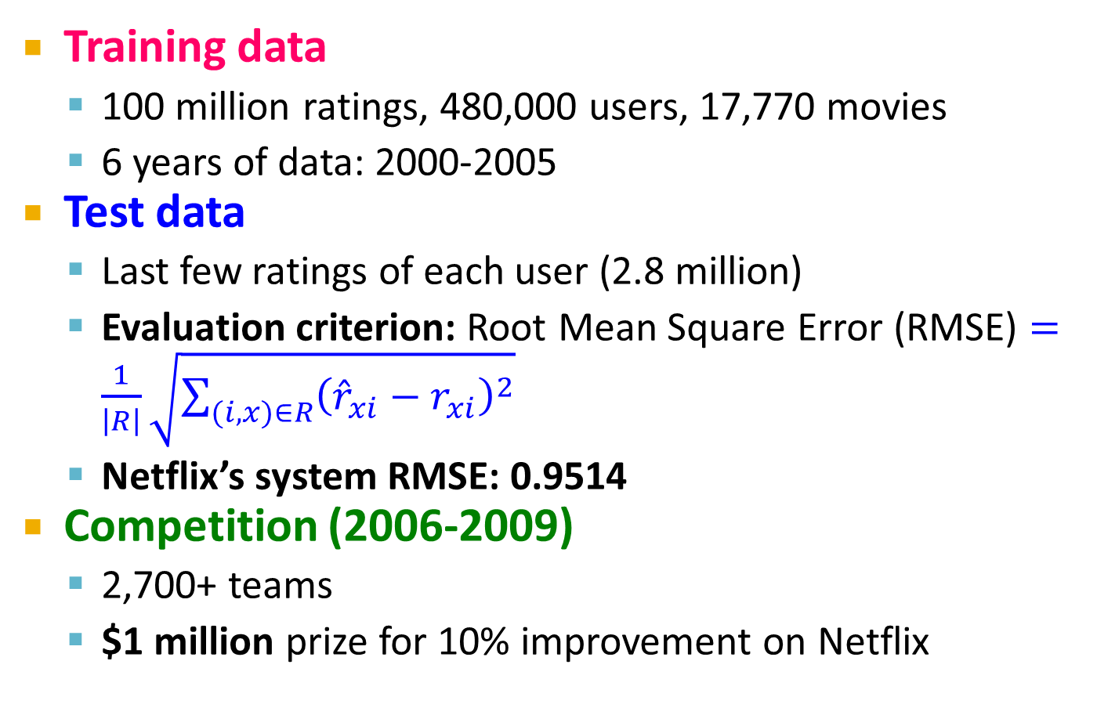
The Netflix Prize
Training data
100 million ratings, 480,000 users, 17,770 movies
6 years of data: 2000-2005
Test data
Last few ratings of each user (2.8 million)
Evaluation criterion: Root Mean Square Error (RMSE) $=\frac{1}{\left|R\right|}\sqrt{\sum_{(i,x)∈R}{{\left({\hat{r}}_{xi}−r_{xi}\right)}^{2}}}$
Netflix’s system RMSE: 0.9514
Competition (2006-2009)
2,700+ teams
$1 million prize for 10% improvement on Netflix

Slide 3
The Netflix Utility Matrix R
480,000 users
Matrix R
1 | 3 | 4
 | 3 | 5 |  |  | 5
 |  | 4 | 5 |  | 5
 |  | 3
 |  | 3
2 |  |  | 2 |  | 2
 |  |  |  | 5
 | 2 | 1 |  |  | 1
 | 3 |  |  | 3
1
17,700 movies

Slide 4

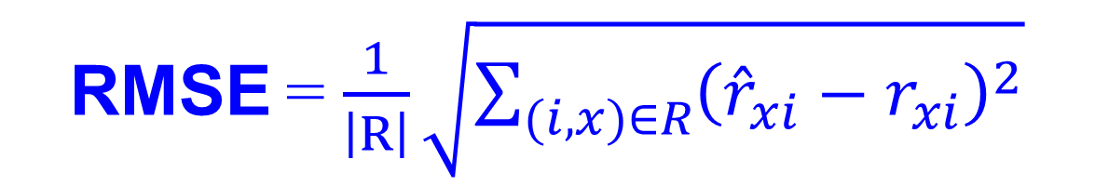
Utility Matrix R: Evaluation
480,000 users
Matrix R
1 | 3 | 4
 | 3 | 5 |  |  | 5
 |  | 4 | 5 |  | 5
 |  | 3
 |  | 3
2 |  |  | ? |  | ?
 |  |  |  | ?
 | 2 | 1 |  |  | ?
 | 3 |  |  | ?
1
$$r_{3,6}$$
17,700 movies
Training Data Set
Test Data Set
True rating of user x on item i
RMSE = $\frac{1}{\left|R\right|}\sqrt{\sum_{(i,x)∈R}{{\left({\hat{r}}_{xi}−r_{xi}\right)}^{2}}}$
Predicted rating

Slide 5
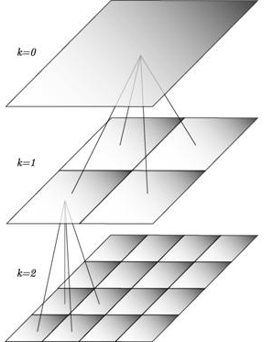
BellKor Recommender System
The winner of the Netflix Challenge!
Multi-scale modeling of the data: Combine top level, “regional” modeling of the data, with a refined, local view:
Global:
Overall deviations of users/movies
Factorization:
Addressing “regional” effects
Collaborative filtering:
Extract local patterns
Global effects
Factorization
Collaborative filtering

Slide 6

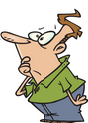

Modeling Local & Global Effects
Global:
Mean movie rating: 3.7 stars
The Sixth Sense is 0.5 stars above avg.
Joe rates 0.2 stars below avg. ⇒ Baseline estimation: Joe will rate The Sixth Sense 4 stars
Local neighborhood (CF/NN):
Joe didn’t like related movie Signs
⇒ Final estimate: Joe will rate The Sixth Sense 3.8 stars

Slide 7
Recap: Collaborative Filtering (CF)
Earliest and most popular collaborative filtering method
Derive unknown ratings from those of “similar” movies (item-item variant)
Define similarity measure s_{ij} of items i and j
Select k-nearest neighbors, compute the rating
N(i; x): items most similar to i that were rated by x
s_{ij}… similarity of items i and j
r_{xj}…rating of user x on item j
N(i;x)… set of items similar to item i that were rated by x

Slide 8

Modeling Local & Global Effects
In practice we get better estimates if we model deviations:
^
baseline estimate for r_{xi}
Problems/Issues:
1) Similarity measures are “arbitrary” 2) Pairwise similarities neglect interdependencies among users
3) Taking a weighted average can be restricting
Solution: Instead of s_{ij} use w_{ij} that we estimate directly from data
$$b_{xi}=μ+b_{x}+b_{i}$$
μ = overall mean rating
b_{x} = rating deviation of user x
= (avg. rating of user x) – μ
b_{i} = (avg. rating of movie i) – μ

Slide 9
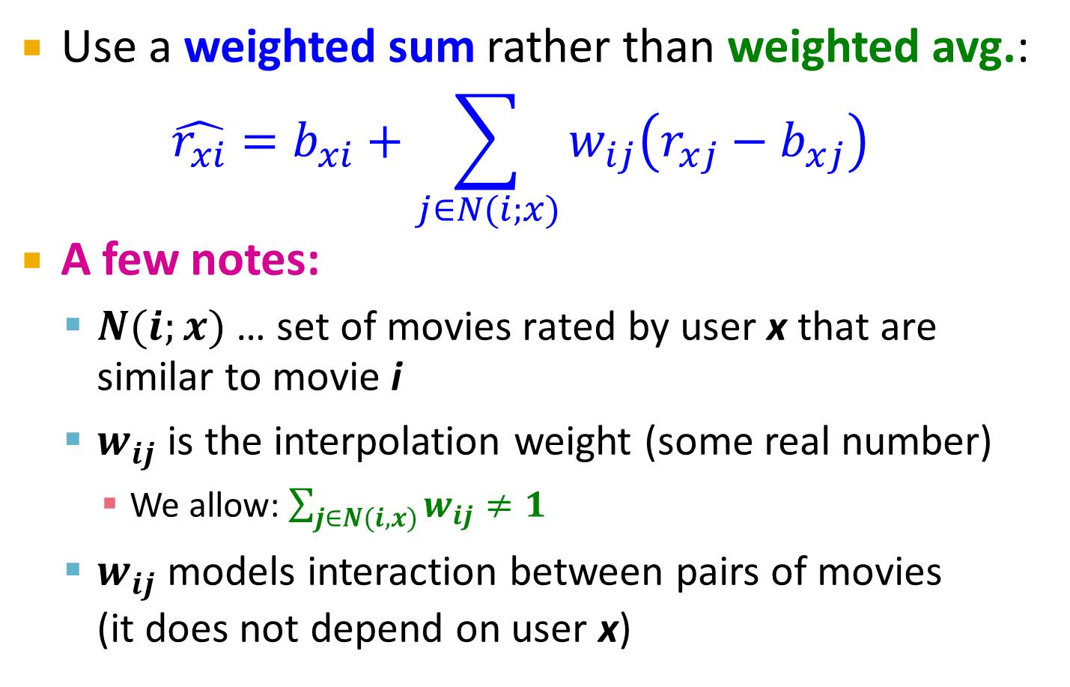
Idea: Interpolation Weights w_{ij}
Use a weighted sum rather than weighted avg.:
$$\hat{r_{xi}}=b_{xi}+\sum_{j∈N(i;x)}{w_{ij}\left(r_{xj}−b_{xj}\right)}$$
A few notes:
$N(i;x)\text{ … }\text{set} \text{of} \text{movies} \text{rated} \text{by} \text{user} \text{x} \text{that} \text{are} \text{similar} \text{to} \text{movie} \text{i}$
$w_{ij}$ is the interpolation weight (some real number)
We allow: $\sum_{j∈N(i,x)}{w_{ij}≠1}$
$w_{ij}$ models interaction between pairs of movies (it does not depend on user x)

Slide 10
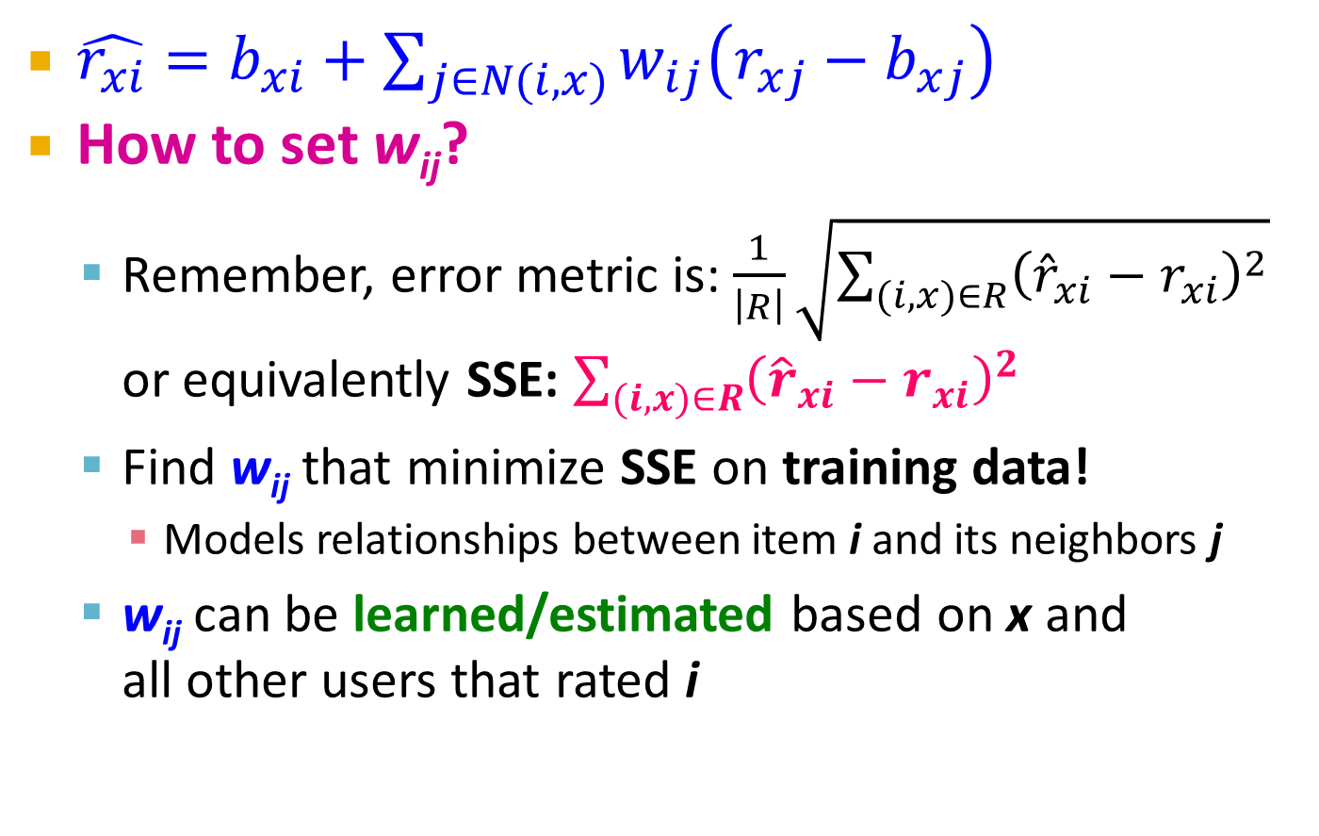
Idea: Interpolation Weights w_{ij}
$\hat{r_{xi}}=b_{xi}+\sum_{j∈N(i,x)}{w_{ij}\left(r_{xj}−b_{xj}\right)}$
How to set w_{ij}?
Remember, error metric is: $\frac{1}{\left|R\right|}\sqrt{\sum_{(i,x)∈R}{{\left({\hat{r}}_{xi}−r_{xi}\right)}^{2}}}$ or equivalently SSE: $\sum_{(i,x)∈R}{{\left({\hat{r}}_{xi}−r_{xi}\right)}^{2}}$
Find w_{ij} that minimize SSE on training data!
Models relationships between item i and its neighbors j
w_{ij} can be learned/estimated based on x and all other users that rated i
Why is this a good idea?

Slide 11
Recommendations via Optimization
1 | 3 | 4
 | 3 | 5 |  |  | 5
 |  | 4 | 5 |  | 5
 |  | 3
 |  | 3
2 |  |  | 2 |  | 2
 |  |  |  | 5
 | 2 | 1 |  |  | 1
 | 3 |  |  | 3
1
Goal: Make good recommendations
Quantify goodness using RMSE: Lower RMSE ⇒ better recommendations
Want to make good recommendations on items that user has not yet seen -> Can’t really do this!
Let’s set build a system such that it works well on known (user, item) ratings And hope the system will also predict well the unknown ratings

Slide 12
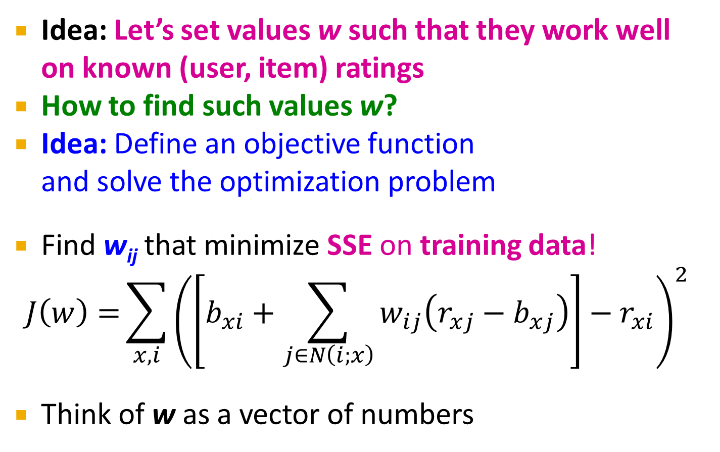
Recommendations via Optimization
Idea: Let’s set values w such that they work well on known (user, item) ratings
How to find such values w?
Idea: Define an objective function and solve the optimization problem
Find w_{ij} that minimize SSE on training data!
$$J\left(w\right)={\sum_{x,i}{{\left(\left[b_{xi}+\sum_{j∈N\left(i;x\right)}{w_{ij}\left(r_{xj}−b_{xj}\right)}\right]−r_{xi}\right)}^{2}}}$$
Think of w as a vector of numbers
True rating
Predicted rating

Slide 13

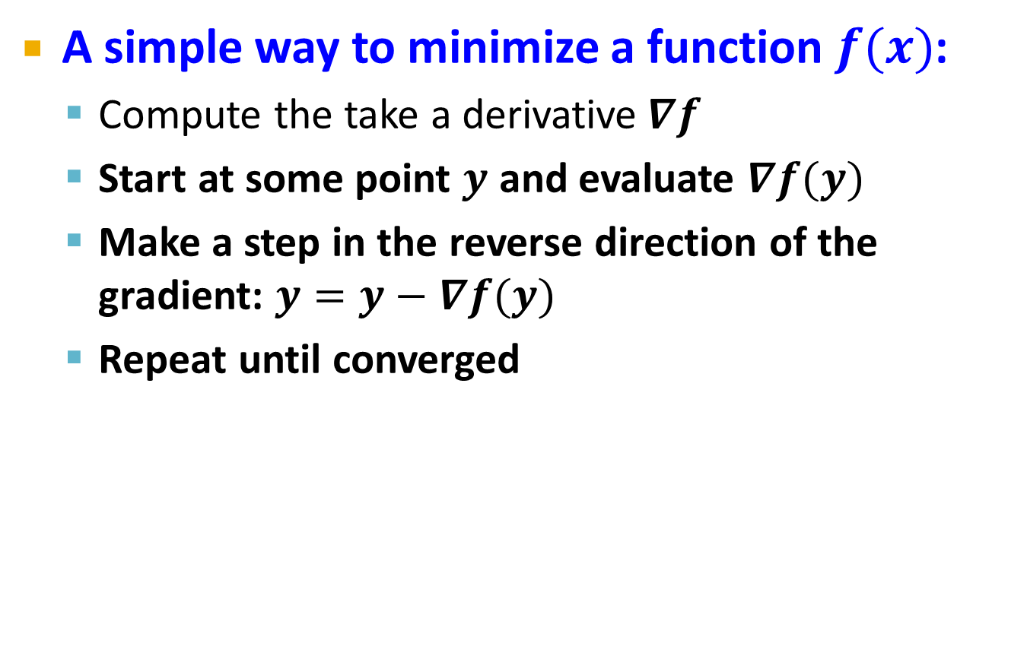


Detour: Minimizing a function
A simple way to minimize a function $f(x)$:
Compute the take a derivative$∇f$
Start at some point $y$ and evaluate $∇f(y)$
Make a step in the reverse direction of the gradient: $y=y−∇f(y)$
Repeat until converged
$$f$$
$$f\left(y\right)+∇f(y)$$
$$y$$

Slide 14
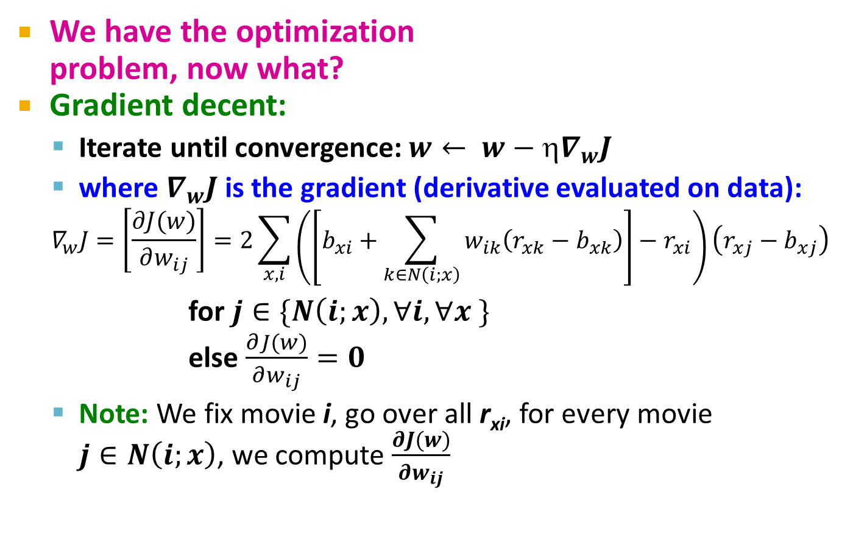
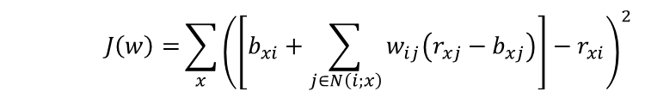
Interpolation Weights
We have the optimization problem, now what?
Gradient decent:
Iterate until convergence: $w← w−∇_{w}J$
where $∇_{w}J$is the gradient (derivative evaluated on data):
$$∇_{w}J=\left[\frac{∂J(w)}{∂w_{ij}}\right]=2\sum_{x,i}{\left(\left[b_{xi}+\sum_{k∈N\left(i;x\right)}{w_{ik}\left(r_{xk}−b_{xk}\right)}\right]−r_{xi}\right)\left(r_{xj}−b_{xj}\right)}$$ for $j∈\{N\left(i;x\right), ∀i,∀x \}$ else $\frac{∂J(w)}{∂w_{ij}}=0$
Note: We fix movie i, go over all r_{xi}, for every movie $j∈N\left(i;x\right)$, we compute $\frac{∂J(w)}{∂w_{ij}}$
$$J\left(w\right)={\sum_{x}{{\left(\left[b_{xi}+\sum_{j∈N\left(i;x\right)}{w_{ij}\left(r_{xj}−b_{xj}\right)}\right]−r_{xi}\right)}^{2}}}$$
η … learning rate
while |w_{new} - w_{old}| > ε:
w_{old} = w_{new}
w_{new} = w_{old} - η ·∇w_{old}

Slide 15
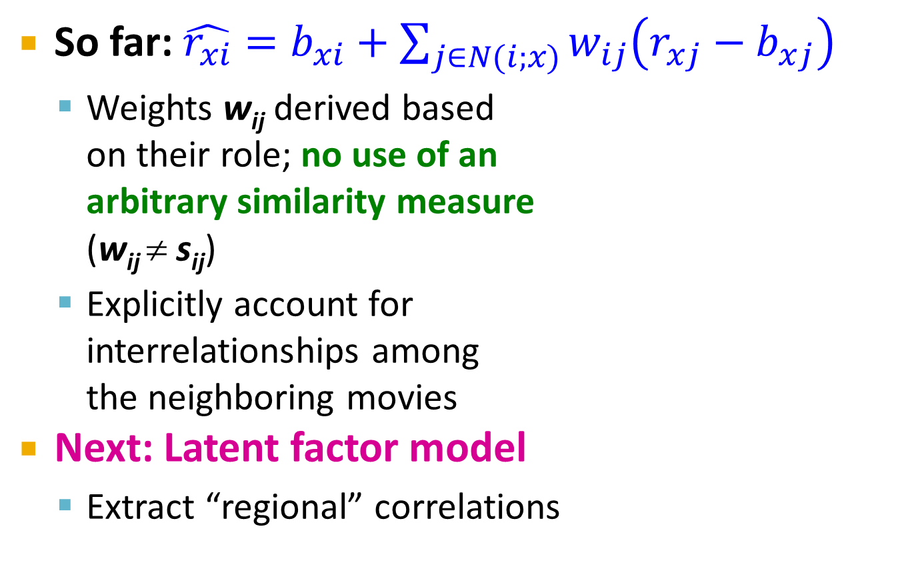
Interpolation Weights
So far: $\hat{r_{xi}}=b_{xi}+\sum_{j∈N(i;x)}{w_{ij}\left(r_{xj}−b_{xj}\right)}$
Weights w_{ij} derived based on their role; no use of an arbitrary similarity measure (w_{ij} ≠ s_{ij})
Explicitly account for interrelationships among the neighboring movies
Next: Latent factor model
Extract “regional” correlations
Global effects
Factorization
CF/NN

Slide 16
Performance of Various Methods
Global average: 1.1296
User average: 1.0651
Movie average: 1.0533
Netflix: 0.9514
Basic Collaborative filtering: 0.94
CF+Biases+learned weights: 0.91
Grand Prize: 0.8563

Slide 17






Latent Factor Models (e.g., SVD)
Serious
Braveheart
The Color Purple
Amadeus
Lethal Weapon
Sense and Sensibility
Geared towards
females
Ocean’s 11
Geared towards
males
The Lion King
The Princess
Diaries
Independence Day
Dumb and Dumber
Funny

Slide 18
Latent Factor Models
SVD: A = U Σ V^{T}
“SVD” on Netflix data: R ≈ Q · P^{T}
For now let’s assume we can approximate the rating matrix R as a product of “thin” Q · P^{T}
R has missing entries but let’s ignore that for now!
Basically, we will want the reconstruction error to be small on known ratings and we don’t care about the values on the missing ones
users
factors
 | 4 |  | 5 |  |  | 5 |  |  | 3 |  | 1
3 | 1 | 2 |  |  | 4 |  |  | 4 | 5
 | 5 | 3 | 4 |  | 3 |  | 2 | 1 |  | 4 | 2
 | 2 |  |  | 4 |  |  | 5 |  | 4 | 2
5 | 2 |  |  |  |  | 2 | 4 | 3 | 4
 | 4 |  |  | 2 |  |  | 3 |  | 3 |  | 1
.2 | -.4 | .1
.5 | .6 | -.5
.5 | .3 | -.2
.3 | 2.1 | 1.1
-2 | 2.1 | -.7
.3 | .7 | -1
users
items
≈
-.9 | 2.4 | 1.4 | .3 | -.4 | .8 | -.5 | -2 | .5 | .3 | -.2 | 1.1
1.3 | -.1 | 1.2 | -.7 | 2.9 | 1.4 | -1 | .3 | 1.4 | .5 | .7 | -.8
.1 | -.6 | .7 | .8 | .4 | -.3 | .9 | 2.4 | 1.7 | .6 | -.4 | 2.1
factors
items
P^{T}
R
Q
Notes:
Difference with SVD:
-- can multiply sigma with V and get the UV decomposition
-- SVD will count errors also on missing entries (zeros)
-- SVD insists U,V are orthonormal. We do not want this here, we do not care, we just want something that works

Slide 19

Ratings as Products of Factors
How to estimate the missing rating of user x for item i?
$${\hat{r}}_{xi}=q_{i}⋅p_{x}^{} \\ =\sum_{f}{q_{if}⋅p_{xf}}$$
users
 | 4 |  | 5 |  |  | 5 |  |  | 3 |  | 1
3 | 1 | 2 |  |  | 4 |  |  | 4 | 5
 | 5 | 3 | 4 |  | 3 |  | 2 | 1 |  | 4 | 2
 | 2 |  |  | 4 |  |  | 5 |  | 4 | 2
5 | 2 |  |  |  |  | 2 | 4 | 3 | 4
 | 4 |  |  | 2 |  |  | 3 |  | 3 |  | 1
?
items
≈
q_{i} = row i of Q
p_{x} = column x of P^{T}
.2 | -.4 | .1
.5 | .6 | -.5
.5 | .3 | -.2
.3 | 2.1 | 1.1
-2 | 2.1 | -.7
.3 | .7 | -1
users
-.9 | 2.4 | 1.4 | .3 | -.4 | .8 | -.5 | -2 | .5 | .3 | -.2 | 1.1
1.3 | -.1 | 1.2 | -.7 | 2.9 | 1.4 | -1 | .3 | 1.4 | .5 | .7 | -.8
.1 | -.6 | .7 | .8 | .4 | -.3 | .9 | 2.4 | 1.7 | .6 | -.4 | 2.1
items
factors
P^{T}
factors
Q

Slide 20
Ratings as Products of Factors
How to estimate the missing rating of user x for item i?
$${\hat{r}}_{xi}=q_{i}⋅p_{x}^{} \\ =\sum_{f}{q_{if}⋅p_{xf}}$$
users
 | 4 |  | 5 |  |  | 5 |  |  | 3 |  | 1
3 | 1 | 2 |  |  | 4 |  |  | 4 | 5
 | 5 | 3 | 4 |  | 3 |  | 2 | 1 |  | 4 | 2
 | 2 |  |  | 4 |  |  | 5 |  | 4 | 2
5 | 2 |  |  |  |  | 2 | 4 | 3 | 4
 | 4 |  |  | 2 |  |  | 3 |  | 3 |  | 1
?
items
≈
q_{i} = row i of Q
p_{x} = column x of P^{T}
.2 | -.4 | .1
.5 | .6 | -.5
.5 | .3 | -.2
.3 | 2.1 | 1.1
-2 | 2.1 | -.7
.3 | .7 | -1
users
-.9 | 2.4 | 1.4 | .3 | -.4 | .8 | -.5 | -2 | .5 | .3 | -.2 | 1.1
1.3 | -.1 | 1.2 | -.7 | 2.9 | 1.4 | -1 | .3 | 1.4 | .5 | .7 | -.8
.1 | -.6 | .7 | .8 | .4 | -.3 | .9 | 2.4 | 1.7 | .6 | -.4 | 2.1
items
factors
P^{T}
factors
Q

Slide 21
Ratings as Products of Factors
How to estimate the missing rating of user x for item i?
$${\hat{r}}_{xi}=q_{i}⋅p_{x}^{} \\ =\sum_{f}{q_{if}⋅p_{xf}}$$
users
 | 4 |  | 5 |  |  | 5 |  |  | 3 |  | 1
3 | 1 | 2 |  |  | 4 |  |  | 4 | 5
 | 5 | 3 | 4 |  | 3 |  | 2 | 1 |  | 4 | 2
 | 2 |  |  | 4 |  |  | 5 |  | 4 | 2
5 | 2 |  |  |  |  | 2 | 4 | 3 | 4
 | 4 |  |  | 2 |  |  | 3 |  | 3 |  | 1
2.4
?
items
≈
q_{i} = row i of Q
p_{x} = column x of P^{T}
.2 | -.4 | .1
.5 | .6 | -.5
.5 | .3 | -.2
.3 | 2.1 | 1.1
-2 | 2.1 | -.7
.3 | .7 | -1
users
-.9 | 2.4 | 1.4 | .3 | -.4 | .8 | -.5 | -2 | .5 | .3 | -.2 | 1.1
1.3 | -.1 | 1.2 | -.7 | 2.9 | 1.4 | -1 | .3 | 1.4 | .5 | .7 | -.8
.1 | -.6 | .7 | .8 | .4 | -.3 | .9 | 2.4 | 1.7 | .6 | -.4 | 2.1
items
f factors
P^{T}
f factors
Q

Slide 22
Latent Factor Models
Serious
Braveheart
The Color Purple
Amadeus
Lethal Weapon
Sense and Sensibility
Geared towards
females
Ocean’s 11
Factor 1
Geared towards
males
The Lion King
The Princess
Diaries
Factor 2
Independence Day
Dumb and Dumber
Funny
Notes:
This graph shows a hypothetical layout of movies in two dimensions.
In the example, the horizontal dimension contrasts “chick flicks” from “macho movies”, while the vertical dimension measures the seriousness of the movie.
In a real application of SVD, an algorithm would determine the layout, so it night not be easy to label the axes.
Feel free to disagree with my placement of the various movies.

Slide 23
Latent Factor Models
Serious
Braveheart
The Color Purple
Amadeus
Lethal Weapon
Sense and Sensibility
Geared towards
females
Ocean’s 11
Factor 1
Geared towards
males
The Lion King
The Princess
Diaries
Factor 2
Independence Day
Dumb and Dumber
Funny
Notes:
Users fall into the same space as movies, where a user’s position in a dimension reflects the user’s preference for (or against) movies that score high on that dimension.
For example, BLUE tends to like male-oriented movies, but dislikes serious movies. Therefore, we would expect him to love “Dumb and Dumber” and hate “The Color Purple”.
Note that these two dimensions do not characterize Dave’s (DOCTOR) interests very well; additional dimensions would be needed.

Slide 24

Recap: SVD
n
n
Remember SVD:
A: Input data matrix
U: Left singular vecs
V: Right singular vecs
Σ: Singular values
So in our case: “SVD” on Netflix data: R ≈ Q · P^{T} A = R, Q = U, P^{T} = Σ V^{T}
A
≈
Σ
V^{T}
m
m
U
$${\hat{r}}_{xi}=q_{i}⋅p_{x}^{}$$
Notes:
Difference with SVD:
-- can multiply sigma with V and get the UV decomposition
-- SVD will count errors also on missing entries (zeros)
-- SVD insists U,V are orthonormal. We do not want this here, we do not care, we just want something that works

Slide 25
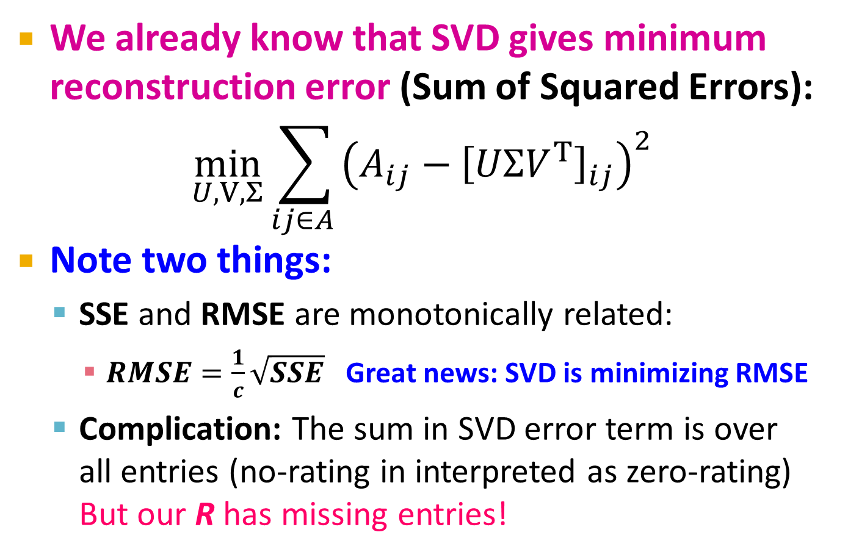
SVD: More good stuff
We already know that SVD gives minimum reconstruction error (Sum of Squared Errors):
$$\min_{U,V, Σ}\sum_{ij∈A }{{\left(A_{ij}−{\left[UΣV^{T}\right]}_{ij}\right)}^{2}}$$
Note two things:
SSE and RMSE are monotonically related:
$RMSE=\frac{1}{c}\sqrt{SSE}$ Great news: SVD is minimizing RMSE
Complication: The sum in SVD error term is over all entries (no-rating in interpreted as zero-rating) But our R has missing entries!
Notes:
Difference with SVD:
-- can multiply sigma with V and get the UV decomposition
-- SVD will count errors also on missing entries (zeros)
-- SVD insists U,V are orthonormal. We do not want this here, we do not care, we just want something that works

Slide 26

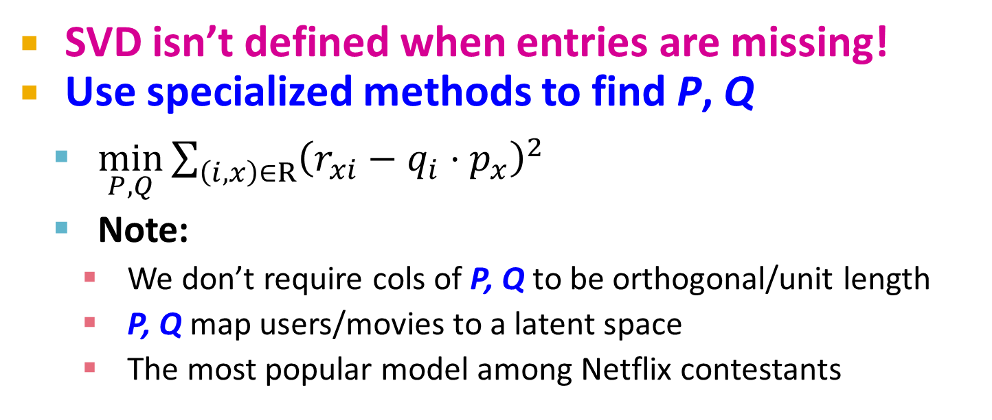
Latent Factor Models
users
factors
 | 4 |  | 5 |  |  | 5 |  |  | 3 |  | 1
3 | 1 | 2 |  |  | 4 |  |  | 4 | 5
 | 5 | 3 | 4 |  | 3 |  | 2 | 1 |  | 4 | 2
 | 2 |  |  | 4 |  |  | 5 |  | 4 | 2
5 | 2 |  |  |  |  | 2 | 4 | 3 | 4
 | 4 |  |  | 2 |  |  | 3 |  | 3 |  | 1
.2 | -.4 | .1
.5 | .6 | -.5
.5 | .3 | -.2
.3 | 2.1 | 1.1
-2 | 2.1 | -.7
.3 | .7 | -1
users
items
≈
-.9 | 2.4 | 1.4 | .3 | -.4 | .8 | -.5 | -2 | .5 | .3 | -.2 | 1.1
1.3 | -.1 | 1.2 | -.7 | 2.9 | 1.4 | -1 | .3 | 1.4 | .5 | .7 | -.8
.1 | -.6 | .7 | .8 | .4 | -.3 | .9 | 2.4 | 1.7 | .6 | -.4 | 2.1
factors
items
P^{T}
Q
SVD isn’t defined when entries are missing!
Use specialized methods to find P, Q
$\min_{P,Q}\sum_{\left(i,x\right)∈R}{{\left(r_{xi}−q_{i}⋅p_{x}^{}\right)}^{2}}$
Note:
We don’t require cols of P, Q to be orthogonal/unit length
P, Q map users/movies to a latent space
The most popular model among Netflix contestants
$${\hat{r}}_{xi}=q_{i}⋅p_{x}^{}$$

Slide 27
Finding the Latent Factors

Slide 28

Latent Factor Models
Our goal is to find P and Q such tat:
$$\min_{P,Q}\sum_{\left(i,x\right)∈R}{{\left(r_{xi}−q_{i}⋅p_{x}^{}\right)}^{2}}$$
users
factors
 | 4 |  | 5 |  |  | 5 |  |  | 3 |  | 1
3 | 1 | 2 |  |  | 4 |  |  | 4 | 5
 | 5 | 3 | 4 |  | 3 |  | 2 | 1 |  | 4 | 2
 | 2 |  |  | 4 |  |  | 5 |  | 4 | 2
5 | 2 |  |  |  |  | 2 | 4 | 3 | 4
 | 4 |  |  | 2 |  |  | 3 |  | 3 |  | 1
.2 | -.4 | .1
.5 | .6 | -.5
.5 | .3 | -.2
.3 | 2.1 | 1.1
-2 | 2.1 | -.7
.3 | .7 | -1
users
≈
-.9 | 2.4 | 1.4 | .3 | -.4 | .8 | -.5 | -2 | .5 | .3 | -.2 | 1.1
1.3 | -.1 | 1.2 | -.7 | 2.9 | 1.4 | -1 | .3 | 1.4 | .5 | .7 | -.8
.1 | -.6 | .7 | .8 | .4 | -.3 | .9 | 2.4 | 1.7 | .6 | -.4 | 2.1
factors
items
items
P^{T}
Q

Slide 29
Back to Our Problem
Want to minimize SSE for unseen test data
Idea: Minimize SSE on training data
Want large k (# of factors) to capture all the signals
But, SSE on test data begins to rise for k > 2
This is a classical example of overfitting:
With too much freedom (too many free parameters) the model starts fitting noise
That is it fits too well the training data and thus not generalizing well to unseen test data
1 | 3 | 4
 | 3 | 5 |  |  | 5
 |  | 4 | 5 |  | 5
 |  | 3
 |  | 3
2 |  |  | ? |  | ?
 |  |  |  | ?
 | 2 | 1 |  |  | ?
 | 3 |  |  | ?
1

Slide 30
Dealing with Missing Entries
1 | 3 | 4
 | 3 | 5 |  |  | 5
 |  | 4 | 5 |  | 5
 |  | 3
 |  | 3
2 |  |  | ? |  | ?
 |  |  |  | ?
 | 2 | 1 |  |  | ?
 | 3 |  |  | ?
1
To solve overfitting we introduce regularization:
Allow rich model where there are sufficient data
Shrink aggressively where data are scarce
“error”
“length”
λ₁, λ₂ … user set regularization parameters
Note: We do not care about the “raw” value of the objective function, but we care in P,Q that achieve the minimum of the objective

Slide 31
The Effect of Regularization
serious
Braveheart
The Color Purple
Amadeus
Lethal Weapon
Sense and Sensibility
Geared towards
females
Ocean’s 11
Geared towards
males
Factor 1
The Princess
Diaries
The Lion King
Dumb and Dumber
Independence Day
Factor 2
min_{factors} “error” + λ “length”
funny
Notes:
Consider Gus.
This slide shows the position for Gus that best explains his ratings for the Training data—i.e., that minimizes his sum of squared errors.
If Gus has rated hundreds of movies, we could probably be confident of that we have estimated his true preferences accurately.
But what if Gus has only rated a few movies—say the ten on this slide? We should not be so confident.

Slide 32
The Effect of Regularization
serious
Braveheart
The Color Purple
Amadeus
Lethal Weapon
Sense and Sensibility
Geared towards
females
Ocean’s 11
Geared towards
males
Factor 1
The Princess
Diaries
The Lion King
Dumb and Dumber
Independence Day
Factor 2
min_{factors} “error” + λ “length”
funny
Notes:
We hedge our bet by tethering Gus to origin with an elastic cord that tries to pull Gus back towards the origin.
If Gus has rated hundreds of movies, he stays about where the data places him.

Slide 33
The Effect of Regularization
serious
Braveheart
The Color Purple
Amadeus
Lethal Weapon
Sense and Sensibility
Geared towards
females
Ocean’s 11
Geared towards
males
Factor 1
The Princess
Diaries
The Lion King
Dumb and Dumber
Independence Day
Factor 2
min_{factors} “error” + λ “length”
funny
Notes:
But if he has hated only a few dozen, he is pulled back towards the origin.

Slide 34
The Effect of Regularization
serious
Braveheart
The Color Purple
Amadeus
Lethal Weapon
Sense and Sensibility
Geared towards
females
Ocean’s 11
Geared towards
males
Factor 1
The Princess
Diaries
The Lion King
Dumb and Dumber
Independence Day
Factor 2
min_{factors} “error” + λ “length”
funny
Notes:
And if he has rated only a handful, he is pulled even further.

Slide 35
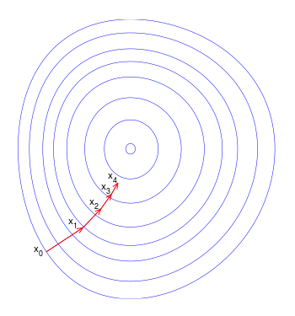
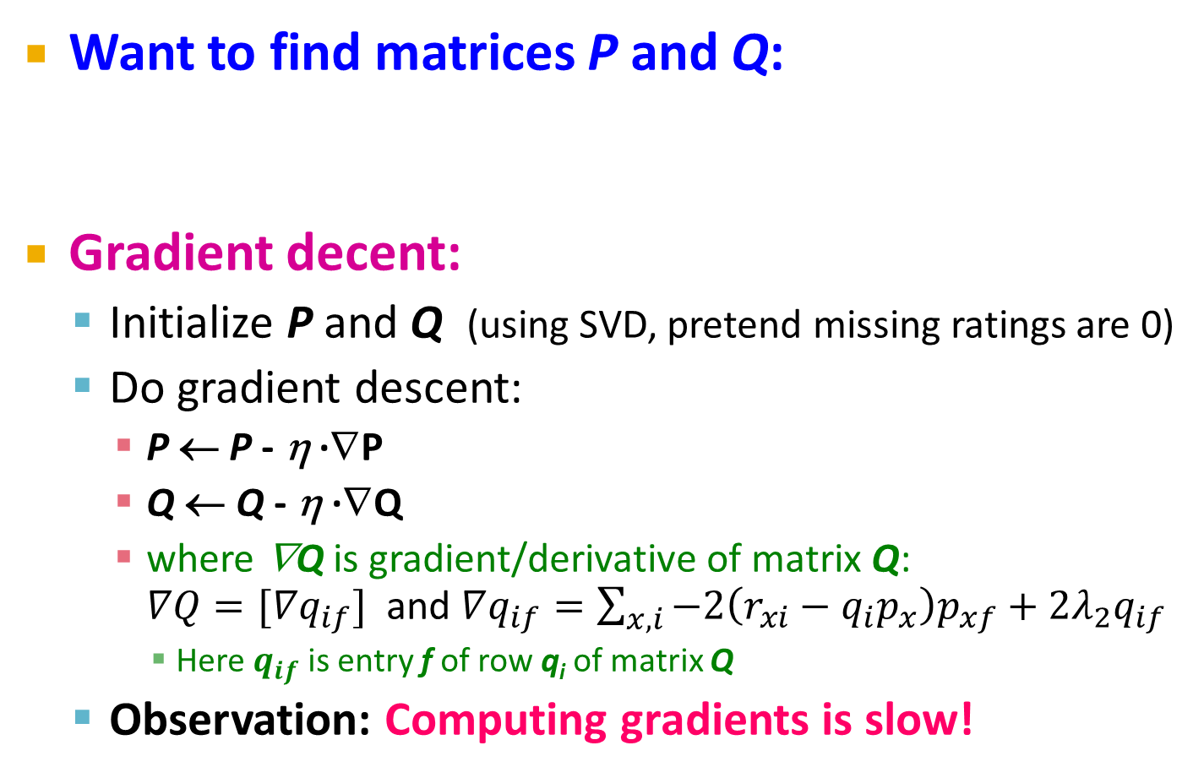
Stochastic Gradient Descent
Want to find matrices P and Q:
Gradient decent:
Initialize P and Q (using SVD, pretend missing ratings are 0)
Do gradient descent:
P ← P - η ·∇P
Q ← Q - η ·∇Q
where ∇Q is gradient/derivative of matrix Q: $∇Q=[∇q_{if}]$ and $∇q_{if}=\sum_{x,i}{−2\left(r_{xi}−q_{i}p_{x}^{}\right)p_{xf}}+2λ_{2}q_{if}$
Here $q_{if}$ is entry f of row q_{i} of matrix Q
Observation: Computing gradients is slow!
How to compute gradient of a matrix?
Compute gradient of every element independently!

Slide 36
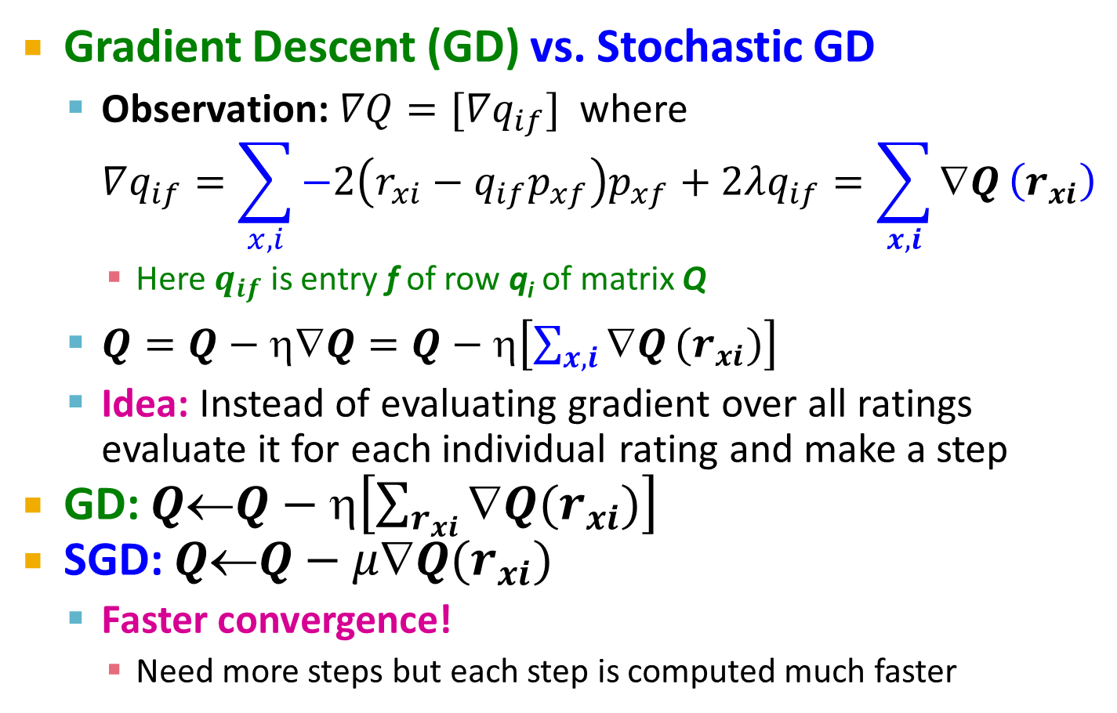
Stochastic Gradient Descent
Gradient Descent (GD) vs. Stochastic GD
Observation: $∇Q=[∇q_{if}]$ where $∇q_{if}=\sum_{x,i}{−2\left(r_{xi}−{q_{if}p}_{xf}\right)p_{xf}}+2λq_{if}=\sum_{x,i}{∇Q}\left(r_{xi}\right)$
Here $q_{if}$ is entry f of row q_{i} of matrix Q
$Q=Q−η∇Q=Q−η\left[\sum_{x,i}{∇Q}(r_{xi})\right]$
Idea: Instead of evaluating gradient over all ratings evaluate it for each individual rating and make a step
GD: $Q←Q−η\left[\sum_{r_{xi}}{∇Q(r_{xi})}\right]$
SGD: $QQ−μQ(r_{xi})$
Faster convergence!
Need more steps but each step is computed much faster

Slide 37
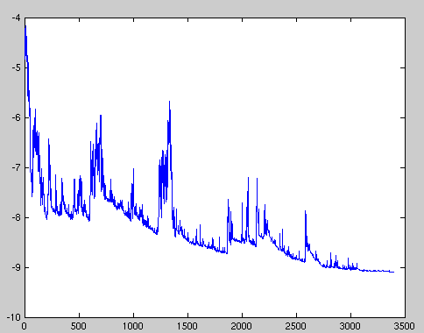
SGD vs. GD
Convergence of GD vs. SGD
Value of the objective function
GD improves the value of the objective function at every step.
SGD improves the value but in a “noisy” way.
GD takes fewer steps to converge but each step takes much longer to compute.
In practice, SGD is much faster!
Iteration/step

Slide 38

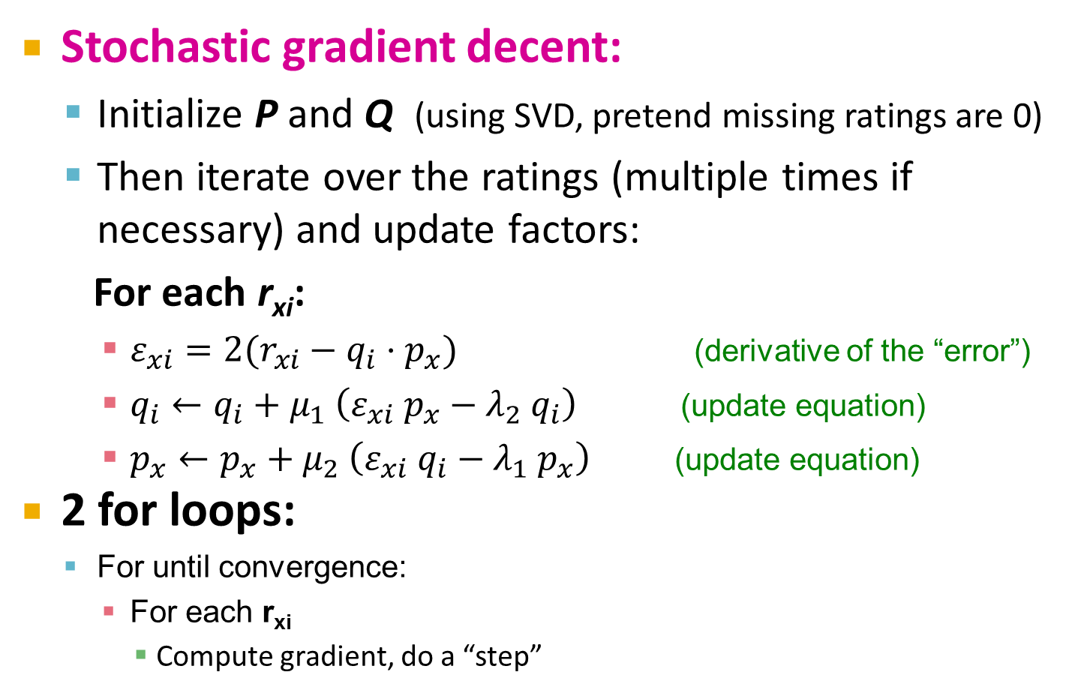
Stochastic Gradient Descent
Stochastic gradient decent:
Initialize P and Q (using SVD, pretend missing ratings are 0)
Then iterate over the ratings (multiple times if necessary) and update factors:
For each r_{xi}:
$ε_{xi}=2(r_{xi}−q_{i}{⋅p}_{x}^{})$ (derivative of the “error”)
$q_{i}←q_{i}+μ_{1} \left(ε_{xi} p_{x}−λ_{2}{ q}_{i}\right)$ (update equation)
$p_{x}←p_{x}+μ_{2} \left(ε_{xi} q_{i}−λ_{1} p_{x}\right)$ (update equation)
2 for loops:
For until convergence:
For each r_{xi}
Compute gradient, do a “step”
$μ$ … learning rate

Slide 39
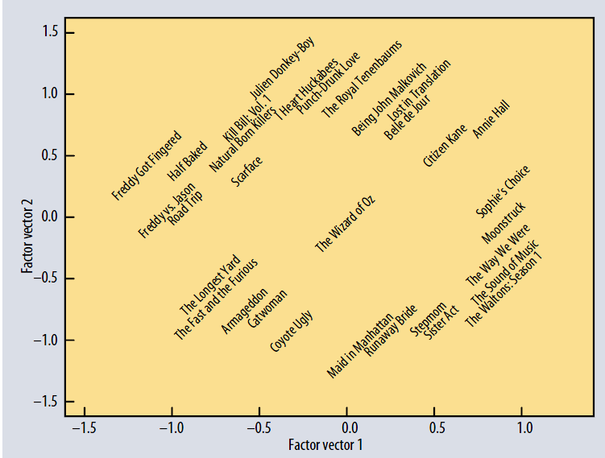
Koren, Bell, Volinksy, IEEE Computer, 2009

Slide 40
Extending Latent Factor Model to Include Biases

Slide 41



Modeling Biases and Interactions
user bias
movie bias
user-movie interaction
Baseline predictor
Separates users and movies
Benefits from insights into user’s behavior
Among the main practical contributions of the competition
User-Movie interaction
Characterizes the matching between users and movies
Attracts most research in the field
Benefits from algorithmic and mathematical innovations
μ = overall mean rating
b_{x} = bias of user x
b_{i} = bias of movie i

Slide 42
Baseline Predictor
We have expectations on the rating by user x of movie i, even without estimating x’s attitude towards movies like i
Rating scale of user x
Values of other ratings user gave recently (day-specific mood, anchoring, multi-user accounts)
(Recent) popularity of movie i
Selection bias; related to number of ratings user gave on the same day (“frequency”)

Slide 43
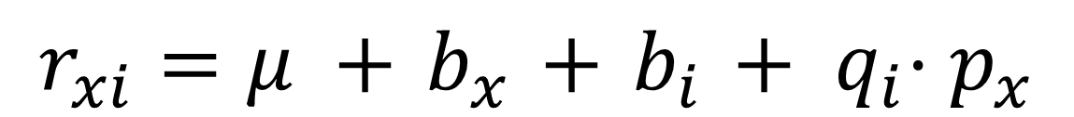
Putting It All Together
$$r_{xi}=μ +{ b}_{x} +{ b}_{i} + { q}_{i}⋅p_{x}^{}$$
Overall mean rating
Bias for user x
Bias for movie i
User-Movie interaction
Example:
Mean rating: μ = 3.7
You are a critical reviewer: your ratings are 1 star lower than the mean: b_{x} = -1
Star Wars gets a mean rating of 0.5 higher than average movie: b_{i} = + 0.5
Predicted rating for you on Star Wars: = 3.7 - 1 + 0.5 = 3.2

Slide 44
Fitting the New Model
Solve:
Stochastic gradient decent to find parameters
Note: Both biases b_{x}, b_{i} as well as interactions q_{i}, p_{x} are treated as parameters (we estimate them)
goodness of fit
regularization
λ is selected via grid-search on a validation set

Slide 45
Performance of Various Methods

Slide 46
Performance of Various Methods
Global average: 1.1296
User average: 1.0651
Movie average: 1.0533
Netflix: 0.9514
Basic Collaborative filtering: 0.94
Collaborative filtering++: 0.91
Latent factors: 0.90
Latent factors+Biases: 0.89
Grand Prize: 0.8563

Slide 47
The Netflix Challenge: 2006-09

Slide 48
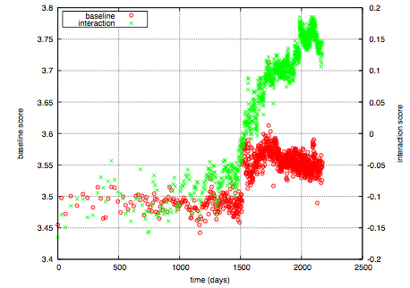
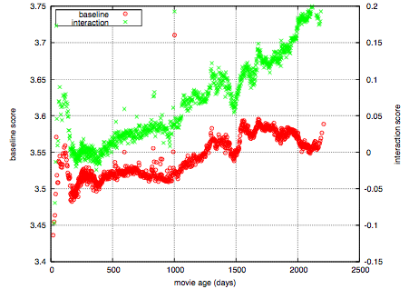
Temporal Biases of Users
Sudden rise in the average movie rating (early 2004)
Improvements in Netflix
GUI improvements
Meaning of rating changed
Movie age
Users prefer new movies without any reasons
Older movies are just inherently better than newer ones
Y. Koren, Collaborative filtering with temporal dynamics, KDD ’09

Slide 49

Temporal Biases & Factors
Original model: r_{xi} = μ +b_{x} + b_{i} + q_{i} ·p_{x}
Add time dependence to biases: r_{xi} = μ +b_{x}(t)+ b_{i}(t) +q_{i} · p_{x}
Make parameters b_{x} and b_{i} to depend on time
(1) Parameterize time-dependence by linear trends (2) Each bin corresponds to 10 consecutive weeks
Add temporal dependence to factors
p_{x}(t)… user preference vector on day t
Y. Koren, Collaborative filtering with temporal dynamics, KDD ’09

Slide 50
Adding Temporal Effects

Slide 51
Performance of Various Methods
Global average: 1.1296
User average: 1.0651
Movie average: 1.0533
Netflix: 0.9514
Basic Collaborative filtering: 0.94
Still no prize! ☹
Getting desperate.
Try a “kitchen sink” approach!
Collaborative filtering++: 0.91
Latent factors: 0.90
Latent factors+Biases: 0.89
Latent factors+Biases+Time: 0.876
Grand Prize: 0.8563

Slide 52
Notes:
Many options for modeling
Variants of the ideas we have seen so far
Different numbers of factors
Different ways to model time
Different ways to handle implicit information
Other models (not described here)
Nearest-neighbor models
Restricted Boltzmann machines
Model averaging is useful….
Linear model combining

Slide 53
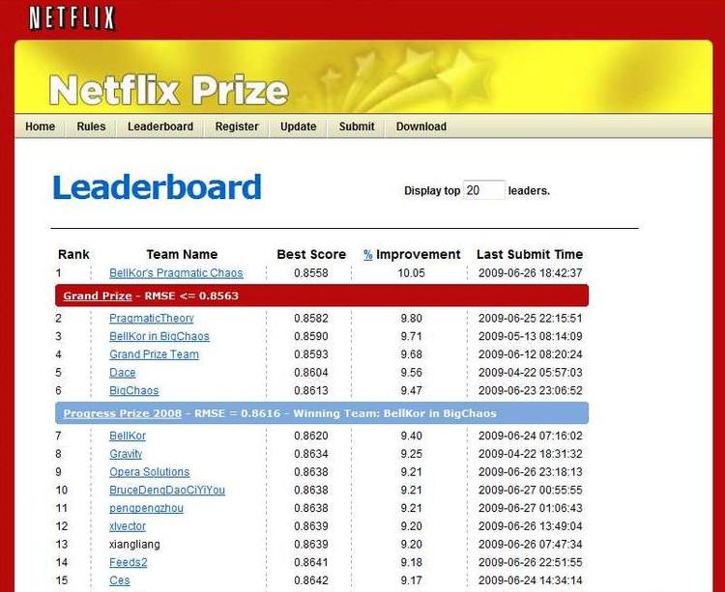
Standing on June 26th 2009
June 26th submission triggers 30-day “last call”

Slide 54
The Last 30 Days
Ensemble team formed
Group of other teams on leaderboard forms a new team
Relies on combining their models
Quickly also get a qualifying score over 10%
BellKor
Continue to get small improvements in their scores
Realize that they are in direct competition with Ensemble
Strategy
Both teams carefully monitoring the leaderboard
Only sure way to check for improvement is to submit a set of predictions
This alerts the other team of your latest score

Slide 55
24 Hours from the Deadline
Submissions limited to 1 a day
Only 1 final submission could be made in the last 24h
24 hours before deadline…
BellKor team member in Austria notices (by chance) that Ensemble posts a score that is slightly better than BellKor’s
Frantic last 24 hours for both teams
Much computer time on final optimization
Carefully calibrated to end about an hour before deadline
Final submissions
BellKor submits a little early (on purpose), 40 mins before deadline
Ensemble submits their final entry 20 mins later
….and everyone waits….

Slide 56
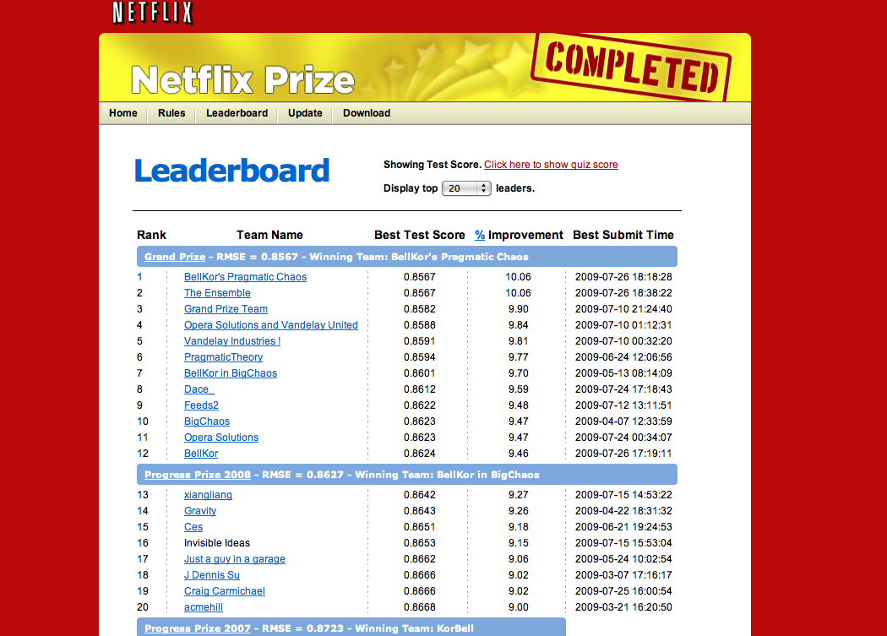

Slide 57

Million $ Awarded Sept 21st 2009

Slide 58
Acknowledgments
Some slides and plots borrowed from Yehuda Koren, Robert Bell and Padhraic Smyth
Further reading:
Y. Koren, Collaborative filtering with temporal dynamics, KDD ’09
http://www2.research.att.com/~volinsky/netflix/bpc.html
http://www.the-ensemble.com/

