Slide 1
Course Overview: Big Data Mining and Applications
J. H. Wang
Sep. 8, 2025

Slide 2
Course Information
Course Website: https://chriswjh.github.io/BDM/
You can check the latest announcements and updates of schedule, slides, and homeworks
Time: 15:10pm-18:00pm, Mon.
Classroom: R234, Technology Building
Classes will be in-person
Course sessions will be recorded using i-School+ and Teams whenever possible

Slide 3
Instructor & TA
Instructor
J. H. Wang (王正豪)
Professor, CSIE, NTUT
Office: R1534, Technology Building
E-mail: jhwang@ntut.edu.tw
Tel: ext. 4238
Office Hour: 9:10-12:00am, every Tuesday and Friday
TA
Mr. Lin (@ R1424, Technology Building)
E-mail: (TBA)

Slide 4
For Online Recording of Course Sessions
Online course sessions will be setup as possible using Microsoft Teams, which will be recorded and put in i-School+
Teams will be created for the course numbers:
[NTUT-Sync]114-1_347338_巨量資料探勘與應用
[NTUT-Sync]114-1_350369_巨量資料探勘與應用-> the major link to our online course
And our online communication channels
Other communication channels:
E-mails, iSchool+, and our course Web site

Slide 5
Why this Course?
If you are interested in learning big data analytics techniques
If you have real-world big data in a particular domain, and want to gain some insights using big data mining techniques
To realize different scenarios of big data applications, and to get hands-on experiences in analyzing open “big” datasets

Slide 6
This Class
This class overlaps with machine learning, statistics, artificial intelligence, databases but more focus on
Scalability (big data)
Algorithms
Computing architectures
Automation for handling large data
Statistics
Machine
Learning
Big
Data Mining
Database systems

Slide 7
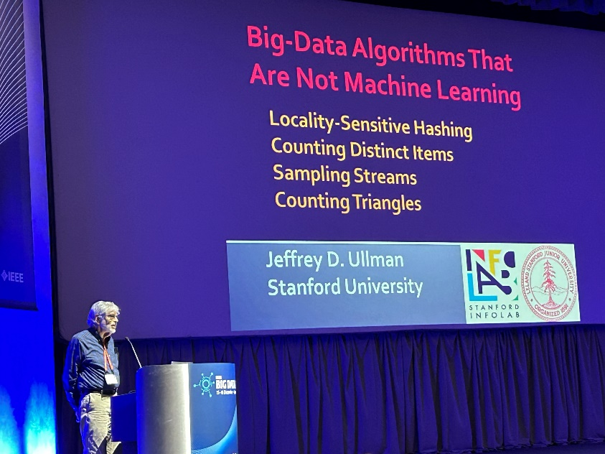
NOTICE
“Big Data” is NOT “Machine Learning”
Some big data algorithms are not machine learning
Locality sensitive hashing
Counting triangles
…
J. Ullman, “Big Data Algorithms that are not Machine Learning,” Keynote Speech at IEEE BigData 2023, https://doi.ieeecomputersociety.org/10.1109/BigData59044.2023.10386233

Slide 8
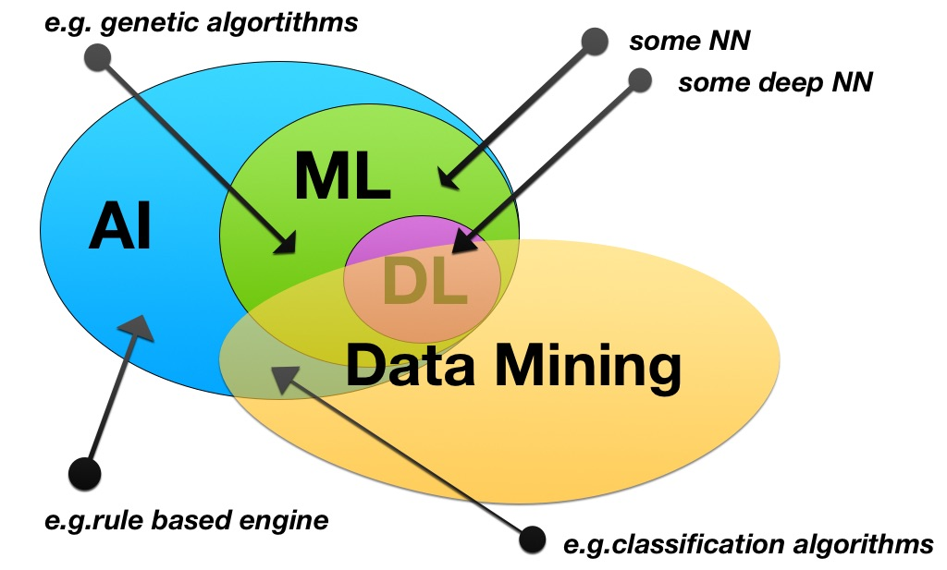
Data mining vs. Machine learning

Slide 9
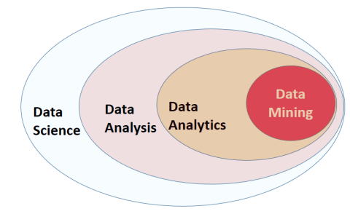
Data Mining Related Terms

Slide 10
Course Materials
Textbook:
Jure Leskovec, Anand Rajaraman, Jeffrey David Ullman, Mining of Massive Datasets, 3rd Edition, Cambridge University Press, Feb. 2020. (Available at: http://www.mmds.org/) (selected chapters)
Reference book:
Jimmy Lin and Chris Dyer, Data-Intensive Text Processing with MapReduce, Morgan & Claypool Publishers, 2010. (selected chapters)
Prerequisites:
Basic knowledge of data structures (and algorithms), database systems, discrete math (probability), linear algebra, and data mining
Programming experience is *required* for completing homeworks & projects

Slide 11
Additional Reading Materials
Books
Jiawei Han, Jian Pei, and Hanghang Tong, Data Mining: Concepts and Techniques, 4th ed., Morgan Kaufmann Publishers, Oct. 2022.
Tom White, Hadoop: The Definitive Guide, 4th ed., O’Reilly Media, 2015.
Holden Karau, Andy Konwinski, Patrick Wendell, Matei Zaharia, Learning Spark: Lightning-Fast Big Data Analysis, O'Reilly Media, January 2015.
Official online documents: Hadoop, Spark, …
Selected academic papers

Slide 12
[Warning] This is NOT an Introductory Course!
Fundamental courses:
Introduction to big data analytics (CSIE, juniors)
Data mining concepts + distributed framework
Educational data mining and applications (CSIE, juniors)
Data mining concepts + educational data analysis
Big data analytics (IFM, with Prof. Li-Chen Cheng)
Data mining concepts
Advanced course:
Big data mining and applications (CSIE, seniors & graduates) – This Course
Distributed analytics on different types of data + heavy loads of parallel programming exercises/projects using open “big data”

Slide 13
Topics in the Textbook
To mine different types of data:
High dimensional data
Graph data
Infinite/never-ending data
Labeled data
To use different models of computation:
MapReduce
Streams and online algorithms
Single machine in-memory

Slide 14
Topics in the Textbook
To solve real-world problems:
Recommender systems
Market Basket Analysis
Spam detection
Duplicate document detection
To learn various “tools”:
Linear algebra (SVD, Rec. Sys., Communities)
Optimization (stochastic gradient descent)
Dynamic programming (frequent itemsets)
Hashing (LSH, Bloom filters)

Slide 15
How It All Fits Together
High dim. data
Locality sensitive hashing
Clustering
Graph data
PageRank, SimRank
Community Detection
Infinite data
Filtering data streams
Web advertising
Dimensionality reduction
Spam Detection
Queries on streams
Machine learning
SVM
Decision Trees
Perceptron, kNN
Apps
Recommender systems
Association Rules
Duplicate document detection

Slide 16
The Topics to be Covered
Introduction
Data mining concepts
Data preprocessing
Frequent pattern mining
Data classification
Data clustering
Distributed platform and parallel programming
Introducing distributed platforms: Hadoop, Spark
Parallel programming paradigm and concepts
MapReduce programming
Advanced topics: analyzing different types of big data
Link analysis
Mining social network graphs
Hashing
Recommender systems
Large-scale machine learning

Slide 17
Tentative Schedule
Before midterm
Introduction to big data analytics (1 wk)
Introducing distributed platforms: Hadoop, Spark (1 wk)
MapReduce programming: design patterns, issues(2 wks)
Finding Similar Items (1 wk)
Clustering (1 wk)
Dimensionality Reduction (1 wk)
Recommendation Systems (1 wk)
After midterm
Page Rank & Link Analysis (2 wks)
Social Network Graph Mining (1 wk)
Others: Machine Learning Methods: NN, SVM (2 wks)
Term Project Presentation (3-4 wks)

Slide 18
Tentative Schedule
Week | Date | Content | Note
1 | 9/8 | Course Overview
2 | 9/15 | Introducing distributed platforms: Hadoop, Spark
3 | 9/22 | MapReduce programming (TA: package installation, platform usage demo)
4 | 9/29 | MapReduce Algorithm Design: design patterns (pairs & stripes), language models | HW#0
5 | 10/6 | Issues of MapReduce in Hadoop
6 | 10/13 | Finding Similar Items | Due: HW#0 HW#1
7 | 10/20 | Clustering
8 | 10/27 | Dimension reduction (TA: Q&A for homework, and term project proposal) | Due: HW#1 HW#2

Slide 19
Week | Date | Content | Note
9 | 11/3 | Recommendation Systems
10 | 11/10 | (Midterm exam): to be confirmed
11 | 11/17 | PageRank | Due: HW#2,Proposal HW#3
12 | 11/24 | Link analysis
13 | 12/1 | Mining social network graphs | Due: HW#3 HW#4
14 | 12/8 | Community detection (Large-scale machine learning)
15 | 12/15 | Term Project Presentation: Week 1 | Due: HW#4 HW#5
16 | 12/22 | Term Project Presentation: Week 2
17 | 12/29 | Term Project Presentation: Week 3 | Due: HW#5
18 | 1/5 | Term Project Presentation: Week 4 | 1/9 Due: Final Report

Slide 20
Grading Policy
Homework assignments and programming exercises: ~40%
Mid-term exam: ~30%
Term project: ~30%
Including proposal, presentation, and final report
All homeworks, projects, and reports must be submitted before the deadline
*before* the end of the semester (Jan. 9, 2026)

Slide 21
Homeworks and Projects
One quiz or HW#0
Individual
For environment setup
About 5 programming exercises
Team-based (<= 2 students per team)
Analysis on open “big” data set
E.g. selected datasets from UCI MLrepository, kaggle, AI cup, …
Parallel programming is different from sequential!
The term project (to be detailed later)
Team-based (<= 2 students per team)
e.g. extension to exercises, system development, or joining competitions, …
Responsibility of each member must be specified in the document for team-based works

Slide 22
[TBD] Quiz or Homework #0
To get each student familiar with the distributed platform or programming environment needed for the homeworks
A quiz on installing/configuring the distributed platform
Or a first homework #0 which analyzes a small dataset using simple statistics in any programming environment

Slide 23
Homework Submission
Written exercises
To hand-in in class
Programming exercises/programs/project proposals/reports
To be submitted directly to the TA
Homework submission site: iSchool+
Your score will be deducted when there’s delay in homework submission
The longer the delay, the higher the deduction

Slide 24
Notes on Homeworks
Rule 1: Plagiarism is strictly prohibited
Near-duplicate codes will get equal and minimum basic scores
Rule 2: Clear documentation is required in your system projects
Instructions on downloading, installing, configuring, and executing your code and open source library, APIs, or codes must be submitted
Package control is recommended

Slide 25
About the Exams
Midterm exam
Date: Nov. 10, 2025 (to be confirmed)
Range: (TBD)
Question Types: Calculation, Short Answer, True-False, Multiple Choice
Time: 15:10-18:00
Location: R234, Technology Building
The exam will be open-book, but ALL electronic devices are prohibited!

Slide 26
About Programming Exercises
For CS students
Python programming on Spark platform with at least two computer nodes (VMs)
Or Java/Scala/R programming
To submit: source code, documentation, and execution result (screenshot or log file showing the analysis result and efficiency)
For non-CS students
Python programming on Google CoLab, a Jupyter Notebook environment, or any existing platforms
To submit: source code, documentation, and execution result (Jupyter notebook file showing the analysis result and efficiency)
[Warning] You have to handle ALL instances in the “big” dataset!
Packages (e.g. Weka) might not be able to handle such big data

Slide 27
Why Different Standards?
For CS students, it’s important to get familiar with:
System structure design and management in cloud computing, or edge computing
Cloud system architect, cloud analyst, …
Platform and framework installation, configuration, and big data management (Linux, Hadoop, Spark, …)
E.g. Server management, data center management
Parallel programming in distributed frameworks to better utilize more computer nodes
To make more flexible and powerful analysis possible
To analyze real “big” data, instead of “toy” datasets

Slide 28
Why Different Standards?
For non-CS students, it’s more important to get familiar with:
Big data analytics concepts
Tools, inputs, outputs
How to analyze the real “big” data
E.g. financial big data such as market indexes, technical indicators, economic indicators, financial news, social media, …
How to interpret the results
Trends, patterns, relations discovered and their meanings

Slide 29
About the Term Project
System development
You can either write your own program, or call existing open source code or library (but NOT only executing existing binary)
E.g. Hadoop, Spark, TensroFlow, Keras, …
Directly running open source package such as Weka is not recommended
Be careful about the “big” data size!
Competition
AI cup 2025: https://www.aicup.tw/ai-cup-2025-competition
Data analysis using open datasets is *suggested* in your project
E.g. UCI Machine Learning repository, kaggle, …

Slide 30
About AI cup 2025 Competition
Link: https://www.aicup.tw/ai-cup-2025-competition
Competition in Fall (秋季賽-電腦斷層心臟肌肉影像分割競賽)
Important dates:
Registration: (TBA)
End of competition: (TBA)
Announcement of final result: (TBA)
Prizes:
Top ? places

Slide 31
More on the Term Project
The score you’ll get depends on the functionality, difficulty, and quality of your project
System functions and correctness
Proposals, presentations, and reports are *required* for each team, and will be counted in the score
Tentative schedule for all teams:
Proposal: *required* one week after midterm (Nov. 17, 2025)
Presentations (including demos): *required* in the last three-four weeks (starting as early as Dec. 15, 2025)
Final report: *required* before the end of the semester (Jan. 9, 2026)
Slides, source code, documentation

Slide 32
Some Example Open Source Tools for Big Data Analytics
Apache Hadoop, Spark (in Java, Scala, Python, R)
For distributed computing and data analysis
Apache Pig, Hive, Flume, Hbase, Cassandra, Alluxio, Mahout, …
For data flow, SQL, streaming data, distributed databases, distributed storage, machine learning,
Spark SQL, Streaming, Mlib, GraphX
For SQL, streaming, machine learning, and graph processing

Slide 33
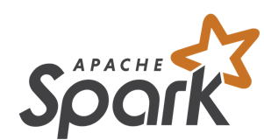
Spark
A general-purpose cluster computing system
It provides high-level APIs in Java, Scala, Python and R, and an optimized engine that supports general execution graphs
It also supports a rich set of higher-level tools
Spark SQL for SQL and structured data processing
MLlib for machine learning
GraphX for graph processing
Spark Streaming

Slide 34
More Popular Tools
PyTorch
Keras, TensorFlow, Distributed TensorFlow
…

Slide 35

TensorFlow
An open source software library from Google for high performance numerical computation
Flexible architecture to deploy computation across a variety of platforms (CPUs, GPUs, TPUs), and devices (desktops, laptops, mobiles)
Strong support for machine learning and deep learning

Slide 36

Why Python?
One of the most popular interpreted programming languages for building websites
They can be used to quickly write small programs or scripts to automate other tasks
A large scientific computing and data analysis community
Improved support for libraries
Strength for general-purpose software engineering
Easy to integrate with other codes such as C, C++, Fortran
Suitable for doing research and prototyping, and also for building production systems

Slide 37
Rich Libraries for Data Analysis in Python
Numpy
Scipy
Scikit-learn
Matplotlib
Nltk
…

Slide 38
Some Opinions against Python
Execution speed slower than code in compiled languages such as C++ or Java
Programmer time vs. CPU time
Challenging for highly concurrent, multithreaded applications
Global interpreter lock, only one Python instruction executed at a time

Slide 39
What is Data Mining
Data mining is the computational process of discovering patterns in large data sets involving methods at the intersection of artificial intelligence, machine learning, statistics, and database systems. [source: Wikipedia]

Slide 40
Knowledge Discovery (KDD) Process
Knowledge
This is a view from typical database systems and data warehousing communities
Data mining plays an essential role in the knowledge discovery process
Pattern Evaluation
Data Mining
Task-relevant Data
Data Warehouse
Selection
Data Cleaning
Data Integration
Databases
[source: Han 2011]

Slide 41
KDD Process: A Typical View from ML and Statistics
Pattern
Information
Knowledge
Input Data
Data Pre-Processing
Data Mining
Post-Processing
Data integration
Normalization
Feature selection
Dimension reduction
Pattern discovery
Association & correlation
Classification
Clustering
Outlier analysis
… … … …
Pattern evaluation
Pattern selection
Pattern interpretation
Pattern visualization
[source: Han 2011]
This is a view from typical machine learning and statistics communities

Slide 42
What is Big Data?
Big data is a term for data sets that are so large or complex that traditional data processing application softwares are inadequate to deal with them
Challenges include capture, storage, analysis, data curation, search, sharing, transfer, visualization, querying, updating and information privacy [source: Wikipedia]

Slide 43
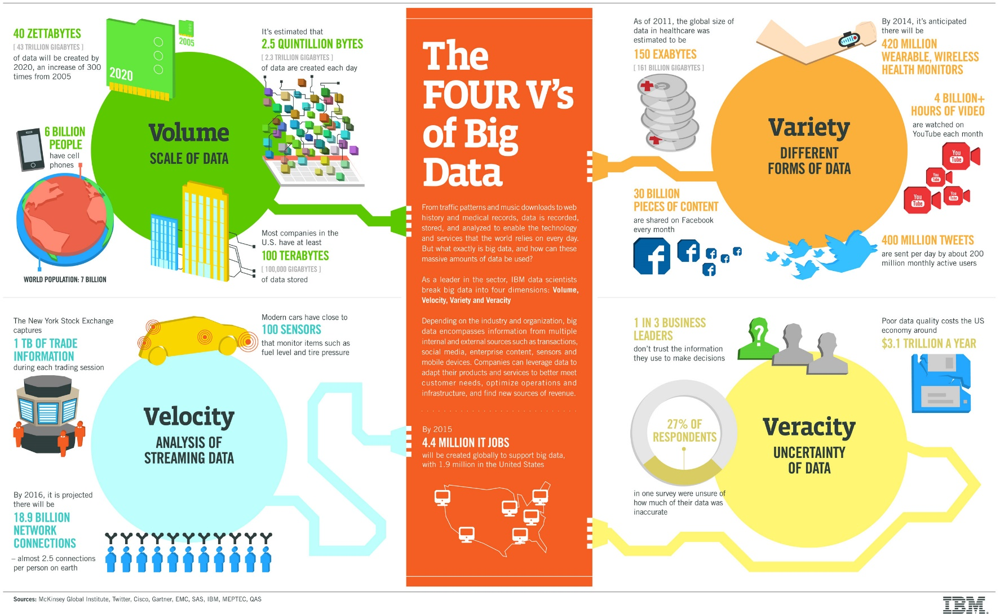
The Four V’s of Big Data
[source: IBM]

Slide 44
What is Big Data?
“Big data is data whose scale, distribution, diversity, and/or timeliness require the use of new technical architectures and analytics to enable insights that unlock new sources of business value.”
[source: C. Manyika, Big Data: The next frontier for innovation, competition, and productivity, McKinsey Global Institute, 2011]

Slide 45
Characteristics of Big Data
Five V’s:
Volume: scale
Velocity: timeliness
Variety: diversity
Veracity: truthfulness
Value

Slide 46
Various Structures in Data
Variety: different forms
Structured: databases, spreadsheets, …
Semi-structured: textual files such as Web pages, XML, …
Unstructured: text documents, images, videos, …
Data growth is increasingly unstructured
E.g. Social media: Facebook, Twitter, …

Slide 47
Differences from traditional data analysis
Distinct requirements
Combining of multiple unrelated datasets
Processing of large amounts of unstructured data
Harvesting of hidden information in a time-sensitive manner
Newer techniques that leverage computational resources
Interdisciplinary
Mathematics, statistics, computer science, domain expertise
Benefits
Optimization, predictions, fault or fraud detection, improved decision making, discoveries

Slide 48
Big Data: Some Examples
Web pages and social media
Retail sales and e-commerce
Sensors, mobile and wearable devices
And many more: healthcare, natural resources, education, public sector, insurance, transportation, finance and crime detection, …

Slide 49
Related Terms
Data science, predictive analytics
Business intelligence, FinTech
IoT, CPS, Industry 4.0
Smart homes, smart cities
Data mining, machine learning, artificial intelligence
Cloud computing, data-intensive computing, parallel computing, distributed computing
…

Slide 50
The Major Focus in Big Data Analytics
The management of complete data lifecycle
Collecting
Cleansing
Organizing
Storing
Analyzing
Visualization & Interpretation
Governing

Slide 51
Why Distributed Framework for Data Analysis?
Motivation
Big data: volume, velocity, variety
We need more storage space
Space efficiency
We need more computing power
Time efficiency
We need more I/O throughput
Inevitable because of the computer architecture

Slide 52
Factors in Data Analysis (or Any Program)
What is a Program?
Algorithm + Data Structures = Program

Slide 53
Factors in Data Analysis
Data to be analyzed
Tall data: large number of cases
Wide data: large number of features
Tall and wide data: large number of both cases and features
Sparse data: large number of zero entries
Algorithm to be used
How complex is your algorithm
How many parameters in your model
Are the optimization processes parallelizable
Does your algorithm learn from all data or small batches of data

Slide 54
Scalability
CPU: computing time to execute the analysis
I/O: how much data can be put in memory per time unit
Memory: how much data can be processed at a time

Slide 55
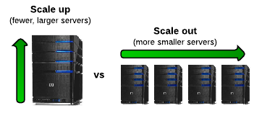
Possible solutions
Scale up: single machine
More memory, faster CPU, faster storage, using GPUs
E.g. TensorFlow, Keras, …
Scale out: distributing computations
Using outside resources: other CPUs, GPUs, storage
E.g. Hadoop, Spark, …
Scale up and out
Distributed TensorFlow, …

Slide 56
Divide and Conquer
“Work”
Partition
w₁
w₂
w₃
worker
worker
worker
r₁
r₂
r₃
Combine
“Result”

Slide 57
Thanks for Your Attention!

