Slide 1
Chapter 1. Introduction
What is Data Mining?
Data Mining: An Essential Step in Knowledge Discovery
Diversity of Data Types for Data Mining
Mining Various Kinds of Knowledge
Data Mining: Confluence of Multiple Disciplines
Data Mining and Applications
Data Mining and Society
Summary

Slide 2
What Is Data Mining?
We live in a world where vast amounts of data are generated constantly and rapidly
Data mining is the process of discovering interesting patterns, models and other kinds of knowledge in large data sets
  “Data mining”: a misnomer? It should be “knowledge mining from data”
  Other terms: Knowledge mining from data, KDD (Knowledge Discovery from Data), pattern discovery, knowledge extraction, data analytics, information harvesting
Data mining is a young, dynamic, and promising field
Example: Data mining turns a large collection of data into knowledge
  Google’s Flu Trends found a close relationship between the number of people who search for flu-related info. and the number of people who have flu symptoms
    It can estimate flu activity up to two weeks faster than traditional systems

Slide 3
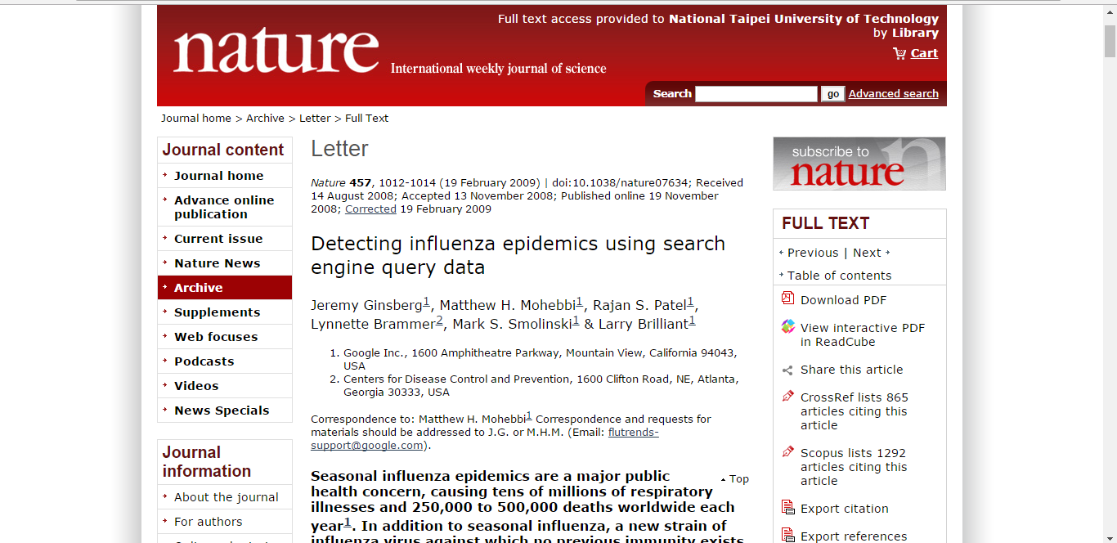
Example of Data Mining:
Google FluTrends (GFT)

Slide 4
“Traps in Big Data Analysis?”
GFT failed missing at the peak of the 2013 flu season by 140 percent
  It’s dangerous to rely on Google Flu Trends for any decision-making
  For example, their algorithm is vulnerable to overfitting to seasonal terms unrelated to the flu, like “high school basketball”
Google also did not take into account changes in search behavior over time
[Source: David Lazer, Ryan Kennedy, Gary King, and Alessandro Vespignani, The Parable of Google Flu: Traps in Big Data Analysis, Science, Vol 343, Issue 6176, pp. 1203-1205, 14 Mar 2014,
DOI: 10.1126/science.1248506]

Slide 5
Data Mining: An Essential Step in Knowledge Discovery
Knowledge Discovery Process
  Data preparation
    Data cleaning
    Data integration
    Data transformation
    Data selection
  Data mining
  Pattern/model evaluation
  Knowledge presentation

Slide 6
Diversity of Data Types for Data Mining (I)
Structured vs. unstructured data
  Structured: uniform, record- or table-like structures, defined by data dictionaries, with a fixed set of attributes, each with a fixed set of value ranges and semantic meaning
    Ex. Data stored in relational databases, data cubes, data matrices, and many data warehouses
  Semi-structured: allow a data object to contain a set value, a small set of heterogeneous typed values, or nested structures, or to allow the structure of objects or sub-objects to be defined flexibly and dynamically
  Data having certain structures with clearly defined semantic meaning, such as transactional data set, sequence data set (e.g., time-series data, gene or protein data, or Weblog data)
  Graph or network data: A more sophisticated type of semi-structured data set
  Unstructured data: text data and multimedia (e.g., audio, image, video) data
The real-world data can often be a mixture of structured, semi-structured data and unstructured data

Slide 7
Diversity of Data Types for Data Mining (II)
Data associated with different applications
  Different applications: different data sets require different data analysis methods
    Sequence data: Biological sequences vs. shopping transaction sequences
    Time-series: ordered set of numerical values with equal time interval
    Spatial, temporal and spatiotemporal data
    Graph and network data: Social networks, computer communication networks, biological networks, and information networks may carry rather different semantics
  On the same data set, finding different kinds of patterns: require different mining methods
    Ex. software programs: finding plagiarized modules vs. finding copy-and-paste bugs
Stored vs. streaming data
  Stored data: Finite, stored in various kinds of large data repositories
  Streaming data (e.g., video surveillance or remote sensing): Dynamic, constantly coming, infinite, real-time response―posing challenges on effective data mining

Slide 8
Mining Various Kinds of Knowledge
Multidimensional Data Summarization
Mining Frequent Patterns, Associations, and Correlations
Classification and Regression for Predictive Analysis
Cluster Analysis
Deep Learning
Outlier Analysis
Are All Mining Results Interesting?

Slide 9
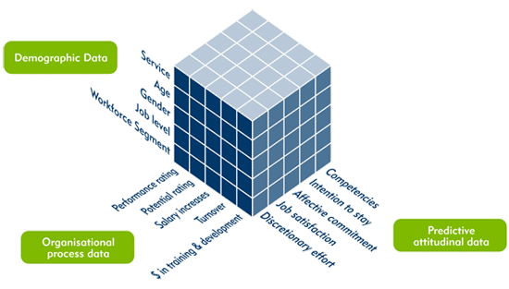
Multidimensional Data Summarization
Information integration and data warehouse construction
  Data cleaning, transformation, integration, and multidimensional data model
Data cube technology
  Scalable methods for computing (i.e., materializing) multidimensional aggregates
  OLAP (online analytical processing)
Multidimensional concept description: Characterization and discrimination
  Generalize, summarize, and contrast data characteristics, e.g., dry vs. wet region

Slide 10
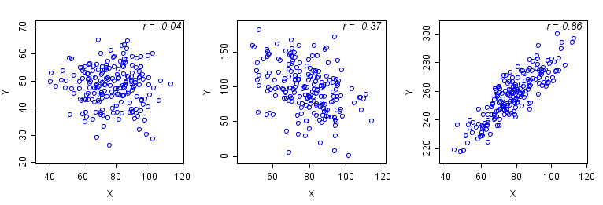
Pattern Discovery: Mining Frequent Patterns, Associations, and Correlations
Frequent patterns (or frequent itemsets)
  What items are frequently purchased together in your Walmart?
Association and Correlation Analysis
A typical association rule
    Diaper → Beer [0.5%, 75%] (support, confidence)
  Are strongly associated items also strongly correlated?
How to mine such patterns and rules efficiently in large datasets?
How to use such patterns for classification, clustering, and other applications?

Slide 11
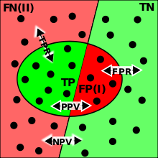
Classification and Regression for Predictive Analysis
Classification and label prediction
  Construct models (functions) based on some training examples
  Describe and distinguish classes or concepts for future prediction
    Ex. 1. Classify countries based on (climate)
    Ex. 2. Classify cars based on (gas mileage)
  Predict some unknown class labels
Typical methods
  Decision trees, naïve Bayesian classification, support vector machines, neural networks, rule-based classification, pattern-based classification, logistic regression, …
Typical applications:
  Credit card fraud detection, direct marketing, classifying stars, diseases, web-pages, …

Slide 12
Cluster Analysis
Unsupervised learning (i.e., Class label is unknown)
Group data to form new categories (i.e., clusters), e.g., cluster houses to find distribution patterns
Principle: Maximizing intra-class similarity & minimizing interclass similarity
Many methods and applications

Slide 13
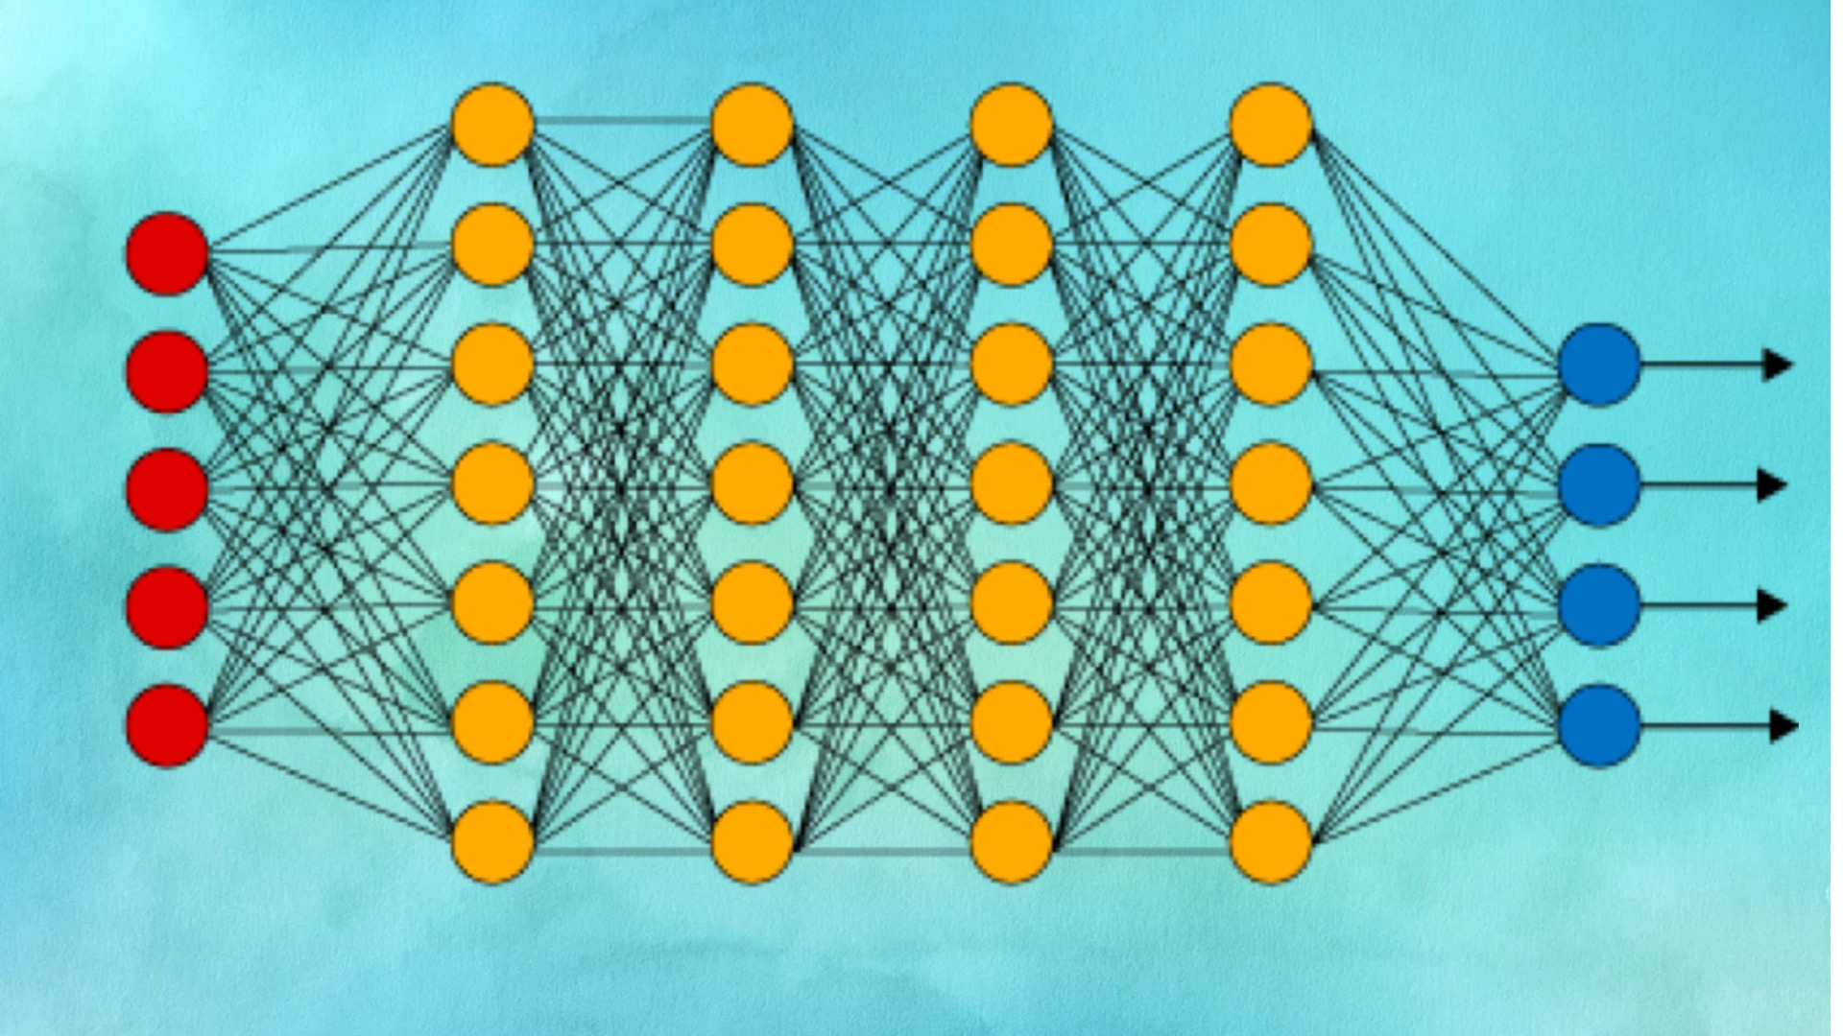
Deep Learning
Deep learning: A fast expanding dynamic frontier in machine learning
Deep learning has developed various neural network architectures
  Feed-forward neural networks
  Convolutional neural networks
  Recurrent neural networks
  Graph neural networks
  Transformer
Deep learning has broad applications in computer vision, natural language processing, machine translation, social network analysis, and so on
Deep learning has been reshaping a variety of data mining tasks
  Ex. classification, clustering, outlier detection, and reinforcement learning

Slide 14
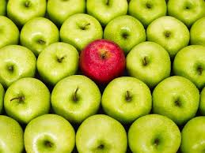
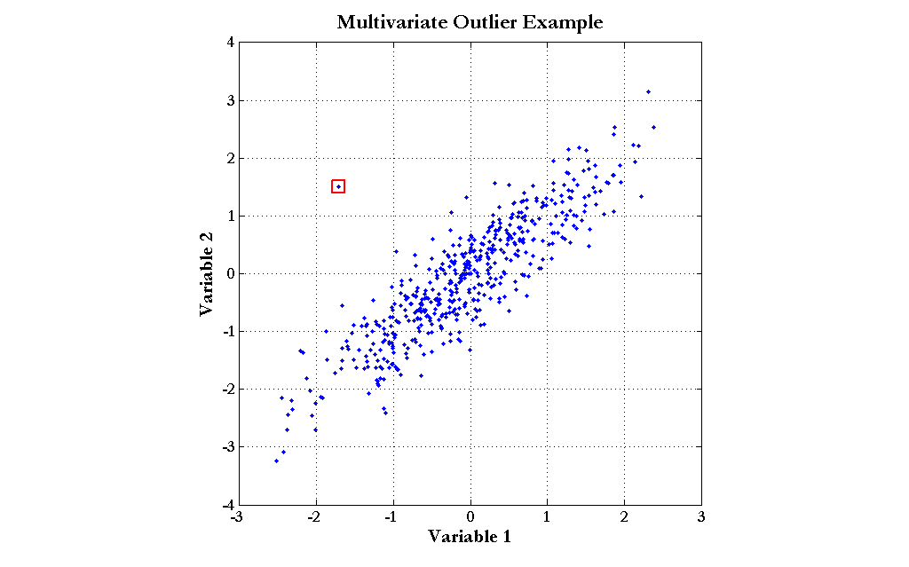
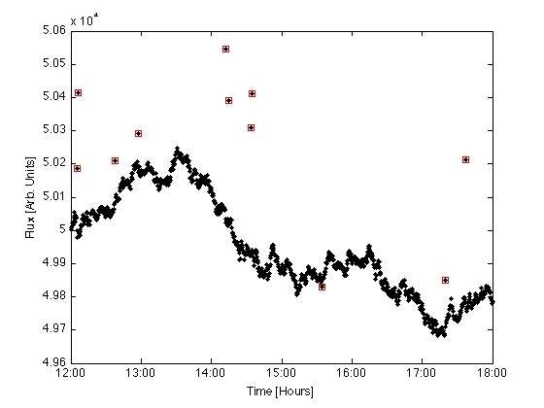
Outlier Analysis
Outlier analysis
  Outlier: A data object that does not comply with the general behavior of the data
  Noise or exception?―One person’s garbage could be another person’s treasure
  Methods: by-product of clustering or regression analysis, …
  Useful in fraud detection, rare events analysis

Slide 15

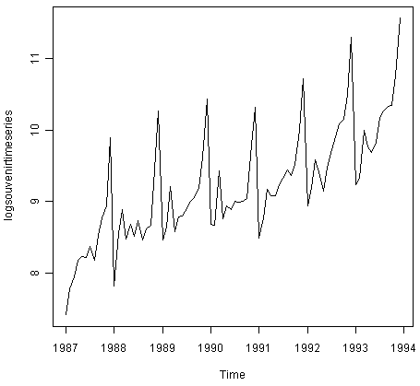
Other Data Mining Functions: Time and Ordering: Sequential Pattern, Trend and Evolution Analysis
Sequence, trend and evolution analysis
  Trend, time-series, and deviation analysis
    e.g., regression and value prediction
  Sequential pattern mining
    e.g., buy digital camera, then buy large memory cards
  Periodicity analysis
  Motifs and biological sequence analysis
    Approximate and consecutive motifs
  Similarity-based analysis
Mining data streams
  Ordered, time-varying, potentially infinite, data streams

Slide 16
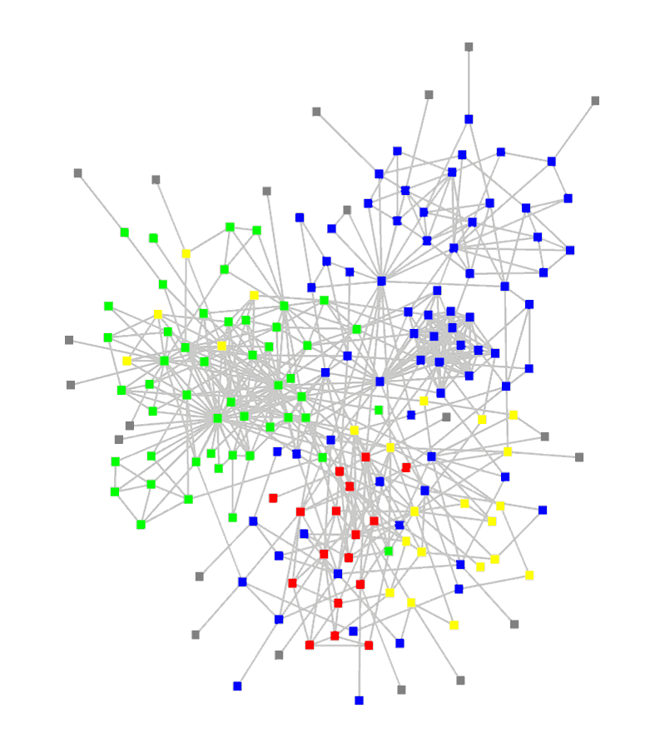
Other Data Mining Functions: Structure and Network Analysis
Graph mining
  Finding frequent subgraphs (e.g., chemical compounds), trees (XML), substructures (web fragments)
Information network analysis
  Social networks: actors (objects, nodes) and relationships (edges)
    e.g., author networks in CS, terrorist networks
  Multiple heterogeneous networks
    A person could be multiple information networks: friends, family, classmates, …
  Links carry a lot of semantic information: Link mining
Web mining
  Web is a big information network: from PageRank to Google
  Analysis of Web information networks
    Web community discovery, opinion mining, usage mining, …

Slide 17

Evaluation of Knowledge
Are all mined knowledge interesting?
  One can mine tremendous amount of “patterns”
  Some may fit only certain dimension space (time, location, …)
  Some may not be representative, may be transient, …
Evaluation of mined knowledge → directly mining only interesting knowledge?
  Descriptive vs. predictive
  Coverage
  Typicality vs. novelty
  Accuracy
  Timeliness
  …

Slide 18
Data Mining: Confluence of Multiple Disciplines

Slide 19
Why Confluence of Multiple Disciplines?
Tremendous amount of data
  Algorithms must be scalable to handle big data
High-dimensionality of data
  Micro-array may have tens of thousands of dimensions
High complexity of data
  Data streams and sensor data
  Time-series data, temporal data, sequence data
  Structure data, graphs, social and information networks
  Spatial, spatiotemporal, multimedia, text and Web data
  Software programs, scientific simulations
New and sophisticated applications
Notes:
Add a definition/description of “traditional data analysis”.

Slide 20

Data Mining and Applications
Web page analysis: classification, clustering, ranking
Collaborative analysis & recommender systems
Basket data analysis to targeted marketing
Biological and medical data analysis
Data mining and software engineering
Data mining and text analysis
Data mining and social and information network analysis
Built-in (invisible data mining) functions in Google, Microsoft, LinkedIn, Meta, …
Major dedicated data mining systems/tools
  SAS, MS SQL-Server Analysis Manager, Oracle Data Mining Tools

Slide 21
Data Mining and Society
Data mining technology may benefit society
  Ex.: Help scientific discovery, business management, economy recovery, and security protection (e.g., the real-time discovery of intruders and cyberattacks)
Need to guard against the misuse of data mining
  Data mining also poses the risk of unintentionally disclosing some confidential business or government information and disclosing an individual’s personal information
Studies on data security in data mining and privacy-preserving data publishing and data mining are important, ongoing research theme
  The philosophy is to observe data sensitivity and preserve data security and people’s privacy while performing successful data mining
These and other related issues will be discussed throughout the book

Slide 22
Summary
Data mining: Discovering interesting patterns and knowledge from massive amounts of data
A KDD process includes data cleaning, data integration, data selection, transformation, data mining, pattern evaluation, and knowledge presentation
Different data mining methods on a wide variety of data
Data mining functionalities: summarization, pattern discovery, classification, clustering, deep learning, outlier analysis, trend and outlier analysis, …
Data mining is a confluence of multiple disciplines
Data mining has broad applications
Promote secure data mining to benefit society

