Slide 1
Chapter 2. Data, Measurements, and Data Preprocessing
Data Types
Statistics of Data
Similarity and Distance Measures
Data Quality, Data Cleaning and Data Integration
Data Transformation
Dimensionality Reduction
Summary

Slide 2
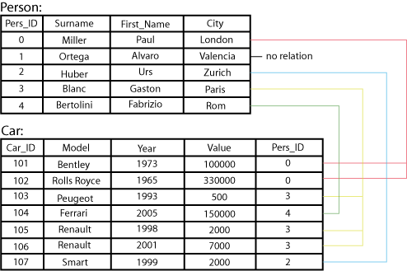
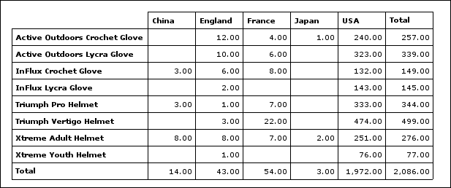
Types of Data Sets: (1) Record Data
Relational records
  Relational tables, highly structured
Data matrix, e.g., numerical matrix, crosstabs
Transaction data
Document data: Term-frequency vector (matrix) of text documents

Slide 3
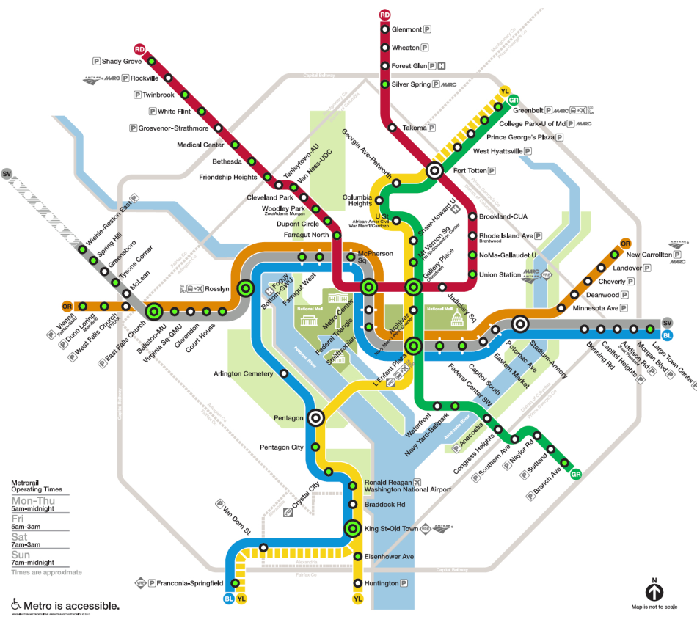

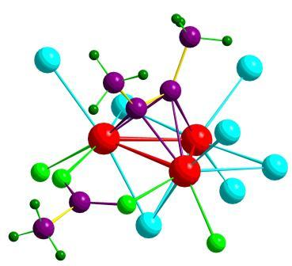

Types of Data Sets: (2) Graphs and Networks
Transportation networks
World Wide Web
Molecular Structures
Social or information networks

Slide 4

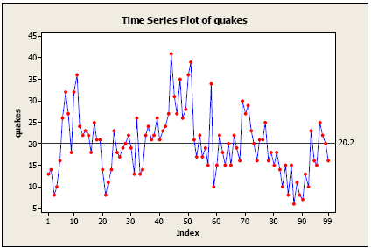
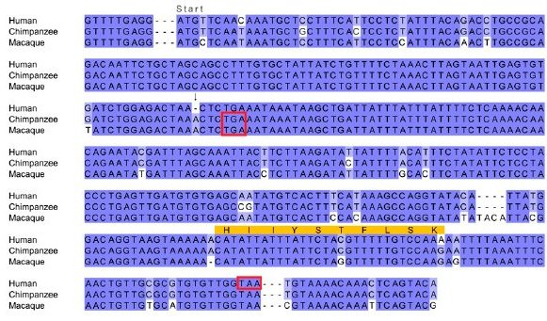
Types of Data Sets: (3) Ordered Data
Video data: sequence of images
Temporal data: time-series
Sequential Data: transaction sequences
Genetic sequence data

Slide 5
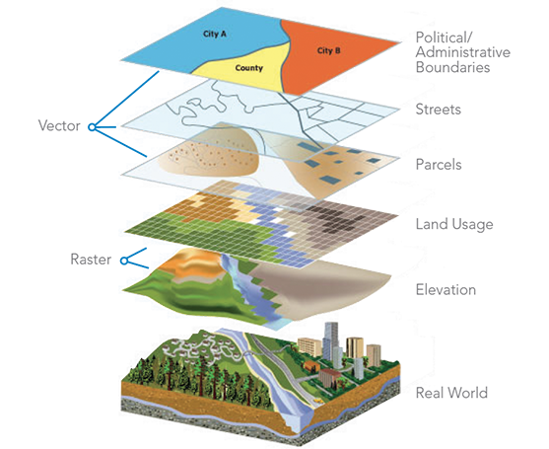

Types of Data Sets: (4) Spatial, image and multimedia Data
Spatial data: maps
Image data:
Video data:

Slide 6
Important Characteristics of Structured Data
Dimensionality
  Curse of dimensionality
Sparsity
  Only presence counts
Resolution
  Patterns depend on the scale
Distribution
  Centrality and dispersion

Slide 7
Data Objects
Data sets are made up of data objects
A data object represents an entity
Examples:
  sales database: customers, store items, sales
  medical database: patients, treatments
  university database: students, professors, courses
Also called samples, examples, instances, data points, objects, tuples
Data objects are described by attributes
Database rows → data objects; columns → attributes

Slide 8
Attributes
Attribute (or dimensions, features, variables)
  A data field, representing a characteristic or feature of a data object
  E.g., customer _ID, name, address
Types:
  Nominal (e.g., red, blue)
  Binary (e.g., {true, false})
  Ordinal (e.g., {freshman, sophomore, junior, senior})
  Numeric: quantitative
    Interval-scaled: 100○C is interval scales
    Ratio-scaled: 100○K is ratio scaled since it’s twice as high as 50 ○K
  Discrete vs. Continuous Attributes

Slide 9
Attribute Types
Nominal: categories, states, or “names of things”
  Hair_color = {auburn, black, blond, brown, grey, red, white}
  marital status, occupation, ID numbers, zip codes
Binary
  Nominal attribute with only 2 states (0 and 1)
  Symmetric binary: both outcomes equally important
    e.g., gender
  Asymmetric binary: outcomes not equally important
    e.g., medical test (positive vs. negative)
    Convention: assign 1 to most important outcome (e.g., HIV positive)
Ordinal
  Values have a meaningful order (ranking) but magnitude between successive values is not known
  Size = {small, medium, large}, grades, army rankings

Slide 10
Numeric Attribute Types
Quantity (integer or real-valued)
Interval
    Measured on a scale of equal-sized units
    Values have order
      E.g., temperature in C˚or F˚, calendar dates
    No true zero-point
Ratio
    Inherent zero-point
    We can speak of values as being an order of magnitude larger than the unit of measurement (10 K˚ is twice as high as 5 K˚)
      e.g., temperature in Kelvin, length, counts, monetary quantities

Slide 11
Discrete vs. Continuous Attributes
Discrete Attribute
  Has only a finite or countably infinite set of values
    E.g., zip codes, profession, or the set of words in a collection of documents
  Sometimes, represented as integer variables
  Note: Binary attributes are a special case of discrete attributes
Continuous Attribute
  Has real numbers as attribute values
    E.g., temperature, height, or weight
  Practically, real values can only be measured and represented using a finite number of digits
  Continuous attributes are typically represented as floating-point variables

Slide 12
Statistics of Data
Measuring the Central Tendency
Measuring the Dispersion of Data
Covariance and Correlation Analysis
Graphic Displays of Basic Statistics of Data

Slide 13
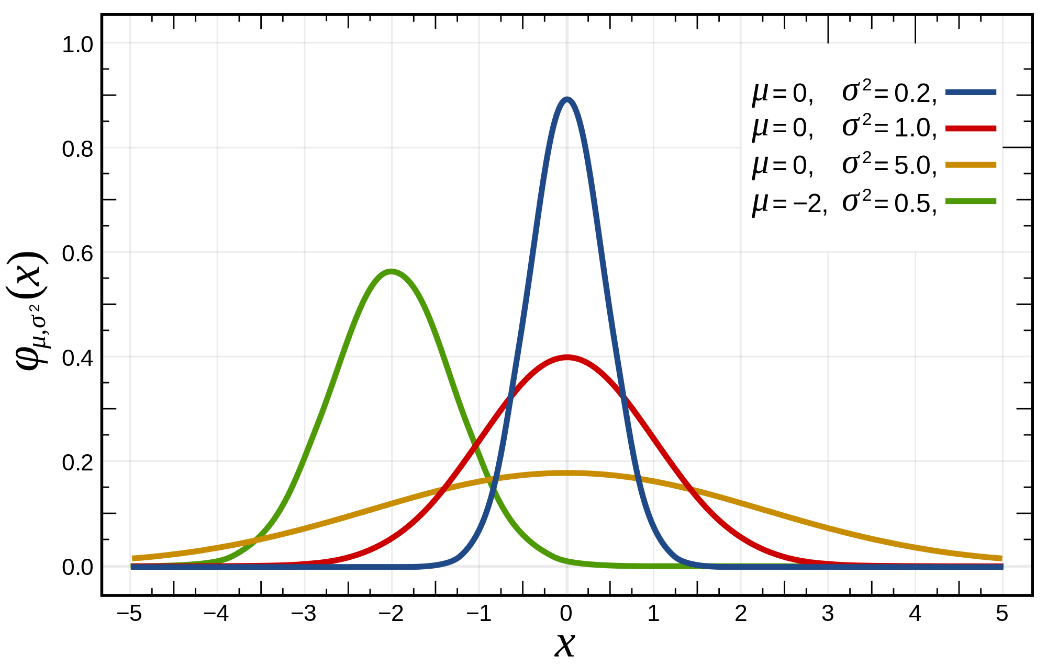
Basic Statistical Descriptions of Data
Motivation
  To better understand the data: central tendency, variation and spread
Data dispersion characteristics
  Median, max, min, quantiles, outliers, variance, ...
Numerical dimensions correspond to sorted intervals
  Data dispersion:
    Analyzed with multiple granularities of precision
  Boxplot or quantile analysis on sorted intervals
Dispersion analysis on computed measures
  Folding measures into numerical dimensions
  Boxplot or quantile analysis on the transformed cube
Notes:
Note to self (MK): last part of slide does not clearly match slides that follow
Introduction slides:
In the current version, we only talk about numeric data. Can we add some materials about non-numeric data.
- text statistics, TF/IDF
- visualization of text statistics such as word cloud
- distribution of Internet (IN, SCC, OUT, …)
- visualization of social relationship (e.g., http://renlifang.msra.cn/)

Slide 14
Measuring the Central Tendency: (1) Mean
Mean (algebraic measure) (sample vs. population):
  Note: n is sample size and N is population size
Weighted arithmetic mean:
Trimmed mean:
  Chopping extreme values (e.g., Olympics gymnastics score computation)

Slide 15
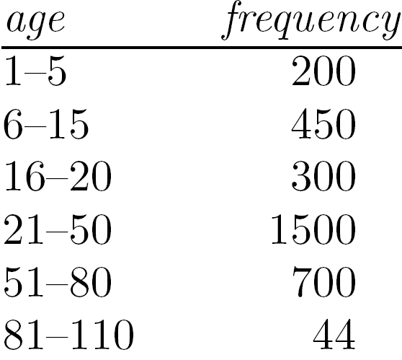
Measuring the Central Tendency: (2) Median
Median:
  Middle value if odd number of values, or average of the middle two values otherwise
Estimated by interpolation (for grouped data):
Approximate median
Sum before the median interval
Interval width (L₂ – L₁)
Low interval limit

Slide 16
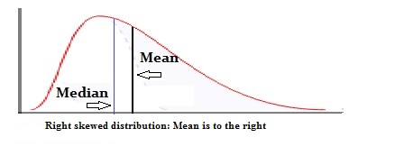
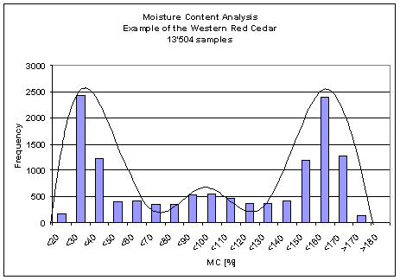
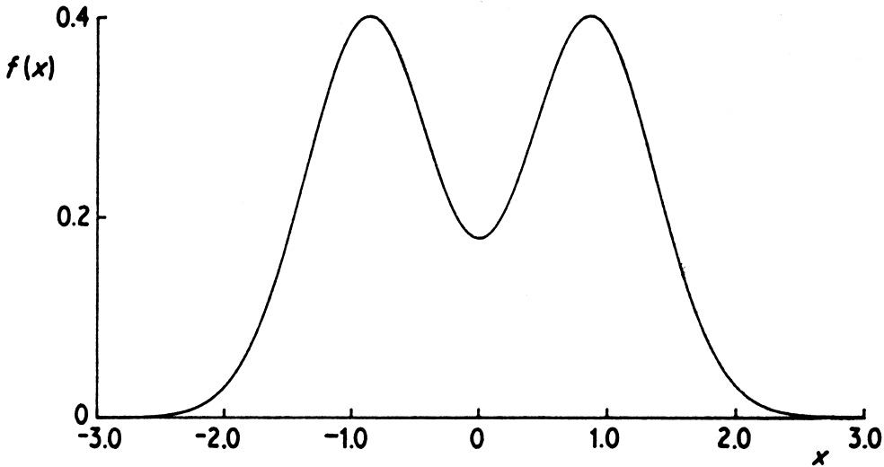
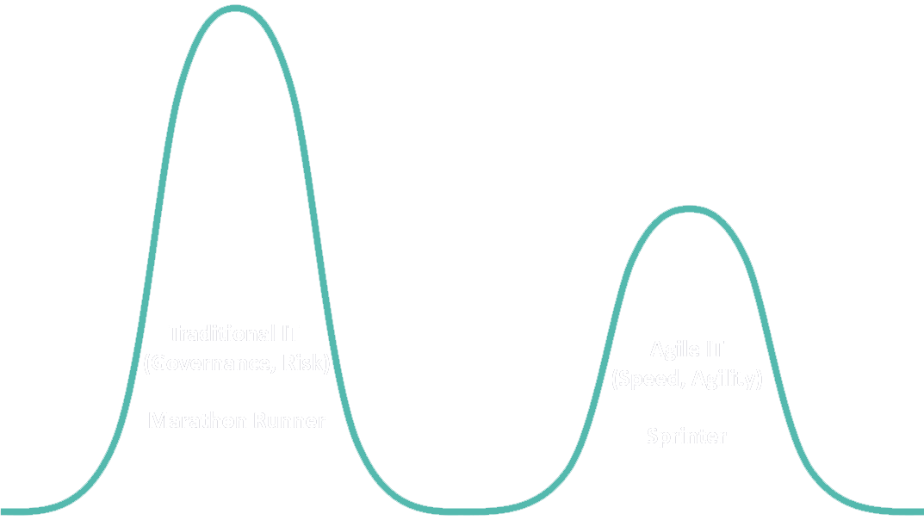
Measuring the Central Tendency: (3) Mode
Mode: Value that occurs most frequently in the data
Unimodal
  Empirical formula:
Multi-modal
  Bimodal
  Trimodal

Slide 17
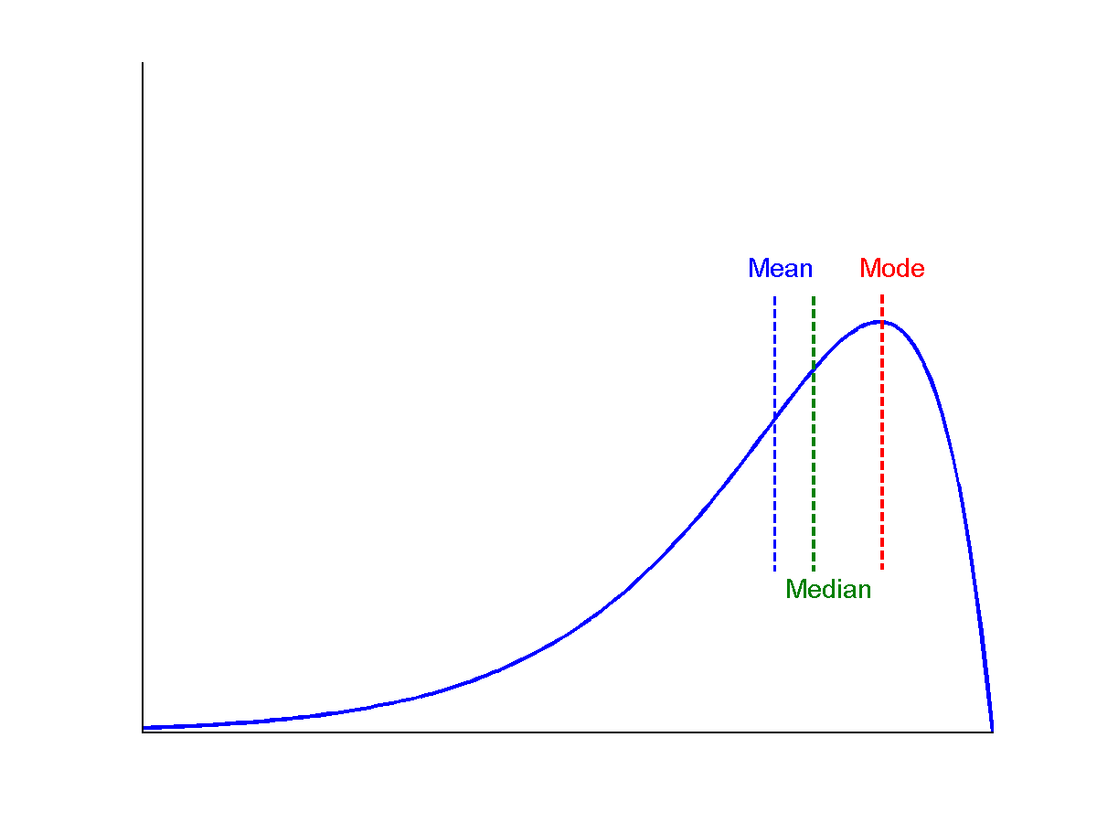
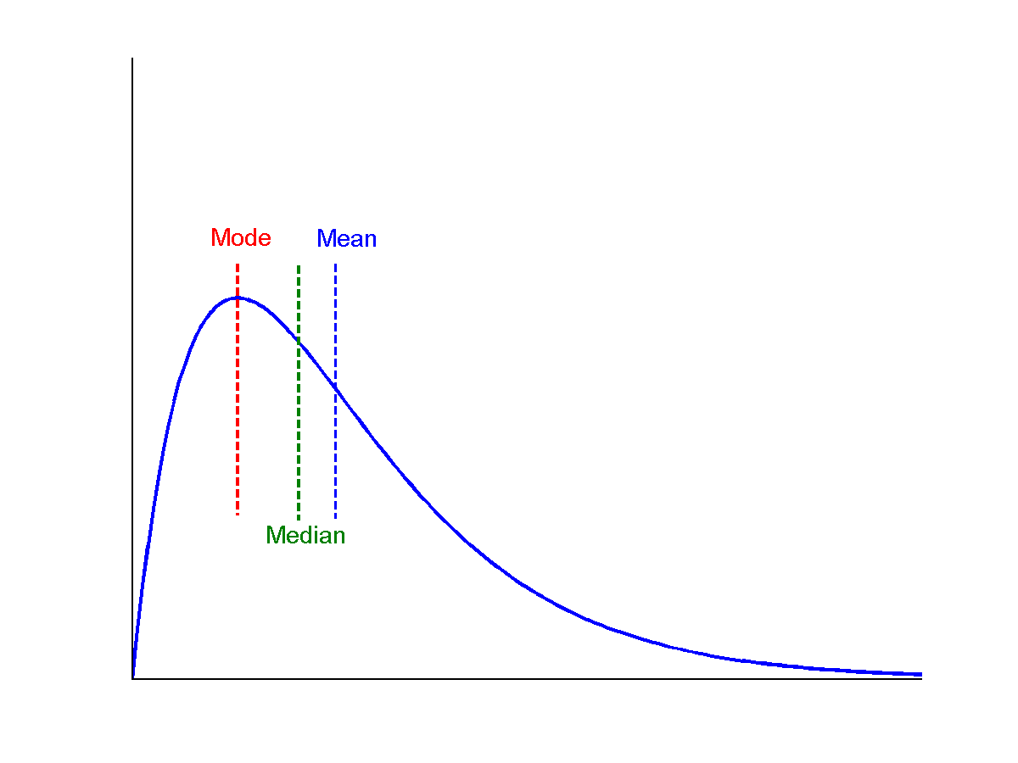
Symmetric vs. Skewed Data
symmetric
Median, mean and mode of symmetric, positively and negatively skewed data
positively skewed
negatively skewed

Slide 18
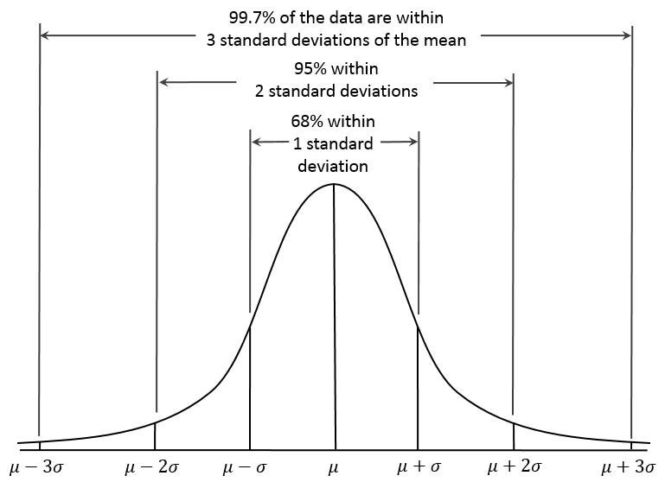
Properties of Normal Distribution Curve
← — ————Represent data dispersion, spread — ————→
Represent central tendency

Slide 19
Measures Data Distribution: Variance and Standard Deviation
Variance and standard deviation (sample: s, population: σ)
  Variance: (algebraic, scalable computation)
      Q: Can you compute it incrementally and efficiently?
  Standard deviation s (or σ) is the square root of variance s² ⁽or σ²⁾
Note: The subtle difference of formulae for sample vs. population
n : the size of the sample
N : the size of the population

Slide 20
Correlation Analysis (for Categorical Data)
Χ² (chi-square) test:
Null hypothesis: The two distributions are independent
The cells that contribute the most to the Χ² value are those whose actual count is very different from the expected count
  The larger the Χ² value, the more likely the variables are related
Note: Correlation does not imply causality
  Example: # of hospitals and # of car-theft in a city are correlated
  Both are causally linked to the third variable: population

Slide 21
Chi-Square Calculation: An Example
 | Play chess | Not play chess | Sum (row)
Like science fiction | 250 (X1) | 200 (X2) | 450
Not like science fiction | 50 (X3) | 1000 (X4) | 1050
Sum(col.) | 300 | 1200 | 1500
Null hypothesis: The two distributions are independent
  What does that mean?
  The ratio between people who play chess vs not play chess is the same for both groups of like science fiction and not like science fiction
  X1:X2=X3:X4=300:1200
  X1:X3=X2:X4=450:1050
  X1+X2=450 X3+X4=1050
  X1+X3=300 X2+X4=1200

Slide 22
Chi-Square Calculation: An Example
 | Play chess | Not play chess | Sum (row)
Like science fiction | 250 (90) | 200 (360) | 450
Not like science fiction | 50 (210) | 1000 (840) | 1050
Sum(col.) | 300 | 1200 | 1500
How to derive 90?
  450/1500 * 300 = 90
We can reject the
null hypothesis of
independence at a confidence level of 0.001
Χ² (chi-square) calculation (numbers in parenthesis are expected counts calculated based on the data distribution in the two categories)
It shows that like_science_fiction and play_chess are correlated in the group

Slide 23
Chi-Square Calculation: An Example
 | A | B | C | D | Sum (row)
1 |  |  |  |  | 200
0 |  |  |  |  | 1000
Sum(col.) | 300 | 300 | 300 | 300 | 1200
Degree of freedom
  (#categories_in_variable_A -1)*(#categories_in_variable_B -1)
  number of values that are free to vary

Slide 24
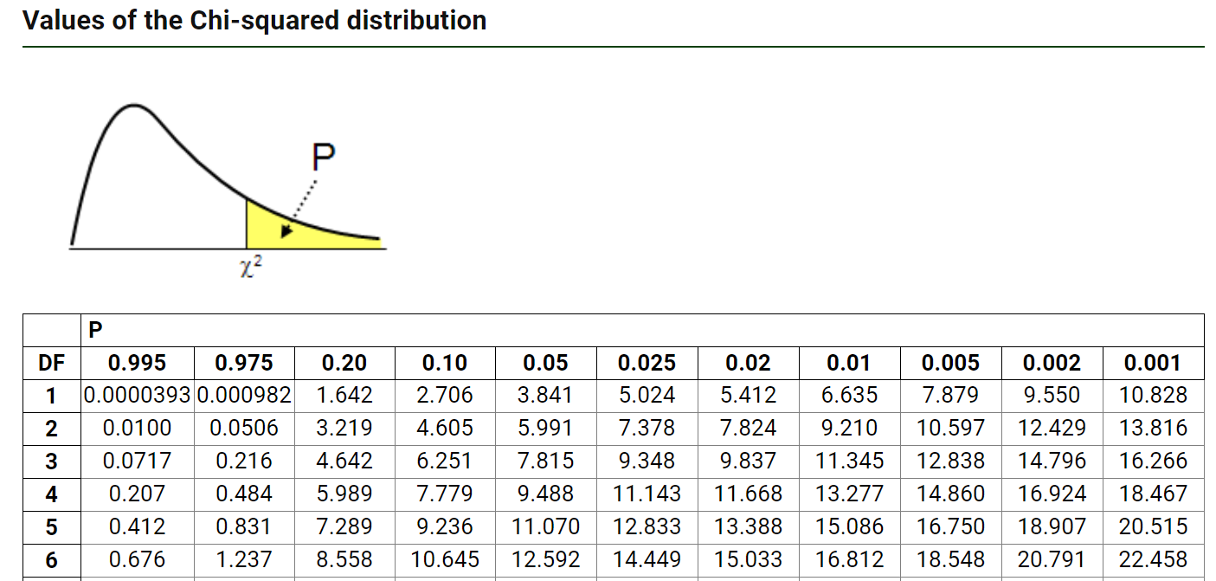
Chi-Square Calculation: An Example
 | Play chess | Not play chess | Sum (row)
Like science fiction | 250 (90) | 200 (360) | 450
Not like science fiction | 50 (210) | 1000 (840) | 1050
Sum(col.) | 300 | 1200 | 1500
We can reject the
null hypothesis of
independence at a confidence level of 0.001
Degree of freedom =?

Slide 25

Variance for Single Variable (Numerical Data)
The variance of a random variable X provides a measure of how much the value of X deviates from the mean or expected value of X:
  where σ² is the variance of X, σ is called standard deviation
        µ is the mean, and µ = E[X] is the expected value of X
  That is, variance is the expected value of the square deviation from the mean
  It can also be written as:
Sample variance
$$s^{2}=\frac{1}{n}\sum_{i}^{n}{{\left(x_{i}−\hat{μ}\right)}^{2}} s^{2}=\frac{1}{n−1}\sum_{i}^{n}{{\left(x_{i}−\hat{μ}\right)}^{2}}$$

Slide 26
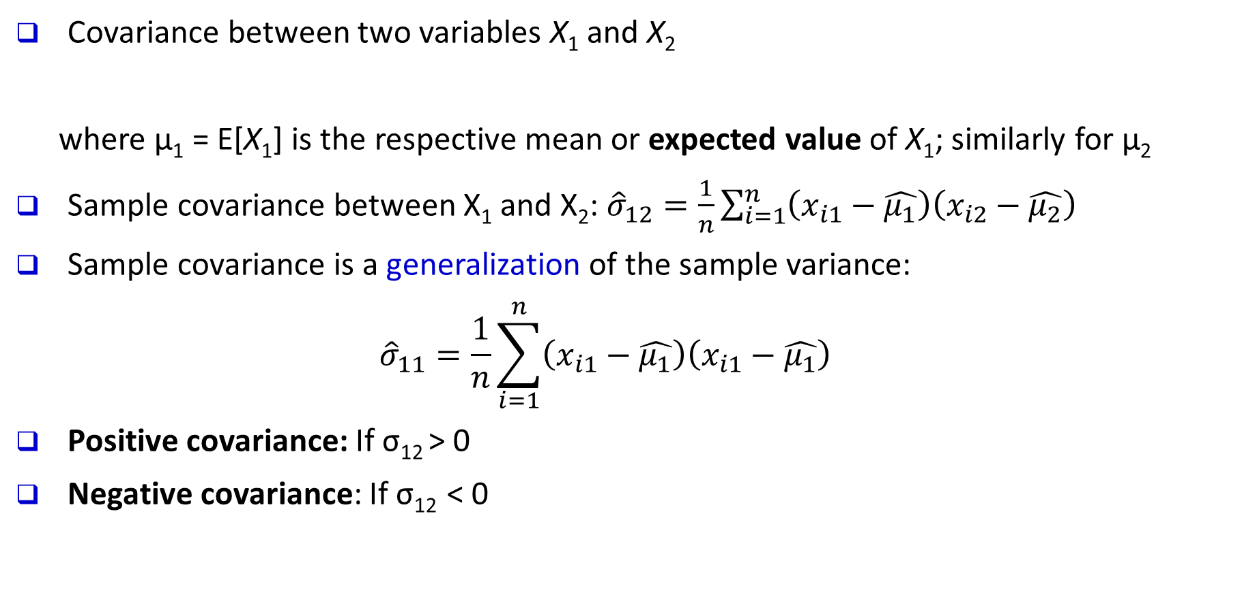
Covariance for Two Variables
Covariance between two variables X₁ and X₂
    where µ₁ = E[X₁] is the respective mean or expected value of X₁; similarly for µ₂
Sample covariance between X₁ and X₂: ${\hat{σ}}_{12}=\frac{1}{n}\sum_{i=1}^{n}{\left(x_{i1}−\hat{μ_{1}}\right)\left(x_{i2}−\hat{μ_{2}}\right)}$
Sample covariance is a generalization of the sample variance:
${\hat{σ}}_{11}=\frac{1}{n}\sum_{i=1}^{n}{\left(x_{i1}−\hat{μ_{1}}\right)\left(x_{i1}−\hat{μ_{1}}\right)}$
Positive covariance: If σ₁₂ > 0
Negative covariance: If σ₁₂ < 0

Slide 27
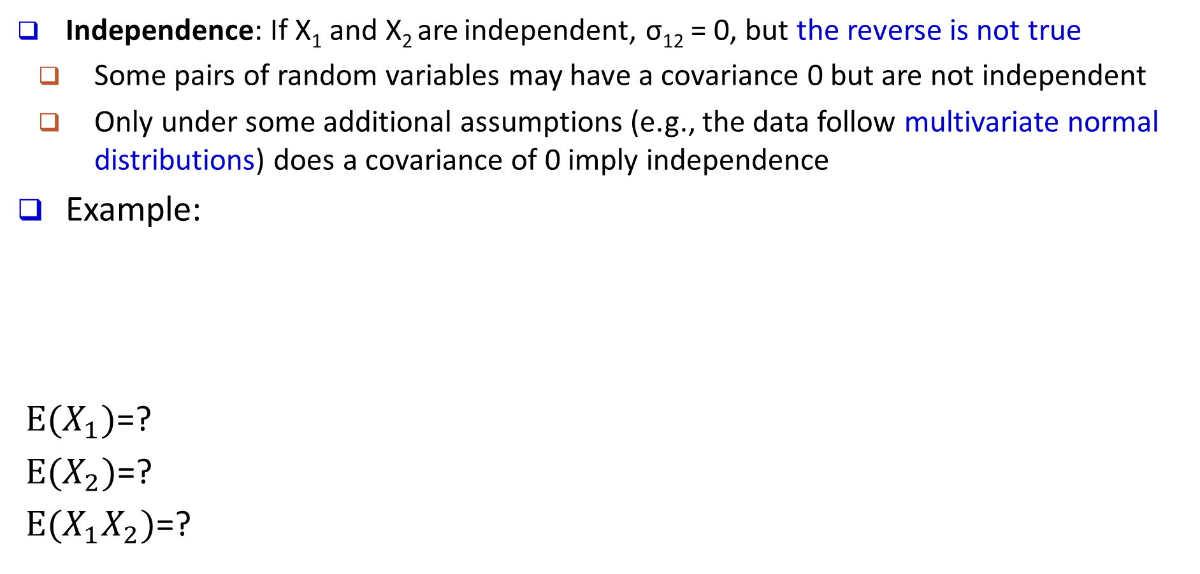
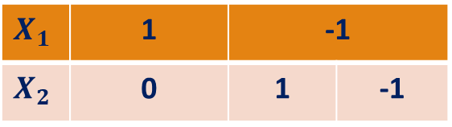
Covariance for Two Variables
Independence: If X₁ and X₂ are independent, σ₁₂ = 0, but the reverse is not true
  Some pairs of random variables may have a covariance 0 but are not independent
  Only under some additional assumptions (e.g., the data follow multivariate normal distributions) does a covariance of 0 imply independence
Example:
$E(X_{1})$=?
$E(X_{2})$=?
$E(X_{1}X_{2})$=?
$$X_{1}$$ | 1 | -1
$$X_{2}$$ | 0 | 1 | -1

Slide 28
Example: Calculation of Covariance
Suppose two stocks X₁ and X₂ have the following values in one week:
    (2, 5), (3, 8), (5, 10), (4, 11), (6, 14)
Question: If the stocks are affected by the same industry trends, will their prices rise or fall together?
Covariance formula
Its computation can be simplified as:
  E(X₁) = (2 + 3 + 5 + 4 + 6)/ 5 = 20/5 = 4
  E(X₂) = (5 + 8 + 10 + 11 + 14) /5 = 48/5 = 9.6
  σ₁₂ = (2×5 + 3×8 + 5×10 + 4×11 + 6×14)/5 − 4 × 9.6 = 4
Thus, X₁ and X₂ rise together since σ₁₂ > 0

Slide 29
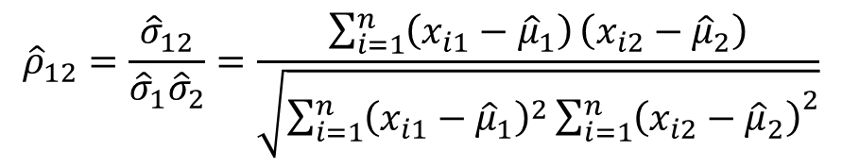
Correlation between Two Numerical Variables
  Correlation between two variables X₁ and X₂ is the standard covariance, obtained by normalizing the covariance with the standard deviation of each variable
Sample correlation for two attributes X₁ and X₂:
      where n is the number of tuples, µ₁ and µ₂ are the respective means of X₁ and X₂ , σ₁ and σ₂ are the respective standard deviation of X₁ and X₂
If ρ₁₂ > 0: A and B are positively correlated (X₁’s values increase as X₂’s)
  The higher, the stronger correlation
If ρ₁₂ = 0: independent (under the same assumption as discussed in co-variance)
If ρ₁₂ < 0: negatively correlated
$${\hat{ρ}}_{12}=\frac{{\hat{σ}}_{12}}{{\hat{σ}}_{1}{\hat{σ}}_{2}}=\frac{\sum_{i=1}^{n}{\left(x_{i1}−{\hat{μ}}_{1}\right)}\left(x_{i2}−{\hat{μ}}_{2}\right)}{\sqrt{\sum_{i=1}^{n}{{\left(x_{i1}−{\hat{μ}}_{1}\right)}^{2}}{\sum_{i=1}^{n}{\left(x_{i2}−{\hat{μ}}_{2}\right)}}^{2}}}$$

Slide 30

Visualizing Changes of Correlation Coefficient
Correlation coefficient value range: [–1, 1]
A set of scatter plots shows sets of points and their correlation coefficients changing from –1 to 1

Slide 31
Covariance Matrix
The variance and covariance information for the two variables X₁ and X₂ can be summarized as 2 X 2 covariance matrix as
Generalizing it to d dimensions, we have,

Slide 32
Graphic Displays of Basic Statistical Descriptions
Boxplot: graphic display of five-number summary
Histogram: x-axis are values, y-axis repres. frequencies
Quantile plot: each value x_{i} is paired with f_{i} indicating that approximately 100 f_{i} % of data are ≤ x_{i}
Quantile-quantile (q-q) plot: graphs the quantiles of one univariant distribution against the corresponding quantiles of another
Scatter plot: each pair of values is a pair of coordinates and plotted as points in the plane
Notes:
JH: Maybe we can remove Loess curve

Slide 33
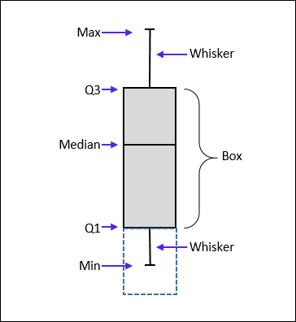
Measuring the Dispersion of Data: Quartiles & Boxplots
Quartiles: Q₁ (25th percentile), Q₃ (75th percentile)
Inter-quartile range: IQR = Q₃ – Q₁
Five number summary: min, Q₁, median, Q₃, max
Boxplot: Data is represented with a box
  Q₁, Q₃, IQR: The ends of the box are at the first and third quartiles, i.e., the height of the box is IQR
  Median (Q₂) is marked by a line within the box
  Whiskers: two lines outside the box extended to Minimum and Maximum
  Outliers: points beyond a specified outlier threshold, plotted individually
    Outlier: usually, a value higher/lower than 1.5 x IQR

Slide 34
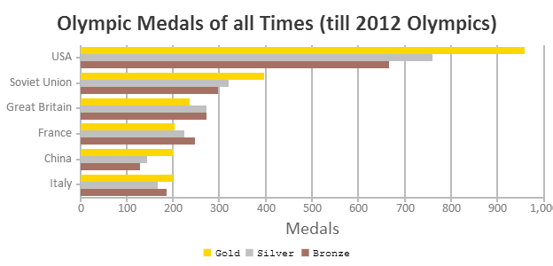
Histogram Analysis
Histogram
Histogram: Graph display of tabulated frequencies, shown as bars
Differences between histograms and bar charts
  Histograms are used to show distributions of variables while bar charts are used to compare variables
  Histograms plot binned quantitative data while bar charts plot categorical data
  Bars can be reordered in bar charts but not in histograms
  Differs from a bar chart in that it is the area of the bar that denotes the value, not the height as in bar charts, a crucial distinction when the categories are not of uniform width
Bar chart
Notes:
JH: A better and BASIC histogram figure --- because this one overlaps with a later one!

Slide 35
Histograms Often Tell More than Boxplots
The two histograms shown in the left may have the same boxplot representation
  The same values for: min, Q1, median, Q3, max
But they have rather different data distributions

Slide 36
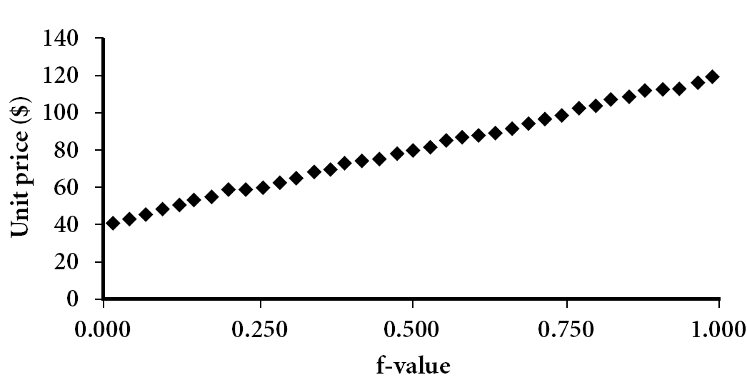
Quantile Plot
Displays all of the data (allowing the user to assess both the overall behavior and unusual occurrences)
Plots quantile information
  For a data x_{i} data sorted in increasing order, f_{i} indicates that approximately 100 f_{i}% of the data are below or equal to the value x_{i}

Slide 37
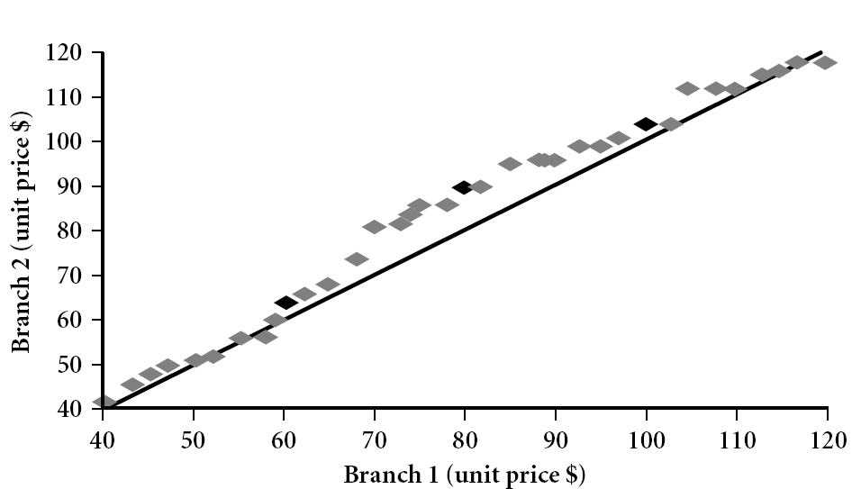
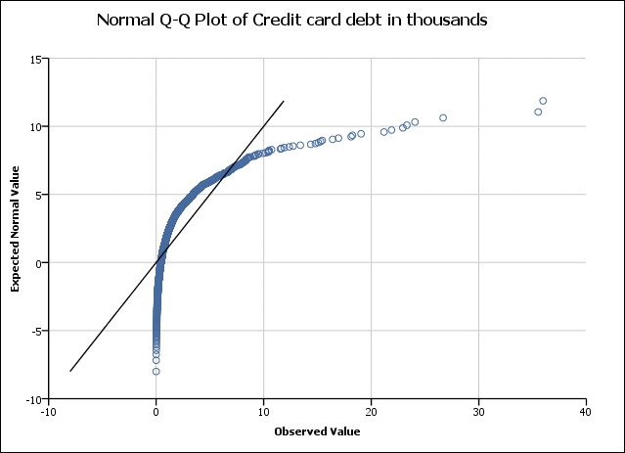
Quantile-Quantile (Q-Q) Plot
Graphs the quantiles of one univariate distribution against the corresponding quantiles of another
View: Is there is a shift in going from one distribution to another?
Example shows unit price of items sold at Branch 1 vs. Branch 2 for each quantile. Unit prices of items sold at Branch 1 tend to be lower than those at Branch 2
Notes:
Note: We need to label the dark plotted points as Q1, Median, Q3 – that would help in understanding this graph.
Tell audience: There is a shift in distribution of branch 1 WRT branch 2 in that the unit prices of items sold at branch 1 tend to be lower than those at branch 2.

Slide 38
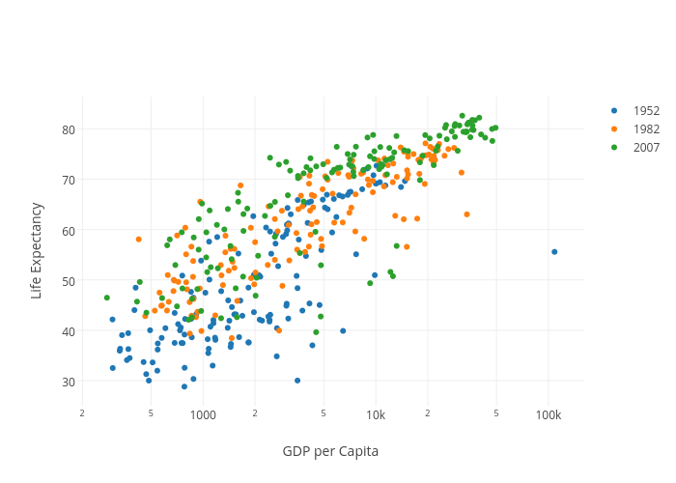
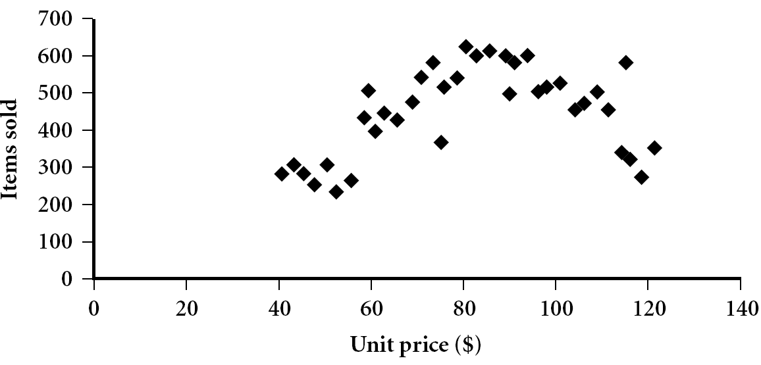
Scatter plot
Provides a first look at bivariate data to see clusters of points, outliers, etc.
Each pair of values is treated as a pair of coordinates and plotted as points in the plane
Notes:
Need a better and more MEANINGFUL scatter plot! -JH

Slide 39
Positively and Negatively Correlated Data
The left half fragment is positively correlated
The right half is negative correlated

Slide 40
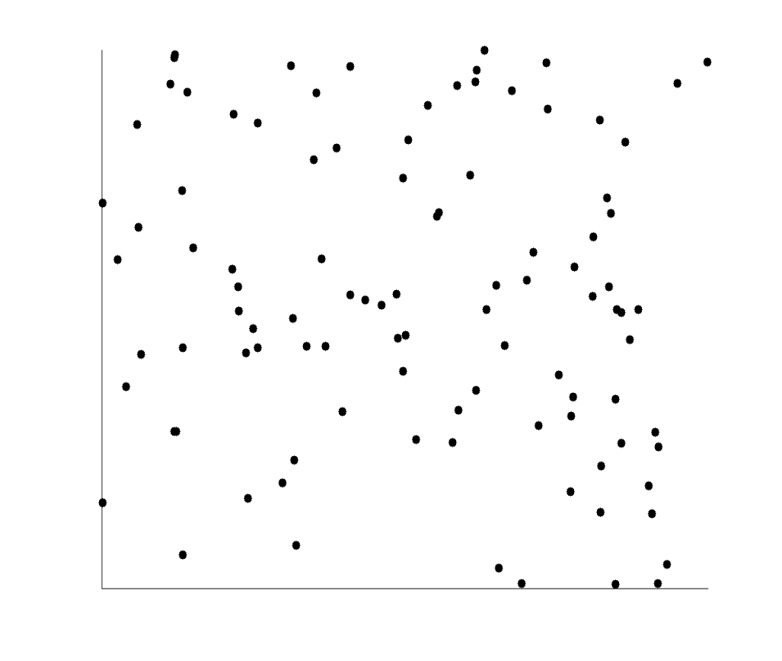
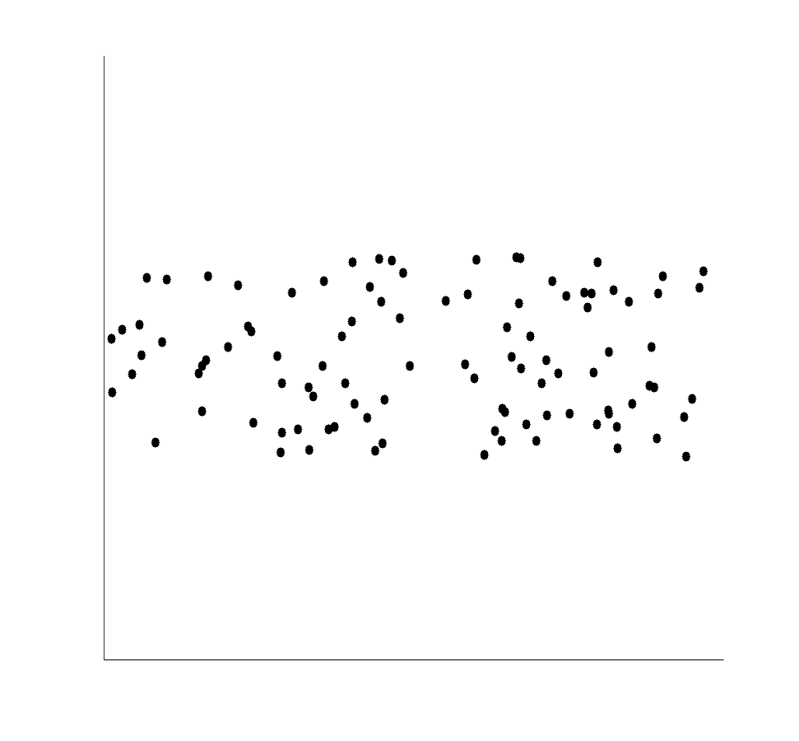
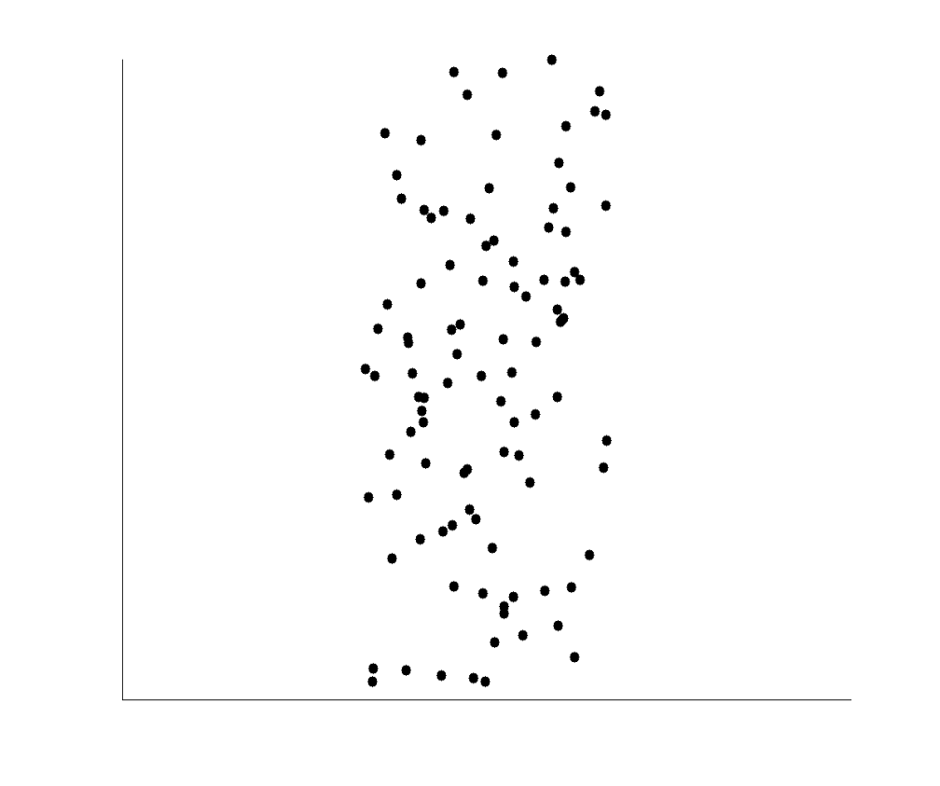
Uncorrelated Data

Slide 41
Similarity and Distance Measures
Data Matrix versus Dissimilarity Matrix
Proximity Measures for Nominal Attributes
Proximity Measures for Binary Attributes
Dissimilarity of Numeric Data: Minkowski Distance
Proximity Measures for Ordinal Attributes
Dissimilarity for Attributes of Mixed Types
Cosine Similarity
Measuring Similar Distributions: The Kullback-Leibler Divergence
Capturing Hidden Semantics in Similarity Measures

Slide 42
Similarity, Dissimilarity, and Proximity
Similarity measure or similarity function
  A real-valued function that quantifies the similarity between two objects
  Measure how two data objects are alike: The higher value, the more alike
  Often falls in the range [0,1]: 0: no similarity; 1: completely similar
Dissimilarity (or distance) measure
  Numerical measure of how different two data objects are
  In some sense, the inverse of similarity: The lower, the more alike
  Minimum dissimilarity is often 0 (i.e., completely similar)
  Range [0, 1] or [0, ∞) , depending on the definition
Proximity usually refers to either similarity or dissimilarity

Slide 43
Data Matrix and Dissimilarity Matrix
Data matrix
  A data matrix of n data points with l dimensions
Dissimilarity (distance) matrix
  n data points, but registers only the distance d(i, j) (typically metric)
  Usually symmetric, thus a triangular matrix
  Distance functions are usually different for real, boolean, categorical, ordinal, ratio, and vector variables
  Weights can be associated with different variables based on applications and data semantics

Slide 44
Standardizing Numeric Data
Z-score:
  X: raw score to be standardized, μ: mean of the population, σ: standard deviation
  the distance between the raw score and the population mean in units of the standard deviation
  negative when the raw score is below the mean, “+” when above
An alternative way: Calculate the mean absolute deviation
  where
  standardized measure (z-score):
Using mean absolute deviation is more robust than using standard deviation
Notes:
MK: For lecture, this may be OK here, but I think discussion of standardization/normalization is better kept all together in Chapter 3

Slide 45
Example: Data Matrix and Dissimilarity Matrix
Data Matrix
Dissimilarity Matrix (by Euclidean Distance)

Slide 46
Distance on Numeric Data: Minkowski Distance
Minkowski distance: A popular distance measure
  where i = (x_{i1}, x_{i2}, …, x_{il}) and j = (x_{j1}, x_{j2}, …, x_{jl}) are two l-dimensional data objects, and p is the order (the distance so defined is also called L-p norm)
Properties
  d(i, j) > 0 if i ≠ j, and d(i, i) = 0 (Positivity)
  d(i, j) = d(j, i) (Symmetry)
  d(i, j) ≤ d(i, k) + d(k, j) (Triangle Inequality)
A distance that satisfies these properties is a metric
Note: There are nonmetric dissimilarities, e.g., set differences

Slide 47
Special Cases of Minkowski Distance
p = 1: (L₁ norm) Manhattan (or city block) distance
  E.g., the Hamming distance: the number of bits that are different between two binary vectors
p = 2: (L₂ norm) Euclidean distance
p → ∞: (L_{max} norm, L∞ norm) “supremum” distance
  The maximum difference between any component (attribute) of the vectors

Slide 48
Example: Minkowski Distance at Special Cases
Manhattan (L₁)
Euclidean (L₂)
Supremum (L∞)

Slide 49
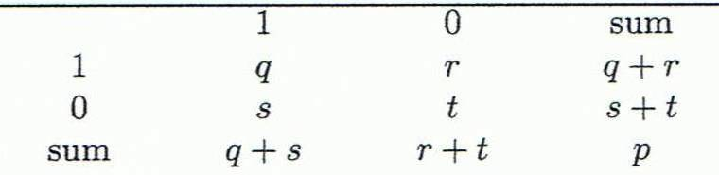
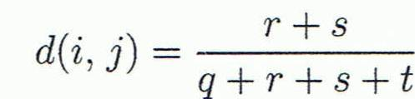
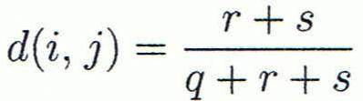

Proximity Measure for Binary Attributes
A contingency table for binary data
Distance measure for symmetric binary variables:
Distance measure for asymmetric binary variables:
Jaccard coefficient (similarity measure for asymmetric binary variables):
Note: Jaccard coefficient is the same as “coherence”:
Object j
Object i
(a concept discussed in Pattern Discovery)

Slide 50
Example: Dissimilarity between Asymmetric Binary Variables
Mary
 | 1 | 0 | ∑_{row}
1 | 2 | 0 | 2
0 | 1 | 3 | 4
∑_{col} | 3 | 3 | 6
Jack
Gender is a symmetric attribute (not counted in)
The remaining attributes are asymmetric binary
Let the values Y and P be 1, and the value N be 0
Distance:
Jim
 | 1 | 0 | ∑_{row}
1 | 1 | 1 | 2
0 | 1 | 3 | 4
∑_{col} | 2 | 4 | 6
Jack
Mary
 | 1 | 0 | ∑_{row}
1 | 1 | 1 | 2
0 | 2 | 2 | 4
∑_{col} | 3 | 3 | 6
Jim

Slide 51
Proximity Measure for Categorical Attributes
Categorical data, also called nominal attributes
  Example: Color (red, yellow, blue, green), profession, etc.
Method 1: Simple matching
  m: # of matches, p: total # of variables
Method 2: Use a large number of binary attributes
  Creating a new binary attribute for each of the M nominal states

Slide 52
Ordinal Variables
An ordinal variable can be discrete or continuous
Order is important, e.g., rank (e.g., freshman, sophomore, junior, senior)
Can be treated like interval-scaled
  Replace an ordinal variable value by its rank:
  Map the range of each variable onto [0, 1] by replacing i-th object in the f-th variable by
    Example: freshman: 0; sophomore: 1/3; junior: 2/3; senior 1
      Then distance: d(freshman, senior) = 1, d(junior, senior) = 1/3
  Compute the dissimilarity using methods for interval-scaled variables

Slide 53
Attributes of Mixed Type
A dataset may contain all attribute types
  Nominal, symmetric binary, asymmetric binary, numeric, and ordinal
One may use a weighted formula to combine their effects:
  If f is numeric: Use the normalized distance
  If f is binary or nominal: d_{ij}^{(f)} = 0 if x_{if} = x_{jf}; or d_{ij}^{(f)} = 1 otherwise
  If f is ordinal
    Compute ranks z_{if} (where )
    Treat z_{if} as interval-scaled

Slide 54
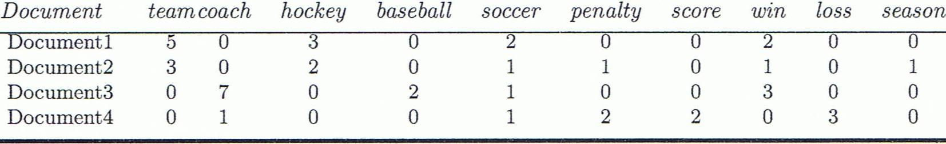
Cosine Similarity of Two Vectors
A document can be represented by a bag of terms or a long vector, with each attribute recording the frequency of a particular term (such as word, keyword, or phrase) in the document
Other vector objects: Gene features in micro-arrays
Applications: Information retrieval, biologic taxonomy, gene feature mapping, etc.
Cosine measure: If d₁ and d₂ are two vectors (e.g., term-frequency vectors), then
    where • indicates vector dot product, ||d||: the length of vector d

Slide 55
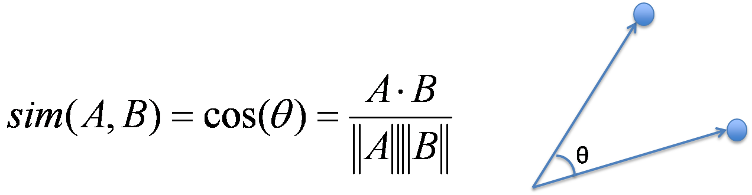
Example: Calculating Cosine Similarity
Calculating Cosine Similarity:
    where • indicates vector dot product, ||d||: the length of vector d
Ex: Find the similarity between documents 1 and 2.
        d₁ = (5, 0, 3, 0, 2, 0, 0, 2, 0, 0) d₂ = (3, 0, 2, 0, 1, 1, 0, 1, 0, 1)
  First, calculate vector dot product
        d₁•d₂ = 5 X 3 + 0 X 0 + 3 X 2 + 0 X 0 + 2 X 1 + 0 X 1 + 0 X 1 + 2 X 1 + 0 X 0 + 0 X 1 = 25
  Then, calculate ||d₁|| and ||d₂||
  Calculate cosine similarity: cos(d₁, d₂ ) = 25/ (6.481 X 4.12) = 0.94

Slide 56
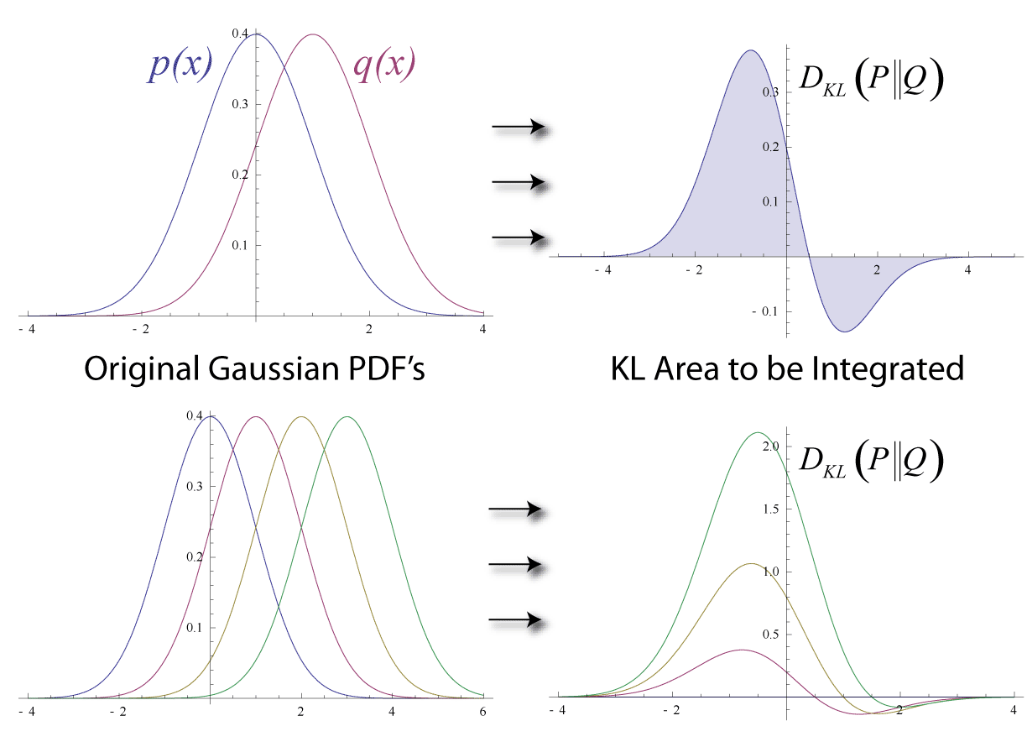
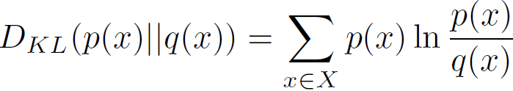
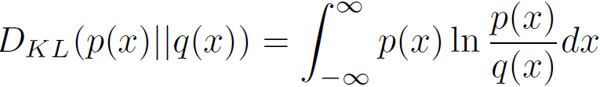
KL Divergence: Comparing Two Probability Distributions
The Kullback-Leibler (KL) divergence: Measure the difference between two probability distributions over the same variable x
  From information theory, closely related to relative entropy, information divergence, and information for discrimination
D_{KL}(p(x) || q(x)): divergence of q(x) from p(x), measuring the information lost when q(x) is used to approximate p(x)
Ack.: Wikipedia entry: The Kullback-Leibler (KL) divergence
Discrete form
Continuous form

Slide 57
More on KL Divergence
The KL divergence measures the expected number of extra bits required to code samples from p(x) (“true” distribution) when using a code based on q(x), which represents a theory, model, description, or approximation of p(x)
The KL divergence is not a distance measure, not a metric: asymmetric, not satisfy triangular inequality (D_{KL}(P‖Q) does not equal D_{KL}(Q‖P))
In applications, P typically represents the "true" distribution of data, observations, or a precisely calculated theoretical distribution, while Q typically represents a theory, model, description, or approximation of P.
The Kullback–Leibler divergence from Q to P, denoted D_{KL}(P‖Q), is a measure of the information gained when one revises one's beliefs from the prior probability distribution Q to the posterior probability distribution P. In other words, it is the amount of information lost when Q is used to approximate P.
The KL divergence is sometimes also called the information gain achieved if P is used instead of Q. It is also called the relative entropy of P with respect to Q.

Slide 58
Subtlety at Computing the KL Divergence
Base on the formula, D_{KL}(P,Q) ≥ 0 and D_{KL}(P || Q) = 0 if and only if P = Q
How about when p = 0 or q = 0?
  lim_{p→0} p log p = 0
  when p != 0 but q = 0, D_{KL}(p || q) is defined as ∞, i.e., if one event e is possible (i.e., p(e) > 0), and the other predicts it is absolutely impossible (i.e., q(e) = 0), then the two distributions are absolutely different
However, in practice, P and Q are derived from frequency distributions, not counting the possibility of unseen events. Thus smoothing is needed
Example: P : (a : 3/5, b : 1/5, c : 1/5). Q : (a : 5/9, b : 3/9, d : 1/9)
  need to introduce a small constant ϵ, e.g., ϵ = 10⁻³
  The sample set observed in P, SP = {a, b, c}, SQ = {a, b, d}, SU = {a, b, c, d}
  Smoothing, add missing symbols to each distribution, with probability ϵ
  P′ : (a : 3/5 − ϵ/3, b : 1/5 − ϵ/3, c : 1/5 − ϵ/3, d : ϵ)
  Q′ : (a : 5/9 − ϵ/3, b : 3/9 − ϵ/3, c : ϵ, d : 1/9 − ϵ/3)
  D_{KL}(P’ || Q’) can then be computed easily

Slide 59
Capturing Hidden Semantics in Similarity Measures
The above similarity measures cannot capture hidden semantics
  Which pairs are more similar: Geometry, algebra, music, politics?
The same bags of words may express rather different meanings
  “The cat bites a mouse” vs. “The mouse bites a cat”
  This is beyond what a vector space model can handle
Moreover, objects can be composed of rather complex structures and connections (e.g., graphs and networks)
New similarity measures needed to handle complex semantics
  Ex. Distributive representation and representation learning

Slide 60
Data Quality, Data Cleaning and Data Integration
Data Quality Measures
Data Cleaning
Data Integration

Slide 61
What is Data Preprocessing? — Major Tasks
Data cleaning
  Handle missing data, smooth noisy data, identify or remove outliers, and resolve inconsistencies
Data integration
  Integration of multiple databases, data cubes, or files
Data reduction
  Dimensionality reduction
  Numerosity reduction
  Data compression
Data transformation and data discretization
  Normalization
  Concept hierarchy generation

Slide 62
Why Preprocess the Data? — Data Quality Issues
Measures for data quality: A multidimensional view
  Accuracy: correct or wrong, accurate or not
  Completeness: not recorded, unavailable, …
  Consistency: some modified but some not, dangling, …
  Timeliness: timely update?
  Believability: how trustable the data are correct?
  Interpretability: how easily the data can be understood?

Slide 63
Data Cleaning
Data in the Real World Is Dirty: Lots of potentially incorrect data, e.g., instrument faulty, human or computer error, and transmission error
  Incomplete: lacking attribute values, lacking certain attributes of interest, or containing only aggregate data
    e.g., Occupation = “ ” (missing data)
  Noisy: containing noise, errors, or outliers
    e.g., Salary = “−10” (an error)
  Inconsistent: containing discrepancies in codes or names, e.g.,
    Age = “42”, Birthday = “03/07/2010”
    Was rating “1, 2, 3”, now rating “A, B, C”
    discrepancy between duplicate records
  Intentional (e.g., disguised missing data)
    Jan. 1 as everyone’s birthday?

Slide 64
Incomplete (Missing) Data
Data is not always available
  E.g., many tuples have no recorded value for several attributes, such as customer income in sales data
Missing data may be due to
  Equipment malfunction
  Inconsistent with other recorded data and thus deleted
  Data were not entered due to misunderstanding
  Certain data may not be considered important at the time of entry
  Did not register history or changes of the data
Missing data may need to be inferred

Slide 65
How to Handle Missing Data?
Ignore the tuple: usually done when class label is missing (when doing classification)—not effective when the % of missing values per attribute varies considerably
Fill in the missing value manually: tedious + infeasible?
Fill in it automatically with
  a global constant : e.g., “unknown”, a new class?!
  the attribute mean
  the attribute mean for all samples belonging to the same class: smarter
  the most probable value: inference-based such as Bayesian formula or decision tree

Slide 66
Noisy Data
Noise: random error or variance in a measured variable
Incorrect attribute values may be due to
  Faulty data collection instruments
  Data entry problems
  Data transmission problems
  Technology limitation
  Inconsistency in naming convention
Other data problems
  Duplicate records
  Incomplete data
  Inconsistent data
Notes:
66

Slide 67
How to Handle Noisy Data?
Binning
  First sort data and partition into (equal-frequency) bins
  Then one can smooth by bin means, smooth by bin median, smooth by bin boundaries, etc.
Regression
  Smooth by fitting the data into regression functions
Clustering
  Detect and remove outliers
Semi-supervised: Combined computer and human inspection
  Detect suspicious values and check by human (e.g., deal with possible outliers)
Notes:
Enrich using data integration research!!

Slide 68
Data Cleaning as a Process
Data discrepancy detection
  Use metadata (e.g., domain, range, dependency, distribution)
  Check field overloading
  Check uniqueness rule, consecutive rule and null rule
  Use commercial tools
    Data scrubbing: use simple domain knowledge (e.g., postal code, spell-check) to detect errors and make corrections
    Data auditing: by analyzing data to discover rules and relationship to detect violators (e.g., correlation and clustering to find outliers)
Data migration and integration
  Data migration tools: allow transformations to be specified
  ETL (Extraction/Transformation/Loading) tools: allow users to specify transformations through a graphical user interface
Integration of the two processes
  Iterative and interactive (e.g., Potter’s Wheels)

Slide 69
Data Integration
Data integration
  Combining data from multiple sources into a coherent store
Why data integration?
  Help reduce/avoid noise
  Get a more complete picture
  Improve mining speed and quality
Schema integration:
  e.g., A.cust-id ≡ B.cust-#
  Integrate metadata from different sources
Entity identification:
  Identify real world entities from multiple data sources, e.g., Bill Clinton = William Clinton
Notes:
Should ask students to do some survey on data integration. -JH

Slide 70
Handling Noise in Data Integration
Detecting data value conflicts
  For the same real world entity, attribute values from different sources are different
  Possible reasons: no reason, different representations, different scales, e.g., metric vs. British units
Resolving conflict information
  Take the mean/median/mode/max/min
  Take the most recent
  Truth finding: consider the source quality
Data cleaning + data integration

Slide 71
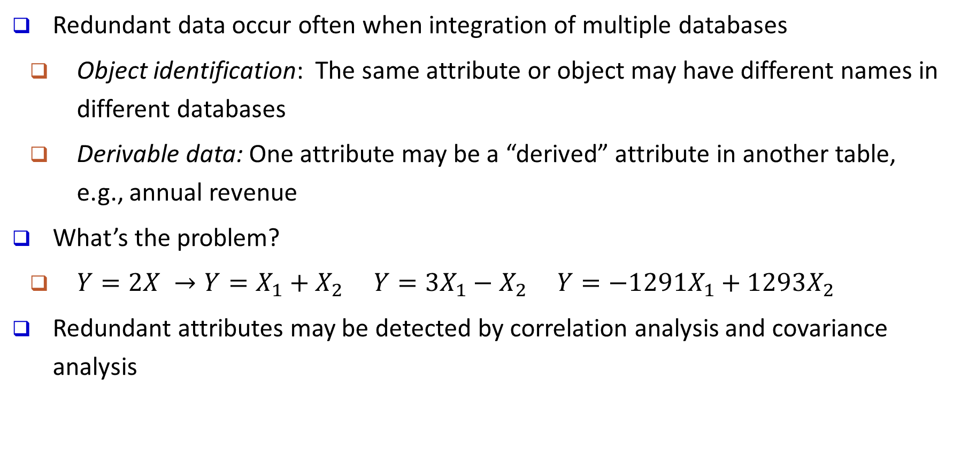
Handling Redundancy in Data Integration
Redundant data occur often when integration of multiple databases
  Object identification: The same attribute or object may have different names in different databases
  Derivable data: One attribute may be a “derived” attribute in another table, e.g., annual revenue
What’s the problem?
  $Y=2X →Y=X_{1}+X_{2} Y=3X_{1}−X_{2} Y=−1291X_{1}+1293X_{2}$
Redundant attributes may be detected by correlation analysis and covariance analysis

Slide 72
Data Transformation
Normalization
Discretization
Data Compression
Sampling

Slide 73
Data Transformation
A function that maps the entire set of values of a given attribute to a new set of replacement values s.t. each old value can be identified with one of the new values
Methods
  Smoothing: Remove noise from data
  Attribute/feature construction
    New attributes constructed from the given ones
  Aggregation: Summarization, data cube construction
  Normalization: Scaled to fall within a smaller, specified range
    min-max normalization
    z-score normalization
    normalization by decimal scaling
  Discretization: Concept hierarchy climbing
Notes:
73

Slide 74
Normalization
Min-max normalization: to [new_min_{A}, new_max_{A}]
  Ex. Let income range $12,000 to $98,000 normalized to [0.0, 1.0]
      Then $73,000 is mapped to
Z-score normalization (μ: mean, σ: standard deviation):
  Ex. Let μ = 54,000, σ = 16,000. Then
Normalization by decimal scaling
Z-score: The distance between the raw score and the population mean in the unit of the standard deviation
Where j is the smallest integer such that Max(|ν’|) < 1

Slide 75
Discretization
Three types of attributes
  Nominal—values from an unordered set, e.g., color, profession
  Ordinal—values from an ordered set, e.g., military or academic rank
  Numeric—real numbers, e.g., integer or real numbers
Discretization: Divide the range of a continuous attribute into intervals
  Interval labels can then be used to replace actual data values
  Reduce data size by discretization
  Supervised vs. unsupervised
  Split (top-down) vs. merge (bottom-up)
  Discretization can be performed recursively on an attribute
  Prepare for further analysis, e.g., classification
Notes:
08.09.12 MK: Slide moved here from Ch. 3. Added examples.

Slide 76
Data Discretization Methods
Binning
  Top-down split, unsupervised
Histogram analysis
  Top-down split, unsupervised
Clustering analysis
  Unsupervised, top-down split or bottom-up merge
Decision-tree analysis
  Supervised, top-down split
Correlation (e.g., χ²) analysis
  Unsupervised, bottom-up merge
Note: All the methods can be applied recursively
Notes:
76

Slide 77
Simple Discretization: Binning
Equal-width (distance) partitioning
  Divides the range into N intervals of equal size: uniform grid
  if A and B are the lowest and highest values of the attribute, the width of intervals will be: W = (B –A)/N
  The most straightforward, but outliers may dominate presentation
  Skewed data is not handled well
Equal-depth (frequency) partitioning
  Divides the range into N intervals, each containing approximately same number of samples
  Good data scaling
  Managing categorical attributes can be tricky

Slide 78
Example: Binning Methods for Data Smoothing
Sorted data for price (in dollars): 4, 8, 9, 15, 21, 21, 24, 25, 26, 28, 29, 34
* Partition into equal-frequency (equal-depth) bins:
- Bin 1: 4, 8, 9, 15
- Bin 2: 21, 21, 24, 25
- Bin 3: 26, 28, 29, 34
* Smoothing by bin means:
- Bin 1: 9, 9, 9, 9
- Bin 2: 23, 23, 23, 23
- Bin 3: 29, 29, 29, 29
* Smoothing by bin boundaries:
- Bin 1: 4, 4, 4, 15
- Bin 2: 21, 21, 25, 25
- Bin 3: 26, 26, 26, 34

Slide 79

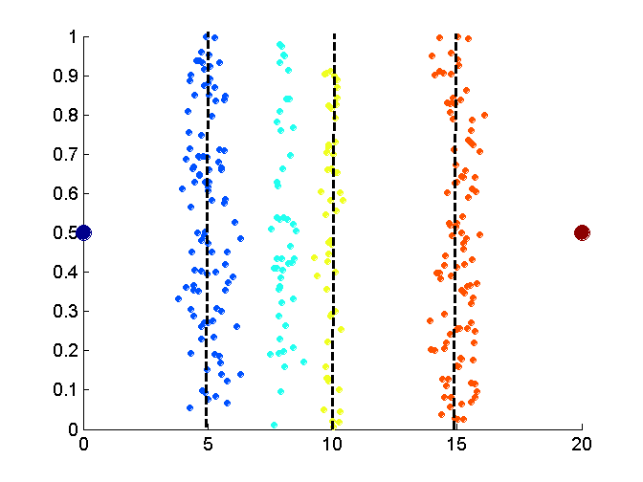
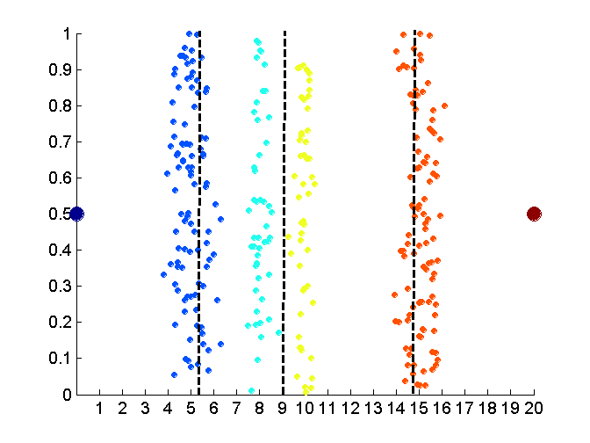

Discretization Without Supervision: Binning vs. Clustering
Data
Equal width (distance) binning
Equal depth (frequency) (binning)
K-means clustering leads to better results
Notes:
79

Slide 80
Discretization by Classification & Correlation Analysis
Classification (e.g., decision tree analysis)
  Supervised: Given class labels, e.g., cancerous vs. benign
  Using entropy to determine split point (discretization point)
  Top-down, recursive split
  Details to be covered in Chapter “Classification”
Correlation analysis (e.g., Chi-merge: χ²-based discretization)
  Supervised: use class information
  Bottom-up merge: Find the best neighboring intervals (those having similar distributions of classes, i.e., low χ² values) to merge
  Merge performed recursively, until a predefined stopping condition
Notes:
80

Slide 81
Concept Hierarchy Generation
Concept hierarchy organizes concepts (i.e., attribute values) hierarchically and is usually associated with each dimension in a data warehouse
Concept hierarchies facilitate drilling and rolling in data warehouses to view data in multiple granularity
Concept hierarchy formation: Recursively reduce the data by collecting and replacing low level concepts (such as numeric values for age) by higher level concepts (such as youth, adult, or senior)
Concept hierarchies can be explicitly specified by domain experts and/or data warehouse designers
Concept hierarchy can be automatically formed for both numeric and nominal data—For numeric data, use discretization methods shown

Slide 82
Concept Hierarchy Generation for Nominal Data
Specification of a partial/total ordering of attributes explicitly at the schema level by users or experts
  street < city < state < country
Specification of a hierarchy for a set of values by explicit data grouping
  {Urbana, Champaign, Chicago} < Illinois
Specification of only a partial set of attributes
  E.g., only street < city, not others
Automatic generation of hierarchies (or attribute levels) by the analysis of the number of distinct values
  E.g., for a set of attributes: {street, city, state, country}
Notes:
Should we briefly introduce ontology? Ontology has been used extensively in bio-medical data warehouses. -- JP
We should introduce this part using 1-2 slides -JH

Slide 83
Data Compression
String compression
  There are extensive theories and well-tuned algorithms
  Typically lossless, but only limited manipulation is possible without expansion
Audio/video compression
  Typically lossy compression, with progressive refinement
  Sometimes small fragments of signal can be reconstructed without reconstructing the whole
Time sequence is not audio
  Typically short and vary slowly with time
Data reduction and dimensionality reduction may also be considered as forms of data compression
Original Data
Compressed
Data
lossless
Original Data
Approximated
lossy
Lossy vs. lossless compression
Notes:
83
PCA and Wavelet are forms of data compression also.

Slide 84
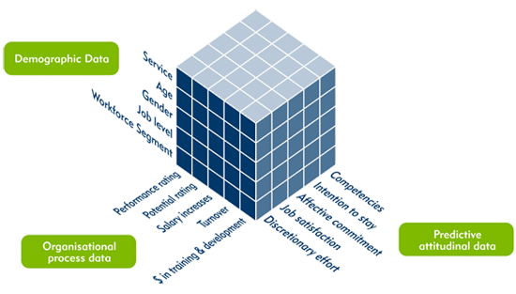
Data Cube Aggregation
The lowest level of a data cube (base cuboid)
  The aggregated data for an individual entity of interest
  E.g., a customer in a phone calling data warehouse
Multiple levels of aggregation in data cubes
  Further reduce the size of data to deal with
Reference appropriate levels
  Use the smallest representation which is enough to solve the task
Queries regarding aggregated information should be answered using data cube, when possible
Notes:
84

Slide 85
Automatic Concept Hierarchy Generation
Some hierarchies can be automatically generated based on the analysis of the number of distinct values per attribute in the data set
  The attribute with the most distinct values is placed at the lowest level of the hierarchy
  Exceptions, e.g., weekday, month, quarter, year
country
15 distinct values
province_or_ state
365 distinct values
city
3567 distinct values
street
674,339 distinct values

Slide 86
Sampling
Sampling: obtaining a small sample s to represent the whole data set N
Allow a mining algorithm to run in complexity that is potentially sub-linear to the size of the data
Key principle: Choose a representative subset of the data
  Simple random sampling may have very poor performance in the presence of skew
  Develop adaptive sampling methods, e.g., stratified sampling:
Note: Sampling may not reduce database I/Os (page at a time)

Slide 87
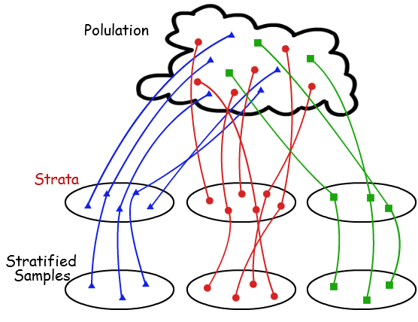
Types of Sampling
Simple random sampling: equal probability of selecting any particular item
Sampling without replacement
  Once an object is selected, it is removed from the population
Sampling with replacement
  A selected object is not removed from the population
Stratified sampling
  Partition (or cluster) the data set, and draw samples from each partition (proportionally, i.e., approximately the same percentage of the data)
Raw Data
SRSWOR
(simple random
sample without
replacement)
SRSWR
Stratified sampling

Slide 88
Data Reduction
Data reduction:
  Obtain a reduced representation of the data set
    much smaller in volume but yet produces almost the same analytical results
Why data reduction?—A database/data warehouse may store terabytes of data
  Complex analysis may take a very long time to run on the complete data set
Methods for data reduction (also data size reduction or numerosity reduction)
  Regression and Log-Linear Models
  Histograms, clustering, sampling
  Data cube aggregation
  Data compression
Notes:
MK 09/09/05: Wiki has dimensionality reduction as feature extraction (PCA) and feature subset selection. It states both wavelet transforms and PCA as forms of data compression. It does not have any pages for "numerosity reduction". We claim there are many different ways to organize data reduction strategies, which is true, so this presentation below should be OK. Let’s discuss.

Slide 89
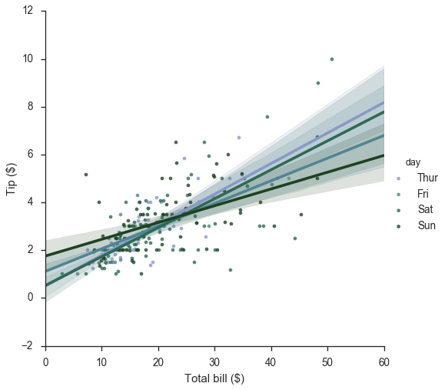
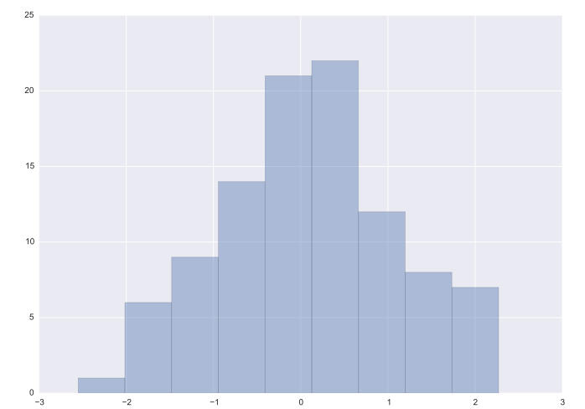
Data Reduction: Parametric vs. Non-Parametric Methods
Reduce data volume by choosing alternative, smaller forms of data representation
Parametric methods (e.g., regression)
  Assume the data fits some model, estimate model parameters, store only the parameters, and discard the data (except possible outliers)
  Ex.: Log-linear models—obtain value at a point in m-D space as the product on appropriate marginal subspaces
Non-parametric methods
  Do not assume models
  Major families: histograms, clustering, sampling, …
tip vs. bill
Clustering on the Raw Data
Stratified Sampling
Histogram

Slide 90
Parametric Data Reduction: Regression Analysis
Regression analysis: A collective name for techniques for the modeling and analysis of numerical data consisting of values of a dependent variable (also called response variable or measurement) and of one or more independent variables (also known as explanatory variables or predictors)
The parameters are estimated so as to give a "best fit" of the data
Most commonly the best fit is evaluated by using the least squares method, but other criteria have also been used
y
Y₁
Y₁’
y = x + 1
X₁
x
Used for prediction (including forecasting of time-series data), inference, hypothesis testing, and modeling of causal relationships

Slide 91
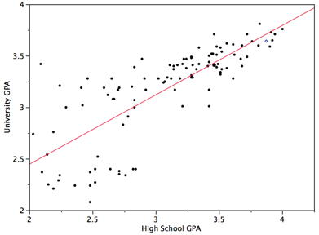
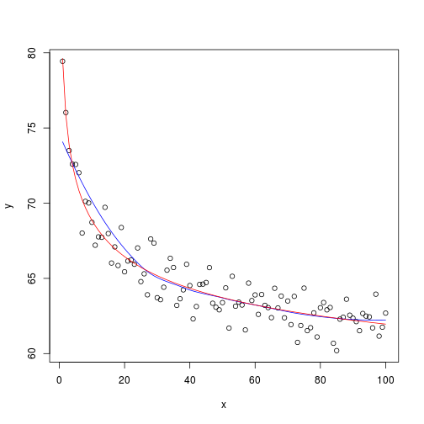
Linear and Multiple Regression
Linear regression: Y = w X + b
  Data modeled to fit a straight line
  Often uses the least-square method to fit the line
  Two regression coefficients, w and b, specify the line and are to be estimated by using the data at hand
  Using the least squares criterion to the known values of Y₁, Y₂, …, X₁, X₂, ….
Nonlinear regression:
  Data are modeled by a function which is a nonlinear combination of the model parameters and depends on one or more independent variables
  The data are fitted by a method of successive approximations

Slide 92
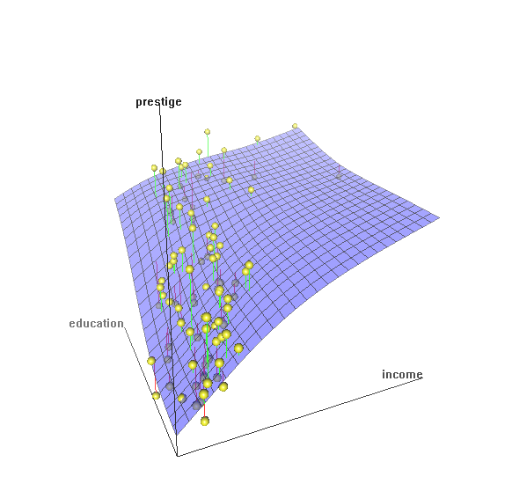
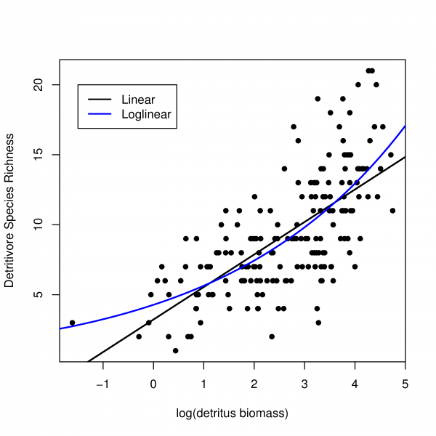
Multiple Regression and Log-Linear Models
Multiple regression: Y = b₀ + b₁ X₁ + b₂ X₂
  Allows a response variable Y to be modeled as a linear function of multidimensional feature vector
  Many nonlinear functions can be transformed into the above
Log-linear model:
  A math model that takes the form of a function whose logarithm is a linear combination of the parameters of the model, which makes it possible to apply (possibly multivariate) linear regression
  Estimate the probability of each point (tuple) in a multi-dimen. space for a set of discretized attributes, based on a smaller subset of dimensional combinations
  Useful for dimensionality reduction and data smoothing

Slide 93
Histogram Analysis
Divide data into buckets and store average (sum) for each bucket
Partitioning rules:
  Equal-width: equal bucket range
  Equal-frequency (or equal-depth)
Notes:
Removed 09/09/10: V-optimal: with the least histogram variance (weighted sum of the original values that each bucket represents)

Slide 94
Clustering
Partition data set into clusters based on similarity, and store cluster representation (e.g., centroid and diameter) only
Can be very effective if data is clustered but not if data is “smeared”
Can have hierarchical clustering and be stored in multi-dimensional index tree structures
There are many choices of clustering definitions and clustering algorithms
Cluster analysis will be studied in depth in Chapter 10

Slide 95
Dimensionality Reduction
What Is Dimensionality Reduction?
Dimensionality Reduction Methods
  Principal Component Analysis
  Attribute Subset Selection
  Nonlinear Dimensionality Reduction Methods

Slide 96
What Is Dimensionality Reduction?
Curse of dimensionality
  When dimensionality increases, data becomes increasingly sparse
  Density and distance between points, which is critical to clustering, outlier analysis, becomes less meaningful
  The possible combinations of subspaces will grow exponentially
Dimensionality reduction
  Reducing the number of random variables under consideration, via obtaining a set of principal variables
Advantages of dimensionality reduction
  Avoid the curse of dimensionality
  Help eliminate irrelevant features and reduce noise
  Reduce time and space required in data mining
  Allow easier visualization
Notes:
96
JH: put SVD at clustering high-D reduction.

Slide 97
Dimensionality Reduction Methods
Dimensionality reduction methodologies
  Feature selection: Find a subset of the original variables (or features, attributes)
  Feature extraction: Transform the data in the high-dimensional space to a space of fewer dimensions
Some typical dimensionality reduction methods
  Principal Component Analysis
  Attribute Subset Selection
  Nonlinear Dimensionality Reduction
Notes:
97
JH: put SVD at clustering high-D reduction.

Slide 98

Principal Component Analysis (PCA)
PCA: A statistical procedure that uses an orthogonal transformation to convert a set of observations of possibly correlated variables into a set of values of linearly uncorrelated variables called principal components
The original data are projected onto a much smaller space, resulting in dimensionality reduction
Method: Find the eigenvectors of the covariance matrix, and these eigenvectors define the new space
Ball travels in a straight line. Data from three cameras contain much redundancy

Slide 99

Principal Component Analysis (Method)
Given N data vectors from n-dimensions, find k ≤ n orthogonal vectors (principal components) best used to represent data
  Normalize input data: Each attribute falls within the same range
  Compute k orthonormal (unit) vectors, i.e., principal components
  Each input data (vector) is a linear combination of the k principal component vectors
  The principal components are sorted in order of decreasing “significance” or strength
  Since the components are sorted, the size of the data can be reduced by eliminating the weak components, i.e., those with low variance (i.e., using the strongest principal components, to reconstruct a good approximation of the original data)
Works for numeric data only
Ack. Wikipedia: Principal Component Analysis

Slide 100

Attribute Subset Selection
Another way to reduce dimensionality of data
Redundant attributes
  Duplicate much or all of the information contained in one or more other attributes
    E.g., purchase price of a product and the amount of sales tax paid
Irrelevant attributes
  Contain no information that is useful for the data mining task at hand
    Ex. A student’s ID is often irrelevant to the task of predicting his/her GPA

Slide 101
Heuristic Search in Attribute Selection
There are 2^{d} possible attribute combinations of d attributes
Typical heuristic attribute selection methods:
  Best single attribute under the attribute independence assumption: choose by significance tests
  Best step-wise feature selection:
    The best single-attribute is picked first
    Then next best attribute condition to the first, ...
  Step-wise attribute elimination:
    Repeatedly eliminate the worst attribute
  Best combined attribute selection and elimination
  Optimal branch and bound:
    Use attribute elimination and backtracking

Slide 102
Attribute Creation (Feature Generation)
Create new attributes (features) that can capture the important information in a data set more effectively than the original ones
Three general methodologies
  Attribute extraction
    Domain-specific
  Mapping data to new space (see data reduction)
    E.g., Fourier transformation, wavelet transformation, manifold approaches (not covered)
  Attribute construction
    Combining features (see discriminative frequent patterns in Chapter on “Advanced Classification”)
    Data discretization
Notes:
102

Slide 103
Nonlinear Dimensionality Reduction Methods
PCA is a linear method for dimensionality reduction
  Each principal component is a linear combination of the original input attributes
  It works well if the input data approximately follows a Gaussian distribution or forms a few linearly separable clusters
When the input data is linearly inseparable, we need to construct a proximity matrix (P) and learn a new matrix with k features (k << d) that preserves the proximity

Slide 104
Nonlinear Dimensionality Reduction (I): Kernel PCA (KPCA)
Use a kernel function κ(·) to construct the kernel matrix: P(i, j) = κ(x_{i}, x_{j}), and learn the best low-dimensional representations so that the estimated proximity matrix Pˆ is as close as possible to the kernel matrix P
This can be obtained by using top-k eigenvectors and eigenvalues of the kernel matrix P
Typical kernel functions:
  (1) polynomial kernel:
  (2) radial basis function (RBF):
  If we choose a linear kernel: κ(x_{i} , x_{j}) = x_{i}・x_{j}, KPCA degenerates to the standard PCA
Major formulas of Kernel PCA vs. SNE (Stochastic neighborhood embedding)

Slide 105
Nonlinear Dimensionality Reduction (II): SNE
SNE (Stochastic neighborhood embedding)
  Construct a proximity matrix P using the formula:
    rep. the probability that x_{j} is the neighbor of x_{i}
  Suppose we have learned the low-dimensional representations x_{i}ˆ, we can compute anther estimated proximity matrix in the similar way: Pˆ (i, j)
  We want to make the estimated proximity matrix P^ to be as close as possible to P
  That is, we want to minimize the overall K-L divergence, that is,

Slide 106
Example: Comparison on Nonlinear Data Points: Linear vs. Nonlinear Dimensional Reduction Methods
Visualization: An example of linear vs. nonlinear dimensionality reduction methods
  Given a collection of input data in 2-D space (Fig. (a)): Red and blue data points are not linearly separable
  PCA transformation can not make it linearly separable
  KPCA can make the points linearly separable
  t-SNE (t-distributional SNE) can make them linearly separable

Slide 107
Heatmap of the Proximity Matrices:
Linear vs. Nonlinear Dimensional Reduction Methods
The heatmaps of the proximity matrices in PCA (a), KPCA (b), and t-SNE(c)
  The two diagonal blocks indicate the proximity within the two clusters respectively
  The two off-diagonal blocks indicate the proximity between the data from the two clusters
  With nonlinear methods (KPCA and t-SNE), the proximity between data tuples from the same cluster is much higher than the proximity between data tuples from different clusters

Slide 108
Summary
Data types and attribute types
  Nominal, binary, ordinal, numerical, discrete vs. continuous attributes
Statistics of data
  Central tendency, dispersion, covariance and correlation, graphical displays
Measure data similarity and correlation
  Proximity measures for nominal, binary, numerical, ordinal and mixed types
  Cosine similarity, KL divergence
Data quality measures, data cleaning, and data integration
Data transformation: normalization, discretization, data compression and sampling
Dimensionality reduction methodologies
  Principal Component Analysis (PCA), attribute subset selection, and nonlinear dimensionality reduction

