Slide 1
Memory Management in Linux
(Chap. 8 in Understanding the Linux Kernel)
J. H. Wang
Nov. 6, 2009

Slide 2
Outline
Page Frame Management
Memory Area Management
Noncontiguous Memory Area Management

Slide 3
Page Frame Management
Two different page frame sizes
  4KB: standard memory allocation unit
  4MB
Page Descriptors
  Of type page
  Stored in the mem_map array

Slide 4
The Fields of the Page Descriptor
Type | Name | Description
unsigned long | flags | Array of flags
atomic_t | _count | Page frame's reference counter
atomic_t | _mapcount | Number of Page Table entries that refer to the page frame
unsigned long | private | Available to the kernel component that is using the page
struct address_space * | mapping | Used when the page is inserted into the page cache
unsigned long | index | Used by several kernel components with different meanings
struct list_head | lru | Contains pointers to the least recently used doubly linked list of pages.

Slide 5
Flags Describing the Status of a Page Frame
PG_locked, PG_error, PG_referenced, PG_uptodate, PG_dirty, PG_lru, PG_active, PG_slab, PG_skip, PG_highmem, PG_checked, PG_arch_1, PG_reserved, PG_private, PG_writeback, PG_nosave, PG_compound, PG_swapcache, PG_mappedtodisk, PG_reclaim, PG_nosave_free

Slide 6
NUMA (Non-Uniform Memory Access)
The physical memory of the system is partitioned in several nodes
  Each node has a descriptor (Table 8-3)
  The physical memory inside each node can be split into several zones
    ZONE_DMA: < 16MB
    ZONE_NORMAL: 16MB-896MB
    ZONE_HIGHMEM: > 896MB
    Each zone has its descriptor (Table 8-4)

Slide 7
The Pool of Reserved Page Frames
The amount of the reserved memory (in kilobytes) is stored in the min_free_kbytes variable

Slide 8
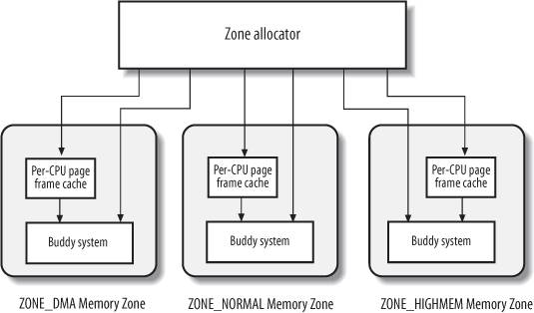
Zoned Page Frame Allocator

Slide 9
Requesting and Releasing Page Frames
Request:
  alloc_pages(), alloc_page(), __get_free_pages(), __get_free_page(), get_zoned_page(), __get_dma_pages()
Release:
  __free_pages(), free_pages(), __free_page(), free_page(),

Slide 10
Buddy System Algorithm
To avoid external fragmentation without paging
  Contiguous page frames are sometimes necessary
  Advantage of leaving kernel page tables unchanged
  Large chunks of contiguous physical memory can be accessed by the kernel through 4MB pages

Slide 11
The Buddy System
  11 lists of blocks: groups of 1, 2, 4, 8, 16, 32, 64, 128, 256, 512, 1024 contiguous page frames
  3 buddy systems in Linux 2.6
    For DMA, normal page frames, and high-memory page frames
  Allocating a block: __rmqueue()
  Freeing a block: __free_pages_bulk()

Slide 12
Per-CPU Page Frame Cache
Each per-CPU cache includes some pre-allocated page frames
  Hot cache
  Cold cache
  The fields of per_cpu_pages descriptor (Table 8-7)
  Allocating page frames: buffered_rmqueue()
  Releasing page frames: free_hot_page(), free_cold_page()

Slide 13
Memory Area Management
To avoid internal fragmentation
  Early Linux version adopt buddy system
    Not efficient
  A better algorithm is derived from slab allocator
    Adopted in Solaris 2.4

Slide 14
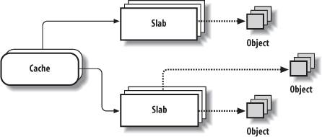
The Slab Allocator

Slide 15
The Slab Allocator
The slab allocator groups objects into caches
  Each cache is a store of objects of the same type
  A cache is divided into slabs
  Each slab consists of one or more contiguous page frames that contain both allocated and free objects
  Cache descriptor of type kmem_cache_t (Table 8-8)
  Slab descriptor of type slab (Table 8-10)
  Object descriptor of type kmem_bufctl_t

Slide 16
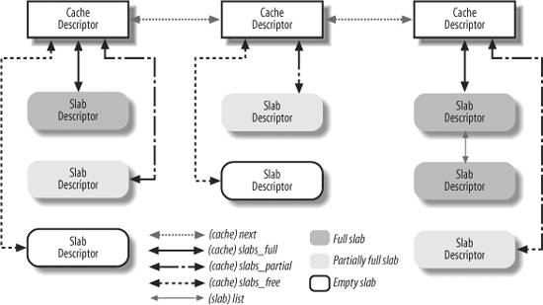
Relationship between Cache and Slab Descriptors

Slide 17
General vs. Specific Caches
General cache: kmem_cache_init()
  kmem_cache
  26 caches: two caches for each of the 13 sizes
Specific cache: kmem_cache_create()

Slide 18
Allocating a slab to a cache
  cache_grow()
Releasing a slab from a cache
  slab_destroy()

Slide 19
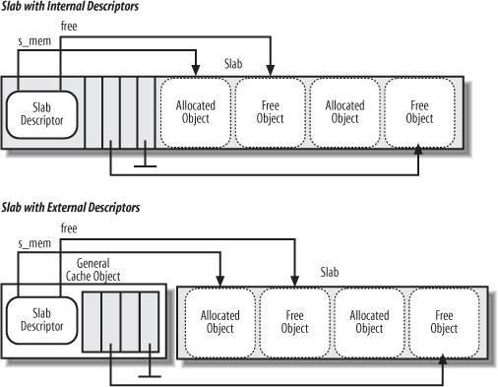
Relationships between Slab and Object Descriptors

Slide 20
Allocating a slab object
  kmem_cache_alloc()
Freeing a slab object
  kmem_cache_free()
General purpose objects
  kmalloc()
  kfree()

Slide 21
Memory Pools
New in Linux 2.6
Type mempool_t
mempool_alloc()
mempool_free()

Slide 22
Noncontiguous Memory Area Management
To avoid external fragmentation
Descriptor of type vm_struct (Table 8-13)
get_vm_area(): look for a free range of linear address
Allocating a noncontiguous memory area
  vmalloc()
Releasing a noncontiguousa memory area
  vfree()

Slide 23
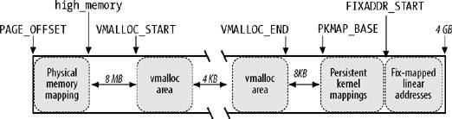
Linear Address Interval Starting from PAGE_OFFSET

Slide 24
Thanks for Your Attention!

