Slide 1
Distributed Word Representations for Information Retrieval
Notes:
13 slides for IR part at end, so allow 15 mins for that. Cut off GloVe as needed!

Slide 2
References
Slides from CS276: Information Retrieval and Web Search, by Christopher Manning and Pandu Nayak
Ch.5: Embeddings,
Daniel Jurafsky and James H. Martin. 2026. Speech and Language Processing: An Introduction to Natural Language Processing, Computational Linguistics, and Speech Recognition with Language Models, 3rd edition. Online manuscript released January 6, 2026. https://web.stanford.edu/~jurafsky/slp3.

Slide 3
How can we more robustly match a user’s search intent?
Sec. 9.2.2
We want to understand the query, not just do String equals()
If user searches for [Dell notebook battery size], we would like to match documents discussing “Dell laptop battery capacity”
If user searches for [Seattle motel], we would like to match documents containing “Seattle hotel”
A naïve information retrieval system does nothing to help
Simple facilities that we have already discussed do a bit to help
Spelling correction
Stemming / case folding
But we’d like to better understand when query/document match

Slide 4
How can we more robustly match a user’s search intent?
Sec. 9.2.2
Use of anchor text may solve this by providing human authored synonyms, but not for new or less popular web pages, or non-hyperlinked collections
Relevance feedback could allow us to capture this if we get near enough to matching documents with these words
We can also fix this with information on word similarities:
  A manual thesaurus of synonyms
  A measure of word similarity
    Calculated from a big document collection
    Calculated by query log mining (common on the web)

Slide 5
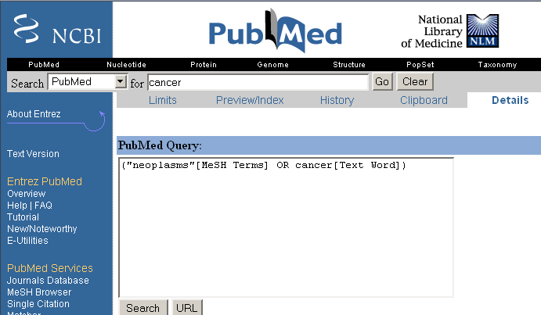
Example of manual thesaurus
Sec. 9.2.2
Notes:
E.g. MedLine: physician, syn: doc, doctor, MD, medico

Slide 6
Search log query expansion
Context-free query expansion ends up problematic
  [light hair] ≈ [fair hair] At least in U.K./Australia? ≈ blonde
    So expand [light] ⇒ [light fair]
  But [outdoor light price] ≠ [outdoor fair price]
You can learn query context-specific rewritings from search logs by attempting to identify the same user making a second attempt at the same user need
  [Hinton word vector]
  [Hinton word embedding]
In this context, [vector] ≈ [embedding]
  But not when talking about a disease vector or C++!

Slide 7
Automatic Thesaurus Generation
Sec. 9.2.3
Attempt to generate a thesaurus automatically by analyzing a collection of documents
Fundamental notion: similarity between two words
Definition 1: Two words are similar if they co-occur with similar words
Definition 2: Two words are similar if they occur in a given grammatical relation with the same words
You can harvest, peel, eat, prepare, etc. apples and pears, so apples and pears must be similar
Co-occurrence based is more robust, grammatical relations are more accurate
Why?

Slide 8
Simple Co-occurrence Thesaurus
Sec. 9.2.3
Simplest way to compute one is based on term-term similarities in C = AA^{T} where A is term-document matrix
w_{i,j} = (normalized) weight for (t_{i} ,d_{j})
For each t_{i}, pick terms with high values in C
d_{j}
N
A
What does C contain if A is a term-doc incidence (0/1) matrix?
t_{i}
M

Slide 9
Automatic thesaurus generation example … sort of works
Word | Nearest neighbors
absolutely | absurd, whatsoever, totally, exactly, nothing
bottomed | dip, copper, drops, topped, slide, trimmed
captivating | shimmer, stunningly, superbly, plucky, witty
doghouse | dog, porch, crawling, beside, downstairs
makeup | repellent, lotion, glossy, sunscreen, skin, gel
mediating | reconciliation, negotiate, cease, conciliation
keeping | hoping, bring, wiping, could, some, would
lithographs | drawings, Picasso, Dali, sculptures, Gauguin
pathogens | toxins, bacteria, organisms, bacterial, parasites
senses | grasp, psyche, truly, clumsy, naïve, innate
But data is too sparse in this form 100,000 words = 10¹⁰ entries in C

Slide 10
How can we represent term relations?
Sec. 9.2.2
With the standard symbolic encoding of terms, each term is a dimension
  One-hot encoding
Different terms have no inherent similarity
motel [0 0 0 0 0 0 0 0 0 0 1 0 0 0 0]^{T}
hotel [0 0 0 0 0 0 0 3 0 0 0 0 0 0 0] = 0
If query on hotel and document has motel, then our query and document vectors are orthogonal

Slide 11
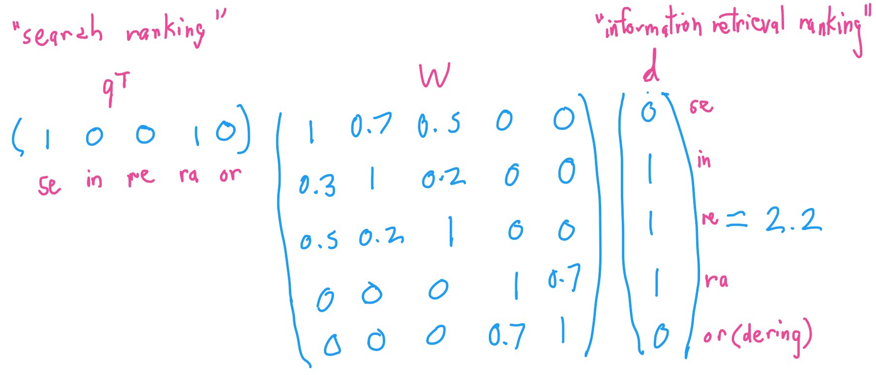
Can you directly learn term relations?
Basic IR is scoring on q^{T}d
No treatment of synonyms; no machine learning
Can we learn parameters W to rank via q^{T}Wd ?
Problem is again sparsity – W is huge > 10¹⁰
Notes:
Not necessarily symmetric – query language vs. collection language – medline neoplasm

Slide 12
Is there a better way?
Idea:
  Can we learn a dense low-dimensional representation of a word in ℝ^{d} such that dot products u^{T}v express word similarity?
  We could still if we want to include a “translation” matrix between vocabularies (e.g., cross-language): u^{T}Wv
    But now W is small!
  Supervised Semantic Indexing (Bai et al. Journal of Information Retrieval 2009) shows successful use of learning W for information retrieval
But we’ll develop direct similarity in this class

Slide 13
Distributional similarity based representations
You can get a lot of value by representing a word by means of its neighbors
“You shall know a word by the company it keeps”
(J. R. Firth 1957: 11)
One of the most successful ideas of modern statistical NLP
  government debt problems turning into banking crises as has happened in
  saying that Europe needs unified banking regulation to replace the hodgepodge
   These words will represent banking 
Notes:
You can vary whether you use local or large context to get a more syntactic or semantic clustering

Slide 14
Let's define words by their usages
One way to define "usage":
  words are defined by their environments (the words around them)
Zellig Harris (1954):
If A and B have almost identical environments we say that they are synonyms.
Notes:
linguists like Joos (1950), Harris (1954), and Firth (1957) had the related idea of defining the meaning of a word by its distribution in language use, meaning its neighboring words or grammatical environments.

Slide 15
What does recent English borrowing ongchoi mean?
Suppose you see these sentences:
  Ong choi is delicious sautéed with garlic
  Ong choi is superb over rice
  Ong choi leaves with salty sauces
And you've also seen these:
  …spinach sautéed with garlic over rice
  Chard stems and leaves are delicious
  Collard greens and other salty leafy greens
Conclusion:
  Ongchoi is a leafy green like spinach, chard, or collard greens
    We could conclude this based on words like "leaves" and "delicious" and "sauteed"
Notes:
For example, suppose you didn’t know the meaning of the word ongchoi (a recent borrowing from Cantonese) but you see it in the following contexts:
…
We can do the same thing computationally by just counting words in the context of ongchoi.

Slide 16
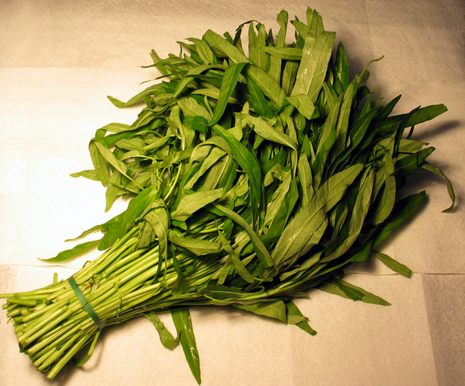
Ongchoi: Ipomoea aquatica "Water Spinach"
空心菜
kangkong
rau muống
…
Yamaguchi, Wikimedia Commons, public domain
Notes:
Here's a picture of ongchoi for you food fans

Slide 17
Idea 1: Defining meaning by linguistic distribution
Let's define the meaning of a word by its distribution in language use, meaning its neighboring words or grammatical environments
Notes:
So we can express this first intuition as Idea 1:

Slide 18
Idea 2: Meaning as a point in space (Osgood et al. 1957)
3 affective dimensions for a word
  valence: pleasantness
  arousal: intensity of emotion
  dominance: the degree of control exerted
Hence the connotation of a word is a vector in 3-space
 | Word | Score |  | Word | Score
Valence | love | 1.000 |  | toxic | 0.008
 | happy | 1.000 |  | nightmare | 0.005
Arousal | elated | 0.960 |  | mellow | 0.069
 | frenzy | 0.965 |  | napping | 0.046
Dominance | powerful | 0.991 |  | weak | 0.045
 | leadership | 0.983 |  | empty | 0.081
NRC VAD Lexicon
(Mohammad 2018)
Notes:
And the second idea is Osgood’s (1957) idea mentioned in the prior lecture, in which the connotation of a word is represented by 3 numbers, it's valence, arousal, and dominance. That means we are essentially representing a word's connotation by a point in three-dimensional space! But suppose we represent more than just a word's connotation

Slide 19
Idea 1: Defining meaning by linguistic distribution
Idea 2: Meaning as a point in multidimensional space
Notes:
So we're going to combine these two ideas:

Slide 20
Defining meaning as a point in space based on distribution
Each word = a vector (not just "good" or "w₄₅")
Similar words are "nearby in semantic space"
We build this space automatically by seeing which words are nearby in text
Notes:
In vector semantics, we define meaning as a point in space based on distribution. Each word is a vector, not just a string like "good" or an index like "w_45". Similar words are nearby in semantic space, and, crucially, as we'll see, we build this space automatically by seeing which words are nearby in text. Here we see shows a visualization of embeddings learned for sentiment analysis, showing the location of selected words projected down from 60-dimensional space into a two dimensional space. Notice the distinct regions containing positive words, negative words, and neutral function words.

Slide 21
Solution: Low dimensional vectors
The number of topics that people talk about is small (in some sense)
    Clothes, movies, politics, …
Idea: store “most” of the important information in a fixed, small number of dimensions: a dense vector
  Usually 25 – 1000 dimensions
How to reduce the dimensionality?
  Go from big, sparse co-occurrence count vector to low dimensional “word embedding”

Slide 22
Traditional Way:
Latent Semantic Indexing/Analysis
Sec. 18.2
Use Singular Value Decomposition (SVD) – kind of like Principal Components Analysis (PCA) for an arbitrary rectangular matrix – or just random projection to find a low-dimensional basis or orthogonal vectors
Theory is that similarity is preserved as much as possible
You can actually gain in IR (slightly) by doing LSA, as “noise” of term variation gets replaced by semantic “concepts”
Popular in the 1990s [Deerwester et al. 1990, etc.]
  Results were always somewhat iffy (… it worked sometimes)
  Hard to implement efficiently in an IR system (dense vectors!)
Discussed in IIR chapter 18, but not discussed further here
  And not on the exam (!!!)

Slide 23
There are 2 kinds of embeddings
Simple count embeddings
  Sparse vectors
  Words are represented by the counts of nearby words
  For information retrieval, we augment this model to create the tf-idf model of weighting those counts
Word2vec
  Dense vectors
  Representation is created by training a classifier to predict whether a word is likely to appear nearby
  Later we'll discuss extensions called contextual embeddings

Slide 24
“Neural Embeddings”

Slide 25
Word meaning is defined in terms of vectors
We will build a dense vector for each word type, chosen so that it is good at predicting other words appearing in its context
… those other words also being represented by vectors … it all gets a bit recursive
linguistics =
0.286
0.792
−0.177
−0.107
0.109
−0.542
0.349
0.271
Notes:
For words that appear in the same contexts, you gain by making their vectors similar!
In probabilistic approaches, all the numbers are non-negative.

Slide 26
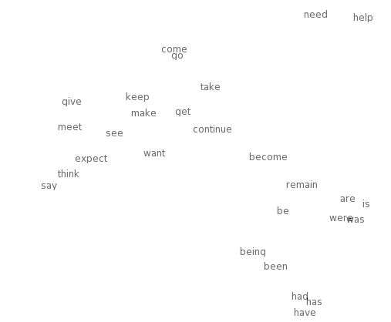

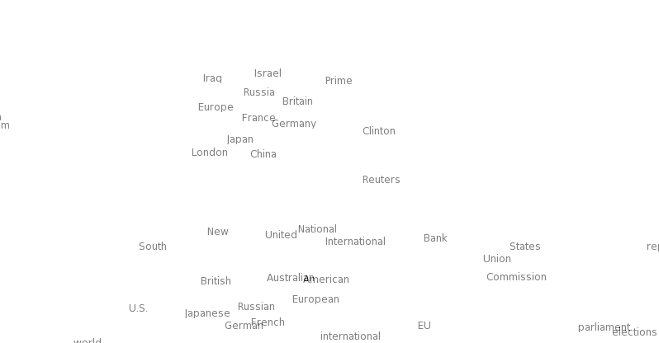
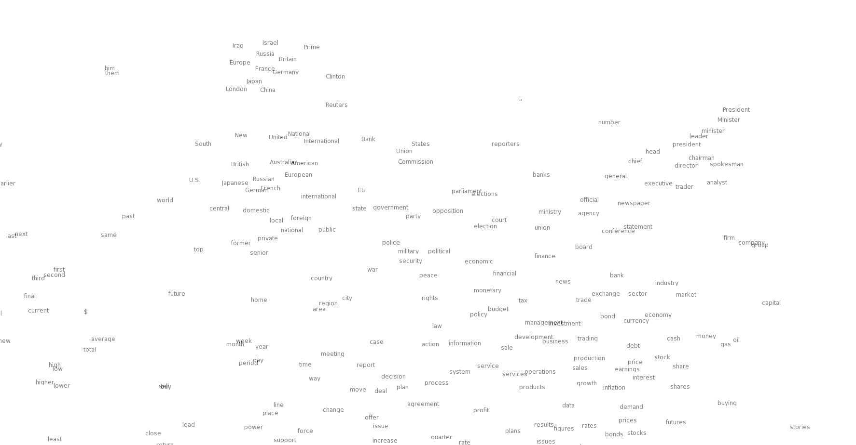
Neural word embeddings - visualization
Notes:
Let’s look at the idea of word vectors in a bit more detail before we describe our model.
…Large clouds of words with similar parts of speech and the smaller regions with similar meaning.
Why would we prefer this representation? To answer this question, let’s consider a commonly used alternative which is to represent words as an index into a vocabulary.

Slide 27
Basic idea of learning neural network word embeddings
We define a model that aims to predict between a center word w_{t} and context words in terms of word vectors
p(context|w_{t}) = …
which has a loss function, e.g.,
J = 1 − p(w_{−t} |w_{t})
We look at many positions t in a big language corpus
We keep adjusting the vector representations of words to minimize this loss
Notes:
The central new idea is that you change the word representation, as well as the other parameters of the model.
I’m going to directly and concretely build one, concrete prediction models. You may already know of some other things you might do, and we’ll come back to other possibilities next week, but this way of doing it is one of the best ways known.

Slide 28
Idea: Directly learn low-dimensional word vectors based on ability to predict
Old idea. Relevant for this lecture & deep learning:
  Learning representations by back-propagating errors (Rumelhart et al., 1986)
  A neural probabilistic language model (Bengio et al., 2003)
  NLP (almost) from Scratch (Collobert & Weston, 2008)
  A recent, even simpler and faster model:
  word2vec (Mikolov et al. 2013) → intro now
  The GloVe model from Stanford (Pennington, Socher, and Manning 2014) connects back to matrix factorization
Initial models were quite non-linear and slow; recent work has used fast, bilinear models

Slide 29
Word2vec is a family of algorithms
[Mikolov et al. 2013]
  Predict between every word and its context words!
Two algorithms
  Skip-grams (SG)
    Predict context words given target (position independent)
  Continuous Bag of Words (CBOW)
    Predict target word from bag-of-words context
Two (moderately efficient) training methods
  Hierarchical softmax
  Negative sampling
  Naïve softmax

Slide 30
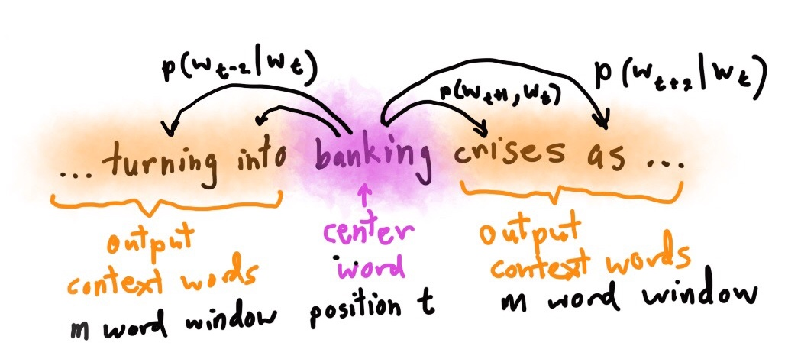
Skip-gram prediction
Notes:
Make a picture!

Slide 31
Skip-Gram Classifier
(assuming a +/- 2 word window)
  …lemon, a [tablespoon of apricot jam, a] pinch…
c1 c2 [target] c3 c4
Goal: train a classifier that is given a candidate (word, context) pair
(apricot, jam)
(apricot, aardvark)
…
And assigns each pair a probability:
P(+|w, c)
P(−|w, c) = 1 − P(+|w, c)
Notes:
Our goal is to train a classifier such that, given a tuple (w,c) of a target word w paired with a candidate context word c (for example (apricot, jam), or perhaps (apricot, aardvark)) it will return the probability that c is a real context word (true for jam, false for aardvark):
The probability that word c is not a real context word for w is just 1 minus

Slide 32
Similarity is computed from dot product
Remember: two vectors are similar if they have a high dot product
  Cosine is just a normalized dot product
So:
  Similarity(w,c) ∝ w ∙ c
We’ll need to normalize to get a probability
  (cosine isn't a probability either)
Notes:
he intuition of the skip- gram model is to base this probability on embedding similarity: a word is likely to occur near the target if its embedding is similar to the target embedding. To compute similarity between these dense embeddings, we rely on the intuition that two vectors are similar if they have a high dot product (after all, cosine is just a normalized dot product). In other words: Similarity(w,c) ∝ w ∙ c

Slide 33
Turning dot products into probabilities
Sim(w,c) ≈ w ∙ c
To turn this into a probability
We'll use the sigmoid from logistic regression:
Notes:
The dot product c · w is not a probability, it’s just a number ranging from −∞ to ∞ (since the elements in word2vec embeddings can be negative, the dot product can be negative). To turn the dot product into a probability, we’ll use the logistic or sigmoid function σ (x) from logistic regression
We model the probability that word c is a real context word for target word w as:
to make it a probability we’ll also need the total probability of the two possible events (c is a context word, and c isn’t a context word) to sum to 1. We thus estimate the probability that word c is not a real context word for w as:

Slide 34
How Skip-Gram Classifier computes P(+|w, c)
This is for one context word, but we have lots of context words
We'll assume independence and just multiply them:
Notes:
This equation gives us the probability for one word, but there are many context words in the window. Skip-gram makes the simplifying assumption that all context words are independent, allowing us to just multiply their probabilities:

Slide 35
Skip-Gram Training data
  …lemon, a [tablespoon of apricot jam, a] pinch…
c1 c2 [target] c3 c4
Notes:
Skip-gram learns embeddings by starting with random embedding vectors and then iteratively shifting the embedding of each word w to be more like the embeddings of words that occur nearby in texts, and less like the embeddings of words that don’t occur nearby. Let’s start by considering a single piece of training data
This example has a target word w (apricot), and 4 context words in the L = ±2 window, resulting in 4 positive training instances (on the left below):

Slide 36
Skip-Gram Training data
  …lemon, a [tablespoon of apricot jam, a] pinch…
c1 c2 [target] c3 c4
For each positive example we'll grab k negative examples, sampling by frequency
Notes:
For training a binary classifier we also need negative examples. In fact skip- gram with negative sampling (SGNS) uses more negative examples than positive examples (with the ratio between them set by a parameter k). So for each of these (w,cpos) training instances we’ll create k negative samples, each consisting of the target w plus a ‘noise word’ cneg. A noise word is a random word from the lexicon, constrained not to be the target word w.

Slide 37
Skip-Gram Training data
  …lemon, a [tablespoon of apricot jam, a] pinch…
c1 c2 [target] c3 c4
Notes:
Here's the setting where k = 2, so we’ll have 2 negative examples in the negative training set − for each positive example w,cpos. The noise words are chosen according to their weighted unigram frequency.

Slide 38
Word2vec: how to learn vectors
Given the set of positive and negative training instances, and an initial set of embedding vectors
The goal of learning is to adjust those word vectors such that we:
  Maximize the similarity of the target word, context word pairs (w , c_{pos}) drawn from the positive data
  Minimize the similarity of the (w , c_{neg}) pairs drawn from the negative data
Notes:
Given the set of positive and negative training instances, and an initial set of embeddings, the goal of the learning algorithm is to adjust those embeddings to
• Maximize the similarity of the target word, context word pairs (w,cpos) drawn from the positive examples
• Minimize the similarity of the (w,cneg) pairs from the negative examples.

Slide 39
Intuition of one step of gradient descent
Notes:
Let's look at the intuition of one step of gradient descent. The skip-gram model tries to shift embeddings so the target embeddings (here for apricot) are closer to (have a higher dot product with) context embeddings for nearby words (here jam) and further from (lower dot product with) context embeddings for noise words that don’t occur nearby (here Tolstoy and matrix).

Slide 40
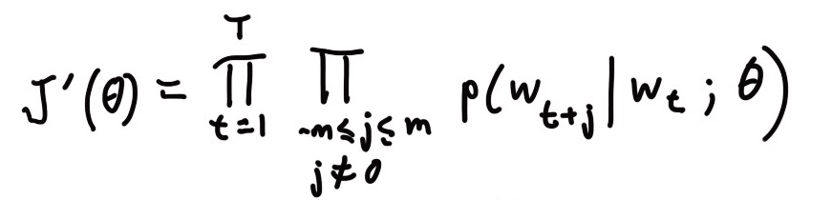
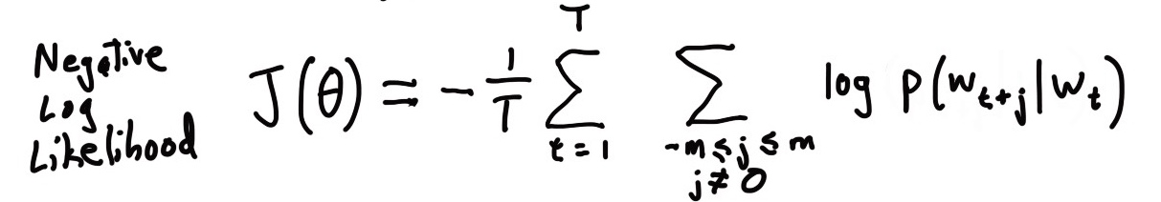
Details of word2vec
For each word t = 1 … T, predict surrounding words in a window of “radius” m of every word
Objective function: Maximize the probability of any context word given the current center word:
Where θ represents all variables we will optimize
Notes:
Add slide with window picture
Draw windows example. How does this give us vectors?

Slide 41
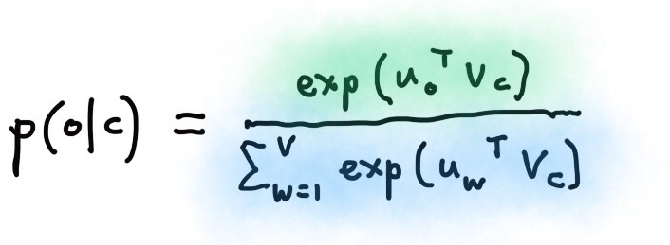
Details of Word2Vec
Predict surrounding words in a window of radius m of every word
For the simplest first formulation is
where o is the outside (or output) word index, c is the center word index, v_{c} and u_{o} are “center” and “outside” vectors of indices c and o
Softmax using word c to obtain probability of word o
Notes:
Move bullet to slide with picture.
Two vectors makes math easier and generally works a fraction better.
We’ve seen dot products before a lot.
Softmax or maxent.

Slide 42
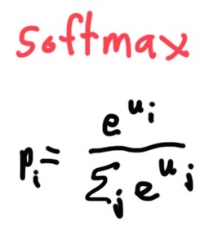
Softmax function: Standard map from ℝ^{V} to a probability distribution
Exponentiate to
make positive
Normalize to
give probability

Slide 43
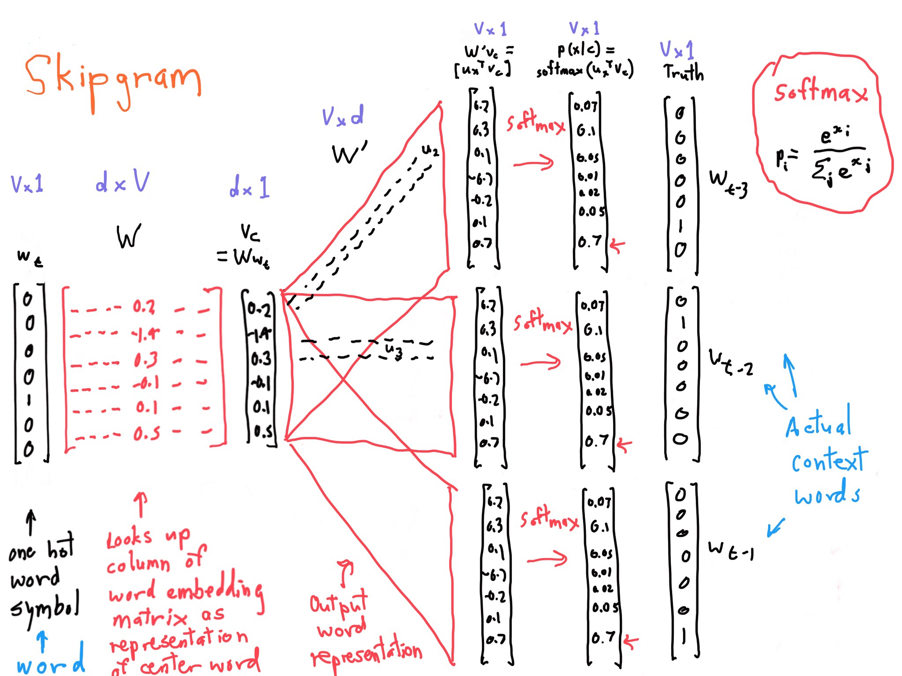
Skip gram model structure
Notes:
You have the same parameters for each matrix in the middle, replicated for each position!

Slide 44

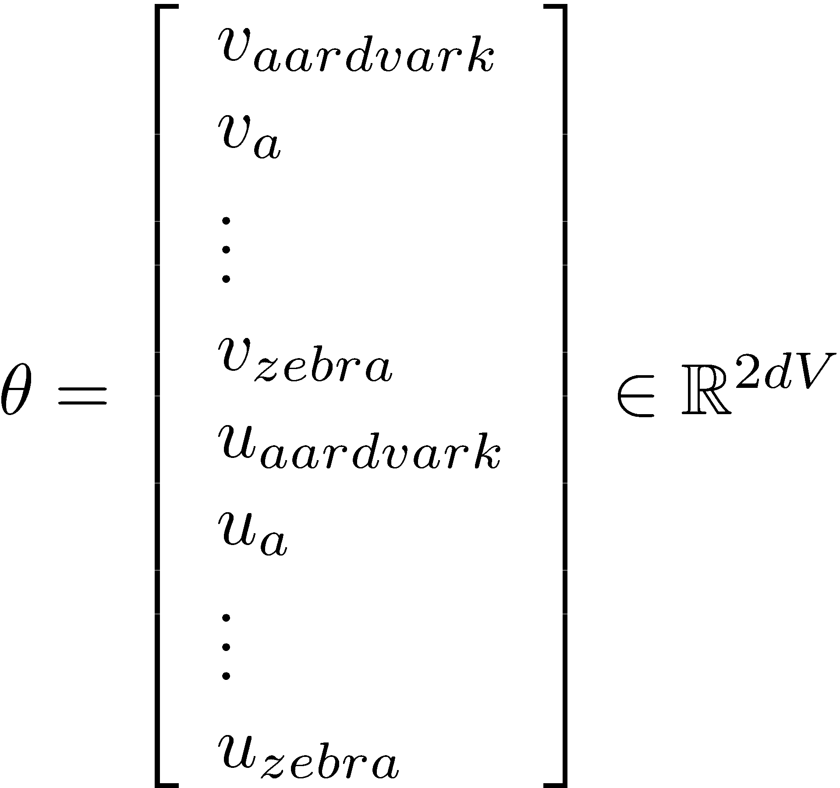
To learn good word vectors:
Compute all vector gradients!
We often define the set of all parameters in a model in terms of one long vector
In our case with
d-dimensional vectors
and
V many words:
We then optimize
these parameters
Note: Every word has two vectors! Makes it simpler!

Slide 45
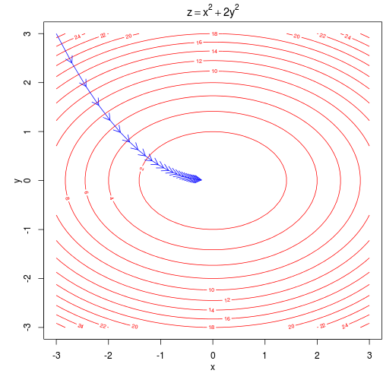
Intuition of how to minimize loss for a simple function over two parameters
We start at a random point and walk in the steepest direction, which is given by the derivative of the function
Contour lines show points of equal value of objective function
Notes:
Ignore other optimization algorithms, for now just SGD
Our objective function is of course a lot higher dimensional and complex!

Slide 46
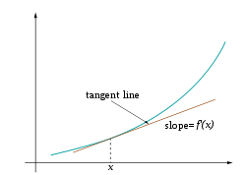
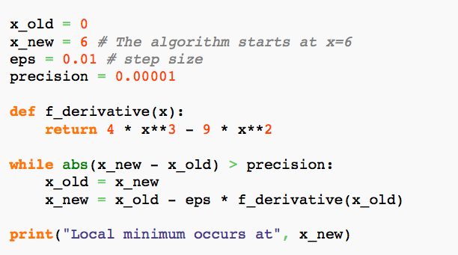
Descending by using derivatives
We will minimize a cost function by
gradient descent
Trivial example: (from Wikipedia)
Find a local minimum of the function
f(x) = x⁴−3x³+2,
with derivative f'(x) = 4x³−9x²
Subtracting a fraction of the gradient moves you towards the minimum!
Notes:
Put minus in front and you can maximize.
This is single variable, whereas we’re doing it over a vector of parameters. And a batch of examples.

Slide 47
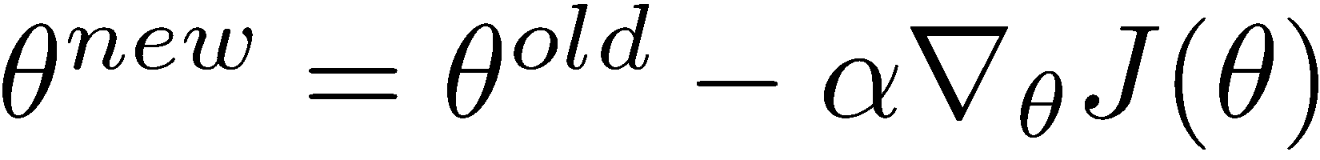
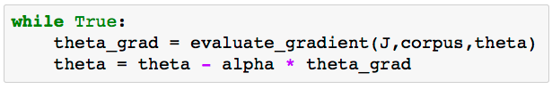
Vanilla Gradient Descent Code

Slide 48
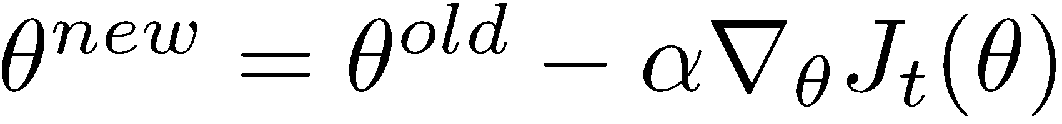
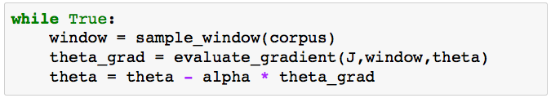
Stochastic Gradient Descent
But Corpus may have 40B tokens and windows
You would wait a very long time before making a single update!
Very bad idea for pretty much all neural nets!
Instead: We will update parameters after each window t
→ Stochastic gradient descent (SGD)
Notes:
in practice we have a maximum number of iterations
More tricks and details in later lectures!
Crazily noisy estimate of the gradient. But we repeat over many times quickly, so it sort of works out. In fact you often win.
Like force directed graph layout!

Slide 49
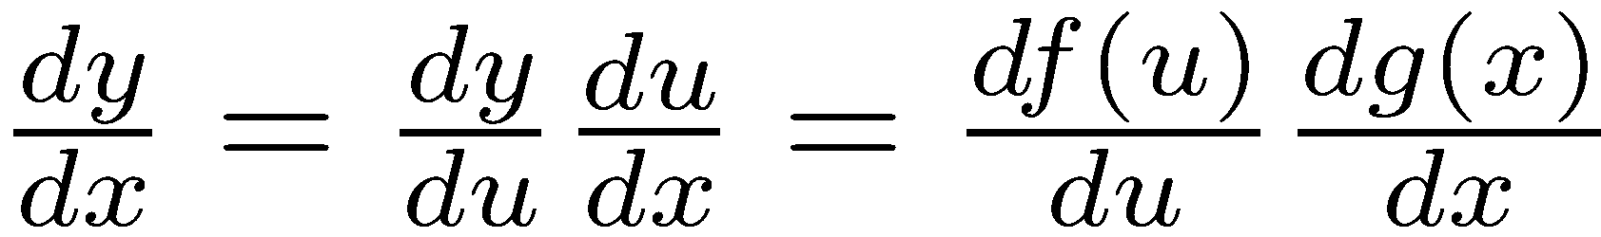
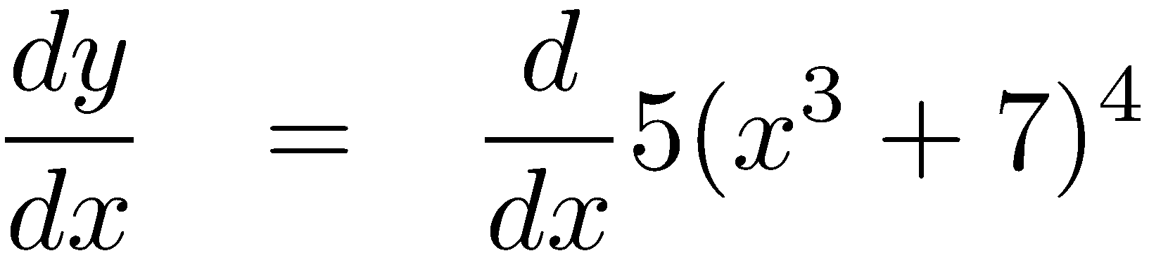
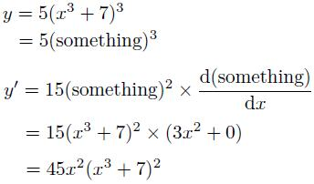
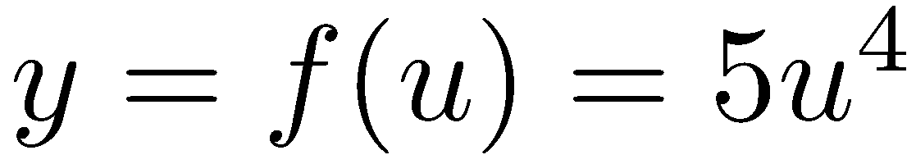
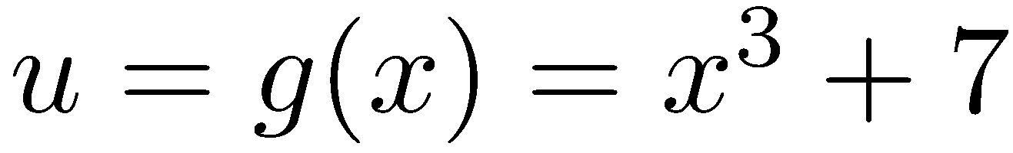
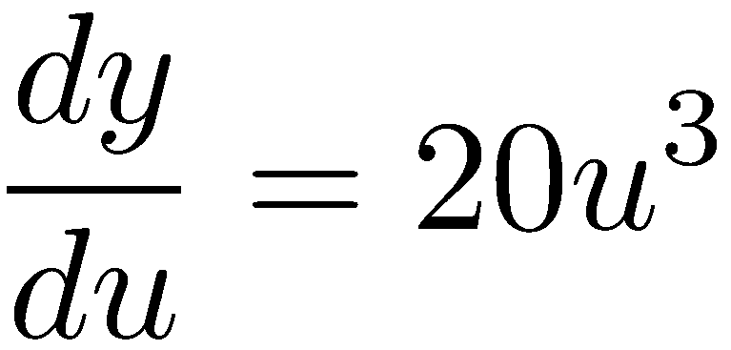
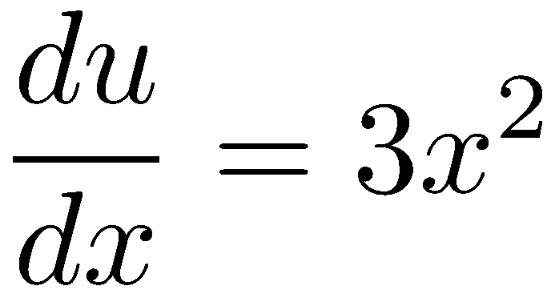
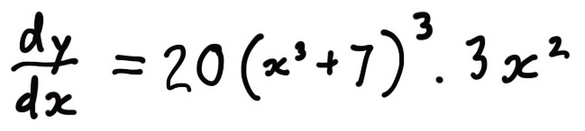
Working out how to optimize a neural network is really all the chain rule!
Chain rule! If y = f(u) and u = g(x), i.e. y = f(g(x)), then:
Simple example:
Notes:
(Leibniz notation):
Also called “backpropagation”

Slide 50
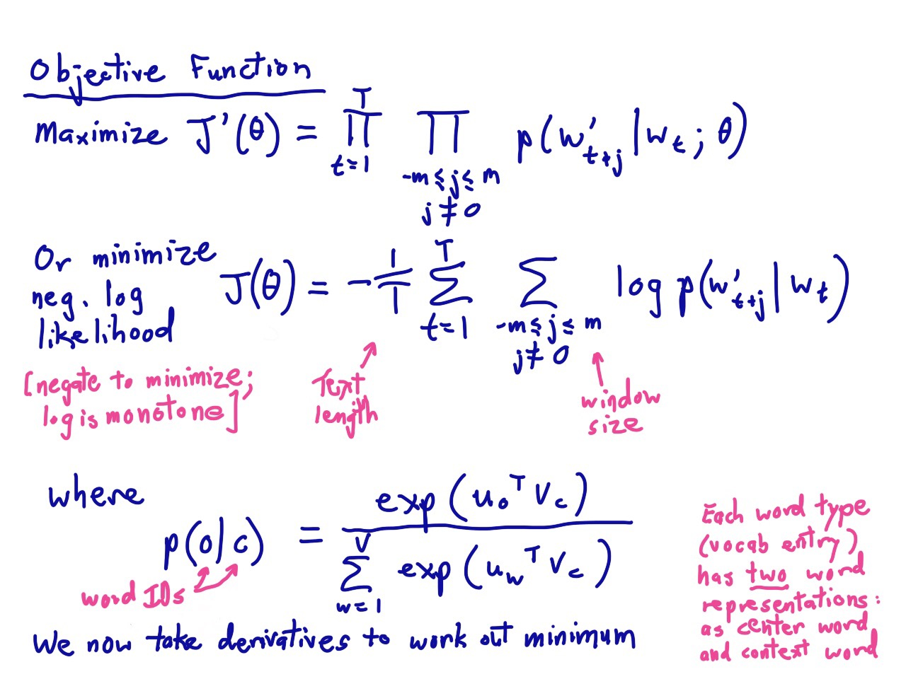
Notes:
Here’s our word vector model again.
AIM TO HAVE 5 MINUTES AFTER CALCULUS!

Slide 51
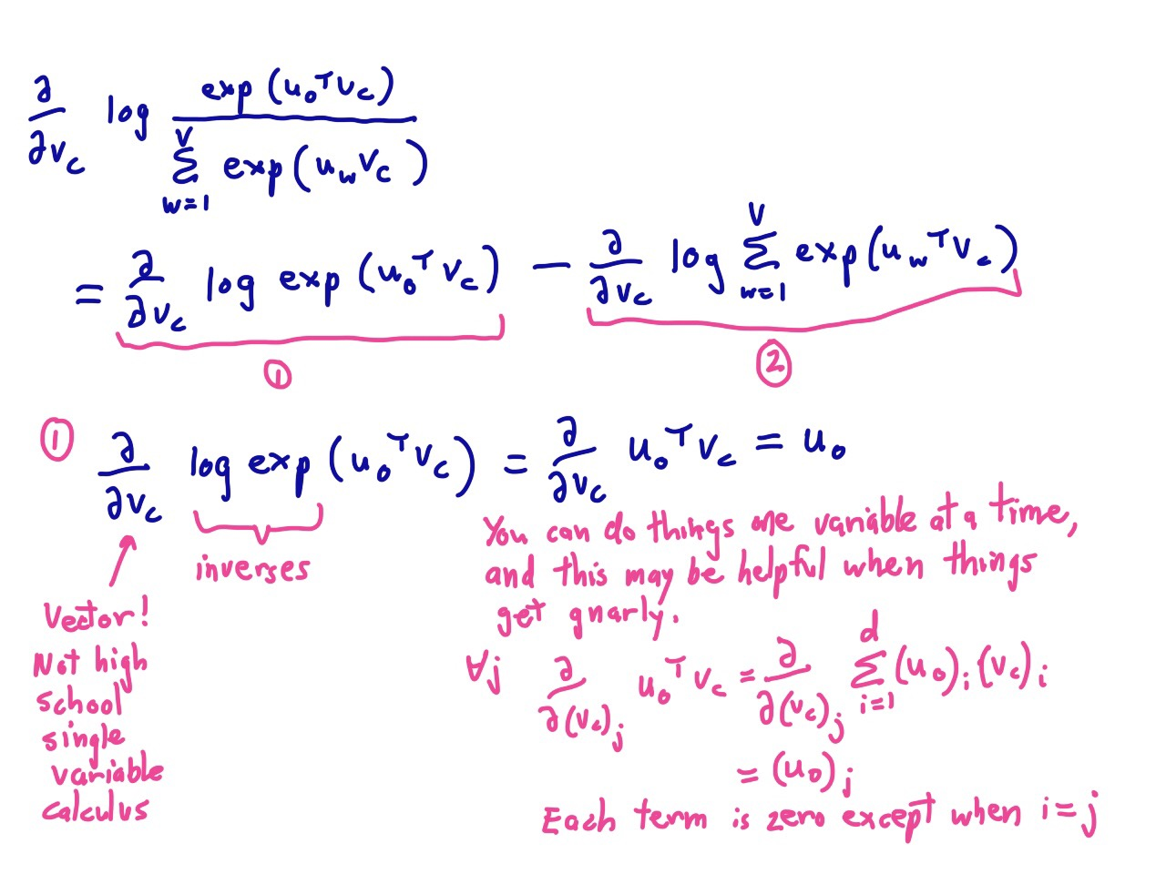

Slide 52
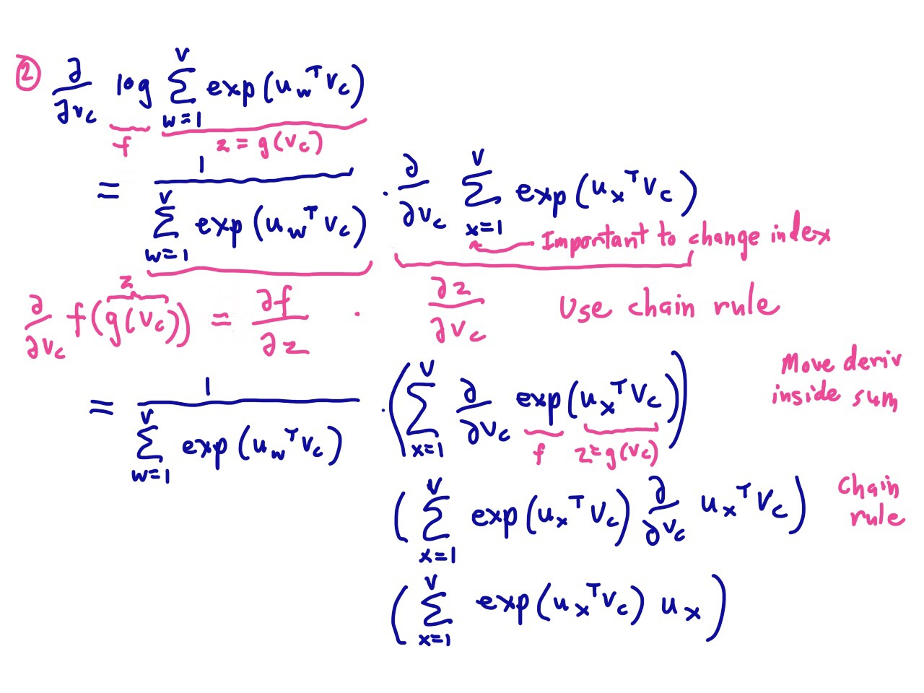

Slide 53
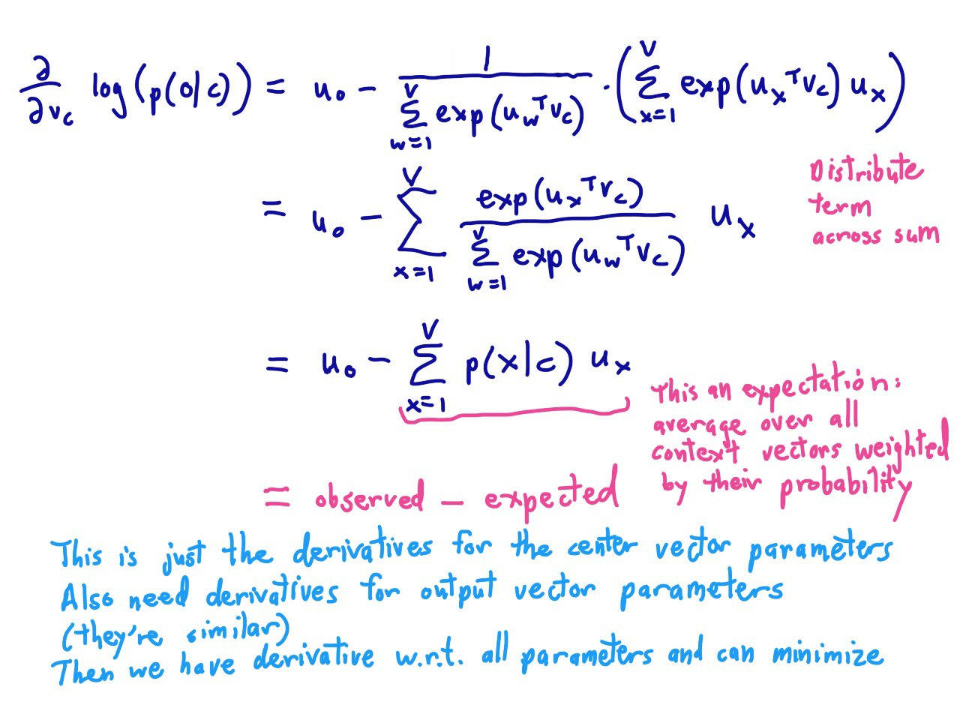

Slide 54
Notes:
But if we then run gradient descent using those calculated derivatives, after a while, a miracle occurs.

Slide 55
The kinds of neighbors depend on window size
Small windows (C= +/- 2) : nearest words are syntactically similar words in same taxonomy
  Hogwarts nearest neighbors are other fictional schools
    Sunnydale, Evernight, Blandings
Large windows (C= +/- 5) : nearest words are related words in same semantic field
  Hogwarts nearest neighbors are Harry Potter world:
    Dumbledore, half-blood, Malfoy
Notes:
One parameter of vector semantic models that is relevant to both sparse tf-idf vectors and dense word2vec vectors is the size of the context window used to collect counts. This is generally between 1 and 10 words on each side of the target word (for a total context of 2-20 words).
The choice depends on the goals of the representation. Shorter context windows tend to lead to representations that are a bit more syntactic, since the information is coming from immediately nearby words. When the vectors are computed from short context windows, the most similar words to a target word w tend to be semantically similar words with the same parts of speech. When vectors are computed from long context windows, the highest cosine words to a target word w tend to be words that are topically related but not similar. For example Levy and Goldberg (2014a) showed that using skip-gram with a window of ±2, the most similar words to the word Hogwarts (from the Harry Potter series) were names of other fictional schools: Sunnydale (from Buffy the Vampire Slayer) or Evernight (from a vampire series). With a window of ±5, the most similar words to Hogwarts were other words topically related to the Harry Potter series: Dumbledore, Malfoy, and half-blood.

Slide 56
Analogical relations
The classic parallelogram model of analogical reasoning (Rumelhart and Abrahamson 1973)
To solve: "apple is to tree as grape is to _____"
Add tree – apple to grape to get vine
Notes:
Another semantic property of embeddings is their ability to capture relational meanings. In an important early vector space model of cognition, Rumelhart and Abrahamson (1973) proposed the parallelogram model for solving simple analogy problems of the form a is to b as a* is to what?. In such problems, a system given a problem like apple:tree::grape:?, i.e., apple is to tree as grape is to , and must fill in the word vine.
In the parallelogram model, the vector from the word apple ito the word tree (= apple − tree)
is added to the vector for grape (grape); the nearest word to that point is returned

Slide 57
Linear Relationships in word2vec
These representations are very good at encoding similarity and dimensions of similarity!
Analogies testing dimensions of similarity can be solved quite well just by doing vector subtraction in the embedding space
  Syntactically
  x_{apple} − x_{apples} ≈ x_{car} − x_{cars} ≈ x_{family} − x_{families}
  Similarly for verb and adjective morphological forms
  Semantically (Semeval 2012 task 2)
  x_{shirt} − x_{clothing} ≈ x_{chair} − x_{furniture}
  x_{king} − x_{man} ≈ x_{queen} − x_{woman}

Slide 58
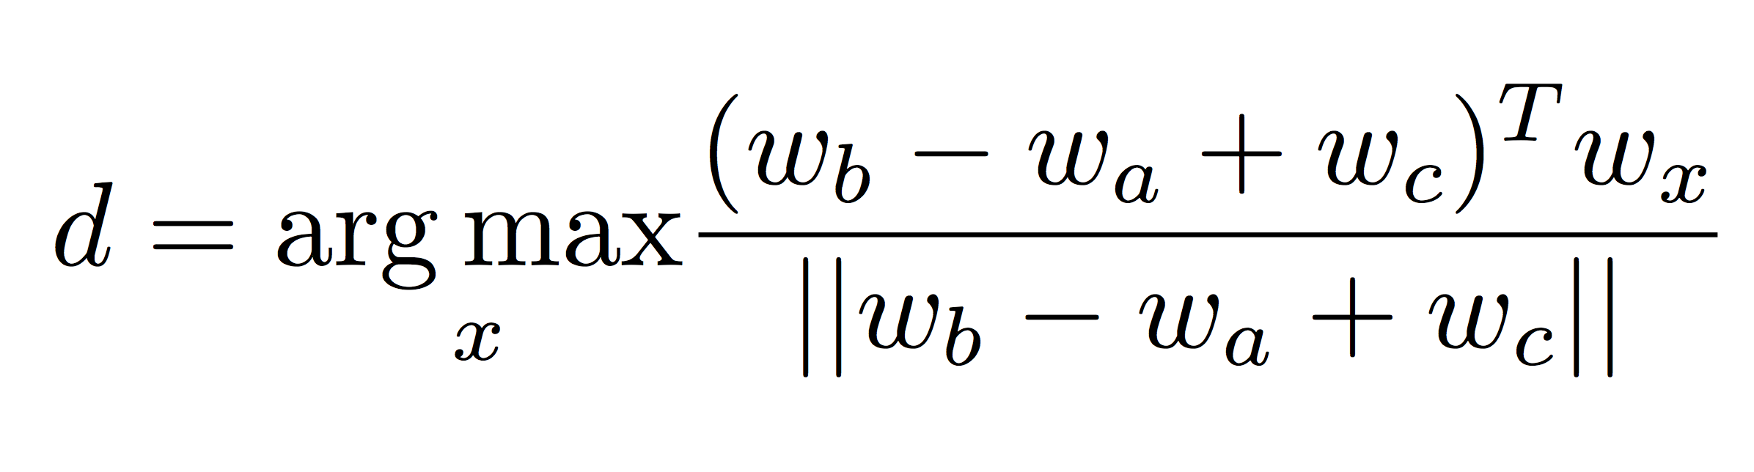
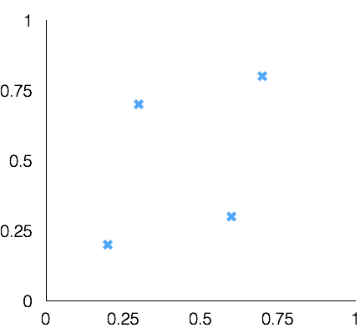
Word Analogies
Test for linear relationships, examined by Mikolov et al.
a:b :: c:?
a:b :: c:?
man:woman :: king:?
+
king
[ 0.30 0.70 ]
queen
king
−
man
[ 0.20 0.20 ]
+
woman
[ 0.60 0.30 ]
woman
queen
[ 0.70 0.80 ]
man

Slide 59
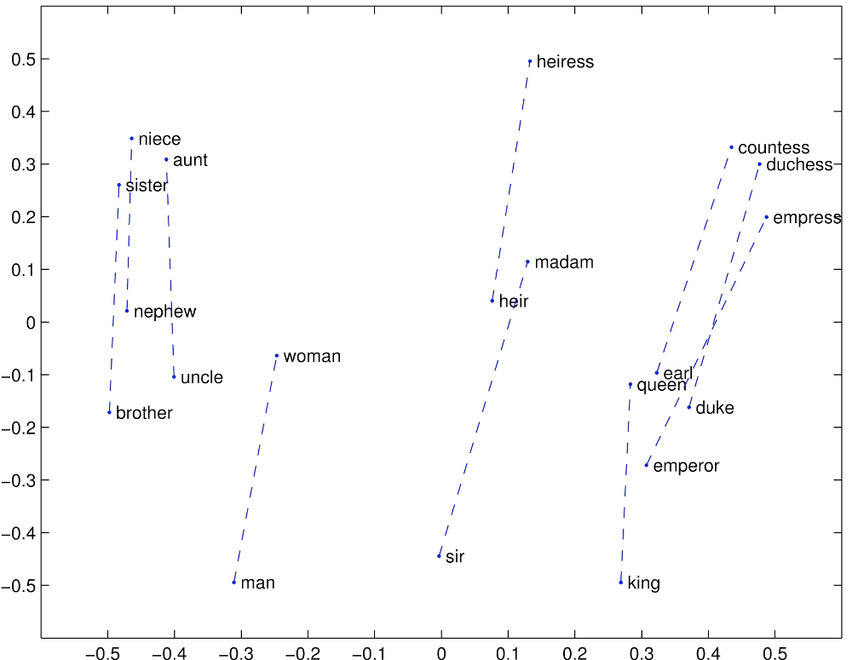
GloVe Visualizations
http://nlp.stanford.edu/projects/glove/

Slide 60
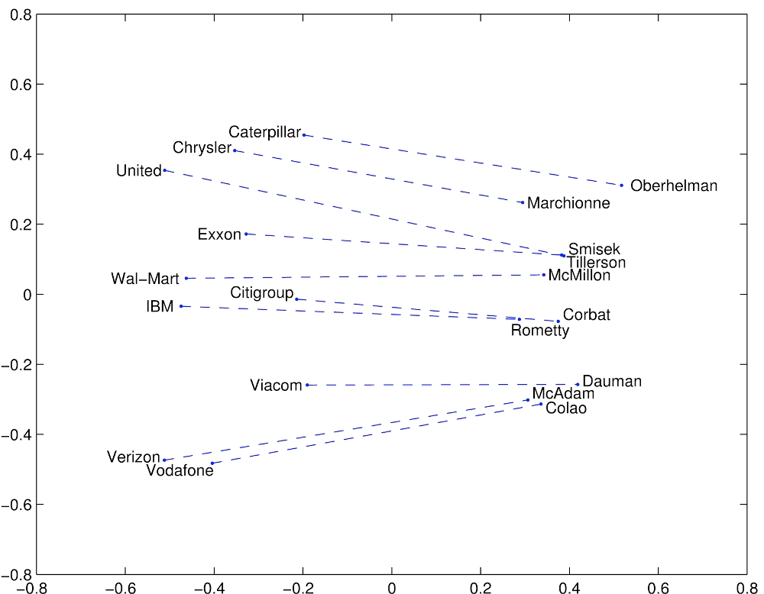
Glove Visualizations: Company - CEO

Slide 61
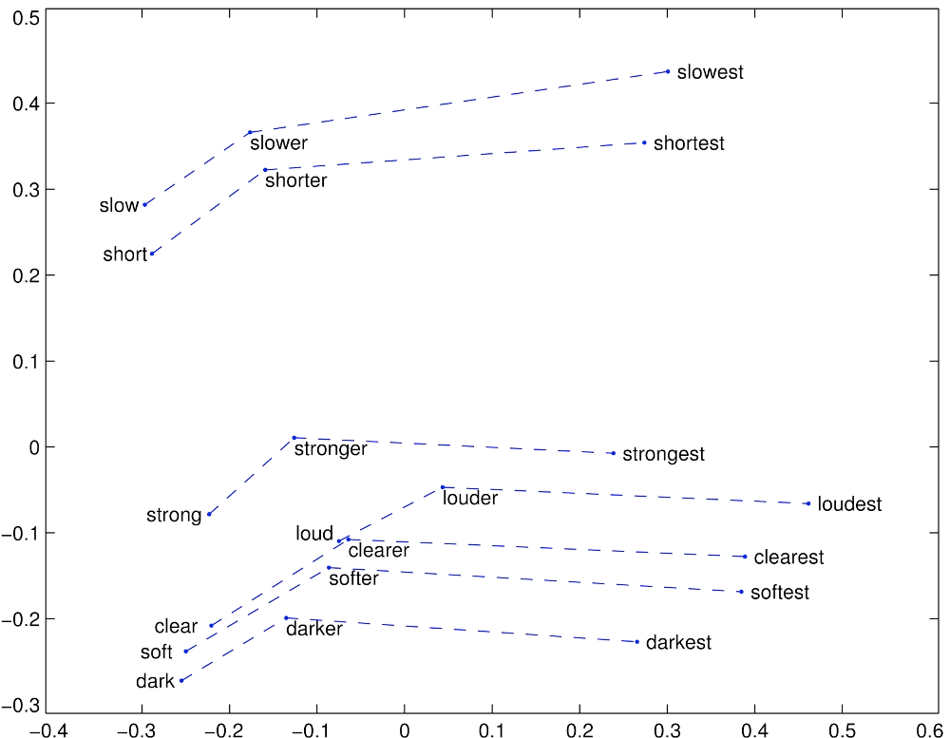
Glove Visualizations: Superlatives

Slide 62

Application to Information Retrieval
Application is just beginning – there’s little to go on
Google’s RankBrain – almost nothing is publicly known
  Bloomberg article by Jack Clark (Oct 26, 2015): http://www.bloomberg.com/news/articles/2015-10-26/google-turning-its-lucrative-web-search-over-to-ai-machines
  A result reranking system
  Even though more of the value is in the tail?
New SIGIR Neu-IR workshop series (2016 and 2017)
Notes:
Remember also RankNet for learning to rank – but here we are interested in neural distributed representations of words.

Slide 63
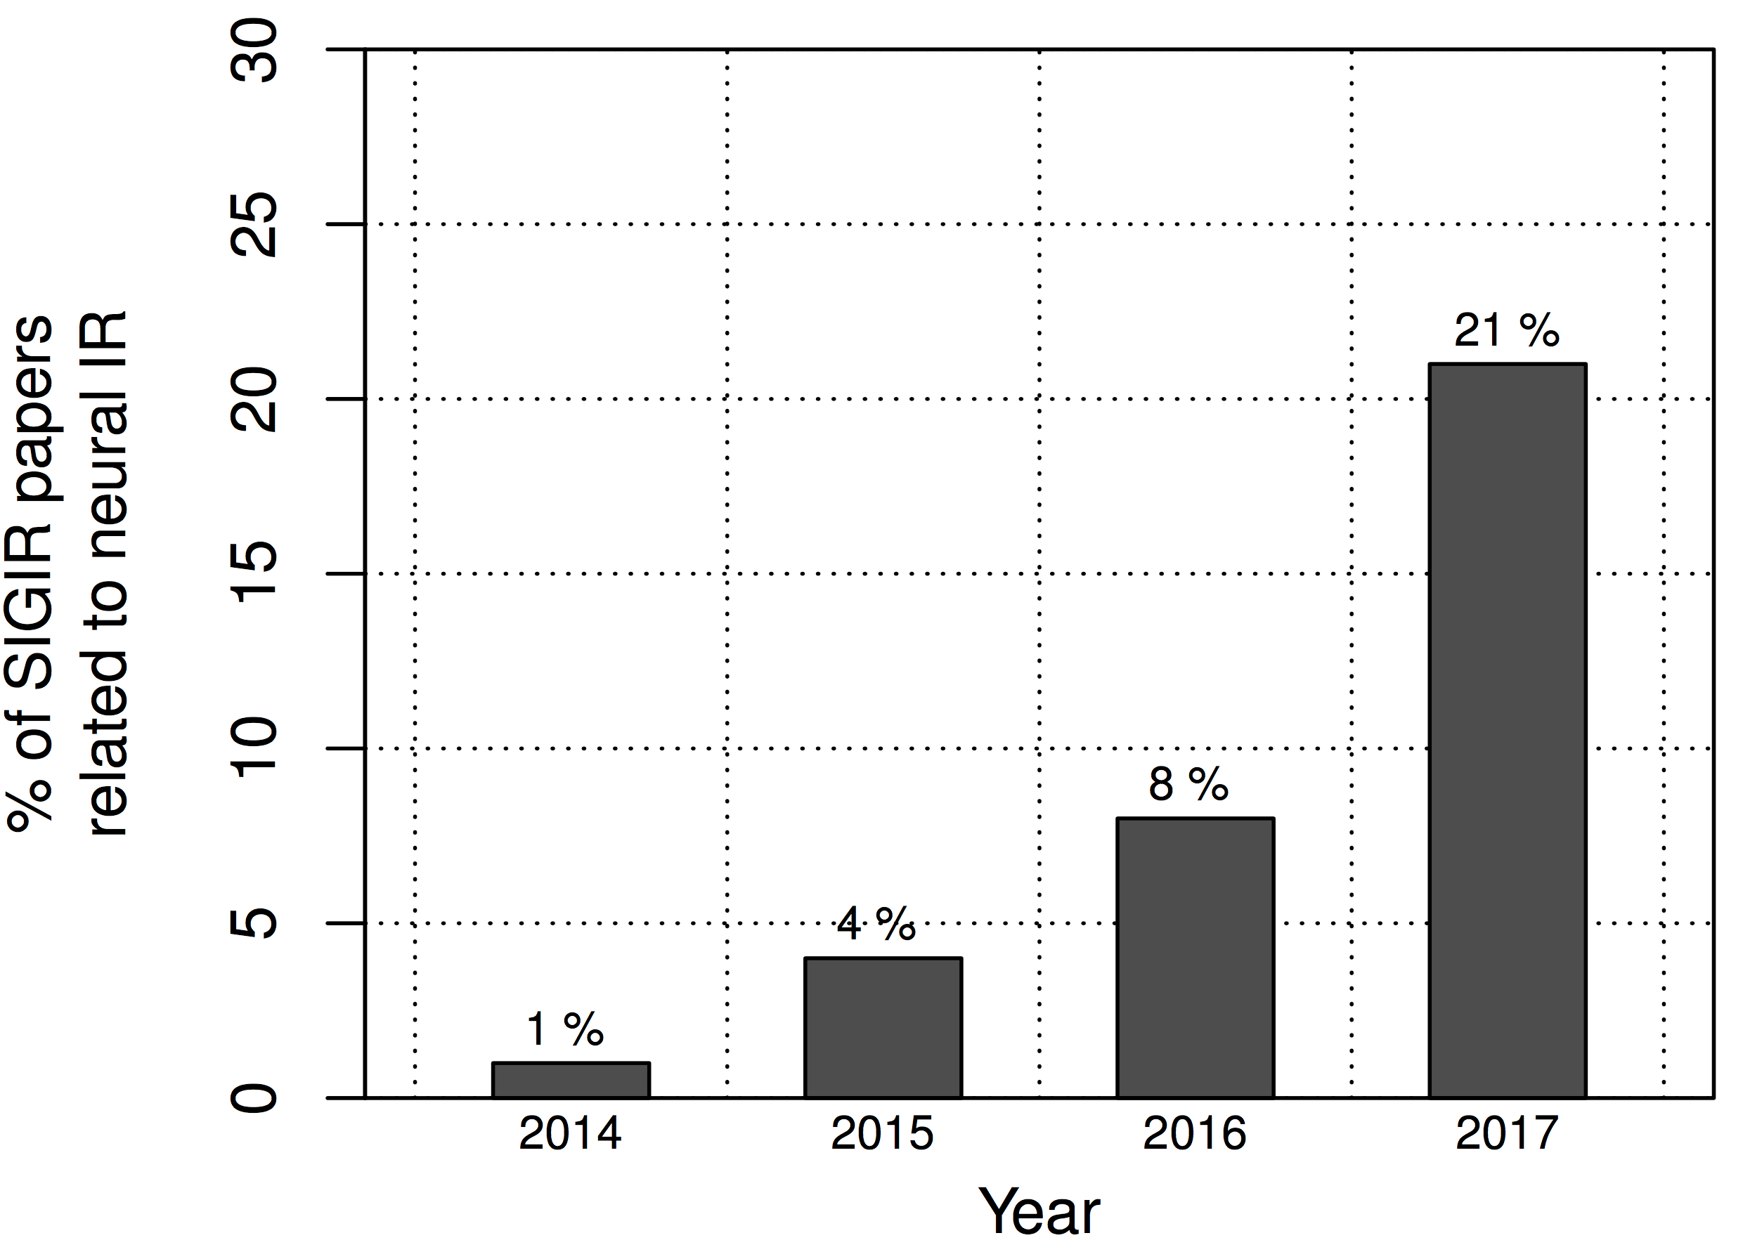
Final Thoughts from Chris Manning SIGIR 2016 keynote
2011 2013 2015 2017
speech vision NLP IR
You are
here
Notes:
I’m sure deep learning will come to dominate SIGIR over the next couple of years … just like speech, vision, and NLP before it.
This is a good thing. There are some powerful new techniques that are just being amazingly successful on many hard applied problems.
However, we should realize that there is also currently a huge amount of hype about deep learning and artificial intelligence. We should not let a genuine enthusiasm for important, successf new techniques lead to irrational exuberance or diminish appreciation for other approaches.
Despite the efforts of a number of people, there has been division of HLT. Time for synergy? Organizational issues?

Slide 64
An application to information retrieval
Nalisnick, Mitra, Craswell & Caruana. 2016. Improving Document Ranking with Dual Word Embeddings. WWW 2016 Companion. http://research.microsoft.com/pubs/260867/pp1291-Nalisnick.pdf
Mitra, Nalisnick, Craswell & Caruana. 2016. A Dual Embedding Space Model for Document Ranking. arXiv:1602.01137 [cs.IR]
Builds on BM25 model idea of “aboutness”
Not just term repetition indicating aboutness
Relationship between query terms and all terms in the document indicates aboutness (BM25 uses only query terms)
Makes clever argument for different use of word and context vectors in word2vec’s CBOW/SGNS or GloVe
Notes:
People at/working with Bing.
Probably not the definitive paper. But it exists today?

Slide 65
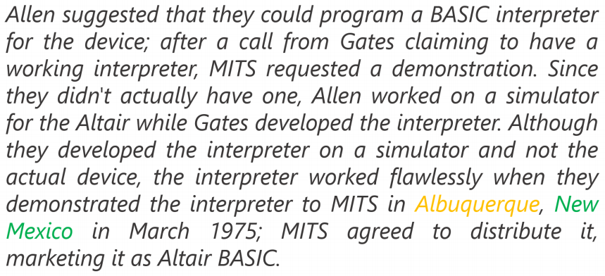
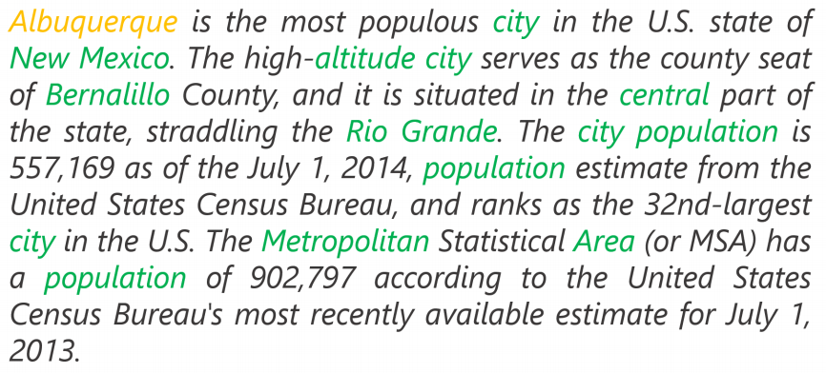
Modeling document aboutness:
Results from a search for Albuquerque
d₁
d₂
Notes:
Both documents have 1 occurrence of the search term, but d2 has a lot more words that commonly co-occur with the search term. This is strong evidence that it is about the search term.

Slide 66
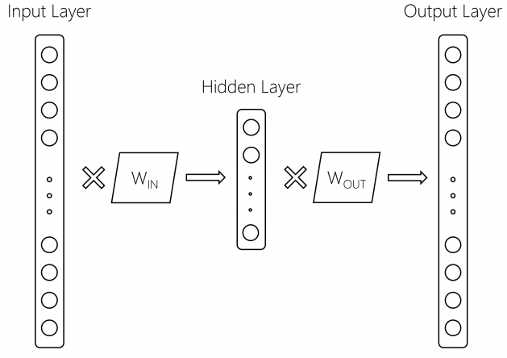
Using 2 word embeddings
word2vec model with 1 word of context
W_{IN}
Embeddings
for focus
words
W_{OUT}
Embeddings
for context
words
Focus
word
Context
word
We can gain by using these
two embeddings differently
Notes:
Current exploitation is usually:
Just throw the context embeddings away (word2vec) – or paper says it always uses Win, which would be funnier but may be true.
Average them (GloVe) – gave gains

Slide 67
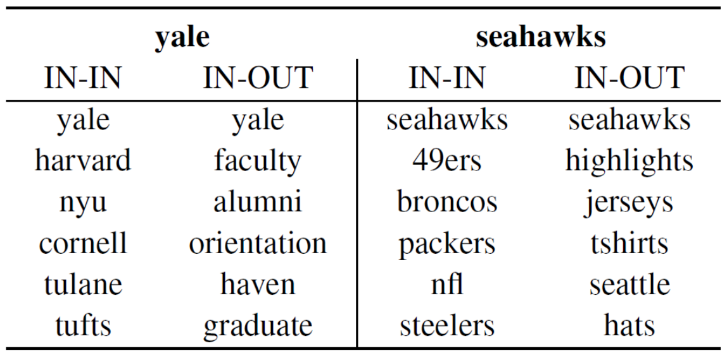
Using 2 word embeddings
Notes:
Either IN-IN or OUT-OUT give a similar ranking that is good for similarity – words that appear in the same context (word similarity).
But for DESM, they are wanting to see whether this is a context about this word, and so they use IN-OUT similarity

Slide 68
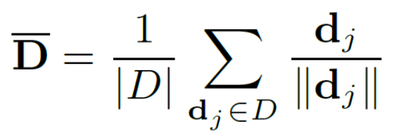
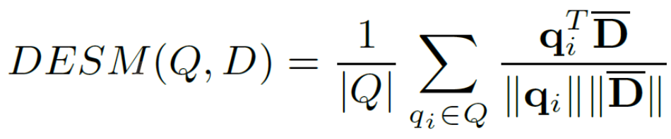
Dual Embedding Space Model (DESM)
Simple model
A document is represented by the centroid of its word vectors
Query-document similarity is average over query words of cosine similarity

Slide 69
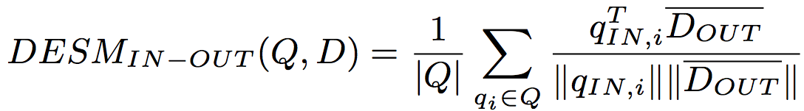
Dual Embedding Space Model (DESM)
What works best is to use the OUT vectors for the document and the IN vectors for the query
This way similarity measures aboutness – words that appear with this word – which is more useful in this context than (distributional) semantic similarity

Slide 70
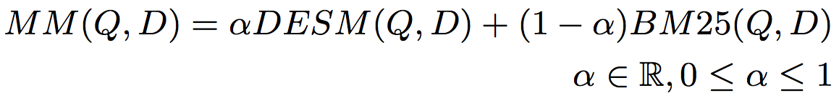
Experiments
Train word2vec from either
  600 million Bing queries
  342 million web document sentences
Test on 7,741 randomly sampled Bing queries
  5 level eval (Perfect, Excellent, Good, Fair, Bad)
Two approaches
  Use DESM model to rerank top results from BM25
  Use DESM alone or a mixture model of it and BM25

Slide 71
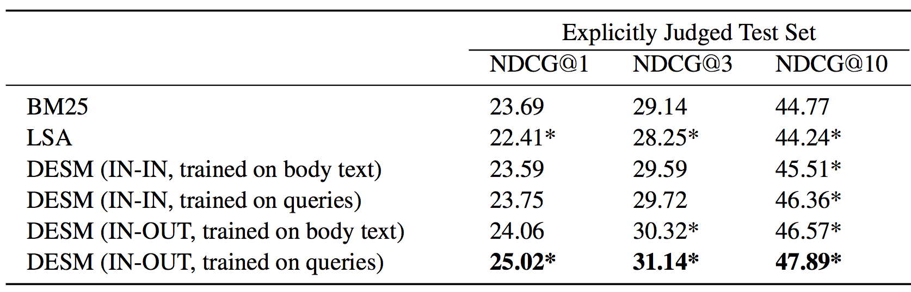
Results – reranking k-best list
Pretty decent gains – e.g., 2% for NDCG@3
Gains are bigger for model trained on queries than docs

Slide 72
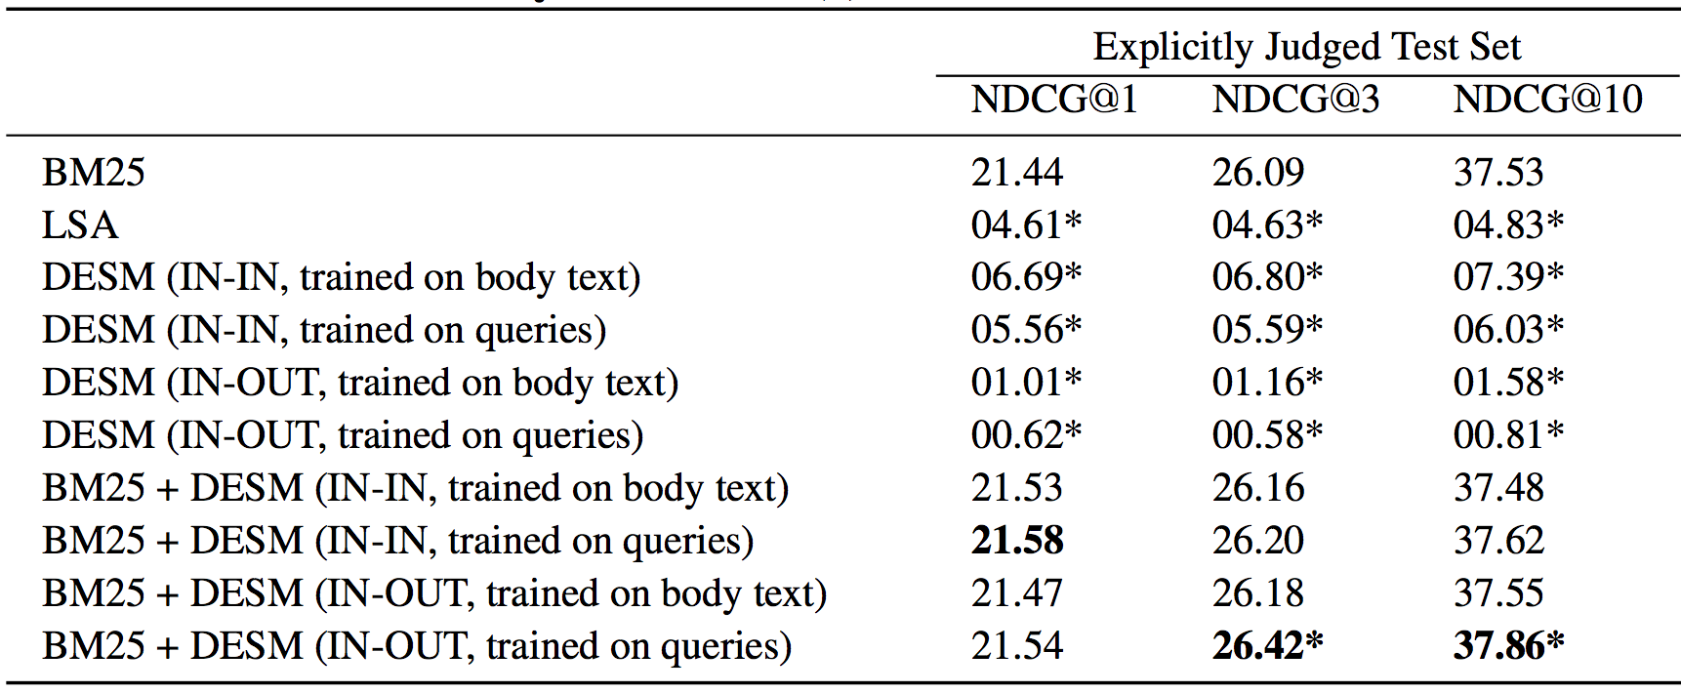
Results – whole ranking system
Notes:
By itself, doesn’t work. Nor does LSA.
Small gains from combination, mainly in-out on queries.
Doesn’t show that distributed word representations don’t work. They’re done broad context here with centroids.

Slide 73
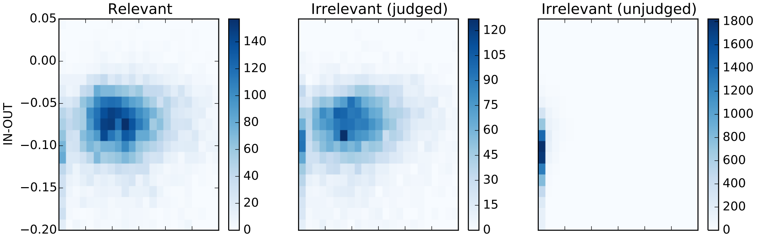
A possible explanation
IN-OUT has some ability to prefer Relevant to close-by (judged) non-relevant, but it’s scores induce too much noise vs. BM25 to be usable alone

Slide 74
DESM conclusions
DESM is a weak ranker but effective at finding subtler similarities/aboutness
It is effective at, but only at, ranking at least somewhat relevant documents
  For example, DESM can confuse Oxford and Cambridge
  Bing rarely makes the Oxford-Cambridge mistake
Notes:
This is where I got to in 2017. Would have to go faster to do the last few slides, but maybe it doesn’t matter and this is fine, and they would only confuse?

Slide 75
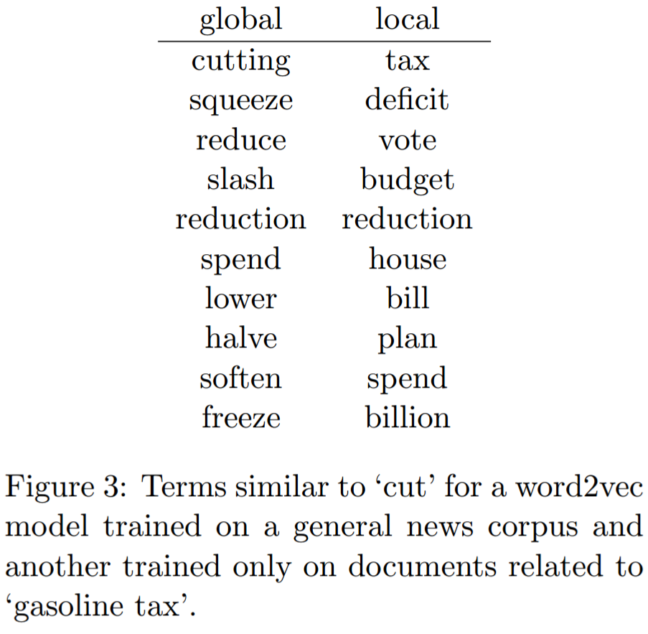
Global vs. local embedding [Diaz 2016]

Slide 76

Global vs. local embedding [Diaz 2016]
Train w2v on documents from first round of retrieval
Fine-grained word sense disambiguation

Slide 77

Ad-hoc retrieval using local and distributed representation [Mitra et al. 2017]
Argues both “lexical” and “semantic” matching is important for document ranking
Duet model is a linear combination of two DNNs using local and distributed representations of query/ document as inputs, and jointly trained on labelled data

Slide 78
Summary: Embed all the things!
Word embeddings are the hot new technology (again!)
Lots of applications wherever knowing word context or similarity helps prediction:
Synonym handling in search
Document aboutness
Ad serving
Language models: from spelling correction to email response
Machine translation
Sentiment analysis
…

Slide 79
Thanks for your attention!

Slide 80
Automatic Thesaurus Generation Issues
Sec. 9.2.3
Quality of associations is usually a problem
Sparsity
Term ambiguity may introduce irrelevant statistically correlated terms.
  “planet earth facts” → “planet earth soil ground facts”
Since terms are highly correlated anyway, expansion may not retrieve many additional documents.
100,000
C
10¹⁰ entries
100,000

Slide 81

COALS model (count-modified LSA)
[Rohde, Gonnerman & Plaut, ms., 2005]

Slide 82
Count based vs. direct prediction
LSA, HAL (Lund & Burgess), COALS (Rohde et al),
Hellinger-PCA (Lebret & Collobert)
NNLM, HLBL, RNN, word2vec Skip-gram/CBOW, (Bengio et al; Collobert & Weston; Huang et al; Mnih & Hinton; Mikolov et al; Mnih & Kavukcuoglu)
Fast training
Scales with corpus size
Efficient usage of statistics
Inefficient usage of statistics
Primarily used to capture word similarity
Generate improved performance
on other tasks
Disproportionate importance given to small counts
Can capture complex patterns
beyond word similarity

Slide 83



Encoding meaning in vector differences
[Pennington, Socher, and Manning, EMNLP 2014]
Crucial insight:
Ratios of co-occurrence probabilities can encode meaning components
x = solid
x = gas
x = water
x = random
large
small
large
small
small
large
large
small
large
small
~1
~1

Slide 84
Encoding meaning in vector differences
[Pennington, Socher, and Manning, EMNLP 2014]
Crucial insight:
Ratios of co-occurrence probabilities can encode meaning components
x = solid
x = gas
x = water
x = fashion
1.9 x 10⁻⁴
6.6 x 10⁻⁵
3.0 x 10⁻³
1.7 x 10⁻⁵
2.2 x 10⁻⁵
7.8 x 10⁻⁴
2.2 x 10⁻³
1.8 x 10⁻⁵
8.9
8.5 x 10⁻²
1.36
0.96

Slide 85







GloVe: A new model for learning word representations
[Pennington, Socher, and Manning, EMNLP 2014]
Notes:
Q: How can we capture this in a word vector space?
A: Log-bilinear model
Fast training
Scalable to huge corpora
Good performance even with small corpus, and small vectors

Slide 86




Word similarities
Nearest words to frog:
1. frogs
2. toad
3. litoria
4. leptodactylidae
5. rana
6. lizard
7. eleutherodactylus
litoria
leptodactylidae
rana
eleutherodactylus
http://nlp.stanford.edu/projects/glove/

Slide 87
Word analogy task [Mikolov, Yih & Zweig 2013a]
Model | Dimensions | Corpus size | Performance (Syn + Sem)
CBOW (Mikolov et al. 2013b) | 300 | 1.6 billion | 36.1
GloVe (this work) | 300 | 1.6 billion | 70.3
CBOW (M et al. 2013b, by us) | 300 | 6 billion | 65.7
GloVe (this work) | 300 | 6 billion | 71.7
CBOW (Mikolov et al. 2013b) | 1000 | 6 billion | 63.7
GloVe (this work) | 300 | 42 billion | 75.0
Notes:
Capturing attributes of meaning through a word analogy task

