Slide 1
Latent Semantic Indexing
(modified from Stanford CS276 Course Lecture: LSI
Thanks to Thomas Hofmann for some slides.)

Slide 2
Today’s topic
Latent Semantic Indexing
  Term-document matrices are very large
  But the number of topics that people talk about is small (in some sense)
    Clothes, movies, politics, …
  Can we represent the term-document space by a lower dimensional latent space?

Slide 3
Linear Algebra Background

Slide 4

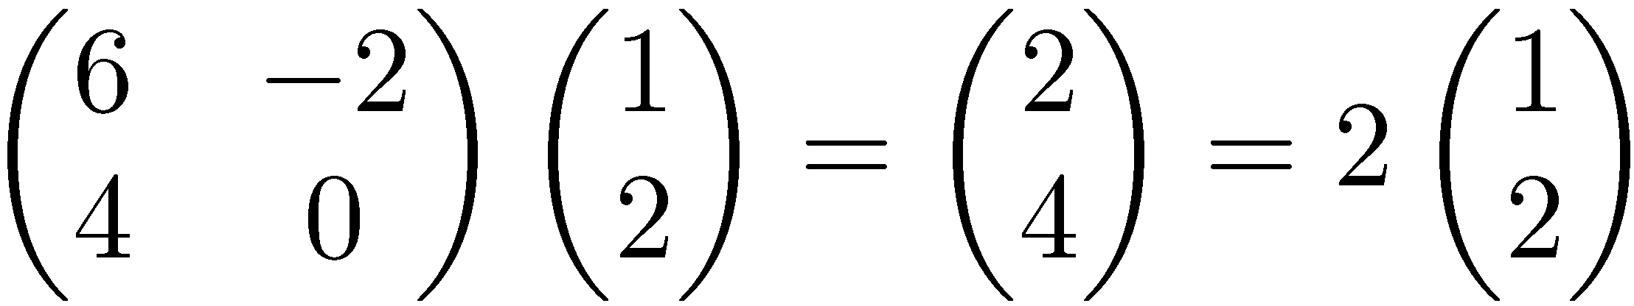
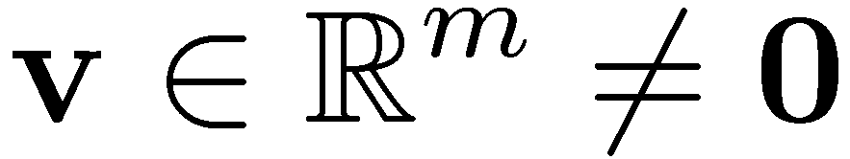

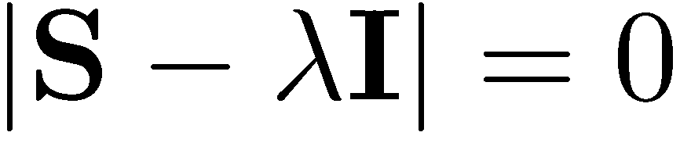
Eigenvalues & Eigenvectors
Eigenvectors (for a square m×m matrix S)
How many eigenvalues are there at most?
Example
(right) eigenvector
eigenvalue
only has a non-zero solution if
this is a m-th order equation in λ which can have at most m distinct solutions (roots of the characteristic polynomial) – can be complex even though S is real.

Slide 5
Matrix-vector multiplication
has eigenvalues 30, 20, 1 with
corresponding eigenvectors
On each eigenvector, S acts as a multiple of the identity
matrix: but as a different multiple on each.
Any vector (say x= ) can be viewed as a combination of
the eigenvectors: x = 2v₁ + 4v₂ + 6v₃

Slide 6
Matrix vector multiplication
Thus a matrix-vector multiplication such as Sx (S, x as in the previous slide) can be rewritten in terms of the eigenvalues/vectors:
Even though x is an arbitrary vector, the action of S on x is determined by the eigenvalues/vectors.

Slide 7
Matrix vector multiplication
Suggestion: the effect of “small” eigenvalues is small.
If we ignored the smallest eigenvalue (1), then instead of
we would get
These vectors are similar (in cosine similarity, etc.)

Slide 8
Eigenvalues & Eigenvectors
For symmetric matrices, eigenvectors for distinct
eigenvalues are orthogonal
  All eigenvalues of a real symmetric matrix are real.
All eigenvalues of a positive semidefinite matrix
are non-negative

Slide 9
Example
Let
Then
The eigenvalues are 1 and 3 (nonnegative, real).
The eigenvectors are orthogonal (and real):
Real, symmetric.
Plug in these values and solve for eigenvectors.

Slide 10
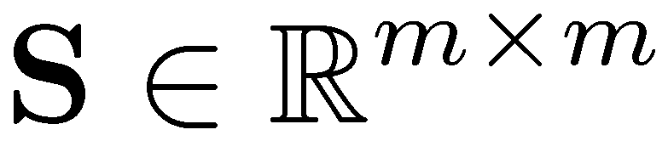
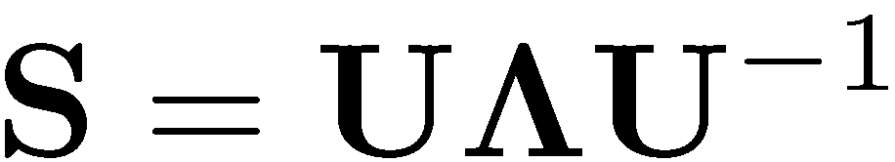
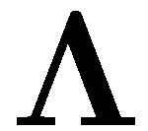

Eigen/diagonal Decomposition
Let be a square matrix with m linearly independent eigenvectors (a “non-defective” matrix)
Theorem: Exists an eigen decomposition
  (cf. matrix diagonalization theorem)
Columns of U are eigenvectors of S
Diagonal elements of are eigenvalues of
Unique for distinct eigen-values
diagonal

Slide 11
Diagonal decomposition: why/how
Let U have the eigenvectors as columns:
Then, SU can be written
Thus SU=UΛ, or U^{–1}SU=Λ
And S=UΛU^{–1}.

Slide 12
Diagonal decomposition - example
Recall
The eigenvectors and form
Recall
UU^{–1} =1.
Inverting, we have
Then, S=UΛU^{–1} =

Slide 13
Example continued
Let’s divide U (and multiply U^{–1}) by
Then, S=
Q
Λ
(Q⁻¹= Q^{T} )
Why? Stay tuned …

Slide 14
Symmetric Eigen Decomposition
If is a symmetric matrix:
Theorem: There exists a (unique) eigen decomposition
where Q is orthogonal:
  Q⁻¹= Q^{T}
  Columns of Q are normalized eigenvectors
  Columns are orthogonal.
  (everything is real)

Slide 15
Exercise
Examine the symmetric eigen decomposition, if any, for each of the following matrices:

Slide 16
Time out!
I came to this class to learn about text retrieval and mining, not have my linear algebra past dredged up again …
  But if you want to dredge, Strang’s Applied Mathematics is a good place to start.
What do these matrices have to do with text?
Recall M × N term-document matrices …
But everything so far needs square matrices – so …

Slide 17
Singular Value Decomposition
For an M × N matrix A of rank r there exists a factorization
(Singular Value Decomposition = SVD) as follows:
M×M
M×N
V is N×N
The columns of U are orthogonal eigenvectors of AA^{T}.
The columns of V are orthogonal eigenvectors of A^{T}A.
Eigenvalues λ₁ … λ_{r} of AA^{T} are the eigenvalues of A^{T}A.
Singular values.

Slide 18
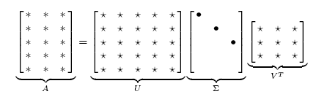
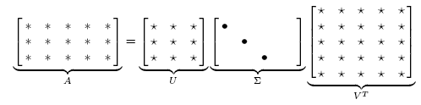
Singular Value Decomposition
Illustration of SVD dimensions and sparseness

Slide 19
SVD example
Let
Thus M=3, N=2. Its SVD is
Typically, the singular values arranged in decreasing order.

Slide 20

Low-rank Approximation
SVD can be used to compute optimal low-rank approximations.
Approximation problem: Find A_{k} of rank k such that
A_{k} and X are both m×n matrices.
Typically, want k << r.
Frobenius norm

Slide 21
Low-rank Approximation
Solution via SVD
set smallest r-k
singular values to zero
k
column notation: sum
of rank 1 matrices

Slide 22
Reduced SVD
If we retain only k singular values, and set the rest to 0, then we don’t need the matrix parts in red
Then Σ is k×k, U is M×k, V^{T} is k×N, and A_{k} is M×N
This is referred to as the reduced SVD
It is the convenient (space-saving) and usual form for computational applications
It’s what Matlab gives you
k

Slide 23
Approximation error
How good (bad) is this approximation?
It’s the best possible, measured by the Frobenius norm of the error:
where the σ_{i} are ordered such that σ_{i} ≥ σ_{i+1}.
Suggests why Frobenius error drops as k increased.

Slide 24
SVD Low-rank approximation
Whereas the term-doc matrix A may have M=50000, N=10 million (and rank close to 50000)
We can construct an approximation A₁₀₀ with rank 100.
  Of all rank 100 matrices, it would have the lowest Frobenius error.
Great … but why would we??
Answer: Latent Semantic Indexing
C. Eckart, G. Young, The approximation of a matrix by another of lower rank. Psychometrika, 1, 211-218, 1936.

Slide 25
Latent Semantic Indexing via SVD

Slide 26
What is SVD
From term-doc matrix A, we compute the approximation A_{k.}
There is a row for each term and a column for each doc in A_{k}
Thus docs live in a space of k<<r dimensions
  These dimensions are not the original axes
But why?

Slide 27
Vector Space Model: Pros
Automatic selection of index terms
Partial matching of queries and documents (dealing with the case where no document contains all search terms)
Ranking according to similarity score (dealing with large result sets)
Term weighting schemes (improves retrieval performance)
Various extensions
  Document clustering
  Relevance feedback (modifying query vector)
Geometric foundation

Slide 28
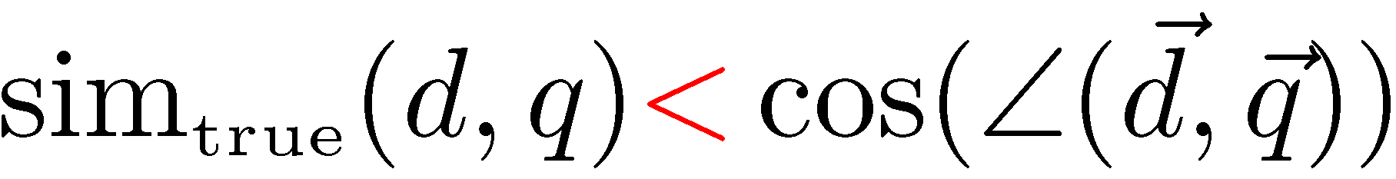
Problems with Lexical Semantics
Ambiguity and association in natural language
  Polysemy: Words often have a multitude of meanings and different types of usage (more severe in very heterogeneous collections).
  The vector space model is unable to discriminate between different meanings of the same word.

Slide 29
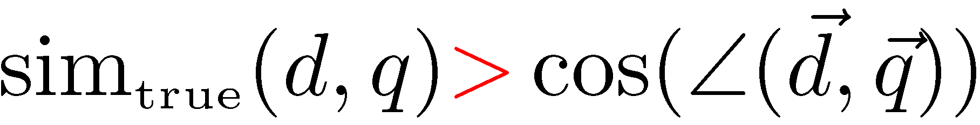
Problems with Lexical Semantics
  Synonymy: Different terms may have an dentical or a similar meaning (weaker: words indicating the same topic).
  No associations between words are made in the vector space representation.

Slide 30
Polysemy and Context
Document similarity on single word level: polysemy and context
ring
jupiter
•••
space
voyager
meaning 1
…
planet
...
…
saturn
...
meaning 2
car
company
•••
dodge
ford
contribution to similarity, if used in 1st meaning, but not if in 2nd

Slide 31
Latent Semantic Indexing (LSI)
Perform a low-rank approximation of document-term matrix (typical rank 100-300)
General idea
  Map documents (and terms) to a low-dimensional representation.
  Design a mapping such that the low-dimensional space reflects semantic associations (latent semantic space).
  Compute document similarity based on the inner product in this latent semantic space

Slide 32
Goals of LSI
Similar terms map to similar location in low dimensional space
Noise reduction by dimension reduction

Slide 33
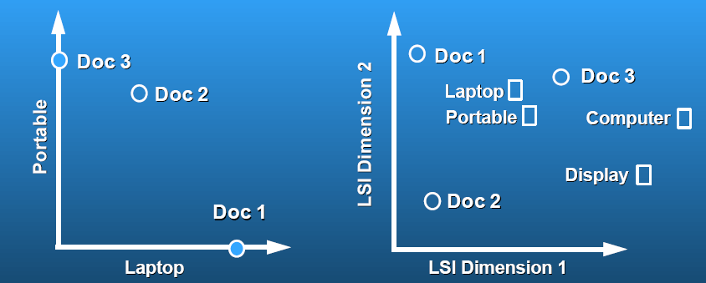
Latent Semantic Analysis
Latent semantic space: illustrating example
courtesy of Susan Dumais

Slide 34
Performing the maps
Each row and column of A gets mapped into the k-dimensional LSI space, by the SVD.
Claim – this is not only the mapping with the best (Frobenius error) approximation to A, but in fact improves retrieval.
A query q is also mapped into this space, by
  Query NOT a sparse vector.

Slide 35
Empirical evidence
Experiments on TREC 1/2/3 – Dumais
Lanczos SVD code (available on netlib) due to Berry used in these expts
  Running times of ~ one day on tens of thousands of docs [still an obstacle to use]
Dimensions – various values 250-350 reported. Reducing k improves recall.
  (Under 200 reported unsatisfactory)
Generally expect recall to improve – what about precision?

Slide 36
Empirical evidence
Precision at or above median TREC precision
  Top scorer on almost 20% of TREC topics
Slightly better on average than straight vector spaces
Effect of dimensionality:
Dimensions | Precision
250 | 0.367
300 | 0.371
346 | 0.374

Slide 37
Failure modes
Negated phrases
  TREC topics sometimes negate certain query/terms phrases – automatic conversion of topics to
Boolean queries
  As usual, freetext/vector space syntax of LSI queries precludes (say) “Find any doc having to do with the following 5 companies”
See Dumais for more.

Slide 38
But why is this clustering?
We’ve talked about docs, queries, retrieval and precision here.
What does this have to do with clustering?
Intuition: Dimension reduction through LSI brings together “related” axes in the vector space.

Slide 39
Intuition from block matrices
N documents
Block 1
What’s the rank of this matrix?
Block 2
0’s
M
terms
…
0’s
Block k
= Homogeneous non-zero blocks.

Slide 40
Intuition from block matrices
N documents
Block 1
Block 2
0’s
M
terms
…
0’s
Block k
Vocabulary partitioned into k topics (clusters); each doc discusses only one topic.

Slide 41
Intuition from block matrices
N documents
Block 1
What’s the best rank-k
approximation to this matrix?
Block 2
0’s
M
terms
…
0’s
Block k
= non-zero entries.

Slide 42
Intuition from block matrices
Likely there’s a good rank-k
approximation to this matrix.
wiper
Block 1
tire
V6
Block 2
Few nonzero entries
…
Few nonzero entries
Block k
car
1
0
automobile
0
1

Slide 43
Simplistic picture
Topic 1
Topic 2
Topic 3

Slide 44
Some wild extrapolation
The “dimensionality” of a corpus is the number of distinct topics represented in it.
More mathematical wild extrapolation:
  if A has a rank k approximation of low Frobenius error, then there are no more than k distinct topics in the corpus.

Slide 45
LSI has many other applications
In many settings in pattern recognition and retrieval, we have a feature-object matrix.
  For text, the terms are features and the docs are objects.
  Could be opinions and users …
  This matrix may be redundant in dimensionality.
  Can work with low-rank approximation.
  If entries are missing (e.g., users’ opinions), can recover if dimensionality is low.
Powerful general analytical technique
  Close, principled analog to clustering methods.

Slide 46
Resources
IIR 18

