Slide 1
Course Overview: Introduction to Big Data Analytics
J. H. Wang
Sep. 7, 2026

Slide 2
Instructor & TA
Instructor
J. H. Wang (王正豪)
Professor, CSIE, NTUT
Office: R1534, Technology Building
E-mail: jhwang@ntut.edu.tw
Tel: ext. 4238
Office Hour: 9:10-12:00am, every Tuesday and Thursday
TA
Mr. Wang (@ R1424, Technology Building)
E-mail: (TBA)

Slide 3
About this Course
Course Web Page:
https://chriswjh.github.io/BDA/
Time: 10:10-12:00am, Mon., 13:10-14:00pm, Tue.
Classroom: R235/R234, Technology Building
Classes will be in-person, offered at sophomore level
The teacher and the TA can be reached via e-mails, Teams, or Facebook group if needed

Slide 4
Other Communication Channels
Class sessions will be recorded using i-School+
Online class sessions using Microsoft Teams will also be provided when possible
Team created for the course number:
[NTUT-Sync] 115-1_365939_巨量資料分析導論
Online communication channels: Teams, iSchool+, course web page, e-mails

Slide 5
Course Materials
Textbook:
Jiawei Han, Jian Pei, and Hanghang Tong, Data Mining: Concepts and Techniques, 4th ed., Morgan Kaufmann Publishers, Oct. 2022. [DM4] (selected chapters)
Prerequisites:
Basic knowledge of data structures (and algorithms), database systems, and discrete math (probability)
Programming experience is *required* for completing homeworks & projects

Slide 6
Target Audience
CSIE sophomores and above
Students who are interested in learning data mining concepts and tools
Applying big data analytics techniques for analyzing real-world data

Slide 7
Differences between Courses with Similar Names
CS:
Basics: Introduction to Big Data Analytics (This course)
Concepts of data mining & big data
Application: Educational Data Mining and Applications (2023-2025)
Data mining concept + educational data analysis
Advanced: Big Data Mining and Applications (graduate-level)
Mining different types of big data + distributed platform
IFM:
Basics: Big Data Analytics
Data mining concepts

Slide 8
Additional Reading Materials
Reference Books
Tom White, Hadoop: The Definitive Guide, 4th ed., O’Reilly Media, 2015.
Jules S. Damji, Brooke Wenig, Tathagata Das, Denny Lee, Learning Spark: Lightning-Fast Big Data Analysis, 2nd ed., O'Reilly Media, Jul. 2020.
Jimmy Lin and Chris Dyer, Data-Intensive Text Processing with MapReduce, Morgan & Claypool Publishers, 2010.
Jure Leskovec, Anand Rajaraman, Jeffrey David Ullman, Mining of Massive Datasets, 3rd Edition, Cambridge University Press, 2020.
http://www.mmds.org/
Official online documents: Hadoop, Spark, …
Academic papers

Slide 9
Grading Policy
Homework assignments and programming exercises: ~40%
Mid-term exam: ~25%
Term project: ~35%
Including proposal, presentation, and final report
All homeworks, projects, and reports must be submitted before the deadline
Late submission has to be done *before* the end of the semester (Jan. 8, 2027), if not specified otherwise

Slide 10
Homeworks and Projects
About 3~4 written assignments
Data mining concepts
About 3 team-based programming exercises
Maximum number of students per team: 4
One term project for data analysis or system development
Team-based (the same as programming exercises)
e.g. to find interesting open datasets and appropriate methods to analyze
Responsibility of each member must be specified in the document for team-based projects

Slide 11
About the Midterm Exam
Date: (TBD) Nov. 16, 2026
Time: 10:10-12:00
Location: R235, Technology Building
Range: (TBD) [DM4] Ch.1-2, 4, 6, 7 (part), 8
Question Types: Calculation, Short Answer, True-False, Multiple Choice
Closed-book

Slide 12
About the Term Project
Proposals, presentations, and reports are *required* for each team, and will be counted in the score
The score you’ll get depends on the functionality, difficulty, and quality of your project
Proposal: A one-page description of your idea on how you are going analyze which dataset
You can either write your own program, or call existing open source code or library (but NOT executing binary code only)
Presentation: ~20 minutes per team
Focus on data description, analytical methods, results and interpretations
Reports: slides, source code, and document

Slide 13
Homework Submission
How to Submit:
Written exercises are to be submitted in paper
Electronic version is also acceptable in iSchool+
Systems, programs & documentation, project proposals, and project reports in electronic files must be submitted online to iSchool+
You will get deducted score when there’s delay in homework submission
The longer the delay, the higher the deduction

Slide 14
What This Course is about
This course can help you
Understand the general techniques of data mining
Apply data mining tools in analyzing different kinds of data
Get an idea of what distributed platforms like Hadoop/Spark can do (if time permits)
And MORE…
Technical and practical skills for:
Data analysis and data mining methods
Environment setup of distributed computing (if time permits)

Slide 15
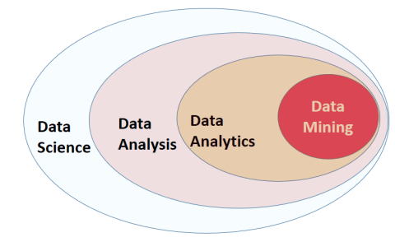
Related Topics

Slide 16
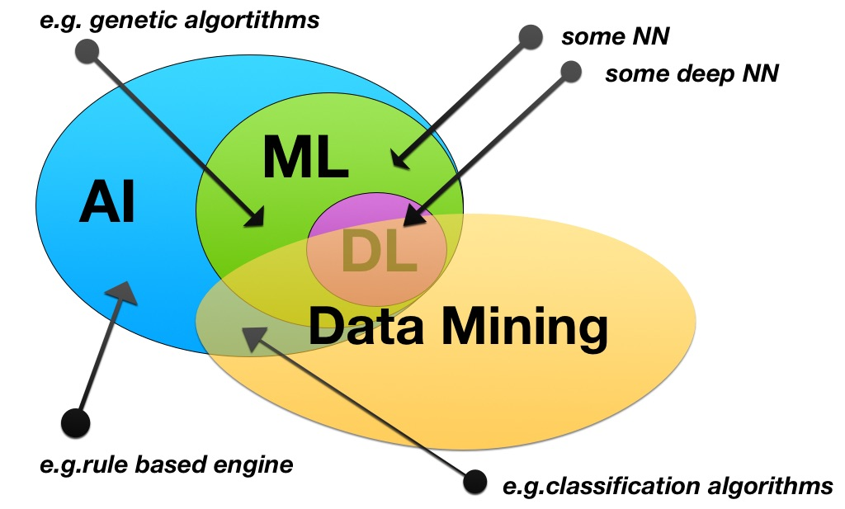
Related Topics

Slide 17
Major Focus in Big Data Analytics
The management of complete data lifecycle
Collecting
Cleansing
Organizing
Storing
Analyzing
Visualization & Interpretation
Governing

Slide 18
The Goal of the Course
To help you learn the basic concepts & principles of data mining
To help you know the characteristics of your data and find appropriate tools to analyze it
To interpret the analytic results of data mining

Slide 19
The Topics to be Covered
Introduction
Data mining concepts
Data preprocessing
Frequent pattern mining
Data classification
Data clustering
Distributed platform for big data
Introducing distributed platforms: Hadoop, Spark
MapReduce programming

Slide 20
Tentative Schedule
Before midterm
Introduction (1 wk)
Data characteristics & preprocessing (2 wks)
Frequent pattern mining (2 wks)
Data classification (2 wks)
Data clustering (1 wk)
After midterm
Advanced methods: pattern mining, classification, clustering (1 wk)
Introducing distributed platforms: Hadoop, Spark (1 wk)
MapReduce programming (1-2 wks)
Term Project Presentation (3-4 wks)

Slide 21
Tentative Schedule
Week | Date | Content | Note
1 | 9/7 9/8 | Course Overview Ch.1, Introduction
2 | 9/14 9/15 | (Leave for Czech project)
3 | 9/21 9/22 | (Leave for Czech project)
4 | 9/28 9/29 | (9/28: Teachers’ Day) Ch.2, Data, Measurements, and Data Preprocessing
5 | 10/5 10/6 | Ch.4, Pattern Mining: Basic Concepts and Methods | HW#1
6 | 10/12 10/13 | Ch.4 Ch.5, Pattern Mining: Advanced Methods
7 | 10/19 10/20 | Ch.6, Classification: Basic Concepts | Due: HW#1 HW#2

Slide 22
Week | Date | Content | Note
8 | 10/26 10/27 | Ch.6
9 | 11/2 11/3 | Ch.8, Cluster Analysis: Basic Concepts and Methods | Due: HW#2 HW#3
10 | 11/9 11/10 | Ch.8 Ch.7, Classification: Advanced Methods
11 | 11/16 11/17 | (11/16: Midterm) | Due: HW#3
12 | 11/23 11/24 | Ch.9, Cluster Analysis: Advanced Methods | Due: Proposal HW#4
13 | 11/30 12/1 | Distributed Platforms: Hadoop, Spark MapReduce Programming
14 | 12/7 12/8 | Spark Programming | Due: HW#4

Slide 23
Week | Date | Content | Note
15 | 12/14 12/15 | Term Project Presentation: Week 1
16 | 12/21 12/22 | Term Project Presentation: Week 2
17 | 12/28 12/29 | Term Project Presentation: Week 3 (online)
18 | 1/4 1/5 | Term Project Presentation: Week 4 (online) | 1/8 Due: Final report

Slide 24
Flexible Learning (Week 17-18)
Group-based term project implementation and presentation
Online
Submission for make-up homeworks, and extra bonus
No more than 10% of the total score

Slide 25
Notes on Homeworks
Rule 1: Plagiarism is prohibited
Near-duplicate codes will get equal and deducted scores
Rule 2: Clear documentation is required in your system projects
Instructions on downloading, installing, configuring, and executing your code, open source library, APIs, or codes must be included in the documentation
Package control is recommended

Slide 26
More on Term Projects
Tentative schedule for all teams:
Proposal: *required* one week after midterm (Nov. 23, 2026)
Presentations (including demos): *required* in the last three-four weeks (starting as early as Dec. 14, 2026)
Final report: *required* before the end of the semester (Jan. 8, 2027)
Slides, source code, documentation

Slide 27
Notes on System Development
You have to write your own code
In any programming language: Python, R, …
Calling existing open APIs or libraries is Ok
E.g. Hadoop, Spark, TensorFlow, Keras, PyTorch, …
But simply running existing binary codes or commercial tools is NOT acceptable
You have to explain the major part of your code
Any application of big data analytics
Public datasets: UCI ML repository, kaggle, …
Relevant competitions
AI cup 2026, …

Slide 28
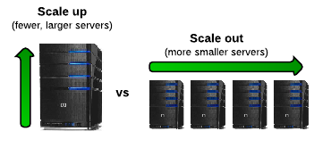
When it comes to Big Data…
It’s all about scalability!
Scale up (vertical scalability)
Scale out (horizontal scalability)

Slide 29
Summary
Introducing data mining concepts and tools
Analyzing real world data
Learning how to interpret the analysis results

