Slide 1
IR Homework #1
By J. H. Wang
Oct. 7, 2026

Slide 2
Programming Exercise #1:
Document Indexing
Goal: to build an inverted index for a text collection
Input: a set of text documents
Output: inverted index
Implementation:
  either calling open source library functions (or APIs)
  or writing your code from scratch in any programming language

Slide 3
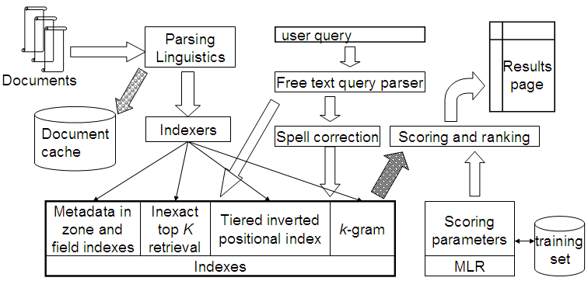
The Major Task to Do
1

Slide 4
Input: a Sample of the Test Collection
A sample from the ClueWeb09 test collection
  File format: WARC (Web ARChive file format)
    http://www.digitalpreservation.gov/formats/fdd/fdd000236.shtml
    Sample Files: http://www.lemurproject.org/clueweb09/sampleFiles.php
  Each file contains about 40,000 Web pages, in 1GB
  Each team will be randomly allocated different files by the TA (later)

Slide 5
Web Test Collections
The ClueWeb09 dataset
  http://lemurproject.org/clueweb09/
    1,040,809,705 Web pages in 10 languages, during Jan.-Feb. 2009
    5TB, compressed (25TB, uncompressed)
    Distributed as two 3TB hard disks for the full dataset
The ClueWeb12 dataset
  A successor to the ClueWeb09 dataset
  http://lemurproject.org/clueweb12/
  733,019,372 English Web pages, in Feb.-May 2012
  5.5TB, compressed (27.3TB, uncompressed)
  Distributed as one 8TB hard disk for the full dataset

Slide 6
Web Test Collections
The ClueWeb22 dataset
  The newest dataset: https://www.lemurproject.org/clueweb22.php/
  10 billion Web pages, organized into three subsets: B (200M), A (2B), L (10B)
    Collected during the first half of 2022 (in Bing)
    1* 8TB disk (B), or on Azure
  A. Overwijk, C. Xiong, and J. Callan. ClueWeb22: 10 billion web documents with rich information. In Proceedings of the 45th International ACM SIGIR Conference on Research and Development in Information Retrieval, ACM, 2022.

Slide 7
Other Test Collections
Datasets previously used in TREC Web, Terabytes, and Blog tracks:
  Currently managed by Univ. of Glasgow at: http://ir.dcs.gla.ac.uk/test_collections/
  WT2g, WT10g, .GOV, .GOV2, Blogs06, Blogs08
Reuters Corpora (RCV1, RCV2, TRC2)
  http://trec.nist.gov/data/reuters/reuters.html
  RCV1: ~810,000 English news stories from 1996/08/20 to 1997/08/19 (2.5GB uncompressed)
  RCV2: 487,000 multilingual news in 13 languages
  TRC2: 1,800,370 news from 2008/01/01 to 2009/02/28 (2.87GB)

Slide 8
Older Test Collections
Reuters-21578:
  21,578 news articles in 1987 (28.0MB uncompressed)
  Publicly available at: http://www.daviddlewis.com/resources/testcollections/reuters21578/
Test collections held at University of Glasgow:
  Publicly available at: http://ir.dcs.gla.ac.uk/resources/test_collections/
  LISA, NPL, CACM, CISI, Cranfield, Time, Medline, ADI
  Ex: The Time Collection: 423 articles from Time magazine (1.5MB)

Slide 9
Output: Inverted Index
Output format: Using the standard positional index (as in Chaps. 1 & 2):
  (1) Dictionary file: a sorted list of vocabularies (in separate lines)
  (2) Postings list: for each term, a list of occurrences in the original text
    Format: (as in Fig. 2.11, Sec. 2.4.2, p.38)
    term_{i}, df_{i}:
    <doc1, tf_{i1}: <pos1, pos2, … >;
    doc2, tf_{i2}: <pos1, pos2, …>;
    …>
    E.g.
    to, 993427:
    <1, 6: <7, 18, 33, 72, 86, 231>;
    2, 5: <1, 17, 74, 222, 255>; … >
df_{i}: document frequency of term_{i}
tf_{ij}: term frequency of term_{i} in doc_{j}

Slide 10
Design Issues
pos means the token positions in the body of documents
  This facilitates easier implementation of some functions, e.g., phrase query, or proximity search
You can design your own internal index formats, as long as necessary information are included
  Dictionary: terms t_{i}, document frequency df_{i}
  Postings: a list of (docID, term frequency tf_{ij}, loc) for each term t_{i}
Preprocessing should be handled with care
  Input formats of data collections
  Please indicate how you will handle digits, hyphens, punctuation marks, … in your tokenizer

Slide 11
Optional Functionality
Efficiency issues
  A separate data structure (e.g. trie) can be used to store the vocabularies and postings in your indexer
  Skip pointers (to be used in query processing)
Language issues in tokenization
  Case folding
  Stopword removal
  Lemmatization/Stemming
  Able to be turned on/off by a parameter trigger

Slide 12
Some Open Source Indexing Tools
Apache Lucene (in Java)
  Lucene Core (in Java)
  PyLucene (Python binding)
  Popular library on which search engines are built: Apache Solr, ElasticSearch
The Lemur Project:
  by CMU/Umass (in C++)
  Lucindri (in Java)
Terrier IR Platform
  by U. Glasgow (in Java)
  PyTerrier (Python binding)
…

Slide 13
Submission
Your submission *should* include
  The source codes
    For calling open source libraries, please indicate which APIs or library functions are needed and instructions on where to download, how to install, configure or compile
  A one-page documentation including
    Major features: ex: optional features, high efficiency, low storage requirement, multiple input formats, huge corpus, …
    Major difficulties encountered
    Instructions for installation/compilation/ configuration/execution environment (ex: Java Runtime, special compilers, …)
    Team members list: The names and the responsible parts of each individual member *should* be clearly identified
Due: two weeks (Oct. 21, 2026)

Slide 14
Submission Instructions
Programs and related electronic files in your homework must be submitted directly on the submission site:
  Submission site: iSchool+
  Preparing your submission file: as one single compressed file
    Name your file according to your ID such as <ID>_HW1.zip
    Remember to specify the names and student IDs of your team members in the documentation
  NOTE:
    You have to register of your team members to the TA first, before we can allocate different files as your test input
    Instructions on where to obtain your copy of the partial dataset will soon be available from the TA
For more information on homework submission issues:
  Please contact with the TA (Ms.Hsu & Ms.Liao, @ R1424, Technology Building)

Slide 15
Evaluation
Minimum requirement: index correctness for your test data
  Using (your allocated copy of) the ClueWeb09 Test Collection as input, the inverted index generated by your program will be checked
  Optional features will be considered as bonus
You might be required to demo if the program submitted was unable to compile/run by the TA

Slide 16
Any Questions or Comments?

