Slide 1
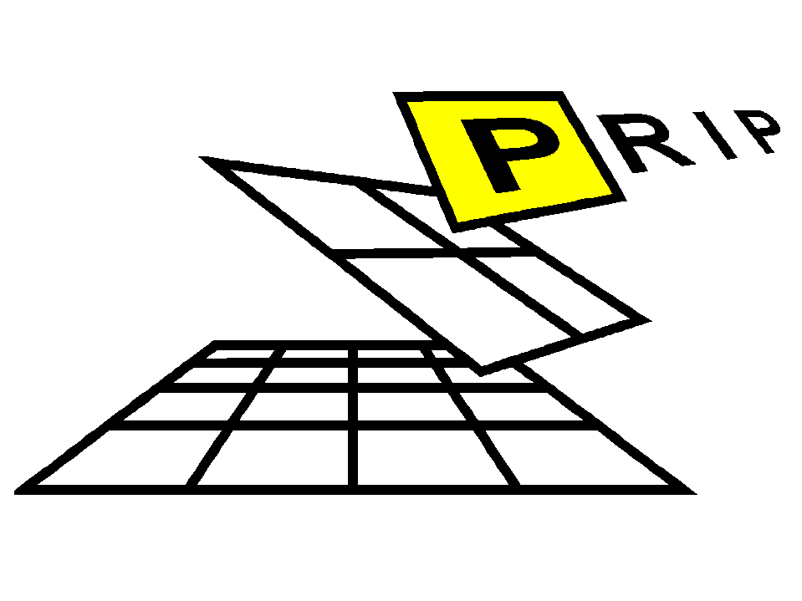





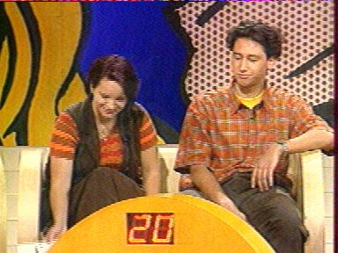
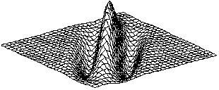

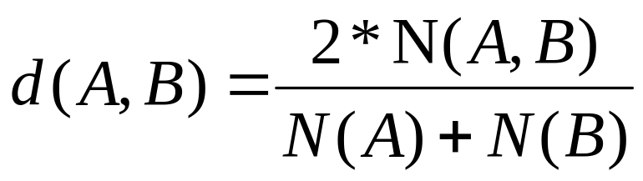
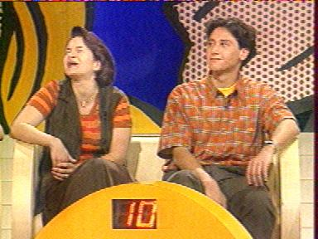
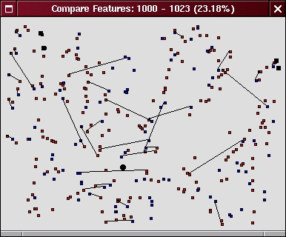
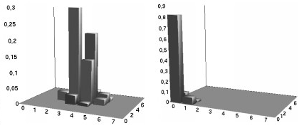
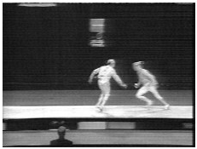
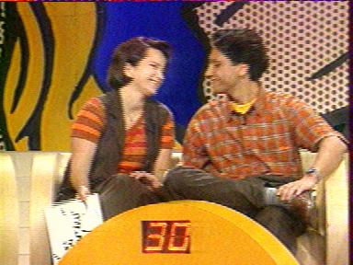
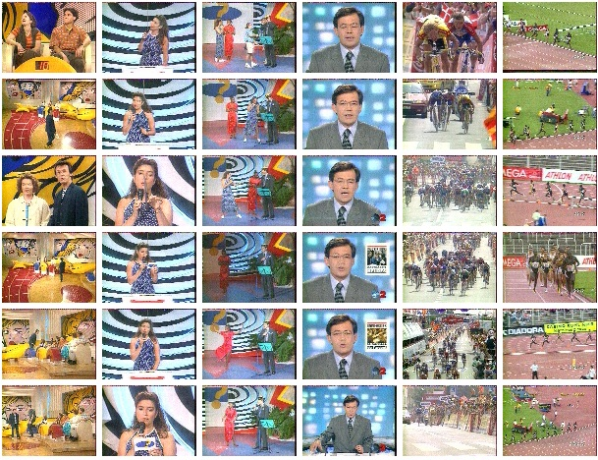
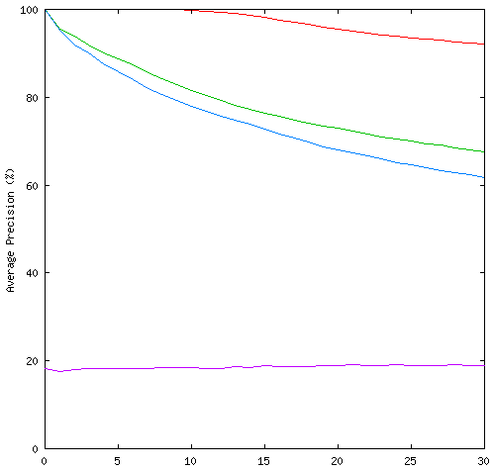
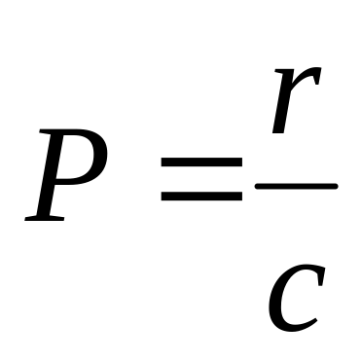
Content based Image Retrieval using Interest Points and Texture Features
Christian Wolf ¹, Jean-Michel Jolion ², Walter G. Kropatsch ¹, Horst Bischof ¹
¹Vienna University of Technology, Pattern Recognition and Image Processing Group
http://www.prip.tuwien.ac.at
² INSA de Lyon, Laboratoire Reconnaissance de Formes et Vision
http://rfv.insa-lyon.fr
Image representation by local Gabor features.
Selection of locations with interest detectors (Harris, Jolion, Loupias)
Scale
IP₁
Scale 1
Scale 2
Scale 3
IP₂
IP₃
IP₄
Representation I - Feature Vectors
One feature vector per interest point
Representation II - Histogram sets
Scale
One Histogram per filter. Histograms model the amplitude distribution of this filter.
Scale 1
Comparion using the Euclidean distance and compensation for small rotations
Scale 2
Scale 3
A n-nearest neighbour search is performed for each interest point
Final distance by number of corresponding interest points
x-axis: the amplitude of the point itself
y-axis: the amplitude of the neighbouring point (nearest neighbour Search)
Test database 1:
609 Images taken from television. 568 used to query, grouped into 11 clusters:
Upper limit
Feature vect.
Histograms
Test database 2:
180 Images taken from various sources.
Performance Evaluation
Precision of the query:
Lower limit
H B F G J K
(Part of test database 1)
See demo at: http://www.prip.tuwien.ac.at/Research/ImageDatabases/Query
This work was supported in part by the Austrian Science Foundation (FWF) under grant S-7002-MAT

