Slide 1





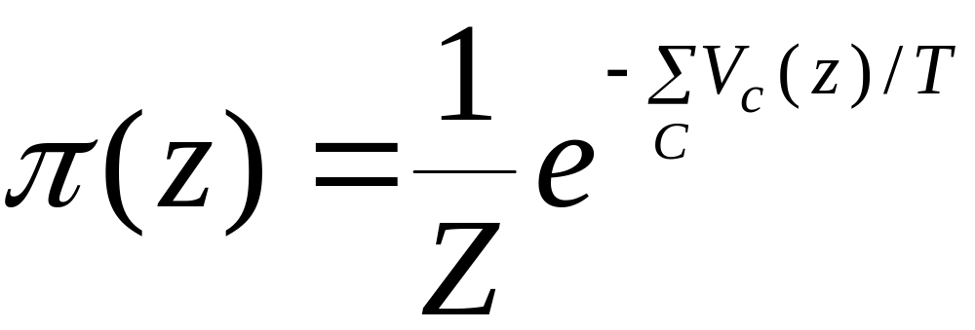


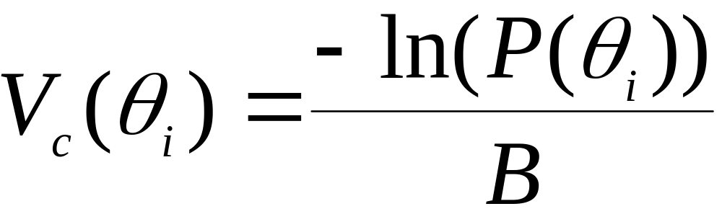

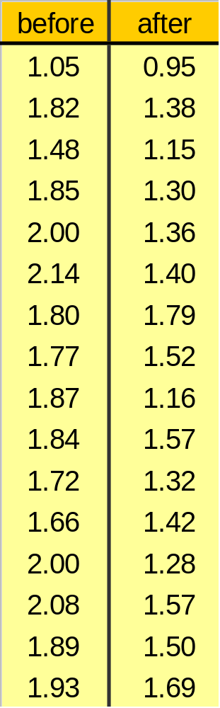
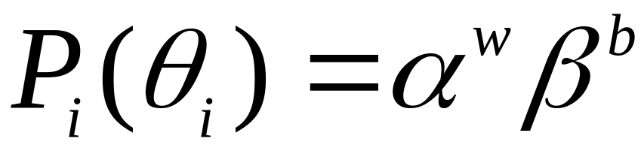
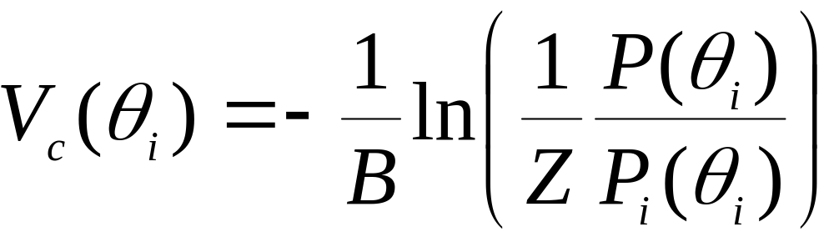

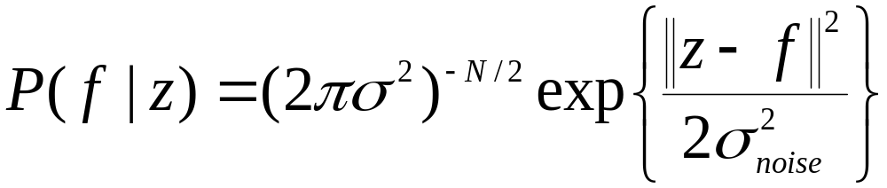
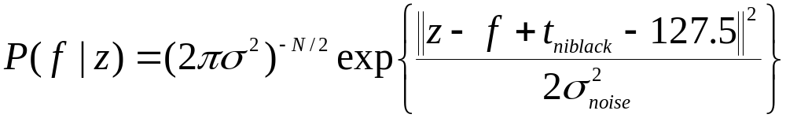
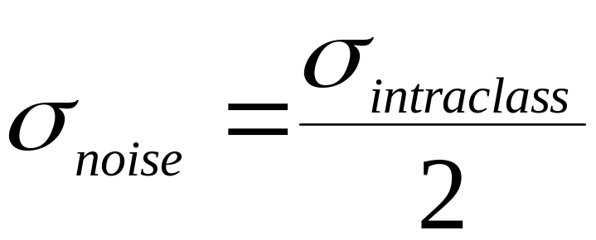


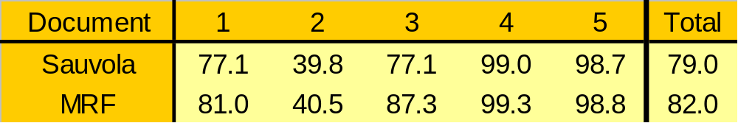
Binarization of Low Quality Text Using a Markov Random Field Model
Christian Wolf and David Doermann
Most existing binarization techniques have been conceived for high-resolution and good quality document images. Binarization of low quality, low resolution and lossly compressed multimedia docu-ments is a non trivial problem.
We present a method using prior information about the spatial configu-ration of the binary pixels. Binarization is performed as a Bayesian estimation pro-blem in a MAP framework using a Mar-kov random field model.
Markov random field models
The MRF models the prior information on the spatial configuration of the binary pixels in the image. Energy potentials are assigned to cliques, i.e. possible black and white labellings of pixel neighborhoods, where high energy means a low possibility for a clique according to the model. The joint probability distribution function of the sites(pixels) of the MRF is a Gibbs Distribution, containing the sum of the clique potentials of all pixels. Optimization is done by simulated annealing.
C ... cliques
Vc .. clique potential
z ... estimated image
T ... Temperature (for the simulated annealing)
The prior distribution
The MRF is defined on a large neighborhood (4x4 pixel cliques). The clique potentials are learned from training data by converting the estimated absolute probabilities into potentials:
... clique labelling
B ... clique size
In order to compensate for the high difference between text and background pixels, each potential is normalized by deviding it by the probability P_{i} of this clique labelling being drawn from a stationary but biased source, which generates white and black pixels with probabilities α and β, respectively (estimated from the frequencies of white and black pixels in the training set).
w ... number of white pixels in the clique
b ... number of black pixels in the clique
The observation model (likelihood)
  Most observation models in MRF based estimation methods use simple models, as e.g. Gaussian noise with zero mean. This corresponds to a fixed thresholding with a threshold of 127.5 if the prior is uniform. is achieved.
z ... estimated gray value
f ... observed gray value
The clique labelings of the repaired pixel before and after flipping it. All 16 cliques favor the change of the pixel.
  We use standard binarization methods (Niblack and derived techniques) to “model” the likelihood. With a uniform prior, the same result as using the classic techniques is obtained. Desired effect: improving the performance of classic methods with prior knowledge of the spatial configuration of the image.Niblack is achieved.
  The noise variance is estimated by maximizing the intra class variance between the text and background pixels using Otsu’s method.is achieved.
Experimental results
Document images from the Pink Panther database and from the Uni-versity of Washington database were down sampled by a factor of 2, coded in JPEG 75% and then binarized passed to the commercial OCR program Finereader.
Sauvola et al.
MRF
Christian Wolf: wolf@rfv.insa-lyon.fr http://rfv.insa-lyon.fr/~wolf David Doermann: doermann@umiacs.umd.edu http://lamp.cfar.umd.edu/~doermann

