Slide 1



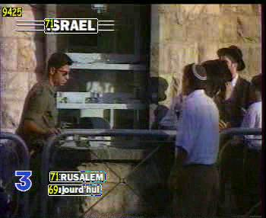

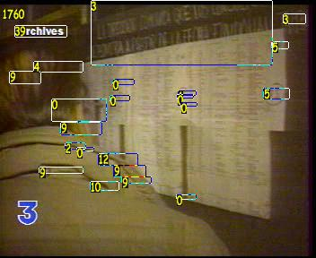
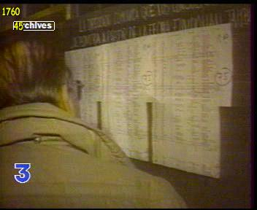

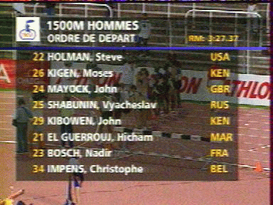
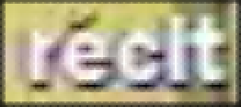
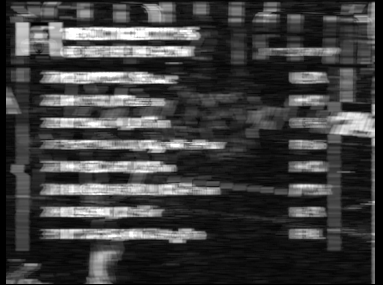
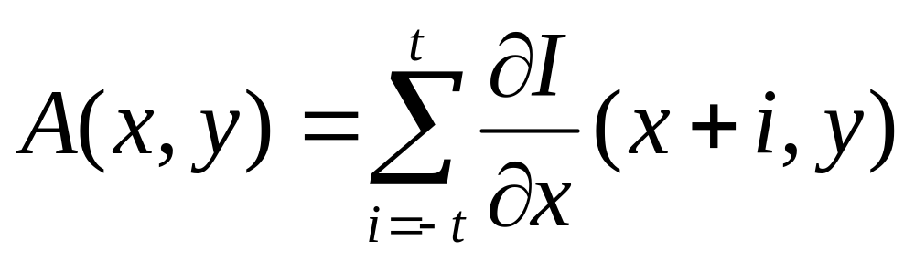
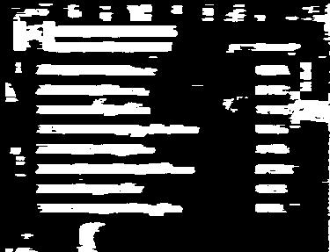
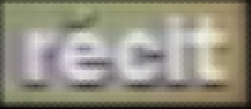
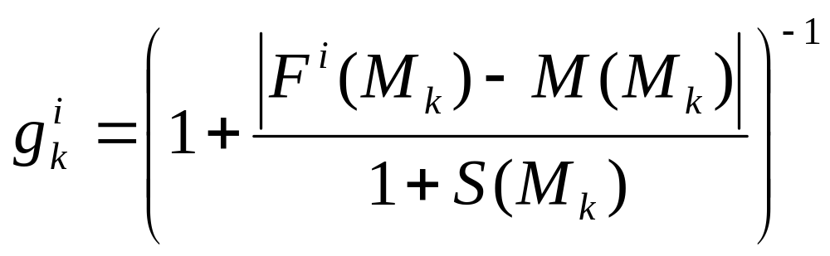
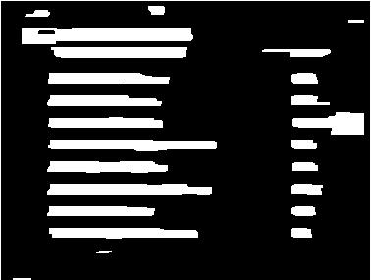
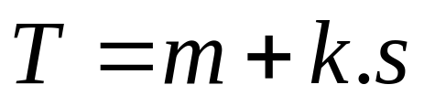
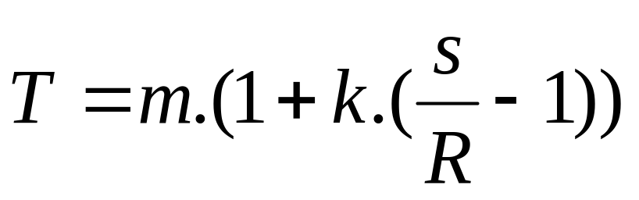
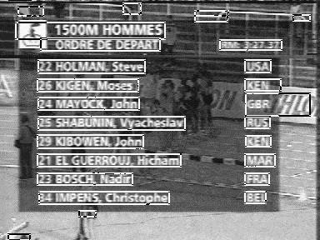
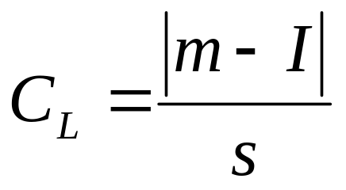
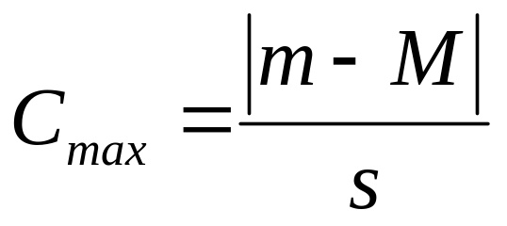
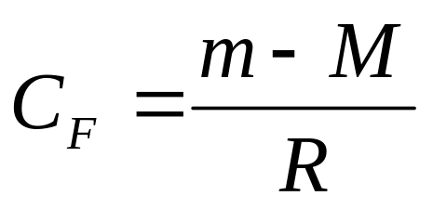
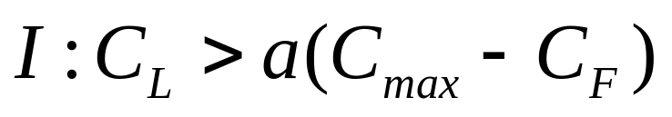
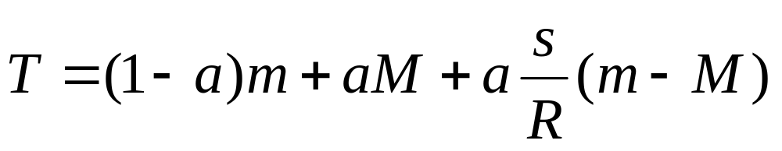
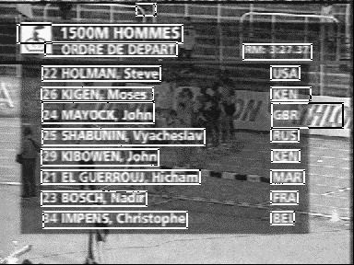

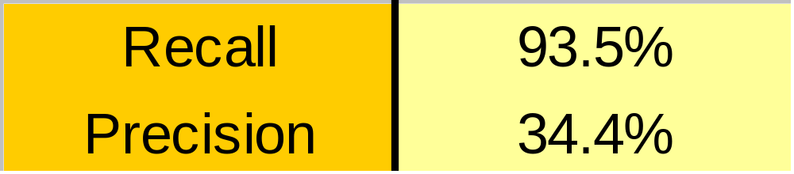
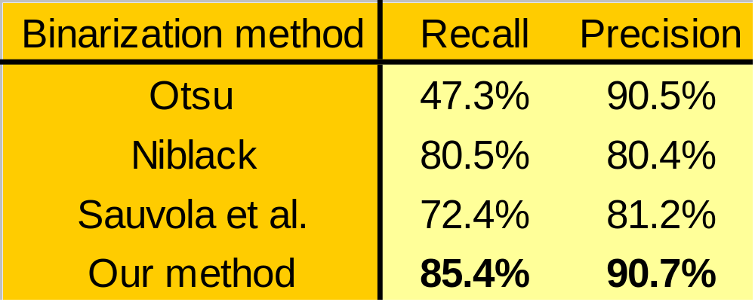



Text Localization, Enhancement and Binarization in Multimedia Documents
Christian Wolf Jean-Michel Jolion Françoise Chassaing
A way to include more semantic knowledge into the process of indexing images and video is to use overlay or artificial text. It is rich in information but easy to use, e.g. by keyword based queries. We present an algorithm to localize artificial text in images and video sequences using a measure of accumulated gradients and morphological post processing. The quality of the localized text is enhanced by robust multiple frame integration. A new technique for the bina-rization of the text boxes based on maxi-mization of local contrast is proposed.
Text detection in video sequences
Detection per
single frame
Initial frame integration (averaging)
Suppression of false alarms
Tracking -
keeping track of
text occurrences
Suppression of
false alarms
Image Enhancement -
Multiple frame integration
Binarization
Text detection in a single frame
Original Image
Multiple frame integration
Robust bi-linear interpolation
Collect statistics on each pixel during its temporal appearance
Use the statis-tics to robustly create an inter-polated image for each frame image of the appearance.
Gradient calculation,
Accumulation
The pixels are weighted by their distance and an add-itional weight calculated from the temporal statistics:
time
Binarization
Combine the images to get a single enhanced image.
Otsu’s method, adapted to two thresholds.
Binarization
Mathematical morphology
- Noise removal
- Connection of characters to words
Niblack’s method and derived methods calculate a threshold for each pixel based on statistics from the pixels in a local window. We propose a method conceived for data found in multimedia documents. This data does not always correspond to the hypotheses taken by the traditional methods.
Niblack:
m.... mean of the window
s..... standard deviation of the window
k..... parameter
R.... dynamics of the gray values of the image
M.... minimum gray value of the image
Sauvola et al.:
Verification of geometrical constraints,
Consideration of special cases,
Combinationof rectangles
Contrast in the cen-ter of the image
The maximum local contrast
The contrast of the window
Result: Extracted text rectangles
Experimental Results
Detection performance
Binarization examples
Original image
Niblack
Sauvola et al.
Our method
OCR/Binarization performance
C. Wolf: wolf@rfv.insa-lyon.fr http://rfv.insa-lyon.fr/~wolf J.-M. Jolion: jolion@rfv.insa-lyon.fr http://rfv.insa-lyon.fr/~jolion F. Chassaing: francoise.chassaing@francetelecom.fr

