Slide 1

Histograms for Texture Retrieval
Christian Wolf ¹ Jean-Michel Jolion ² Horst Bischof ¹
¹Pattern Recognition and Image Processing, Vienna University of Technology Group Favoritenstr.9/1832, 1040 Wien, Austria.
² INSA de Lyon, Laboratoire Reconnaissance de Formes et Vision
20, Avenue Albert Einstein, 69621 Villeurbanne cedex, France

Slide 2
Tasks
Content based image query:
Retrieval of images from a database by specifying an example query image. The retrieved images must be similar according to a pre-defined image similarity measure.
Examples: Video databases, web based search...
Two Tasks:
Find a suitable description for images
Create a method to compare the images, i.e. find a distance for the descriptions.

Slide 3
Interest points and Gabor features
Gabor filter bank
Interest regions
IP2
Or1 Or2 Or3 Or4
IP2
Interest point detectors:
Harris (corners)
Jolion (Multi resolution Constrast based)
Loupias (Haar & Daubechie wavelets)
S1
S2
S3
IP2
IP2

Slide 4
Creating histograms - 2 types
One histogram for each filter
n-nearest neighbour search
Absolute Amplitudes:
x-axis: the amplitude of the point itself
y-axis: the amplitude of the neighbouring point
Differences of Amplitudes:
x-axis: The difference of amplitudes
y-axis: The distance ranking of the neighbour

Slide 5
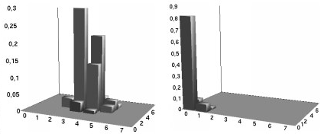
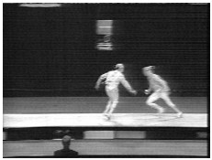
Absolute Amplitudes - Example
0º
45º

Slide 6
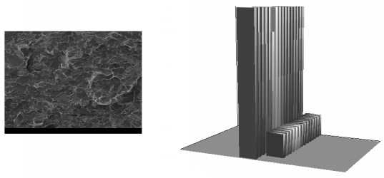
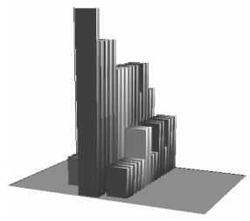
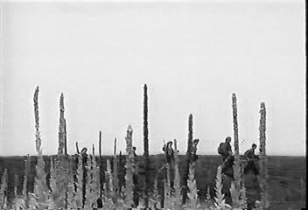
Differences of Amplitudes - Example

Slide 7
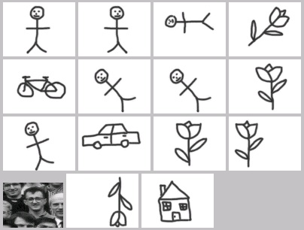
Performance Evaluation
How can we measure the quality of the result set of a single query?

Slide 8
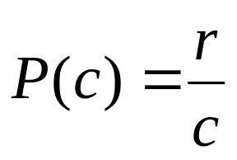
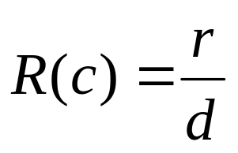
Test databases
Image Database 1: 609 Images taken from television. 568 are used as query images, grouped into 11 clusters:
Image Database 2: 179 Images taken from the DB of J.M.Jolion. 105 are used as query images, grouped into 6 clusters:
r ... relevant in result set
d ... relevant in the DB
c ... size of the result set

Slide 9
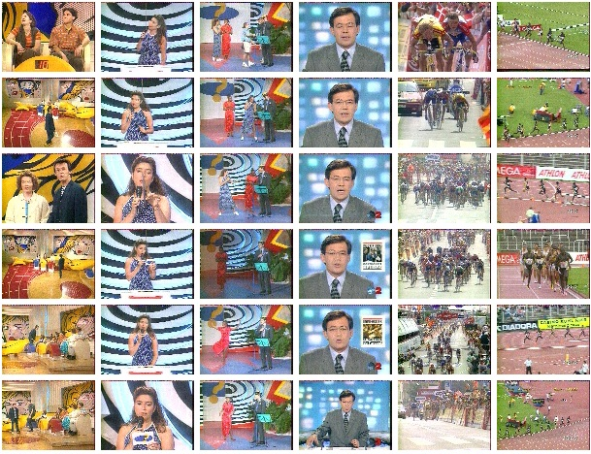
DB 1

Slide 10
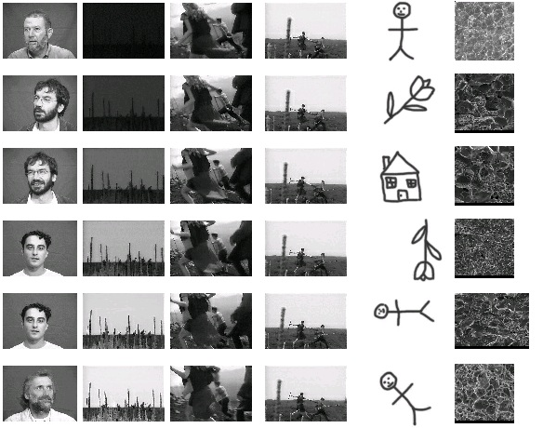
DB 2

Slide 11
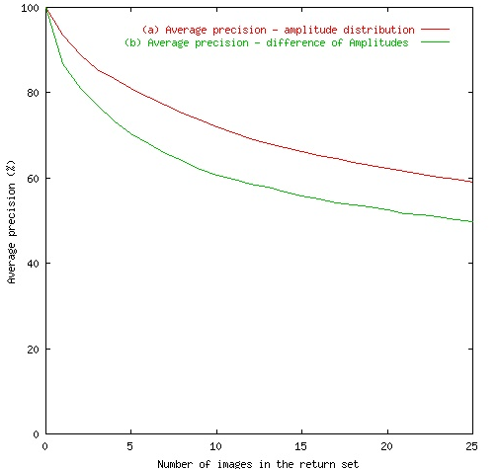
Results - algorithms

Slide 12
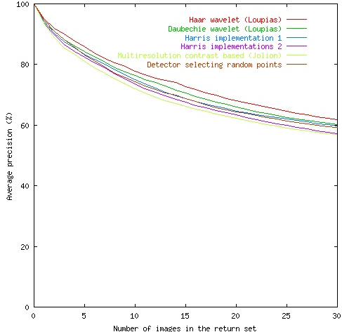
Results - Interest Detectors

Slide 13
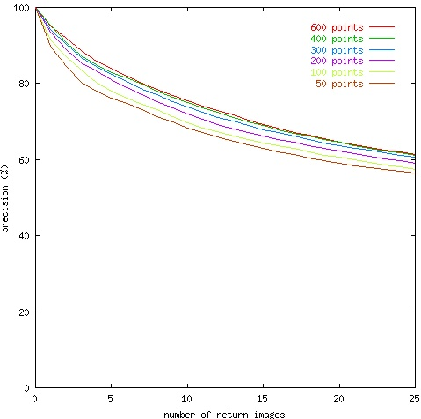
Results - Count of interest points

Slide 14
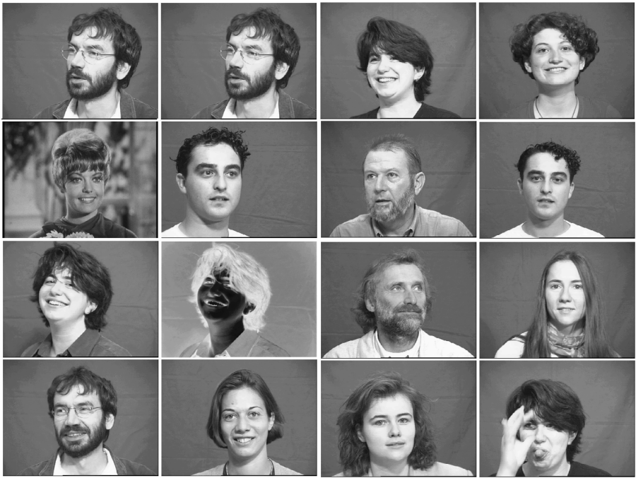
Example query

Slide 15
Conclusion
Good characterization of images by local descriptors
Good results for different types of images (photos, drawings).
Distinction of similar natural scenes or shots of the same natural scenes (e.g. TV broadcasts).
Almost no dependency on interest operators and the count of interest points
See demo at http://www.prip.tuwien.ac.at/Research/ImageDatabases/Query

