Slide 1
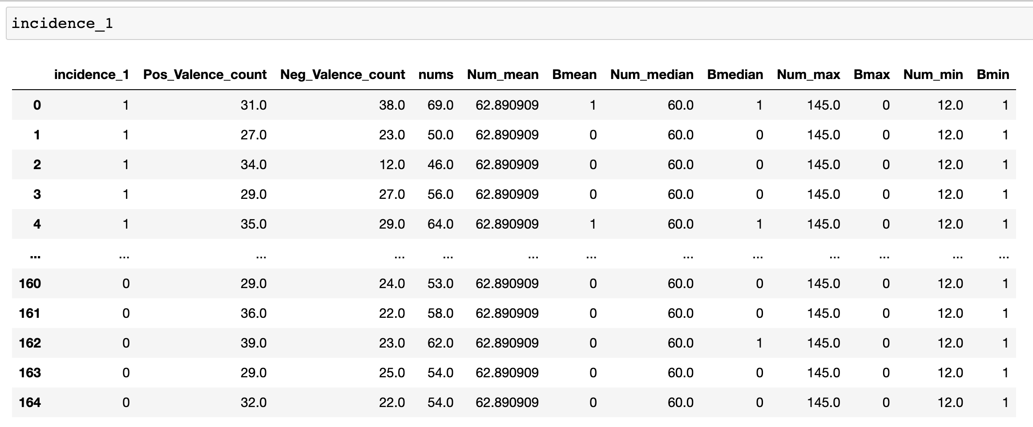

Slide 2
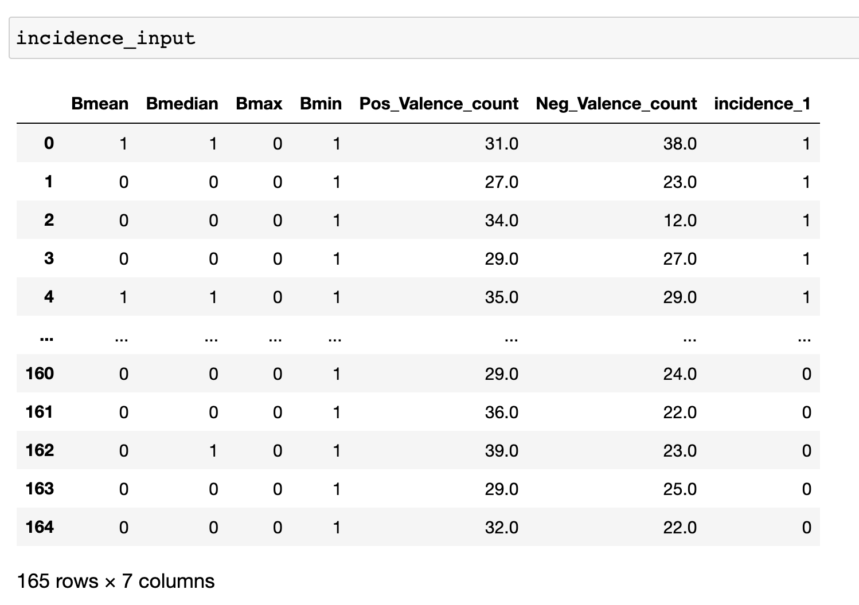
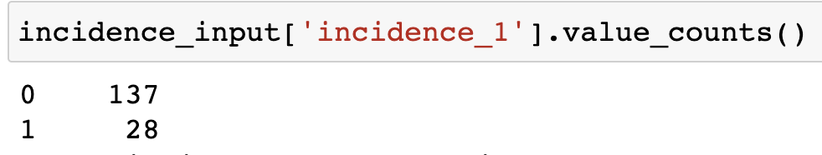

Slide 3
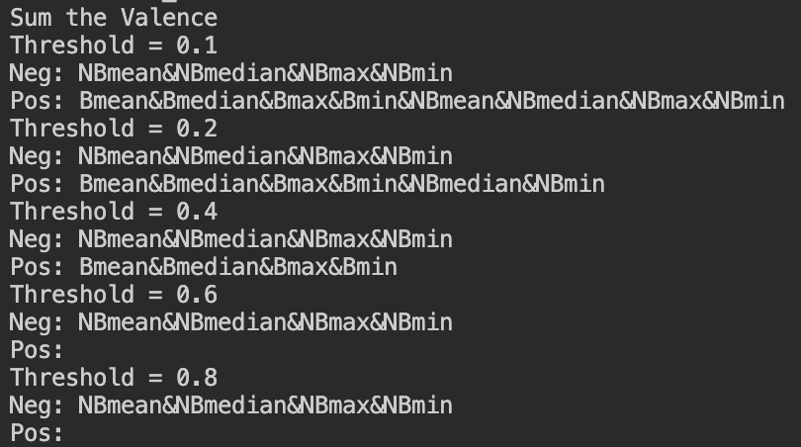
Using the example of Threshold = 0.4
Neg: NBmean&NBmedian&NBmax&NBmin
Meaning: No civil war if mean number of victims not higher than group mean value and median number of victims not higher than group median value and max number of victims not equal to group max value and min number of victims not equal to group min value
Pos: Bmean&Bmedian&Bmax&Bmin
Meaning: Civil war if mean number of victims higher than group mean value and median number of victims higher than group median value and max number of victims equal to group max value and min number of victims equal to group min value

Slide 4
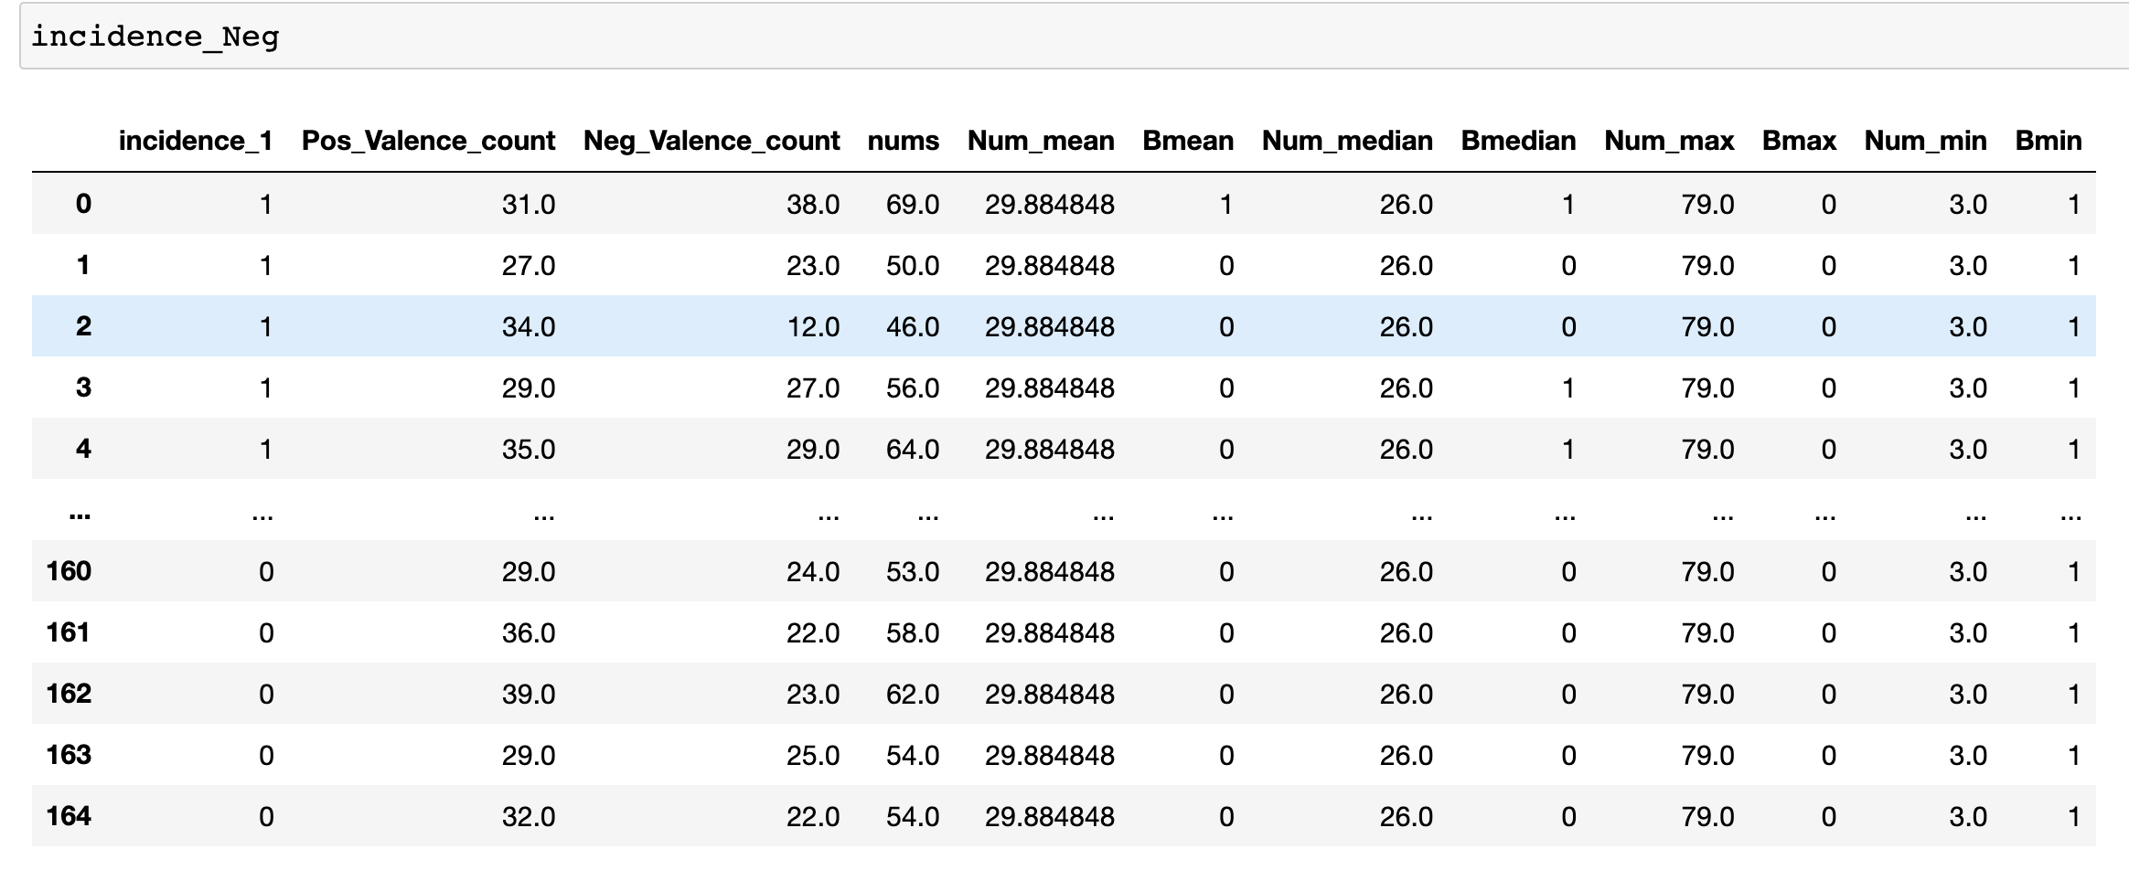
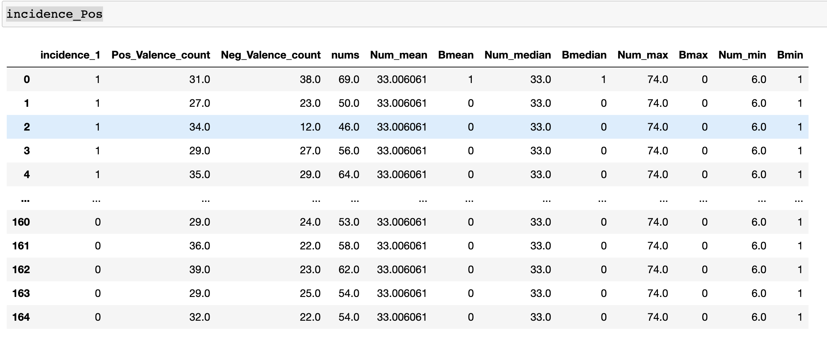

Slide 5
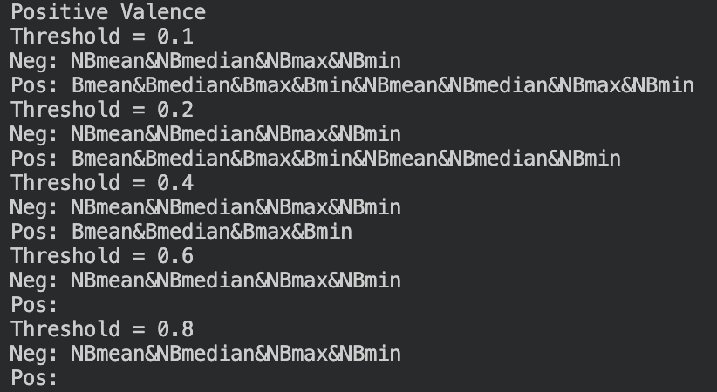
Using example Threshold = 0.4 with Positive Valance
Neg: NBmean&NBmedian&NBmax&NBmin
Meaning: Only refer to Positive Valance, there is no civil war if mean number of victims not higher than group mean value and median number of victims not higher than group median value and max number of victims not equal to group max value and min number of victims not equal to group min value
Pos: Bmean&Bmedian&Bmax&Bmin
Meaning: Civil war if mean number of victims higher than group mean value and median number of victims higher than group median value and max number of victims equal to group max value and min number of victims equal to group min value

