Slide 1
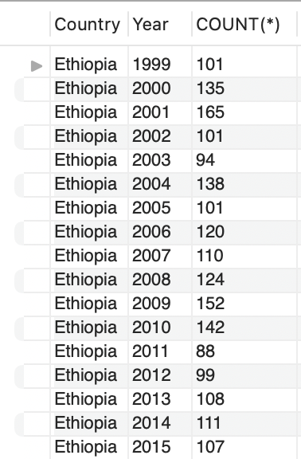
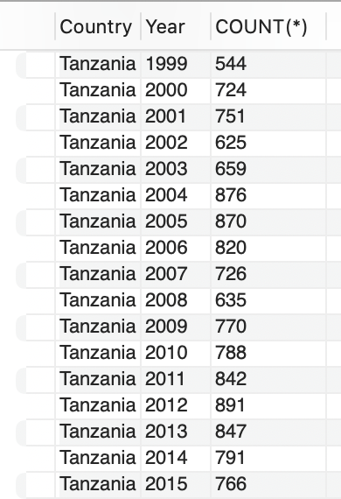
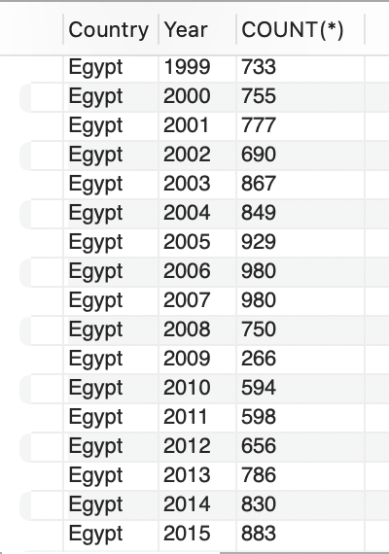

Slide 2
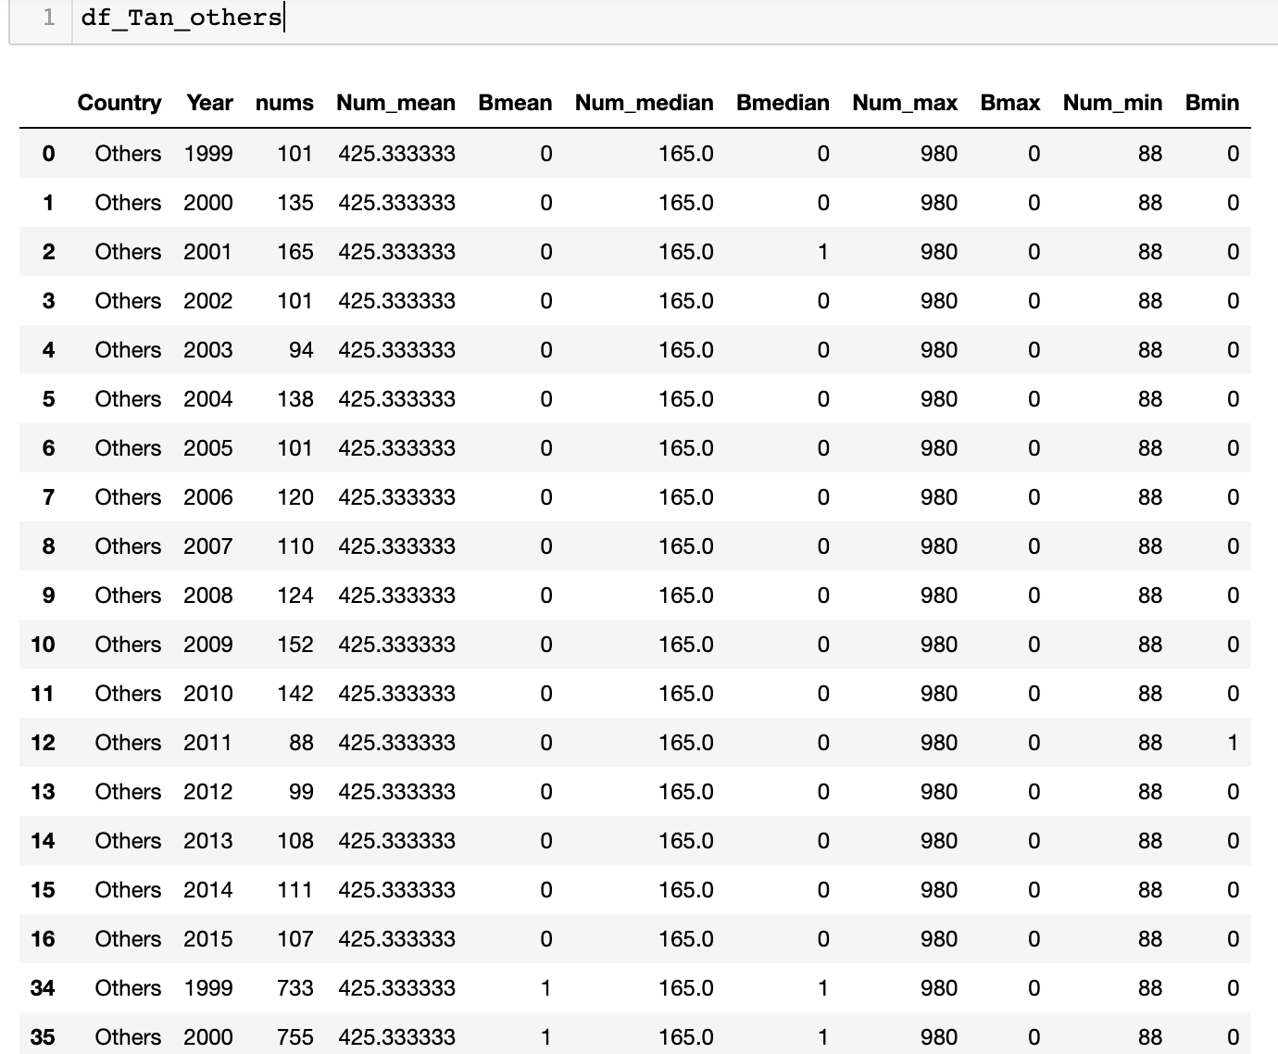
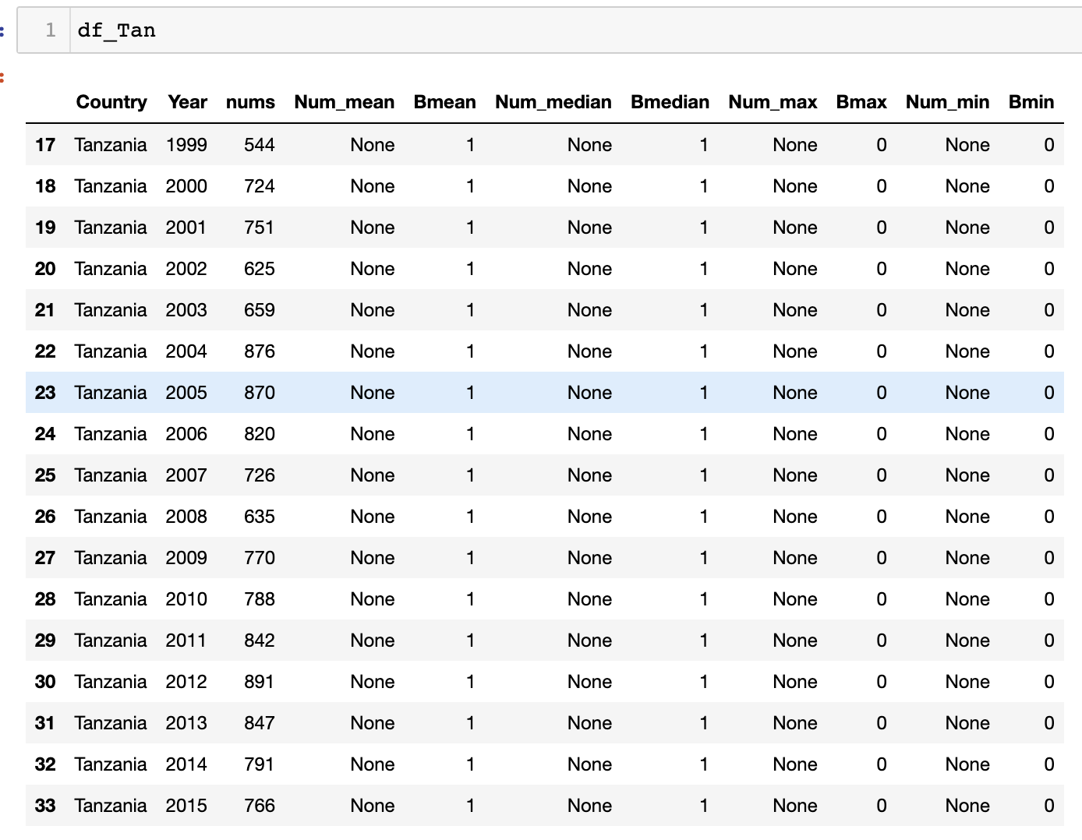
If one row’s number >= dataset mean value, Bmean = 1. Otherwise, Bmean = 0
If one row’s number >= dataset median value, Bmedian = 1. Otherwise, Bmedian = 0
If one row’s number is the dataset maximum, Bmax = 1. Otherwise, Bmax = 0
If one row’s number is the dataset minimum, Bmin =1. Otherwise, Bmin = 0
dataset exclude Tanzania
Dataset of Tanzania

Slide 3
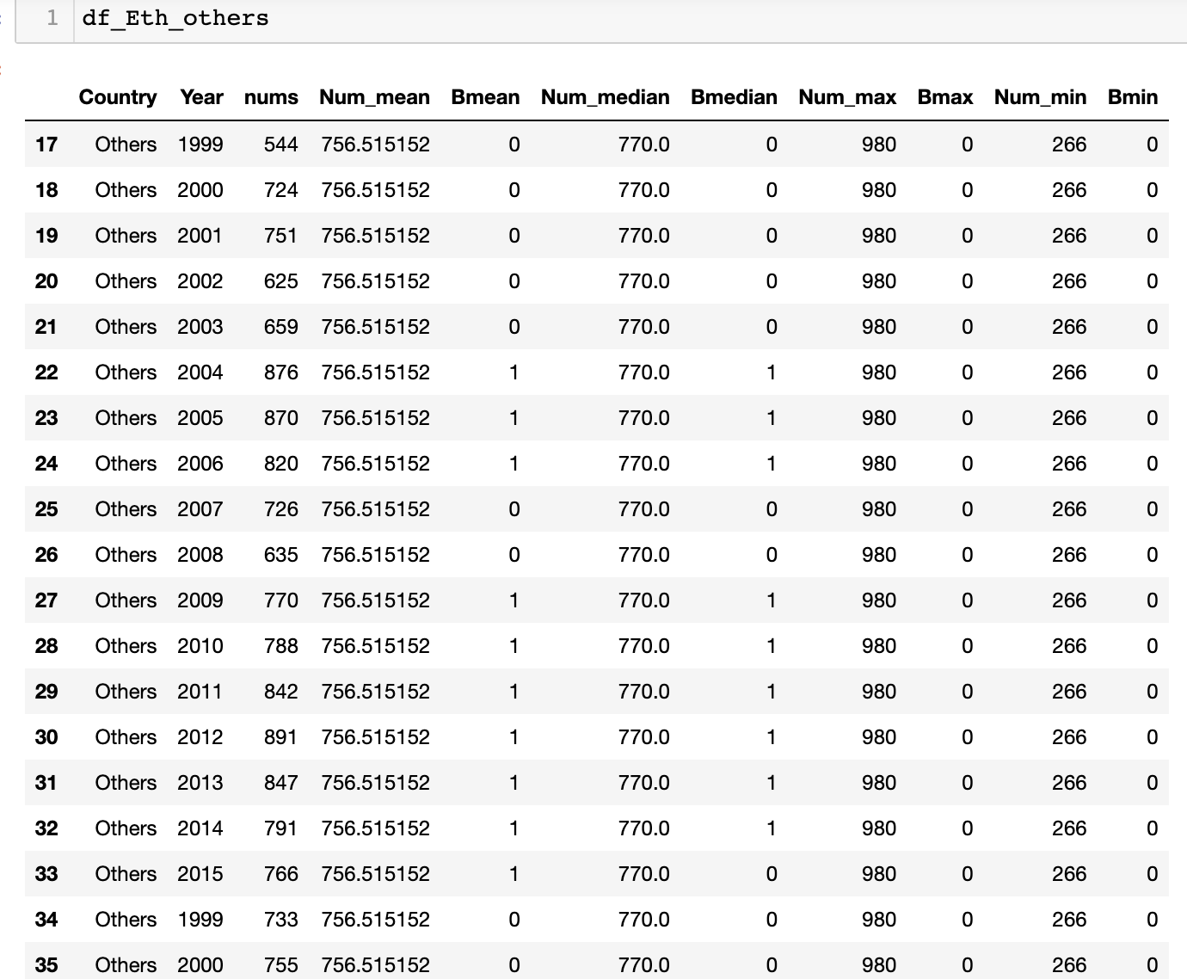
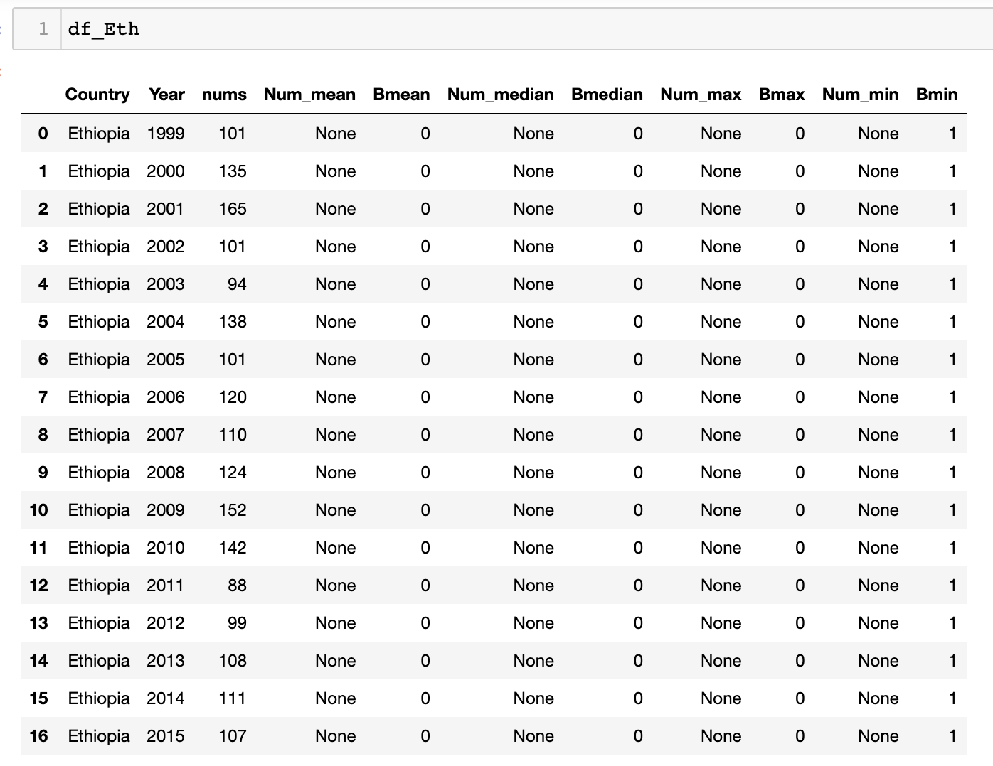
If one row’s number >= dataset mean value, Bmean = 1. Otherwise, Bmean = 0
If one row’s number >= dataset median value, Bmedian = 1. Otherwise, Bmedian = 0
If one row’s number is the dataset maximum, Bmax = 1. Otherwise, Bmax = 0
If one row’s number is the dataset minimum, Bmin =1. Otherwise, Bmin = 0
Dataset exclude Ethiopia
Dataset of Ethiopia

Slide 4
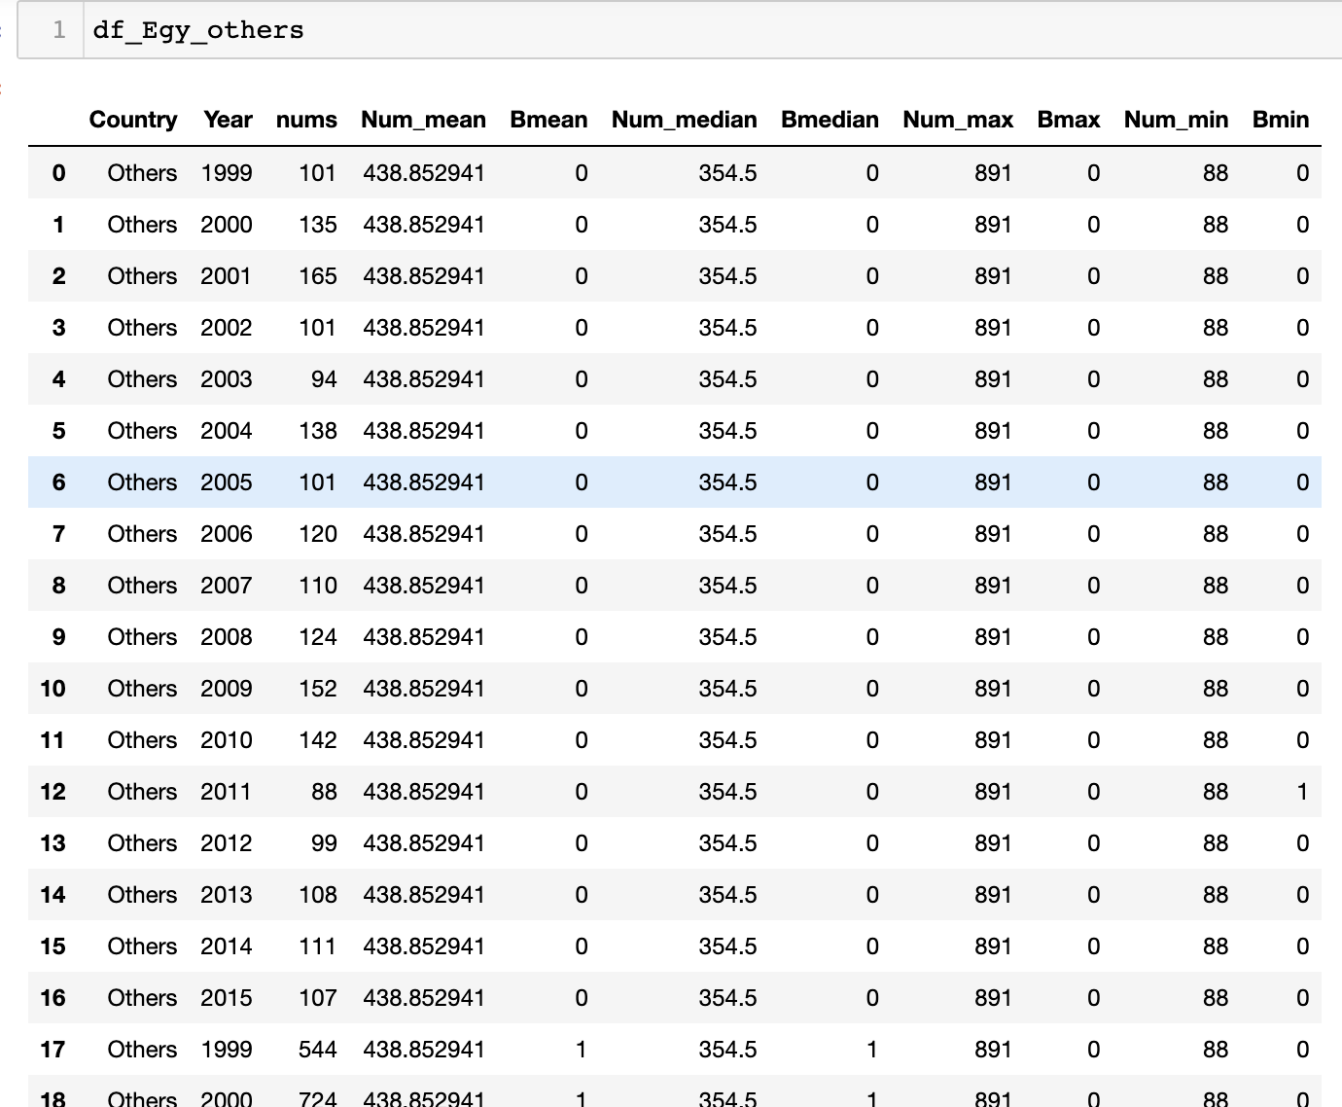
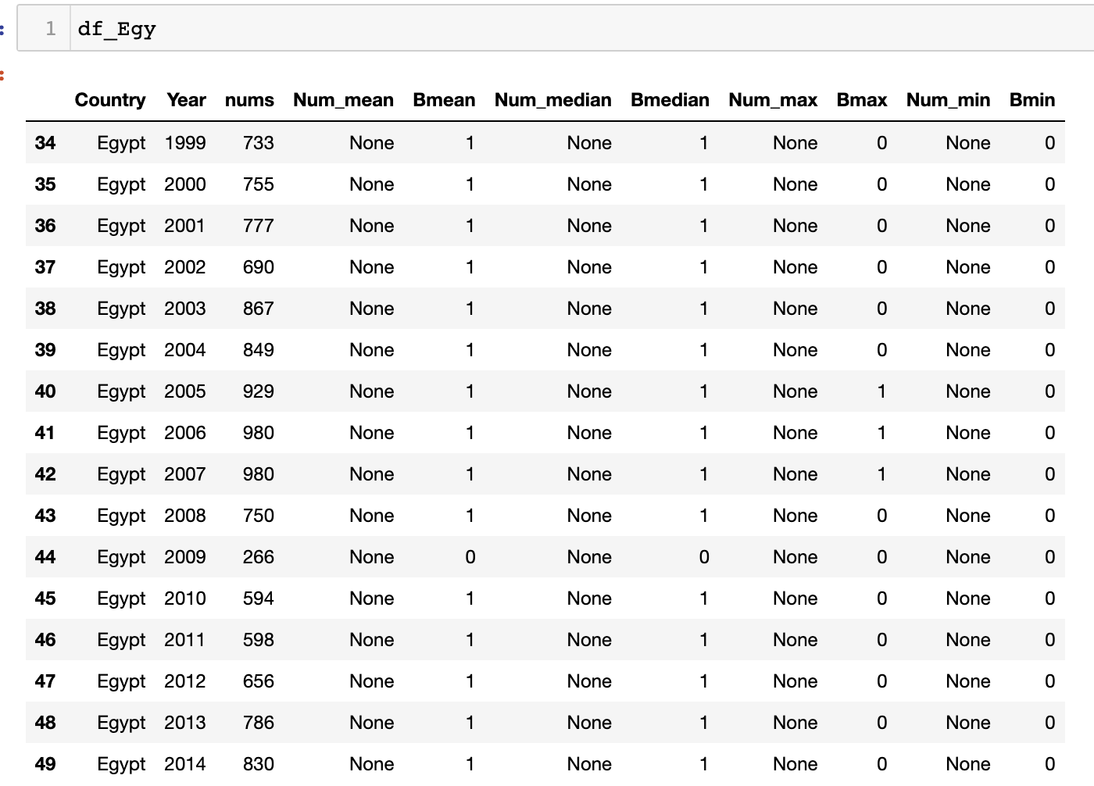
If one row’s number >= dataset mean value, Bmean = 1. Otherwise, Bmean = 0
If one row’s number >= dataset median value, Bmedian = 1. Otherwise, Bmedian = 0
If one row’s number is the dataset maximum, Bmax = 1. Otherwise, Bmax = 0
If one row’s number is the dataset minimum, Bmin =1. Otherwise, Bmin = 0
Dataset exclude Egypt
Dataset of Egypt

Slide 5
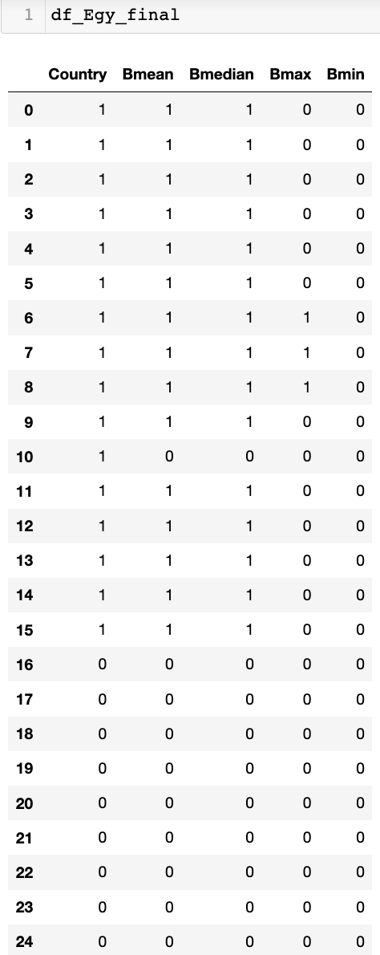
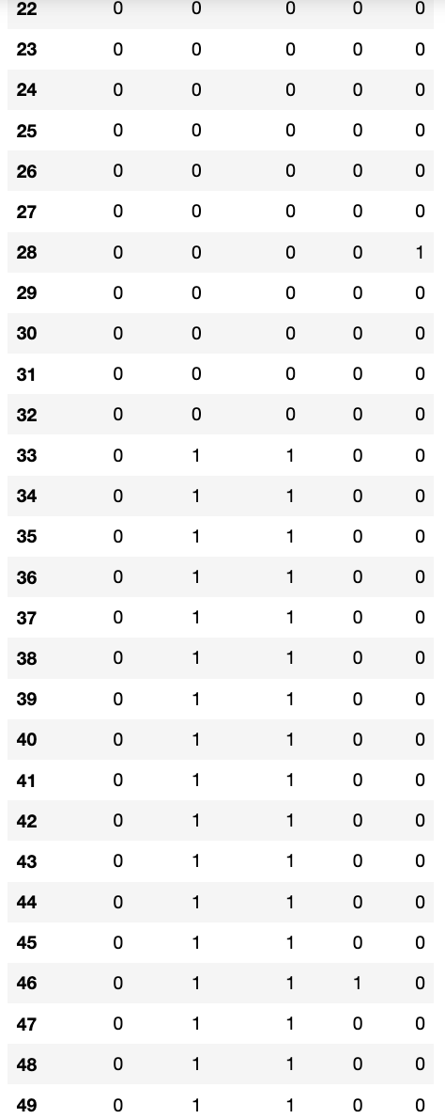
Merge two dataset and
filter binary data.
The country value 1 means Egypt
0 means other counties

Slide 6
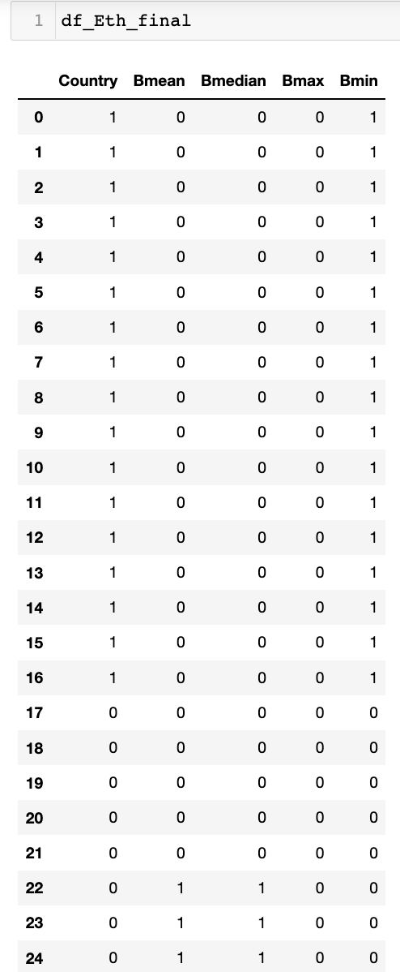
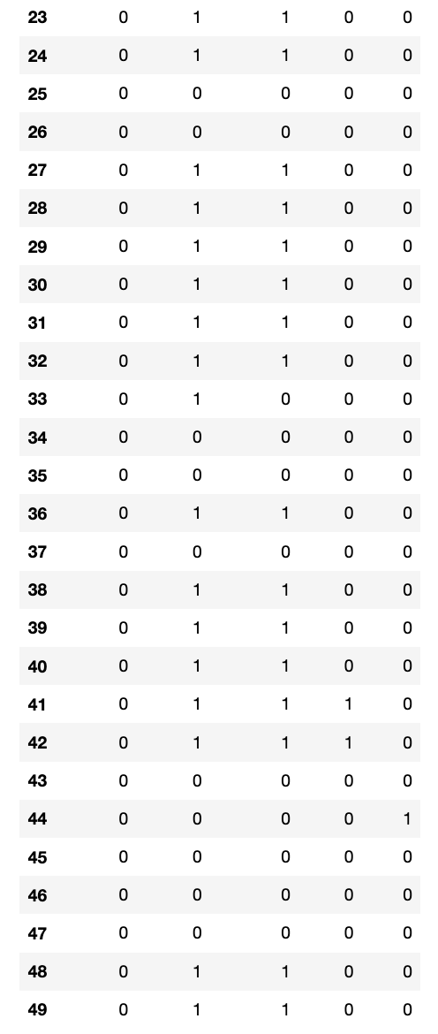
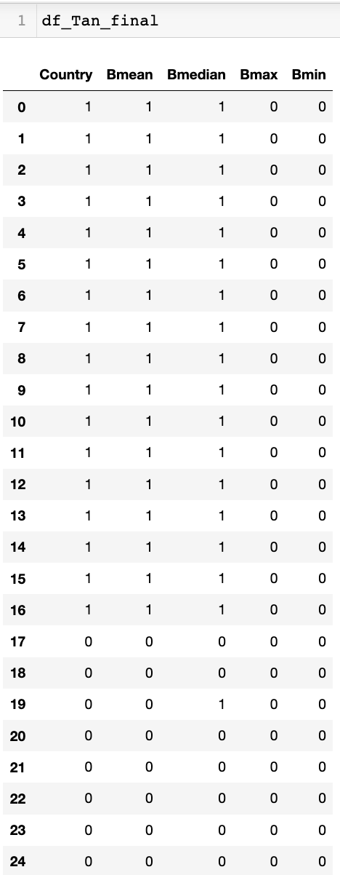
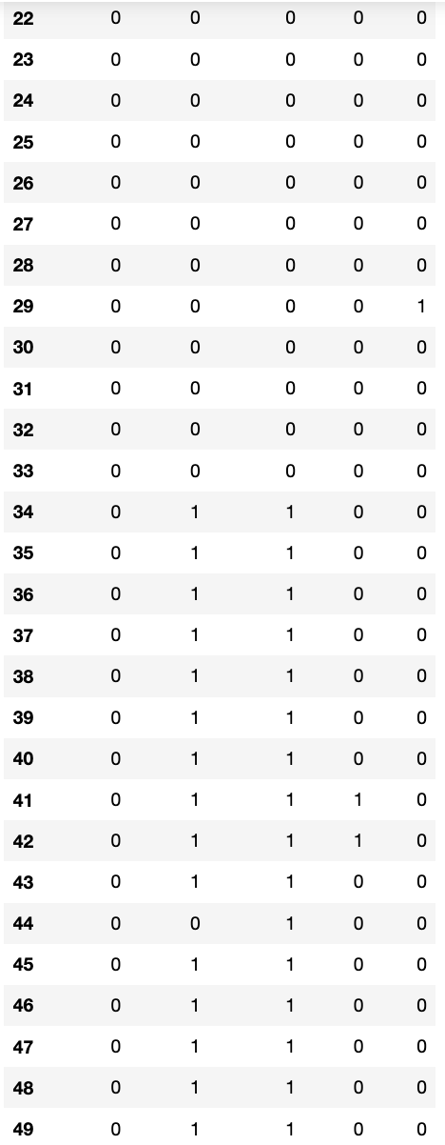

Slide 7
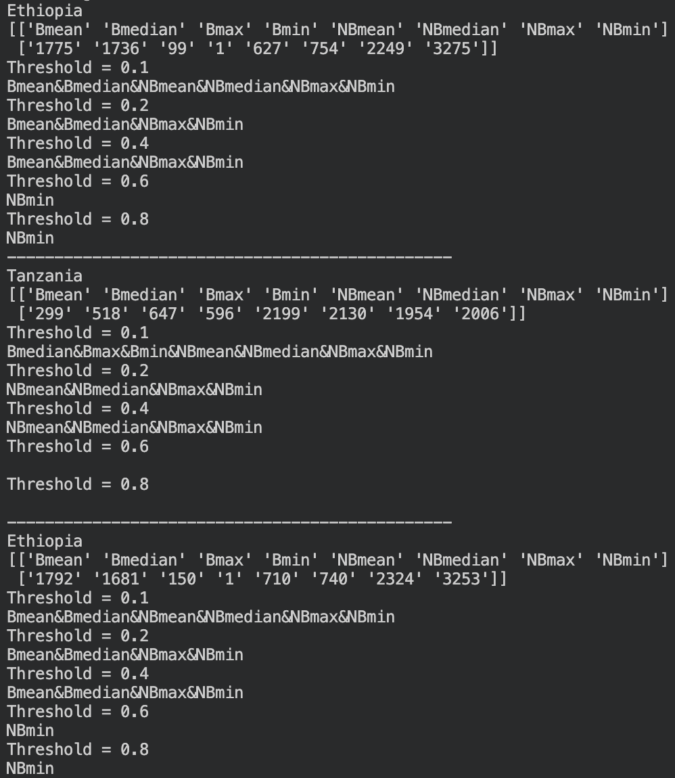
Three countries’ result
Only Positive
One clause

Slide 8
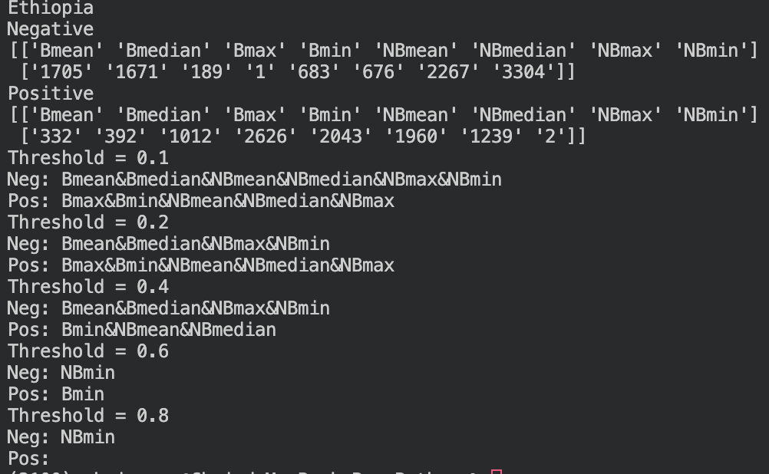
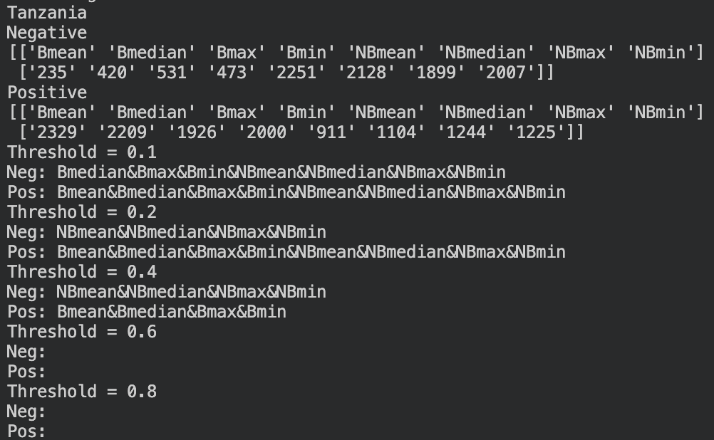
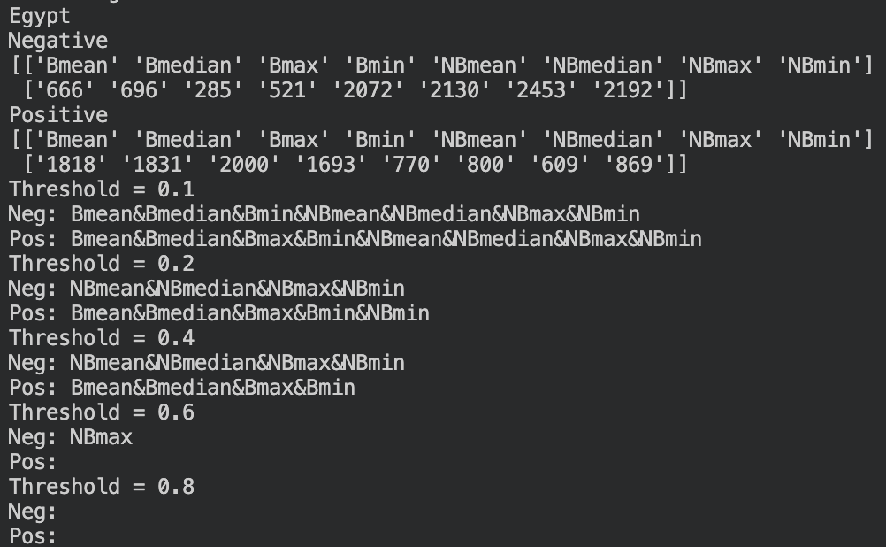
Negative and Positive
One clause

Slide 9
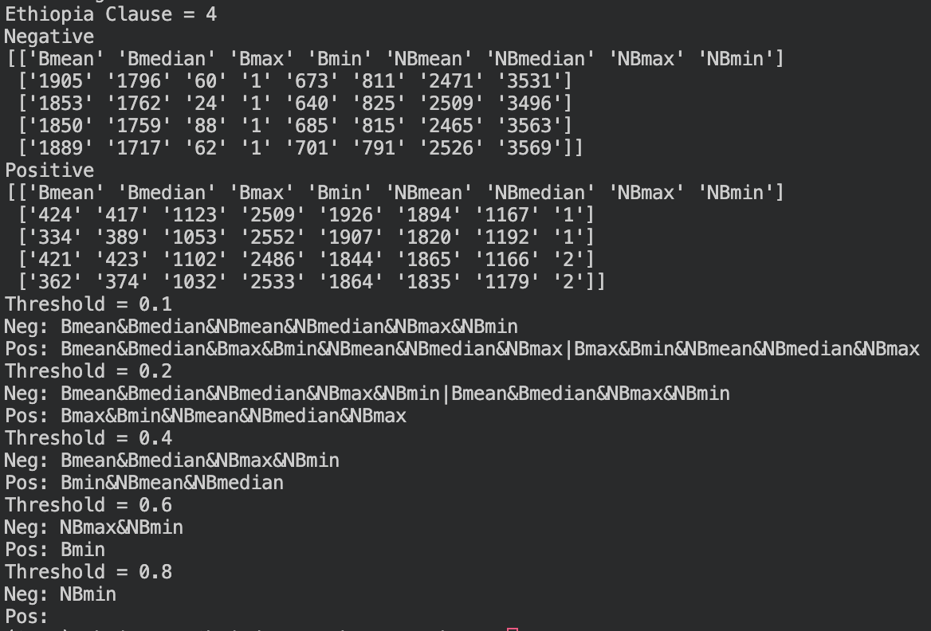
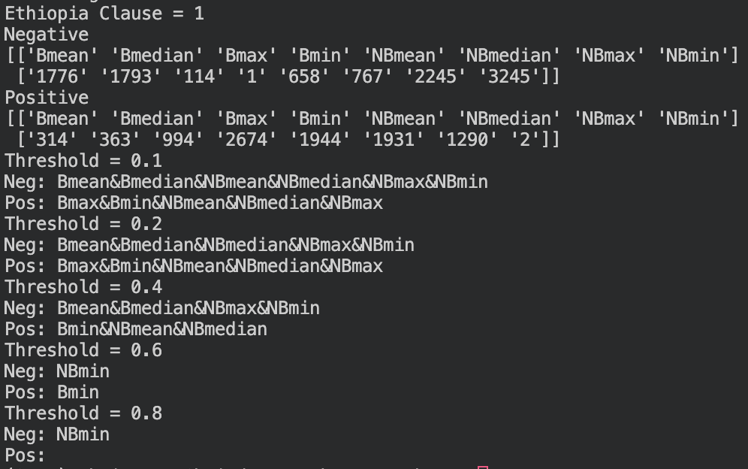
Ethiopia
Clause = 1
Clause = 4
Negative and Positive
Multiple clauses

Slide 10
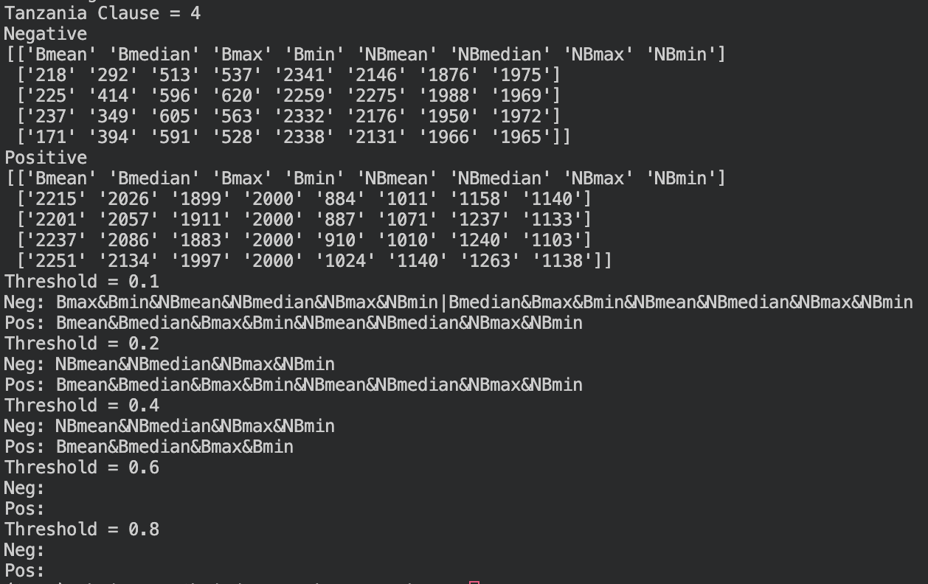
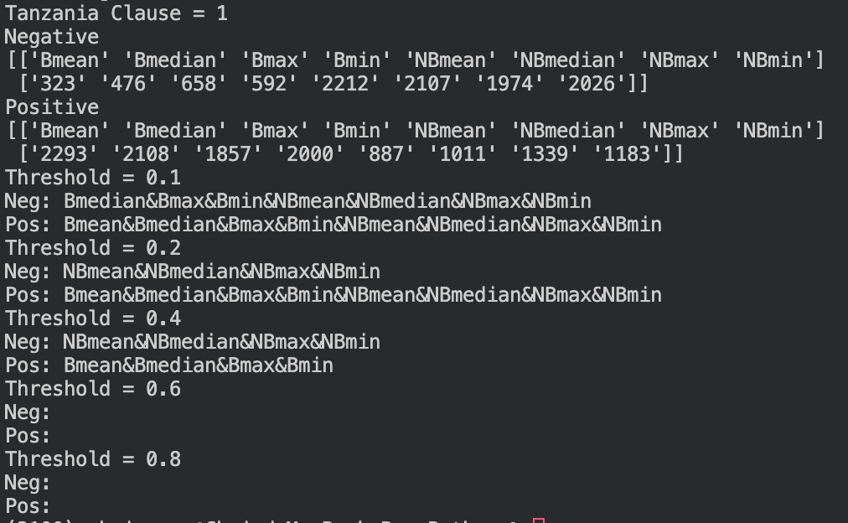
Tanzania
Clause = 1
Clause = 4
Negative and Positive
Multiple clauses

Slide 11
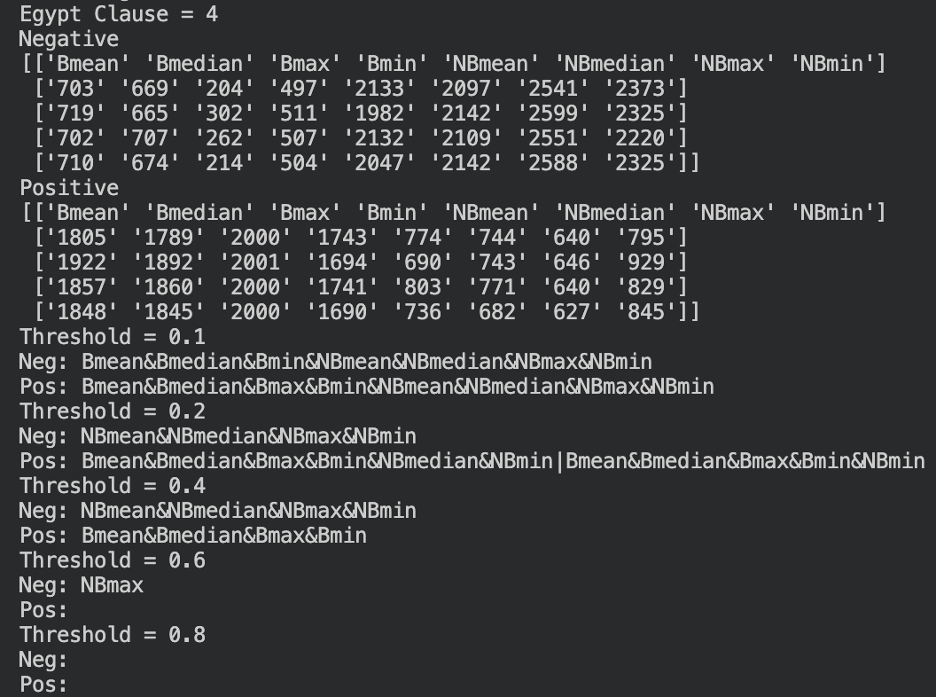
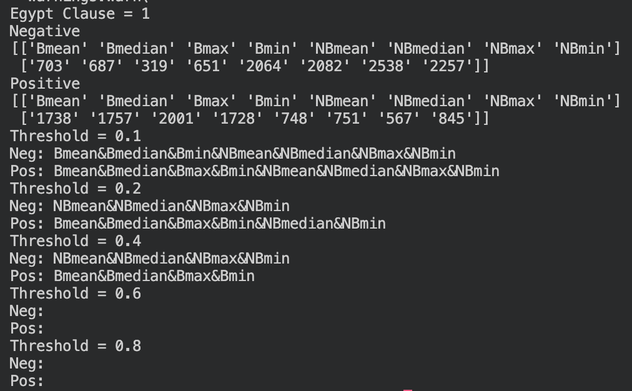
Egypt
Clause = 1
Clause = 4
Negative and Positive
Multiple clauses

