Slide 1
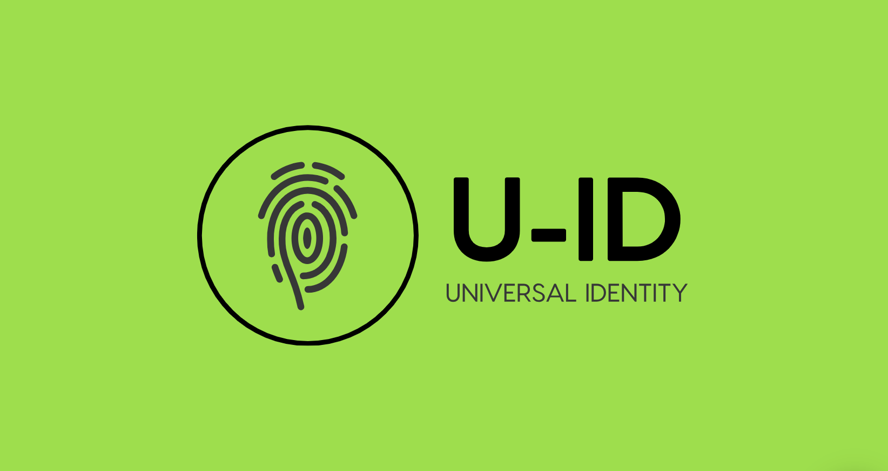
Chris Woodle and Nick Silva

Slide 2
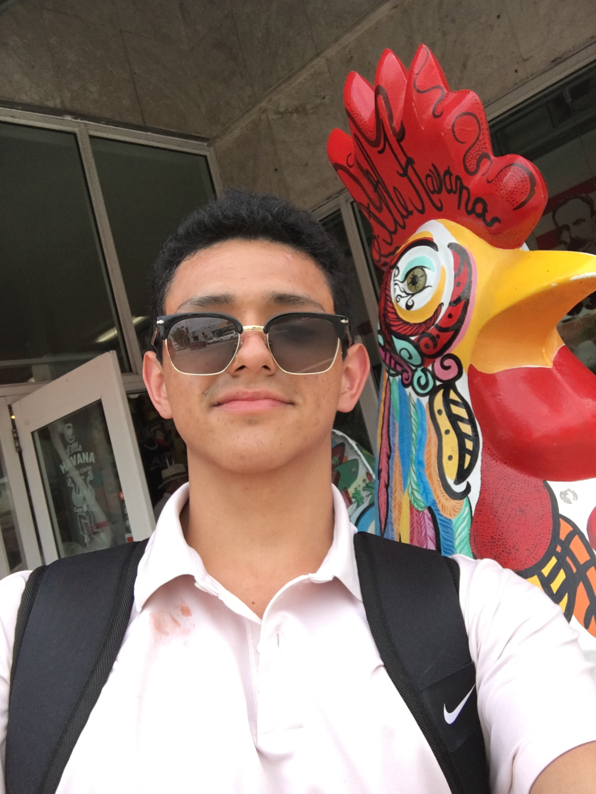

Team
Chris Woodle :
Backend API
Nick Silva
- UI integration

Slide 3
Overview
Security in transfers of info/payments
Approach, Universal Identity platform trust
2 Model approach
NFC Hardware demo (Model B)

Slide 4
Current status
Providing a credit card number is too powerful
You must trust who you give your card details
If your card is compromised or lost
Handing your drivers license to someone may reveal more information than you want.

Slide 5
Universal Identity
u-ID for short, is a digital identity platform that is interoperable and accepted by different requesting parties. Data, API's and other information related to a unique identity are accessible through a secure and permissioned interface.

Slide 6
Components
Server/API
Web interface
Client Kiosk (USB NFC reader)

Slide 7
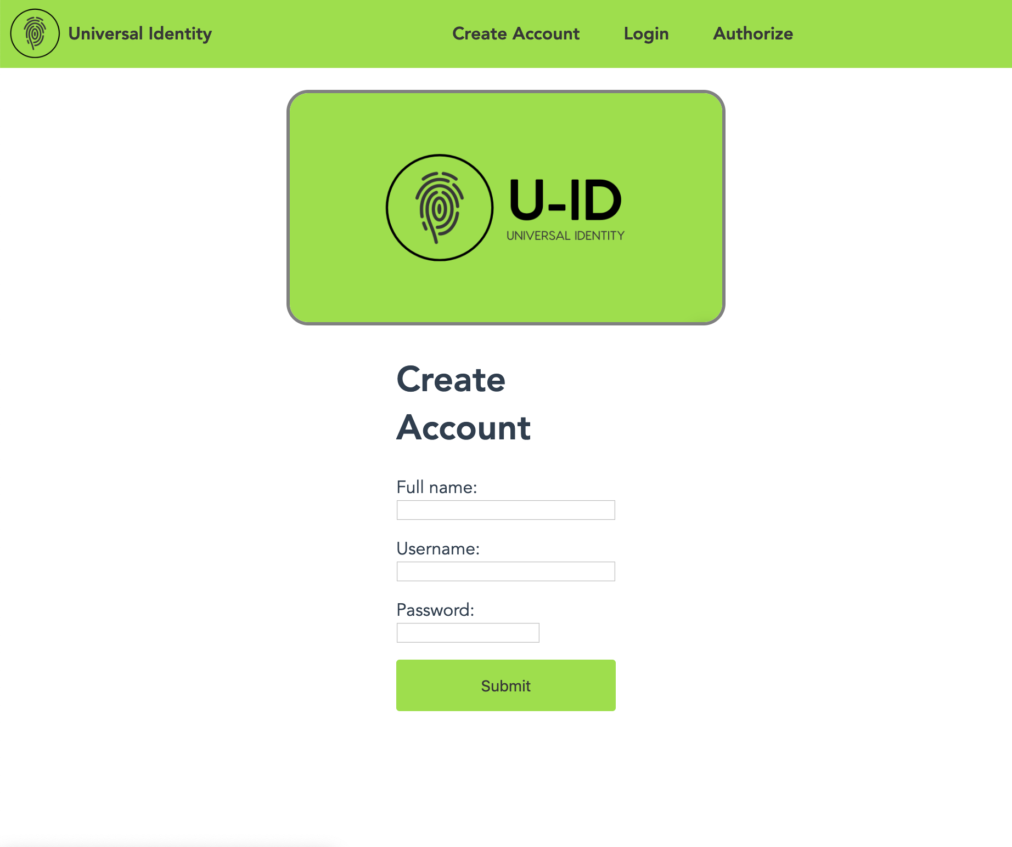
Web Interface

Slide 8
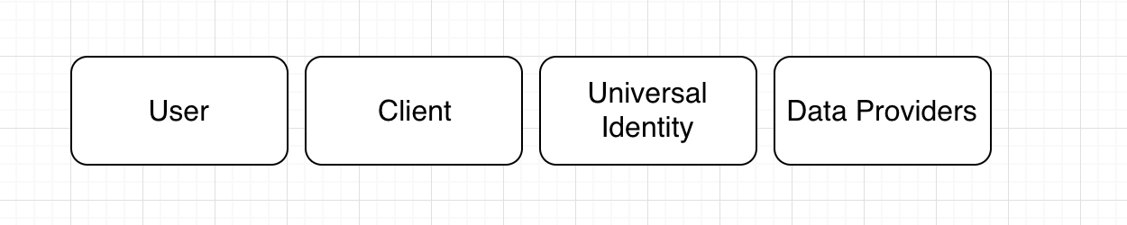
Approach
User-to-Provider (Universal Identity) trust relationship
A ”Client” is not trusted
“Data providers” may not only hold data; execute actions
Minimal number of interactions between client and user should be 1

Slide 9
Approach 2
Session based
Creates keys
Sessions may expire after use, or time
Are audited on blockchain (in memory python demo)
Generic model (smartphone based), and fast/low-tech model (dumb hardware)

Slide 10
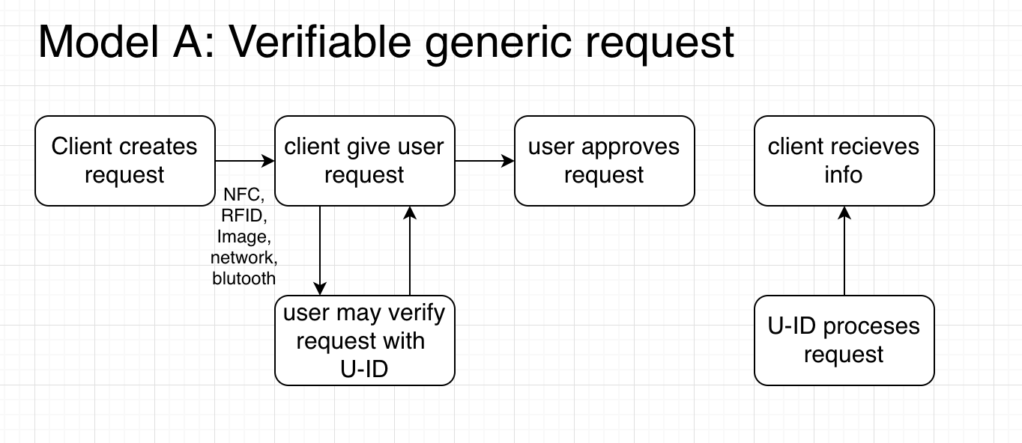

Slide 11
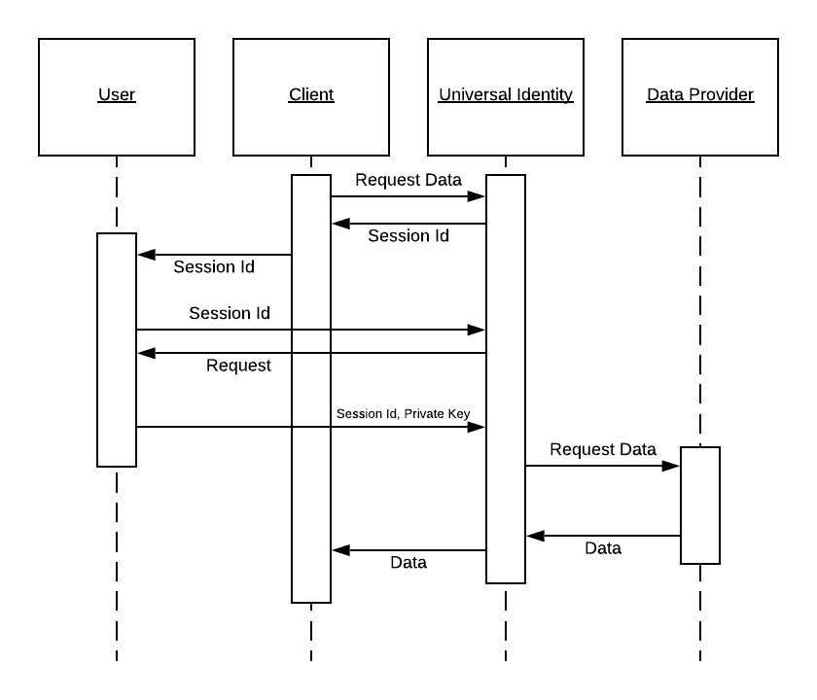

Slide 12
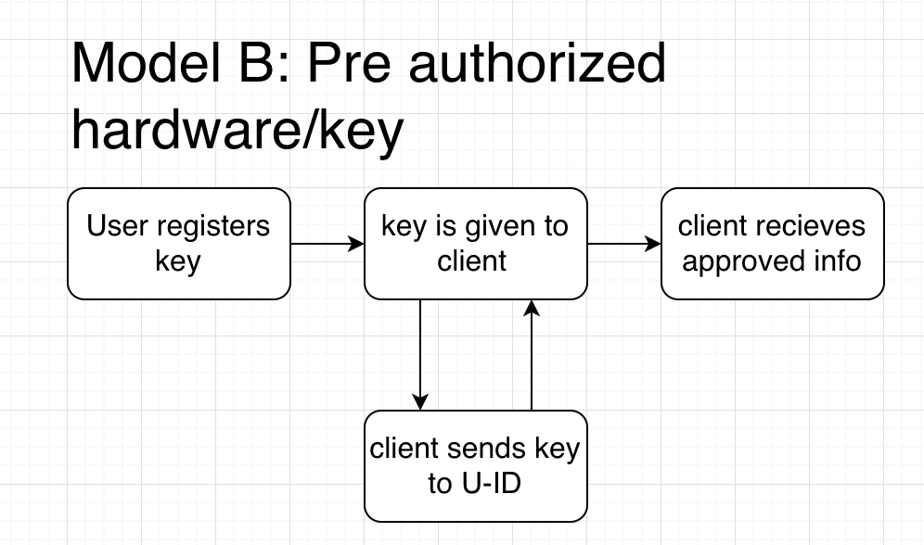

Slide 13
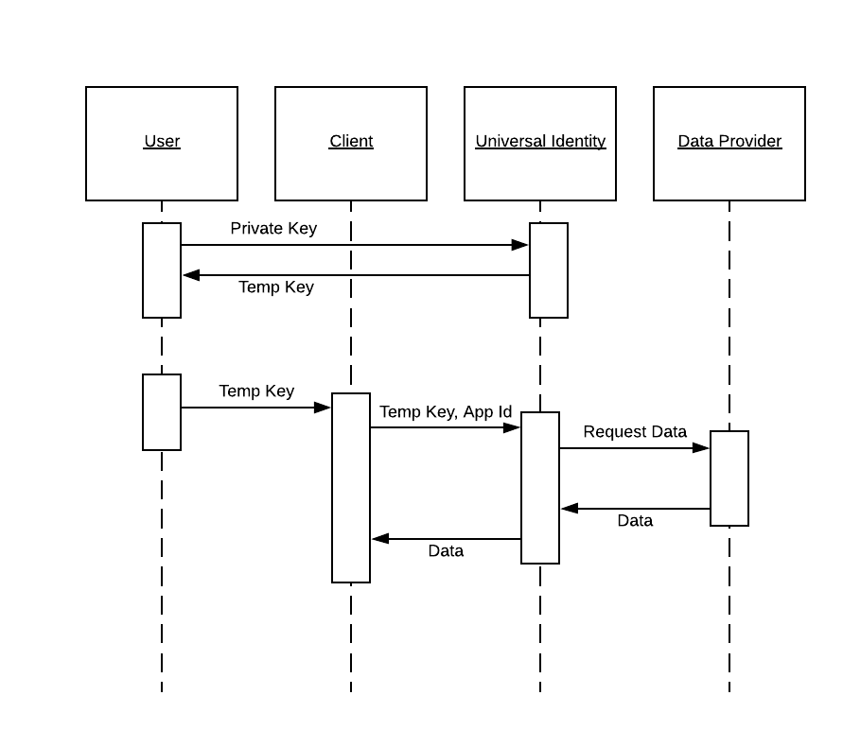

Slide 14
Demo

Slide 15
Future
Parameter based requests
Integrate Oauth lifecycle for approving other 3rd party data sources (citi api)
Possible native mobile app or native mobile integration (apple pay)

