Slide 1
As the plot[ly] thickens…

Slide 2
Why ARE GRAPHS USEFUL?

Slide 3
Why ARE GRAPHS USEFUL?
Tell a story
Explore data
Allow audiences to better understand your results
Provide another way to communicate information
Notes:
Tell a story – a more thorough narrative. A picture is worth a thousand words
Explore Data – it can be too difficult to print out tons of stats. Sometimes, visualizing graphs can allow you to better see what’s going on.
Allow Audience -- Example, my research. Or, voting data. Imagine trying to make sense of printing 1,000s of counties voting data in a terminal. Even if you do relevant things like print the counties with the highest incomes or whatever, it can be nearly impossible to understand dozens of #s.
Another way to communicate – not just the amount and efficacy, but some people learn differently. My slides are visual. Imagine if I didn’t provide them.

Slide 4
How?
Choose an appropriate chart type to display information
Bar Chat
Comparing types across a specific category
Line Graph
Plot data that change with regard to a continually increasing variable (often time)
Scatter Plot
Displaying connections between two or more numerical values
Other?
Plot data : use color, text, and presentation choices to enhance your ability to communicate

Slide 5
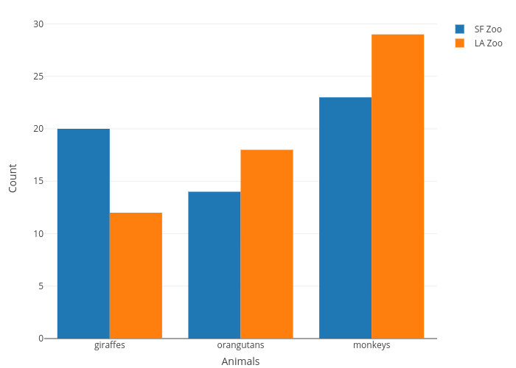
How?
Choose an appropriate chart type to display information
Bar Chat
Comparing types across a specific category
Line Graph
Plot data that change with regard to a continually increasing variable (often time)
Scatter Plot
Displaying connections between two or more numerical values
Other?
Plot data : use color, text, and presentation choices to enhance your ability to communicate

Slide 6
How?
Choose an appropriate chart type to display information
Bar Chat
Comparing types across a specific category
Line Graph
Plot data that change with regard to a continually increasing variable (often time)
Scatter Plot
Displaying connections between two or more numerical values
Other?
Plot data : use color, text, and presentation choices to enhance your ability to communicate

Slide 7
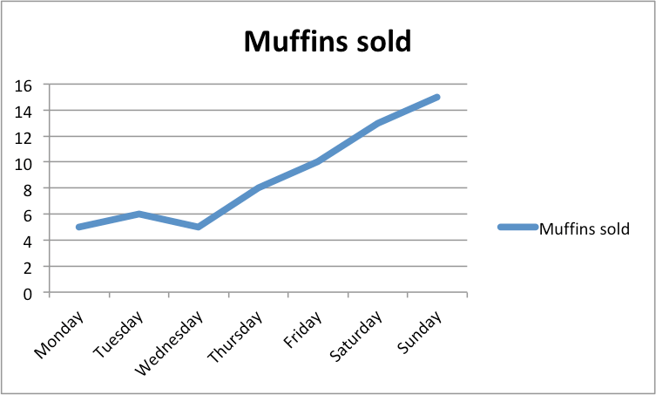
How?
Choose an appropriate chart type to display information
Bar Chat
Comparing types across a specific category
Line Graph
Plot data that change with regard to a continually increasing variable (often time)
Scatter Plot
Displaying connections between two or more numerical values
Other?
Plot data : use color, text, and presentation choices to enhance your ability to communicate

Slide 8
How?
Choose an appropriate chart type to display information
Bar Chat
Comparing types across a specific category
Line Graph
Plot data that change with regard to a continually increasing variable (often time)
Scatter Plot
Displaying connections between two or more numerical values
Other?
Plot data : use color, text, and presentation choices to enhance your ability to communicate

Slide 9
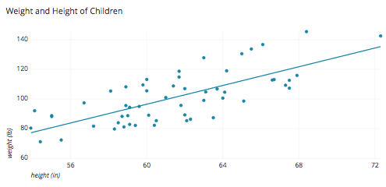
How?
Choose an appropriate chart type to display information
Bar Chat
Comparing types across a specific category
Line Graph
Plot data that change with regard to a continually increasing variable (often time)
Scatter Plot
Displaying connections between two or more numerical values
Other?
Plot data : use color, text, and presentation choices to enhance your ability to communicate

Slide 10
How?
Choose an appropriate chart type to display information
Bar Chat
Comparing types across a specific category
Line Graph
Plot data that change with regard to a continually increasing variable (often time)
Scatter Plot
Displaying connections between two or more numerical values
Other?
Plot data : use color, text, and presentation choices to enhance your ability to communicate

Slide 11
Plotly: What we’ll be using for this course
Powerful library supported by many languages (javascript, r, python)
Check out the documentation: https://plot.ly/python/
Integrate with pandas! : https://plot.ly/pandas/

Slide 12
Plotly: How to install
pip3 install plotly
pip3 install plotly --upgrade

Slide 13
Plotly: How to make graphs
import plotly.graph_objs as go
import plotly.offline as plot
…
# a Figure object must take a Data object # (and optionally a Layout object)

Slide 14
Plotly: How to make graphs
NOTE: when looking at examples online:
iplot() is for the interactive shell
plot() is for running your normal .py programs
(so, just use the one that makes sense for you)

Slide 15

REAL-TIME CODING

Slide 16

LAB TIME

