Slide 1
“We global” -- Professor DJ Khaled
Notes:
can be helpful compared to other standard forms of data visualization as it displays the data in a more meaningful context
Choropleth, scatter map and bubble map
we will also show how to draw these in python

Slide 2
Announcements
Final Project Proposals:
Think of what you want me to cover for the final lecture(s)
Final Project MUST NOT BE LATE – Dec 3.
My new office: CIT 317
List who your partner is (if applicable), and have only 1 person submit the proposal
Each person will receive the same grade
Notes:
can be helpful compared to other standard forms of data visualization as it displays the data in a more meaningful context
Choropleth, scatter map and bubble map
we will also show how to draw these in python

Slide 3
Visualizing Data -- Outline
Different Types of Geographic Graphs
Plotly Examples
Real-Time Coding / Practice
Notes:
can be helpful compared to other standard forms of data visualization as it displays the data in a more meaningful context
Choropleth, scatter map and bubble map
we will also show how to draw these in python

Slide 4
Warm-up
Lately, we’ve used incredibly useful external libraries (e.g., Pandas), why not make 100% of the class revolve around using these?
Notes:
can be helpful compared to other standard forms of data visualization as it displays the data in a more meaningful context
Choropleth, scatter map and bubble map
we will also show how to draw these in python

Slide 5
Warm-up
Lately, we’ve used incredibly useful external libraries (e.g., Pandas), why not make 100% of the class revolve around using these?
We needed a foundation in computing first, allow us:
To understand how to use the libraries
Do anything we want – not confined to others’ libraries
Libraries can come and go and change, but a diamond foundation is foreverdasdfasdfa
Notes:
can be helpful compared to other standard forms of data visualization as it displays the data in a more meaningful context
Choropleth, scatter map and bubble map
we will also show how to draw these in python

Slide 6
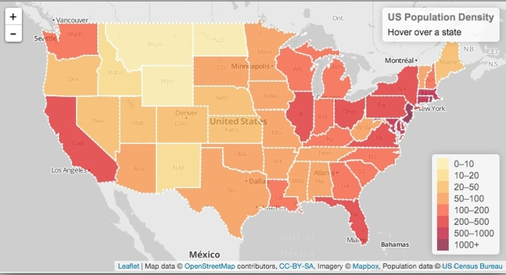
Choropleth graph
colors distinct regions according to the information being visualized
choropleth graphs can plot data using a color scale
Notes:
choropleth of US by population density
This lets us quickly see where certain features may be more true than others (you can easily see California, New York, New Jersey, and in general the coastal states have higher population densities than other states) but it can be difficult to compare data between regions far apart

Slide 7
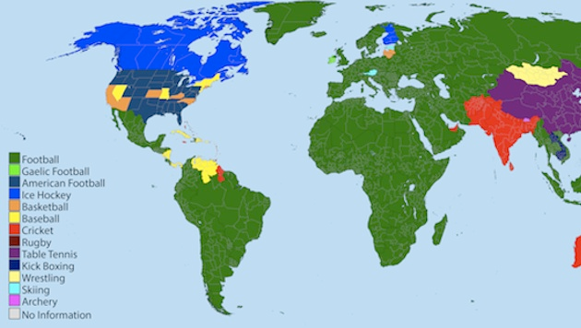
Notes:
Sometimes it can be better to have a more discrete color scale, in this case a distinct color scheme rather than a spectrum is better.
CATEGORIES
QUESTION: WHAT ARE POSSIBLE ISSUES WITH TRYING TO PLOT DATA ON A GEOPLETH GRAPH?
Again, this works when we know we have data representation from every state or country. And, if that level of granularity is sufficient for our interests.
STATEMENT: Imagine if we wanted to view voting records, namely voting for a republican or democrat president in 2016. What would that graph look like? Texas would be red. California would be blue.
QUESTION: what’s a potential problem with that? (ANS: granularity) imagine a sparse state such as Wyoming (I’m going to practice my drawing skills here)
QUESTION: what could we do then? (ANS: dots to represent people!)

Slide 8
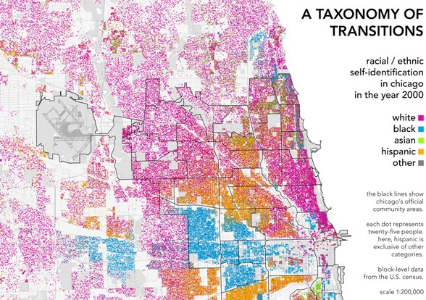
Scatter map
Plots a point for every 25 people
Easily visualize where there is population density of each race
This type of map by Radical Cartography has brought about discussion regarding segregation in modern cities
Notes:
Well, instead of voting patterns, here’s an example looking at race, which visualizes how segregated certain cities are.
This handles sparsity too – if there’s a region with nobody present – e.g., nobody lives there, or nobody votes from there – then it doesn’t mislead the audience into thinking that it constitutes a signal.
QUESTION: now, what if the data is even more sparse, but we’re still interested in viewing such for a large scale, such as how many Bowling Alleys are there in the USA?
“If we just had 1 single dot for each one, that would be a very boring map. I mean, because it would be hard to see just a few dots, not that bowling is boring – to all the Professional Bowlers in the audience, I’m sorry”
“What are some ideas on how we could visualize such? Feel free to get creative!”

Slide 9
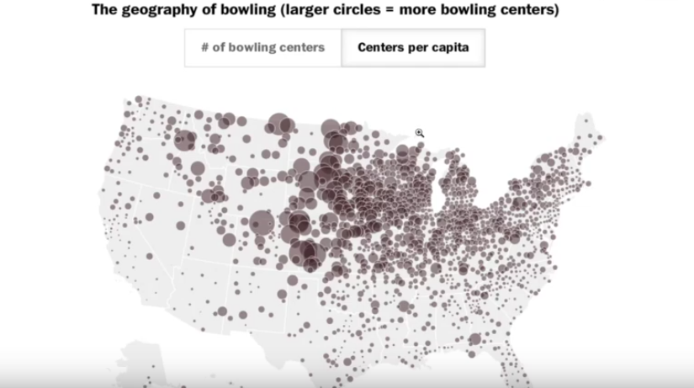
Bubble Map
Notes:
Similar to a scatter map but provides non uniform data points, in this case, the size of each bubble is proportional to the number of bowling centers.
From here we can establish an inverse relation between the number of people and bowling centers per state :p

Slide 10
How to make this in Python: Getting Started
## these are your import statements
import pandas as pd from plotly.offline import plot import plotly.graph_objs as go
## you can also import csv from Kaggle or from your own personal directory
data_frame = pd.read_csv(‘https://raw.githubusercontent.com/plotly/datasets/master/2011_us_ag_exports.csv’)
Notes:
these are libraries that have done a lot of the implementation for you to make these geographic graphs.
QUESTION: if we wanted to inspect the .csv and see what the data looks like, what are some python functions we could use?
Some useful commands:
data_frame.head()
data_frame.describe() It isn’t necessary to parse through them (you can of course!) they are just good to print out what your data looks like

Slide 11
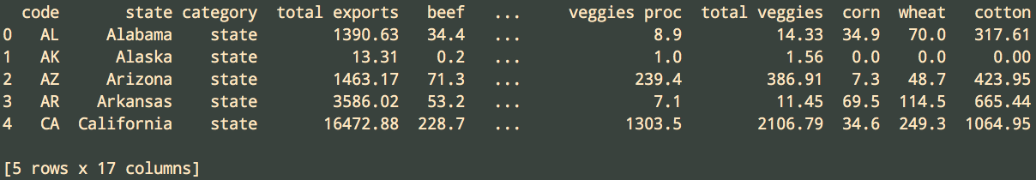
data_frame.head()
Notes:
we are printing out the data_frame.head() in the terminal here, which lets you see the first couple rows of your csv. Let’s say we want to plot the total export by state on a chorograph

Slide 12
Creating your choropleth
choropleth = go.Choropleth(z = data_frame[‘total exports’], locations = data_frame[‘code’], locationmode = ‘USA-states’)
z is the data you want to graph
locations is the corresponding column to that data (z)
locationmode can be either:
'ISO-3’ country codes (which is the default) – check here for a listing
‘USA-states’
‘country names’
https://plot.ly/python/reference/#choropleth-locationmode
Notes:
reference link for documentation

Slide 13
Layout
## provides the parameters how the map will be displayed
layout = go.Layout(title = ‘Total exports of the US’, \
geo = {‘scope’: ‘usa’, ‘projection’: {‘type’: ‘albers usa’}})
- title of the graph
- geo refers to geo-specific information, which is the form of a dictionary - scope is the the region the map contains - type is the type of map
Notes:
type: since 2D representations can cause distortions when it comes to continents etc., there are different types of maps that adjust for this in different ways.

Slide 14
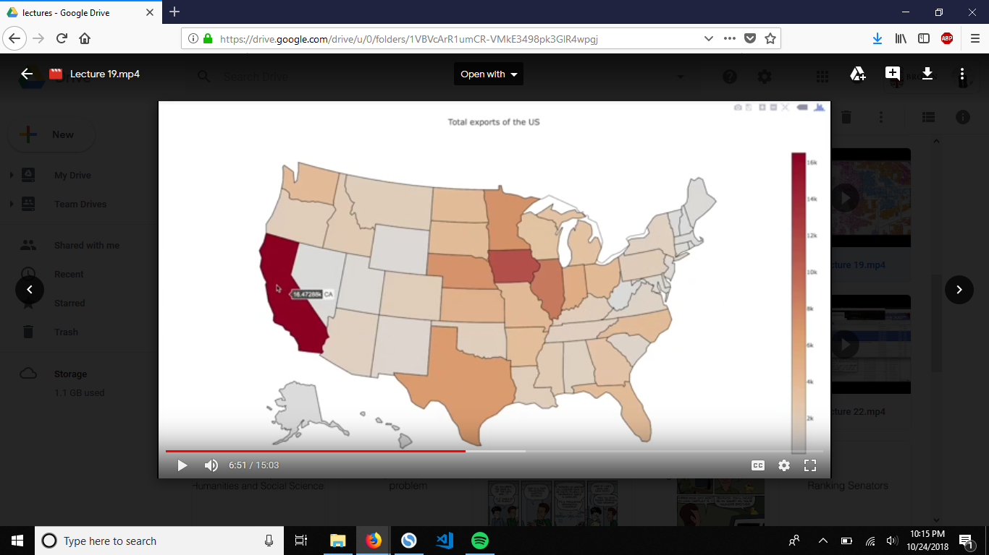
Drawing the graph
figure = go.Figure(data = [choropleth], layout = layout) plot(figure)
Notes:
If you hover over, it can display the exact values
That’s cool, but what if we want to change the colors?

Slide 15
Customizing the Figure
## color_scale = [[0.0, ‘Blue’], [1.0, ‘Red’]] color_scale = [[0.0, ‘Blue’], [0.5, ‘White’], [1.0, ‘Red’]]
## add a new attribute (colorscale stuff) to the choropleth choropleth = go.Choropleth(z = data_frame[‘total exports’], locations = data_frame[‘code’], locationmode = ‘USA- states’, colorscale = color_scale, autocolorscale = False)
## we turn off the autocolorscale by assigning it to False ## re-plot! plot(figure)
Notes:
This is the same example as just a few slides ago, but now, we’ll also specify the exact color_scale that we want.
So, the only additions are:
The top line
The colorscale properties
We can set colors to transition from 0 to 1. Color options are any HTML color codes. (RGB values like #)

Slide 16
Customizing the Figure
## color_scale = [[0.0, ‘Blue’], [1.0, ‘Red’]] color_scale = [[0.0, ‘Blue’], [0.5, ‘White’], [1.0, ‘Red’]]
## add a new attribute (colorscale stuff) to the choropleth choropleth = go.Choropleth(z = data_frame[‘total exports’], locations = data_frame[‘code’], locationmode = ‘USA- states’, colorscale = color_scale, autocolorscale = False)
## we turn off the autocolorscale by assigning it to False ## re-plot! plot(figure)
Notes:
This is the same example as just a few slides ago, but now, we’ll also specify the exact color_scale that we want.
So, the only additions are:
The top line
The colorscale properties
We can set colors to transition from 0 to 1. Color options are any HTML color codes. (RGB values like #)

Slide 17
Adding Text Labels
text_labels = data_frame[‘state’].astype(str) + “</br>Total Exports: “ + data_frame[‘total exports’].astype(str)
## add text labels choropleth = go.Choropleth(z = data_frame[‘total exports’], locations = data_frame[‘code’], locationmode = ‘USA-states’, colorscale = color_scale, autocolorscale = False, text = text_labels )
plot(figure)
astype is similar to str() type casting except it converts each column into a string
</br> is the HTML version of newline

Slide 18
Adding Text Labels
text_labels = data_frame[‘state’].astype(str) + “</br>Total Exports: “ + data_frame[‘total exports’].astype(str)
## add text labels choropleth = go.Choropleth(z = data_frame[‘total exports’], locations = data_frame[‘code’], locationmode = ‘USA-states’, colorscale = color_scale, autocolorscale = False, text = text_labels)
plot(figure)
astype is similar to str() type casting except it converts each column into a string
</br> is the HTML version of newline

Slide 19
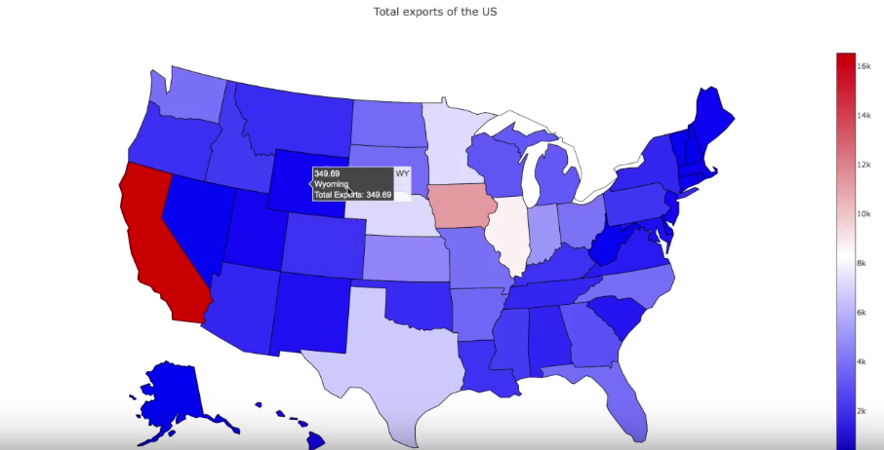
Final Result
Notes:
notice the hover now

Slide 20
We can do the same for other geographic maps!
# make your data frame # try with http://raw.githubusercontent.com/plotly/datasets/master/2011_february_us_airport_traffic.csv’
scattergeo = go.Scattergeo(lat = data_frame[‘lat’], lon = data_frame[‘long’], node = ‘markers’, locationmode = ‘USA-states’)
layout = go.Layout(title = “Map of US major airports”, geo = {‘scope’: ‘usa’, ‘projection’: {‘type: ‘albers usa’}})

Slide 21
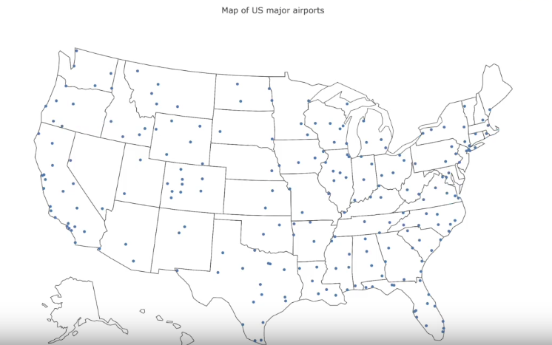
Should look something like this!

Slide 22
Adding Text Labels and Markers
text_labels = data_frame[‘airport’].astype(str) + “</br>Takeoff/Landings: “ + data_frame[‘cnt’].astype(str)
## if you would like this to be a bubble map rather than a uniform scatter map scattergeo = go.Scattergeo(lat = data_frame[‘lat’], lon = data_frame[‘long’], \ mode = ‘markers’, locationmode = ‘USA-states’, text = text_labels, \ marker = {‘size’: data_frame[‘cnt’] / 100})
## we adjust this last attribute so it looks right. Something like: ## will make sure bubbles don’t get too small or too large maker = {‘size’: 10 + data_frame[‘cnt’] / 500} #

Slide 23
Adding Text Labels and Markers
text_labels = data_frame[‘airport’].astype(str) + “</br>Takeoff/Landings: “ + data_frame[‘cnt’].astype(str)
## if you would like this to be a bubble map rather than a uniform scatter map scattergeo = go.Scattergeo(lat = data_frame[‘lat’], lon = data_frame[‘long’], \ mode = ‘markers’, locationmode = ‘USA-states’, text = text_labels, \ marker = {‘size’: data_frame[‘cnt’] / 100})
## we adjust this last attribute so it looks right. Something like: ## will make sure bubbles don’t get too small or too large maker = {‘size’: 10 + data_frame[‘cnt’] / 500} #

Slide 24
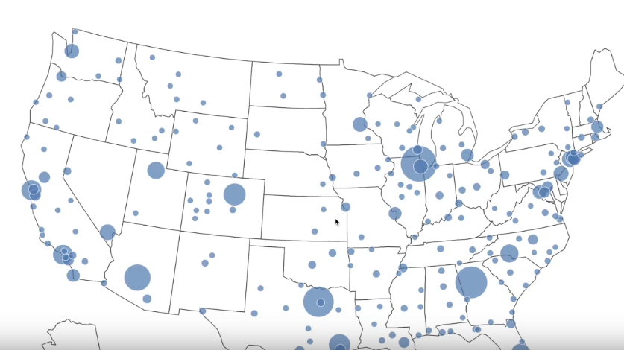
Notes:
This looks good!
You can see all the major airports in the US and you can approximately compare them by size
Hover over to see the text label!

Slide 25
REAL-TIME CODING

Slide 26

LAB TIME

