Slide 1
Lecture 22: Animated and Interactive Visuals

Slide 2
Dynamic and Interactive Visualization
Last week we learned about static graphs
Dynamic/Interactive graphs change based on time or user input
Often used to demonstrate a relationship in the data over time
Examples
Business Insider, Spread of 5 Major Religions Map https://www.youtube.com/watch?v=AvFl6UBZLv4
NYTimes, Renting vs buying calculator https://www.nytimes.com/interactive/2014/upshot/buy-rent-calculator.html

Slide 3
Python and Dynamic Visualization
Plotly can do this for us!
Upgrade plotly:
pip install plotly --upgrade
Dynamic visualizations add a new field to the figure: Frames!

Slide 4
Frames
Frames represent the data at each step in the animation
Frames are a list of data points, so we need a list of lists for x-values and y-values.
x = [[1, -1], [1, -1], [-1, 1], [-1, 1]]
y = [[1, -1], [-1, 1], [-1, 1], [1, -1]]
1st step
2nd step
3rd step
4th step

Slide 5
Creating data points
We will use plotly’s Scatter class to plot the data points.
go.Scatter(
x=x_value,
y=y_value,
mode = ‘markers’,
marker = {‘color’ : ’Blue’, ‘size’:10})
X_value and y_value are two lists. Each value in x_value has a corresponding value in y_value. These two points are the x and y coordinates for each point.
If we pass in:
x_value=[2,-1]
y_value=[3,-2]
The two points we plot will be:
(2,3) and (-1,-2).

Slide 6
Creating data points
We will use plotly’s Scatter class to plot the data points.
go.Scatter(
x=x_value,
y=y_value,
mode = ‘markers’,
marker = {‘color’ : ’Blue’, ‘size’:10})
Here we can pass in “lines”, “markers”, “text”, or a combination of these.
This determines how each point is represented on the graph.
“Marker” will be a point.

Slide 7
Creating data points
We will use plotly’s Scatter class to plot the data points.
go.Scatter(
x=x_value,
y=y_value,
mode = ‘markers’,
marker = {‘color’ : ’Blue’, ‘size’:10})
Here we can edit the marker’s color and size.

Slide 8
Creating data points
For each frame we want to create a new scatterplot.
def create_data(x_values, y_values):
data = [go.Scatter( x = x_values, y = y_values, mode = ‘markers’, marker = {‘color’ : ’Blue’, ‘size’:10})]
return data

Slide 9
Creating frames
We want to create a list of dictionaries called frames to pass into the plotly Figure object.
frames = [
{‘data’: create_data(x[0], y[0]},
{‘data’: create_data(x[1], y[1])},
{‘data’: create_data(x[2], y[2])},
{‘data’: create_data(x[3], y[3])}
]
Where create_data is a function that returns a go.Scatter object.
go.Scatter(
x=x[0],
y=y[0],
mode=”markers”,
marker={‘color’:’Blue’,
‘Size’:10}
)

Slide 10
Creating layout
Our layout for dynamic visualizations are more complicated because we want users to be able to interact with them
In this example, we are creating a button to dynamically show all the frames
go.Layout(updatemenus=
[ {‘buttons’: [{‘label’: ‘Animate’,
‘method’: ‘animate’,
‘args’: [None]}],
‘showactive’: False,
‘type’: ‘buttons’}
])

Slide 11
Putting it all together
Finally, we want to create the figure by passing in all the data, frames, and layout
figure = go.Figure(data=data,
layout=layout,
frames=frames)

Slide 12
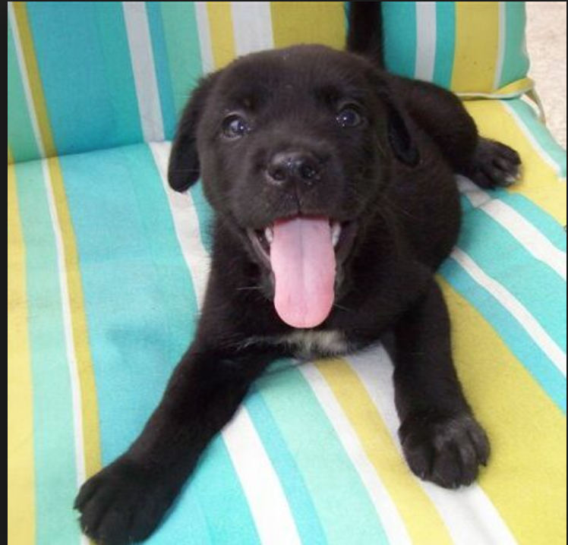
Lab Time

