Slide 1
Lecture 18: HTML and Web Scraping
November 6, 2018

Slide 2
Reminders
Project 2 extended until Thursday at midnight!
Turn in your python script and a .txt file
For extra credit, run your program on two .txt files and compare the sentiment analysis/bigram and unigram counts in a comment. Turn in both .txt files
Final project released Thursday
You can do this with a partner if you want!
End goal is a presentation in front of the class in December on your results
Proposals will be due next Thursday

Slide 3
Today’s Goals
Understand what Beautiful Soup is
Have ability to:
download webpages
Print webpage titles
Print webpage paragraphs of text

Slide 4
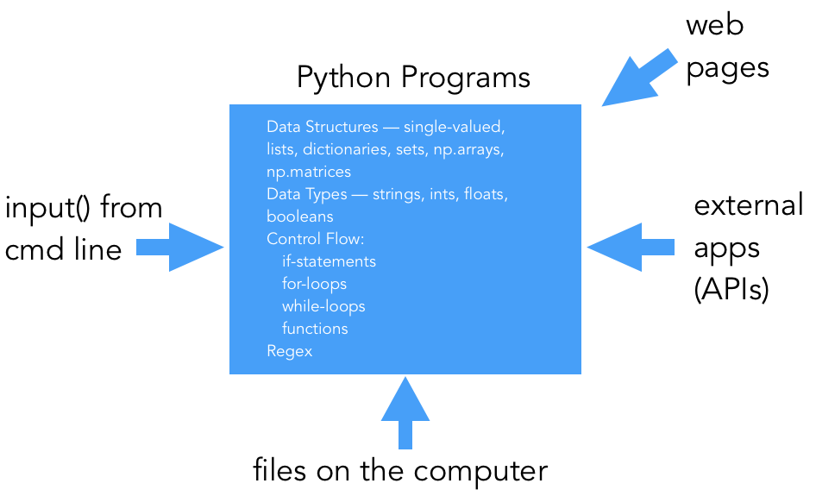

Slide 5
HTML
Hypertext Markup Language: the language that provides a template for web pages
Made up of tags that represent different elements (links, text, photos, etc)
See HTML when inspecting the source of a webpage

Slide 6
HTML Tags
<html>, indicates the start of an html page
<body>, contains the items on the actual webpage (text, links, images, etc)
<p>, the paragraph tag. Can contain text and links
<a>, the link tag. Contains a link url, and possibly a description of the link
<input>, a form input tag. Used for text boxes, and other user input
<form>, a form start tag, to indicate the start of a form
<img>, an image tag containing the link to an image

Slide 7
Getting webpages online
Similar to using an API like last time
Uses a specific way of requesting, HTTP (Hypertext Transfer Protocol)
HTTPS has an additional layer of security
Sends a request to the site and downloads it
HTTP/HTTPS have status codes to tell a program if the request was successful
2—, request was successful; 4— client error, often page not found; 5— server error, often that your request was incorrectly formed

Slide 8
Web Scraping
Using programs to download or otherwise get data from online
Often much faster than manually copying data!
Makes the data into a form that is compatible with your code

Slide 9
Python and Webpages and Scraping, made easy
Requests library: gets a webpage for you
requests.get(url)
BeautifulSoup library parses webpages (.html content) for you!
Use BeautifulSoup to find all the text or all of the links on a page
Documentation: https://www.crummy.com/software/BeautifulSoup/

Slide 10
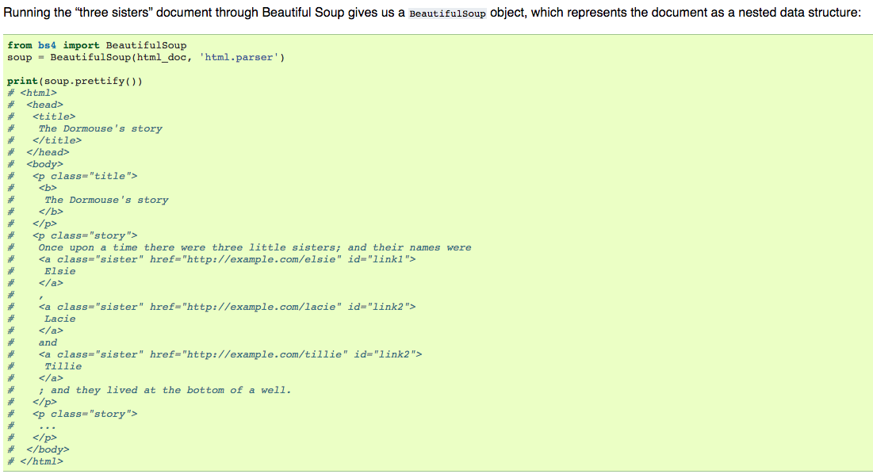

Slide 11
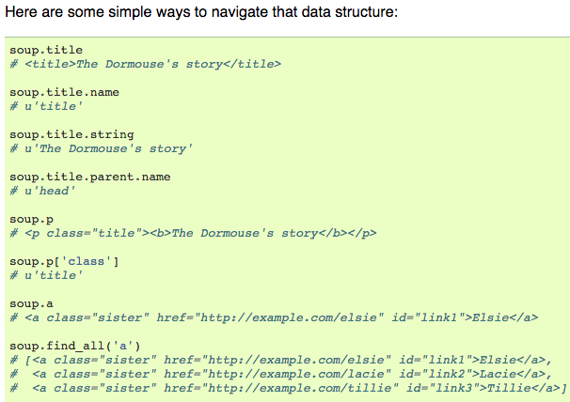

Slide 12
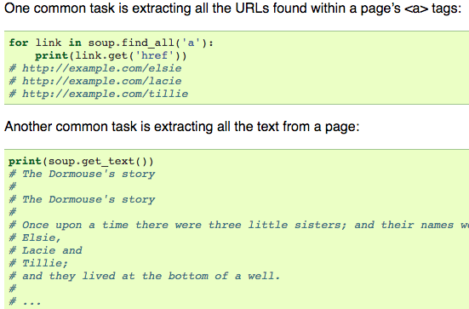

Slide 13
Quick demo on getting webpages from server and parsing!

Slide 14
Advanced Topic
Given this knowledge, how could we build a web crawler that downloads every webpage on the Internet?
If we downloaded every webpage, what could we do with it?

Slide 15
Advanced Topic II
Making requests to download a webpage is literally demanding resources (time and compute power) from the website’s server.
What if we make MANY requests? Is this allowed?
What are the consequences if we made 100 simultaneous requests to CNN.com at the same time? What about 1,000? 1,000,000?

Slide 16
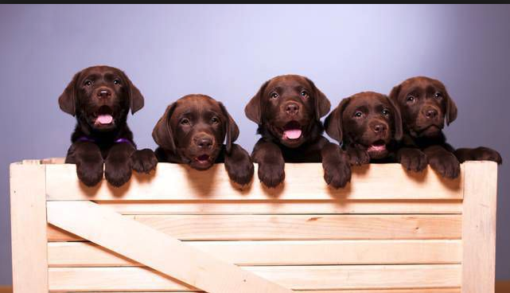
LAB TIME

